Slide 1
Dodsboro District Centre Enhancement Scheme
26th September 2023
Notes:
Sign in sheet

Slide 2
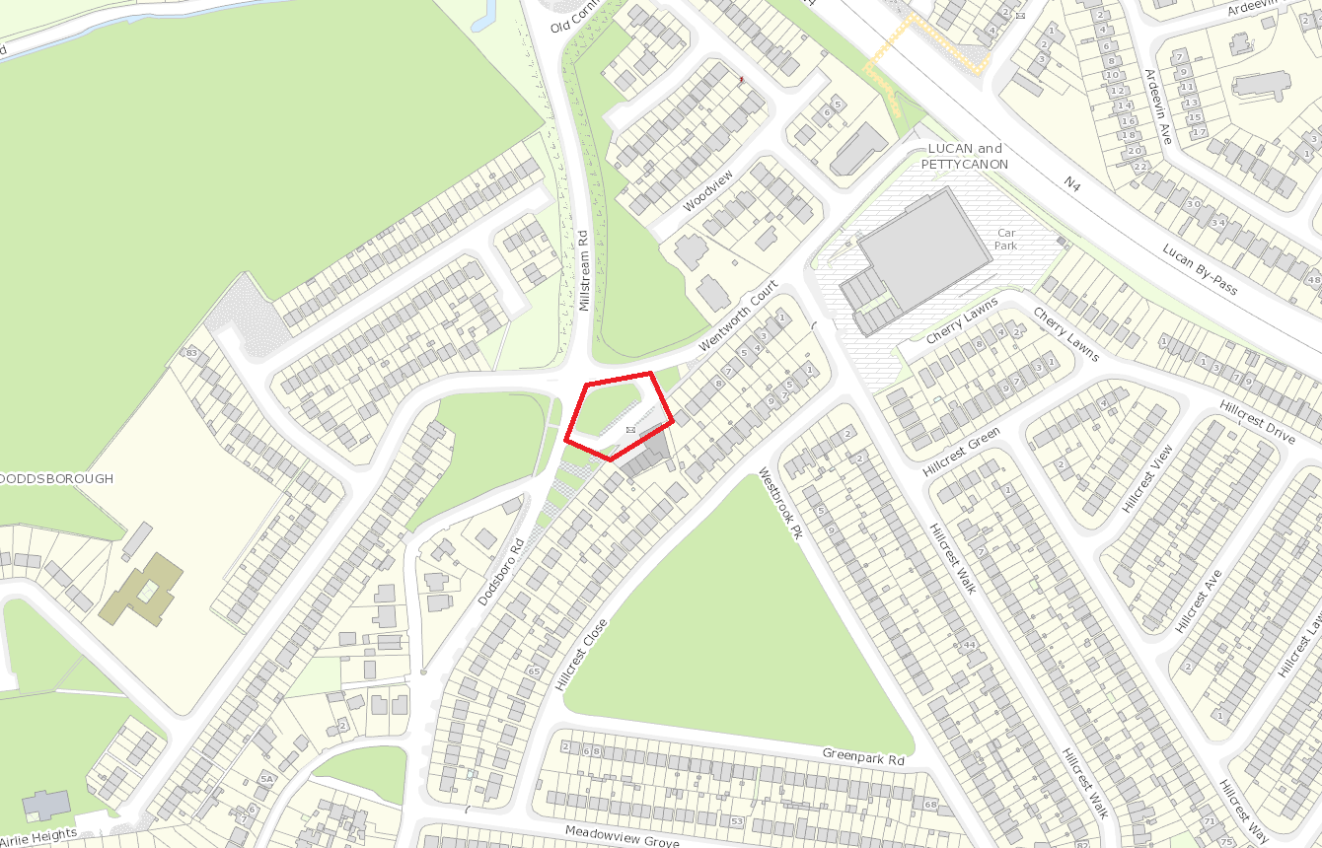
Site Location

Slide 3
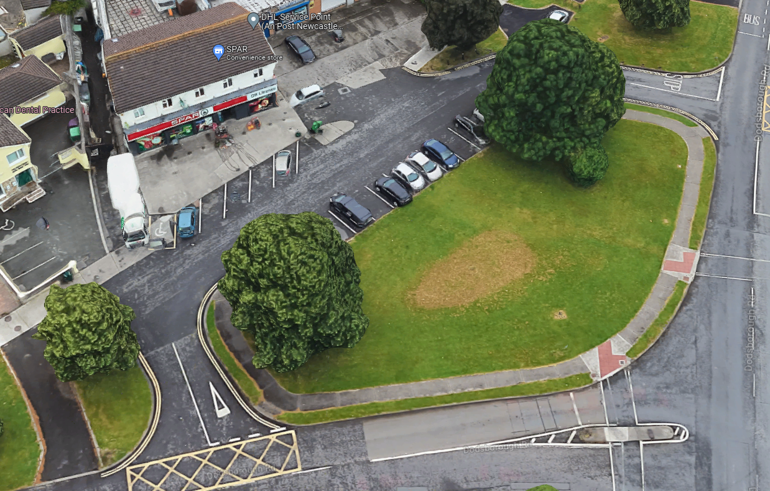
Site Location

Slide 4
Background
February 2023 – Tender issued for Consultancy Services
April 2023 - CIVIC Engineers Ltd. appointed to lead the design of District Centre Schemes at Rosemount, Bawnogue and Dodsboro
4th May 2023 – Internal Workshop held with SDCC staff from various departments.
June – 2 on site stakeholder workshops held.
1st June - Aimed to identify the problems and challenges locally.
Attended by a number of traders and residents
30th June – 2 Scheme Options presented.
July/August – Detailed Design

Slide 5
Stakeholder Engagement
1st June - Initial Workshop
Aimed to identify the problems and challenges locally.
Attended by a number of traders and residents
Problems – parking arrangement, rat running, speed, connectivity, litter, deliveries
30th June – Second Workshop
2 No. Scheme Options Presented
Convergence on one preferred option.
Removal of throttle gate following discussion with resident.
Ongoing Engagement
As the scheme will impact the local shops mostly there has been ongoing informal discussions with them throughout.

Slide 6
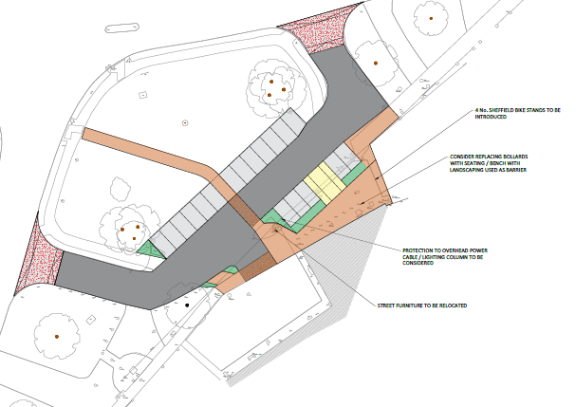
Preferred Option

Slide 7
Proposed Scheme
The proposed scheme will:
Provide a direct pedestrian link from the signalised junction to the shops.
Reconfigure parking – remove angled parking and improve disabled bay.
Improve east – west pedestrian access
Provide gateway treatment in the form of raised traffic calming measures
Install rain gardens as a means of Sustainable Urban Drainage (SuDS).
Remove bollards and replace with appropriate seating and bike stands

Slide 8
Next Steps
The cost estimate of the scheme is €111,192 and so Part 8 Planning is not required.
As the scheme has modest alterations to the public environment and engagement with the relevant stakeholders has been regular and positive it is not proposed to conduct any further public consultation.
Proposed to progress to construction in the coming weeks and aim to have works complete by year end.
Ongoing engagement will take place with the traders prior to and during construction works.

