Slide 1
Bawnogue Shopping Centre TIC
20th September 2023
Notes:
Sign in sheet

Slide 2
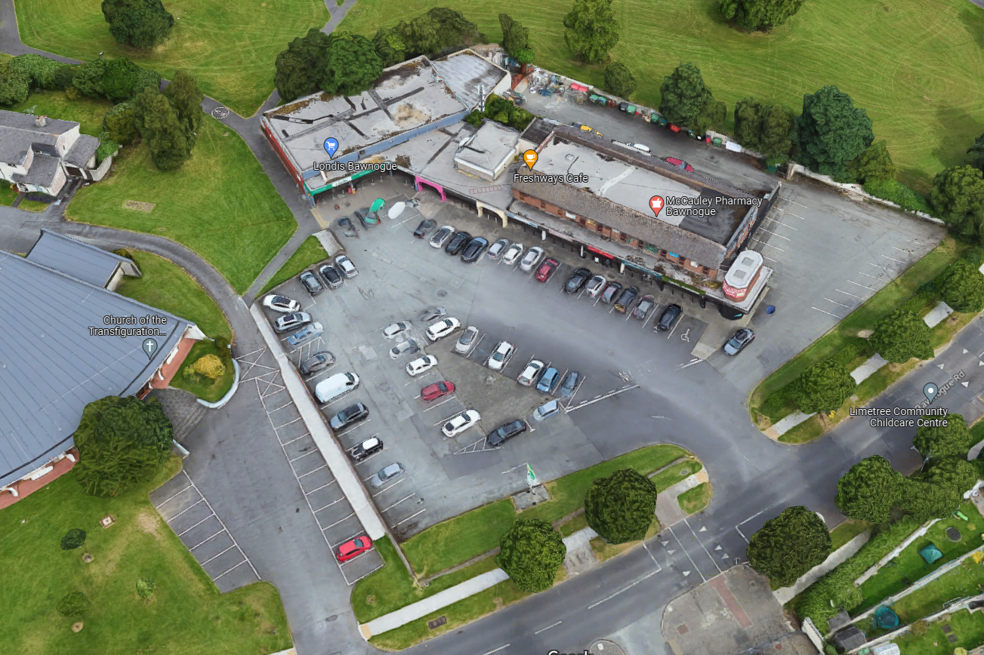
Site Location

Slide 3
Background
SDCC progressing the design of the Bawnogue District Centre Enhancement Scheme.
Bawnogue Shopping Centre – Focal point of the community – Busy retail area.
Carpark is privately owned – Registered to Bawnogue Shopping Centre Management Limited – dissolved.
Carpark surface is in very poor condition and requires upgrade.
Ongoing requests to council to carry out works to repair the carpark.
Good engagement with the local traders.

Slide 4
Proposal
At present the carpark is not to TIC standard and would require significant investment once TIC – possibly as Phase 2 of the DCEP Scheme.
Provides direct permeability routes from Ace Enterprise Park / Community Centre and School directly to the shopping centre and the existing permeability route east of the shops.
Provide additional public parking to offset any potential loss of parking along Bawnogue Rd.
Aids the objectives of the DCEP scheme in terms of improving the visual amenity and vibrancy of the area.
Community benefit – accessibility and connectivity within the centre.

Slide 5
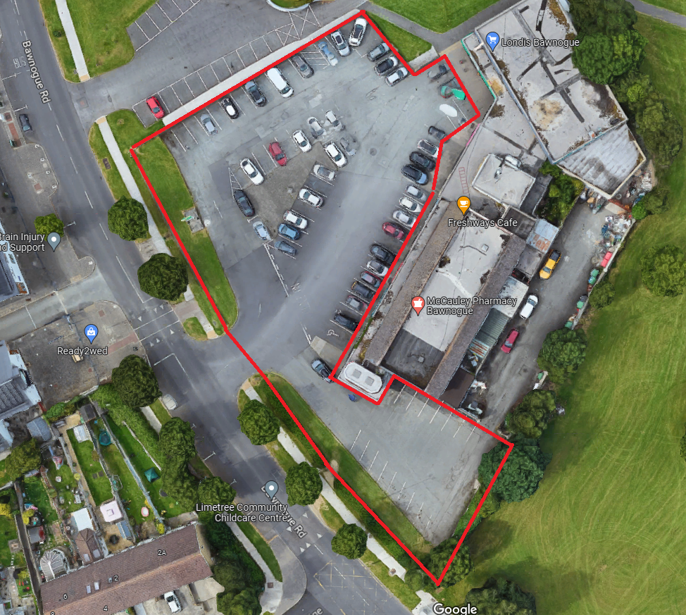
Proposal

Slide 6
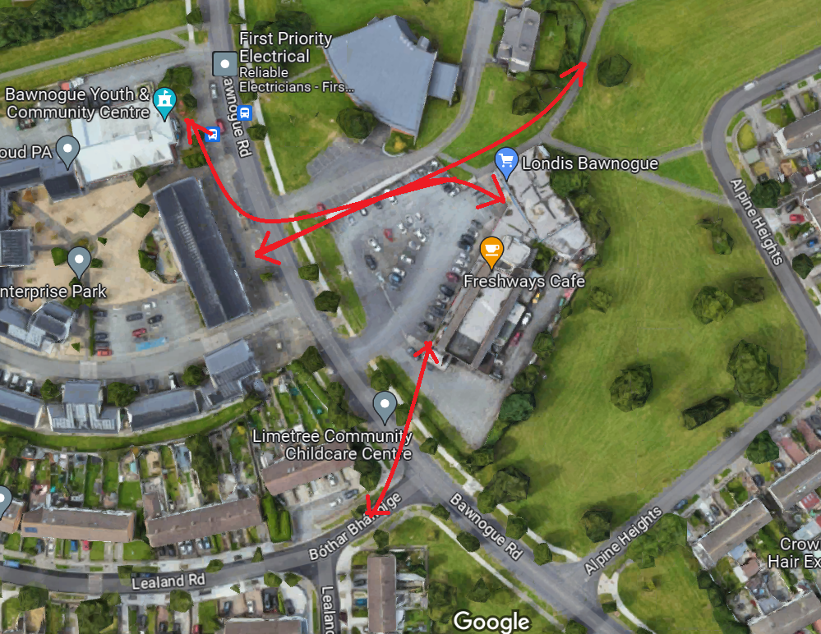
Proposal

Slide 7
Next Steps
SDCC will advertise the proposed TIC
Signage to be erected locally informing the community and letter drops to all traders
Submissions will be invited in relation to the proposal.
Revert to ACM – date TBC
If TIC, then works to carpark to be carried out as Phase 2 of DCEP Scheme.
Proposed work will not require any further formal public consultation

