Slide 1
Headed Item H
Planned Maintenance/EERP
Meeting of Housing SPC
14th September 2023

Slide 2
Key Details
Energy Retrofit
183 homes issued to contractors for completion in 2023
138 homes surveyed and subject to tender preparation
Windows and Doors
200 homes issued to contractors to date in 2023
223 properties surveyed and subject to tender preparation
Going forward window replacements will be completed under Energy Efficiency Retrofit Programme
Balgaddy & MacUilliam Quarterly Clean up ongoing
Roofing works ongoing in Balgaddy
External painting complete in Tor an Rí
Safety Works – Smoke/CO Alarms, Fire extinguishers/blankets, window restrictors
Boiler Servicing
Property Condition Surveys

Slide 3
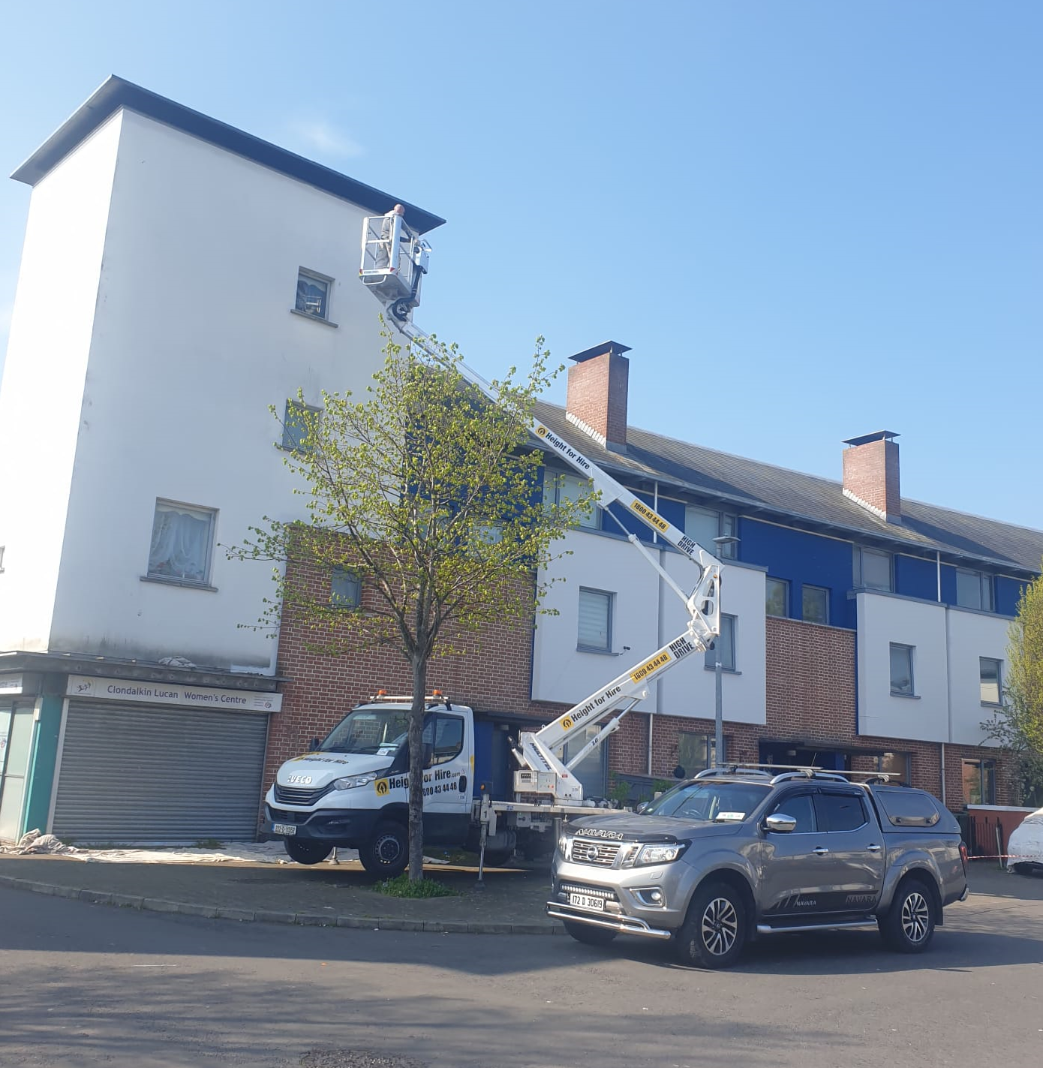
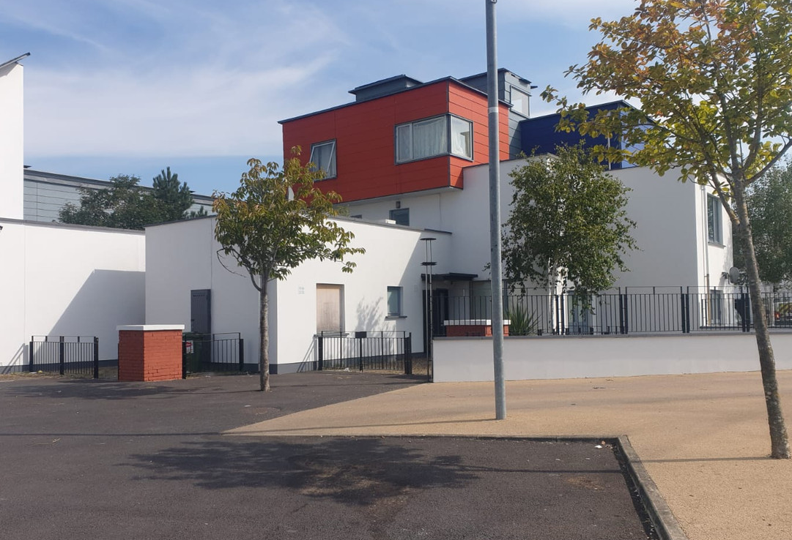
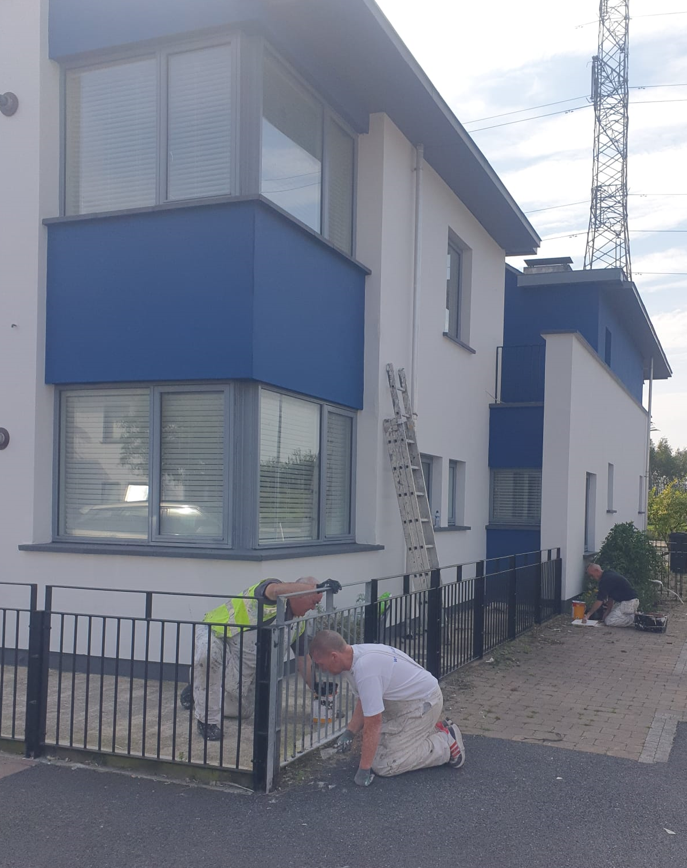
Painting - Tor an Rí

Slide 4
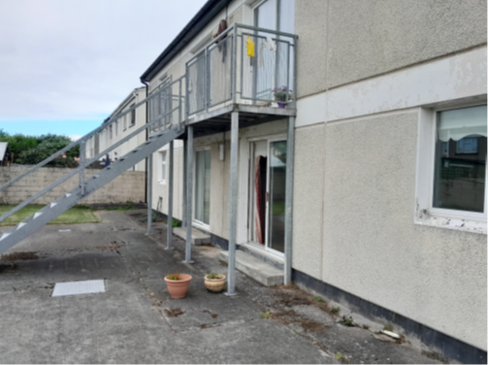
EERP - Limekiln

Slide 5
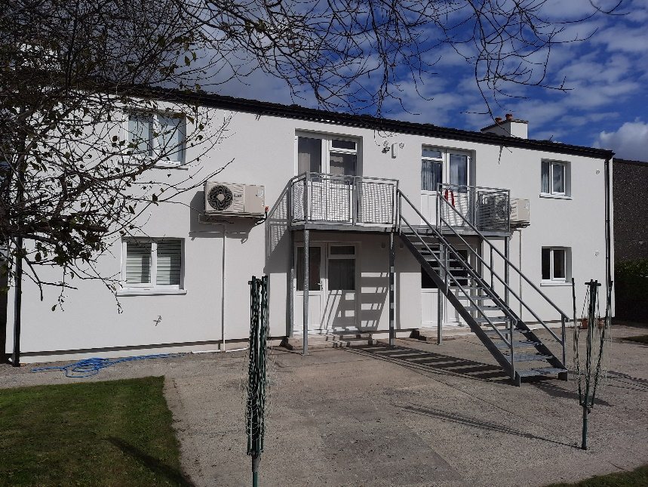
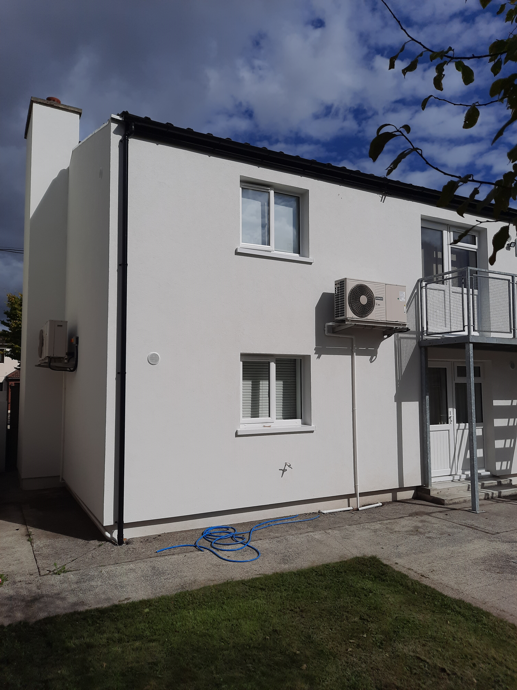
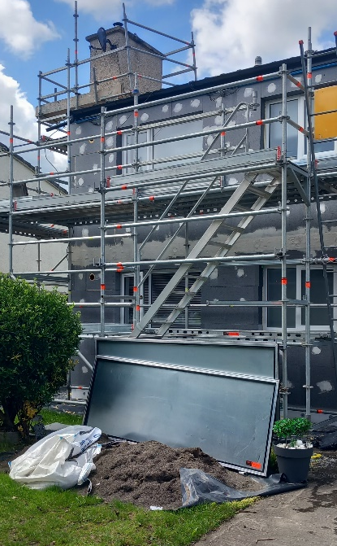
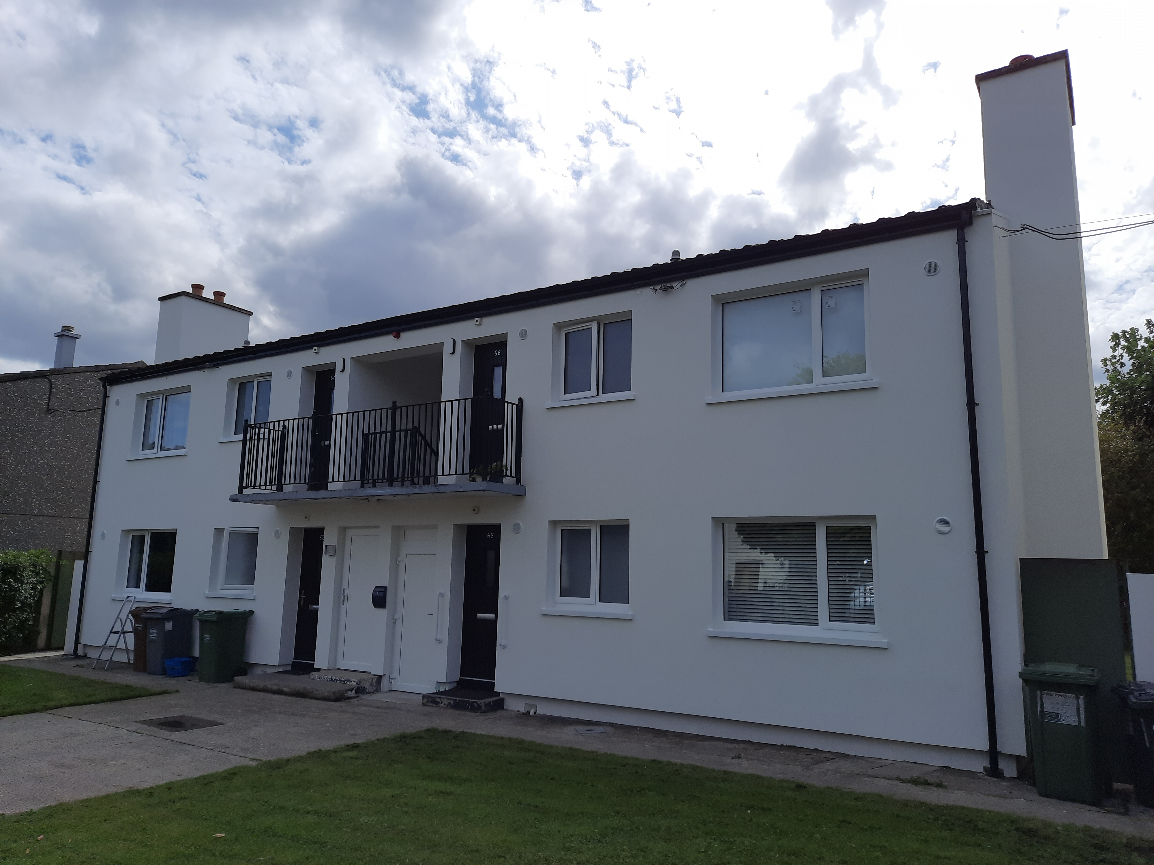
EERP - Limekiln

