Slide 1
Glendown Rd Cycle Scheme
Section 38

Slide 2
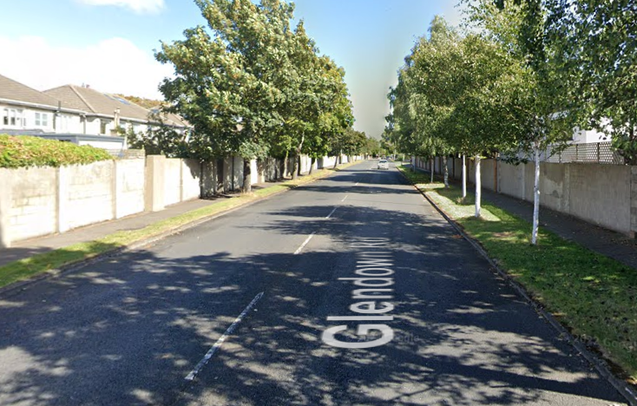
Project Overview
South Dublin County Council, with support from the Nation Transport Authority, are planning to improve pedestrian and cyclist safety and conditions in the Templeogue Area.
The Glendown Road Cycle Scheme will have a dual purpose. Firstly, by narrowing the lane widths to 3 metres speeds will reduce and make the road safer for vulnerable road users. Secondly it will prove a vital link the Templeville Rd scheme to the north with future works in Orwell Rd to the south, thus creating a vital link in the network.
South Dublin County Council is asking the public to give feedback and input on the design for the Glendown Road Cycle Scheme. This informal non-statutory public consultation will commence shortly and is an opportunity for the community to express their views, suggest potential changes, and voice their option on the proposed design. The Council will review all submissions and incorporate suggestions into the design where possible.

Slide 3
Why?
The Benefits are;
Reduce Speed
Lower traffic – 1 bike on the road is potentially 1 less car
Lower emissions – Improving health for individual and for overall community
Reduced noise levels
Improved Pedestrian facilities

Slide 4
How?
Reduction of vehicular lane widths to 3 metres
Raised adjacent cycle lanes on either side of the road
Realigning footpaths to match desire lines
Raised table crossing on side roads to provide easier movements for elderly and those with reduced mobility
Tightening of corner radii
Removal of right turn lane on to Cypress Drive
Removal of 1 tree, replaced by 5

Slide 5
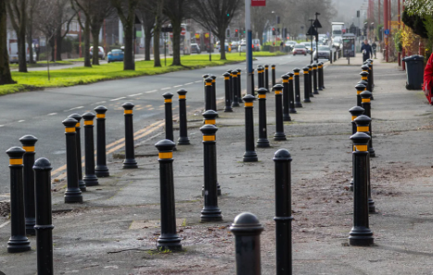
What it is not?
No removal of large numbers of trees along the length of the road
A long line of bollards

Slide 6
Typical Cross Section

Slide 7
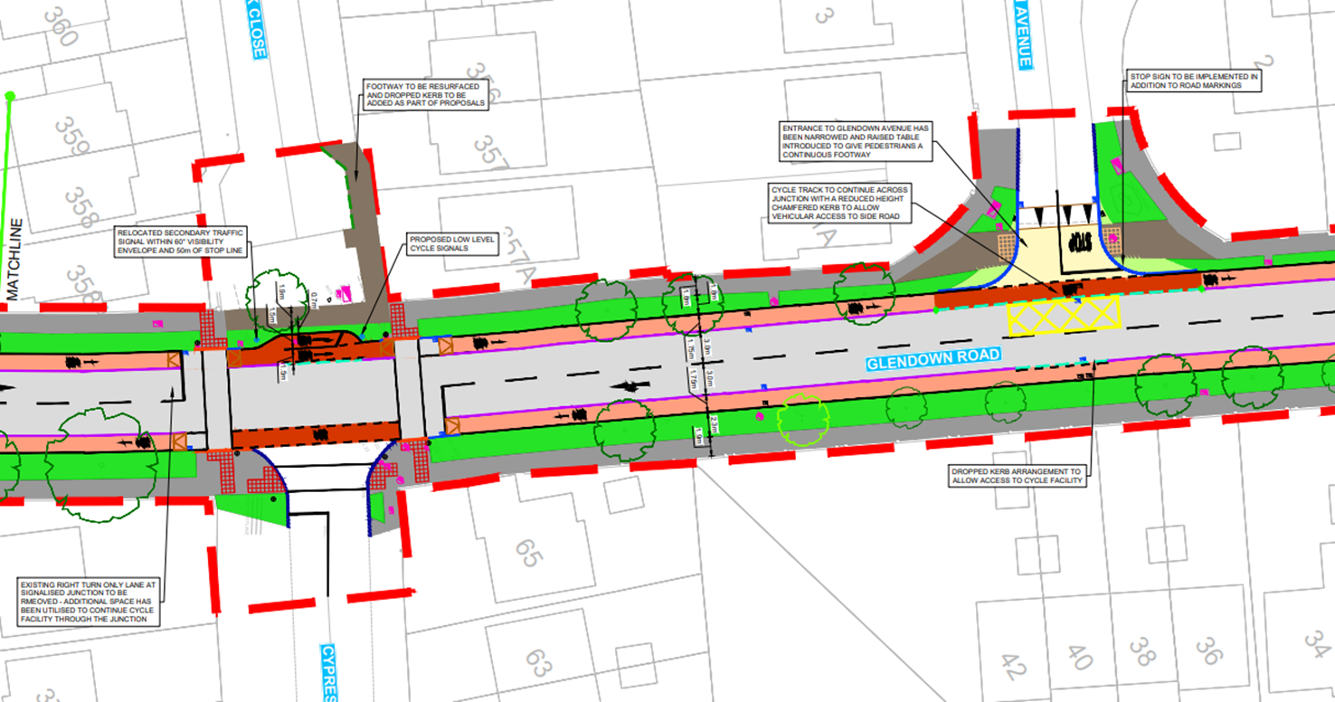
Current v Proposed– Cypress Drive Junction

Slide 8
Preliminary Design – Cypress Drive Junction

Slide 9
Next Steps
After the non-statutory consultation, the SDCC Active Travel team will read and consider all the submissions. Below are the steps and timeline for the project:
Sept/Oct 2023: 1 month Non-Stat Consultation
Oct/Nov 2023: Detailed design and procuring a contractor
Jan 2024: Construction to begin
June 2024: Construction to finish

