Slide 1

SDCC URDF Round 1 & 2 Updates
Work IQ Innovation Building
Tallaght Stadium / Sean Walsh Park Astro
Tallaght Public Realm & Mobility Hub
Airton Road Extension & Belgard North Link Road
Clonburris & Adamstown SDZs
City Edge
September 2023 Council Meeting

Slide 2
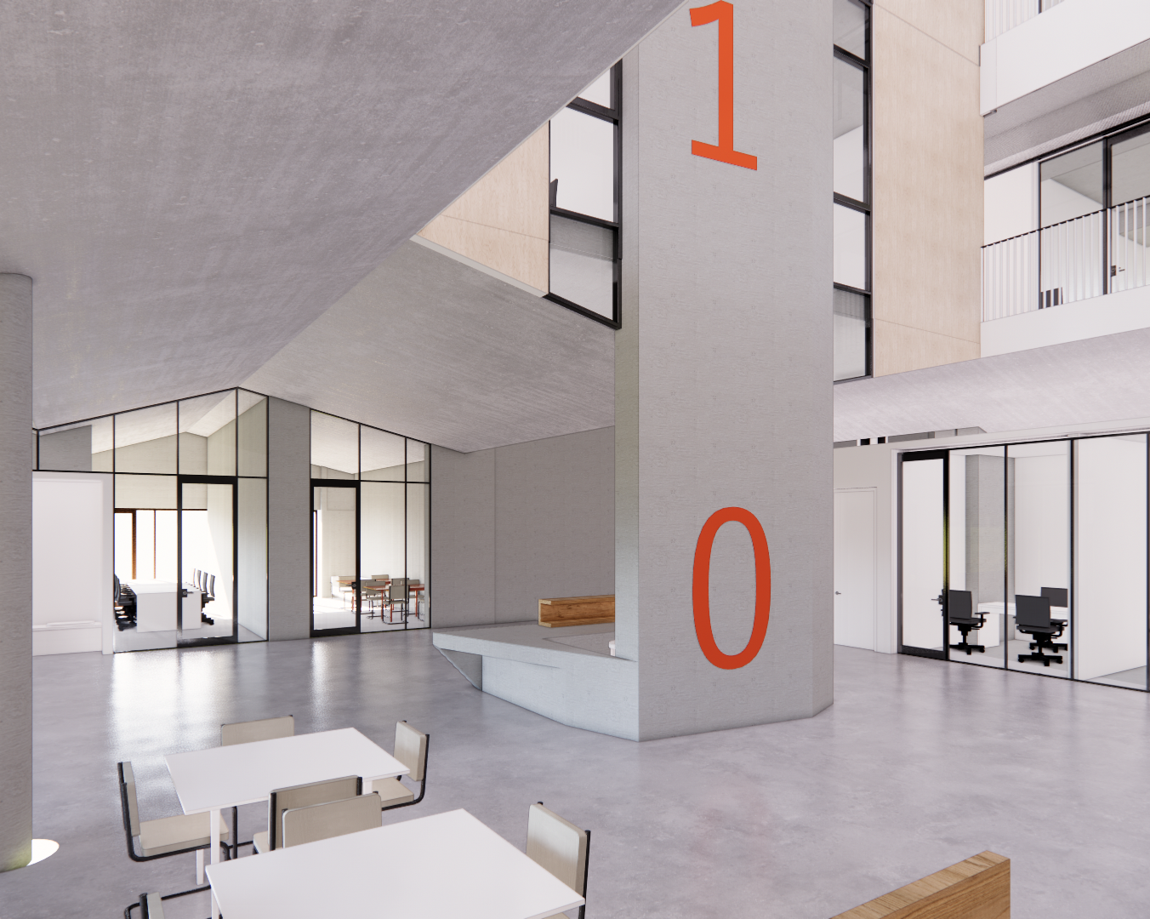
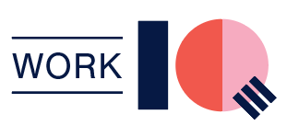
Tallaght Innovation Centre
Works complete this Autumn
Oxford Innovation Mobilisation
Launch January 2024
3,000 m²
facility

Slide 3
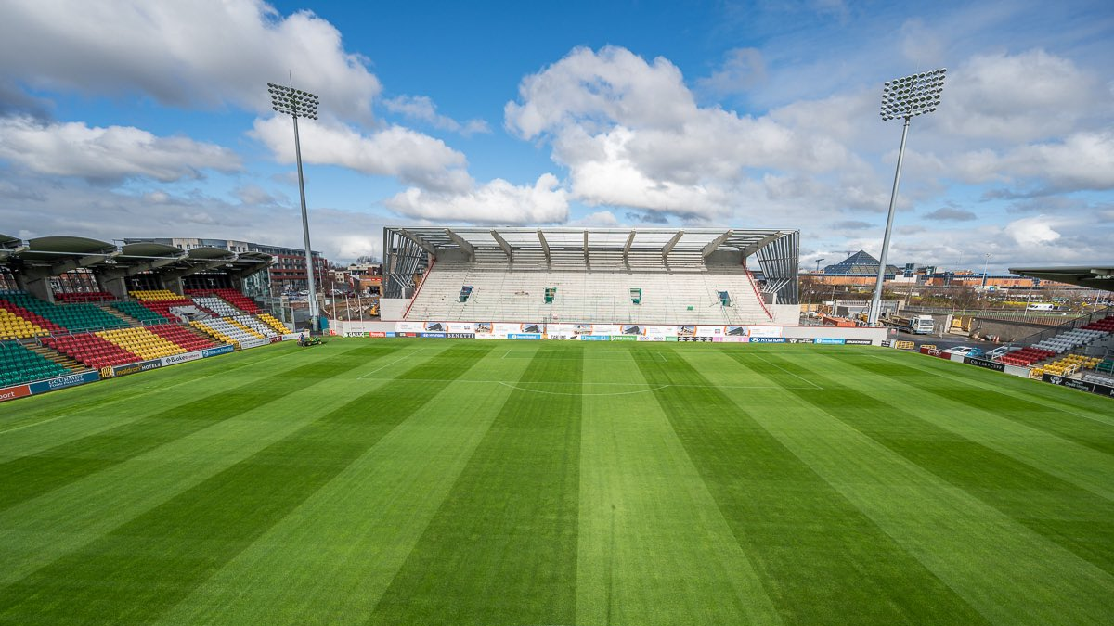
Tallaght Stadium
Digital Upgrades
Completion
October 2023
Seating North & West Stands
UEFA Category 4
10,000 Spectators
20,000
Event Venue
Hospitality Facilities
Media Centre & Facilities

Slide 4
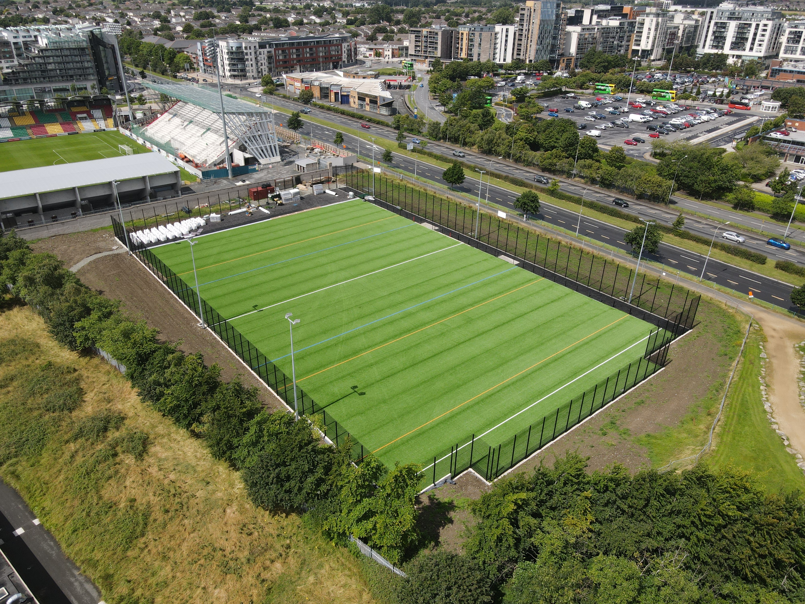
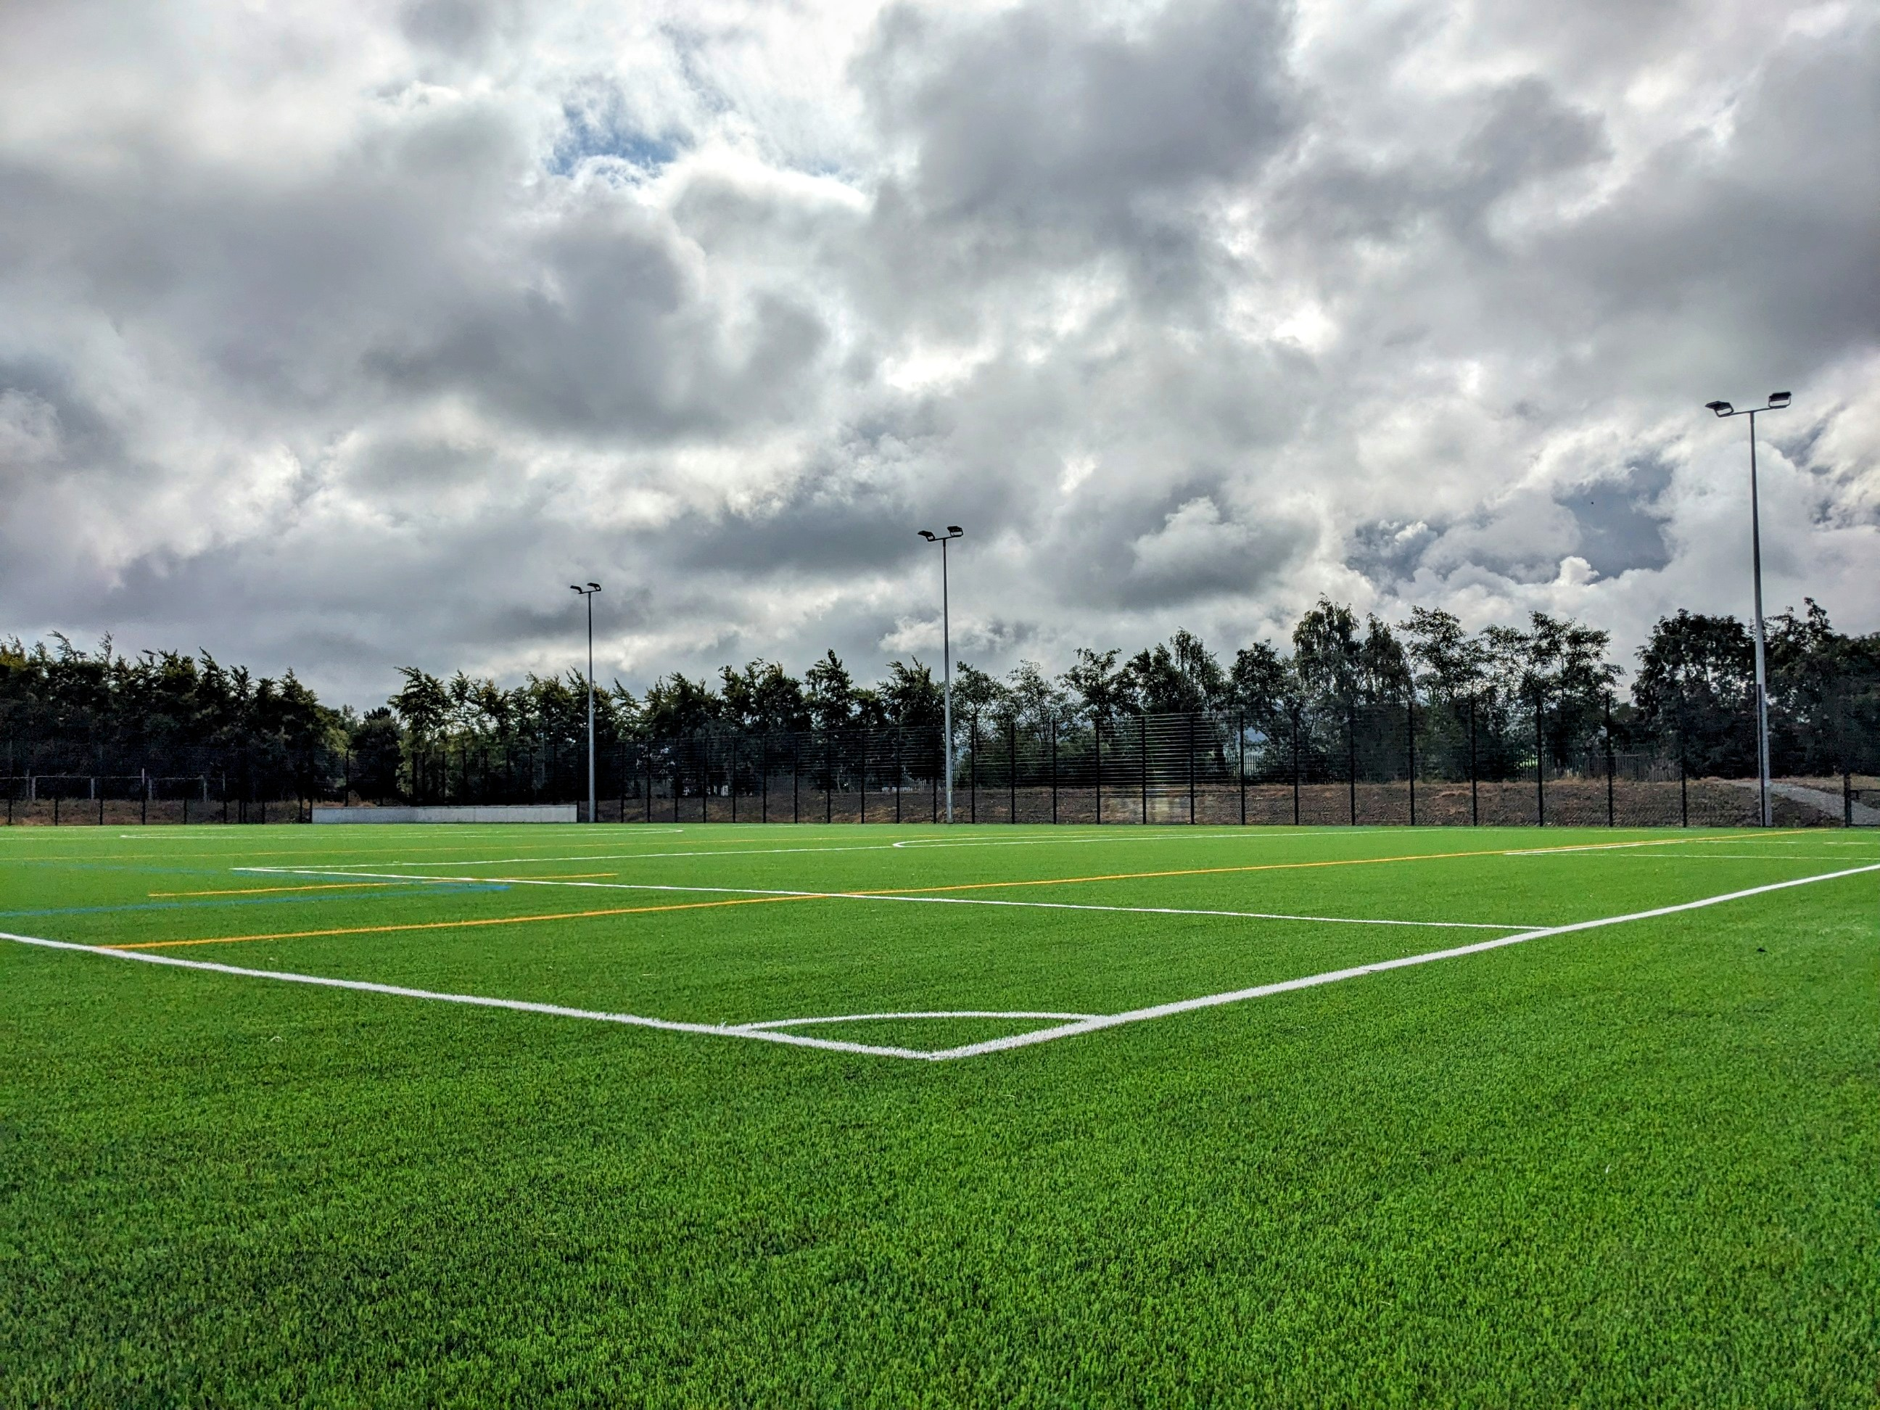
Sean Walsh Park All Weather Pitch
Construction Now Practically Complete
Construction Practically
Complete
11-a-side soccer &
smaller size rugby/GAA pitches
11a-side soccer &
Small- size rugby GAA pitches
Will facilitate training for all 3 codes
Booking arrangements will be confirmed later this month

Slide 5
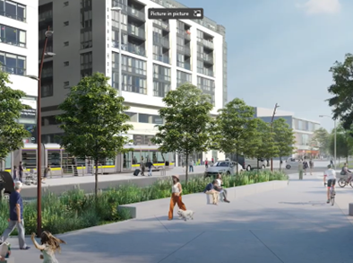
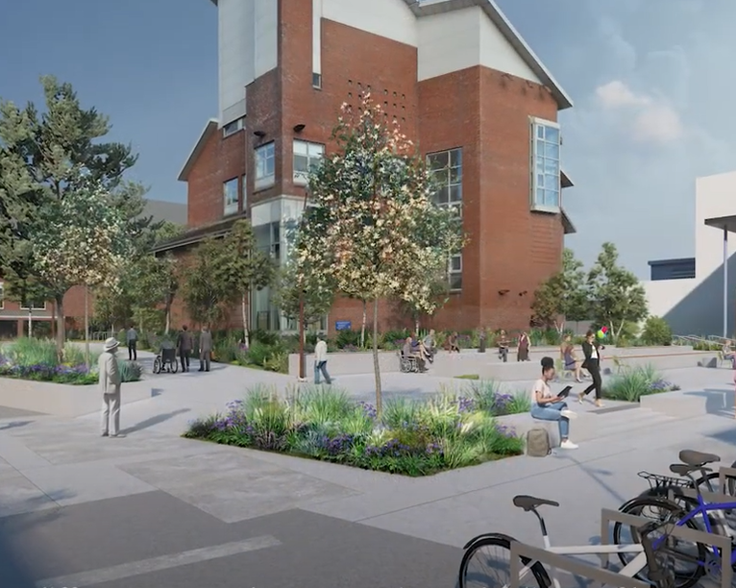
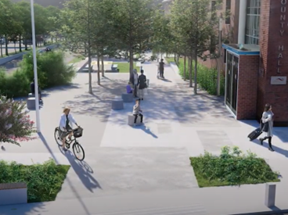
Tallaght Public Realm
Started
Q4 2022
Approx
14-month Construction
Mobility Hub
Completion in Q1 2024
URDF Funding €6,903,636
County Hall Pedestrian Link
Chamber Square

Slide 6
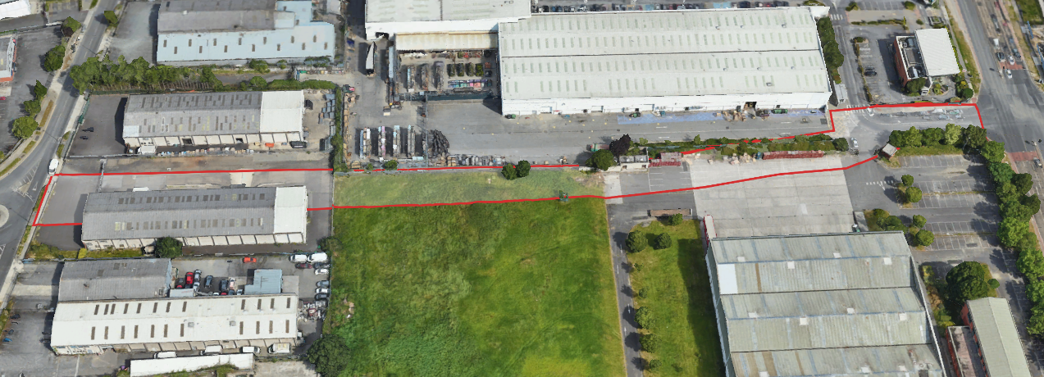
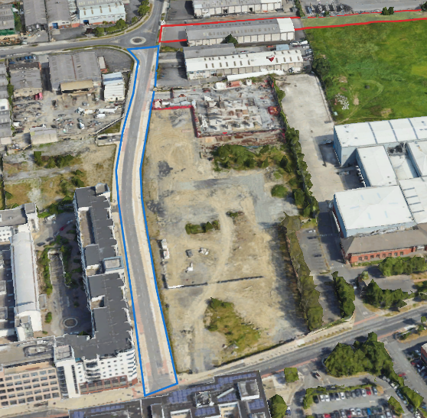
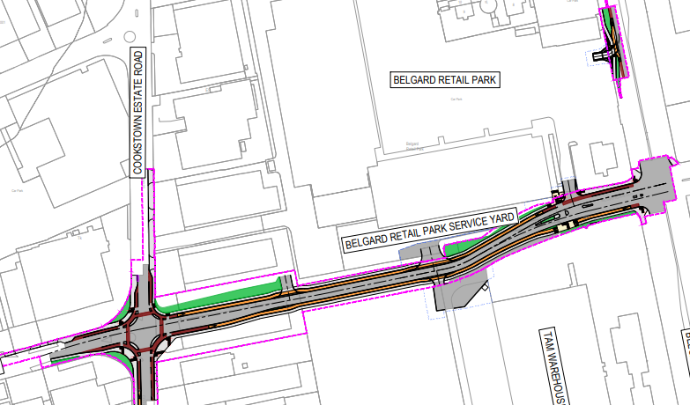
Airton Road Extension
12-month Construction
Period
Start
Nov 2023
URDF
Funding €5,807,191
Belgard Link Road
Belgard Link Road N/S
2021
URDF Funding
€1,726,511
County Hall Pedestrian Link

Slide 7
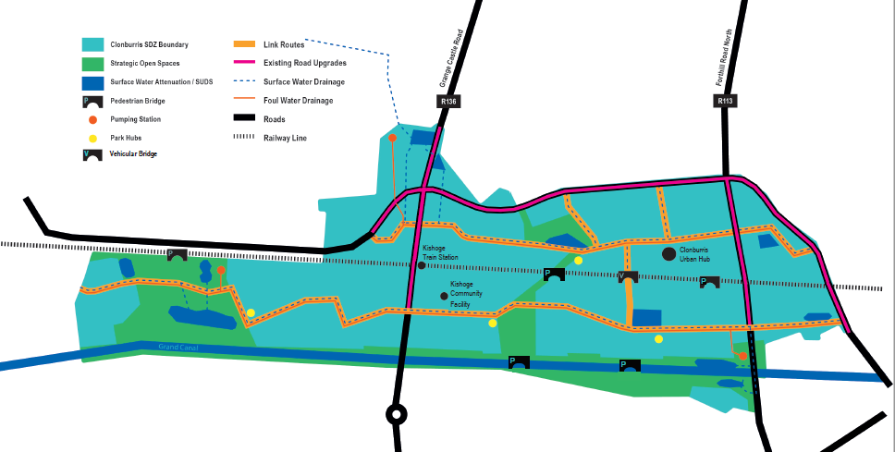

Clonburris URDF
€737m Exchequer Returns
8,714 Homes
€2.54bn Project
23,000 People
44% Social & Affordable
Programme Cost €322.7m
-------------------------------------------------
URDF Funding €186.3m
NTA Funding €18.8m
-------------------------------------------------
8km new link streets, cycleways and footpaths, 4 new pedestrian bridges & 1 new vehicular bridge
47ha Parks and Open Spaces
7,300sqm community floorspace
Phase 1 of first project, ‘The Southern Link Street’, started on site in Dec 2022
Phase 2 to start in Oct 2023 (subject to DHLGH approval)
Due to complete in Q4 2025 & will support delivery of 1600+ homes by 2026
4km link street / utility corridor
Commence Oct 23
South Link Street:

Slide 8
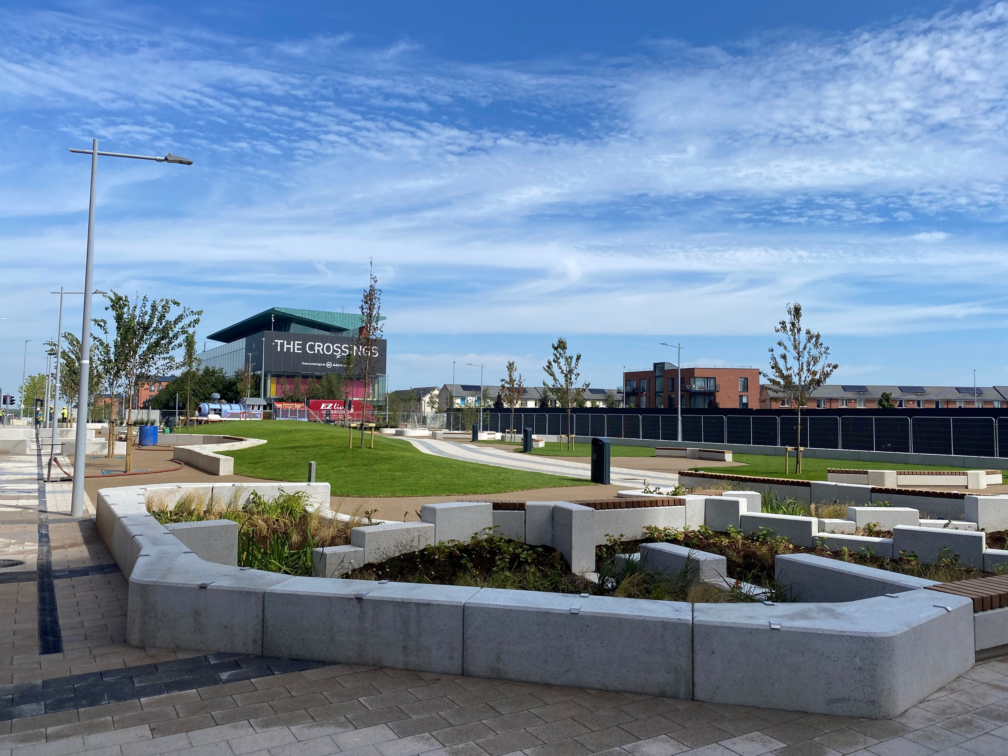

Adamstown URDF
Project 1: Adamstown Plaza - Complete
Design for Projects 2 & 3 starting H2 2023
€9.998m URDF
Projects 2 & 3: Central Boulevard & Enterprise Hub/Library
Linked to Delivery of 589 Homes
(incl. 59 Affordable)
Project 2: Central Boulevard Park –
Awaiting Design Team Appointment
Project 3: Civic Library/Enterprise Centre – Scoping Stage
Substantial
completion
achieved
Link to Adamstown Station
Opening Event
23rd Sept
Benefits 18 Retail Units

Slide 9
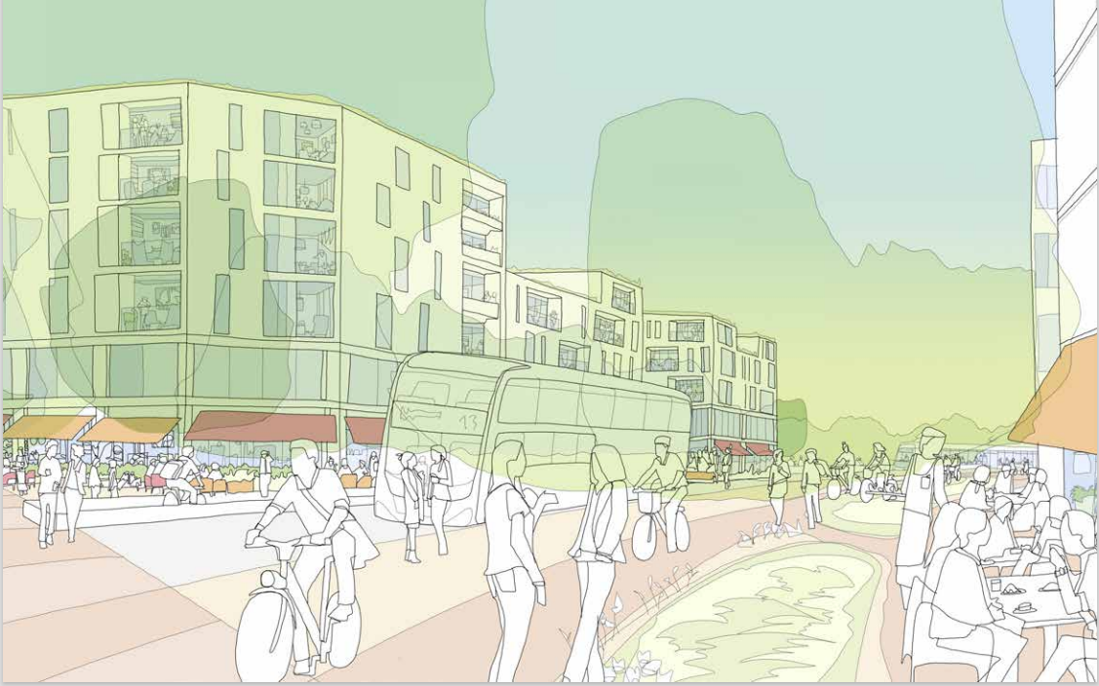
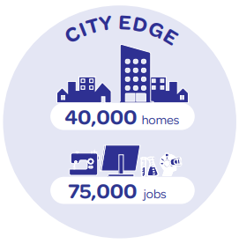
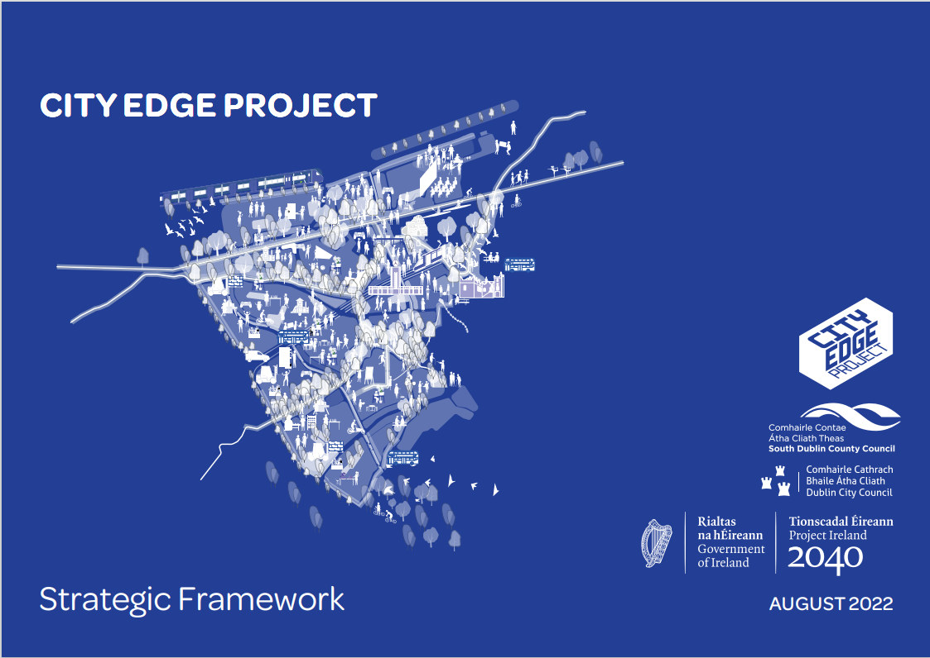
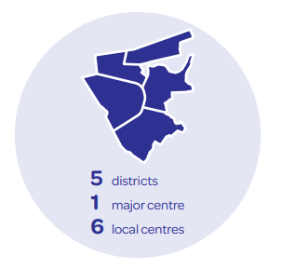

City Edge Strategic Framework
€920,000 URDF funding
Strategic Framework Published Aug 2022
High level vision and delivery strategy to 2070
Variation of Development Plan in 2024

