Slide 1
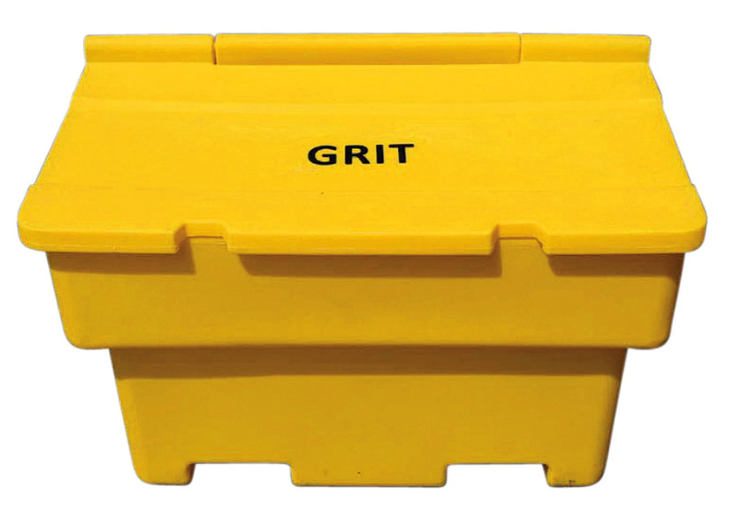
SDCC Salt Bin Strategy

Slide 2
Background
SDCC first introduced salt bins in the county in 2011 as a response to the two heavy snow events.
Salt bins were to be located at short steep inclines that were not on gritting routes
Salt bin locations were chosen from a list of locations provided by elected members
In 2022 there was 61 salt bins in the county and each bin holds 1 ton of salt

Slide 3
Issues with our Current Arrangement
Our current salt bin locations have developed from requests and without any strategic basis.
Majority of salt bins are not used except in extreme cold weather events.
SDCC do not have the resources to provide a salt bin for each estate.
SDCC have no way of getting salt to estates without salt bins in extreme weather.
Rock Salt within the bins hardens due to lack of use and loses it’s effectiveness so it needs to be emptied every two years.

Slide 4
Proposal
Salt bins to be located strategically throughout the county as opposed to areas of incline. New locations will be in the vicinity of multiple estates.
Multiple estates/community groups can avail of salt from a bin.
Salt bins will be situated in easily accessed areas so that they can be re-filled quickly and regularly during periods of bad weather.
SDCC will be increasing the number of bins across the county by over 50%
Existing number of salt bins – 61
Proposed number - 99

Slide 5
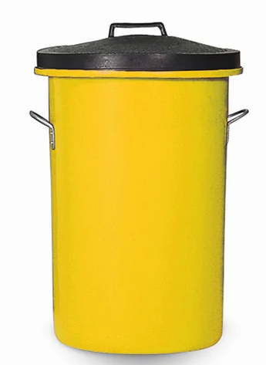
Estate Bins
For the 2023/24 season estates who have had their salt bin removed can apply for what we are calling an “estate salt bin”.
This bine will store approx. 100kg of salt which will treat up to 1km at the recommended spread rate.
The residents will be responsible for refilling this bin from the community salt bins as required, SDCC will not be filling these bins.
This is a one time offer and will not be available after this season

Slide 6
Existing Salt Bin Locations

Slide 7
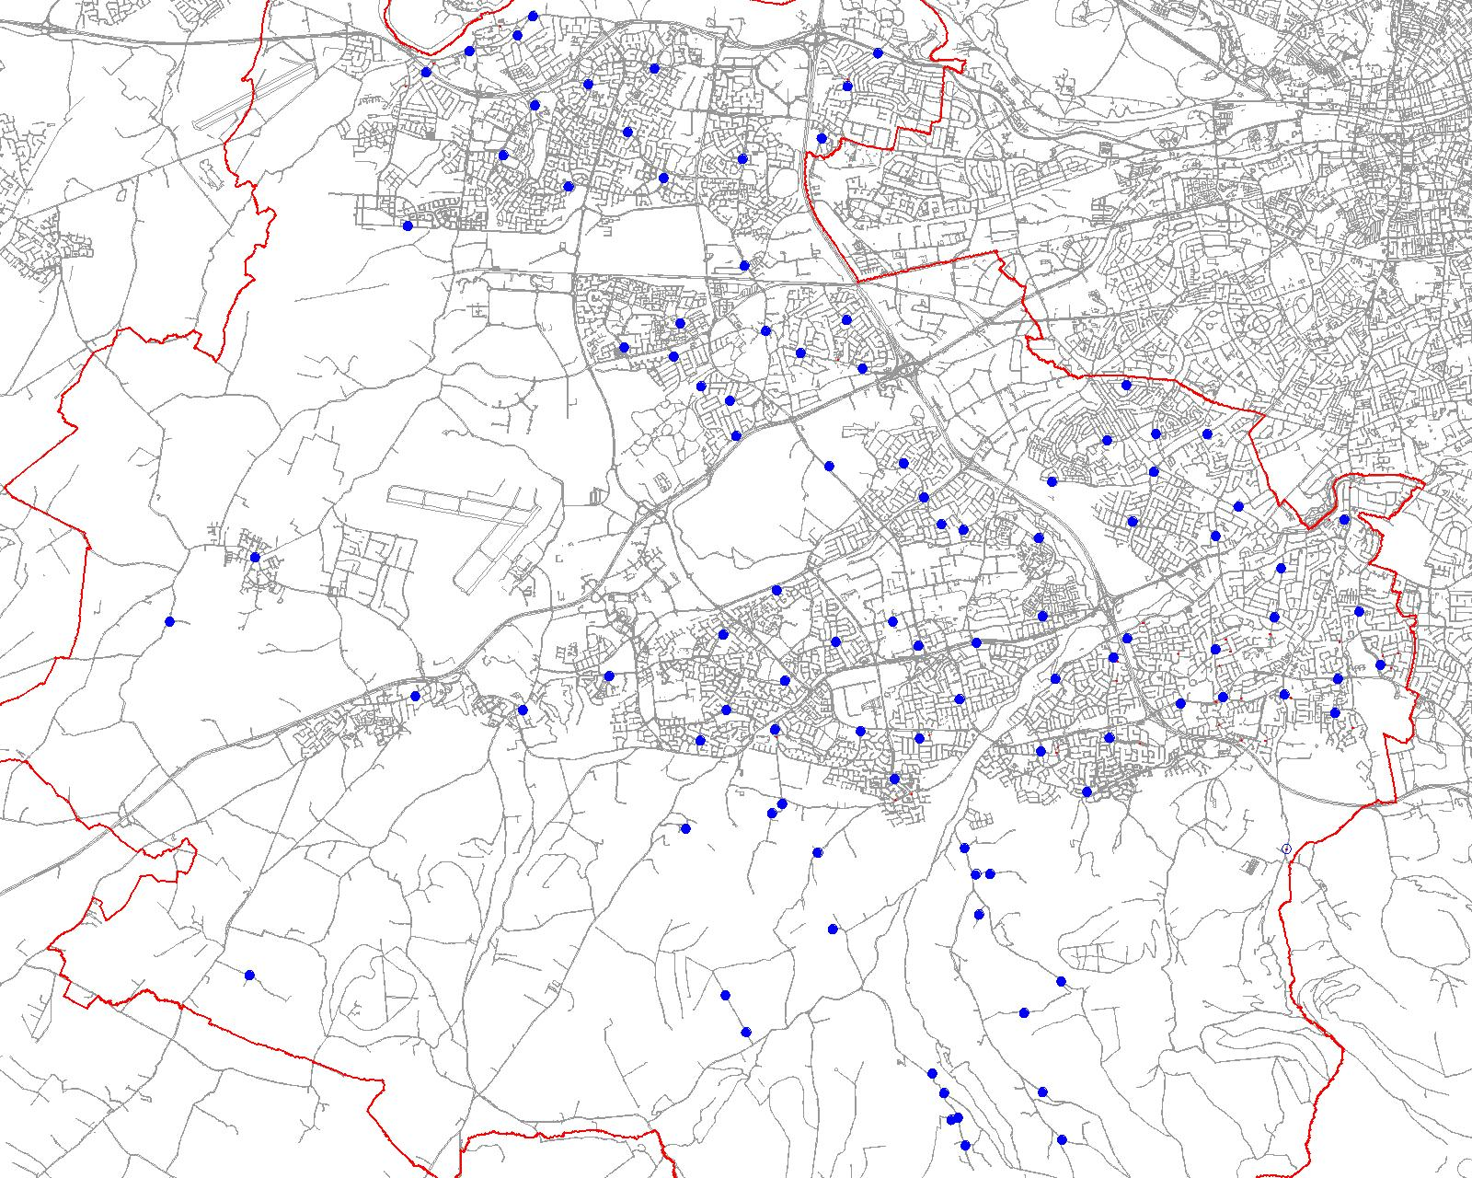
Proposed Salt Bin Locations

Slide 8
Salt Bin Numbers
 | Existing | Proposed
Lucan | 5 | 9
Palmerstown Fonthill | 1 | 7
Clondalkin | 4 | 16
Tallaght South | 10 | 16
Tallaght Central | 4 | 13
Firhouse Bohernabreena | 27 | 23
Templeogue Rathfarnham | 13 | 16
 | 64 | 100

Slide 9
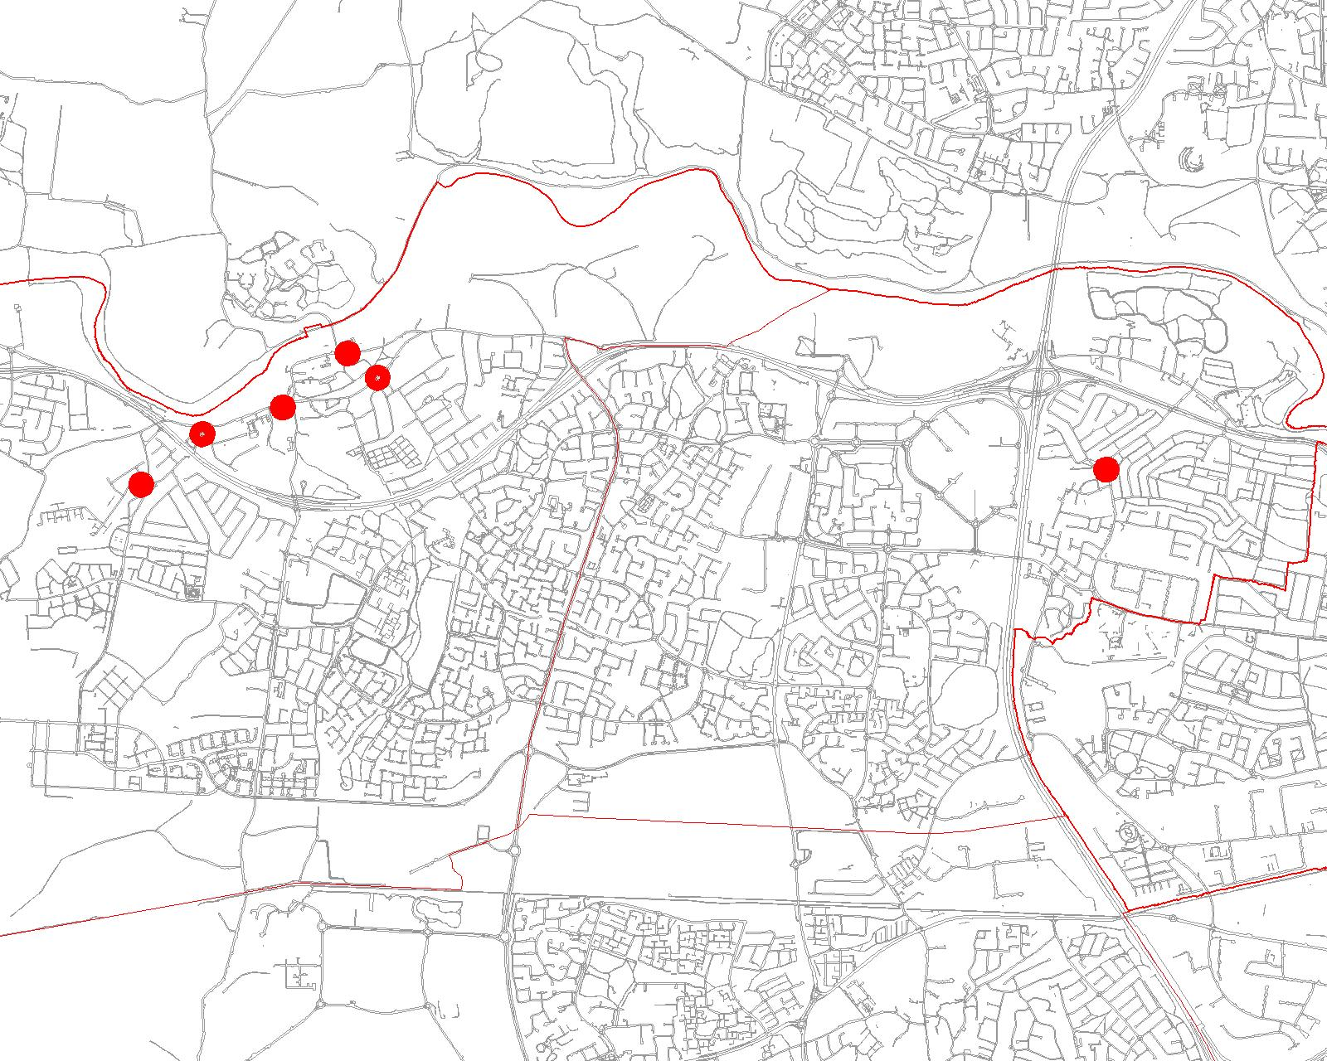
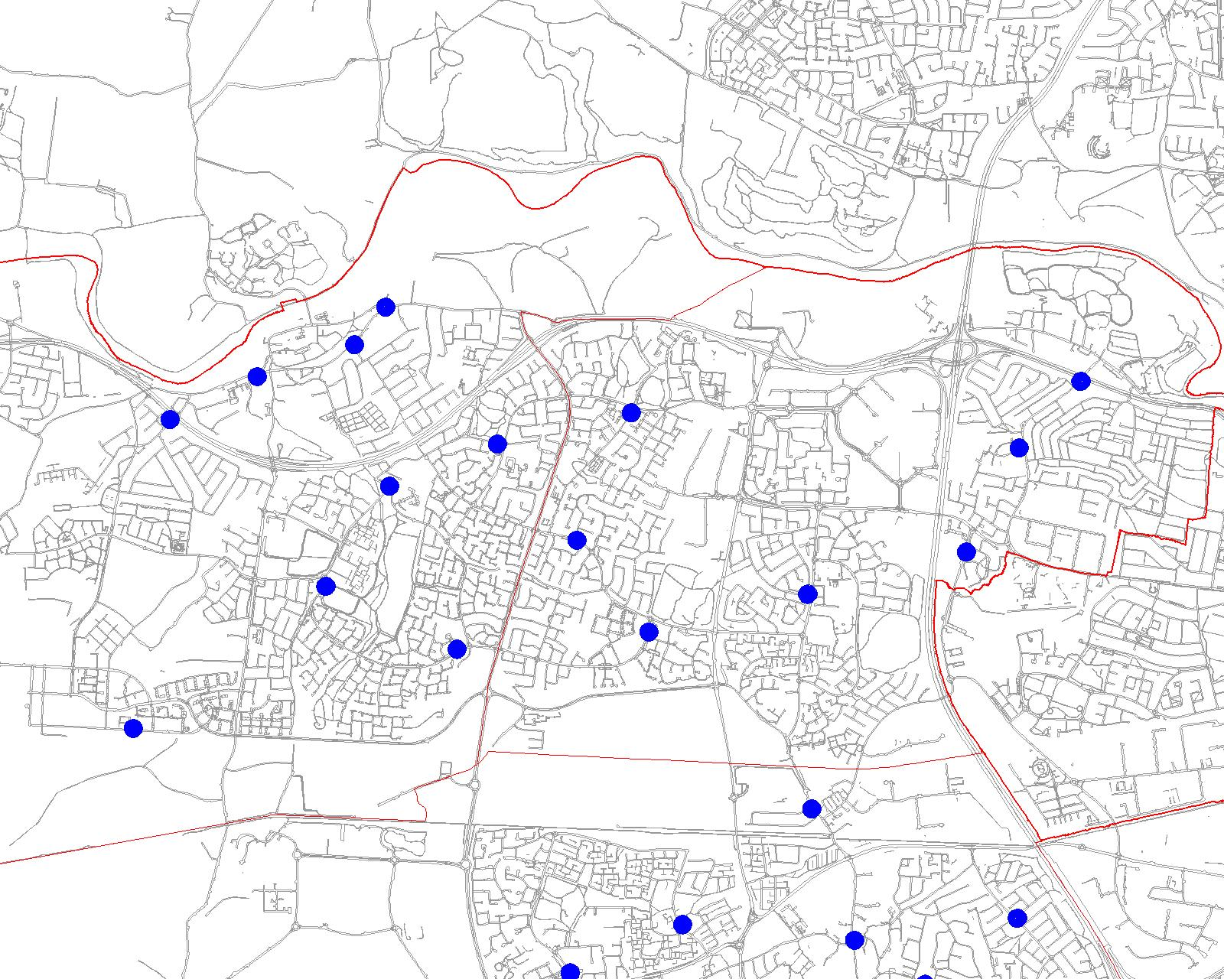
Lucan, Palmerstown Fonthill

Slide 10
Questions?

