Slide 1

Annual Report 2022
Presentation to SDCC
Mary P. Corcoran, Chairperson LCDC
June 12, 2023

Slide 2

What We Do
Co-ordinate, plan and oversee local and community development funding and bring a more joined-up approach to the running of local and community development programmes and interventions in South Dublin County.
https://www.youtube.com/watch?v=_o7lPeDBbWQ

Slide 3
LCDC Managed Funding Streams
The biggest of these is the SICAP programme which had a budget of allocation of €2,451,324 from the DRCD in 2022.
In 2022, the Community Activities Fund (CAF) under the DRCD’s Community Enhancement Programme allocated €338,797.
The Community Support Fund under the Community Enhancement Programme 2022 was launched by the Department on 23rd November 2022. South Dublin LCDC has been allocated a total of €430,326 currently in train.
Since June 2017, €3,904,144 from schemes other than the SICAP programme has been channelled through the LCDC.

Slide 4

SICAP GOAL 1
Supports communities and target groups to engage with relevant stakeholders in identifying and addressing social exclusion and equality issues, developing the capacity of Local Community Groups, and creating more sustainable communities through enhanced representation and collaboration. The primary beneficiaries of Goal 1 are Local Community Groups and Social Enterprises that have a remit in working with or providing services to SICAP target groups.
SICAP GOAL 2
Supports disadvantaged individuals in improving the quality of their lives through the provision of mental health and well-being supports, lifelong learning and labour-market supports. The primary beneficiaries of Goal 2 are disadvantaged individuals aged 15 years upwards, children and families.

Slide 5
The current SICAP (2018-2022) contract was tendered in 2017 and the contract was awarded to South Dublin County Partnership (SDCP). In 2022 SDCP has successfully achieved both KPIs agreed in the SICAP contract.
Mid-programme Review was held in November 2022 with POBAL and report submitted to LCDC.

Slide 6
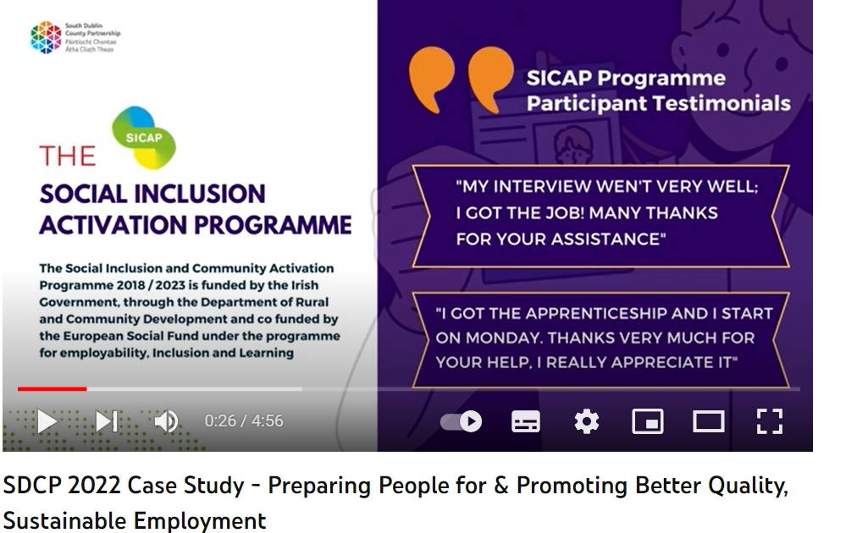
SICAP Case study 2022
“This is an excellently presented video case study which clearly illustrates the benefits of their employer liaison team in tackling social and economic inequality. The support and services not only benefit the long-term unemployed but also many local employers through engagement with local job hunters.” (POBAL)
https://www.youtube.com/watch?v=GJhQh2iH8bI

Slide 7
Sláintecare Healthy Communities (SHC) and LCDC
In 2021/2022, the Department of Health invested €13m to provide health services to support healthy communities.
The goal of the Sláintecare Healthy Communities Programme is to improve the long-term health of target populations and improve the quality of life of individuals in those communities.
South Dublin is a selected county with two areas- Tallaght and Clondalkin- both benefitting from resourcing via Sláintecare Healthy Communities.
SHC Local Development Officer (Tallaght) Grainne Meehan presented to the LCDC on September 21, 2022. A second Local Development Officer covers the Clondalkin area.

Slide 8

Activities in 2022
Seed funding: €75,000 towards needs analysis and energy poverty
Sláintecare Community Enhancement Funding has supported the following:
Healthy exercise route – MacUilliam; Adult changing room and sensory garden –St Aongus Community Centre; Multi-Use Games Area – Citywise Education; Resilience programme – Brookfield Community Centre; Healthy/Active Families – South Dublin Partnership; Outdoor calisthenics equipment- Balgaddy; Public realm upgrades – Black lane, Neilstown; Community health fair – Rowlagh Community Centre; Resilience programme for young women – Collinstown Sports Complex; Period Poverty Initiative – Foroige

Slide 9

Healthy Ireland
Healthy Ireland Round 4 launched in 2022. The project is managed by SDCC in partnership with the HSE. A Healthy South Dublin County Coordinator commenced working on the 3-year Healthy Ireland Fund Local Strategy in October 2022.
The core of the strategy is to take an outcomes approach based on local data, needs and in collaboration with local stakeholders.
Funding of €155,000 allotted over a three-year period 2023-25
Additional Healthy Ireland funding of €66,000 made available to SDCC in 2022 to support social inclusion of Ukrainian refugees in the county.

Slide 10
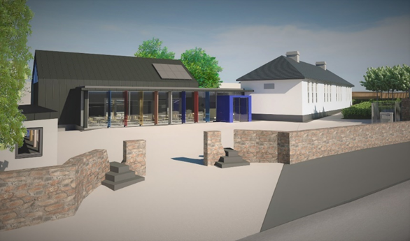
LCDC Annual Report 2022: LEADER
Dublin Rural LEADER ran from 2014-2020.
The respective percentage of rural area population, as per the LDS, are Fingal 67%, DLR 8% and SD 25%.
The respective approved funding percentages are Fingal 64.72%, DLR 5.68% and SD 29.61%. (source: Review of the Leader Local Development Strategy in Dublin Rural, 2020 DRAFT)
Transition LEADER Programme Commenced April 1st, 2021 & ran until December 31st, 2022. SDCC drew down €33, 204.62 (6.67% of value of the overall budget) during that period.

Slide 11
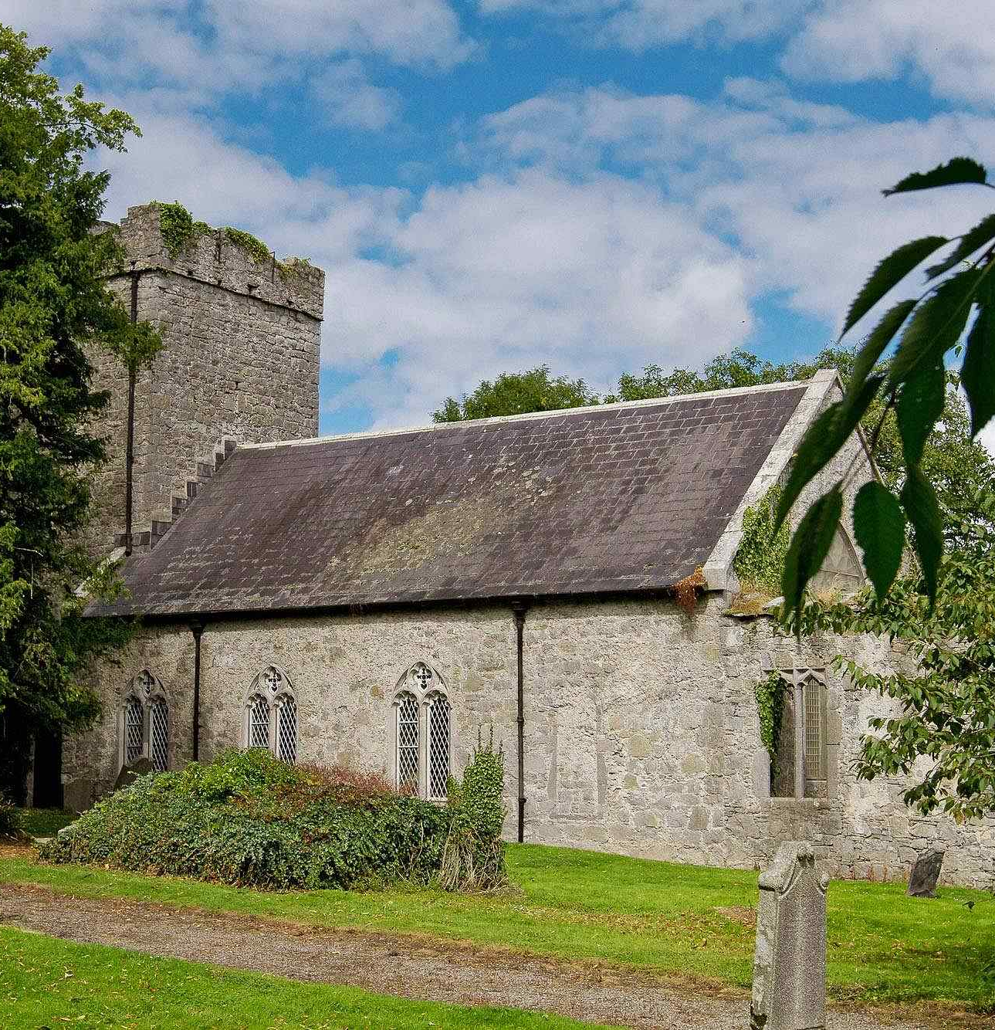
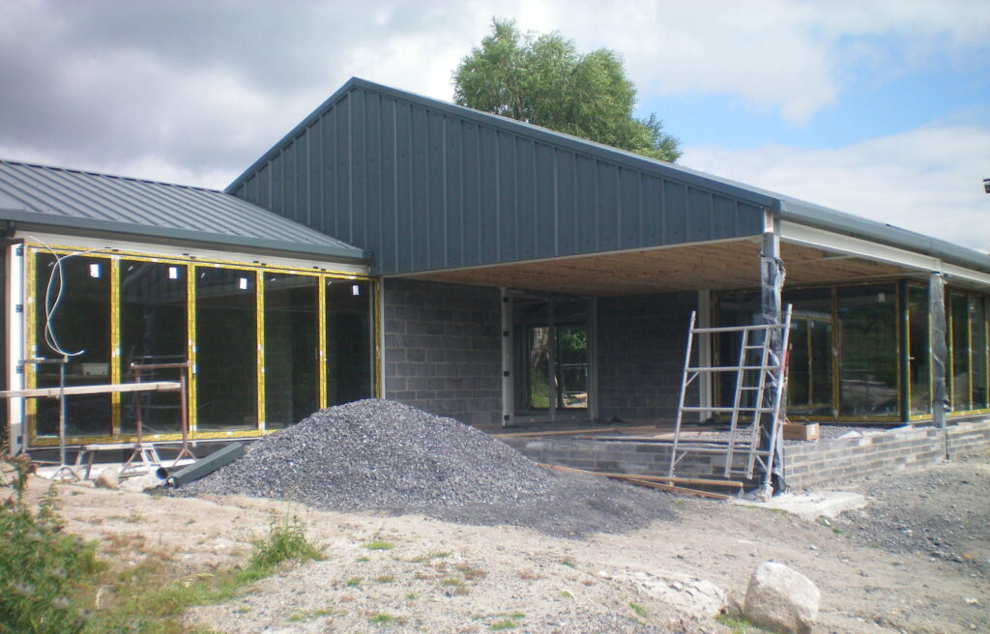
South Dublin projects supported by Leader
Saggart School House Community centre - €500K
Glenasmole Community Centre Facility Upgrade - €500K
The Artisan Pizza Company Business Expansion Plan 2020 -€104K
The Newcastle Lyons Heritage Trail Project - €23K
Calliaghstown Equestrian Centre Upgrade - €24K
Colin Harris Design Ireland Product Launch - €14K
Development of Typing Tutor Program Prototype - €30k
Expansion of Activities and Equipment for Slade Valley Men's Shed - €20K
Footee Expansion & Upgrade - €11K

Slide 12

LCDC Annual Report 2022:
New LECP – under construction
New guidelines published Nov 2021
Review of 2016-2021 Plan completed 2022
Advisory Group formed and met several times in 2022
Draft High-Level Goals agreed in January 2023
Consultation underway from late 2022 e.g. Poverty in South Dublin: Developing our understanding and collaborative planning, seminar held October 5th, 2022
External company contracted to undertake further consultation exercises and draft new LECP.
Draft plan to be reviewed by LCDC/SPC later this year.

Slide 13

Looking Ahead
Ensure membership and representation in place, renewed periodically and active
Committee structures work well but mainly focuses on operational rather than strategic matters
Increased levels of grant administration is challenging because of diversification of grant schemes and short timelines – LCDC members have worked with SDCC staff to ensure optimal grant management process
Presentations from staff of SDCC and from service providers across the county are invaluable for LCDC members to get a handle on pressing issues, and “the state of the county”.
New LECP an opportunity to focus effort in a strategically targeted way that can be monitored across the timeframe of the plan.

