Slide 1
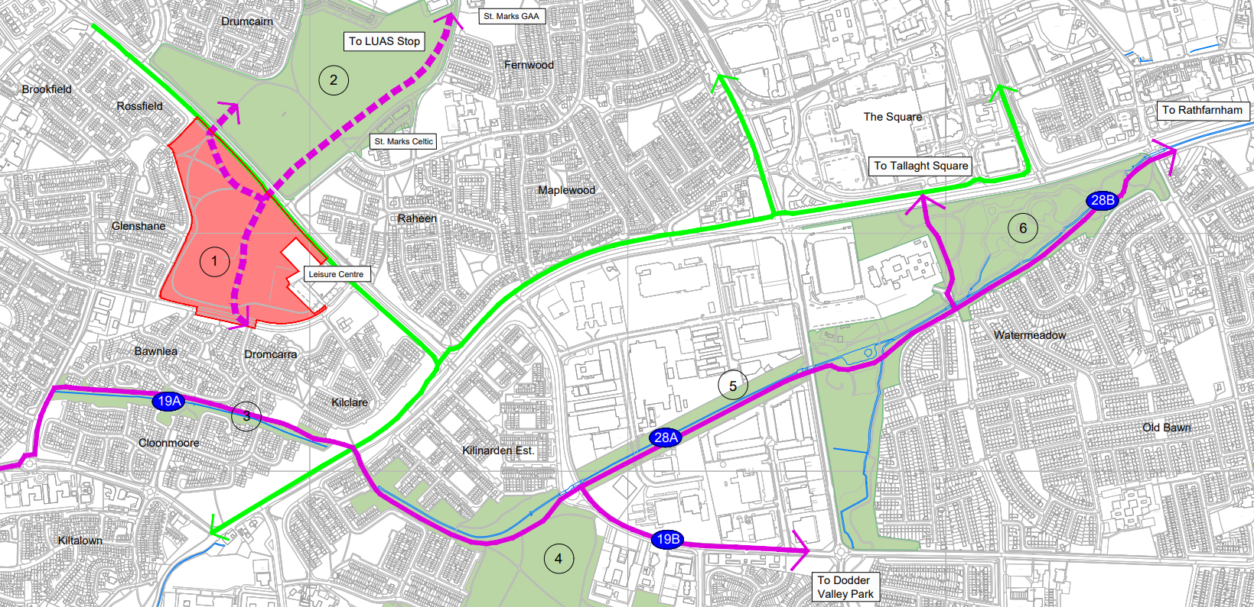
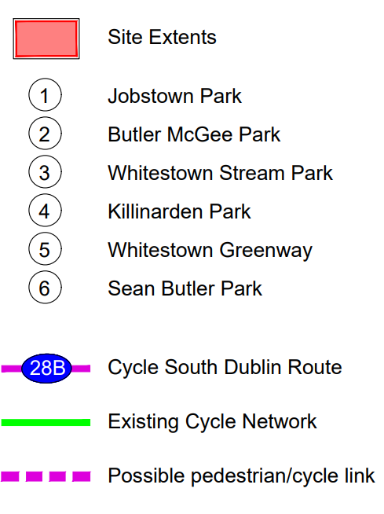
Jobstown Park Upgrade PUBLIC REALM SECTION Part 8 Report Presentation
Context of project & location
Jobstown Park is a park in West Tallaght that is 28.68 acres (11.60 ha) in size. The Park is located approx. 500m from the new N81 greenway and 27m away from Butler Magee Park. The Park is bounded by R136 in the north, Fortunestown Way in the South and Glenshane Dr in the west.
Jobstown Park will be connected to Butler Magee Park, Whitestown Stream Park, Killinarden Park (both soon to be upgraded) and onwards via the Whitestown Green Corridor to Sean Walsh Park, forming a significant continuous Green Infrastructure link in South Dublin.
Jobstown Park is zoned in the South Dublin County Development Plan 2022- 2028 as Objective OS, ‘To preserve and provide for open space and recreational amenities’

Slide 2
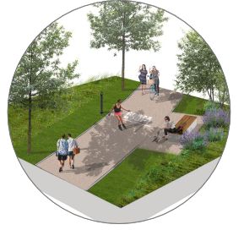
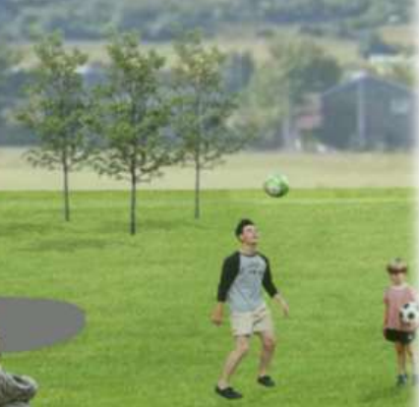
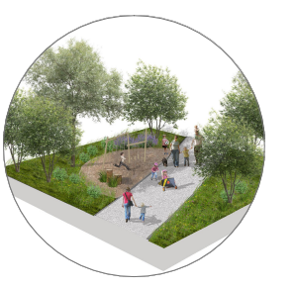
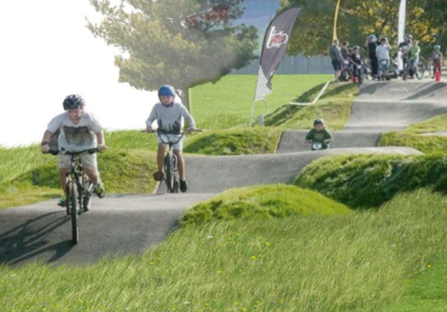
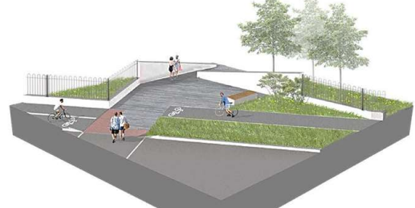
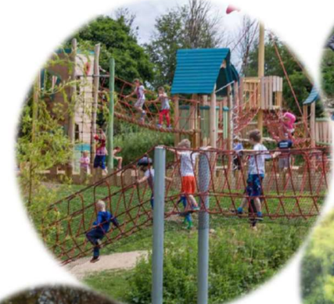
The Jobstown Park Upgrade will consist of:
Upgrade of existing boundaries and access points including provision of focal entrances.
A shared pedestrian/cycle route with lighting columns linking Butler McGee Park to Whitestown Stream Park, via Dromcarra Estate.
Upgrading existing footpaths where required, install new secondary footpath linkages and realignment of other footpaths.
Retention of existing sports pitches (northern pitch re-orientated) - refurbished where necessary with drainage and re-levelling.
Four new pedestrian entrances to provide access into the Leisure Centre, in the southeast, southwest and the northeast of the site.
Retaining existing kissing gates and upgrade where required.
An activity circuit 900m long - with seats and play/exercise equipment
A provision for teenspace area, fitness/workout area, natural play areas, pump track and natural play mounds.
The provision of on-street parking and associated hard and soft landscaping on Fortunestown Way.
Retention and replanting of existing hedgerows.
Attenuation swales for enhanced biodiversity.
Planting of trees, shrubs, hedgerows, and bulbs.
All associated landscape works.
All ancillary works.

Slide 3
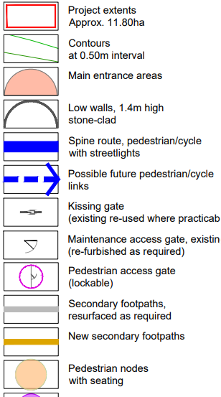
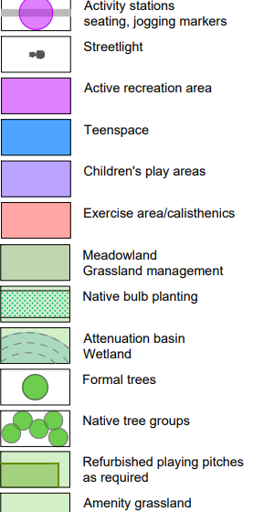
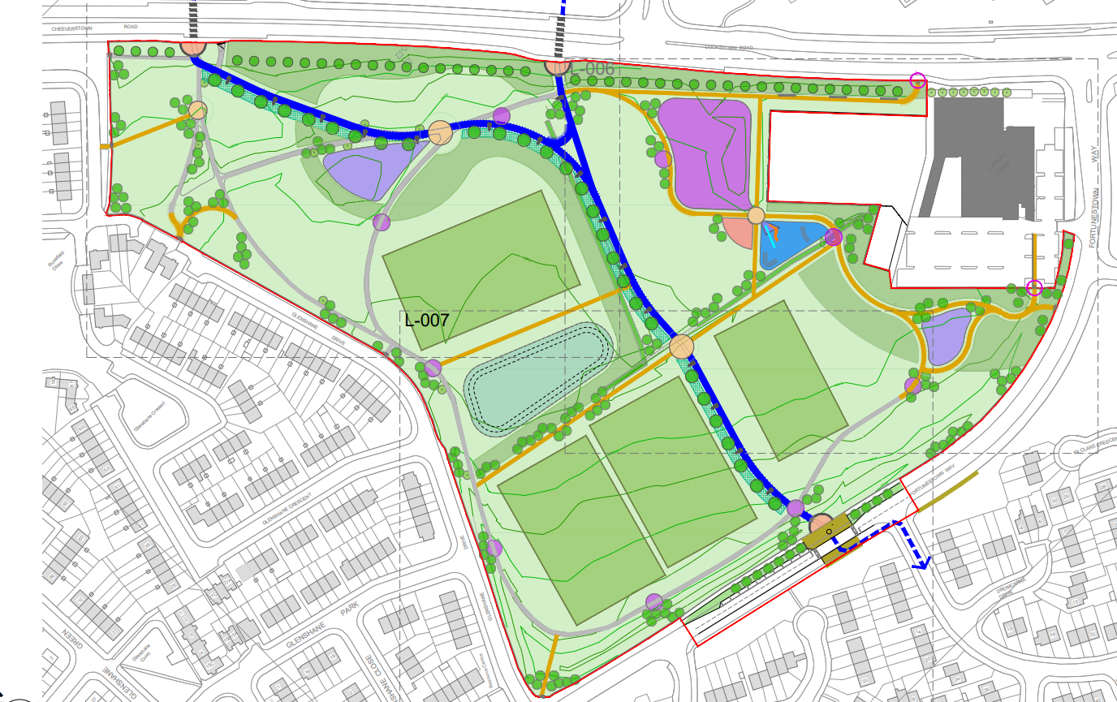
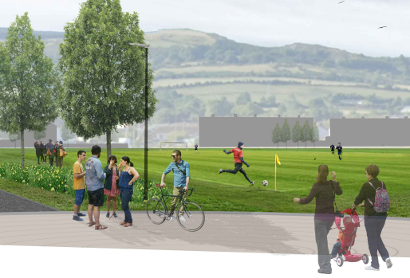
Proposed Landscape Masterplan/Layout

Slide 4
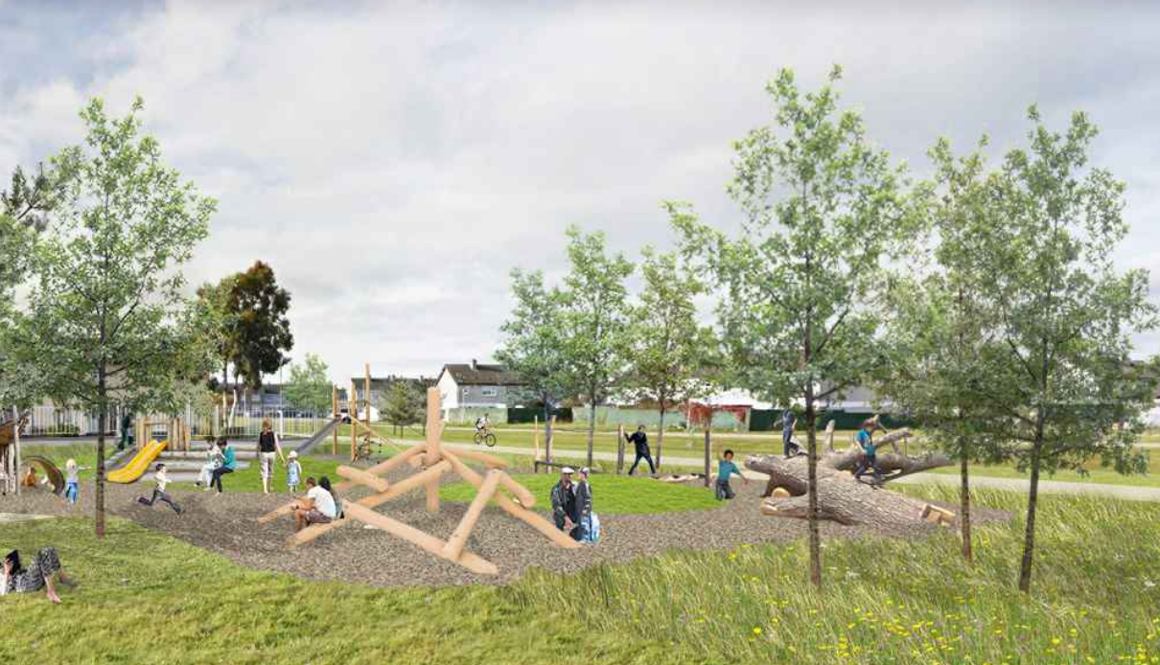
Summary of Jobstown Park Part 8 Process
Non-Statutory Period
Initial presentation to Elected Members.
Consultation with SDCC staff.
Informal Non-Statutory Consultation with key community stakeholders (residents, schools, clubs, groups, etc)
Statutory Period
Public Consultation period 5th April 2023 to 18th May 2023
Issue of CE report and recommendation.
Five (5) submissions were made during the Statutory Consultation process.
They have been summarized and responded to in the CE Report.

Slide 5
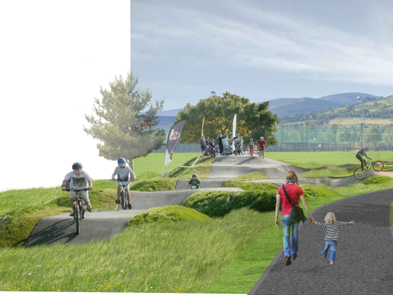
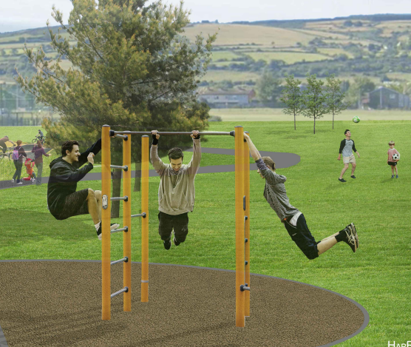
Issues/ Comments Raised: please see CE report for full summary, response and recommendation in relation to the submissions received.
Submissions received welcomed the development
Requests for biodiversity & pollinator planting/areas
Request for community spaces
Sensory communication boards and play equipment
An area for dogs
Controlled access points stop scramblers
Request for active recreational to be provided such as a bike/scooter track, play area, football, walking areas and fitness/ calisthenics area.
Requests for additional lighting and CCTV cameras

Slide 6
Recommendations for Part 8 Adoption
Following consideration of the submissions, the Chief Executive is of the view that the issues raised by way of the submissions can be satisfactorily addressed at the detailed design stage, operational stages and as outlined in the foregoing report.
It is recommended that, as the proposal is consistent with the County Development Plan and the proper planning and sustainable development of the area, that the Council proceed with the Part 8 proposal for the upgrade of Jobstown Park.

Slide 7
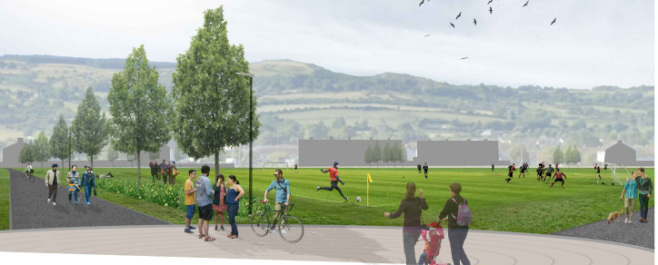
Thank You

