Slide 1
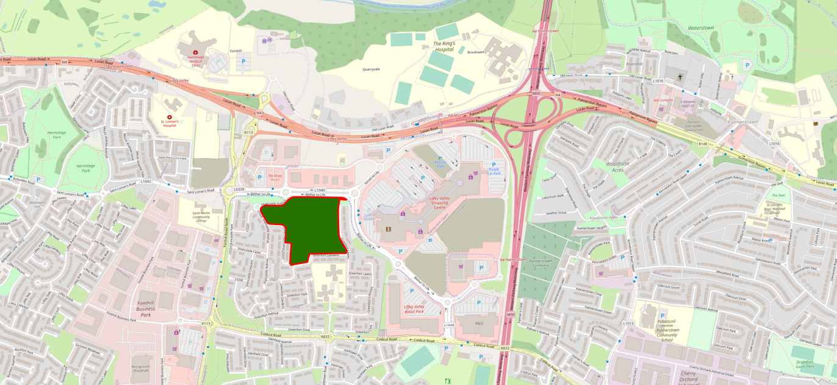
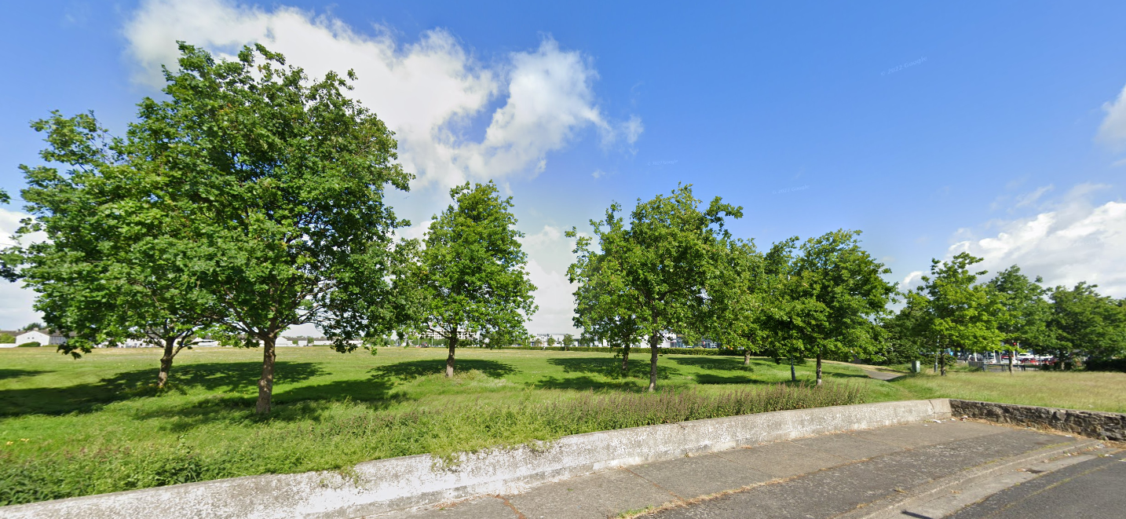
Quarryvale Park Upgrade Public Realm Section Part 8 Report Presentation
Context of project & location
Quarryvale is a neighborhood park measuring approximately 6.5 hectares in size. Bound on three sides by the residential areas of Greenfort Gardens, Greenfort Lawns, Shancastle Lawns and Shancastle Avenue, the northern edge of the park runs parallel to the busy Fonthill Road.
The park itself is surrounded by, not only houses and homes but, commercial hubs such as Liffey Valley Shopping Centre, car dealerships and industrial estates. With such a high density of people living and working right next to this park coupled with its proximity to the N4, M50, Coldcut Road, Fonthill Road and routes serviced by Dublin bus there is huge potential for the park to be used as a recreational, amenity and transitional space.
Quarryvale Park is zoned in the South Dublin County Development Plan 2022- 2028 as Objective OS, ‘To preserve and provide for open space and recreational amenities’

Slide 2
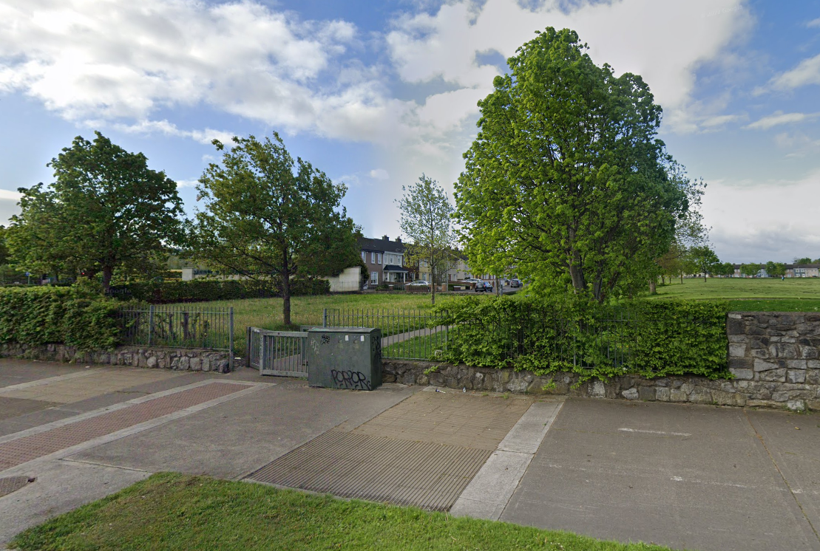
The Quarryvale Park Upgrade will consist of:
New Park layout including new and upgraded pathways.
Shared footpath/cycle routes linking the main entrance at the Fonthill Road to Shancastle Lawns and Greenfort Gardens including street lighting and formal trees.
Pedestrian areas with seating.
Playground and Teen Space.
Repair to broken sections of periphery wall and the installation of a new boundary fence.
Existing Oak trees retained.
Provision for active recreation.
800m Activity Circuit around the periphery of the park.
Relocation and upgrade of Grass Sports Pitch.
Biodiversity improvements - existing boundary hedge retained, grass meadowland, management bands, bulbs in linear strips, informal native tree groups.
All associated landscape design including street furniture, surfacing and signage.
All ancillary works.

Slide 3
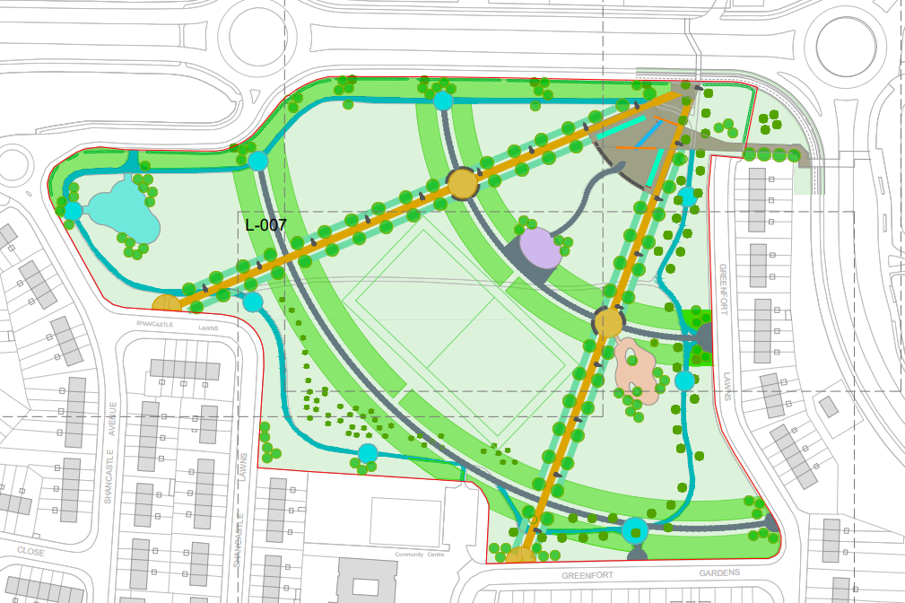
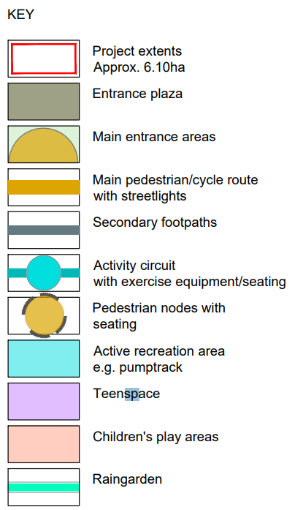
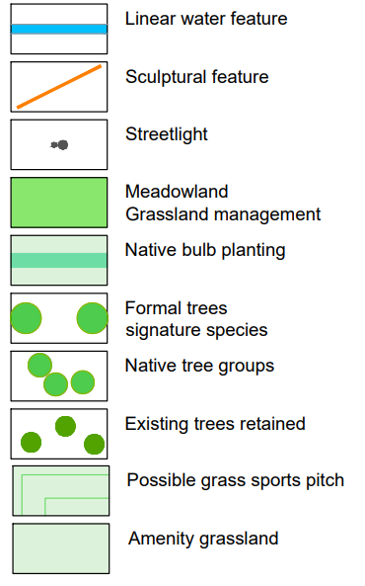
Proposed Landscape Masterplan

Slide 4
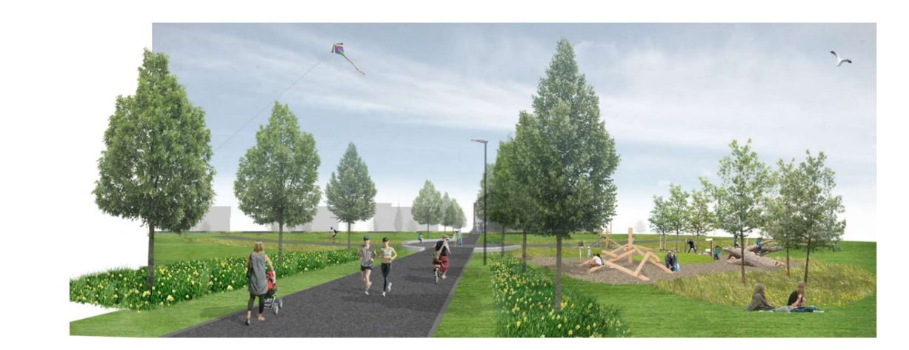
Summary of Quarryvale Park Part 8 Process
Non-Statutory Period
Initial presentation to Elected Members (16th Feb 2023)
Consultation with SDCC staff
Informal Non-Statutory Consultation with key community stakeholders (residents, schools, clubs, groups, etc) (Jan-Feb 2023)
Statutory Period
Public Consultation period 6th April 2023 to 19th May 2023
Issue of CE report and recommendation.
2 submissions were made during the Statutory Consultation process.
They have been summarized and responded to in the CE Report.

Slide 5
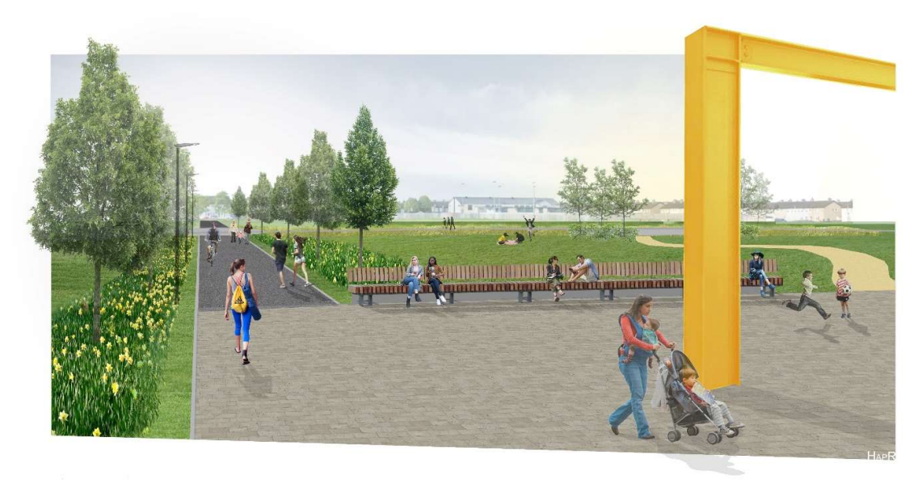
Issues/ Comments Raised
Submissions received generally welcomed the development.
Requests for further biodiversity & pollinator planting as well as the inclusion of meadows, re-wilding and “Stepping Stone Forests”/Mini Woodlands.
Requests for informal play spaces such as basketball courts or bike tracks as well as water stations and bike parking facilities.
The hiring of a dedicated Park Ranger.
Upgrade of the boundary treatment for improved security.
Requirement for additional lighting and CCTV.
Inclusion of a Dog Run as well as Dog bins and water stations.
The need for universal access points, wheelchair friendly play spaces and a sensory area/areas.
The need to plant semi mature/mature trees.
Request for the commemoration of a local activist.
Please see CE report for full summary, response and recommendation in relation to the submissions received.

Slide 6
Recommendations for Part 8 Adoption
Following consideration of the submissions, the Chief Executive is of the view that the issues raised by way of the submissions can be satisfactorily addressed at the detailed design stage, operational stages and as outlined in the foregoing report.
It is recommended that, as the proposal is consistent with the County Development Plan and the proper planning and sustainable development of the area, that the Council proceed with the Part 8 proposal for the upgrade of Quarryvale Park.

Slide 7
Thank You

