Slide 1
Age Friendly Programme Manager
Housing SPC
30th May 2023
Notes:
Hi, my name is Niall Noonan and I’m the still newish Communications Manager of South Dublin County Council. I joined in July of this year and it is my first post within a local authority. So I’ve received a crash course in citizen engagement at local government level and want to take you through a few of SDCC’s key campaigns and achievements.

Slide 2
FAQ Design
Housing Allocations
Consultation
Age Friendly Alliance
&
Older People’s Council
Final Rightsizing FAQ
SDCC IT channels & hard copy
Notes:
Give CC and Comms figures for Emma, talk of how our county is the most engaged on social media during events like this

Slide 3
1 What is Rightsizing?
2. Who can right size with South Dublin County Council?
3. What are the benefits of rightsizing?
4. Preparing for Rightsizing / What to Consider
5. I own my home. What is the Community List (financial contribution to the Council)?
6. I am an SDCC tenant. How do I apply?
7. How long does the process take ?
9. Where will properties be available for rightsizing?
What are the features of age friendly housing development?
What are the tenancy rules for new age friendly homes?
How do I find out more information about Rightsizing?

Slide 4
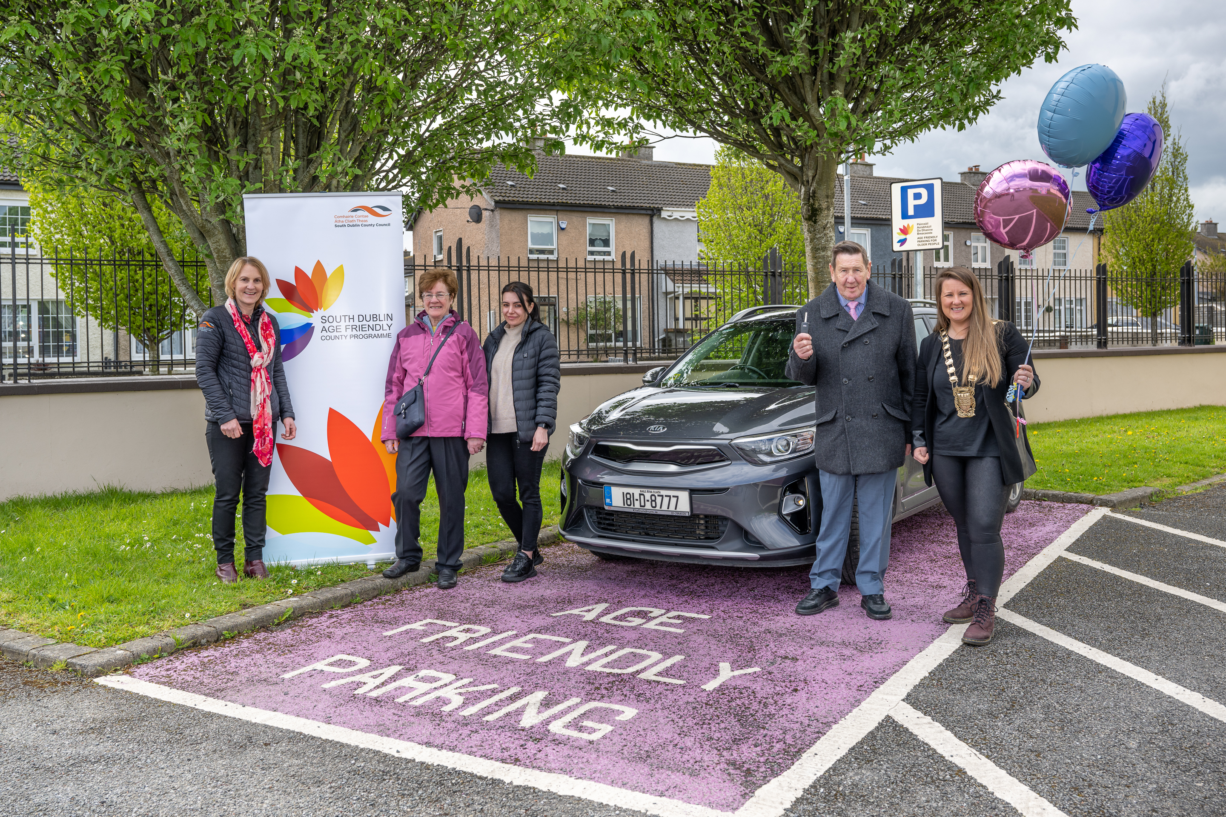
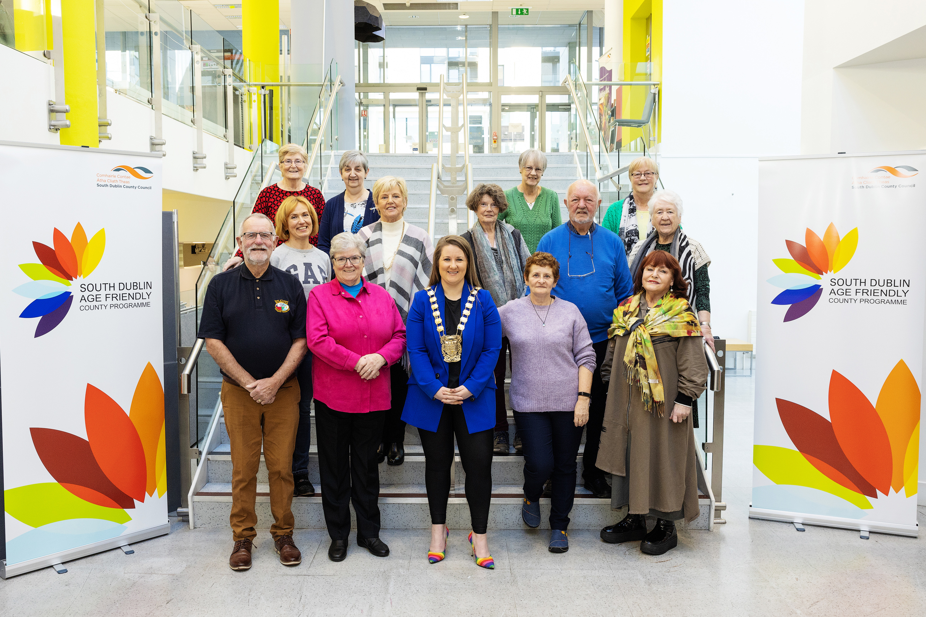
Notes:
Give CC and Comms figures for Emma, talk of how our county is the most engaged on social media during events like this

