Slide 1
Cheeverstown
SDCC Disability Steering Group
May 2023

Slide 2
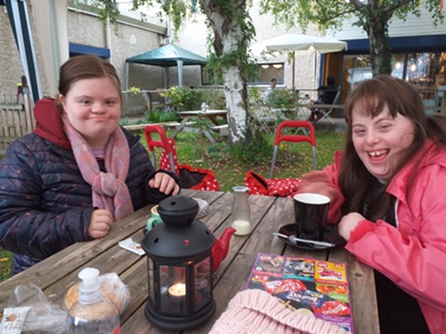
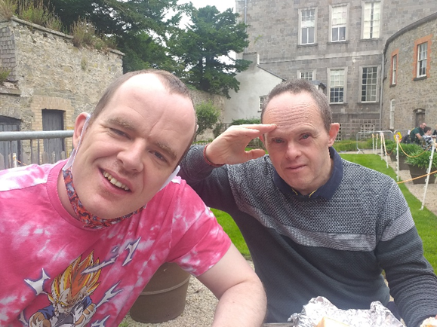
Contents
Cheeverstown overview
Strategic Plan 2023-2026
Housing Needs
Progress to date & challenges

Slide 3
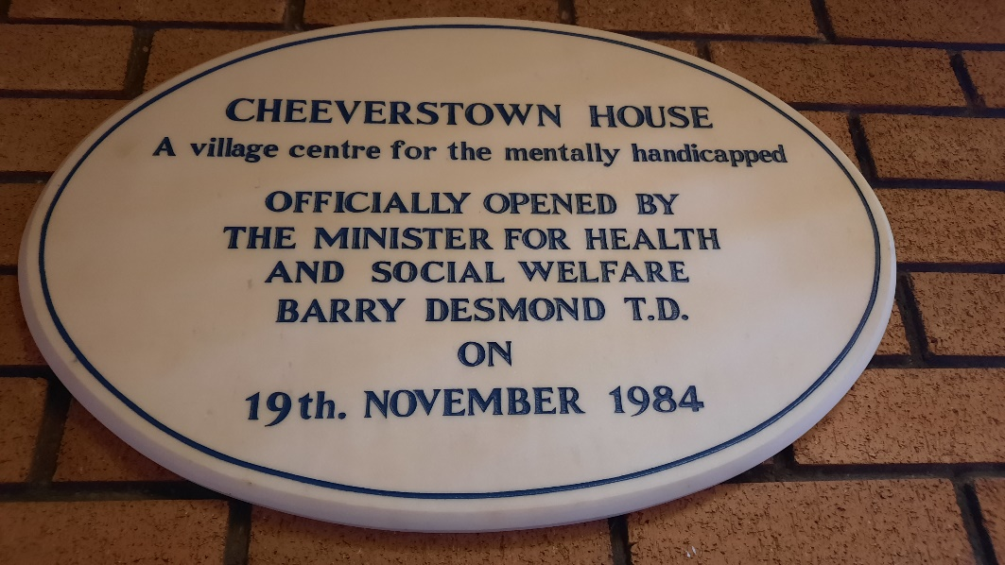
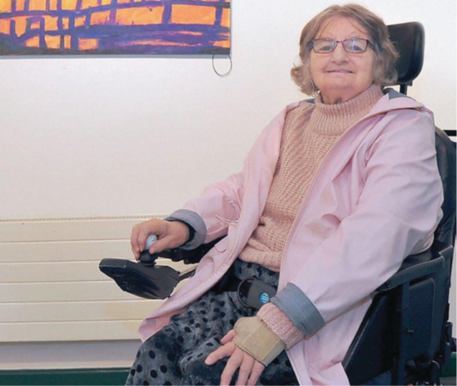
Cheeverstown
Voluntary body, registered charity, section 38
Built in 1984 by Eastern Health Board
Has evolved to provide residential, day, respite, employment support
Approx. 500 staff supporting 400 adults
Broad range of people and needs supported
Intellectual disabilities and physical disabilities

Slide 4
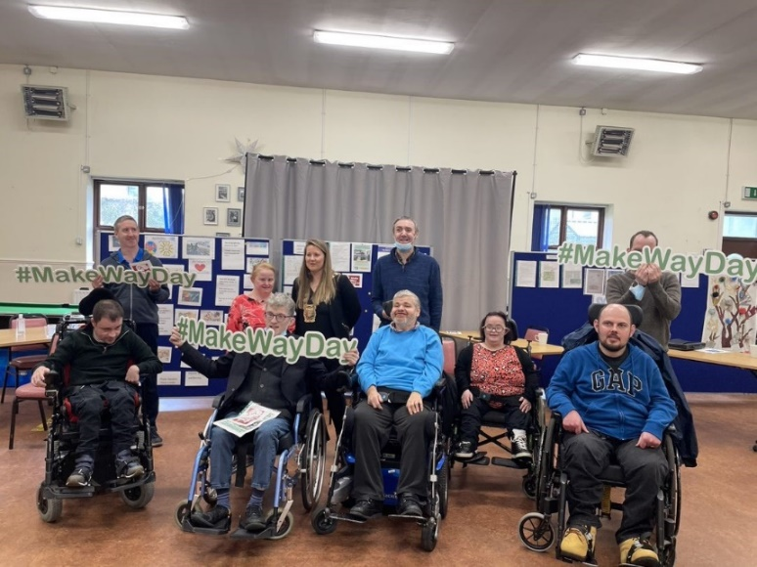
Strategic Plan 2023-2026
Priority 1 Services
Residential supports – closure of congregated setting
Day Supports - campus based services to community under New Directions
Respite - Alternate respite options: community based
Priority 2 Communication – promote the vision and values
Priority 3 Partnerships - Strengthen the circle of support placing the service user at the core of all decision making. Advocate for the people we support. Connect with local employers and community groups

Slide 5
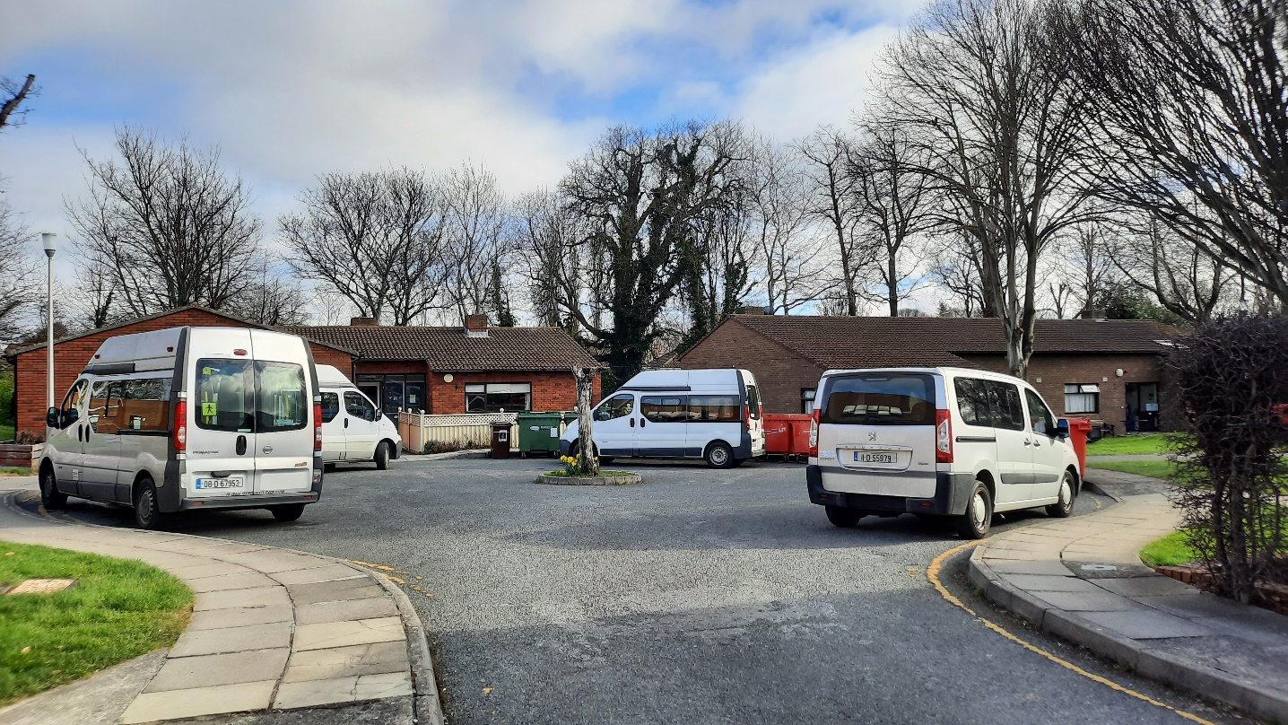
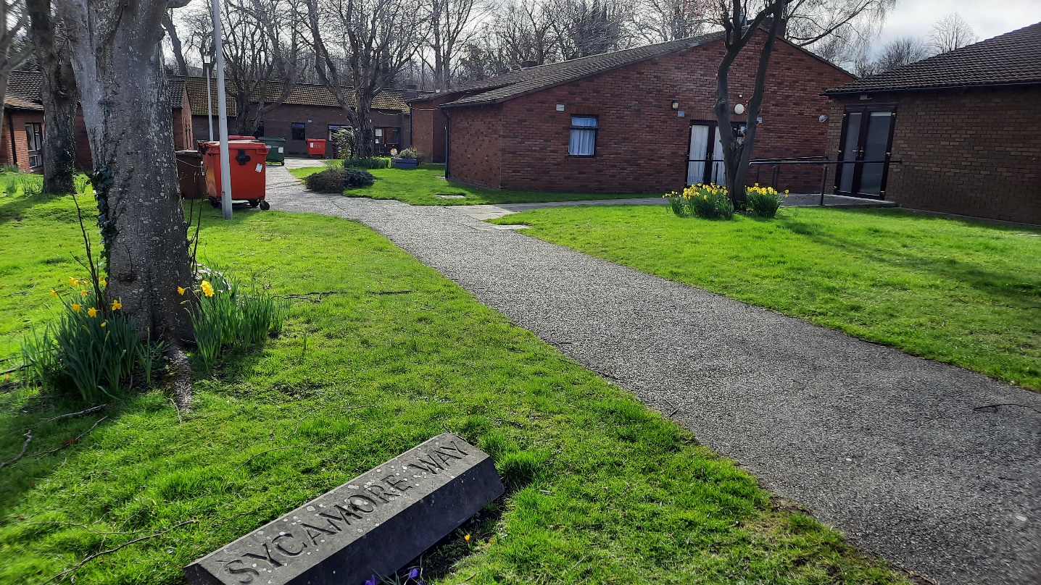
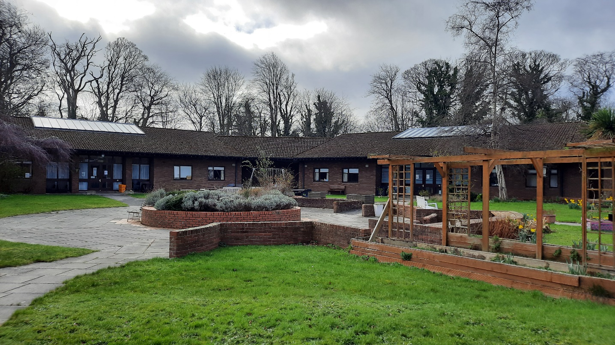

Slide 6
Other Housing Needs & Solutions
Campus
Community Homes – not fit for purpose
People living with ageing parents
TTMO Funding
Charity Funds
Housing List SDCC
Partnering with AHBs
Locations of new homes

Slide 7
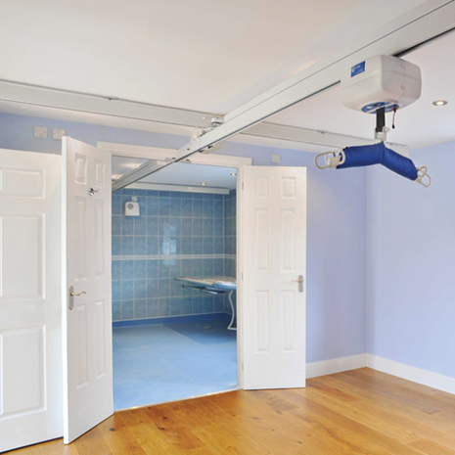
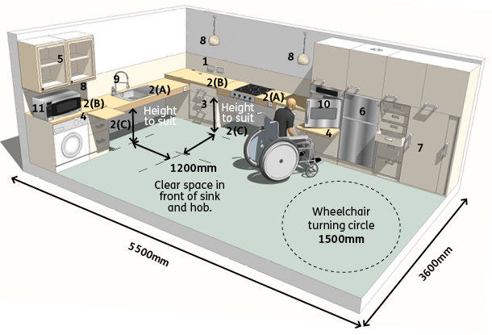
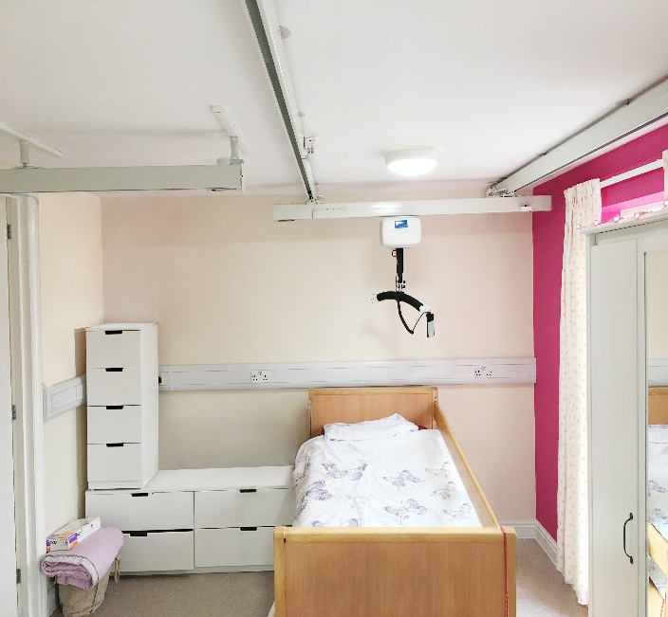
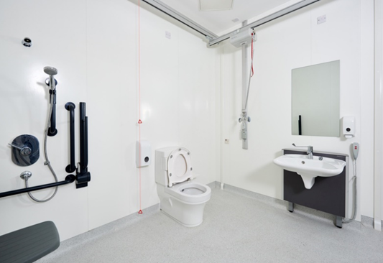
Challenges
Accessible – ageing in place with complex disability
Renovation cost
Staff support
Firefighting

Slide 8
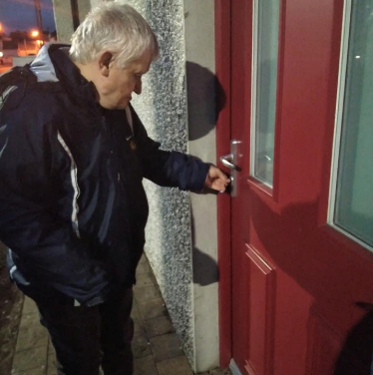
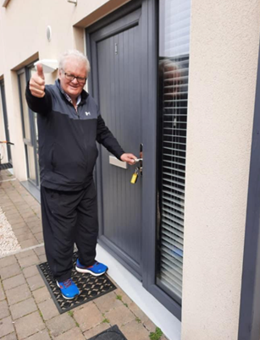
Progress
Welcomed new people to community supported living over 2021
4 people moved from campus to community during 2021 & 2022
Process informed by SRV
Transition community based service users into homes that better suit their changing needs – adapting community homes
Plan for 2023 – 5 properties, 14 people

