Slide 1
Care and Support Plus Housing Model
Susan Kehoe Service Improvement Lead, CHO7 Mental Health Services
Catherine McGillicuddy Development Specialist, Irish Council for Social Housing
On behalf of the
Care and Support plus Housing Model Development Group CHO7 MHS
09.05.2023

Slide 2
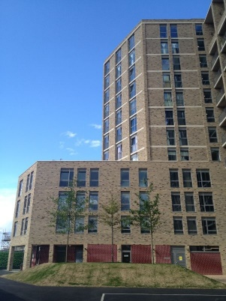
Care and Support Plus Housing Model
Established in 2012 in the UK
Partnership between One Housing Group (OHG) and Camden and Islington NHS Foundation Trust and Camden Council
Supported housing and recovery for people with complex mental health needs
Redesign of care pathway

Slide 3
Partnership Model
Tripartite agreement - NHS Trust, Housing provider, Local Authority
Joint Service protocols
Tenancies tied to support agreement including Mental Health Service inputs
Similar model – The Housing and Accommodation Support Initiative (HASI) in NSW
Expanding the model in UK and Australia

Slide 4


Intensive supported housing
TILE HOUSE
15 new-build apartments
3 floors with 5 units each
£2.5m investment (2012)
Self-contained units
Beautiful places
Specific design is key
Expert staff team
Person focused offer
www.onehousinggroup.co.uk

Slide 5
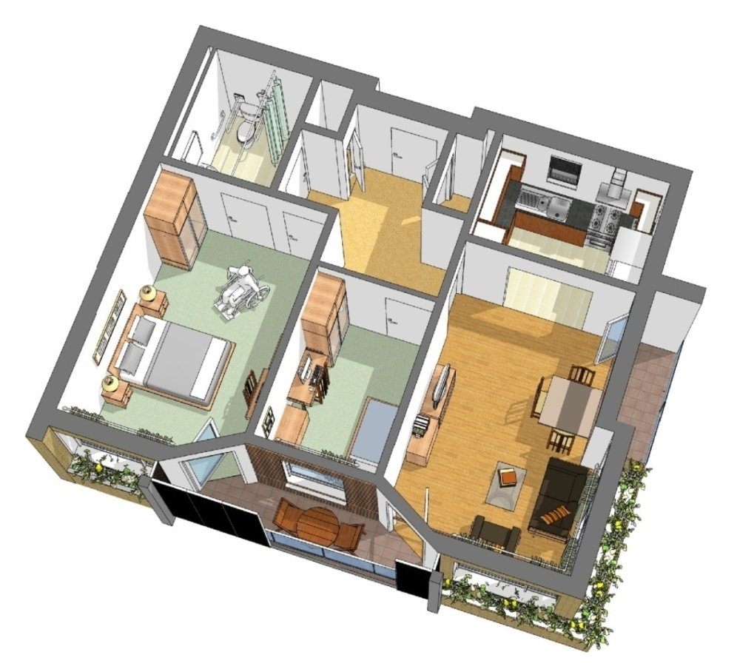

Build for technology
Quality build & design
Highest telecare specification
On call & sensors
Personalised approach
Unobtrusive
Supports strict visitor policy
www.onehousinggroup.co.uk
Notes:
Market test focus groups
Strettons market analysis
Crucially the care in extra care drives value.
Also Location
Then quality of services of which choice is an element. But Care is key.
Then feelings
Care must be part of the offer

Slide 6
Key Ingredients
A defined clinical team working onsite under agreed hours and working as part of an integrated team
The specification of the physical building (single point of entry, CCTV, sprinkler system, airlock doors etc)
Quality of the support staff – psychological therapy models training and supervision

Slide 7
Eligibility Criteria
Individuals with a severe and enduring mental illness with either persistent symptoms, treatment resistance, functional impairments or negative symptoms. Typically they will have:
Dual diagnosis (e.g. schizophrenia and substance misuse, paranoid schizophrenia and cannabis use)
A history of hospitalisation and/or other forms of institutional care
Significant risk issues arising from their mental disorder
Need for medication support
Difficulties with or no experience of independent living
Chaotic lifestyle – difficulty in keeping appointments
Where are they now?
Delayed discharges on Acute Mental Health Units in St. James and Tallaght
Homeless services
In and out of HSE residences ie. unable or unwilling to live in group living environments
Out of Area placements

Slide 8
Local Need
> 70 individuals identified across DSC and SDCC area
Dual Diagnosis – Schizophrenia, Addictions, Intellectual Disability
> 1/3 living in homeless accommodation
Male >> Female
Out of area placements
Poor fit with 24 hour supported HSE residences

Slide 9
Current thinking
Policy
Housing First.
Recovery focused options
Separation of Housing and Support
Person Centred Planning
Models / approaches
UNCRPWD
Sharing the Vision
National Housing Strategy for Disabled People
Notes:
Theme 2 : Interagency collaboration and the provision on supports

Slide 10
Community Living Continuum
Acute Units, Out of Area, Homeless, SRU
Spectrum of Support
Housing
(provided by Housing partner)
-----------------------
Independent Living
Care & Support Plus Model
Support
(provided by MH service)
-----------------------
Wrap around individualised support
Intensive, specialised support

Slide 11
Benefits for Service User
A tenancy - ‘home’ or “place of their own”
Environment where the person can cope
Functional demands similar to what a person would meet in independent living
Non-institutional social relationships
Not managed by medical / MH service
Increases choice, responsibility, recovery.
Decreases restrictions, transient/unstable options

Slide 12
Benefits to Service Providers
Less and shorter admissions to acute services
Tenancies that do not breakdown – no evictions to date for CSP in the UK
Cost saving- compared to previous placements, Tile house saved the system money
Better outcomes for service users

Slide 13
Care and Support Plus Development Group
Established in 2019 under the governance of the Community Living Implementation group CHO7
Multi perspective group
Membership includes:
  Senior management HSE
  Clinicians (Consultant Psychiatrist, OT, SW, Nursing)
  Housing Agency
  Irish Council for Social Housing
  SDCC and DCC representation
  Mental Health Engagement Lead

Slide 14
Partnership Approach
Mental Health Service
Clinical service
Approved Housing Body
Assessment and support planning
Local Authority
Facilitation of pathways towards community living through the provision of long-term accommodation for individuals who successfully transition through the CSP model
Care coordination
Pyschiatric consultation
Medication Prescription
Mental Health Assessment and Support
Medication management
Tenancy sustainment
Life skills
Budgeting
Training and employment

Slide 15
Next Steps
Funding received from HSE to carry out a feasibility study on a HSE site in DCC (Inchicore)
Finding and appraising other sites across SDCC area
Forming Partnership with AHB/Council(s)
Capital Assistance Scheme (CAS) – capital grants available for AHBs

