Slide 1
Private Housing and Disability Grants Online
Housing Strategic Policy Committee
30th May 2023

Slide 2
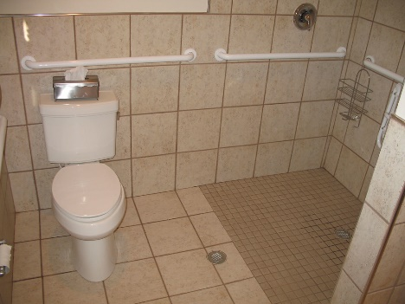
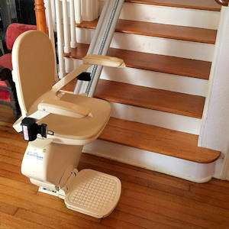
Private Housing and Disability Grants available Housing Adaptation Grant (HAG) Housing Aid for Older People (HOP) Mobility Aid Grant (MAG) The amount of the grant awarded is based on a a household income assessment.
This Photo by Unknown Author is licensed under CC BY-NC-ND

Slide 3
Budget 2023
Minister for Housing Darragh O’Brien has announced €83.125 million in funding for Housing Adaptation Grants for Older and Disabled people for 2023. This is a 2.3% increase nationally on the initial 2022 funding allocation and represents a continuation of the year-on-year increases in the grant since 2014.
South Dublin County Council has been allocated €3,792,515, a €221,075 (6.2%) increase on their 2022 allocation

Slide 4
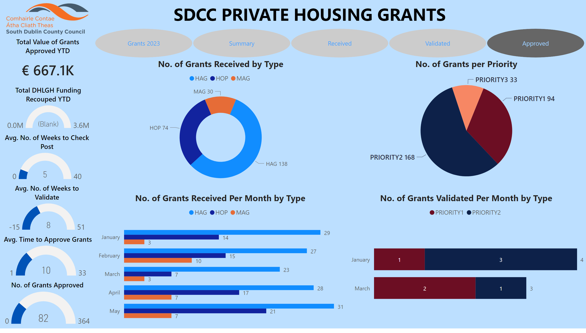
Grant Applications Jan – May 2023

Slide 5
Housing Grants Online New platform to enable applications for Private Housing and Older Persons Grants online
https://hol.sdublincoco.ie
Aim:
Making Housing Grants a website that it can be easily accessed, understood and used to the greatest extent possible by all people regardless of their age, size, ability or disability.
This is part of our ongoing digital transformation to provide the best possible service to our citizens.

Slide 6
Infographic and online video

Slide 7
My Housing Options Private Housing and Older Persons Grants

Slide 8
Digitalised version of Housing Grants Form

Slide 9
Answer a series of questions to complete application

Slide 10
After submission, applications are presented with what they have applied for

Slide 11
Current Stage:
System being tested by Age Council of Ireland Target Online Date: June 2023
Please Note:
This facility is additional to the current paper application form.
Applications will continue to be accepted on line and by hard copy.
Next Stage:
Explore roll out of online system to Disabled Persons Grant (DPG) to Council tenants

