Slide 1
South Dublin County Council
School Crossing Report 2023

Slide 2
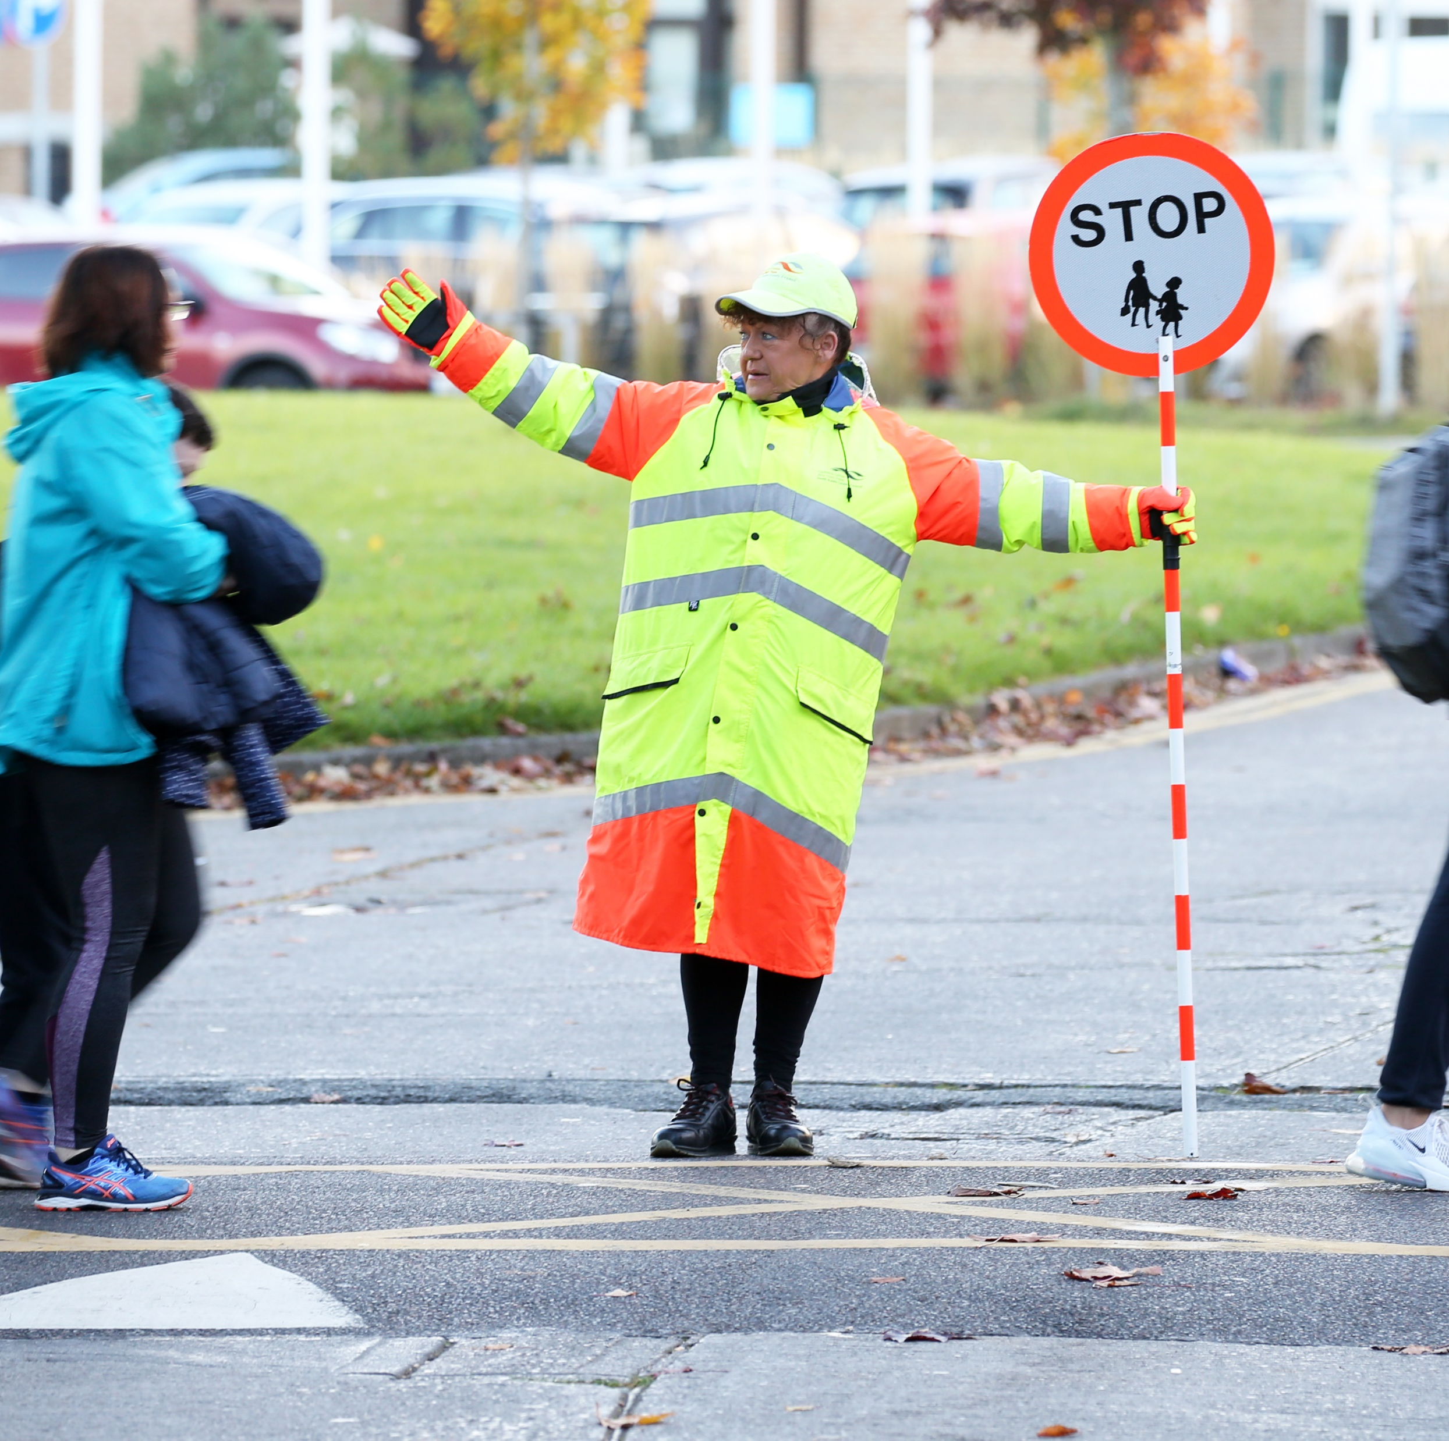
Overview
95 Primary School Crossings:
Lucan/Clondalkin – 37 *
Tallaght/Rathcoole – 31
Templeogue/Rathfarnham – 27
104 School Wardens (Permanent/Relief)
Counts undertaken at crossing locations and requested new locations to inform an evidence based next step approach.

Slide 3
Data Collection and Analysis
Tracsis LTD procured to undertake a data count at each of the crossing locations,
Data coded as:
V = Traffic Vehicle
A = Adults
AC = Accompanied Child
UC = Unaccompanied Child
T = Teenager
Data recorded in 15 minute segments and crossing duty times used to extract data for analysis.

Slide 4
Data Collection and Analysis
The following scenarios were used to inform how the crossings were being used:
Ratio of V:UC&T
UC&T per minute
All pedestrians per minute
Peak users per minute
Additional data (speed limit and whether the crossings is controlled/uncontrolled also added)

Slide 5
Lucan/Clondalkin Results
KEY
< 1 Peak User PM
> 1 but < 2 Peak User PM

Slide 6
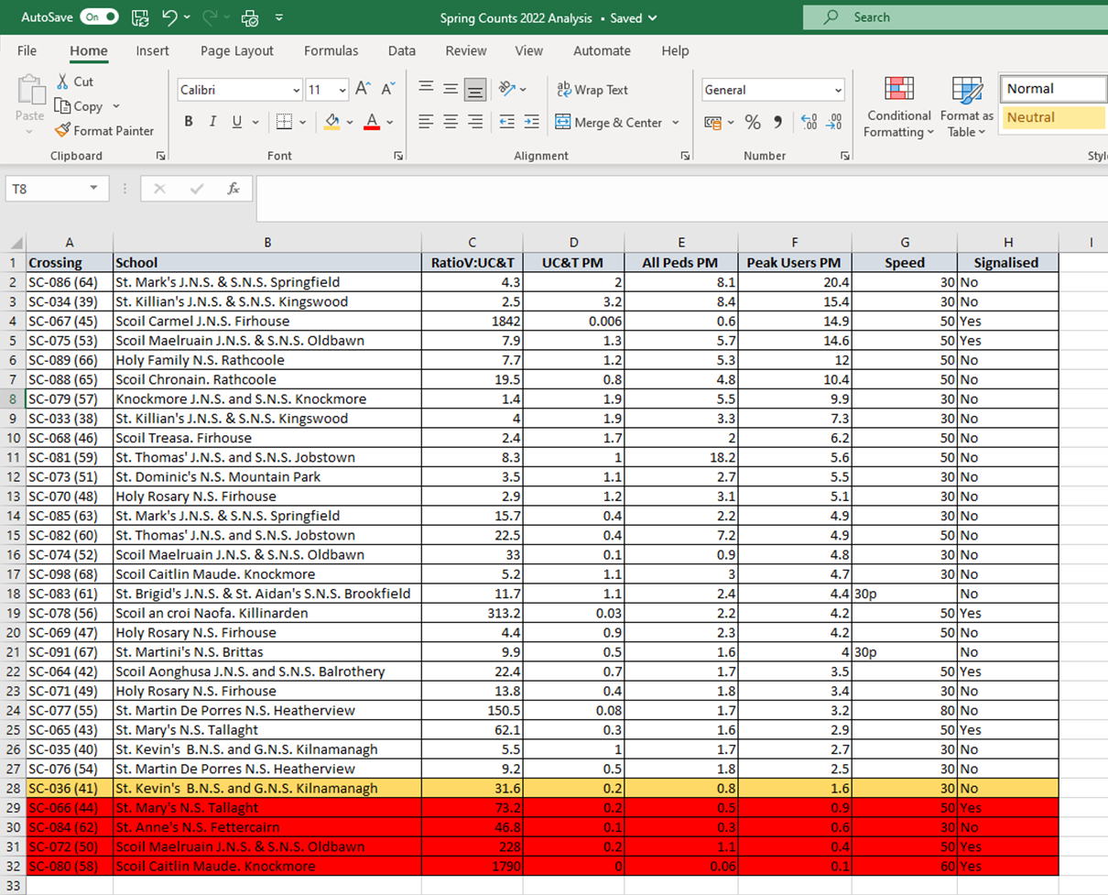
Tallaght/Rathcoole Results
KEY
< 1 Peak User PM
> 1 but < 2 Peak User PM

Slide 7
Templeogue/Rathfarnham Results
KEY
< 1 Peak User PM
> 1 but < 2 Peak User PM

Slide 8
Additional Count Results
KEY
> 2 Peak User PM

Slide 9
Next Steps
Examine crossings highlighted red (except for SC-032 due to Luas track) in consultation with Traffic technical staff to explore alternative road safety engineering solutions,
Explore whether staff assigned to crossings highlighted in red (except for SC-032 due to Luas track) can be relocated/ reassigned to new crossings identified and highlighted in green,
If, point 2 above is not feasible, submit business cases for additional staff appointments to cover new crossings meeting criteria,
Begin processes of exploring 30km/h zones, were appropriate, initially outside primary schools in consultation with Traffic technical staff and plan to deliver as a separate project to upcoming speed limit review.

