Slide 1
City Edge – Proposed Variation of County Development Plan
LUPT SPC
25th May 2023

Slide 2
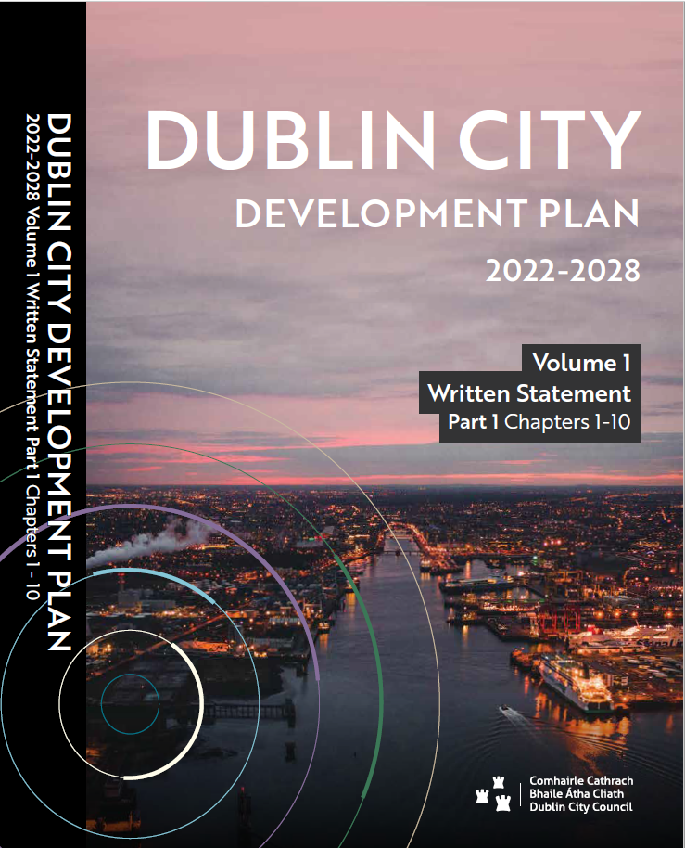
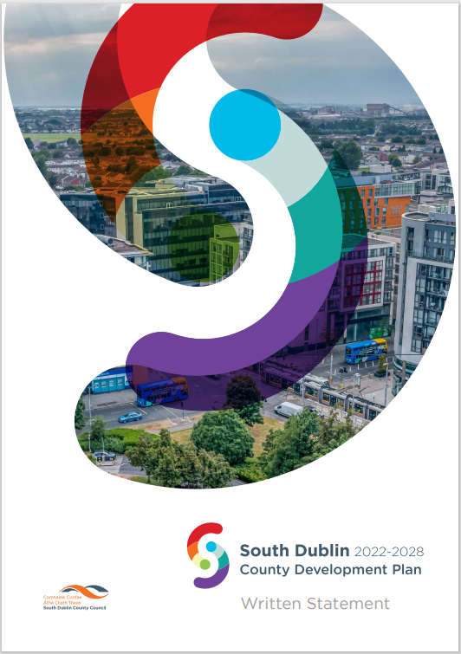
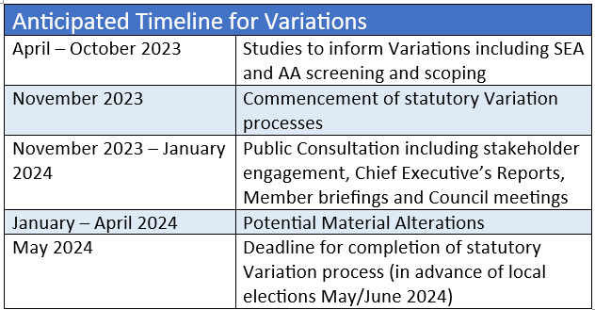
Proposed Development Plan Variation
SDCC to propose Variation to County Development Plan 2022-2028
Purpose is to:
Provide a statutory basis for provisions of Strategic Framework
Refine provisions of Strategic Framework to provide more detailed planning and design guidance
DCC to also undertake Variation to DCC CDP to provide statutory basis for Strategic Framework and to align land use zoning within DCC area with Strategic Framework vision
Consultants’ services (Macreanor Lavington and sub-consultants) extended to carry out background studies to inform Variations – work has commenced

Slide 3
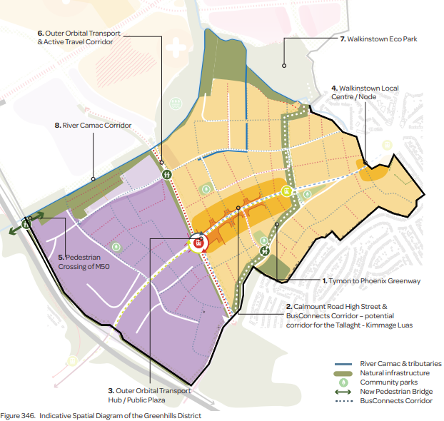
Background Studies to Support Variation
Refine the Strategic Framework Provisions
Provide supplementary area-wide urban design guidance and analysis
Provide updated district level urban design guidance (for each of the five districts)
Establish sequencing through identification of Priority Development Areas and key infrastructure requirements
Variation to include (not limited to)
Urban framework and land use mix
Sample typologies for mixed use
Residential and non-residential capacity
Distribution of social infrastructure
Estimated foul capacity demand
Parking strategy
Approach to open space provision
A Phasing approach
Sequencing of regeneration
Development management standards/requirements
Environmental Reports
Strategic Environmental Assessment (SEA)
Appropriate Assessment (AA)
Strategic Flood Risk Assessment (SFRA)

Slide 4
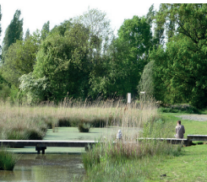
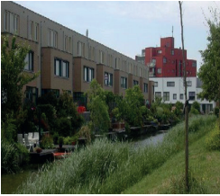
Environmental Reports for Variations
SEA and AA Screening was carried out at non-statutory Strategic Framework stage.
Undertaking given in Framework to recommence SEA and AA processes at statutory Variation/Plan stage.
Fresh screening and scoping will be now carried out
To be followed by Natural Impact Statement and Strategic Environmental Assessment
Process will be parallel and iterative to plan-making
Updated Strategic Flood Risk Assessment will be carried out

Slide 5
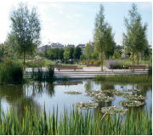
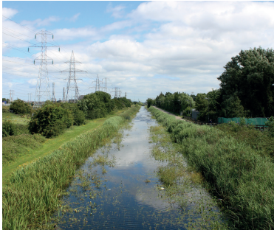
Further Studies informing Variation
Ongoing stakeholder consultation with NTA, LDA, HSA, ESB/Eirgrid & IW
First Park
Grant Associates engaged to undertake feasibility study for first large park involving:
Appraisal, vision, high level concept plan
Delivery strategy, high level cost benchmarking, funding opportunities
Power Lines
TLI Group engaged by LDA/SDCC/DCC to prepare technical brief for Feasibility Study into undergrounding of overhead high voltage electricity cables
Will potentially release 40 Ha plus of developable land
Will improve visual amenity, setting and placemaking
Energy
Codema engaged by SDCC/DCC to undertake energy management and provision feasibility study
Report will set out policy-based recommendations and conclusions on:
Low-carbon heating and heat networks including potential for district heating and waste heat source
Low-carbon transport including an assessment of emissions pathways for different modes/routes
Renewable electricity
Building energy efficiency and embodied carbon in buildings

