Slide 1
Heritage Plan Review
LUPT SPC, 25th May 2023

Slide 2
Grant of €12,000 was awarded by the Heritage Council for the Review of the Heritage Plan, under their 2023 programme of support for County Heritage Plan projects.
Following the Internal Consultation Workshop hosted with EPIC consultants in December 2022, two External Stakeholder Workshops were hosted in the Tallaght Library on 6th March and 15th March (facilitated by EPIC consultants).
Review of Heritage Plan

Slide 3
Public Consultation Survey for the Review of the Plan was live on the Council’s Consultation Portal between March 10th and April 11th.
43 submissions received through the on-line consultation survey
Review of submissions and outputs from both the external consultation workshops and the on-line survey are currently being reviewed and assessed in conjunction with EPIC consultants.
Pre Draft Consultation on Heritage Plan

Slide 4
Prepare a Draft Plan (June – August)
Present on Draft Plan content and consultation to September LUPT SPC
Present to October Council meeting
Public consultation on Draft Plan (October/ November)
CE Report on submissions received and amendments recommended (November/ December)
Revised final plan prepared (November/ December)
Full Council in January /February for noting of CE Report and final Heritage Plan
Heritage Plan Programme

Slide 5
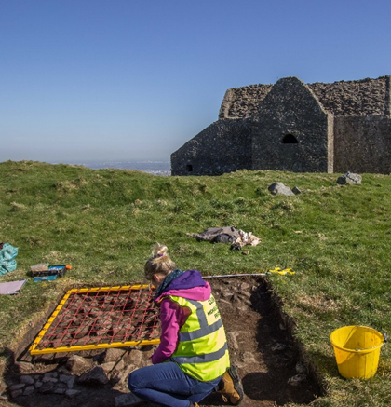
Proposed Format of the Plan
SECTION 1
Introduction to the Heritage Plan Review process, highlighting changes in national legislation, policies, obligations etc.
Brief case examples of 4 achieved projects from the first plan (i.e. archaeology, natural heritage, built heritage, cultural heritage) that have expanded our knowledge of the County’s heritage

Slide 6
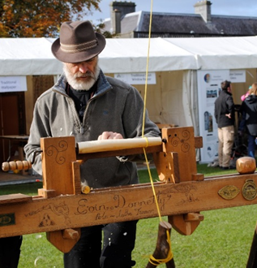
Proposed Format of the Plan
SECTION 2
Summary of the Plan making process
Implementation process for the new Plan (Heritage Forum/Plan Governance, a costed Plan, monitoring and evaluation of success and impact

Slide 7
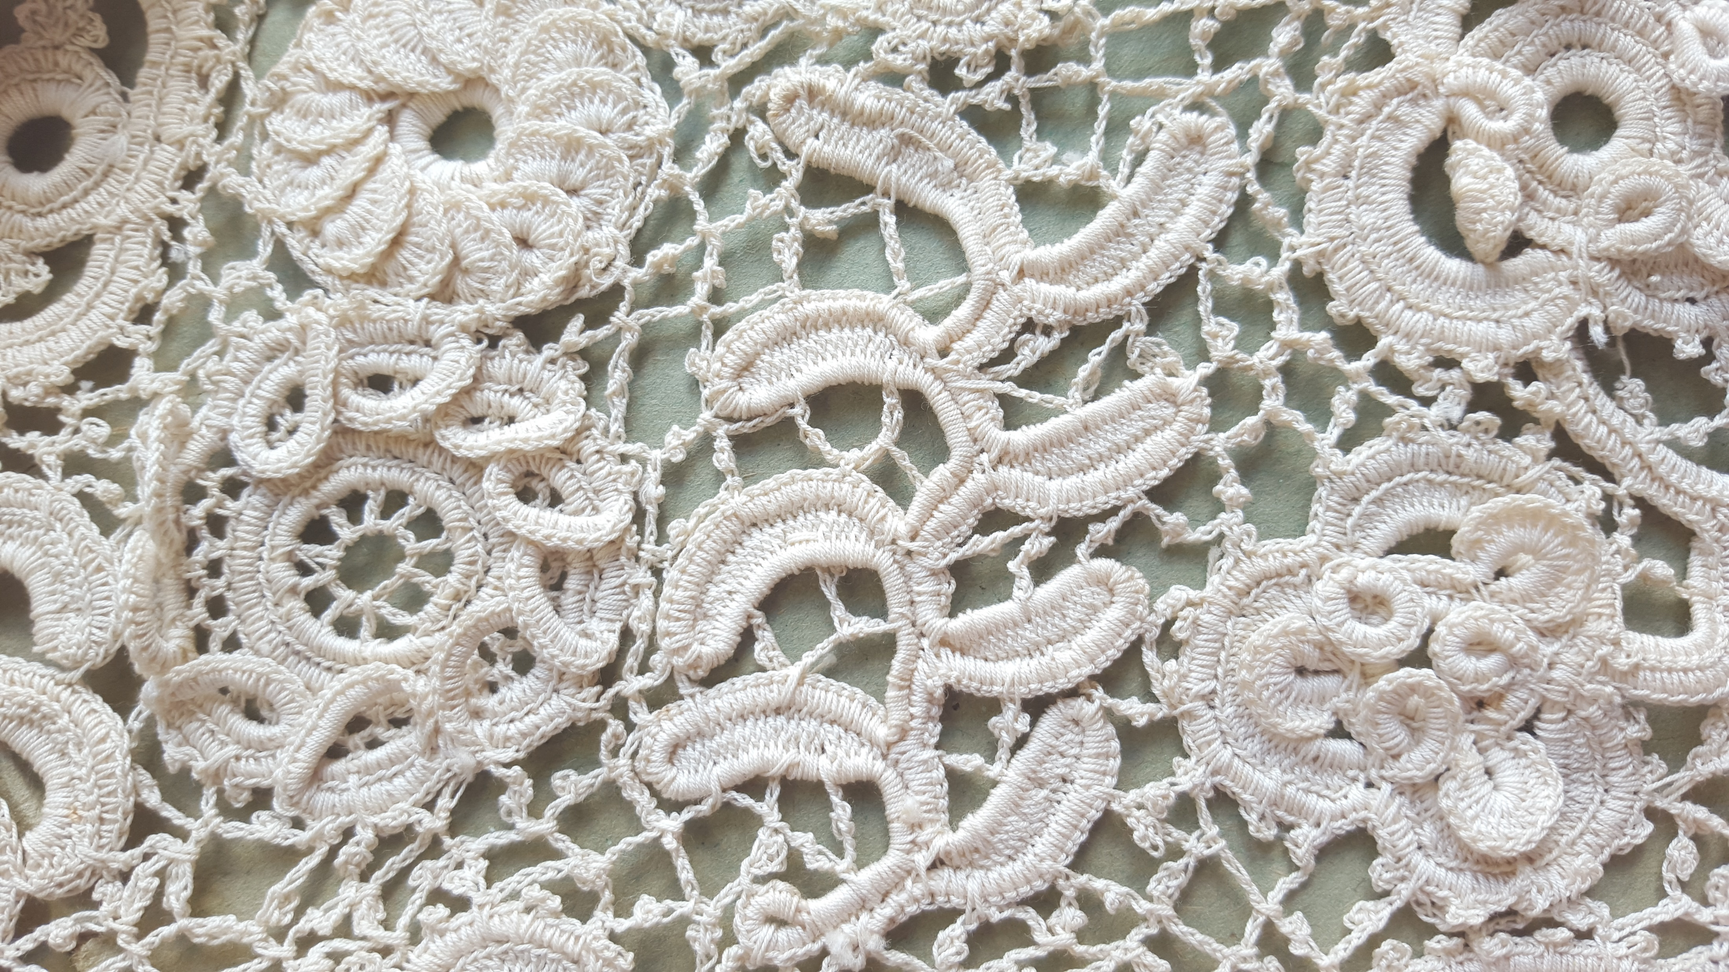
Proposed Format of the Plan
SECTION 3
Focus Points/Categories for listed actions
Finding and telling the stories
Managing heritage data and resources
Supporting community engagement and access to heritage
Building resilience/adapting to change

