Slide 1
Clondalkin Local Area Plan
Preparation 2023
Presentation to SPC 25th May 2023

Slide 2
County Development Plan context
Objectives: QDP14 - 3 and EDE4 - 14
“To prepare a LAP for Clondalkin, the extent of the boundary to be defined, which will be guided by the Local Area Plans Guidelines for Planning Authorities, 2013 (Department of the Environment, Community and Local Government) or any superseding guidelines and which will incorporate:
A vision for the development of Clondalkin
Wider urban design principles
Framework plans for larger infill sites
A Conservation Plan
A local Green Infrastructure strategy derived from the County GI Strategy
Transport movement study.”

Slide 3
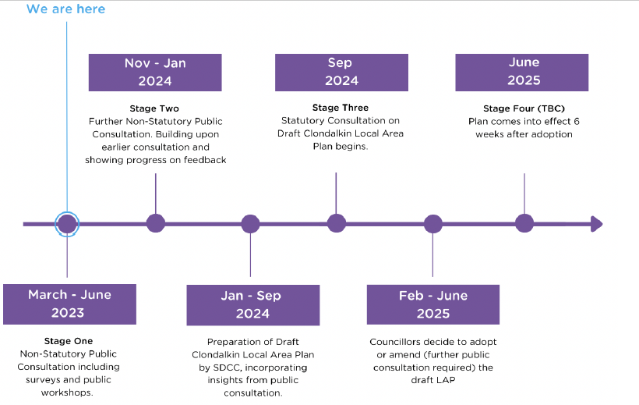

Slide 4
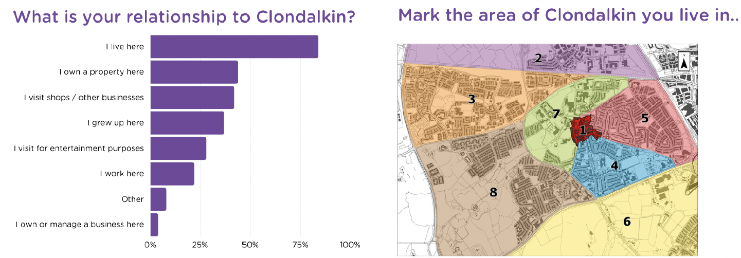
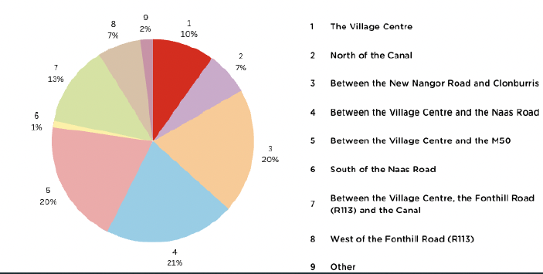

Slide 5
Online Survey FEEDBACK: April - may

Slide 6
Online survey - Feedback

Slide 7
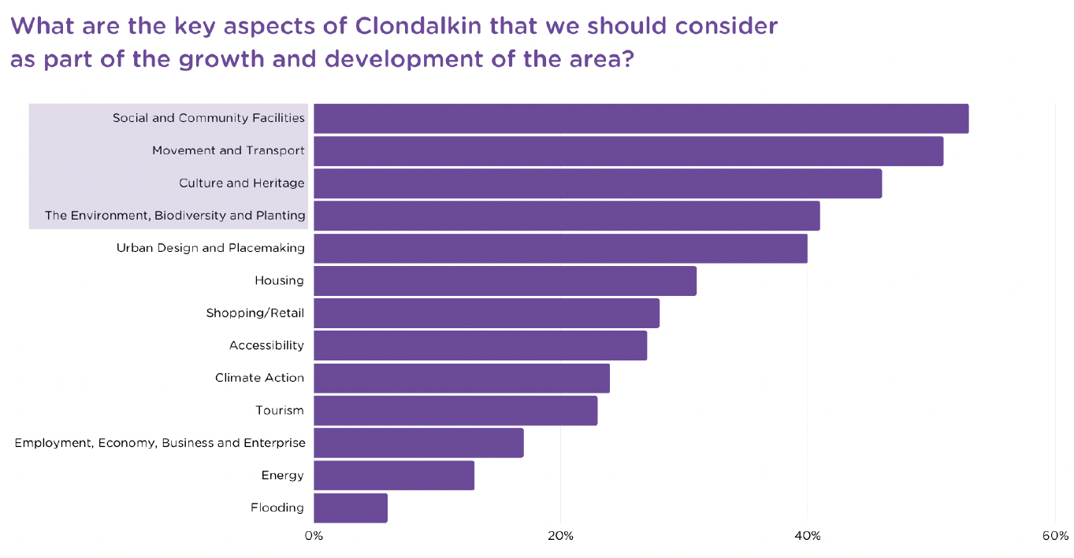
Online Survey: April - may

Slide 8
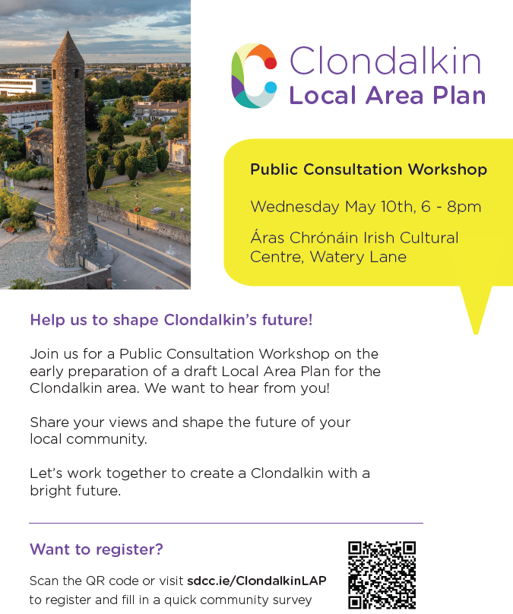
Clondalkin Face to Face And online workshops
10th May in Áras Chrónáin
23rd May Workshop - Webinar
Goals of the Workshops
Explain the process and explain a LAP (briefly)
Feedback to the public on the issues raised during the survey (sense check)
Sense check a vision for Clondalkin based on survey insights
Workshop each theme moving from current state (continue to understand) to future state/vision at a high level
Demonstrate a fair and transparent consultation process. (Content from the survey, timeline of public consultation process, quotes)

Slide 9
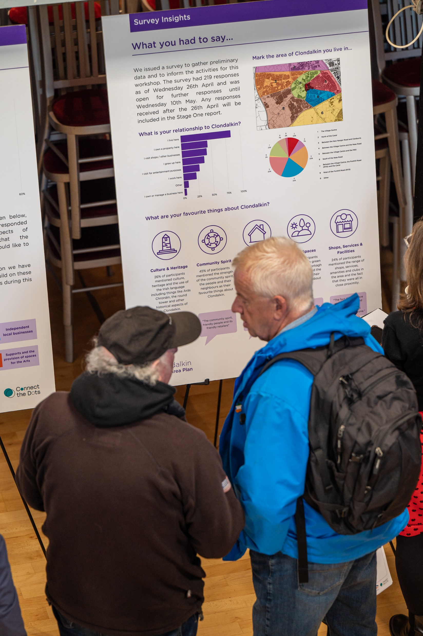
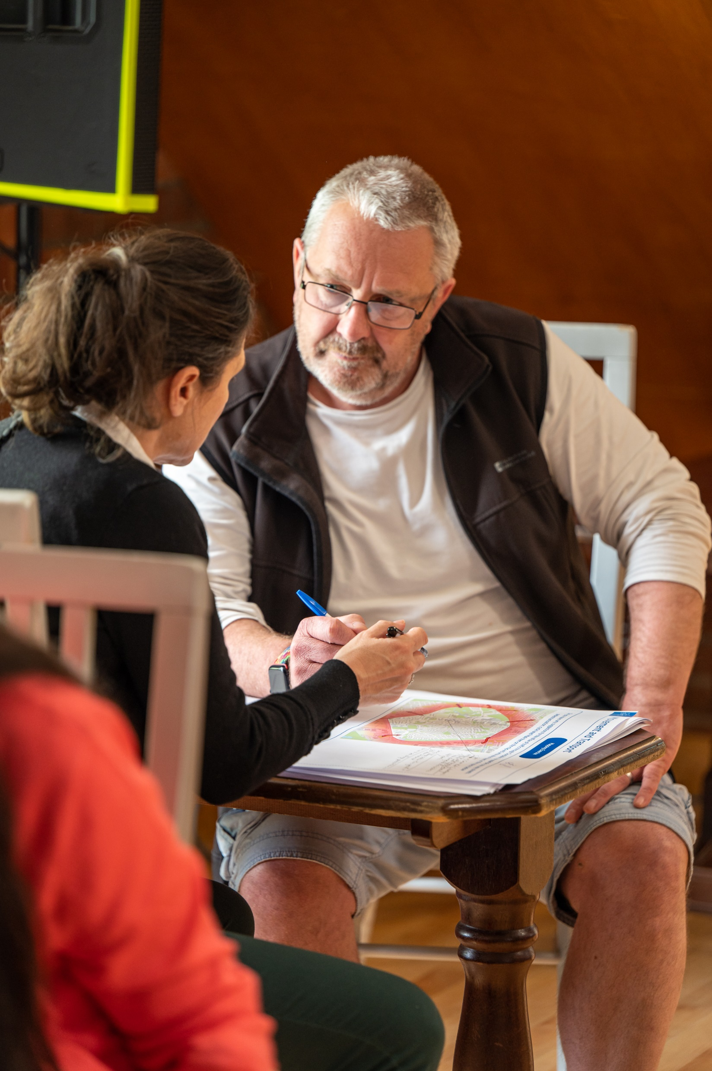
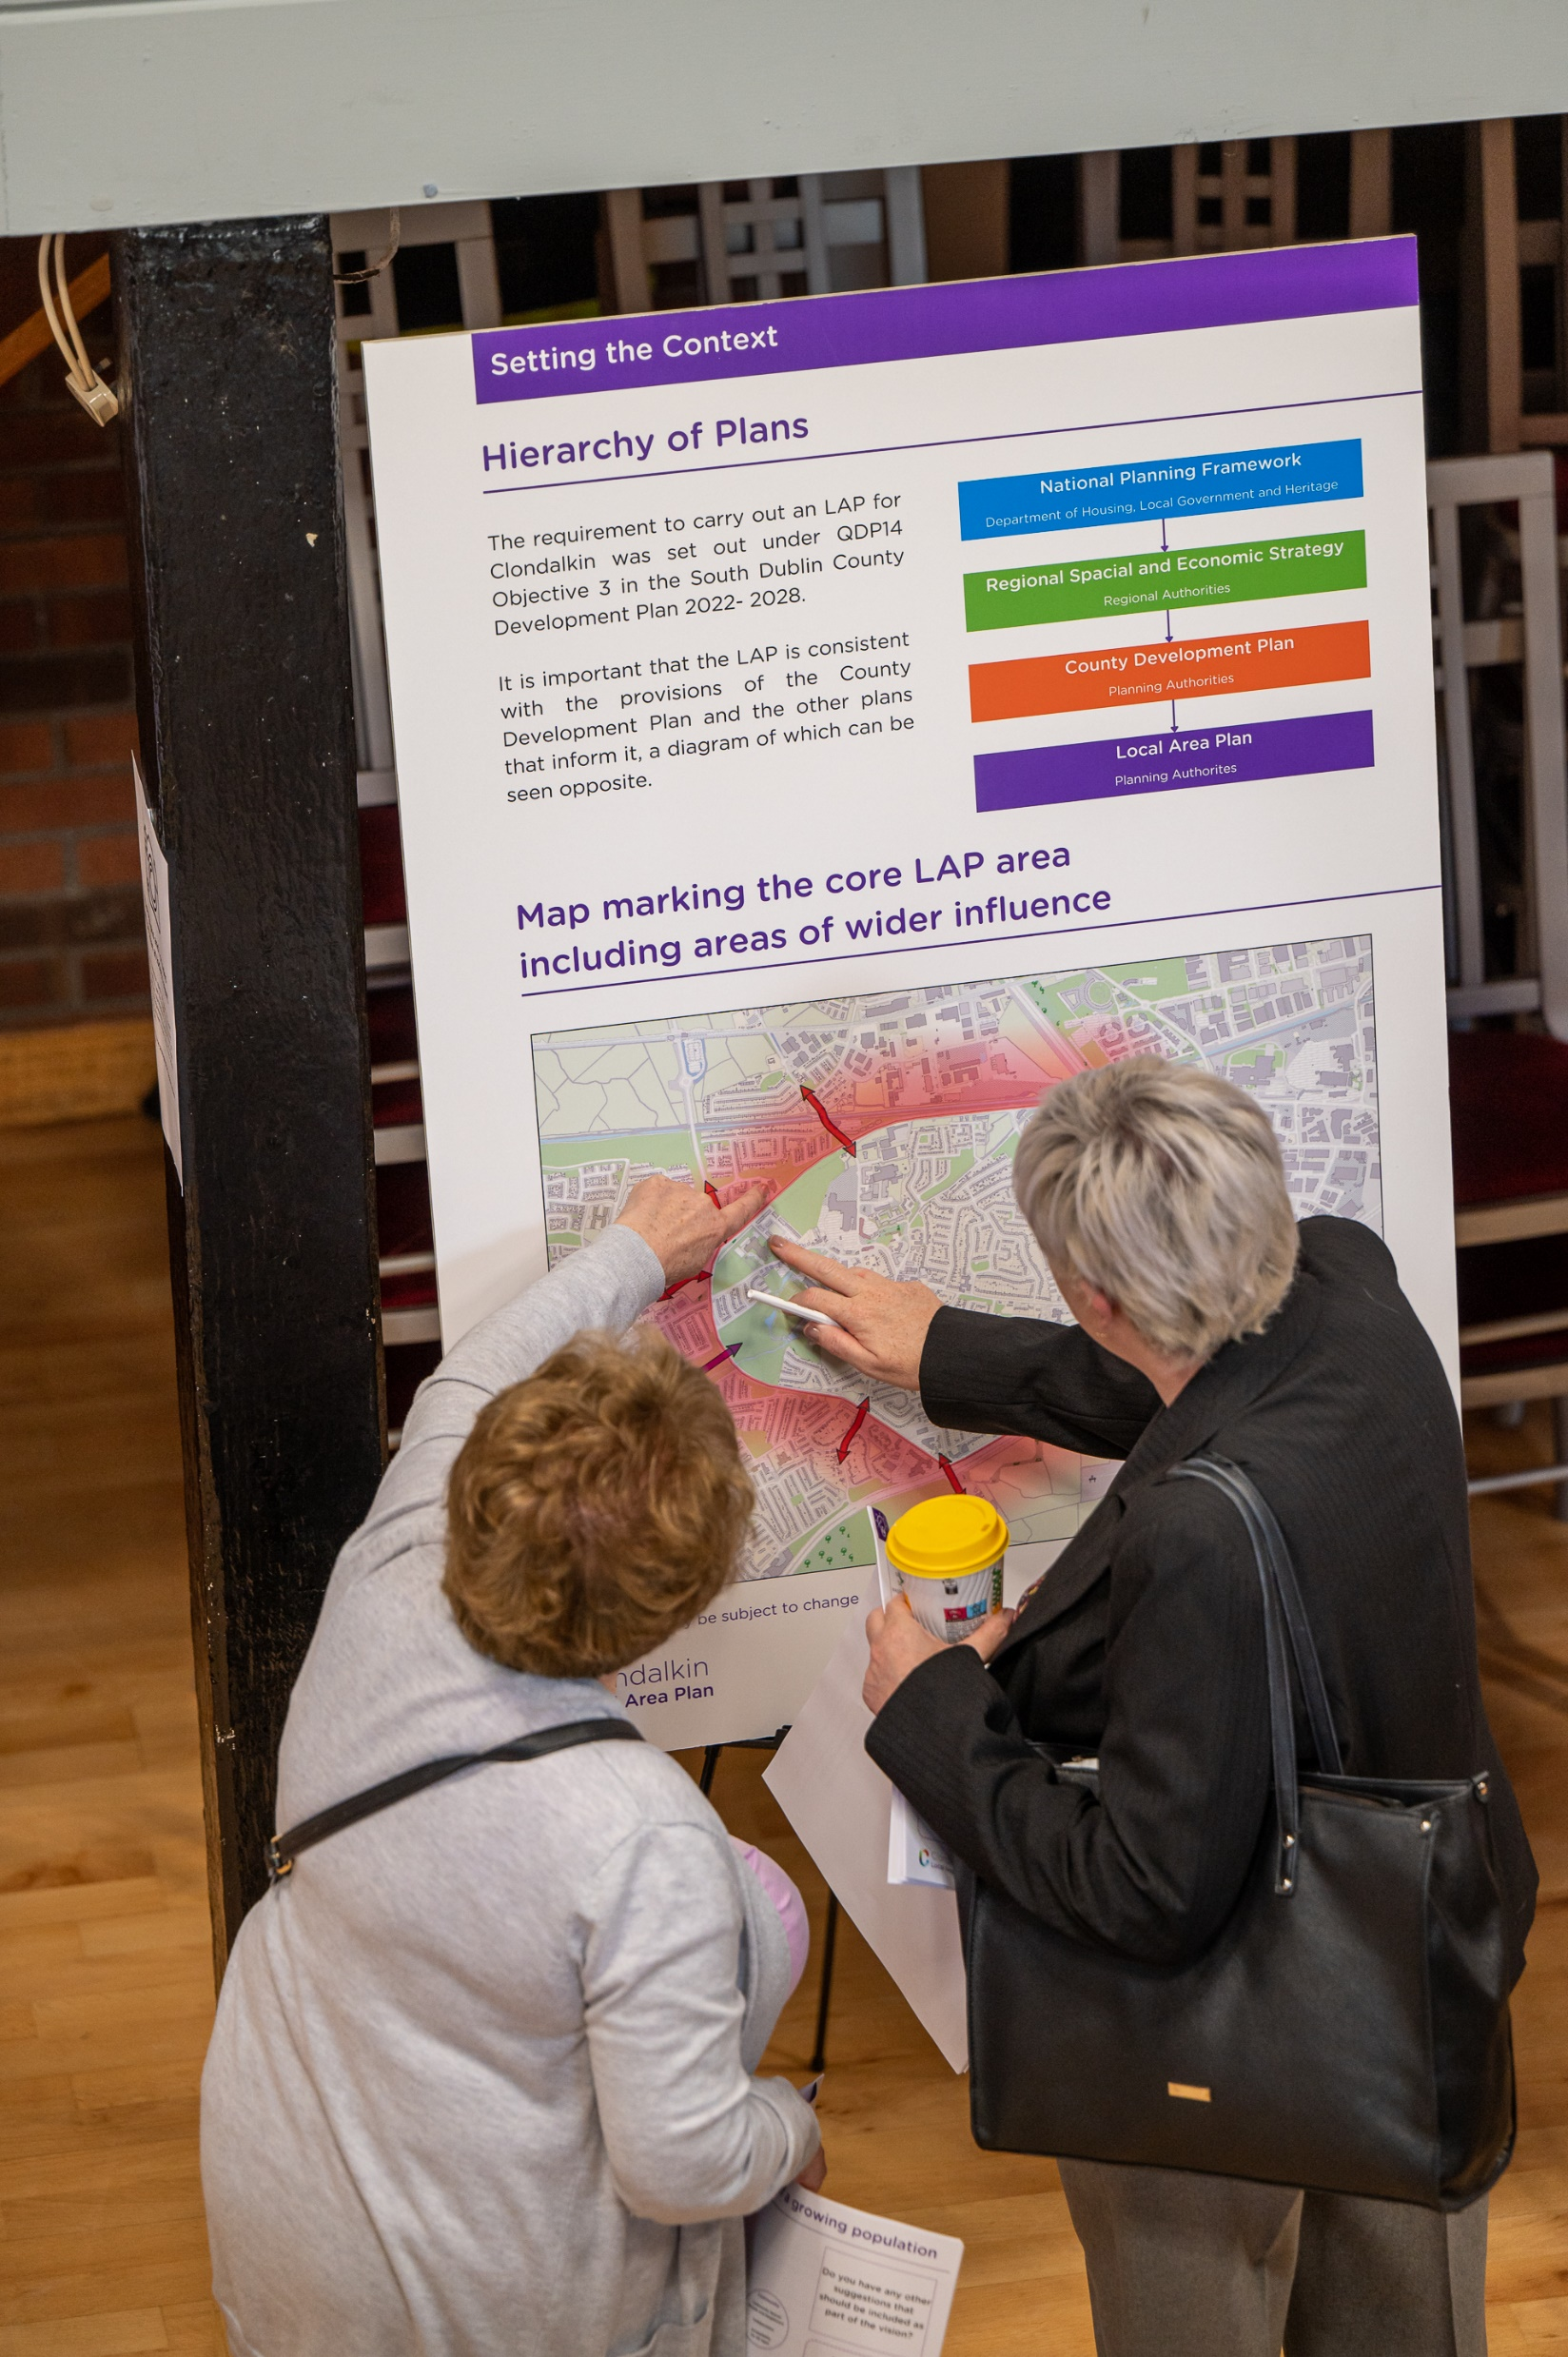

Slide 10
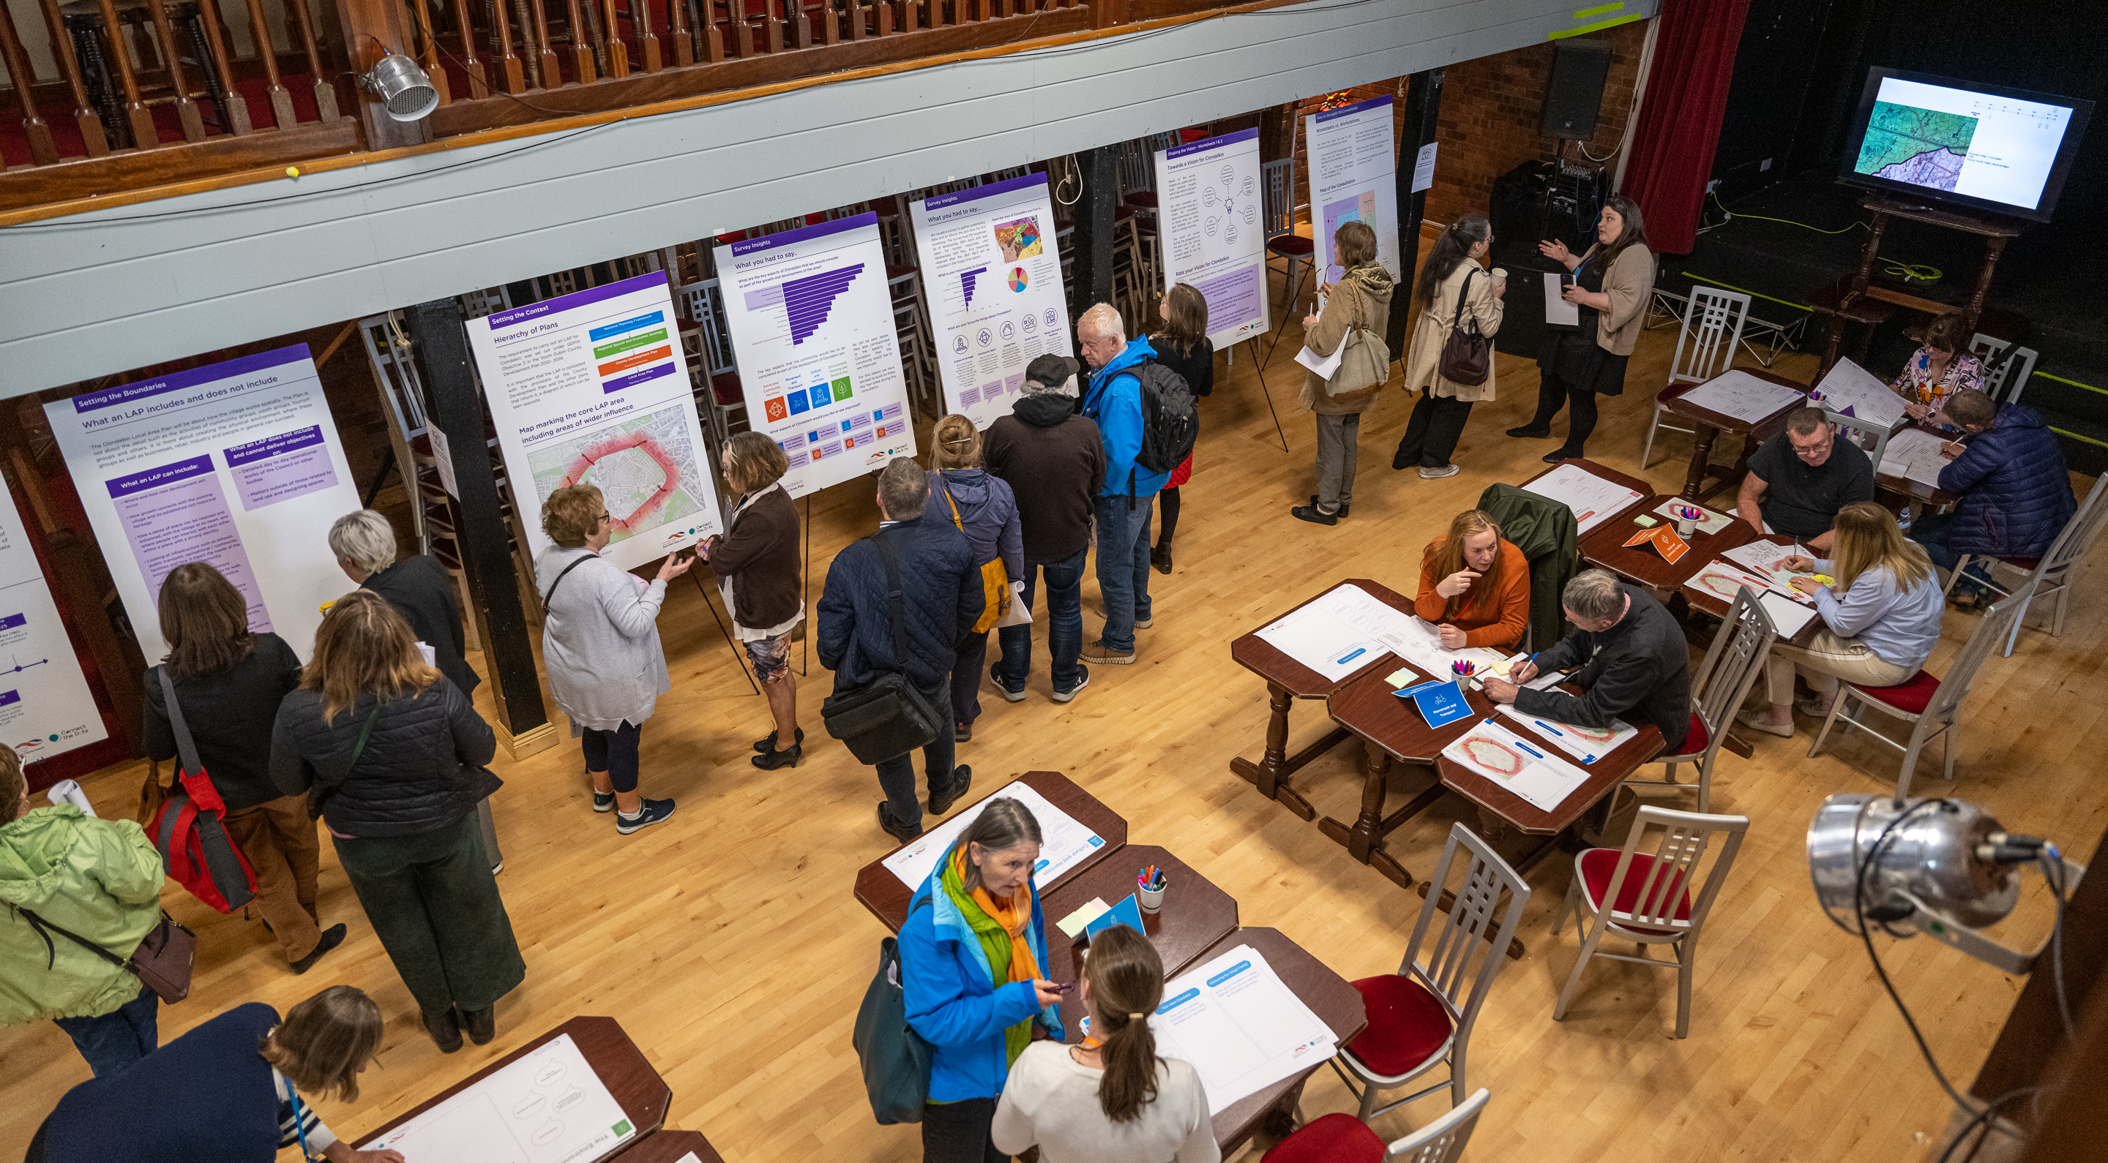

Slide 11
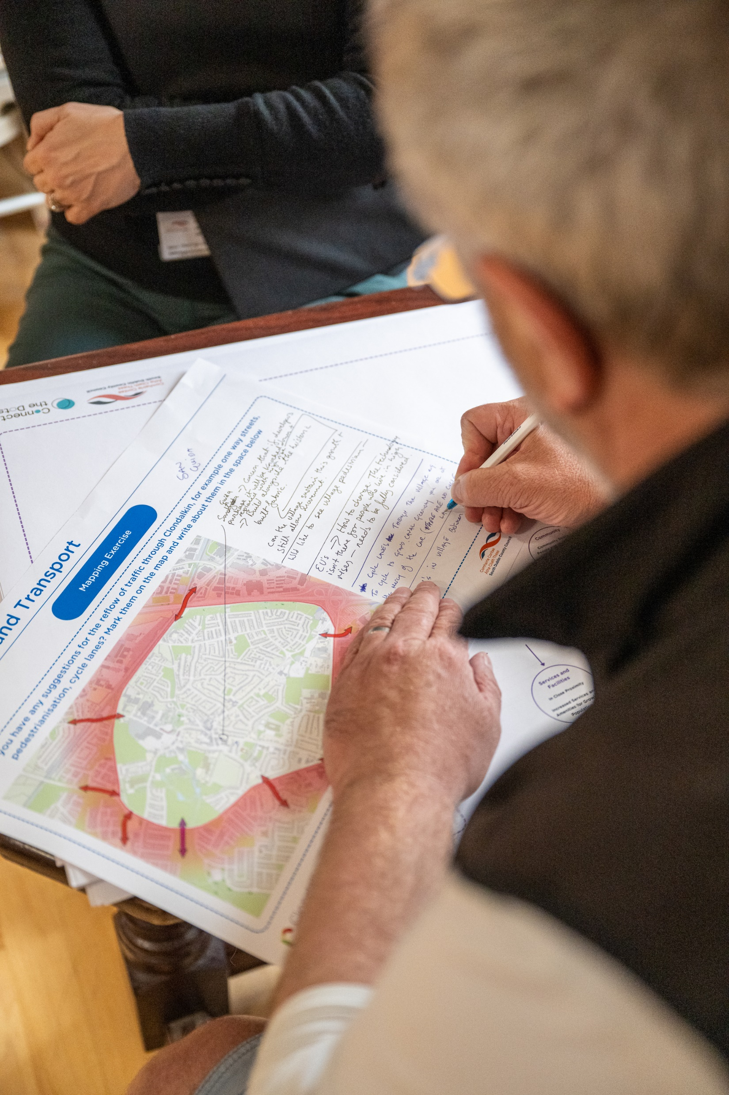
Additional consultation
Disabled Persons Interviews – One to One during May
Youth specific online survey (almost 223 responses 6th April to 23rd May, ages 8-18)
Childrens Corner at in-person workshop on 10th May
Actively encouraged engagement with Online Workshop on 23rd May
Outreach to Library, Local Groups, Sports Clubs, Clondalkin Education Centre, Schools
Output - Report on themes and issues arising from this first round of public consultation

Slide 12
Next steps – Urban design procurement
Urban Design – Stage 1 – July 2023 to Q1 2024
Objectives for growth
High level concepts for development
Vision
Consultation Feedback Jan/Feb 2024
This stage will involve early work on Stage 2
Urban Design – Stage 2 - Q1 2024- Q3 2024
Conservation Plan
Wider urban design principles
Framework Plans examining land use capacity and principles for development
Principles for Development for Infill sites
Integration of Movement
Concepts for Village Enhancement Scheme

Slide 13
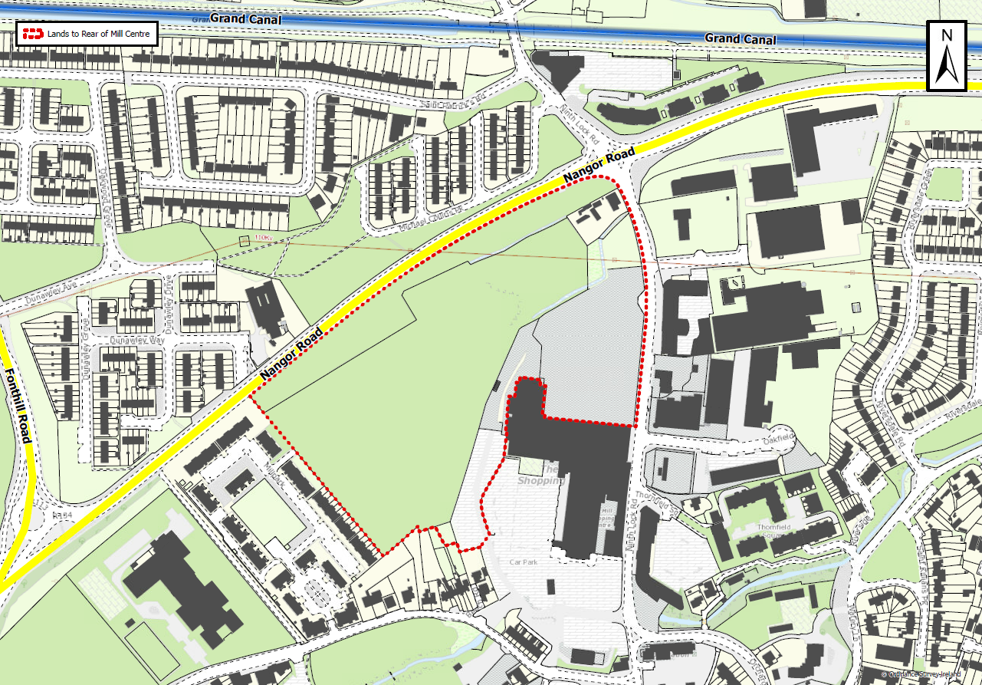
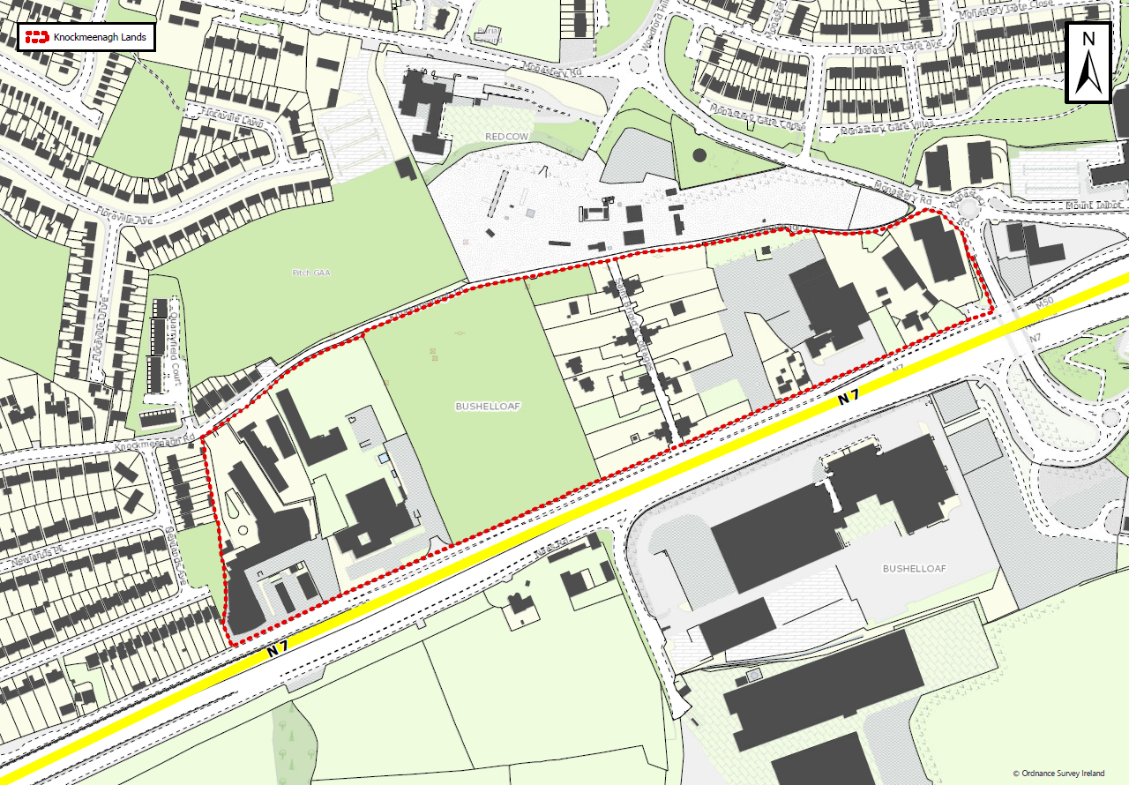
Framework Plan Lands
Lands along Nangor Road and Ninth Lock Road to rear of Mill Centre
Lands between N7 and Knockmeenagh Lane

Slide 14
Next steps – Sustainable movement - procurement
Procurement – Sustainable Movement – Area Based Transport Assessment (ABTA)
Examine traffic and active travel movement – SWOT exercise
Traffic Modelling exercises as required
Integrate movement with Urban Design principles
Input to Framework Plans
Identify routing for Cycle South Dublin Active Travel Routes – Clondalkin to Tallaght and Corkagh Park to Grand Canal
Prioritise sustainable modes of transport to support 10 minute settlement concept

Slide 15
Next Steps -
Final Report on round one of public consultation - emerging themes and issues – June 2023
Report will be published
Findings will be used to inform early work on urban design and movement
Engagement of consultants – July 2023 [urban design; transport; SEA/AA; SFRA]
Stage 1 work to advance to second round of public consultation and feedback – Q1 2024
Preparation of Draft Plan to go on statutory public consultation in Sept 2025
Briefings of Councillors at various stages in advance of Draft Plan being published

