Slide 1
Community Development Update
Social, Community & Equality SPC Meeting
16th May 2023

Slide 2
Community Development
Community grants provide an opportunity to voluntary groups and communities to apply for financial assistance across various funding streams.
Applicants were able to access funding from March this year.
Our endeavour is to make the online application facility live from February in 2024 which will further increase funding accessibility.
We have processed 88 applications since March with total cumulative funding request of €199k

Slide 3
Community & Sports Grants Breakdown

Slide 4
Grants by LEA

Slide 5
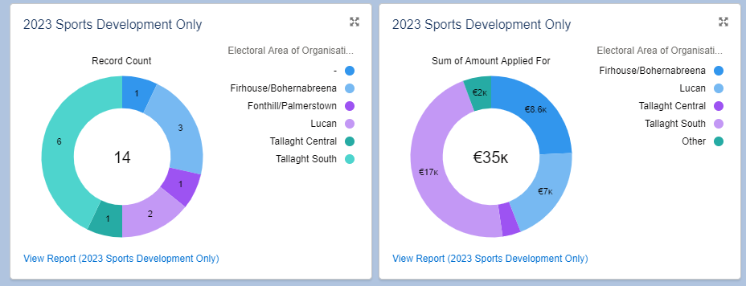
Sports Grants only by LEA

Slide 6
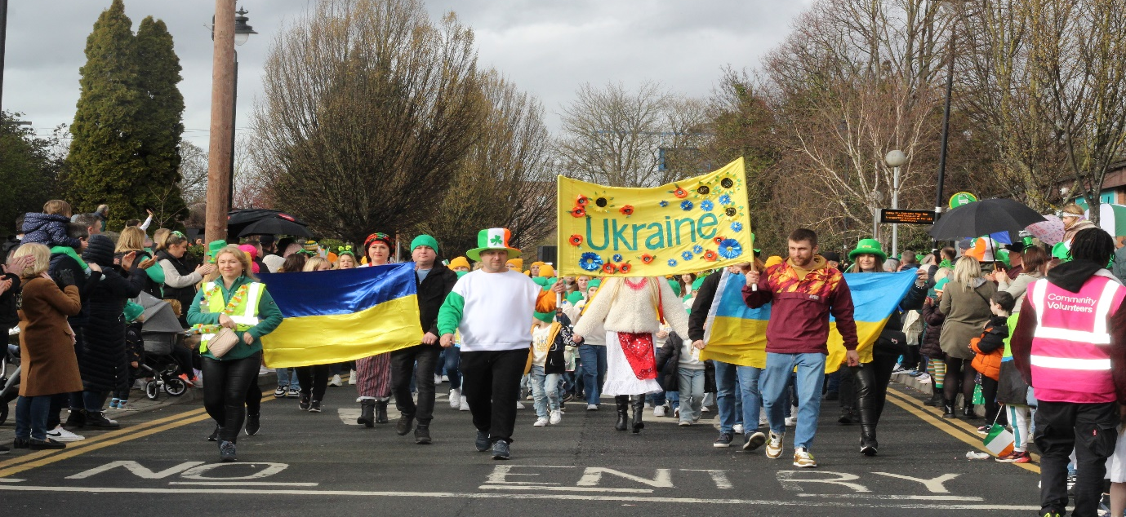
Funding provided for St Patrick's Day celebrations

Slide 7
Community Development
Continue to support community development via our funding streams, facilities and personnel.
Collaborate with partner organisations to achieve common goals
Continuous assessment of Salesforce data to ensure a targeted, informed service delivery model is utilised
Promotion of community event/festival & Community funding opportunities

Slide 8
BEALTAINE
Firhouse Active Age Group - Weed Wanders workshop. Exploration of medicinal and folklore properties of wildflowers growing Venue – Firhouse Community Centre.
Active Seniors flower arranging class. 18th May. Venue – An Cosan
Coffee Morning, Week starting 29th May, Venue Jobstown Community Centre
Bealtaine Art morning , Knockmitten Youth & Community Centre

Slide 9
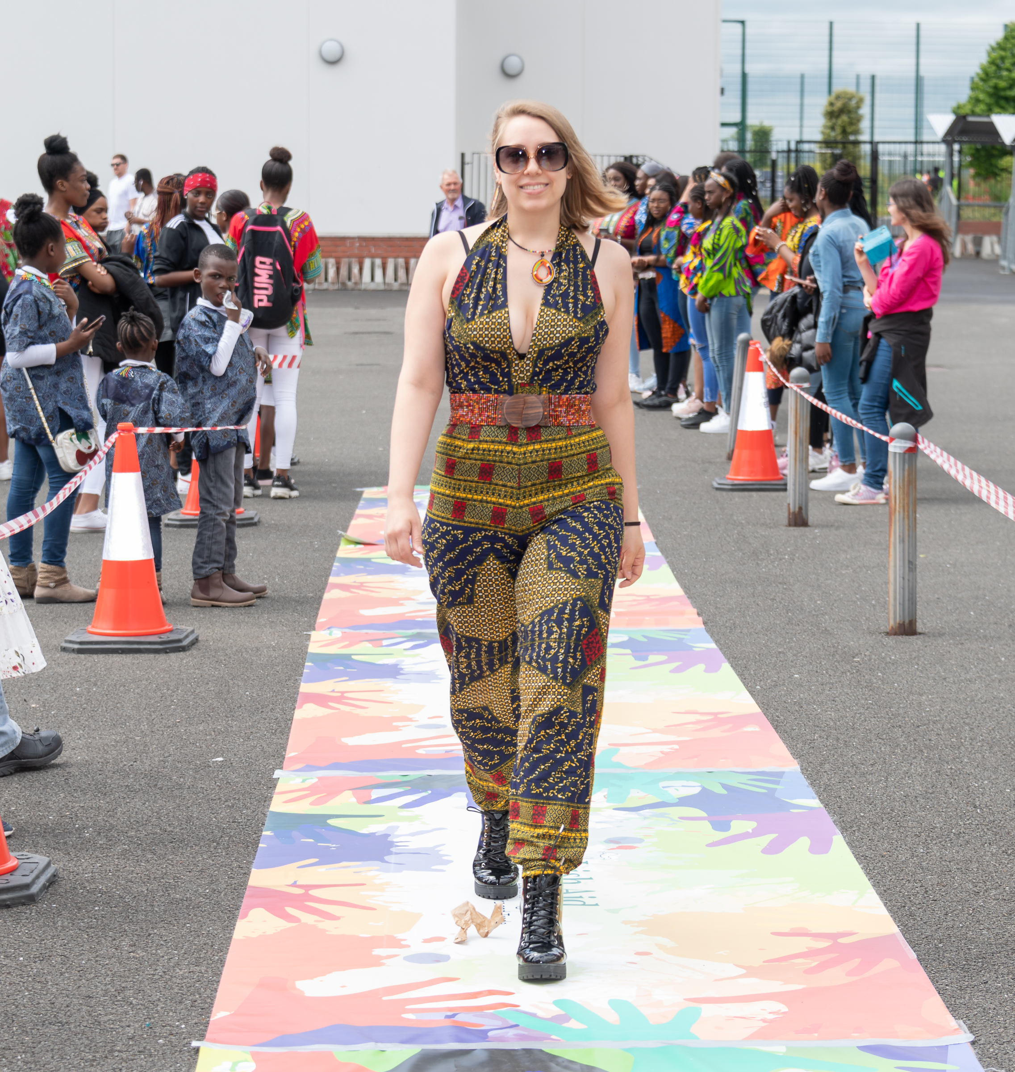
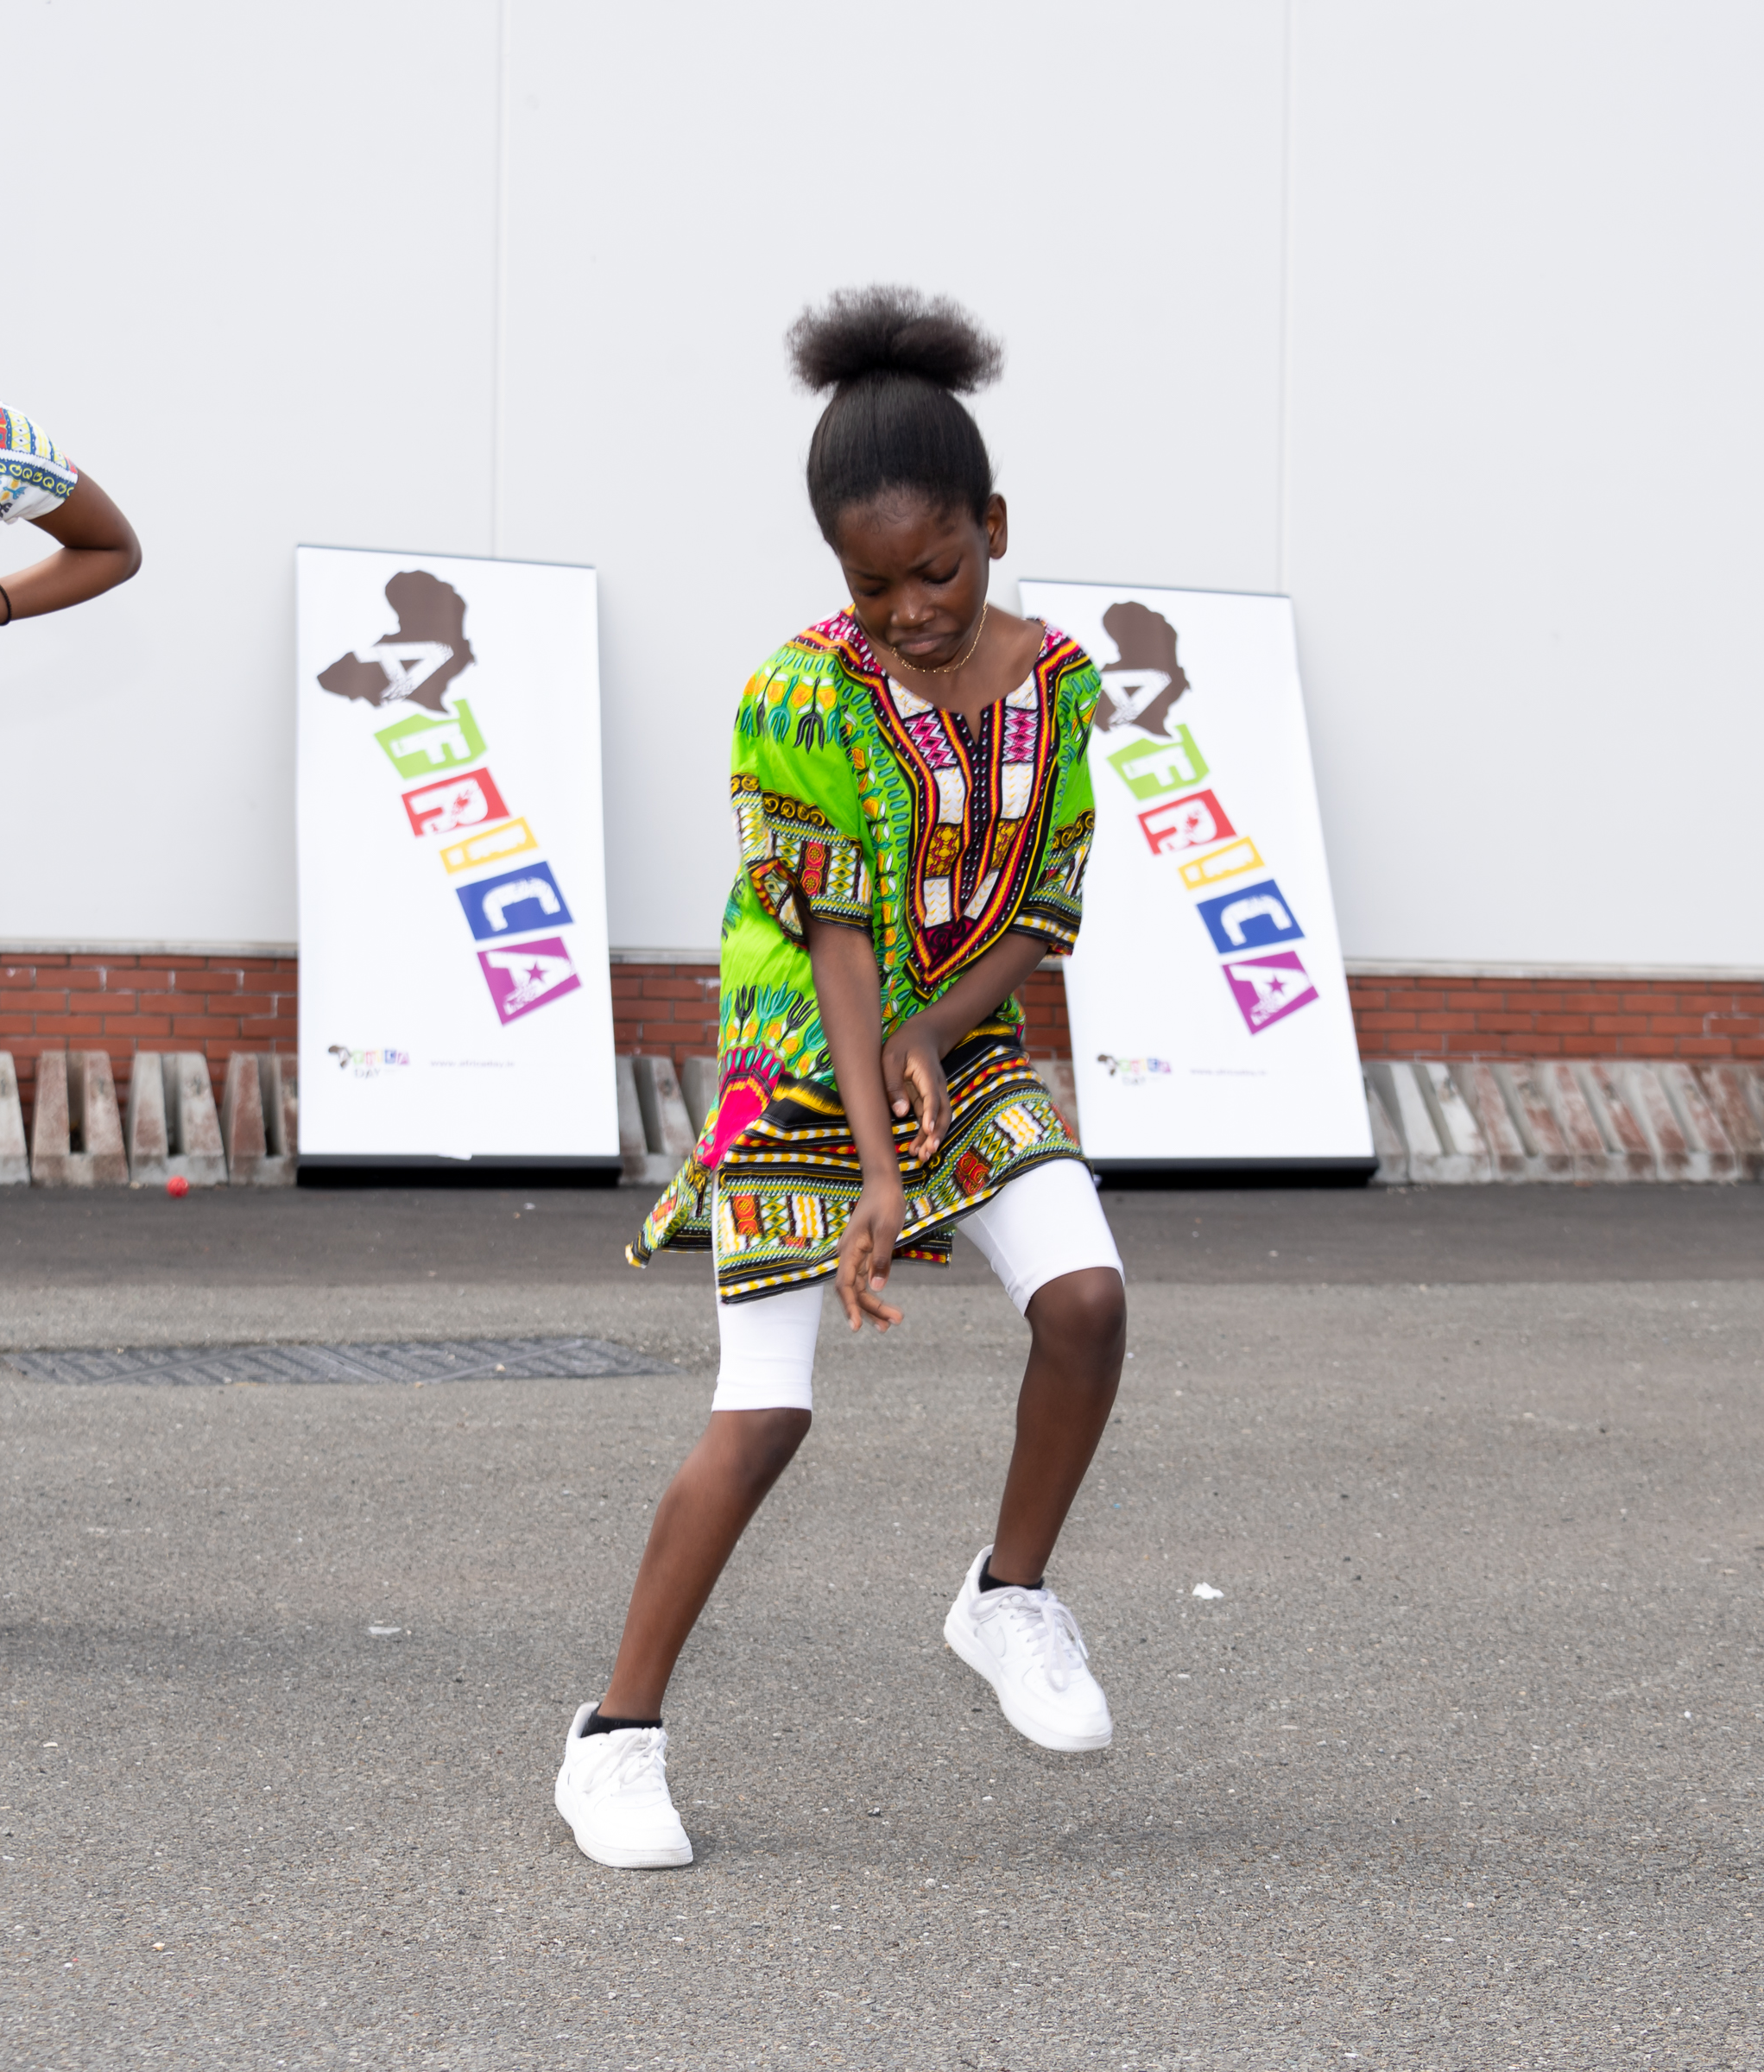
AFRICA DAY 2023
Africa day events scheduled to place between 18th -31st May.
Adamstown - Family fun day,
Lucan & Palmerstown – African History workshop, Drumming showcase & exhibition of the adCenter
Jobstown – Food tasting, Dance show, Showcase of African attire.

Slide 10
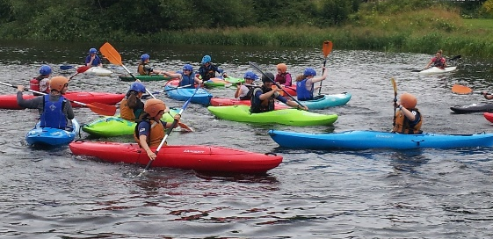
Summer Projects
Summer Projects deliver 2 – 4 weeks of activities for children ages 5 – 12
We will be accepting applications for Summer projects until 19th May 2023
Current status – 21 application which represents increase of 2 from last year.

Slide 11
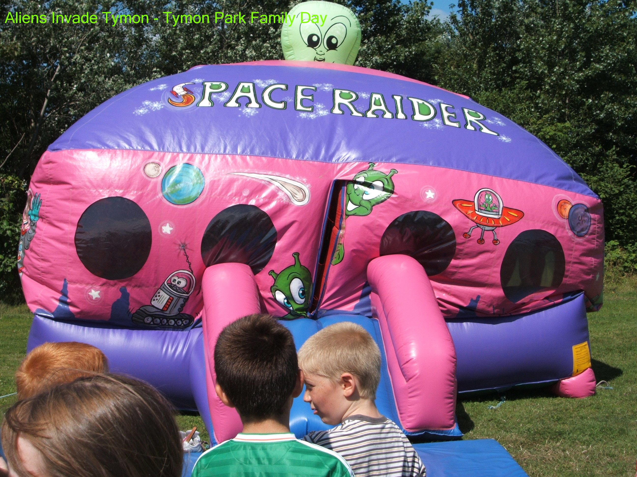
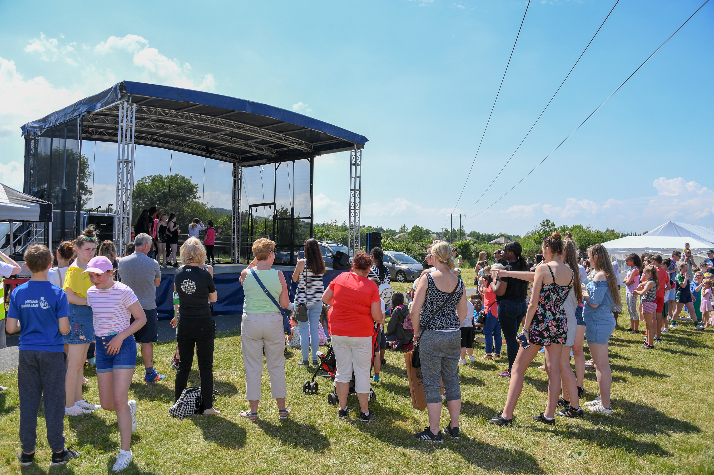
MacUilliam
Family Fun Day on 24th June
Fun day to incorporate various community stakeholders. Activities include, arts and crafts, reptile zoo, sports, singing and dancing.
We are currently formulating plans for Balgaddy

Slide 12
Thank you

