Slide 1



Capital Projects Update
Social, Community & Equality SPC
16th May 2023
Notes:
Hi, my name is Niall Noonan and I’m the still newish Communications Manager of South Dublin County Council. I joined in July of this year and it is my first post within a local authority. So I’ve received a crash course in citizen engagement at local government level and want to take you through a few of SDCC’s key campaigns and achievements.

Slide 2

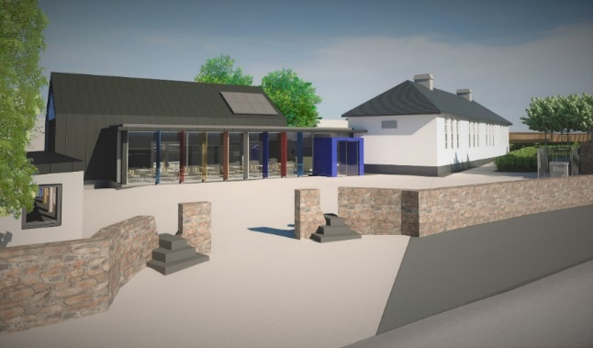
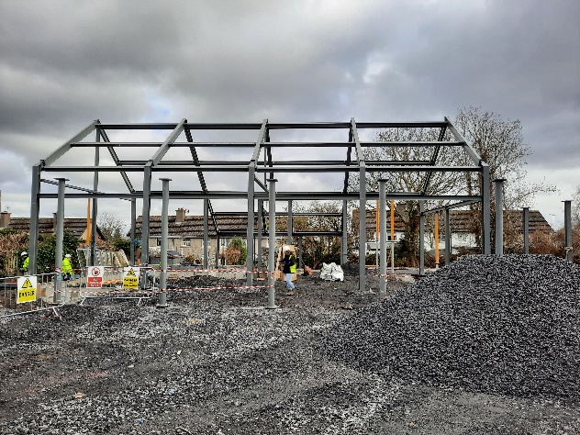
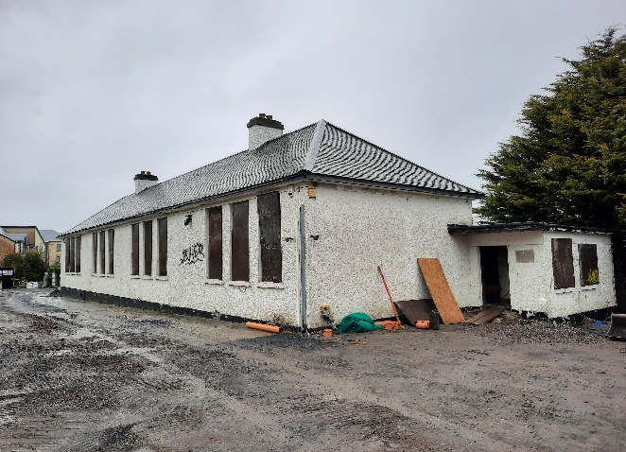
Capital Projects Update:
Saggart Schoolhouse Community Centre:
Construction works on the new community centre on the site of the former St. Mary’s National School continuing.
Capital Project of €2.3million, primarily funded by the Council and funding of €500K from Rural Dublin Leader.
There have been some delays in the construction programme, new expected completion date end of Oct/Nov.

Slide 3
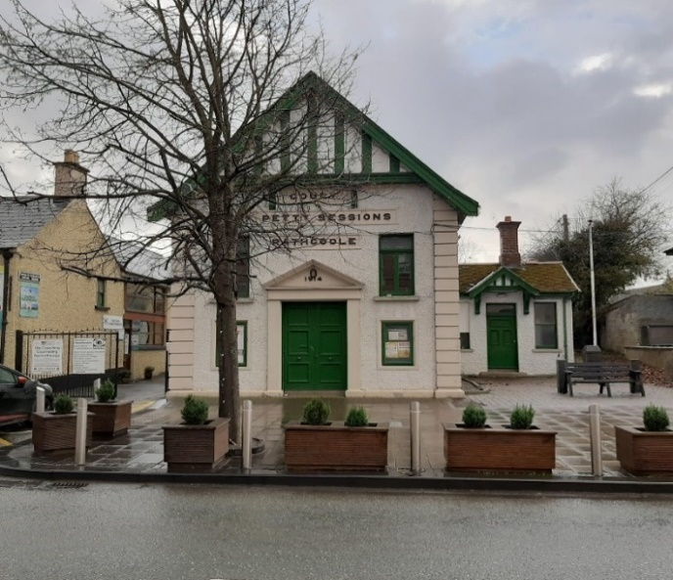
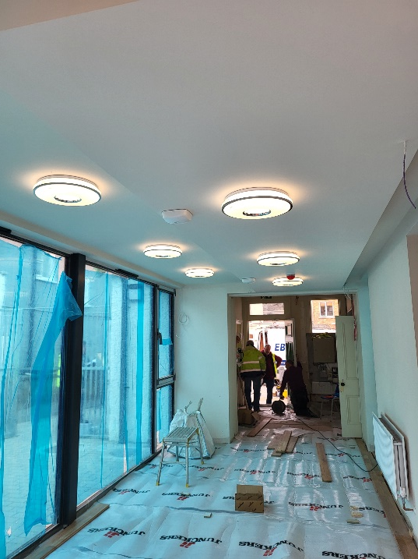
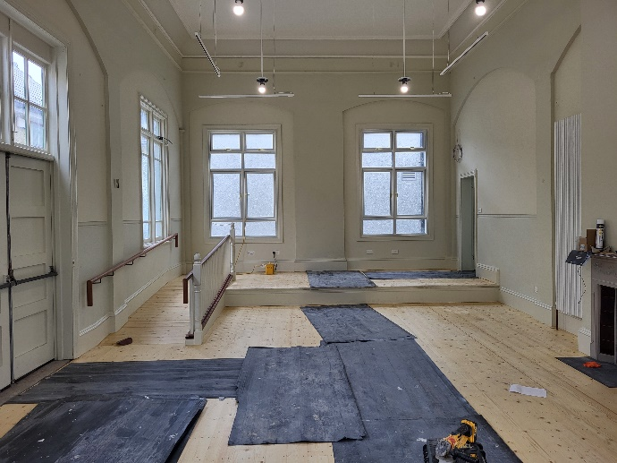
Capital Projects Update:
Rathcoole Old Courthouse:
Conservation & upgrade works on the historic Rathcoole Courthouse building continuing, expected completion now anticipated in June 2023.
Total project cost is in excess of €600k with funding from the Council and the Town and Village Renewal Scheme from DRCD.
New local BOM being formed to manage the upgraded community facility, under management licence from the Council.

Slide 4
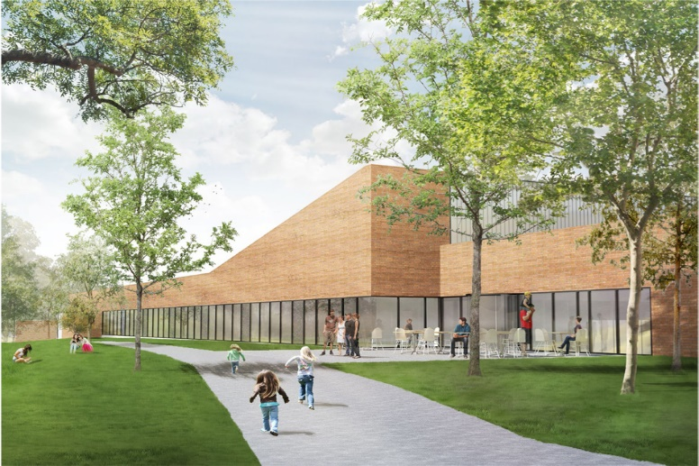
Capital Projects Updates:
Lucan Swimming Pool:
Construction works progressing, with anticipated completion of end of Summer 2023. Aura Leisure have been appointed as the operator of the new facility and will commence operation prior to the opening.
Balgaddy Community Centre:
Constructions works have commenced, with expected completion Apr 2024. New local BOM to be formed.

Slide 5
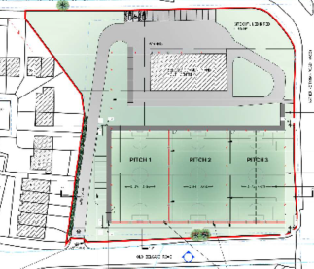
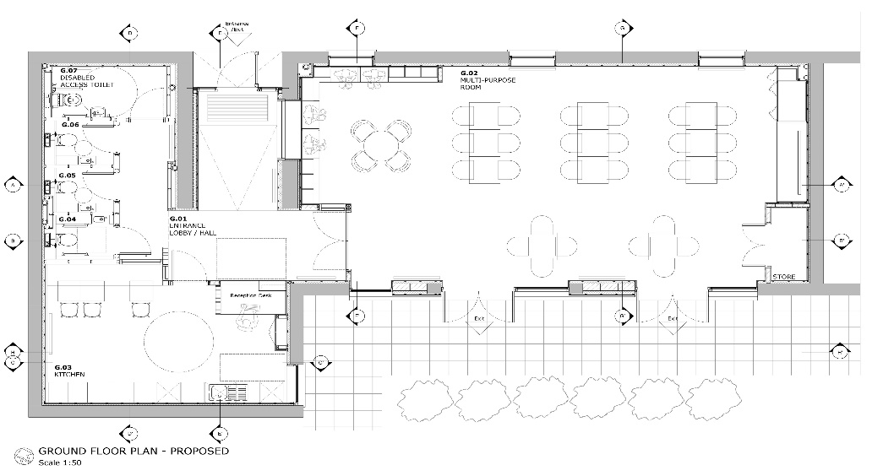
Capital Projects Updates:
Belgard All Weather Pitch:
Council engaging with Community Centre local BOM. Sportslab have been engaged with a view to appoint them to manage the project delivery.
Orchard Lodge:
Building fit out works due to commence 15th of May,
with works expected to be completed Aug 2024.

Slide 6
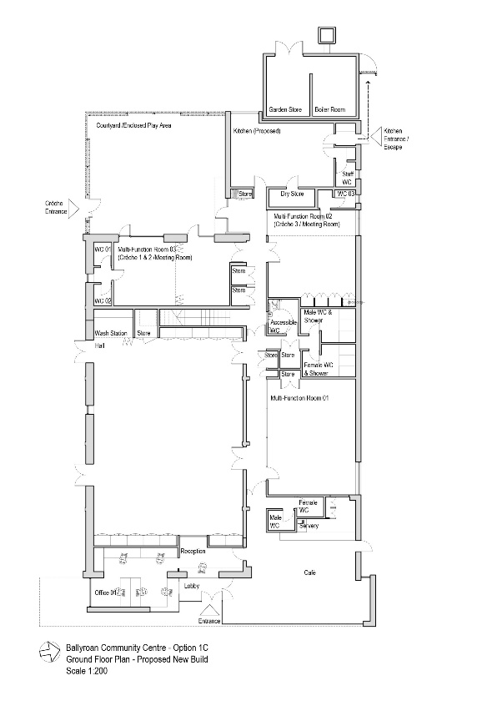
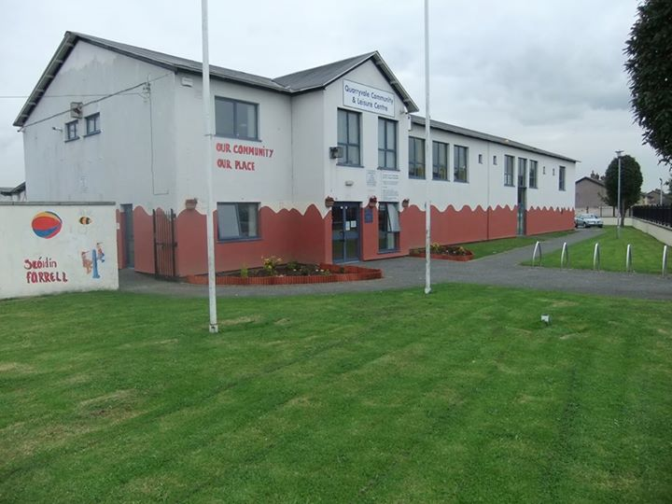
Community Centre Extensions
& Upgrades
Ballyroan Community & Youth Centre:
Drawings for Centre extension completed. Architects and Community Depts liaising with Law Dept re: property boundaries. Anticipated project will progress to Part 8 late Q2/early Q3.
Quarryvale Community & Leisure Centre:
Tender package being prepared by Architects for number of upgrade works to the centre. Anticipated works will commence in Aug and will be completed by end of October
Park Community Centre:
Architects preparing draft drawings for proposed Centre extension to be discussed with local BOM. Hoped to progress project to Part 8 later in the year

