Slide 1
Notes:
3 slides each x 4 people
Jagoda
Katherine + interagency
Halimat
Izzie

Slide 2
Comhairle na nÓg March - May 2023
The Comhairle have had a busy couple of months since we last presented to the SPC in February
We have launched our 2022/23 topic on Mental Health
We have taken part in consultations
The Comhairle has attended the National Showcase in Croke Park with Minister O’Gorman and Tánaiste Varadkar
And we have been working on our 2023 topic of Drugs and Addiction, focussing on young people vaping

Slide 3
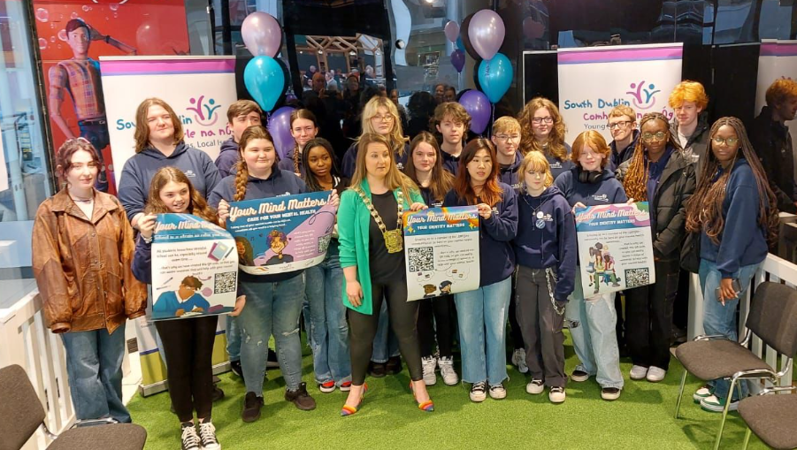
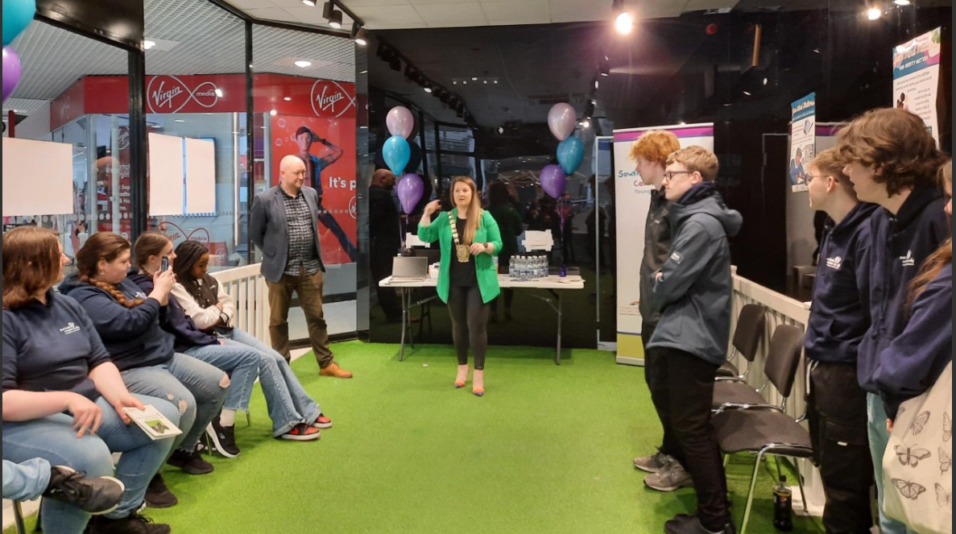
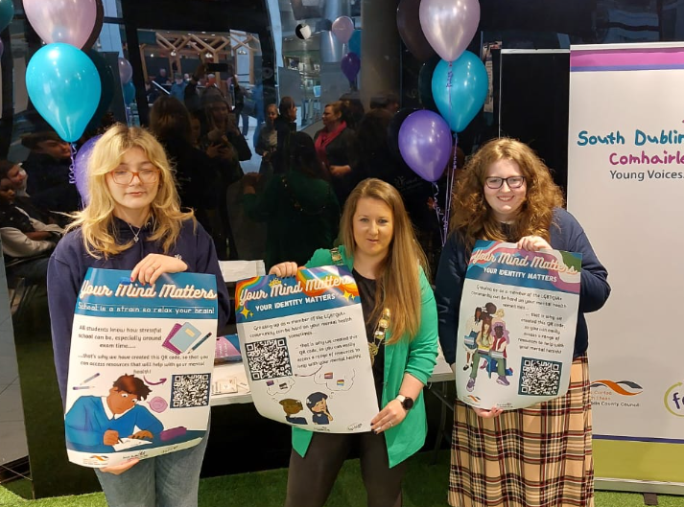
2022/23 Topic – Mental Health
The Comhairle launched our poster campaign on Mental Health with Mayor Emma Murphy in the Community Hub in The Square.
The posters were designed and illustrated by our members

Slide 4
2022/23 Topic –Mental Health
The posters have a QR code that when scanned leads you to the websites of national and local organisations that can help young people who are experiencing mental health difficulties, like Jigsaw and Beacon of Light
The posters have been sent to all secondary schools, Alternative Learning Programmes and Youth Services in South Dublin

Slide 5
2022/23 Topic –Mental Health Posters

Slide 6
2023 Topic – Drugs and Addiction
The Comhairle has been working on the topic of Drugs and Addiction, with a particular focus on vaping, as our members feel that this is a major issue for young people.
We have met with representatives from YoDA (Youth Drug and Alcohol Service), and the HSE and learned about the impacts vaping has on health and upcoming legislation
The Comhairle is currently in the process of consulting young people about vaping through an online survey we are promoting on our social media
We hope to work with WEE Ireland on raising awareness of vape battery recycling, as we see the waste created by incorrect disposal as an issue affecting our communities
We continue to work closely with Mayor Emma Murphy on our topic

Slide 7
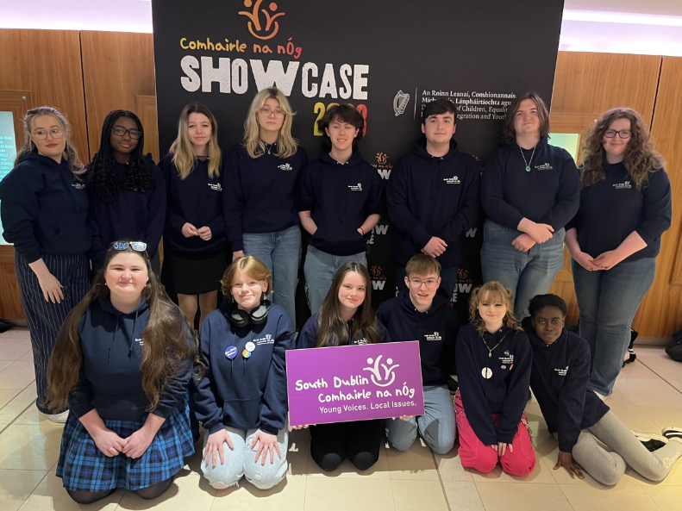
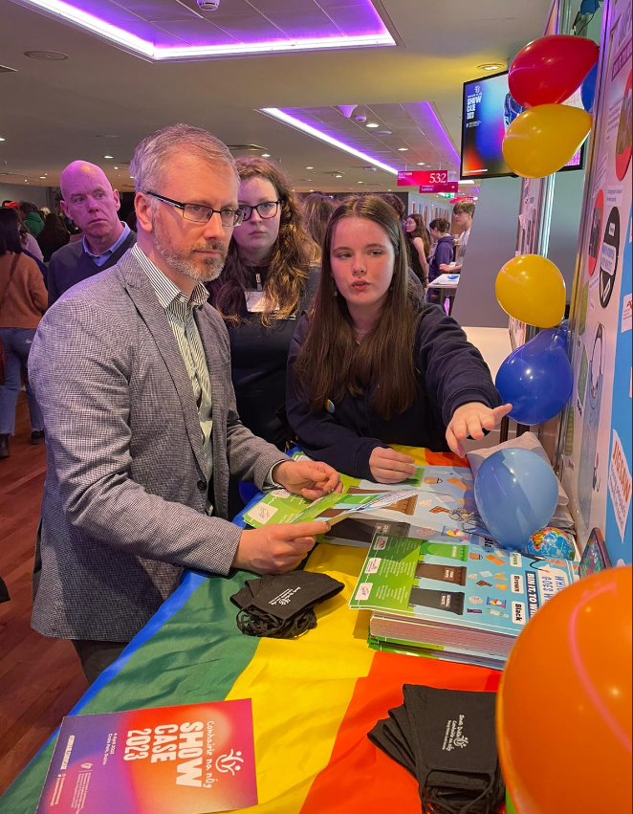
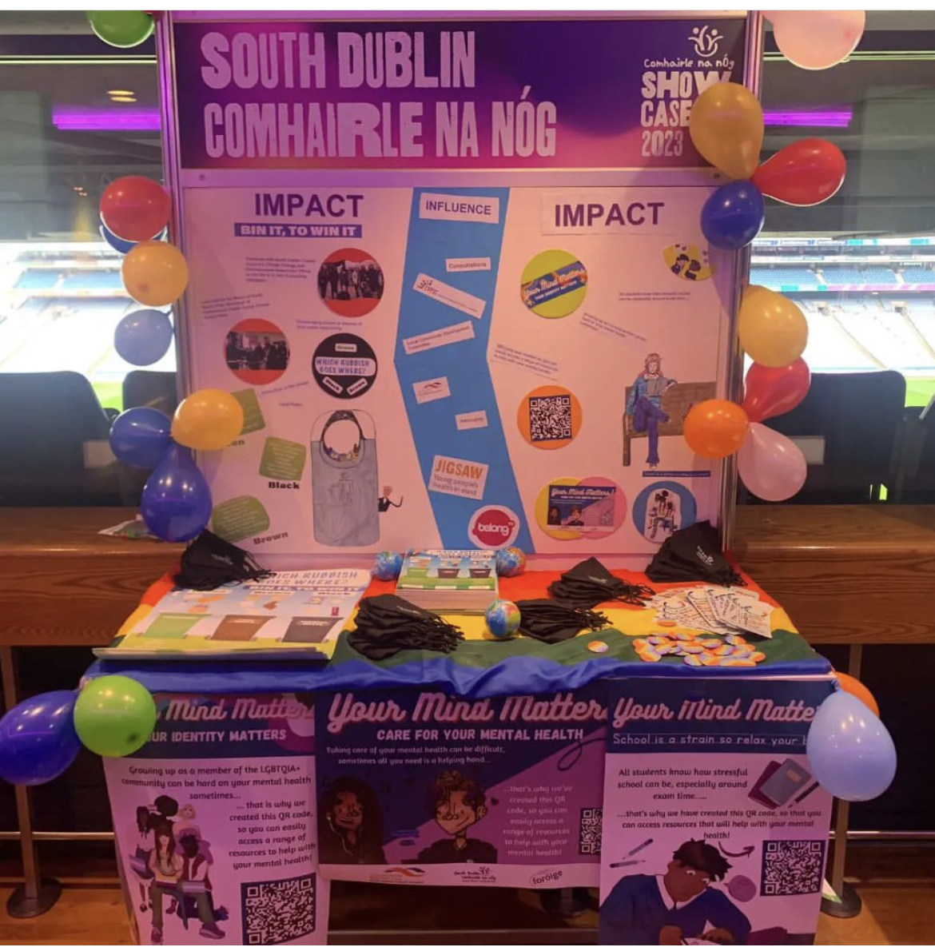
Comhairle na nÓg National Showcase
The Comhairle attended the Comhairle na nÓg National Showcase in Croke Park along with every other Comhairle in the country.
It was a chance for the Comhairlí to network and show off their achievements

Slide 8
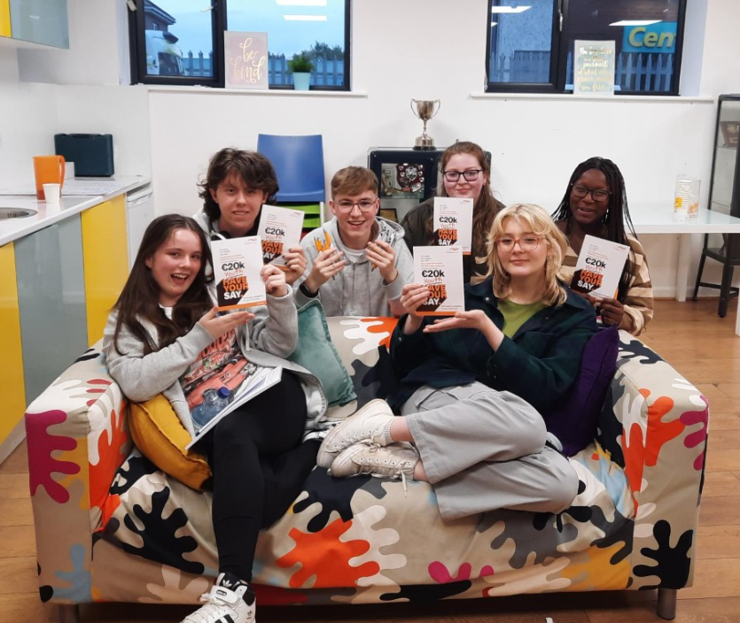
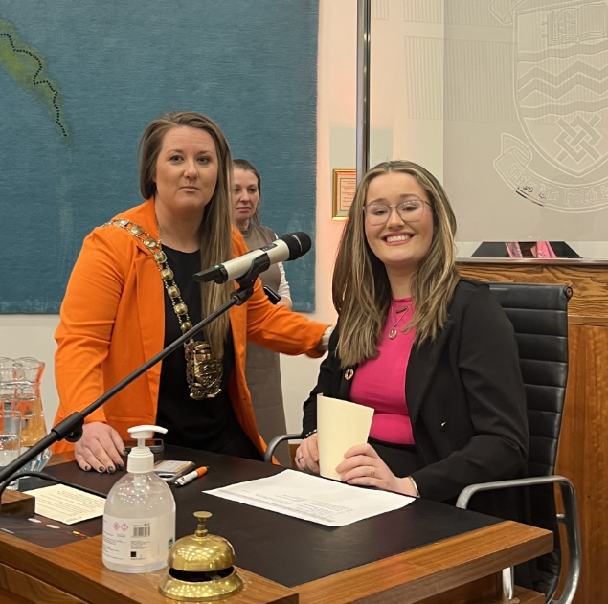
Involvement in Council Work
Have Your Say €20K
Comhairle members have both facilitated and taken part in the Have Your Say sessions
Poverty Consultation
The Comhairle have taken part in the poverty consultation as part of the preparation of the LECP
International Woman’s Day
Comhairle member Izzie chaired a discussion on Women in Politics to mark International Woman’s Day

Slide 9
Working with Decision Makers
South Dublin CYPSC
Comhairle members will be sitting on CYPSC subgroups on Education, Youth Diversion, Homelessness and Mental Health
We will be presenting to the full CYPSC on our work in July
LCDC
The Comhairle will be presenting to the LCDC in June
Council
We will be presenting to the Council at the OP&F meeting in May
Notes:
Katherine

