Slide 1
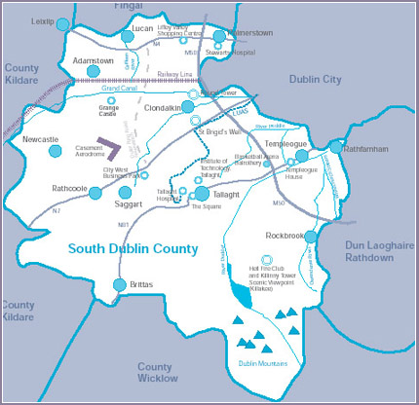
South Dublin Chamber
Accredited 1997 formerly Tallaght Chamber founded 1984

Slide 2
Core Mission:
To support the economic growth of our county so that it is a great place to live, work and study
We do this through being the voice of the business community and providing the supports our members need
Lobbying & Representation
Events and Activities
Chamber Learning / Training
Networking and Communication
Corporate Members Programme / International

Slide 3
Who Are our Members
The majority 80% + employ less than 10 people and many only have 1-3 employees.
They are located throughout the county with strong representation in the Industrial Estates and Business Parks.
They cover many areas such as tradespeople, retail, manufacturers, service providers, data centres, logistics, specialist supports, accountants and bankers.
We also have the large companies, Microsoft, Google, AWS, CRH.
All have different needs and engage in different ways with the Chamber.

Slide 4
Awareness of South Dublin County as a location of Choice, Retention and Growth
County Marketing Programme
e.g. Partner Chambers promoting and World Expo Dubai 2020
Commissioned Reports – from the 140 page Development Strategy for South Dublin 2001-2016 (published in June 2001) to our most recent report by Octavian “Building on Success”
Winner of Awards such as the Chambers Ireland 2019 Collaboration with a Local Authority for the Business Sustainability Programme
Promote through Eurochambers and World Federation of Chambers
Only Irish Chamber to be a Winner of the National, European and World Awards.

Slide 6
Working in Partnership with South Dublin County Council and other local stakeholders
Flagship Business Sustainability Programme
Surveys including the first county wide business survey in 2014
Training
Gaelforce Triathlon 2017 and 2018
Business cannot succeed without good infrastructure
Roads, water, waste disposal, housing, schools, hospitals
If you produce a good product but cant get it to market it’s a failure
Governance – local and national very important
Irelands economic freedom score is 82.0 making it the 3rd freest in the 2023 index
We work with schools, community groups as partners and as a support
We are the business partners in “Inspiring the Future” programme

Slide 7
Our CSR forum incorporates UN Sustainable Development Goals, Corporate responsibility, Equality and inclusion and our ESG (Environmental, Social and Governance) Programme. We have chosen to focus on 3 of the 17 Sustainable Development Goals that we believe we can both contribute directly towards and champion through our work over the forthcoming years - Goal 5: Gender Equality - Goal 10: Reducing Inequalities - Goal 13: Climate Action
Our local economy is part of the National Economy
Doing well with need for some improvement
2.7 million people working in Ireland , Unemployment down to 3.9% least variation in regional unemployment in EU.
Budget surplus 16.2 Billion

Slide 8
Challenges
Shortage of skilled workers
Housing
Transport, roads and public transport
Inflation – Energy costs
War in Ukraine – uncertainty
Climate Change
Domestic economy slowing
Brexit

Slide 9
Solutions
Increased skills based training and apprentices, improve supports for long term unemployed and increase progression pathways to employment. Provide opportunities for those who have migrated here to enter the workforce.
Housing – increase supply and improve home ownership figures otherwise major problem as people retire. – worldwide problem, no quick fix. 28,373 houses built in 2022.
Transport – greater investment in public and private transport systems. Dublin Outer Orbital Route (2008) badly needed M50 at capacity and now it’s a inner orbital route.

Slide 10
Cont:
Inflation – Macro issue dependent on energy costs which impacts all supply chains, need to have some restraint to prevent spiral of increasing costs increasing other costs. Improve supply of sustainable energy.
War in Ukraine – support for refugees, supports for those staying their country, active part of the peace finding process.
Climate Change – adhere to our commitments internationally, support lifestyle choices that reduce emissions and waste at personal, local and national level.
Domestic Economy in 2022 GDP Growth 12.2% Modified Domestic Demand 8.2% predicted that it could drop to 0.7%. Need to stimulate domestic economy through increased demand and export maximisation.
Brexit – Adapt and be responsive to changes as they are occurring biggest challenge is Divergence.

Slide 11
Summary
For 39 years we have represented the business community in our area which was originally Tallaght and with the formation of our County is South Dublin County.
We provide a voice for this communities needs and the services they require to grow and sustain their business.
The business community is an integral part of our wider community. The success of the communities of South Dublin County are interlinked to the success of any part of that community.
Local Government is a key driver of local economic growth through the provision of transparent governance, infrastructure, regulation and compliance, fair taxation and ensuring our county is a great place to live, work and study.
We greatly value the open and honest relationship we have had with South Dublin County Council since its formation and the common goal we share for our County to grow and develop for the benefit of those who live and work here.

Slide 12
South Dublin Chamber
Tallaght Business Centre
Whitestown Business Park
Dublin 24
D24 K59A
Tel: 00 353 1 4622107
Email business@sdchamber.ie
Check out our website - www.sdchamber.ie
Facebook / LinkedIn / Twitter

