Slide 1
Innovation Centre Project Update
Agreed project scope / targets:
The design, build and operation of a 3,000 sq. metre enterprise/innovation space in the County
KEY MILESTONES | Agreed Date | Revised Date
Detailed Design | 10/06/2021 | Complete
Final Tender Construction | 01/02/2022 | Complete
Project implementation | 04/04/2022 | Complete
Project Completion | 26/10/2023 | In progress

Slide 2
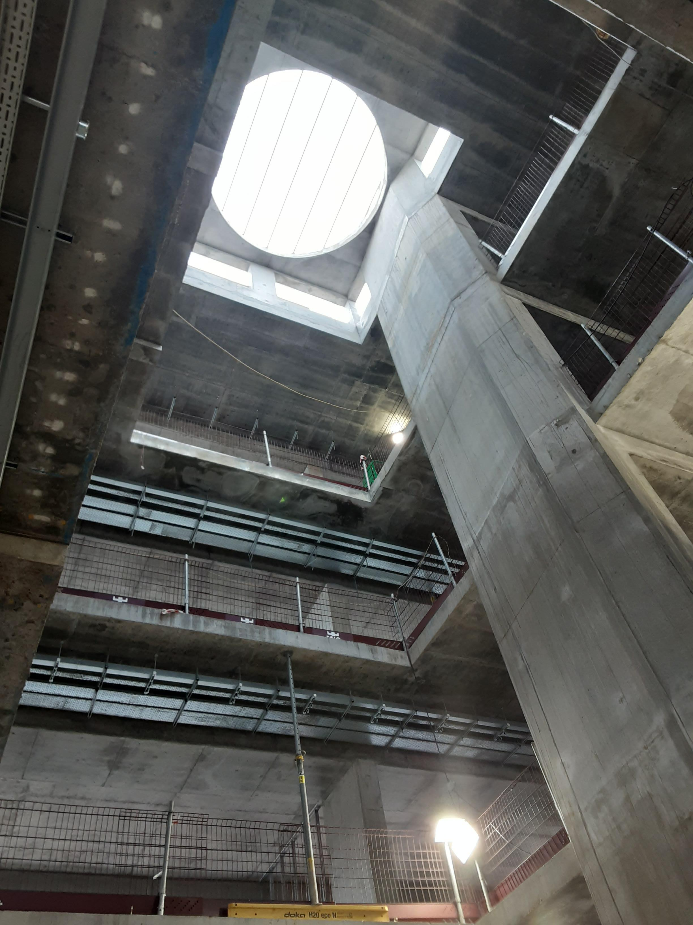
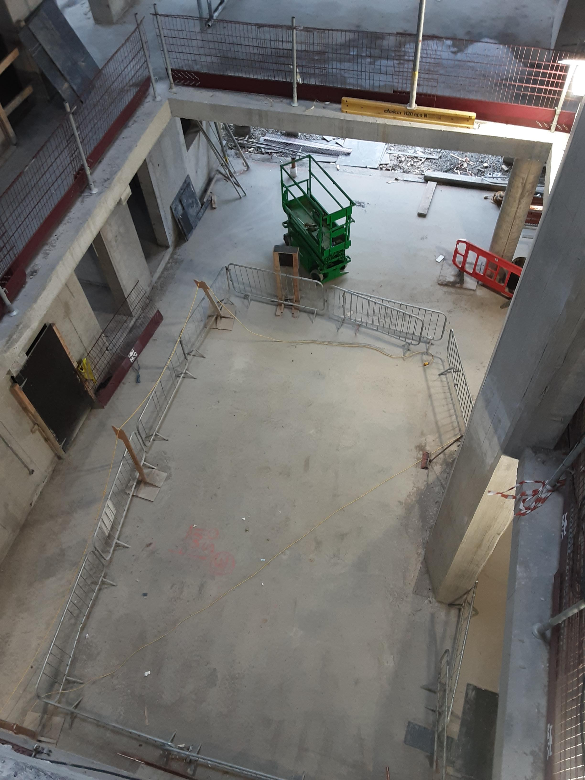
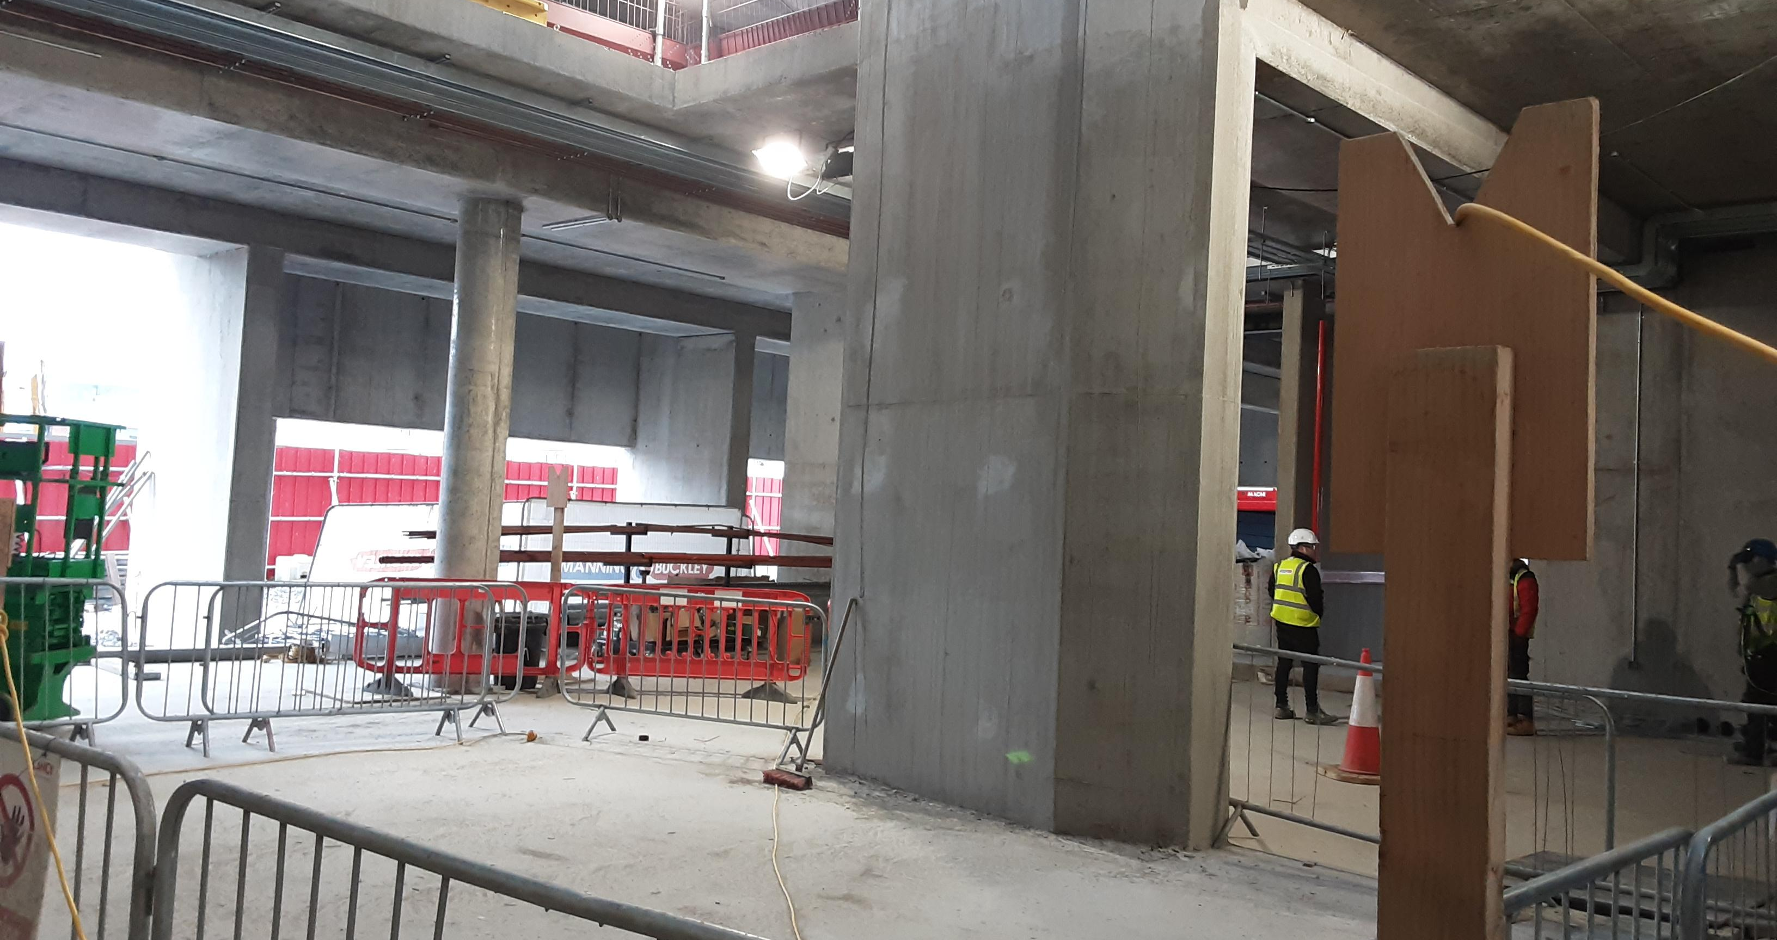
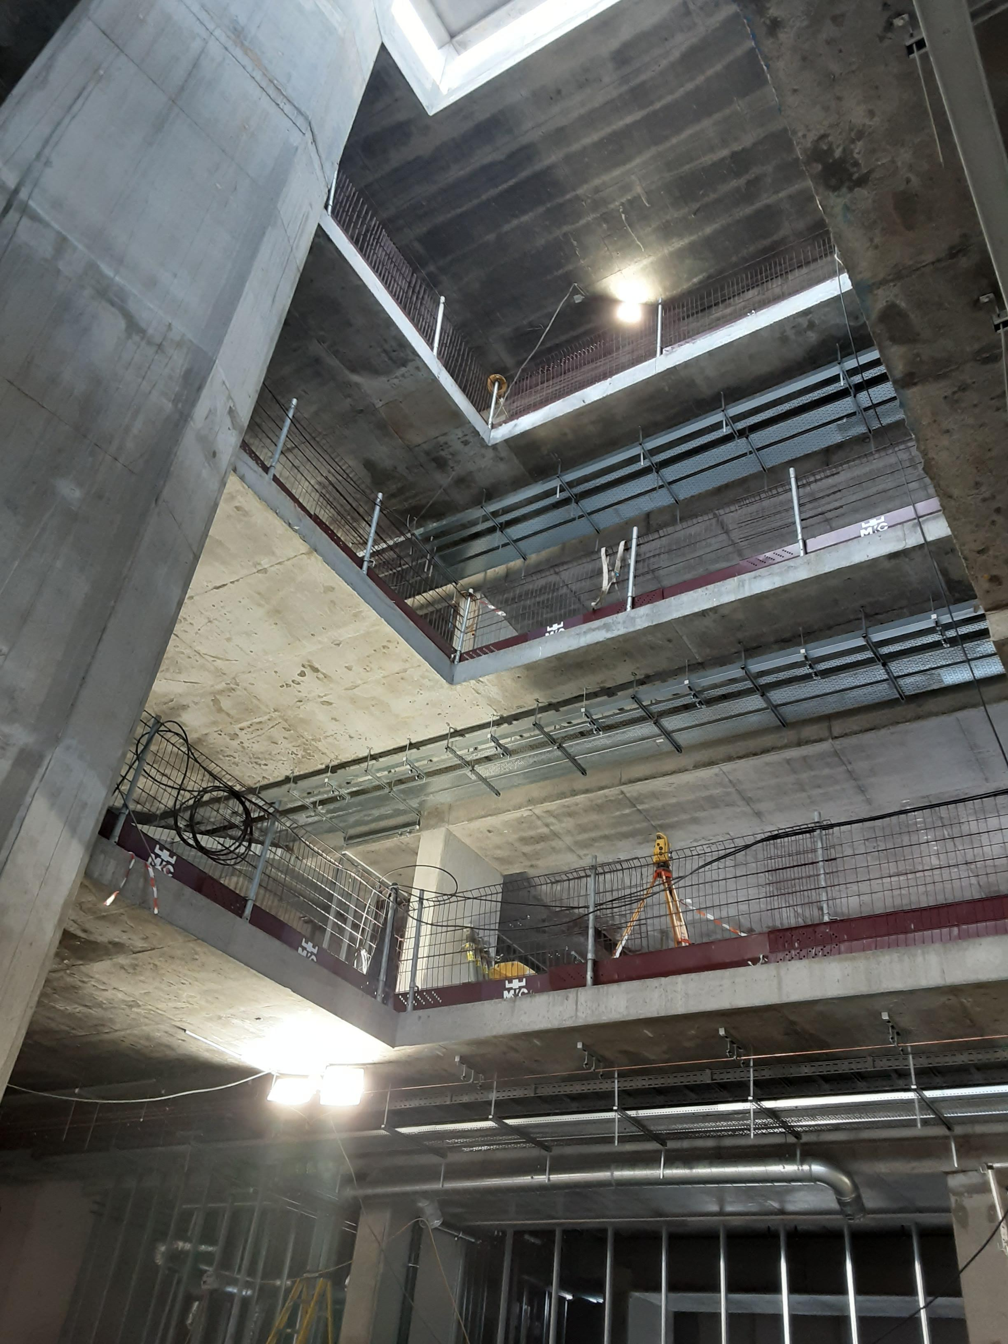
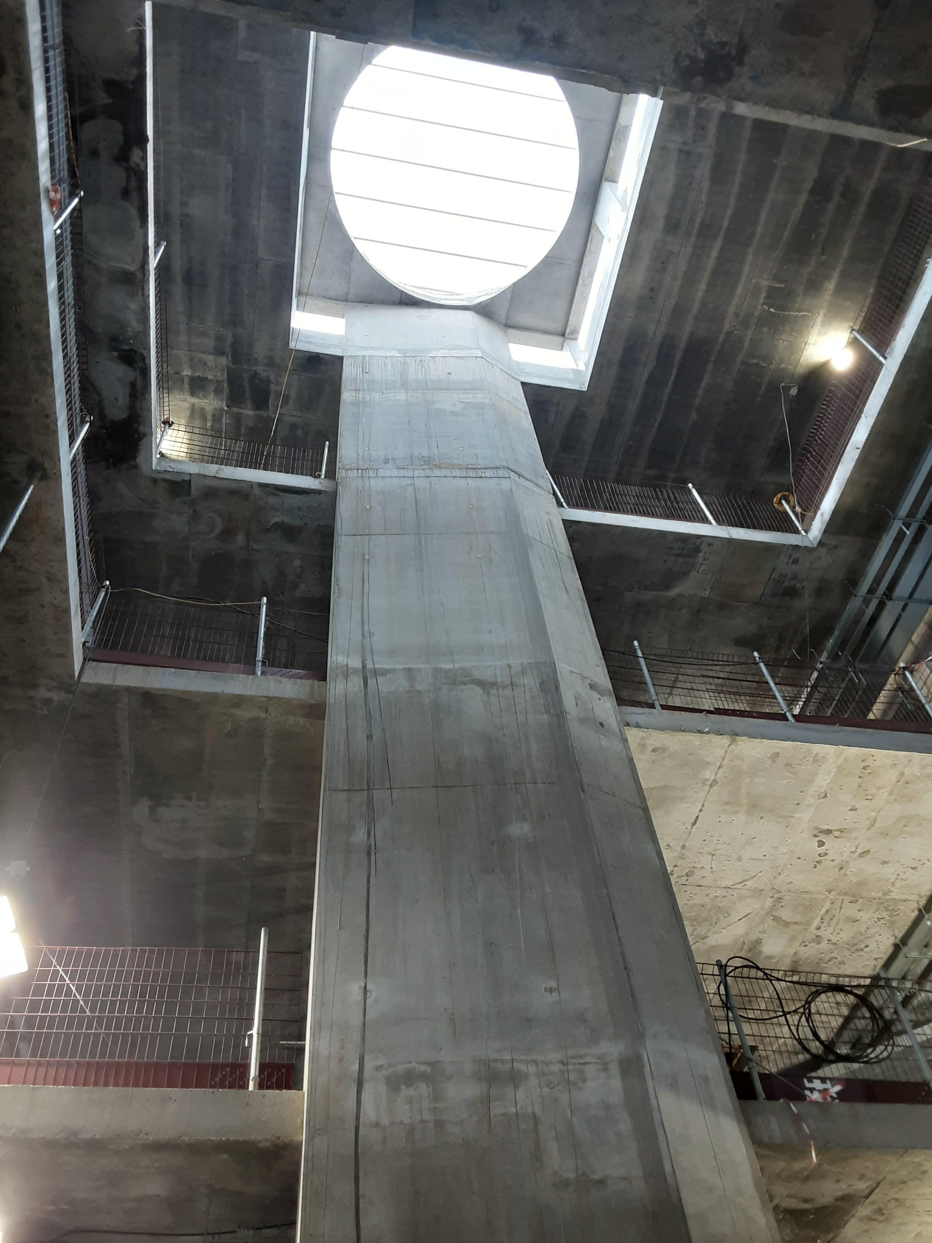
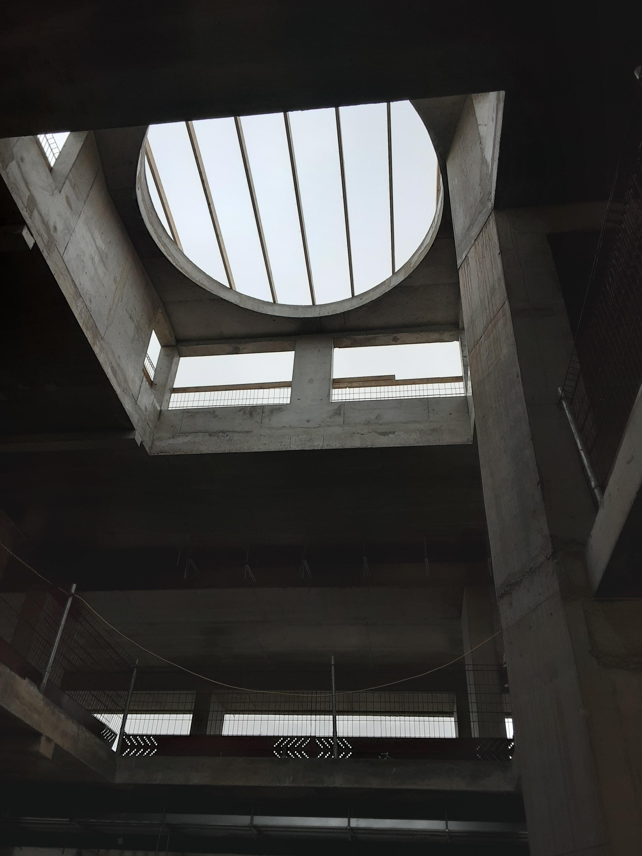
Innovation Centre Tallaght - site inspection - 230202
Innovation Centre Tallaght
Photographs as at April 2023

Slide 3
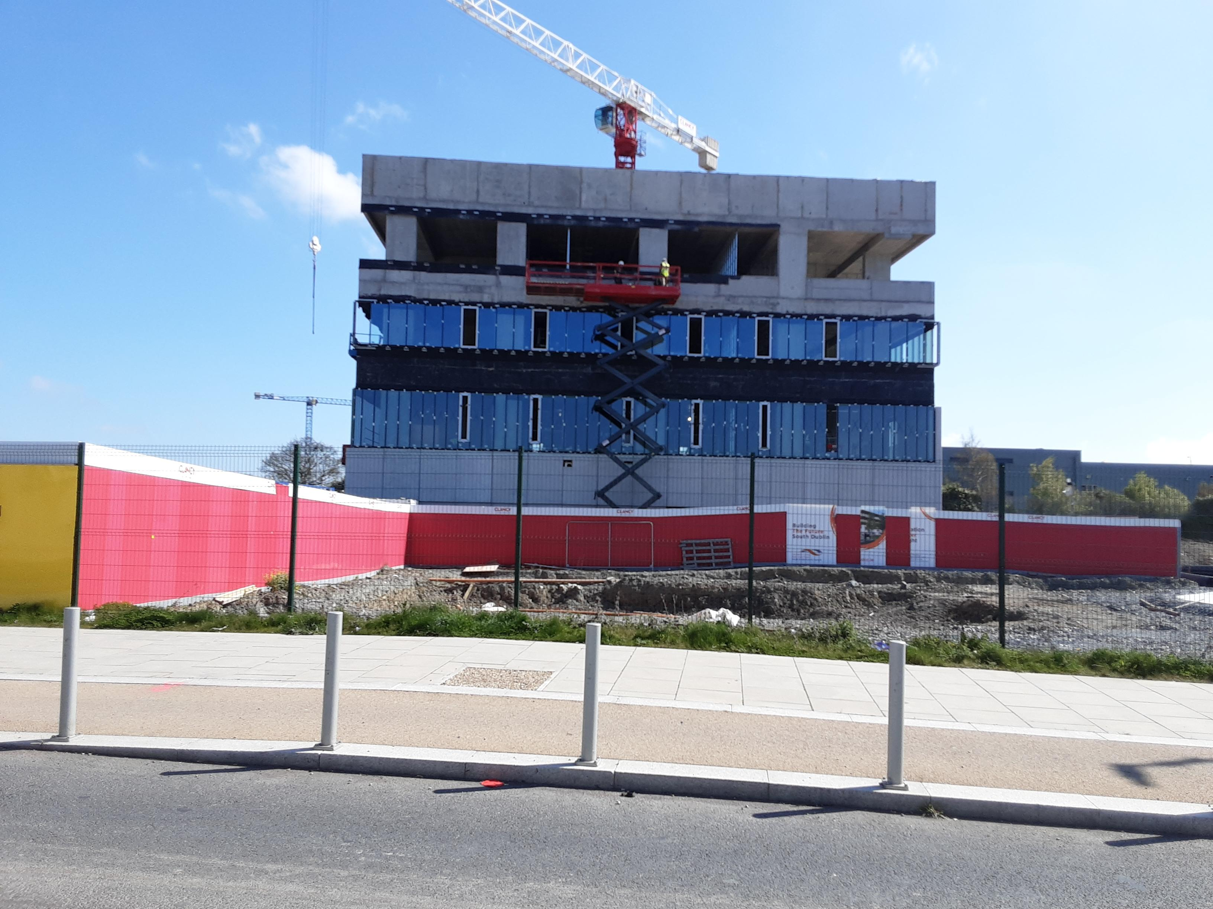
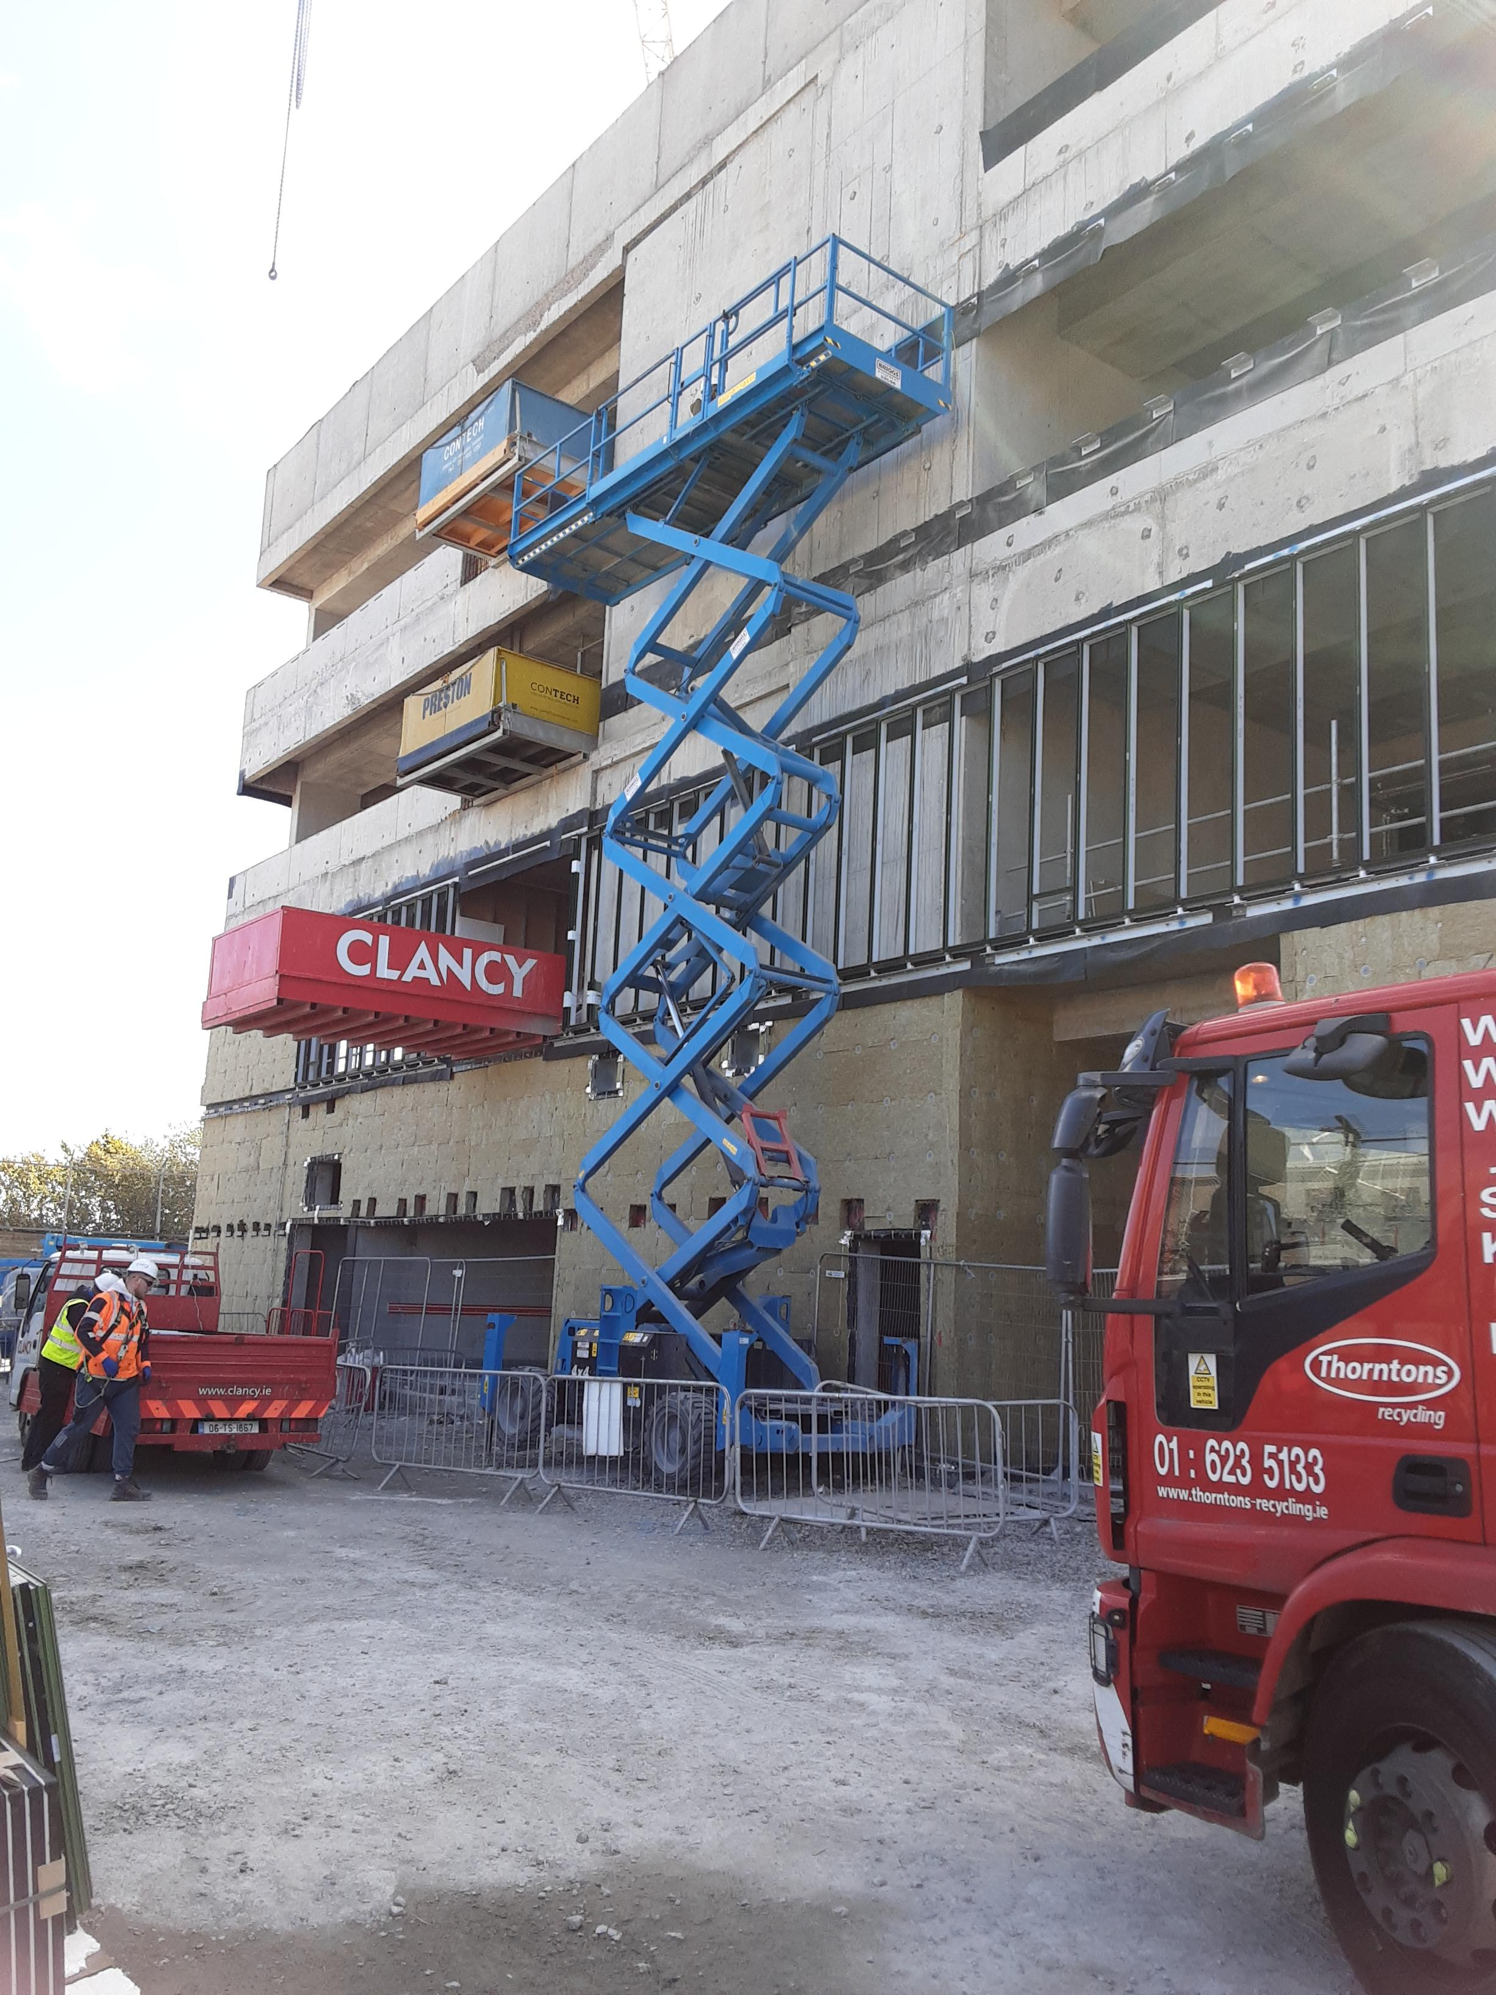
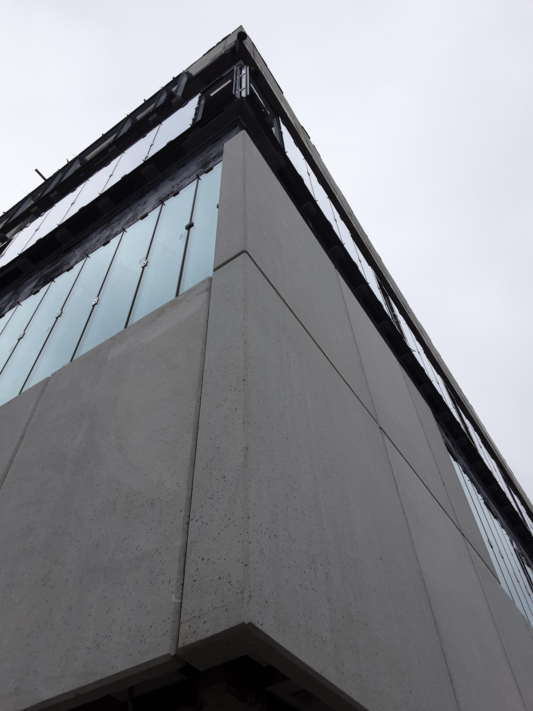
Innovation Centre Tallaght - site inspection - 230202
Innovation Centre Tallaght
Photographs as at April 2023

Slide 4
Work IQ Website & Mobilisation Plan
Oxford Innovation have development a ‘Mobilisation Plan’ which will go into Active Phase from April 2023 to September 2023
Preplanning activities / meetings with Oxford Innovation & SDCC are ongoing with regard to :
  Building Design and Fitout
  IT / Access Security
  Website and Social Media
  Oxford Innovation Site Visit in May

Slide 5

WORK IQ

Slide 6


