Slide 1
Active South Dublin Local Sport & Physical Activity Plan 2023-2027 Meeting of South Dublin County Council 8th May 2023

Slide 2
Notes:
The image here represents the architecture of our strategy
At the centre is our mission to develop active and healthy lifestyles for all in south Dublin. This mission is supported by four strategic themes, each of which is underpinned by several ambition statements.
Collectively these set out our ambition through this strategy – later in the plan we will look at the specific things we need do to in order to deliver on our plan

Slide 3
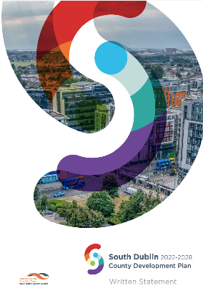
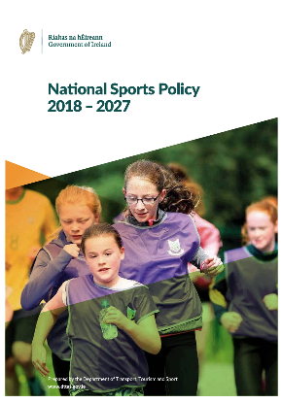
Setting the Sport and Physical Activity Plan in Context
By the end of period of this plan in 2028, South Dublin will be a place that our communities are proud of, that our businesses can thrive in and that will help us to live greener and healthier lives
Increase number of adults regularly playing sport (excluding recreational walking) from 43% in 2017 to 60% by 2027 (National Sports Policy)
Increased number of children regularly playing sport from 13% in 2018
Local authorities mandated in NSP to develop a local sports plan in this context
Overarching target of National Physical Activity Plan to increase proportion of population undertaking regular physical activity by 1% per annum
Exercise is one of the primary drivers of good health – referenced as a key driver across Healthy Ireland, Sláintecare and other strategies and priorities
Notes:
Research indicates that to shift participation gradients in a meaningful way, we need to make concentrated efforts to support those that are most likely to be inactive or that face multiple barriers to participation - people with disabilities, ethnic minorities, new communities and those from areas of high socio economic disadvantage
In addition, evidence suggests that to effect sustainable improvements in health and wellbeing and to deliver on the significant and ambitious participation targets at a national level, a whole-system approach is needed.

Slide 4
Notes:
The main survey used to monitor sport and physical activity in Ireland is the Irish Sports Monitor (ISM). The ISM is a representative survey of the Irish population aged 16 and over.
The findings from consultations carried out in developing our Active South Dublin plan closely resemble the national picture – for example in our south Dublin survey 44% of respondents reported that they are active five days a week and therefore meeting National Physical Activity Guidelines.

Slide 5
Notes:
The main survey used to monitor sport and physical activity in Ireland is the Irish Sports Monitor (ISM). The ISM is a representative survey of the Irish population aged 16 and over.
The findings from consultations carried out in developing our Active South Dublin plan closely resemble the national picture – for example in our south Dublin survey 44% of respondents reported that they are active five days a week and therefore meeting National Physical Activity Guidelines.
Improving health & fitness, controlling weight and having fun or relaxing are far and away the most common factors that motivate people in South Dublin to participation in sport and physical activity where as in terms of barriers
Time was identified as the major barrier – due to both work and family commitments. Practical barriers such as timing of classes, access to childcare, proximity to adequate facilities, limited or no public transport to facilities, restrictive or no safe cycle infrastructure and personal safety in their area were also highlighted consistently. The issue of cost may relate to the cost of activity itself, or the cost of equipment and getting to and from activities.

Slide 6
Consultation Activity
22
Semi Structured Interviews
29
People engaged in 5 x Focus Groups with Stakeholder Organisations
111 Responses
To our Online Survey for stakeholder organisations from 90 different groups
1626 Responses
To our Online Survey for local residents

Slide 7
Insights from the Consultation Process
A need to improve communication and integration between SDCC Departments both in the development, design and activation of facilities and spaces
A need to embrace sport and physical activity as a council wide responsibility and increase the value and status placed on sport and physical activity
A need to ensure adequate staffing and resources are available to develop and deliver opportunities, both within the Local Sports Partnership and across other SDCC Departments
A need to work collaboratively to maximise the assets available in South Dublin for physical activity including Tallaght Stadium, the Basketball arena, the Dublin Mountains, greenways, parks, leisure centres, schools and community centres
Notes:
We are doing lots of things really well
The majority of respondents reflected positively on SDCC Sport and Leisure facilities such as sports pitches and leisure centres, that they cater for the level and type of sport and physical activity they want to take part in
We received really positive feedback on the role of our staff teams and people’s experience of programmes and initiatives delivered in South Dublin
However - A need to enhance access to indoor halls was identified, both by maximizing community & school facilities as well as developing new indoor provision with a particular focus on population growth areas and those without leisure centre access. In addition Reducing cost, better advertising of what is available and providing a wider variety of accessible facility types were the 3 key factors that could improve access to sport and physical activity facilities

Slide 8
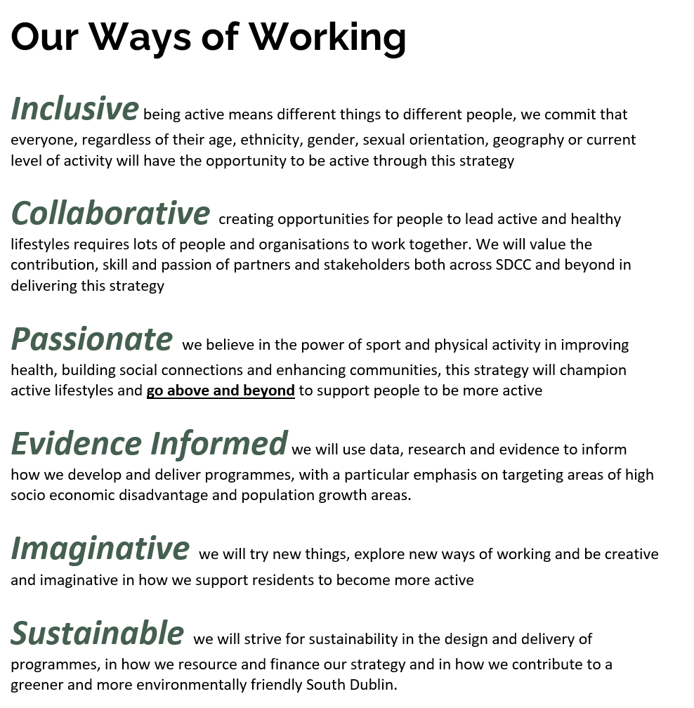
Our Mission
Active & healthy lifestyles for all in South Dublin

Slide 9
Active Communities & Clubs
Notes:
Through this plan we want to support people to lead active and healthy lifestyles whether the focus is on walking in the local park or whether it is competitive sport through club and school structures. Being active means different things to different people and different groups of people face different barriers to participation in sport and physical activity.
Our consultation findings are in line with national research in that time (work or family commitment), lack of motivation and injury, illness or disability represent the main barriers to participation. In order to shift the dial in sport and physical activity participation, we need to develop, promote and deliver programmes and opportunities that help overcome these barriers. We also need to ensure that these programmes and opportunities target those that are least likely to be active – such as areas of high social and economic deprivation, people with a disability and minority ethnic communities.
We want to promote South Dublin as an active place and build a culture of ‘being active’. The delivery of large participation events and generating a momentum behind participation opportunities can help advance that culture. In addition, we hope to inspire and instil a culture of active participation from an early age through our engagements with schools and a new focus on non- structured play.
There are approximately XX sports clubs in South Dublin currently, these clubs provide a vital outlet and pathway to participation in sport and physical activity. Our plan has a clear focus on ensuring that clubs have adequate support, capacity and resources to provide inclusive and accessible opportunities, catering for our fast growing population. This will be enhanced by our partnerships with NGBs and national organisations such as Active Disability Ireland.

Slide 10
Active Communities and Clubs
Ambition 1 - Develop active lifestyles amongst communities in South Dublin, in all their diversity, innovative annual programmes of participation opportunities
More participation by Travellers, people in homelessness, new arrivals, older people, those with medical & mental health needs
Targeted and evidence based programmes
Optimise funding for innovative new participation projects
(Sports Inclusion, Women in Sport, Diversity & Inclusion etc.)
Recruit, train and support new tutors and facilitators for more sports and activities
Partner with TUD Tallaght for community initiatives for sport & health students
Support All-Ireland Physical Literacy consensus for schools & pre-schools
Initiatives for non-structured enjoyment of sport, physical activity & recreation for all
Ongoing disability participation programmes
Notes:
Through this plan we want to support people to lead active and healthy lifestyles whether the focus is on walking in the local park or whether it is competitive sport through club and school structures. Being active means different things to different people and different groups of people face different barriers to participation in sport and physical activity.
Our consultation findings are in line with national research in that time (work or family commitment), lack of motivation and injury, illness or disability represent the main barriers to participation. In order to shift the dial in sport and physical activity participation, we need to develop, promote and deliver programmes and opportunities that help overcome these barriers. We also need to ensure that these programmes and opportunities target those that are least likely to be active – such as areas of high social and economic deprivation, people with a disability and minority ethnic communities.
We want to promote South Dublin as an active place and build a culture of ‘being active’. The delivery of large participation events and generating a momentum behind participation opportunities can help advance that culture. In addition, we hope to inspire and instil a culture of active participation from an early age through our engagements with schools and a new focus on non- structured play.
There are approximately XX sports clubs in South Dublin currently, these clubs provide a vital outlet and pathway to participation in sport and physical activity. Our plan has a clear focus on ensuring that clubs have adequate support, capacity and resources to provide inclusive and accessible opportunities, catering for our fast growing population. This will be enhanced by our partnerships with NGBs and national organisations such as Active Disability Ireland.

Slide 11
Active Communities and Clubs
Ambition 2 - Enhance South Dublin as an ‘Active Place’ by delivering flagship participation opportunities and sporting events
Calendar of large scale events
(Park Fit, Park Yoga, Couch 2 5k e.g.)
National Awareness Programmes (Bike Wike, Women in Sport, Active Schools)
Commit resources and supports to deliver the Marathon Kids, Schools Cross Country Event annually
Continued support for swimming, cycling and athletics initiatives in schools
Enhance partnership with South Dublin Volunteer Centre to maximise volunteering at events
Maximise regional growth opportunities for diverse range of sports & activities
Maximise use of Tallaght Stadium and other facilities

Slide 12
Active Communities and Clubs
Ambition 3 - Support the development of vibrant, inclusive sports clubs across South Dublin, building pathways to long term sustainable participation
Work with national governing bodies for more co-funded development officers
Support local clubs to access funding and build capacity
Annual grant funding for coach education, purchase of equipment & capital works
Use our programmes to increase connectivity between clubs & communities
Provide safeguarding , disability awareness & first aid and other key training supports

Slide 13
Active Spaces and Places
Notes:
South Dublin has 142 schools (primary and post primary), 33 community centres, 4 regional parks, 2 leisure centres, over 1500ha of open spaces and a wide range of sports pitches as well as access to the Dublin Mountains and an ever expanding network of greenways and cycle paths. We need to ensure that we maximise our existing assets as spaces and places where people can be active, particularly those that are currently underused.
The launch of the new National Outdoor Recreation Strategy and the national investment via Sport Ireland in a team of Outdoor Recreation Officers across the Local Sports Partnership Network provides an ideal opportunity to focus on optimising our outdoor spaces to enhance participation – captialising on the interest and momentum that developed during the pandemic.
We know that we need to continuously invest in improving existing and developing new facilities but that we can do this in a more coordinated way by sharing information, resources and expertise internally within SDCC. In recognising the cross cutting role of sport and physical activity in terms of tourism, the economy, health & wellbeing, environment and communities - an enhanced involvement of our dedicated sport and physical activity staff during the planning and decision making process on new capital developments should ensure that sport and physical activity has a seat at the table.
This sport and physical activity plan supports and complements the delivery of other SDCC strategies, particularly in relation to sport pitches, parks and open spaces and cycling strategies.
A need for enhanced indoor provision was consistently raised during consultation alongside other facilities, we need to evaluate our requirements and make evidence informed decisions. An early focus on delivering on our agreed strategic projects then working together to create a new pipeline of sport and physical activity projects will be a key priority

Slide 14
Active Spaces and Places
Ambition 4 - Optimise the potential of existing natural and physical assets such as community centres, parks, mountains, water, leisure centres and schools as places where sport, physical activity and recreation can occur
Scale up the ‘Try One Challenge Initiative’ across all 35 community centres
Maximise school and community access to our network of leisure centres
Work with Dept. of Education and DDLETB to expand evening and weekend access to school facilities
Use Active Cities for better workstream integration for more active use of our built and natural resources
Develop synergies between the Active Travel and Active Cities (Dublin Officers) teams to optimise school commuting by walking and cycling initiatives
Under the National Outdoor Recreation Strategy, work with Sport Ireland Outdoors Unit & the Council’s County Promotion Unit to increase participation in sport, physical activity & recreation in the outdoors, including through tourism opportunities

Slide 15
Active Spaces and Places
Ambition 5 - Ensure that sport and physical activity is imprinted into planning and decision making processes on new facilities and new developments in South Dublin
Ensure intergenerational and universal access in the design, provision and operation of sport, recreation and physical activity facilities
Design, construct and operate sports and recreational facilities that support positive climate action initiatives and impacts
Engage the Active South Dublin team on planning and development, including Local Area Plans, and on new capital projects
Protect areas within parks and open spaces for nature and passive recreation as important components of health and wellbeing

Slide 16
Active Spaces and Places
Ambition 6: Significantly enhance the availability of quality sport, recreation and physical activity facilities and spaces through full delivery of our sports capital programme and other capital programmes
Work collaboratively to deliver the planned projects included in the current Three-Year Capital Programme 2023-2025 and seek to extend sport and physical activity projects based on assessed need and demand
Evaluate existing and projected sporting and recreational requirements for the County to inform future developments
Ensure Active South Dublin work programmes are aligned to ongoing implementation of the Council’s strategic plans for pitches, parks and open space, green infrastructure, cycling and other strategies
Deliver the Cycle South Dublin programme including forty-one specific projects for up to 210 kilometres of new / improved cycle lanes over next ten years

Slide 17
Active Communication
Notes:
The consultation process identified a need to continue to support residents and communities to enhance knowledge and understanding of, and appreciation for, the multiple benefits of regular physical activity, according to ability and at all ages.
This plan offers an opportunity to carry this out in a streamlined and coherent way through the development of consistent brand for the Active South Dublin team and strategy – enabling us to extend the reach of our own campaigns and information but also to ensure that national campaigns and messages reach people at a local level – particularly those targeted at underrepresented or inactive groups.
The need to invest time, energy and resources to improve the evidence behind decision making in sport and physical activity and to measure the impact of our work was a key priority during consultations.
As a core member of the Local Sports Partnership Network, our access to Sport Ireland’s research and evaluation unit provides us with a unique opportunity to enhance our capacity, our understanding and our implementation of good quality research and evaluation processes. The establishment of a local baseline position for sport and physical activity participation to enable us to measure progress will be a priority. In addition, the emergence of the National Geo Digital Database through Sport Ireland during the life course of this strategy will help decision making processes on new sport and physical activity facility projects

Slide 18
Active Communication
Ambition 7: Enhance Active South Dublin brand to promote value, benefits & opportunities in sport, physical activity and recreation
Ambition 9: Maximise use of data & evidence in sport & physical activity decision making and share good practice & communicate impacts
Ambition 8 - Proactively target underserved and underrepresented communities through positive, inclusive messaging on motivation, capability and opportunity to be active
Active South Dublin communications plan with website, social media channels etc.
Support National Sport & Recreation Amenities Database to enhance planning
Dedicated Active South Dublin promotion, supported by the Council’s Communications team & other key partners, including high-profile, targeted events.
Develop/use baseline sport & physical activity participation metrics to monitor progress
Promote national & international sport & physical activity campaigns
Deliver ongoing communications programme to support key target groups to get active
Annual dashboard of activity, evaluation of impacts & key achievements
Invest in digital infrastructure, including online booking systems

Slide 19
Active Partnerships and Systems
Notes:
SDCC has dedicated and passionate teams of people that work to deliver sport, physical activity and recreational opportunities for our residents. We heard during the consultation process that whilst we are doing lots of things well across our teams – we could enhance how we do things together.
Evidence suggests that to effect sustainable improvements in health and wellbeing, a whole-system approach is needed, involving government and society.
Implementing a whole-of-government/society approach, addressing the broader determinants of health such as people’s living environments and behaviours is endorsed in the Healthy Ireland Framework. The need for a systems based approach is also endorsed in the Global Action Plan on Physical Activity 2018-2030. This global action plan was developed through a worldwide consultation process found that a systems-based approach with policy actions was required nationally to reverse current trends and reduce disparities in physical activity. The Global Action Plan on Physical Activity 2018-2030 makes it clear that ‘Increasing physical activity requires a systems-based approach – there is no single policy solution’
The further development of our Active Cities Project and the amalgamation and integration of our team will help to embed a whole of council approach and streamline how we engage and work with partners to improve sport and physical activity opportunities. Enhancing integration needs to be reinforced by an increase in the availability of staff and resources to deliver new sport and physical activity opportunities – this plan includes such a commitment. This plan also reinforces both a) a need and b) our commitment to work collaboratively with local and national partners and structures to leverage opportunities and resources for people in South Dublin.

Slide 20
Active Partnerships and Systems
Ambition 10: Ensure integrated working by fully resourced teams across the Council with the common goal of supporting active and healthy lifestyles for all in South Dublin
Resourced Active South Dublin team with to achieve objectives and ambitions of Plan with Council & Sport Ireland supports
Amalgamate Sports Office & Local Sports Partnership teams into single Active South Dublin team aligned to Plan’s actions & priorities
Establish Active South Dublin implementation team with relevant cross-departmental and stakeholder representation to oversee delivery of this plan
Maximise collaboration with Community Development team
Ambition 11: Proactively engage and collaborate with a range of partners in the delivery of local, regional and national strategies and policies
Participate in local sports partnership network
Support local delivery of national participation initiatives
Partner with HSE to embed physical activity initiatives in health & wellbeing programmes
Work with partners to support sport hub development
Collaborate to further develop the Active Cities model

Slide 21
What's new - 10 Key Commitments
Develop new Active South Dublin team & implementation programme to deliver the plan’s ambitions
Deliver programmes to increase physical activity among low-participation groups (particularly people in homelessness, Travellers, older people, those with medical & mental health needs, new arrivals)
Integrate the work of Active South Dublin, HSE and other key health & wellbeing partners
Maximise regional & local growth opportunities for a diverse range of sports & activities
Fund (new & existing) clubs to address participation needs in population growth areas
Expand use of & access to community, school & other facilities for sports & physical activity
Commit to ongoing large-scale events including schools cross-country, Marathon Kids, ParkRun etc.
Collaborate across all Council workstreams and beyond on initiatives to support the non-structured enjoyment of sport, physical activity and recreation for all age ranges
Create Active South Dublin oversight group with relevant stakeholders
Engaging Active South Dublin team in consultations on planning, development & capital projects
Notes:
Much of the plan builds on the positive and impactful work carried out to date by our various council teams and departments.
We will continue to deliver large scale events, use evidence based programmes, enhance our facilities and more. However this plan contains a number of new or focused commitments – these include

