Slide 1
03 May 2023
Geraldine O’Meara | Senior Executive Librarian responsible for Technology, Special Projects & Staff Development
Champion for Innovation and Creativity

Slide 2
Innovation
“The creation of a new, viable offering that adds value”
It is deemed a critical requirement for all Public Service Organisations to progress the development and delivery of services both today and for tomorrow.

Slide 3
Role of Innovation Champion
Foster a Culture of Innovation
Develop Processes and Practices
Encourage the Development of Technology
Support Collaborations

Slide 4
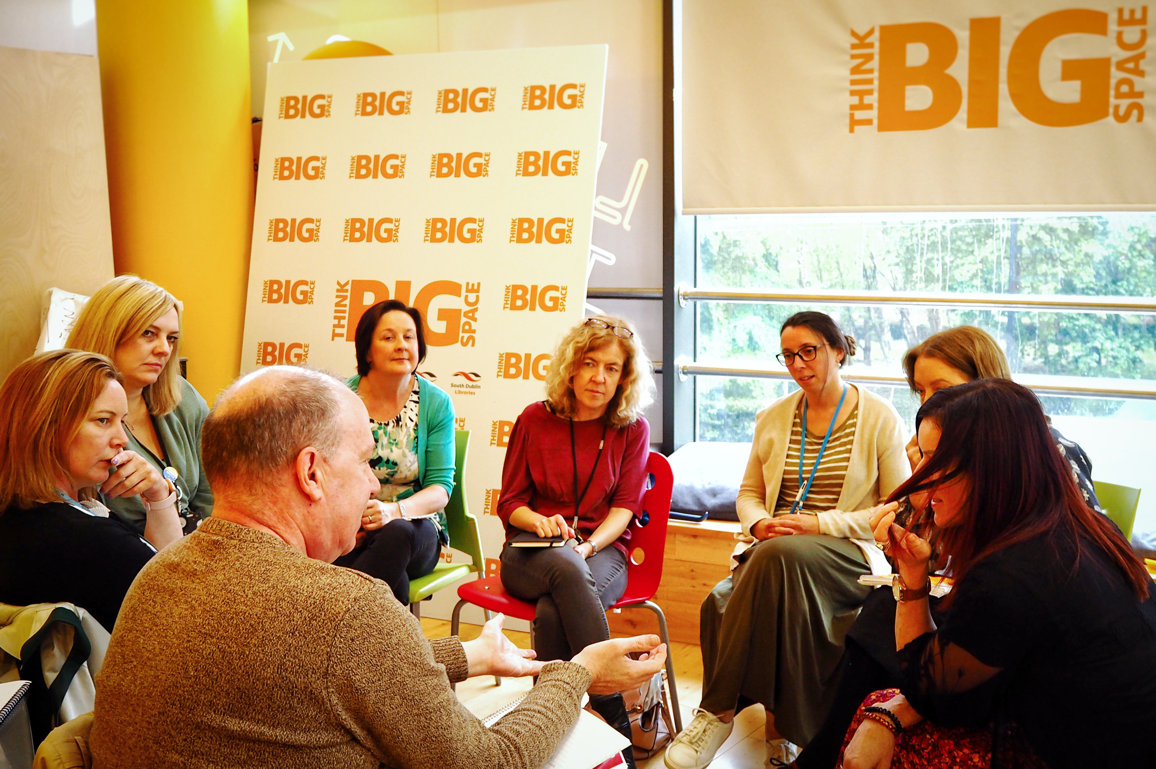
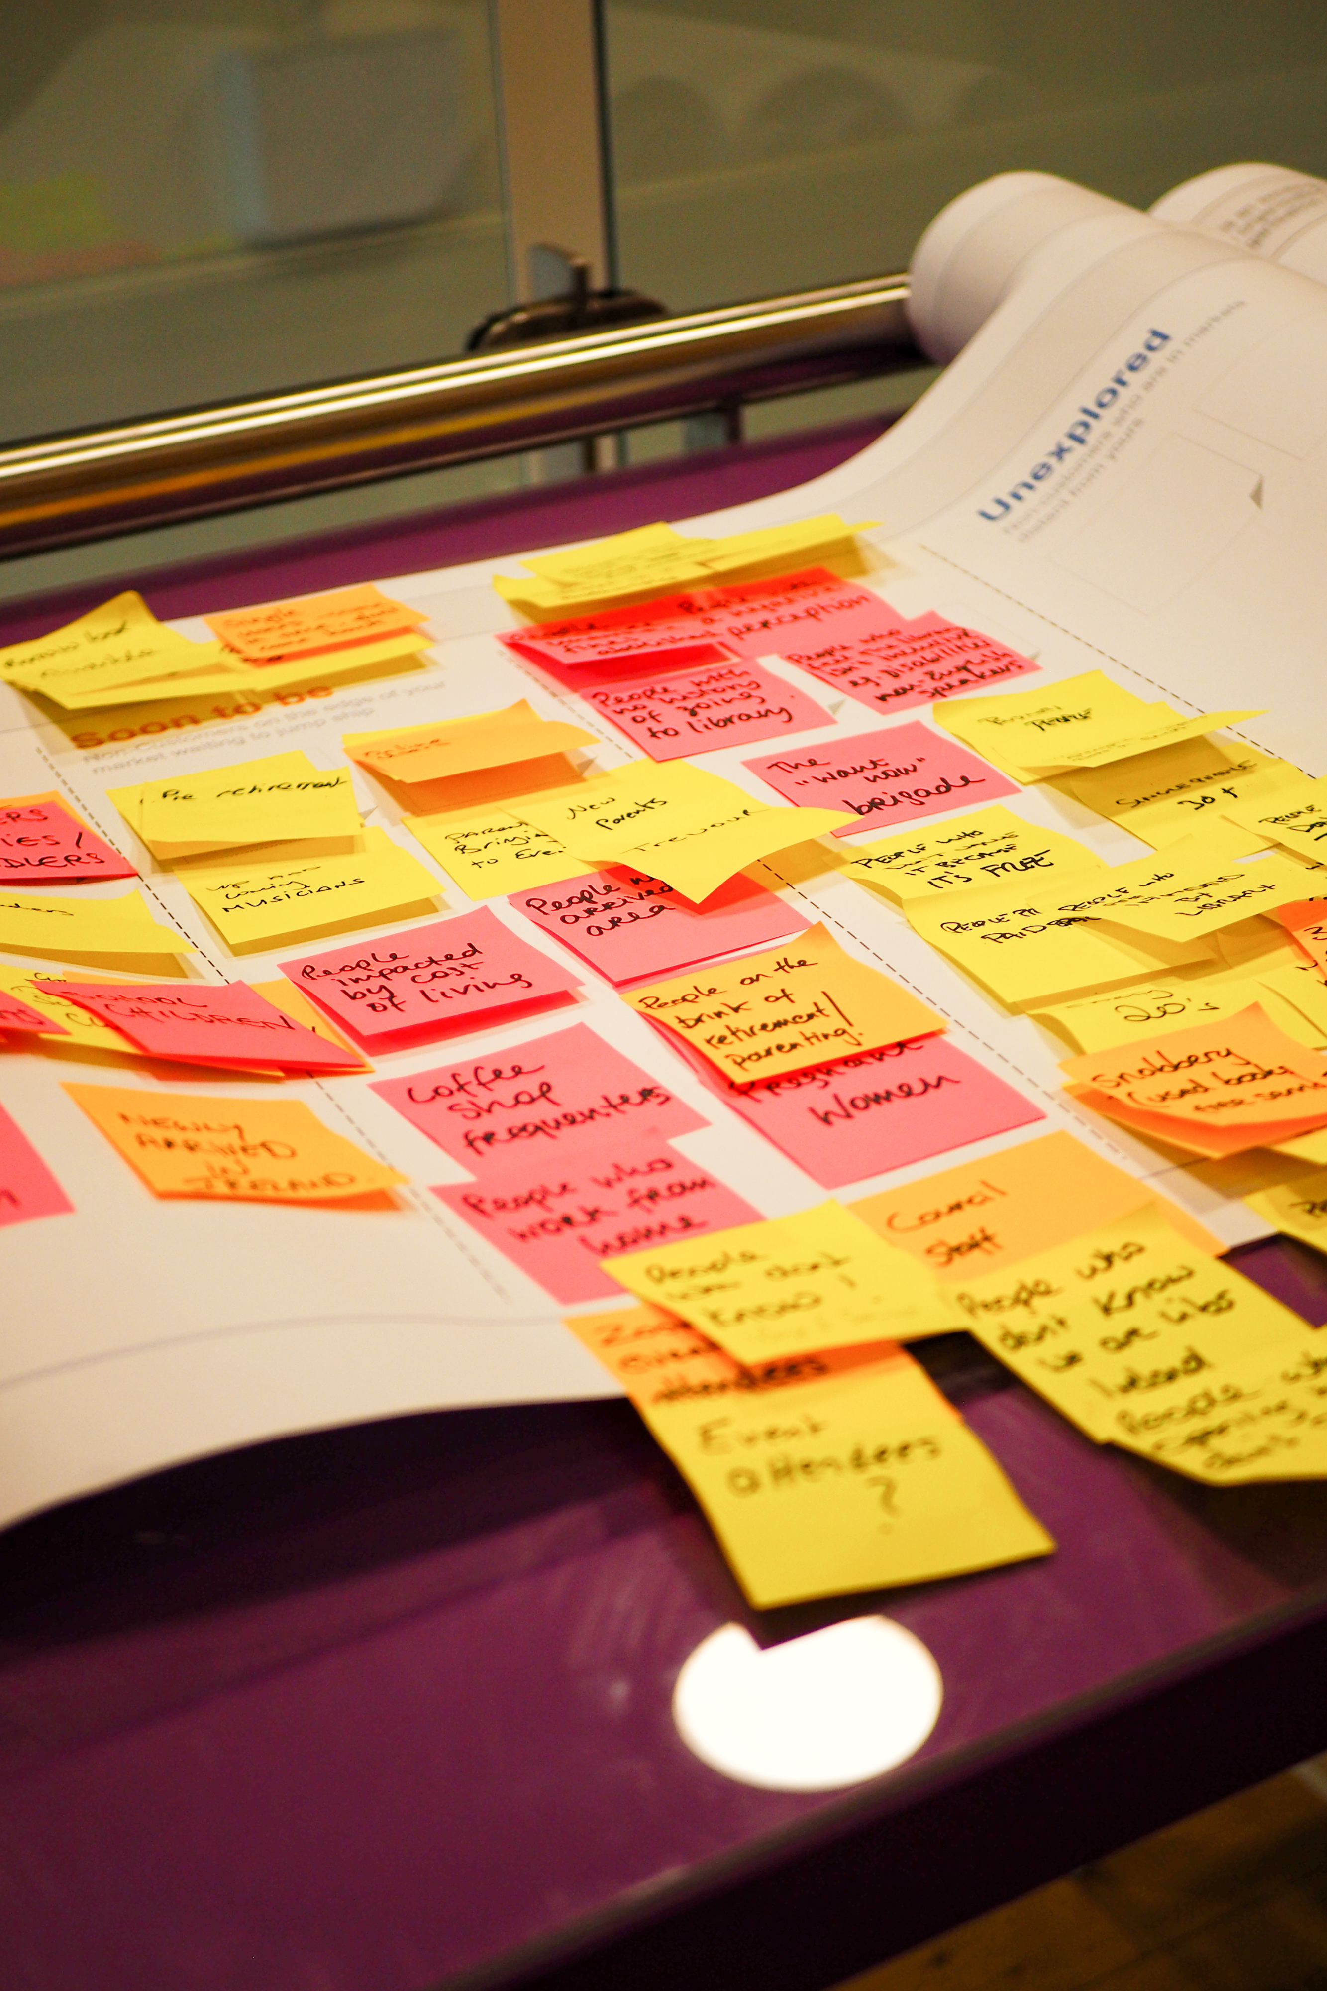
A Culture of Innovation
Support for new ideas and implementation
Staff Development and Training
Opportunities for staff to learn new skills

Slide 5
Processes & Practices
Pilot Projects
Palmerstown Hub
Neurodiversity Programme (TTT)

Slide 6
Technology

Slide 7
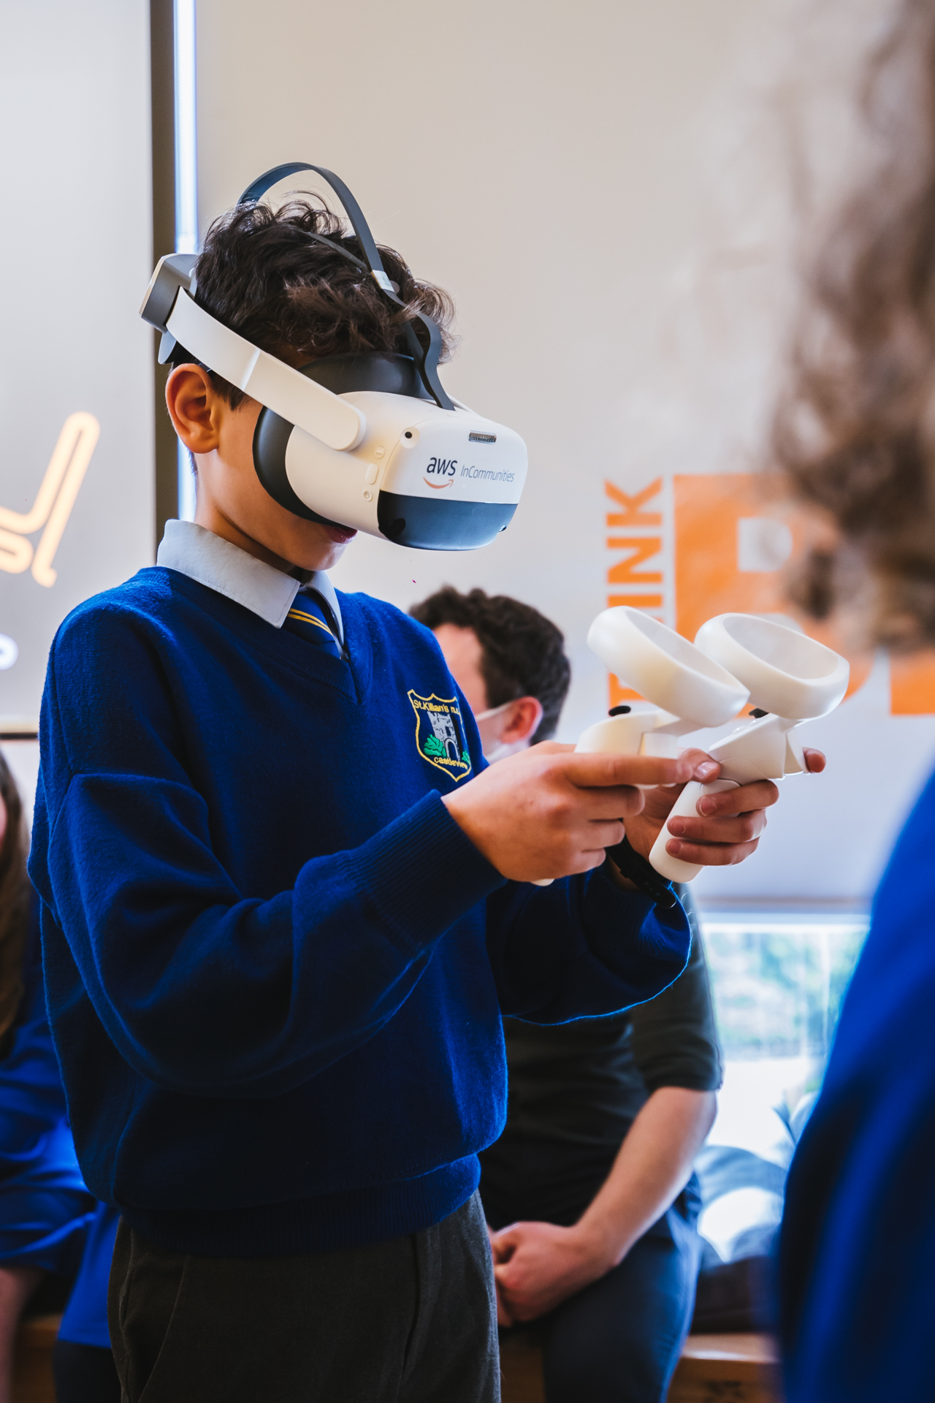
COLLABORATIONS AND PARTNERSHIPS
Recognising the potential for partnerships as a source of innovation and creativity
AWS and Think Big Space
https://www.instagram.com/reel/Cln8t5-uHqx/

Slide 8
Moving Forward…what’s next for South Dublin Libraries?
Fostering Innovation
Processes and Practices
Technology
Collaborations/Partnerships
Staff Skills Database
Brainstorming Sessions
My Open Library
Gaming Library
Livestreaming
Microsoft- Sensory Cubbie
User Feedback Portal
Innovation Workshops
STEAM - Train The Trainer
Capture and share insights

Slide 9
Thank You

