Slide 1
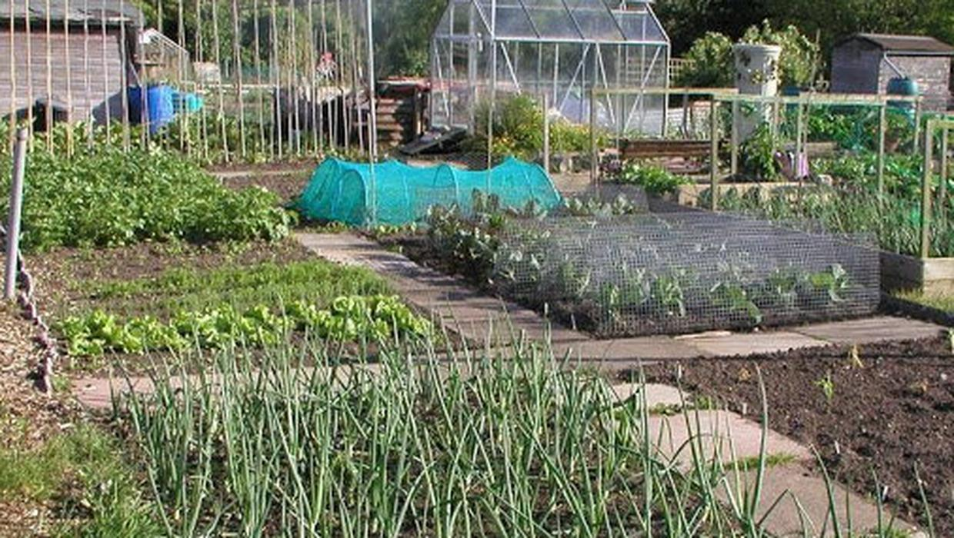
ALLOTMENTS POLICY

Slide 2
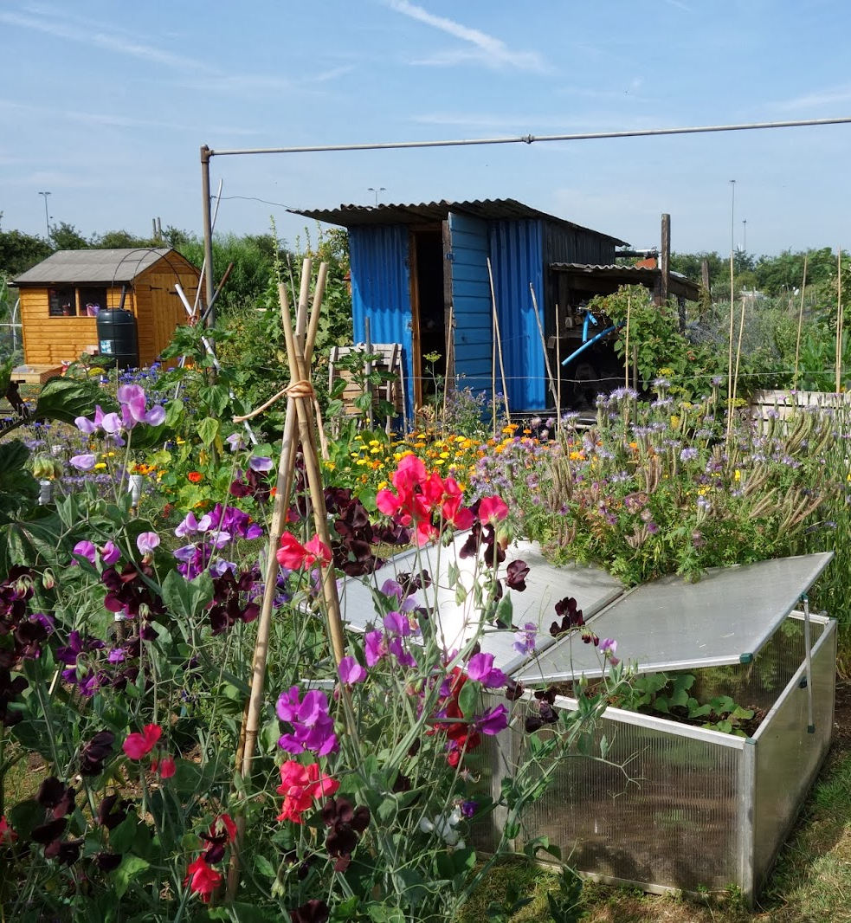
Allotment policy
The Allotment Policy includes information on the following:
History and Background
Benefits of having an allotment
Allotment provision:
Existing allotments
Management of demand
Delivery strategy of new allotments
Fee structure
How to apply for an allotment
Terms and conditions of Letting

Slide 3
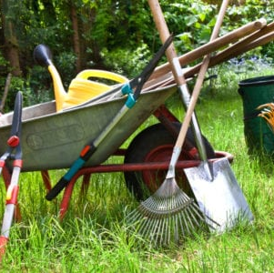
Allotment Survey
600 surveys issued by post, including those on waiting lists.
56% returns received in total
Friarstown 54%
Tymon 62%
Corkagh 62%
Mill Lane 50%

Slide 4
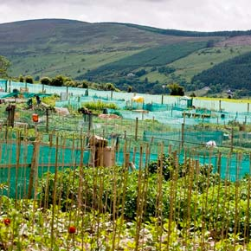
Survey Feedback
61% hold allotment sized between 101 & 200 sqm, 34% <100 sqm and 4% >200sqm
58% spent 10 – 20 hours on allotment, 30% 2-5 hours and 12% over 20 hours
The majority of people grow fruit & veg
Enjoy the outdoors/fresh air
86 found weed control the most challenging
87 were happy with the overall conditions/facilities
Administration efficient/provide good services
64 felt vacant plots should be allocated more quickly

Slide 5
Interest in Allotments
During Covid, there was an increase in demand for allotments, as Covid prompted a surge in interest in home-grown food.
Post Covid, the demand has not been quite as high as people have returned to work and other interests
This is evident from our waiting lists across the 4 sites, from 2020 to 2022:
2020 156 on waiting lists (>120)
2021 247 on waiting lists (>91)
2022 293 on waiting lists (>46)
As of March 2023, the number on the waiting list 297.

Slide 6
Analysis
It should be noted, when people make an application for an allotment they often indicate all 4 locations and are therefore placed on all 4 waiting lists.
In March 2023, we carried out an analysis of the 4 waiting lists to ascertain the greatest areas of demand. At that time there were 297 people on waiting lists.

Slide 7
Inspection of Allotments
In accordance with condition 5 of the Schedule of Terms and Conditions of Letting, inspections are carried out regularly.
Approximately 50 unused/under worked plots have been identified.
Of this 50 a total of 40 were handed back to the Council and are in the process of being allocated, reducing the waiting list by 40.
Identification and delivery of future sites has been added to the list of items for consideration under the Parks and Open Space Strategy and will be examined under the development of that strategy.

Slide 8
Provision of Allotments
The active management of the waiting list as set out in the previous two slides will continue going forward as set out in this policy.
This policy also commits to the provision of new allotments to meet the demand.
The Parks and Open Space Strategy scheduled for completion in 2023 is considering the optimal location, numbers and delivery of new allotments to meet demand.

Slide 9
THANK YOU

