Slide 1
Balgaddy Estate Quarter 1 2023

Slide 2
Allocations and Relets 2023
Pre - Works | Work in Progress | Ready for Allocation | Total
15 | 4 | 3 | 22
Surrenders | New Tenancies
2 | 4

Slide 3
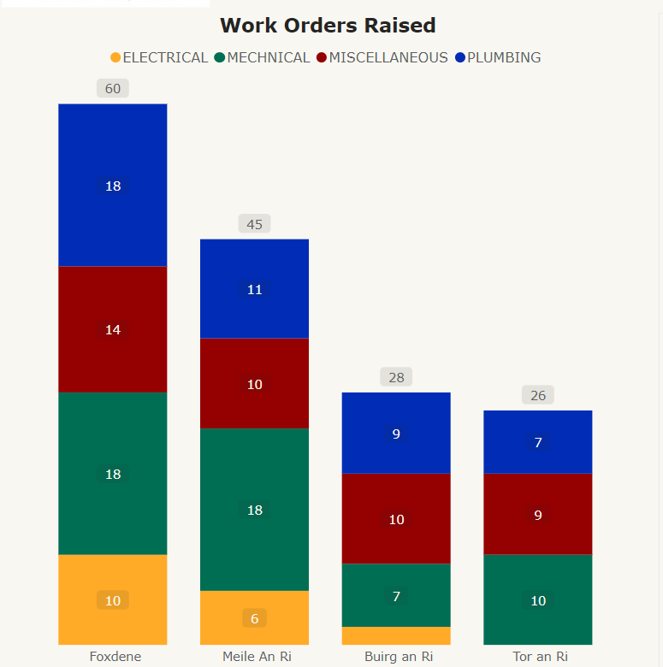
Response Maintenance Quarter 1- 2023

Slide 4
Planned Maintenance- Balgaddy
Roofing Works
Roofing repairs completed to properties in Buirg an Rí
Initial investigations for roofing works have commenced at the following
Tor an Rí – flat roofed properties
Méile an Rí Drive – apartment units
Communal Areas
Installation of communal doors and fan lights to 3 communal doors on Foxdene Avenue in Quarter 1 2023.
Additional security lighting to be installed in conjunctions with the door works.
Energy Efficiency Retrofit Programme
Properties in Tor an Rí to be assessed for inclusion in the EERP programme for 2023/24
Painting
Works on 57 properties in Tor and Rí has commenced
Tender documentation is being prepared for external painting works and communal areas in Foxdene Avenue with works to commence in Quarter 1 2023
Bin Storage Areas
Ongoing refurbishment of bin storage areas being carried out to reduce anti social behaviour.

Slide 5
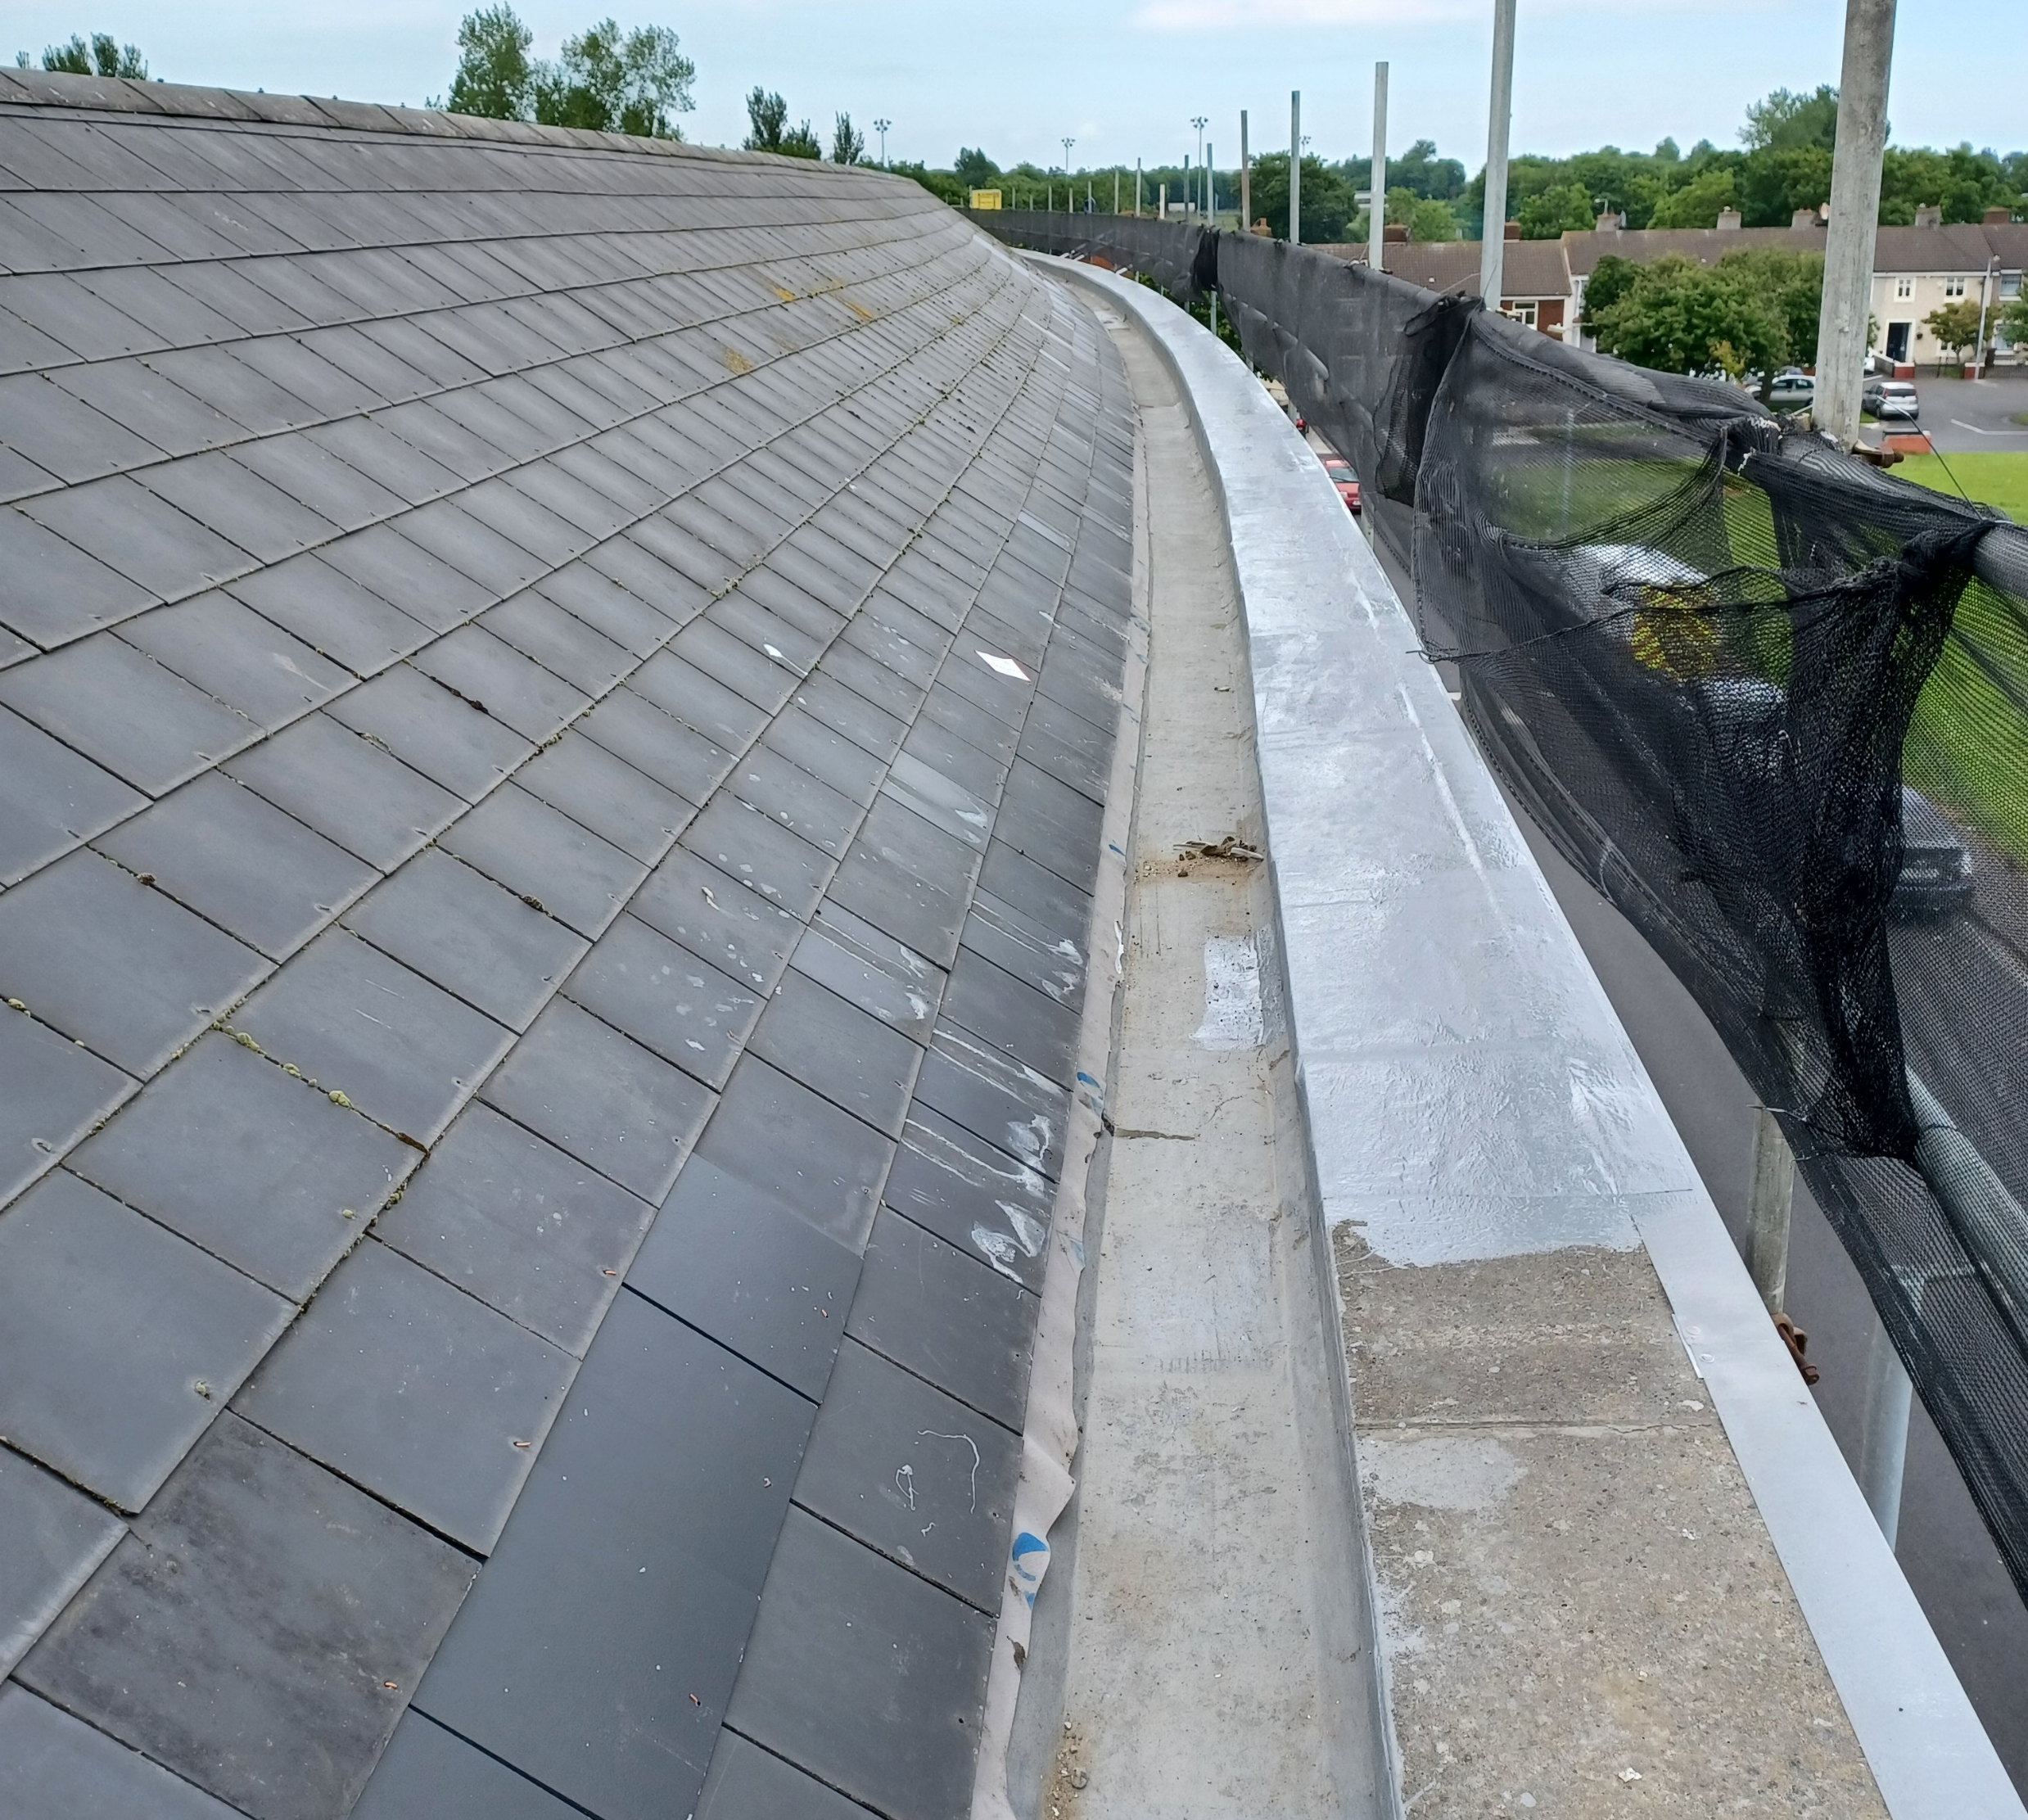
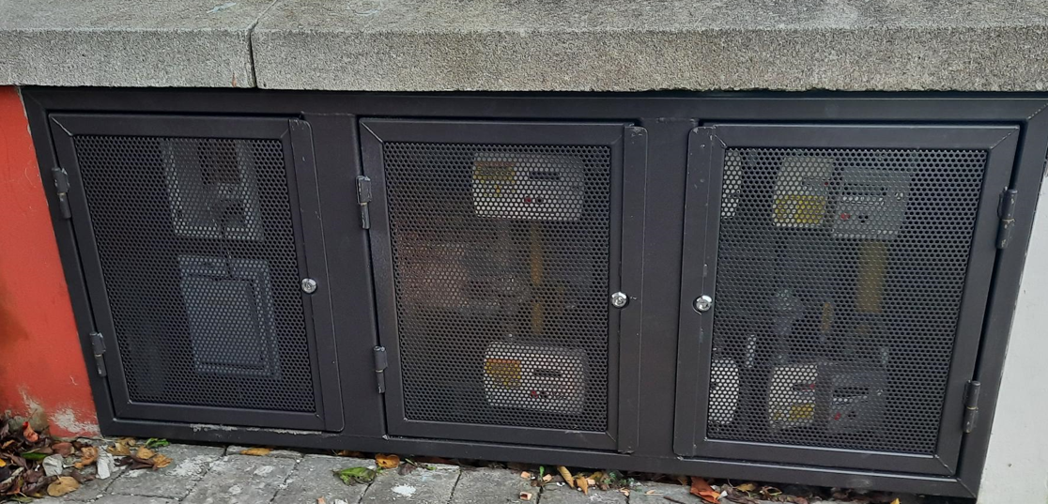
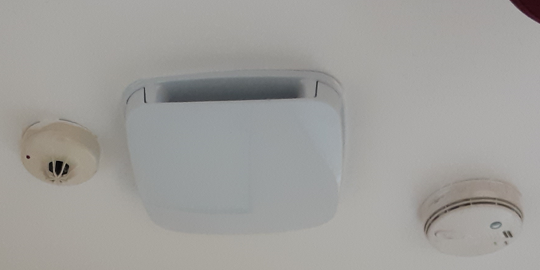
Planned Maintenance- Balgaddy
Replacement of Utility Box Covers
Installation of Mechanical Ventilation
Replacement of Garden Doors
Roof Repairs

Slide 6
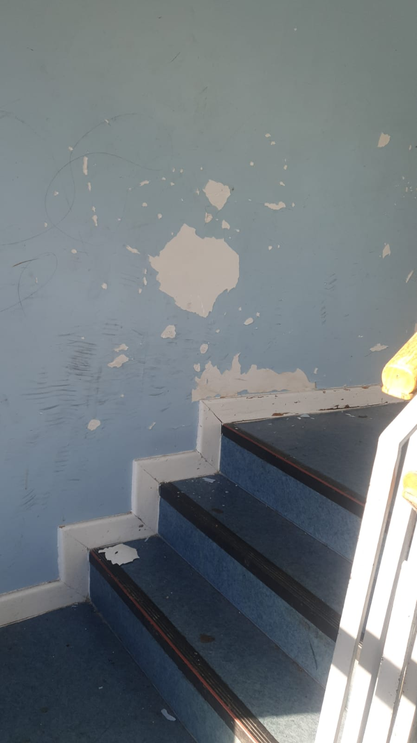
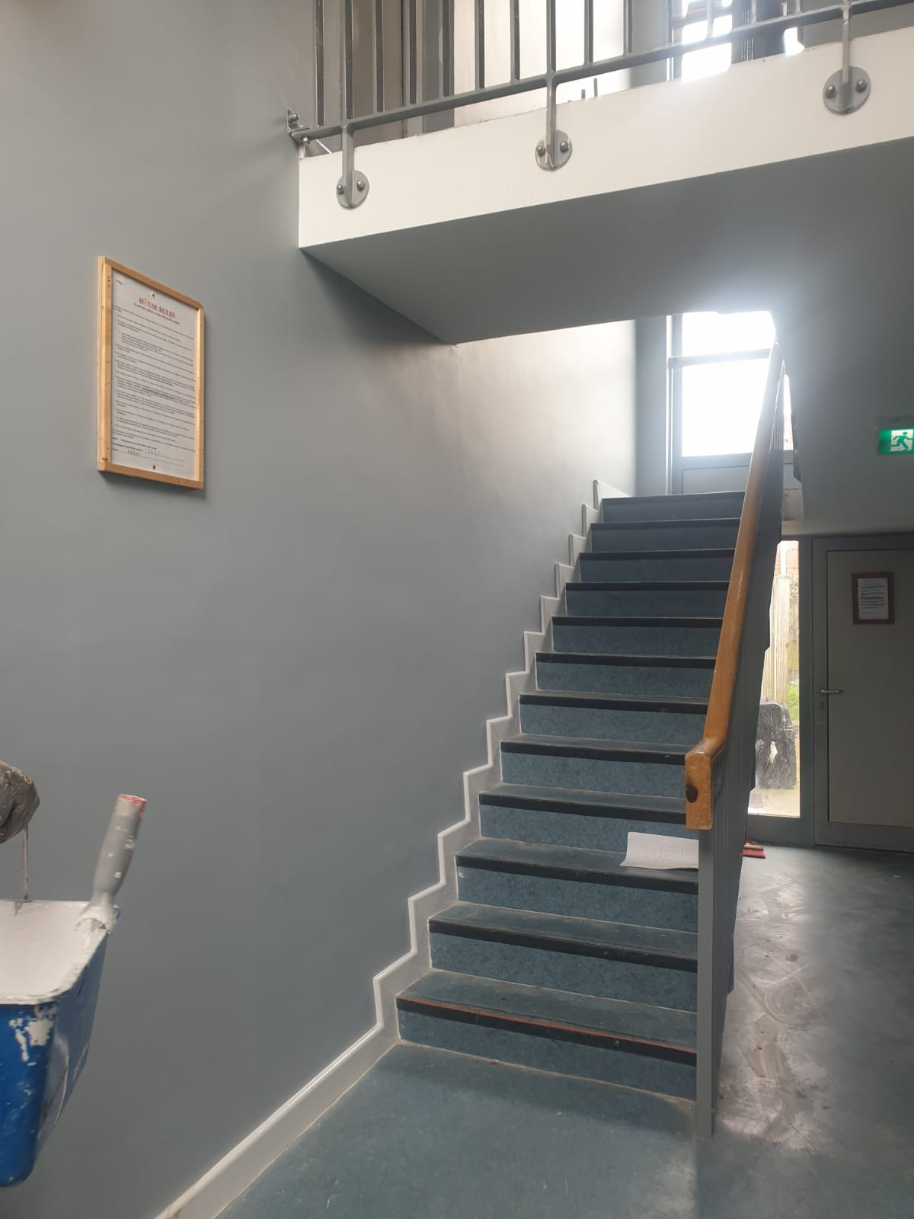
Painting Programme Communal Area Méile an Rí
Before
After

Slide 7
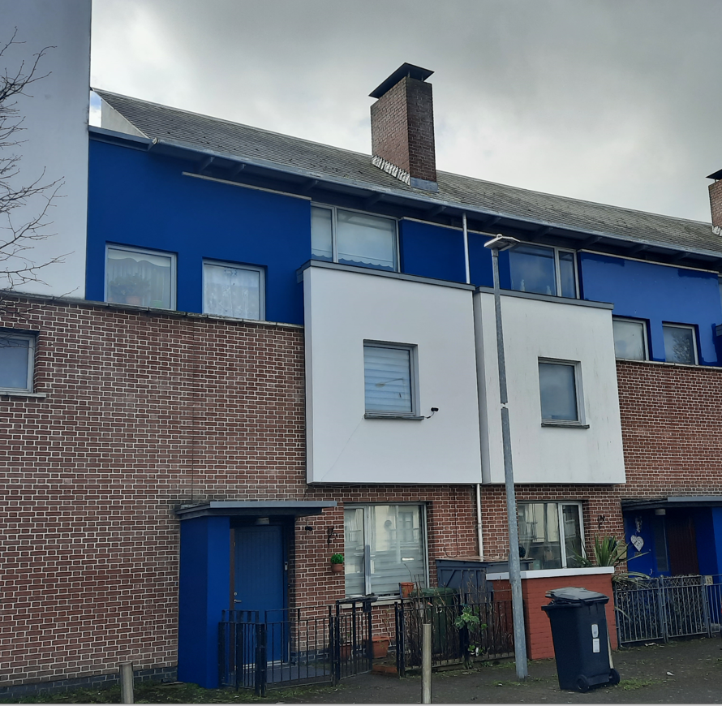
External Painting Tor an Rí

Slide 8
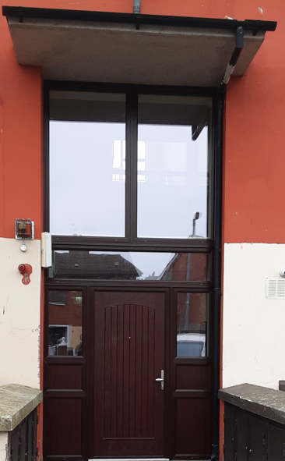
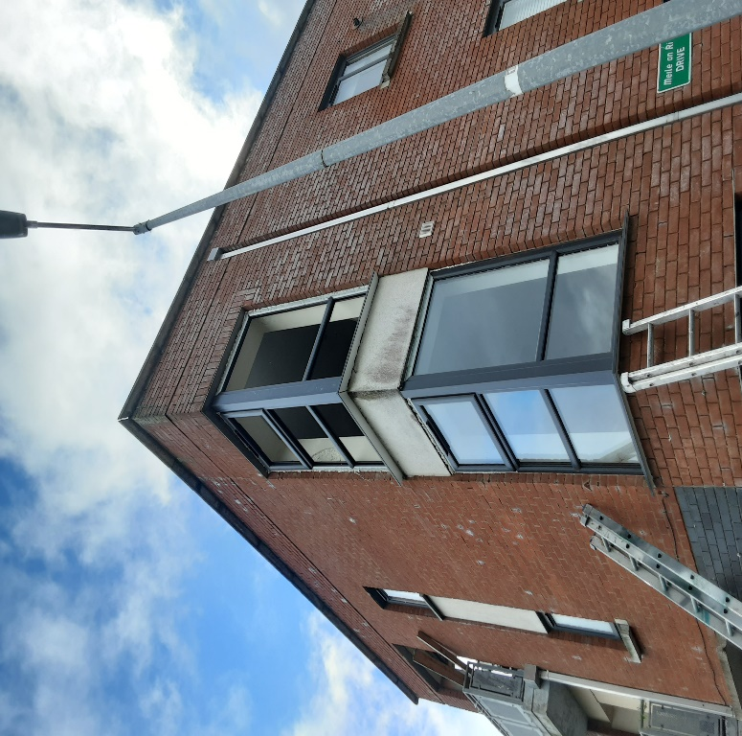
Windows & Door Replacement
Meile an Ri- Window Replacement
Foxdene Avenue- Communal Door Replacement

Slide 9
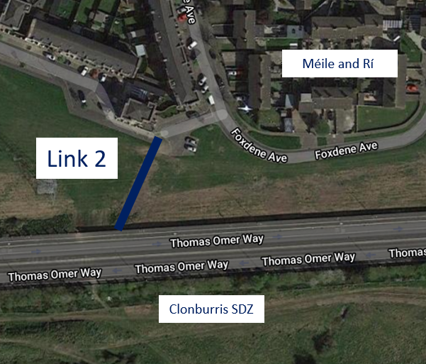
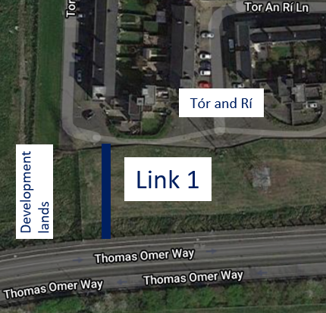
Permeability Routes
Tór an Rí & Méile an Rí to Thomas Omer Way
Design being optimised to increase value of scheme
Discussions taking place to secure a construction contractor for works
Liaison with ESB ongoing in order to secure approval of works in vicinity of high voltage power lines

Slide 10
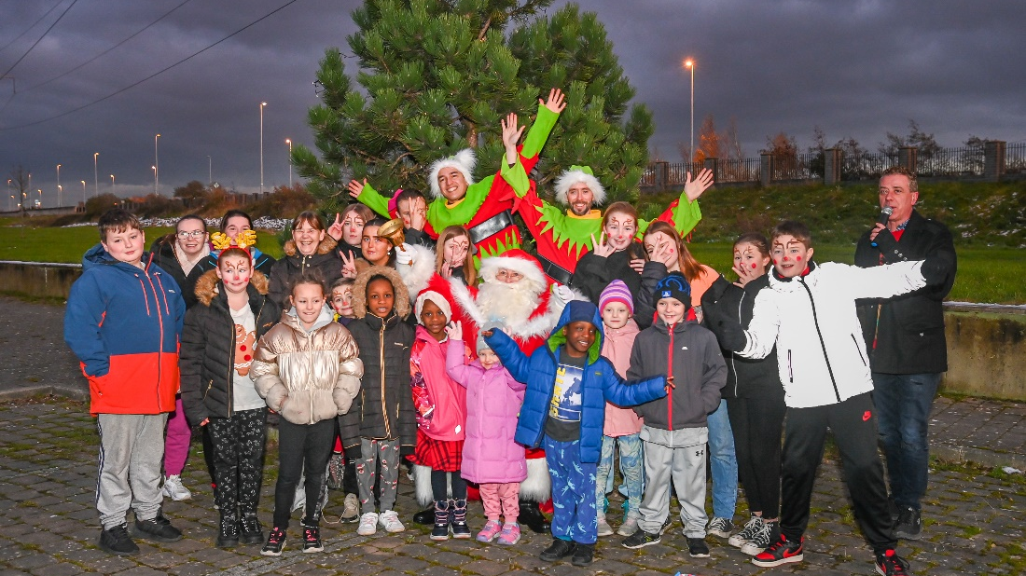
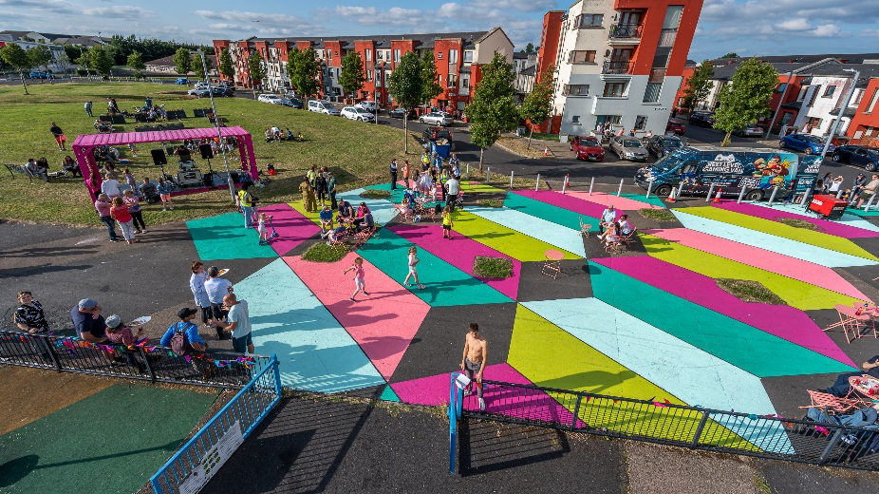
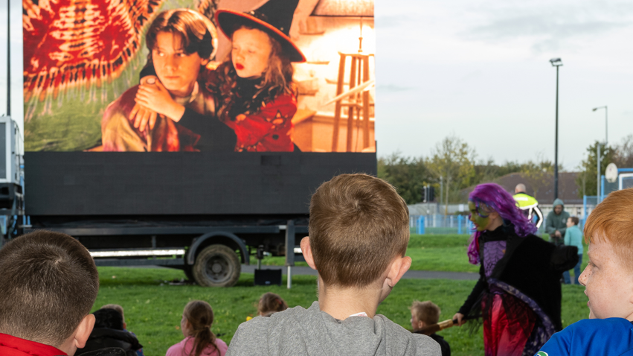
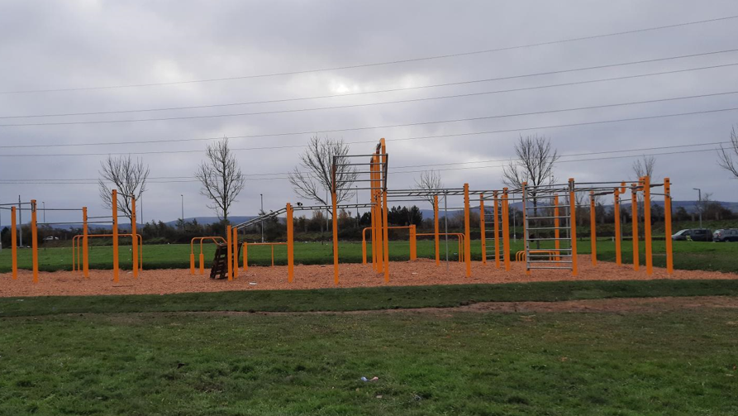
Estate Management

Slide 11
Estate Management Initiatives
Easter event planned in the Balgaddy Child and Family Centre for local youths aged 6-12yrs. We are currently planning a one day sports event for local children with special needs and a separate one day arts and crafts event along with an Easter hunt.
Working with Crosscare to develop a community garden for Spring/Summer in Tor An Ri with a group of local youths. The group are planning to build a herb garden and intend on submitting an application to the ‘Youth Environment Action Childrens Awards’ 2023.
Estate Management are carrying out random spot checks on rear gardens and communal areas in Meile An Ri and Foxdene as a response to the high levels of dumping in the communal bin shed spaces. Action in the form of bin receipt requests and tenancy warnings will be taken where necessary.
Estate Management and Housing Maintenance are currently liaising with residents on Tor An Ri to make tenants aware of the new painting programme which has just commenced.

Slide 12
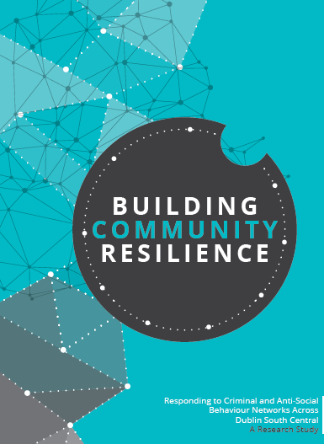
Balgaddy Working Group
The Balgaddy working Group was established to implement the recommendations outlined in the Community Crime Impact assessment undertaken in March 2021. Group meets on a quarterly basis. The membership consists of:
Estate Management and Community Development Teams from SDCC
An Garda Siochana (Ronanstown)
North Clondalkin Community Development Programme
Co- Ordinator from Clondalkin Drugs Task Force
Ronanstown Crosscare
Chair of Local Policing Forum
DDETB ( seeking nomination)
Meeting Dates for 2023
14th March
6th June
12th September
5th December

