Slide 1

SDCC Cycle Infrastructure Condition Survey

Slide 2
Background
Over 200km of existing cycle infrastructure within South Dublin
Much of the cycle infrastructure not up to current design standards
€400,000 being spent annually on maintenance of these cycle track
Road Maintenance reluctant to invest in substandard design and want to upgrade the standard of cycle track as part of the maintenance works
Barry Transportation was appointed to carry out a survey of existing infrastructure

Slide 3
Quality of Cycle Infrastructure
(Combination of Type and Width of Infrastructure)
Type of Cycle Infastructure
Level | Description
1 | Advisory
2 | Shared Walking and Cycling
 | On road with road marking delineation
3 | Walking and cycling segregated by white line only
4 | Greenway
 | Cycle track segregated with kerb/bollard
Width of Cycle Provision
Level | Description
1 | Less than or equal to 1.3m
2 | 1.3 – 1.75m
3 | 1.75 or greater

Slide 4
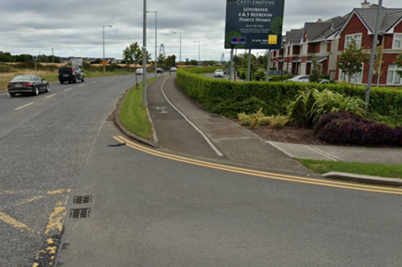
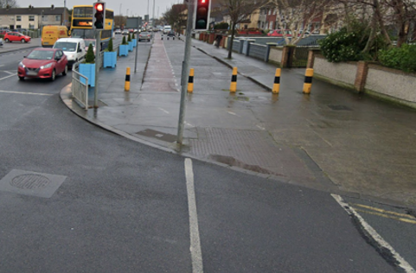
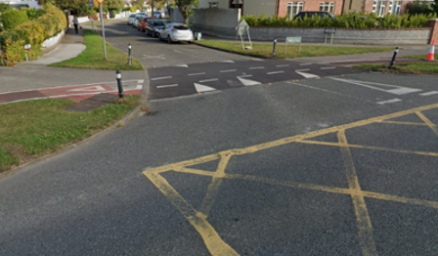
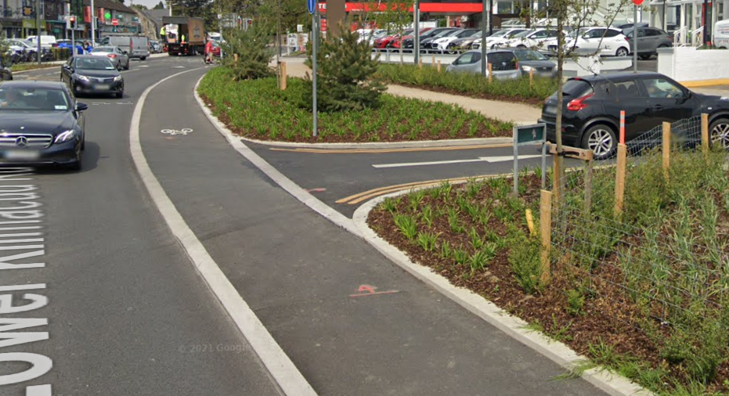
Treatment at side roads
Level 1 - Cyclists give way to side road traffic with no crossing features provided for them. May be unclear who has right of way.
Level 2 - Cyclists share pedestrian crossing and give way to side road traffic.
Level 3 - Cyclists have dedicated infrastructure to take them across side road separately to pedestrians, however it may be unclear who has priority between cyclists and cars
Level 4 - Cyclists have priority across junction

Slide 5
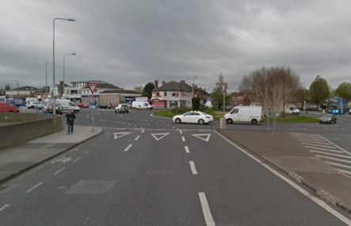
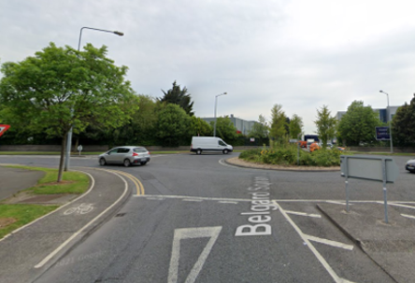
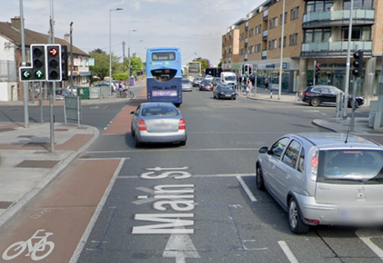
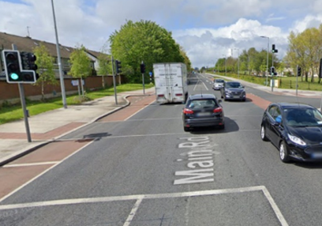
Treatment at Large Junctions
Level 1 - No cycle provision, or cycle provision stops short of junction. Mutiple lanes to cross makes the junction dangerous even for confident cyclists.
Level 2 - No cycle provision but fewer lanes or left only provision
Level 3 - Provision for a non-confident cyclist to make a left and straight ahead movement. No provision for right turns without conflict
Level 4 - Provision suitable for a non-confident cyclist to safely make all movements. Cyclists do not share space with pedestrians.

Slide 6
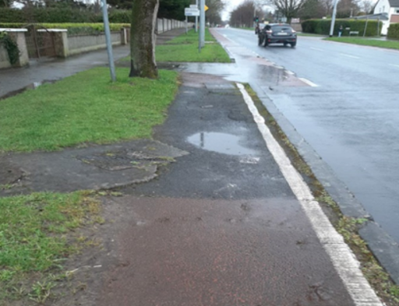
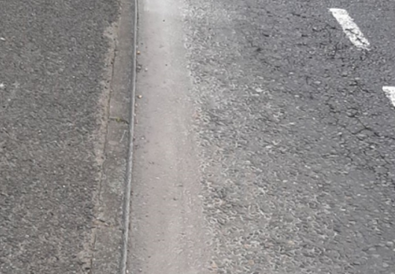
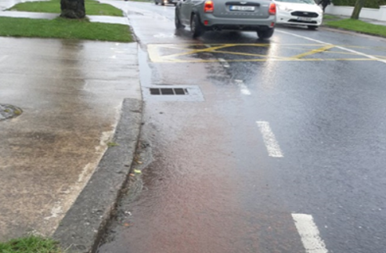
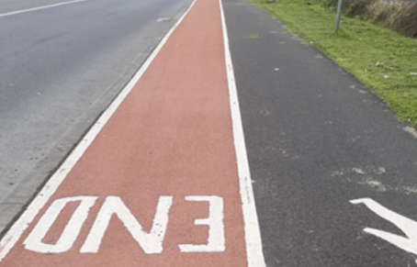
Pavement Condition Examples
Level 1 - Major surface deterioration (loss of wearing course, potholes and structural defect, & tree root uplift)
Level 2 - Minor surface defects (surface cracking, ravelling)
Level 3 - No surface defects but poor appearance (cycle track markings could require refreshing)
Level 4 - Good, no action required.

Slide 7
Survey
Results

Slide 8
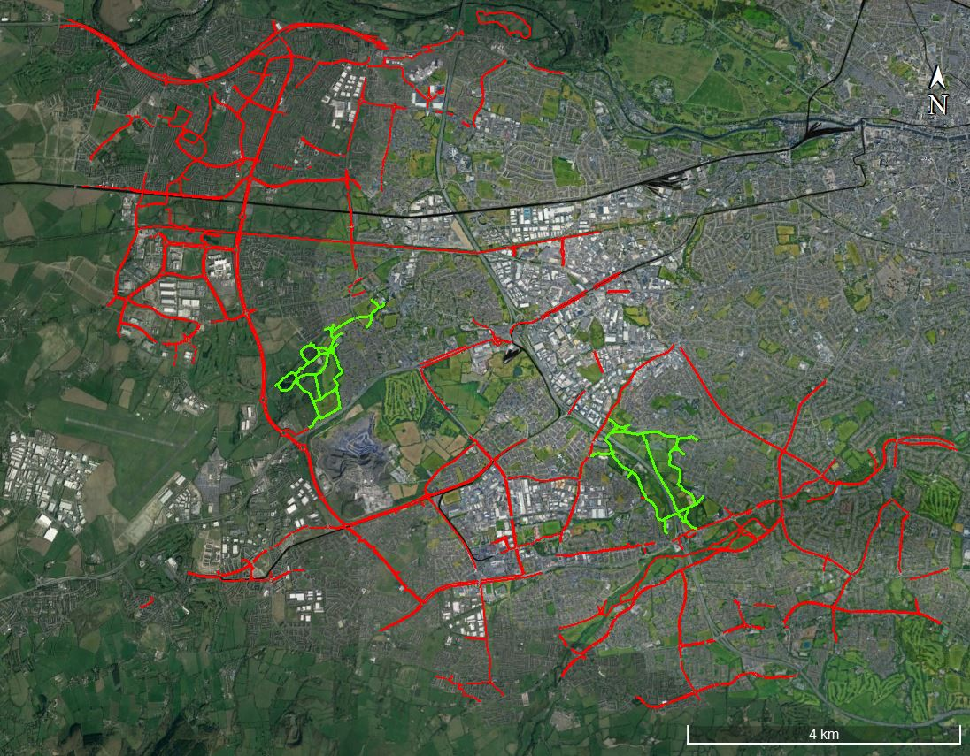
SDCC Cycle Network
- July 2022

Slide 9
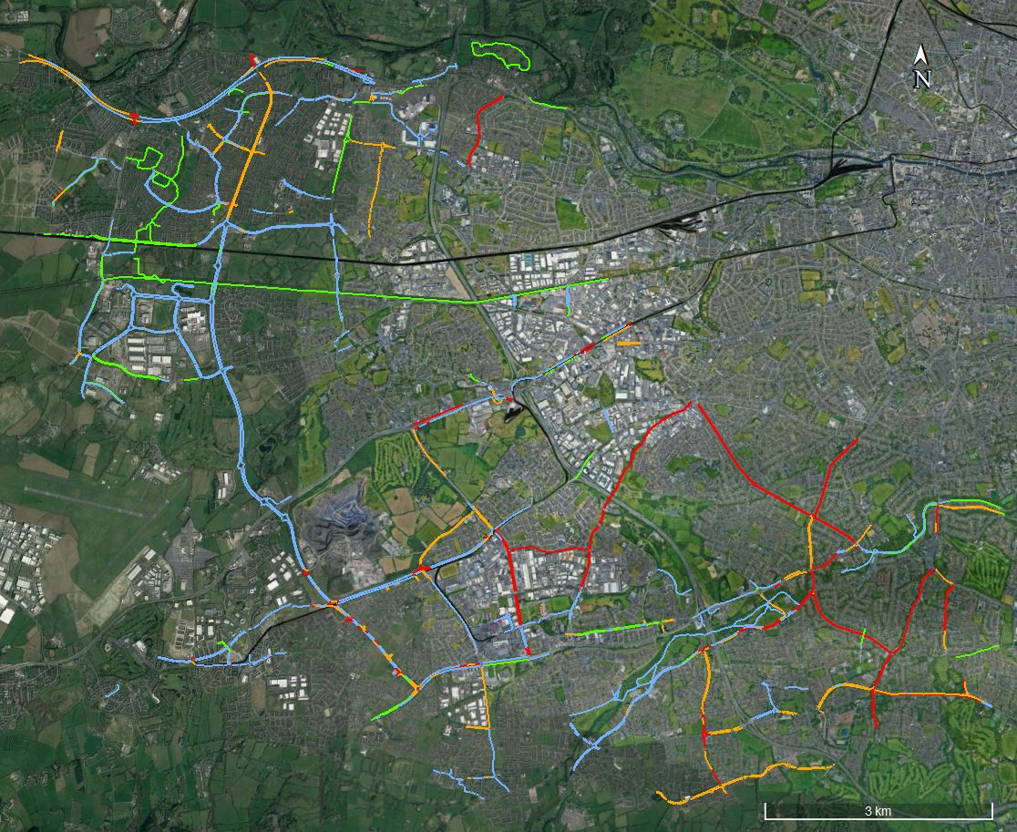
Quality of Infrastructure Design
(Combination of type and width)

Slide 10
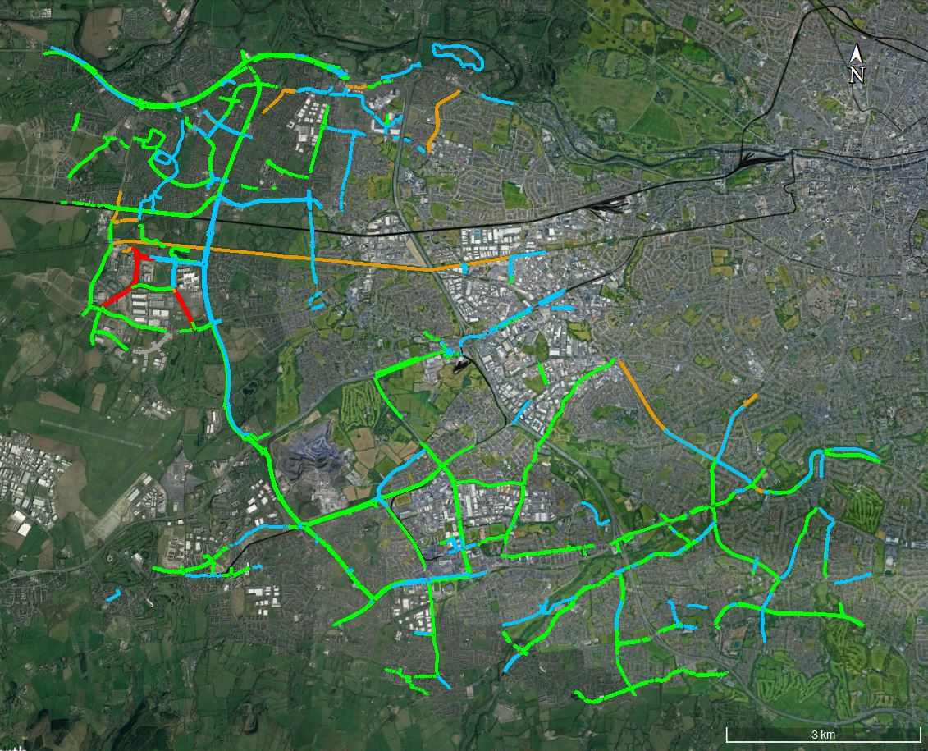
Pavement Condition

Slide 11
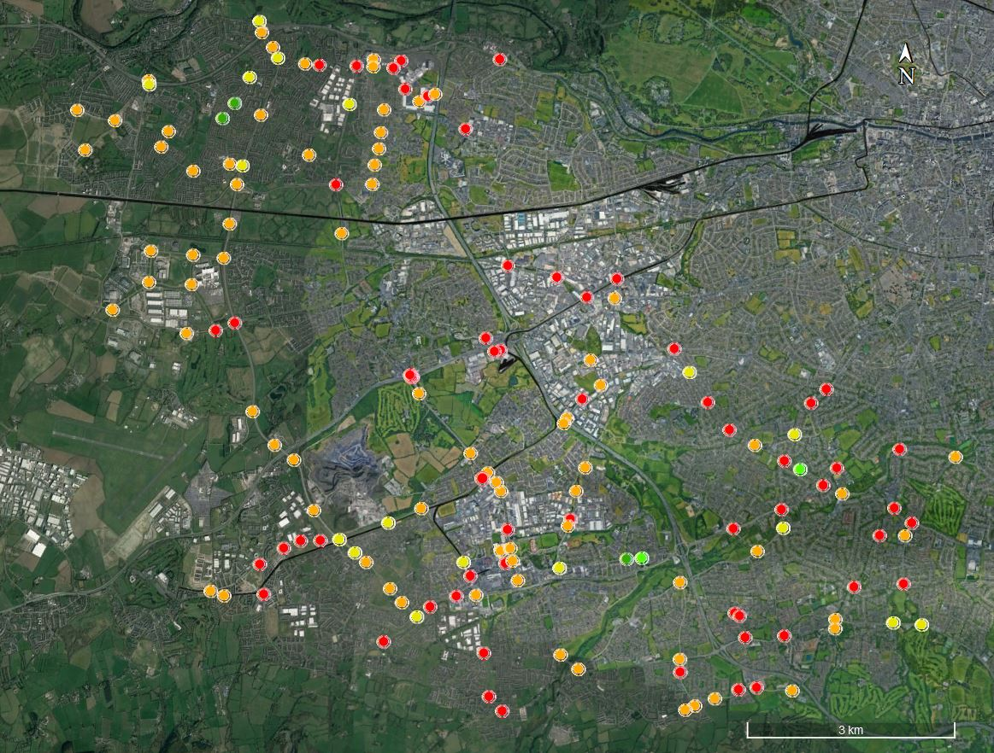
Junction Treatments
- major junctions

Slide 12
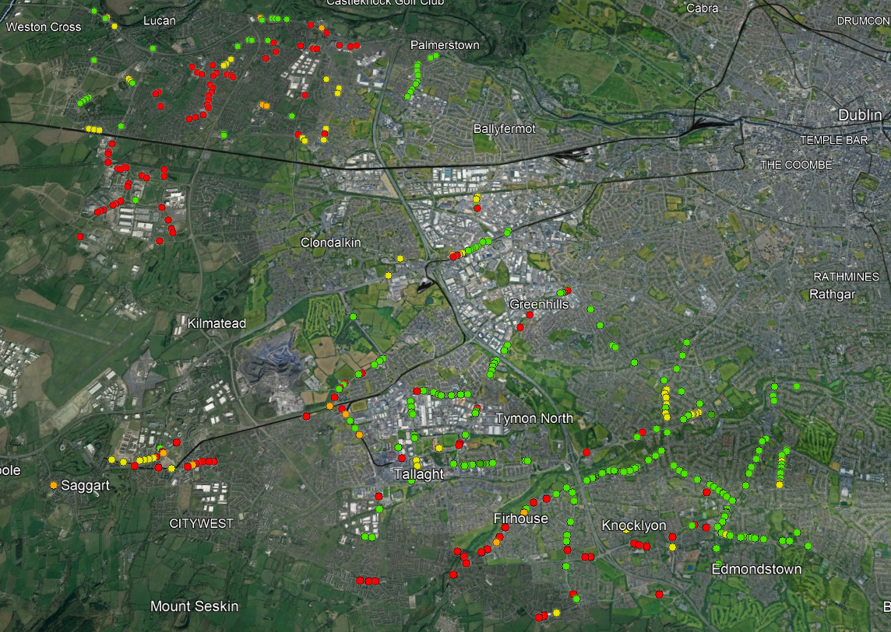
Junction Treatments
- side roads

Slide 13
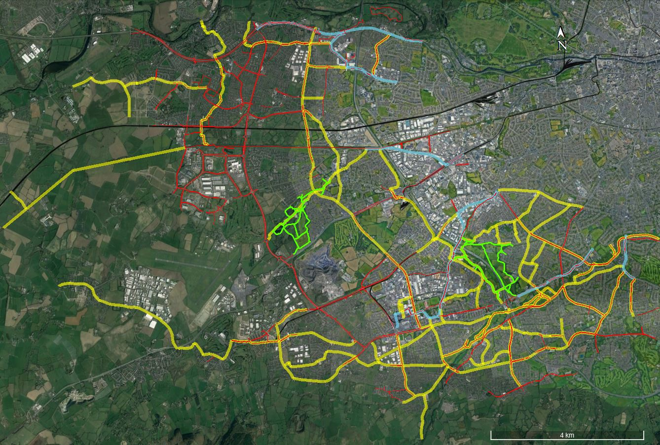
Future
SDCC Cycle Network

Slide 14
Assessment of Findings
Advisory cycle lanes (on road with insufficient width) are weakest sections of network and will need full re-design to rectify in most instances
On road with sufficient width could be converted to raised adjacent. Junction details to be assessed on a case by case
Major junctions are providing a poor service level for cyclists but will need a detailed design to resolve, likely requiring a consultant to be appointed
Side road junction details tend to be consistent along each route. These should be reviewed based on stretches of road as opposed to individual junctions. Standard details are sufficient to upgrade these in most instances

Slide 15
What
Next

Slide 16
Proposed Works
Identify areas for rapid build cycle protection, these routes will be primarily on road with available widths of 1.5m or greater
    Being undertaken by SDCC Active Travel Team
Identify any local links that will improve connectivity for cyclists
    Being undertaken by SDCC Active Travel Team
Identify routes where the upgrade of side road junctions will raise the quality of the route to compliance with current cycling standards (junctions to be upgraded for both cyclists and pedestrians)
    Being undertaken by SDCC Road Maintenance
Update the Cycle Survey on a quarterly basis to reflect the works carried out to date

Slide 17
2023 Plan – Upgrade of Side Road Jcts
Q1
  Identify locations to prioritise first
  Ensure standard design works are applicable to the locations
  Carry out a non statutory public consultation as part of a Section 38 process
Q2
  Prepare tender docs and procure a contractor to undertake the works
Q2 – Q4
  Carry out upgrade works
Q4
  Review 2023 programme and identify areas of improvement
  Prepare 2024 Plan

Slide 18
2023 Works Location
- Griffeen

Slide 19
Standard
Side Road
Detail

Slide 20
Roundabout
Detail

Slide 21
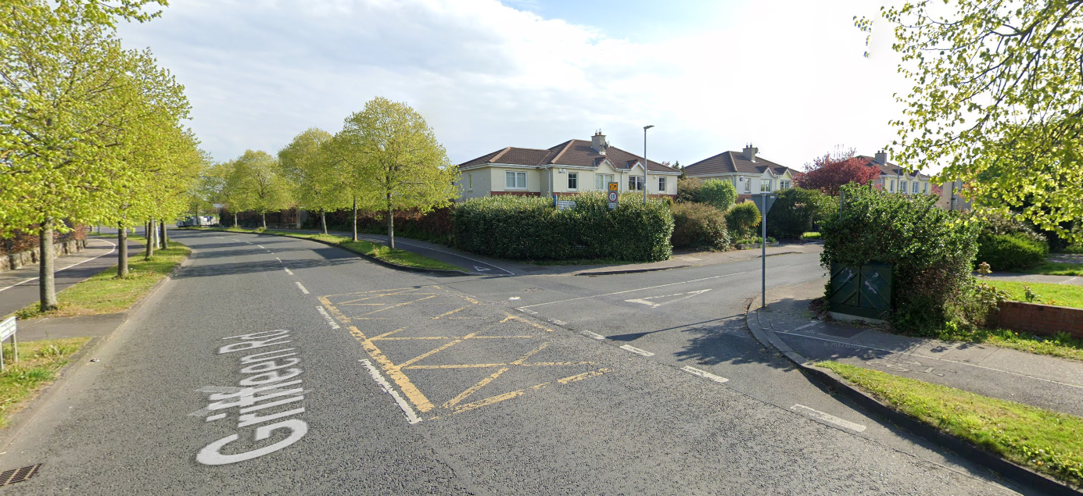
Sample Junction - Proposed Layout

Slide 22
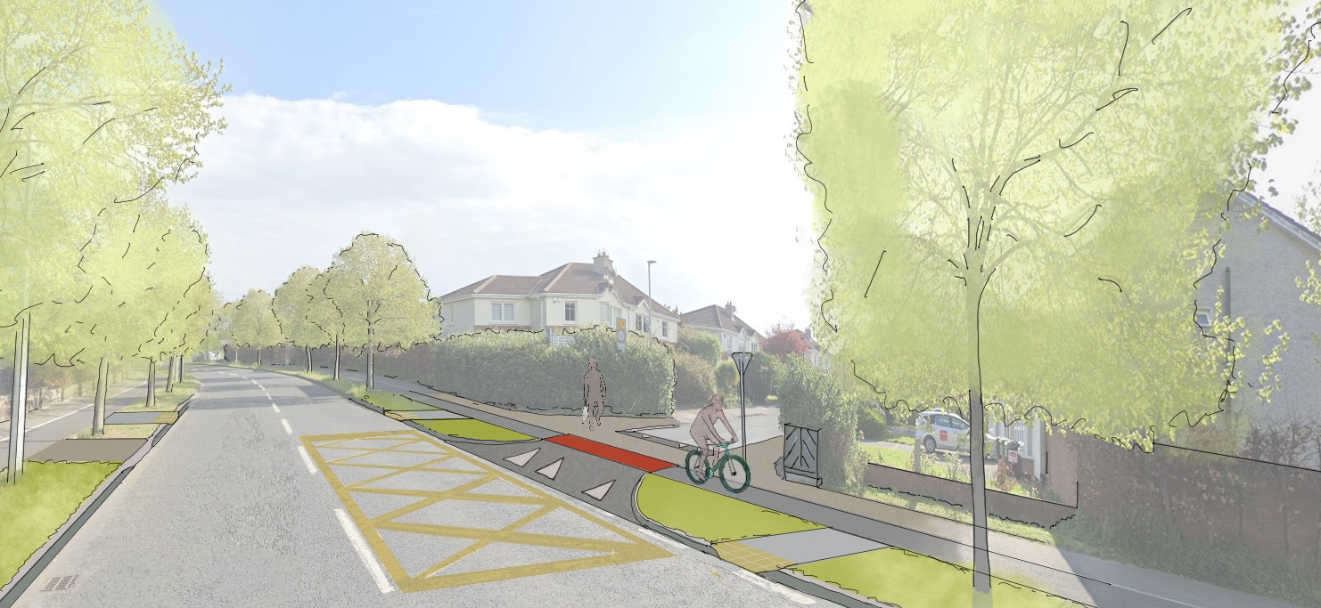
Sample Junction - Proposed Layout

Slide 23
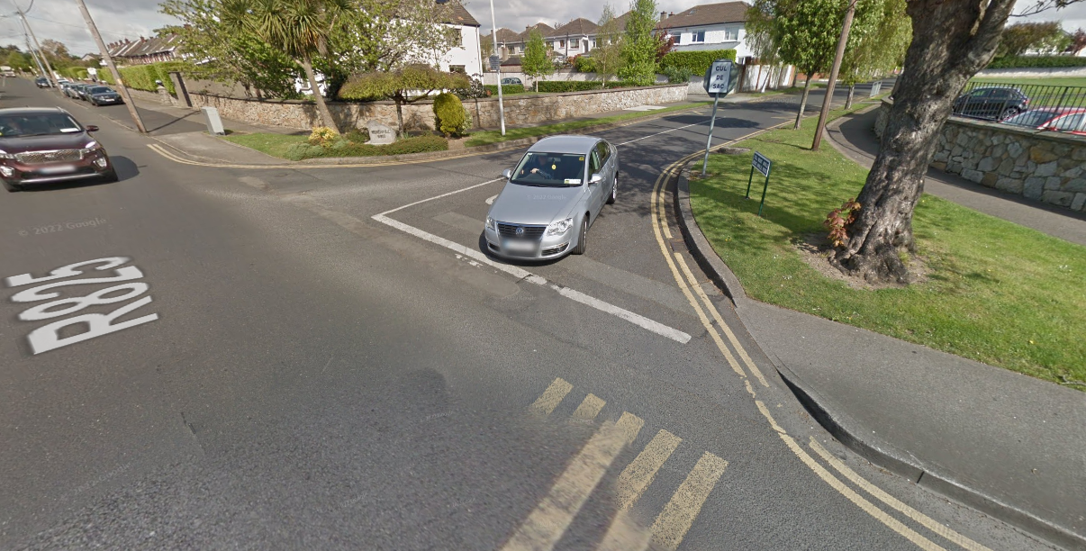
Case Study Example – Drumartin Rd - Before

Slide 24
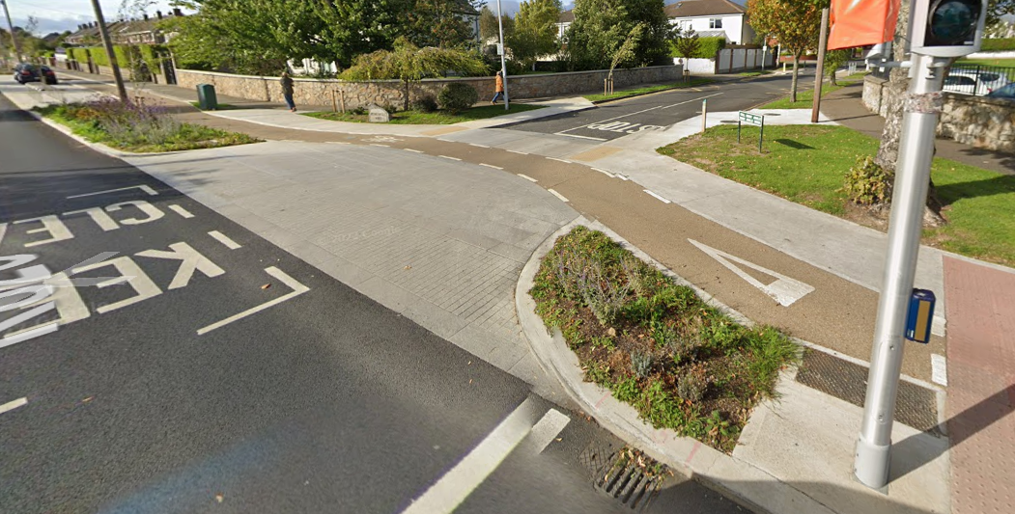
Case Study Example – Drumartin Rd - After

Slide 25
Questions?

