Slide 1
Headed Item
Update on Proposed Traveller Accommodation Redevelopments at Owendoher Haven, Oldcastle Park and Kishogue Park
Meeting of South Dublin County Council
13th March 2023

Slide 2
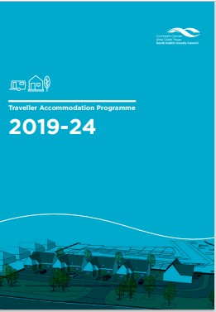
Background & Context
Housing for All: “increased & improved Traveller accommodation”
SDCC Traveller Accommodation Programme:
First group housing delivered in Adamstown & commencement at Fonthill site imminent
Commitment to redevelopment of Owendoher Haven & Oldcastle Park
Kishogue Park: ongoing engagement in context of Clonburris SDZ
County Development Plan 2022-28:
Housing Policy objectives for Traveller Accommodation (6.4)
highest standards, proximity to services
detailed consultation

Slide 3
Consultation
Extensive consultation with residents, local Traveller support groups
Engagement of CENA for Oldcastle and Owendoher residents
Ongoing updates to LTACC and briefings for relevant ACMs
High-quality, culturally appropriate homes, including to meet specific medical and older person needs, & specific design preferences accommodated
Integrated developments within wider mixed housing tenure
Provision of play spaces & community facilities
Some previous residents of Kishogue have been allocated alternative accommodation to meet their housing preferences
Insufficient space to accommodate potential future family formations –some opportunities in adjacent developments to accommodate households with preferences for standard social housing

Slide 4
Site Specific Issues
New family formations (all sites):
Oldcastle will accommodate some additional households
Reduced need in Kishogue with re-location of some prior residents
Limited options for Owendoher
Appropriate opportunities will be explored developments to meet households’ needs/preferences (standard social housing in adjacent developments / CBL process for new TA in Adamstown)
Drainage (Owendoher): telemetry installed & alert system in place
Road safety (Kishogue): revised design with new road layout
Permeability (Oldcastle): permeability options to be finalised
Estate management (Oldcastle): Address ongoing dumping/burning
---------------------------------------------------------------------------------------------
✓Design agreed with Owendoher residents
? Lack of consensus with Oldcastle & Kishogue residents

Slide 5
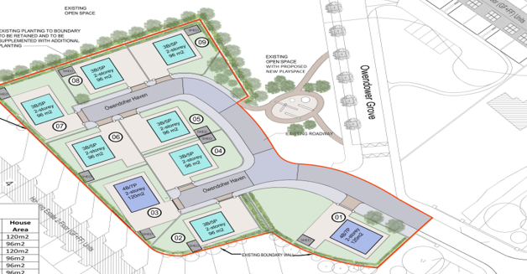
Owendoher Haven, Ballyboden
Replace existing 8 bays and caretaker’s house with 9 x two-storey group homes & adjacent play space

Slide 6
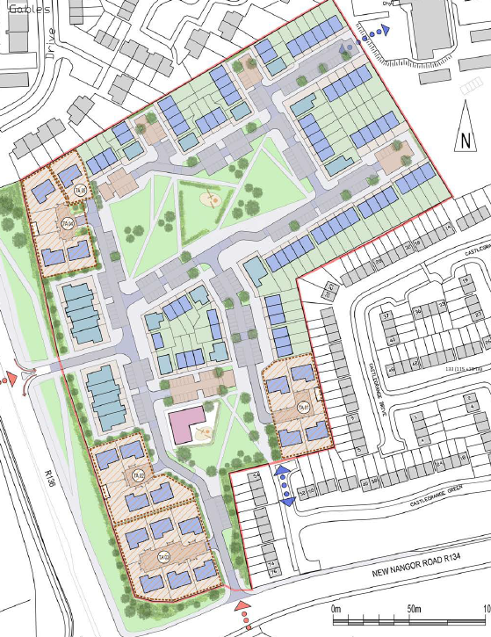
Oldcastle Park
Replacing existing 50-bay temporary site from 1990s
18 group houses and/or bays with day unit in three clusters of TA
Infill social & affordable homes
Permeability issues

Slide 7
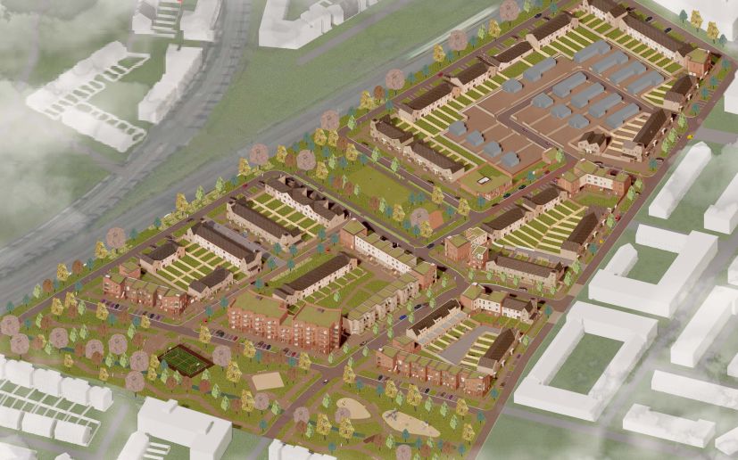
Kishogue Park
Existing 10 bay/10 group house development to be replaced by 15 group houses
Aerial View of Proposed Clonburris SDZ Phase 1 Development with existing Kishogue Park TA circled

Slide 8
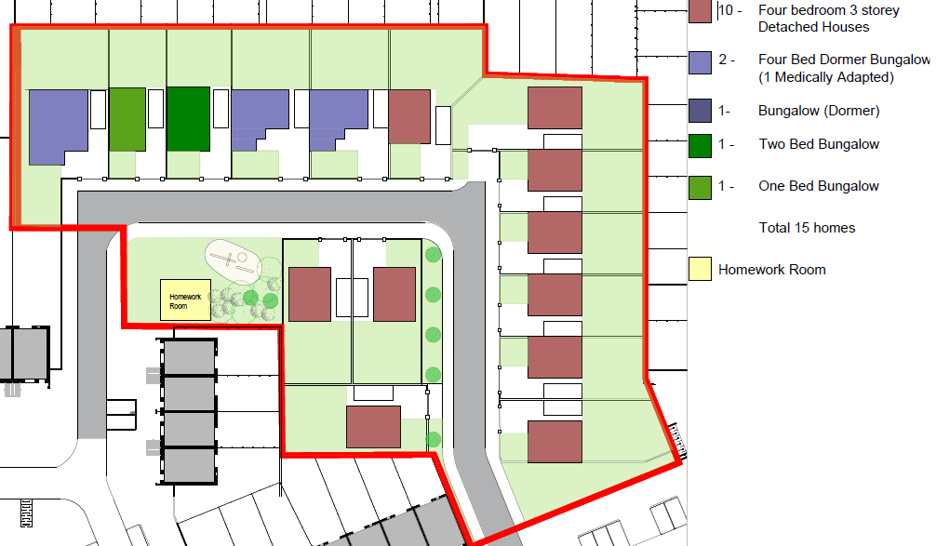
Kishogue Park
To be replaced by 15 group houses comprising a mix of typologies and sizes
Aerial View of Proposed Clonburris SDZ Phase 1 Development with existing Kishogue Park TA circled

Slide 9
Next Steps
Expenditure provided for in Council’s Three-Year Capital Programme 2023-25
Ready* to develop detailed design & proceed to tender to aim to be on site in Q1 2024 (Owendoher & Oldcastle Park) & potentially later in 2024 for Kishogue Park (*subject to planning approval)
Developments will involve phased re-location (temporary) of residents & continued engagement
Given the time and level of consultation undertaken, it is now to progress proposals to planning stage
Planning process to now commence (subject to derogation)
Projects to be funded by DHLGH under national Traveller accommodation capital funding programme

