Slide 1
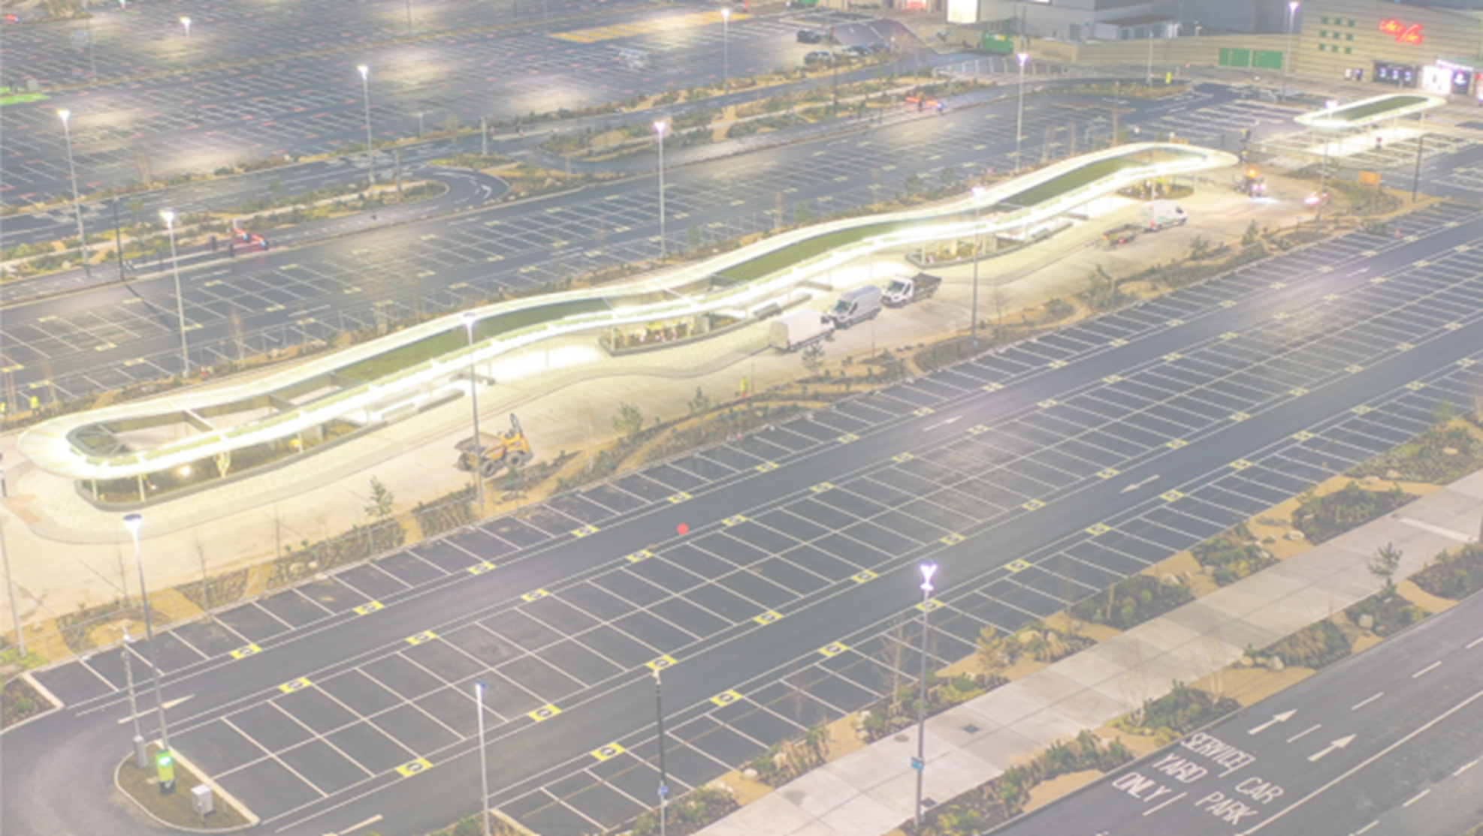
LUPT SPC 23 February 2023
Bus Interchanges
Core Bus Corridor Applications
Update on Spine Route Services
Bus Connects Update

Slide 2
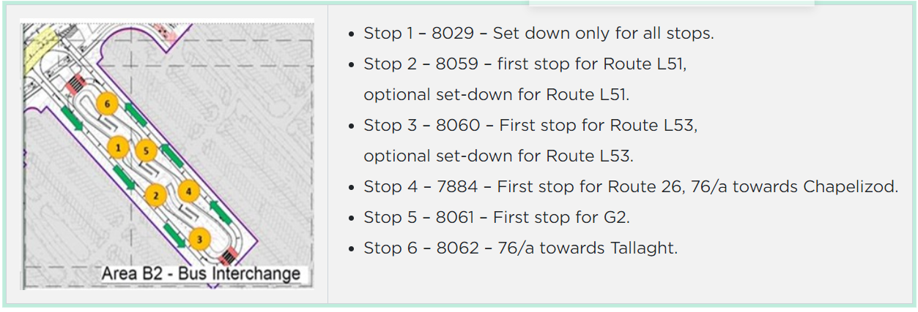
From Sunday 19 February 2023 at Liffey Valley Bus Plaza Bus stop changes for some Dublin Bus and Go Ahead Ireland routes.

Slide 3
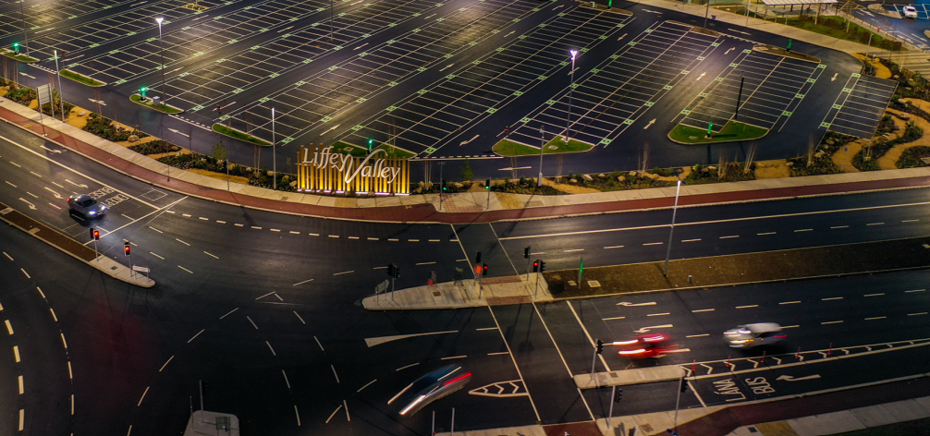
Liffey Valley Bus Interchange
Multi-Bay Bus Terminus
Dedicated Bus Lanes and Bus Gates
Improved Pedestrian and Cycleway access to and from the Centre and increased covered and secure Cycle Parking
20no. New Electric Vehicle Charging Points

Slide 4
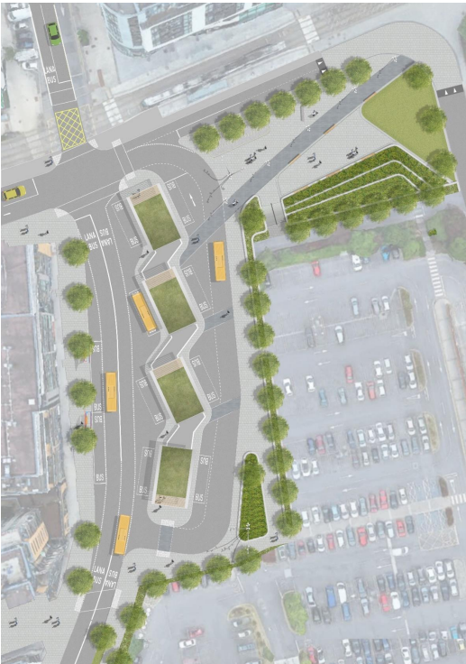
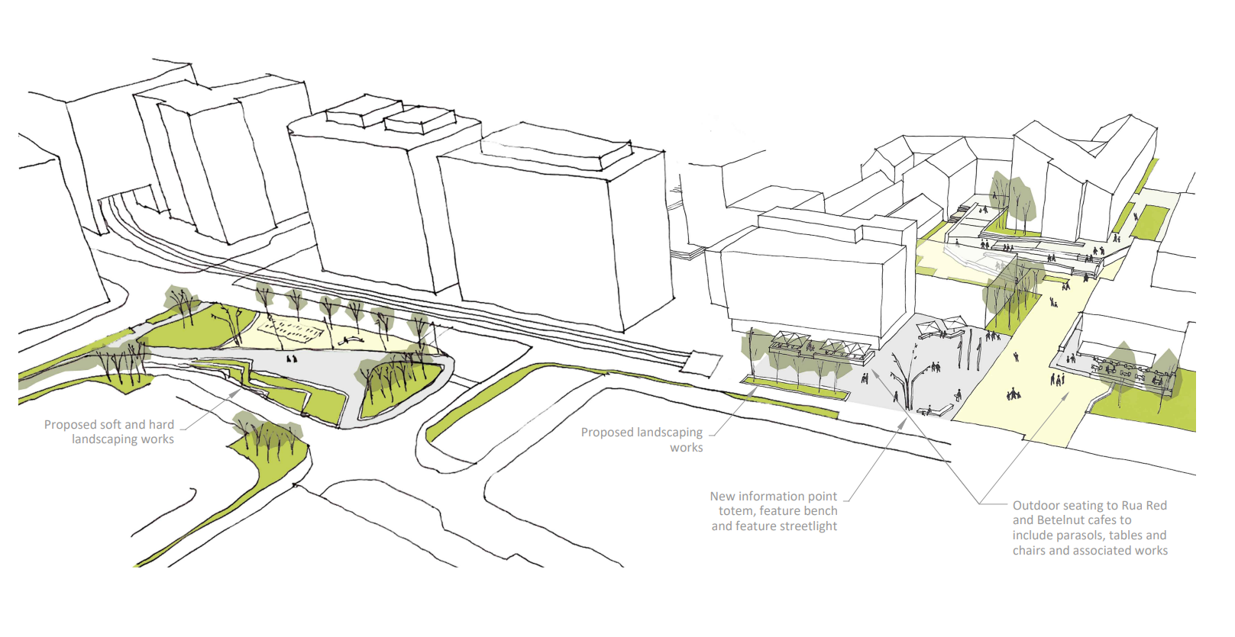
Tallaght Bus Interchange and the Tallaght Public Realm Redevelopment
The Tallaght Bus Interchange will be delivered by the NTA along with the Tallaght to City Centre Core Bus Corridor
The neighbouring Part 8 Public Realm redevelopment will be delivered by SDCC
Part 8 Public Realm Redevelopment
Bus Connects Interchange
Part 8 - Public Realm Redevelopment

Slide 5
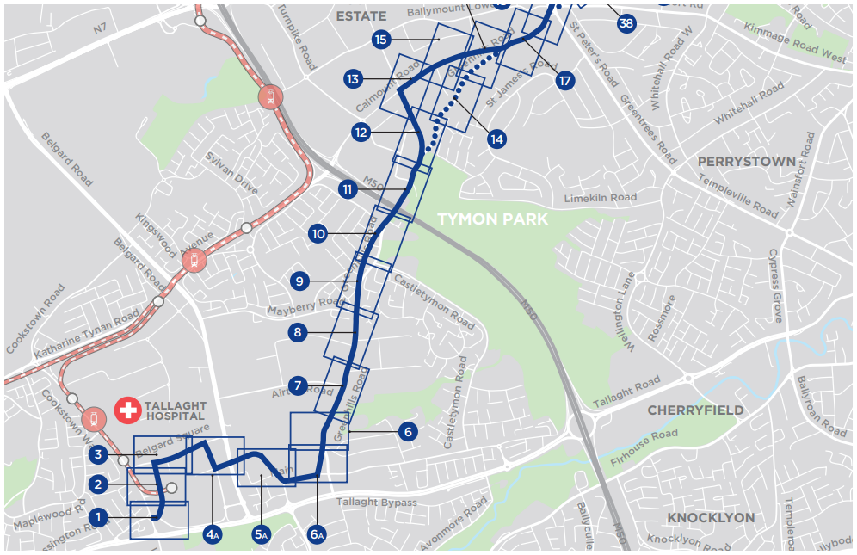
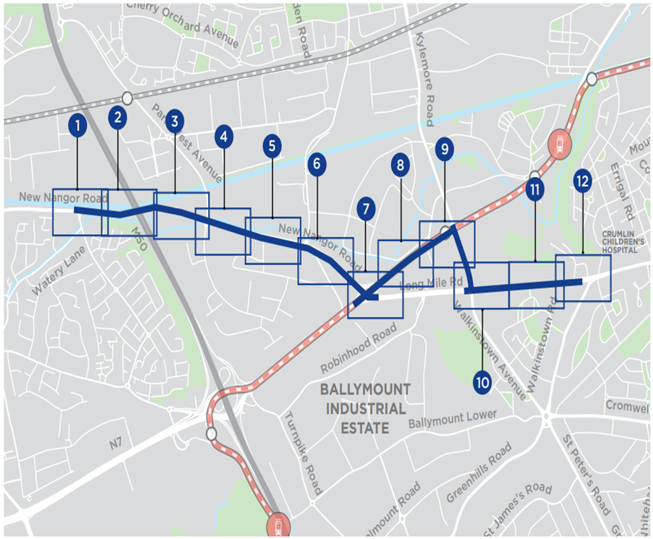
Tallaght and Clondalkin Core Bus Corridors:
The Tallaght and Clondalkin Core Bus Corridor Applications will be lodged in April of 2023
Tallaght to City Centre
Clondalkin to City Centre

Slide 6
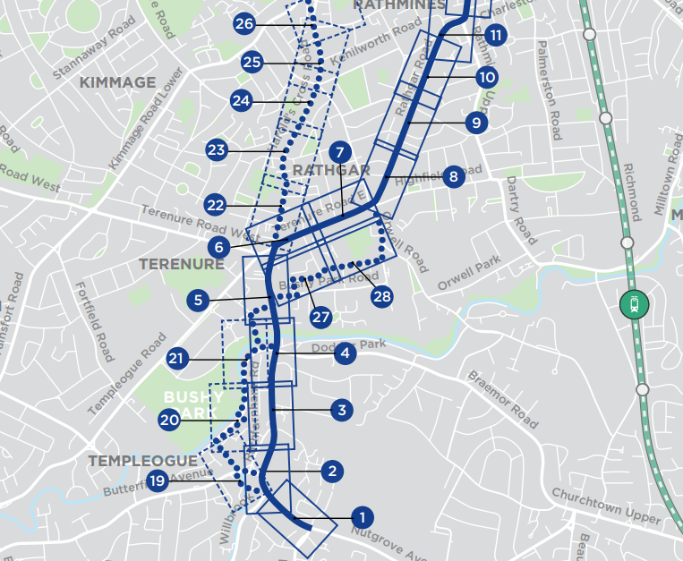
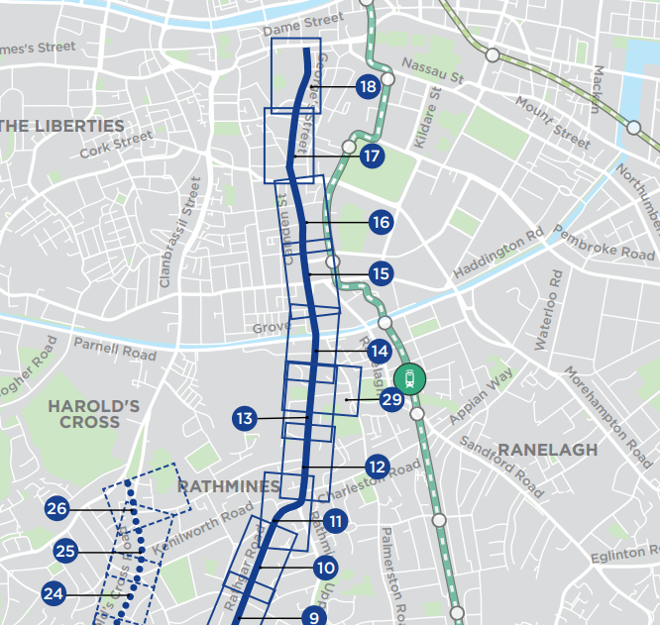
Rathfarnham Core Bus Corridor:
The Rathfarnham Core Bus Corridor Application will be lodged with the Bord in April of 2023.
Southern Section
Northern Section

Slide 7
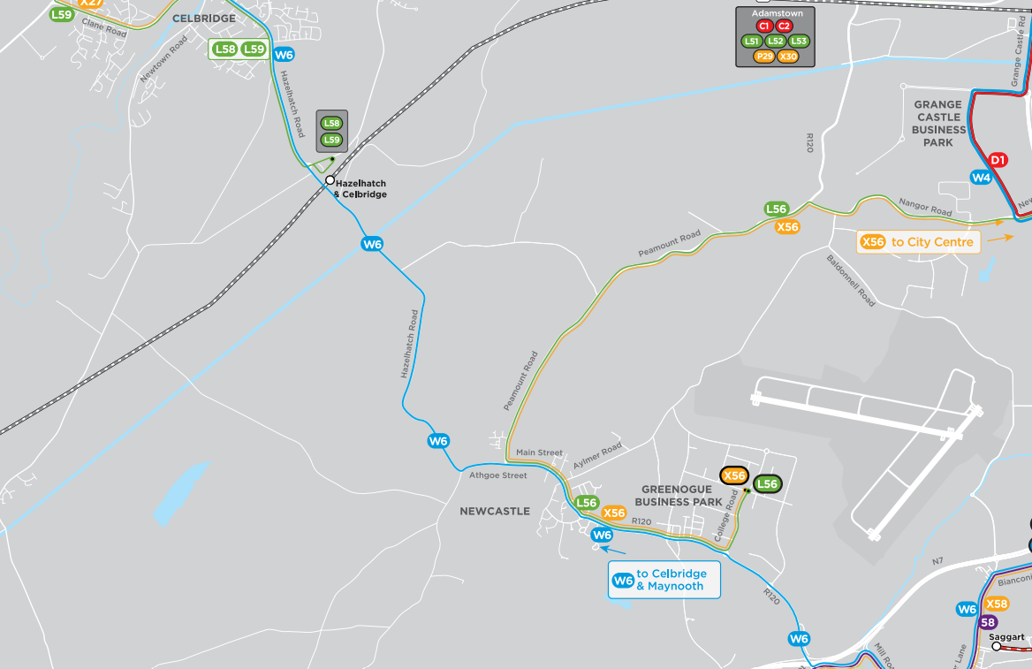
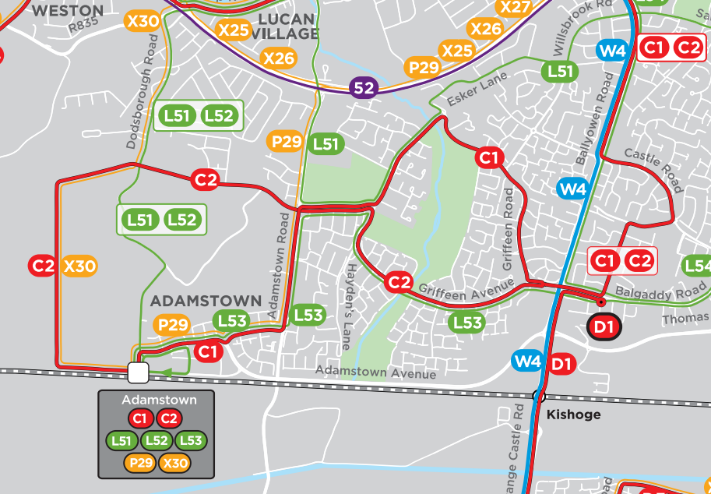
Bus Service Improvements:
W6 Route: Tallaght to Maynooth route. Split route to be introduced this year. Tallaght to Newcastle and Celbridge to Hazelhatch (½ hour services)
Meanwhile: Road widening works south of Hazelhatch bridge have been approved to go to Design Stage. Design Consultants are currently being procured.
C - Spine Routes: South West Dublin C2 now using the Adamstown Boulevard. Celbridge Link Road now open.
W6 Route: Tallaght to Maynooth Service
C Spine Routes: Sout-West Dublin

