Slide 1

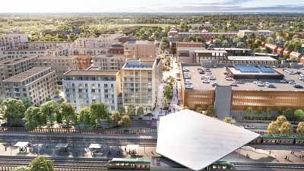

Adamstown SDZ
Proposed Non Material Amendment to Planning Scheme
LUPT SPC Februrary 2023

Slide 2
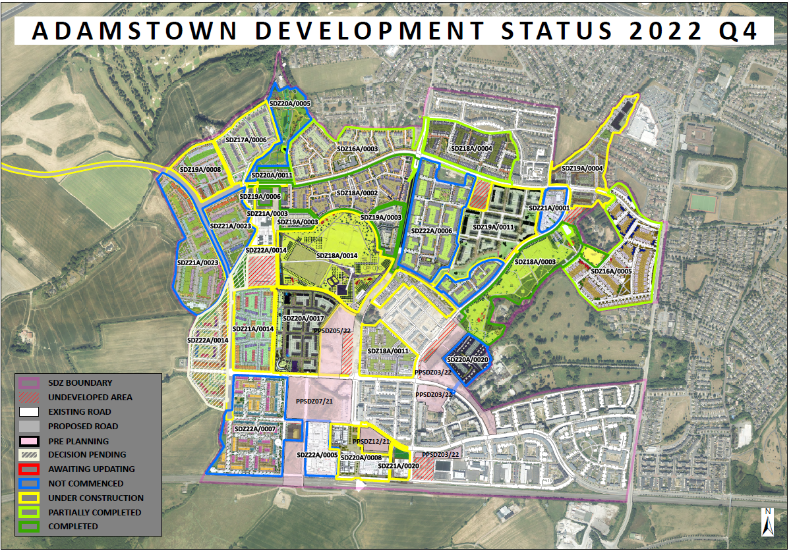
Adamstown SDZ – Context of Proposed Amendment
Q4 2022
- 7,200 units with Permission
- 3,656 completed
- 976 under construction
Phasing:
Phase 4 - Completed
Phase 5 – Ongoing
URDF:
€9.997m from DHLGH
3 Key Projects:
Adamstown Plaza
Central Boulevard Park
Adamstown Civic Library
LIHAF:
Tandy’s Lane - Completed
Airlie Park – Near Completion
CLR – Opened Feb 2023
A new Health Centre and School have planning permission

Slide 3
Adamstown SDZ – SDZ Amendment Process
Under Section 170A of the Planning and Development Act (as amended), a Planning Authority may make an application to An Bord Pleanala to request an amendment to a Planning Scheme
An Bord Pleanala decides if amendment is in accordance with criteria in Section 170A and if material
If the amendments proposed are deemed by An Bord Pleanala to be in accordance with the criteria below, minor in nature and not likely to have a significant effect on the environment, the Board may approve the making of the amendment (non material amendment).
If deemed to be a material change and in accordance with criteria, the Board, subject to consideration of impact on the environment, may make the amendment (or may make an alternative amendment) following public consultation.
Section 170A criteria
The criteria referred to above are that the amendment to the planning scheme concerned—
would not constitute a change in the overall objectives of the planning scheme concerned,
(ii) would not relate to already developed land in the planning scheme,
(iii) would not significantly increase or decrease the overall floor area or density of proposed development,
(iv) would not adversely affect or diminish the amenity of the area that is the subject of the proposed amendment
For the proposed Adamstown Planning Scheme Amendment 2023, the Planning Authority have submitted to the Board that the proposed amendments are not a material change, are in accordance with the criteria and are not likely to have significant effects on the environment

Slide 4
Adamstown SDZ – Amendment Process
Timeframe of Decision: Dependant on work load and resources in An Bord Pleanála
Consultation: The Board will assess the proposed changes to the scheme and will consider if the changes are material or non-material. If the Board consider the proposed changes as material, then an additional process of consultation is required to be undertake by SDCC.
Council Decision (Only if new scheme): In the event that the proposed changes are deemed to not be in accordance with Section 170A, the changes would need to be made as part of a new Planning Scheme with public consultation and decisions by Elected Members.
Next Steps:
- Await the Board assessment and response on materiality

Slide 5
Adamstown SDZ – Proposed Non Material Amendment Summary of Changes
Minor amendment to the phasing requirement in relation to schools. The amendment provides flexibility to allow School Site 4 in the Planning Scheme to be either a primary or a secondary school. Currently this is only permitted to be a primary school.
Minor text amendment to current Phase 7 phasing requirement for construction of a leisure centre with a swimming pool. In the context of the delivery of the Lucan pool in the area, the Planning Authority has proposed an amendment to this phasing requirement to broaden the scope of opportunities for community floorspace and/or community gain.
Minor text amendment to Quality Bus Corridors wording to reflect current status of National Transport Authority (NTA) guidance (National Cycle Manual) and Bus Connects;
Minor text amendment to wording related to the existing option in the Planning Scheme to provide residential units on the potential Fire Station site (in the event that Fire Station Is progressed in Clonburris);

Slide 6
Adamstown SDZ – Proposed Non Material Amendment Summary of Changes
Minor amendment to allow, provided sufficient justification and evidence is supplied, the consideration of timing of phasing requirements by the Planning Authority
Minor amendment to enable transferring of residential units between neighbouring Development Areas;
Minor amendment to increase non-residential floorspace requirement in Adamstown Castle Development Area to cater for the phase 7 requirement as mentioned previously;
Other minor amendments including updating references, summaries of policy and guidance, updating of typographical errors and other clarifications (e.g. Development Plan 2022 – 2028)

Slide 7
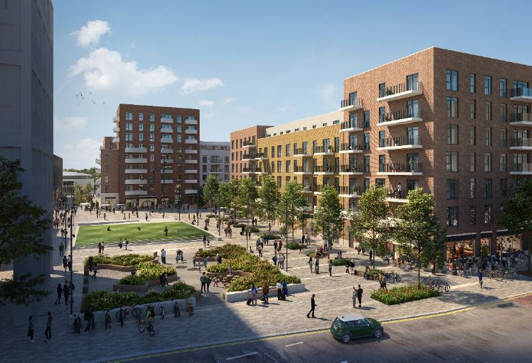
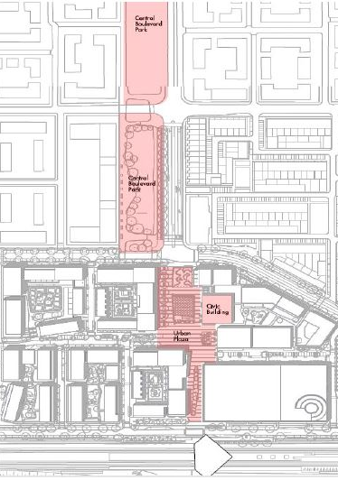
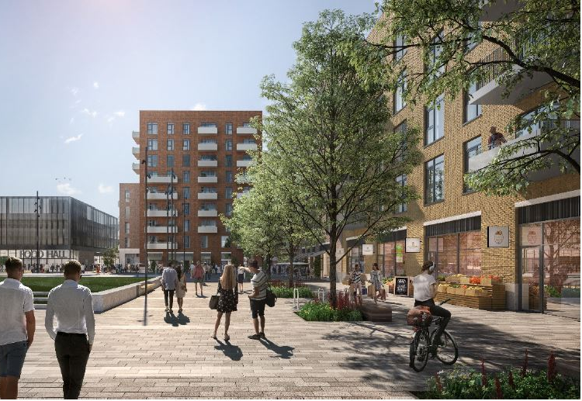
Adamstown SDZ – Infrastructure Projects
URDF
1. Plaza (ongoing)
2. Central Boulevard Park (Design)
3. Library/Civic building with integrated Enterprise Centre (Scoping)
Central
Boulevard
Park
Phasing Requirements:
Phase 6 – Civic / Library
Phase 7 – Central Boulevard
Phase 8 – Enterprise Centre
Civic
Building
Plaza
Train station

Slide 8
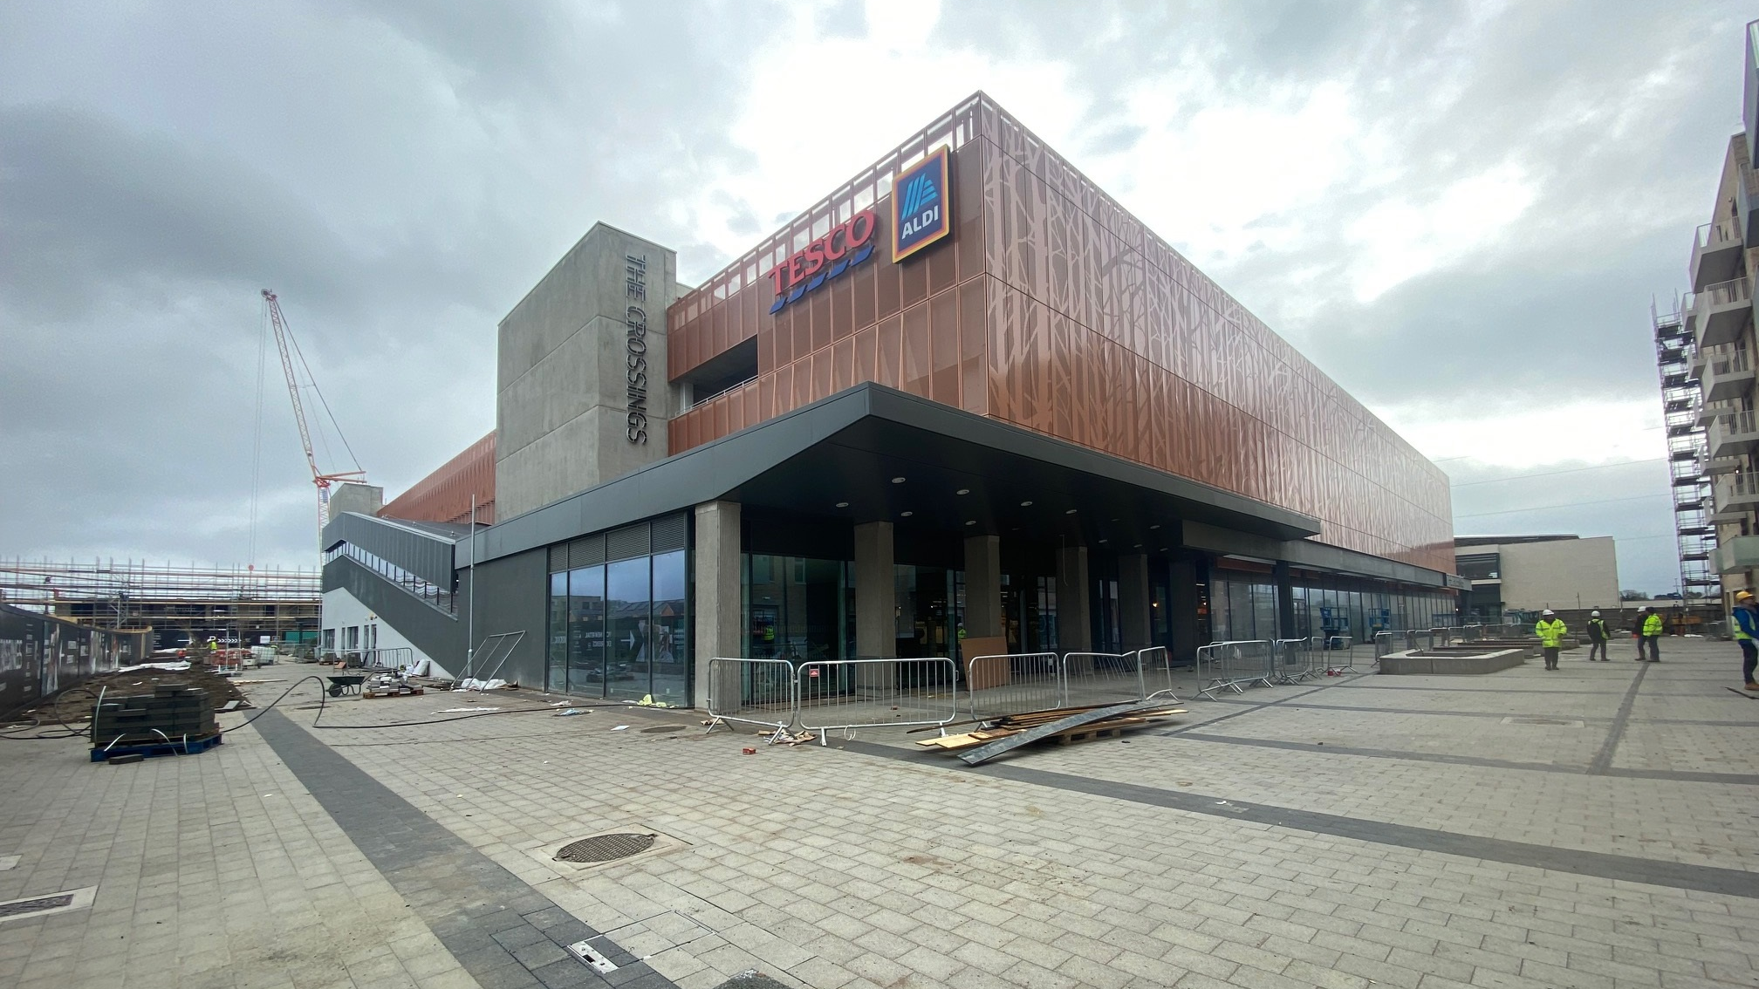
Adamstown District Centre Plaza
URDF Project 1 (Feb 2023)

Slide 9
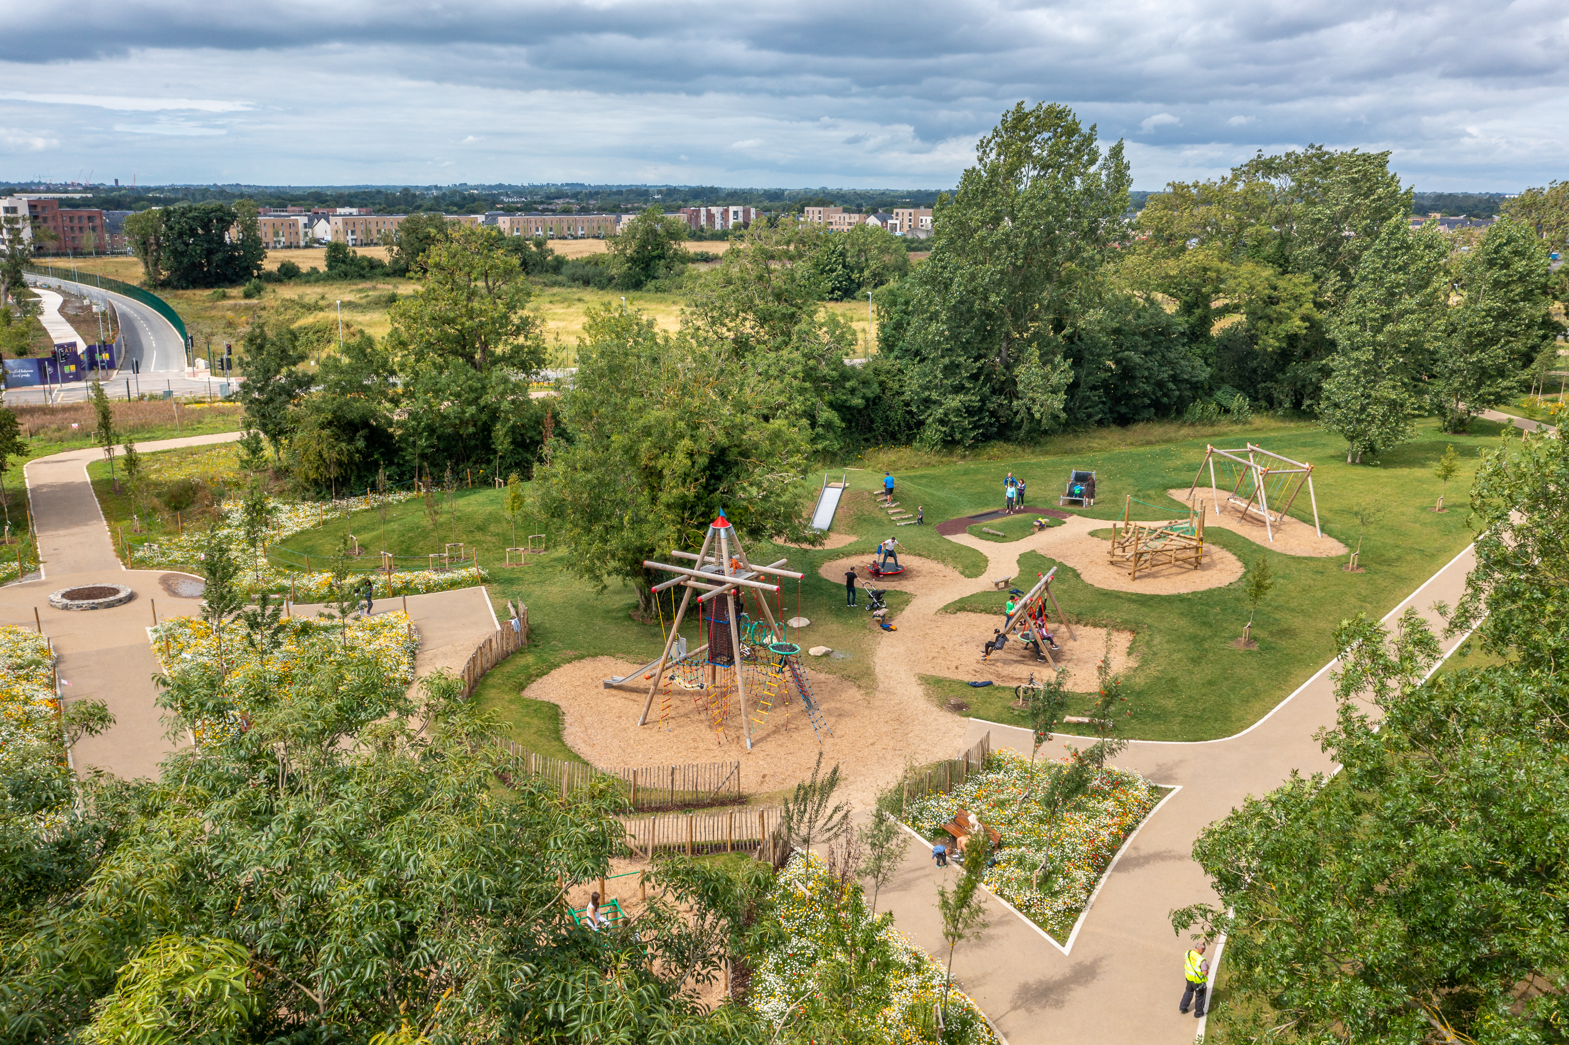
LIHAF Projects | Timelines
Tandy’s Lane Park | Substantial completion achieved June 2021.
Notes:
9

Slide 10
LIHAF Projects | Timelines
Celbridge Link Road | Road Opened on Friday 17th February 2023

Slide 11
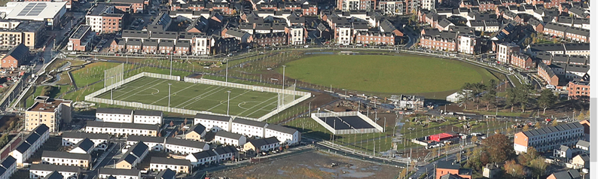
LIHAF Projects | Timelines
Airlie Park | Anticipated Substantial Completion Q2/Q3 2023

