Slide 1
SPC Meeting 23rd February 2023

Slide 2
County Development Plan context
Objectives: QDP14 - 3 and EDE4 - 14
“To prepare a LAP for Clondalkin, the extent of the boundary to be defined, which will be guided by the Local Area Plans Guidelines for Planning Authorities, 2013 (Department of the Environment, Community and Local Government) or any superseding guidelines and which will incorporate:
A vision for the development of Clondalkin
Wider urban design principles
Framework plans for larger infill sites
A Conservation Plan
A local Green Infrastructure strategy derived from the County GI Strategy
Transport movement study.”

Slide 3
Why Prepare a Local Area Plan for Clondalkin?
Clondalkin is an important and growing settlement within South Dublin
It sits within the Dublin City and Suburbs area within the Regional Spatial and Economic Strategy
There are sites which have potential for further integrated development which would help meet SDCC housing targets up to 2028 and beyond
Clondalkin is situated in close proximity to lands at Clonburris and City Edge providing opportunities for increased connectivity and linkages along the Dublin-Cork rail corridor.
There are opportunities to improve movement and linkages within and around the centre and wider area, including active travel schemes
It has an historic context through its medieval urban form which will inform placemaking and urban design opportunities.
There are opportunities to identify village improvement schemes and to provide frameworks for infill sites
There are opportunities to implement policies and objectives for social infrastructure, green infrastructure, preserving, improving and extending amenities and to combat climate change

Slide 4
CLONBURRIS
Notes:
Clondalkin is a secondary administrative centre for South Dublin County and a Level 3 Retail Centre in the Regional Spatial and Economic Strategy.
Outside of the centre, the area is characterised by low density suburban neighbourhoods that are based around a network of local retail centres.
Lands at Clonburris have an approved SDZ Planning Scheme (2019) and represent a major expansion of the footprint of Clondalkin along the Dublin-Cork rail corridor.
City Edge regeneration lands at Naas Road / Ballymount lie immediately to the east with potential for improved connectivity
Adamstown represents a major expansion of the footprint of Lucan to further west along the Dublin - Cork rail corridor

Slide 5
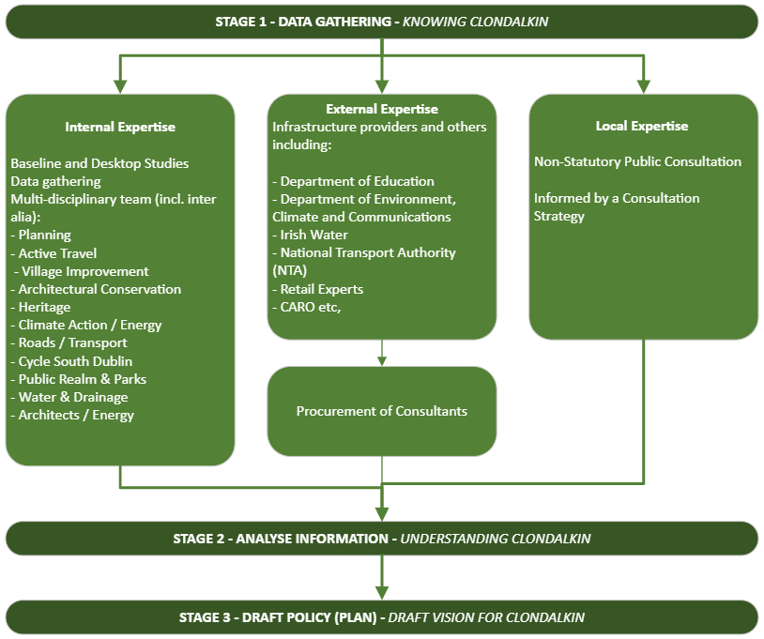
input to the LAP Process
Stage 1: Data Collection
Internal, External and Local expertise assisting with the process
Stage 2: Data Analysis
The process of collecting, modeling, and analysing data to extract insights that support decision-making of the Draft Plan
Stage 3: Draft Plan
Publication of Draft Plan informed by Stages 1 & 2
Notes:
Fiona, I would start with new slide: Title: Expert input to the LAP Process

Slide 6
Clondalkin LAP preparation
Background Data, Health Check, CSO Data April 2023
In the process of procuring Transport Strategy and Urban Design & Building Conservation Consultants – Request for Tender to be issued by early March
SEA/AA and SFRA consultants also in the process of being procured
Public Consultation consultants and facilitators ‘Connect the Dots’ have been employed to prepare and implement a Public Consultation Strategy.
The Pre-Plan consultation to commence in the coming
ACM Members will be briefed in the coming weeks on the consultation strategy prior to its commencement
Clondalkin Population by Age
Notes:
Almost 13,000 in the study area total.

Slide 7
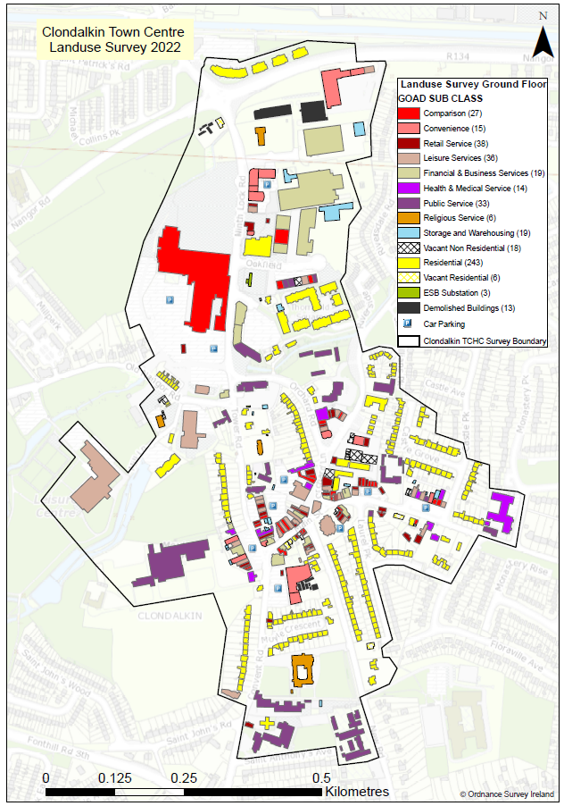
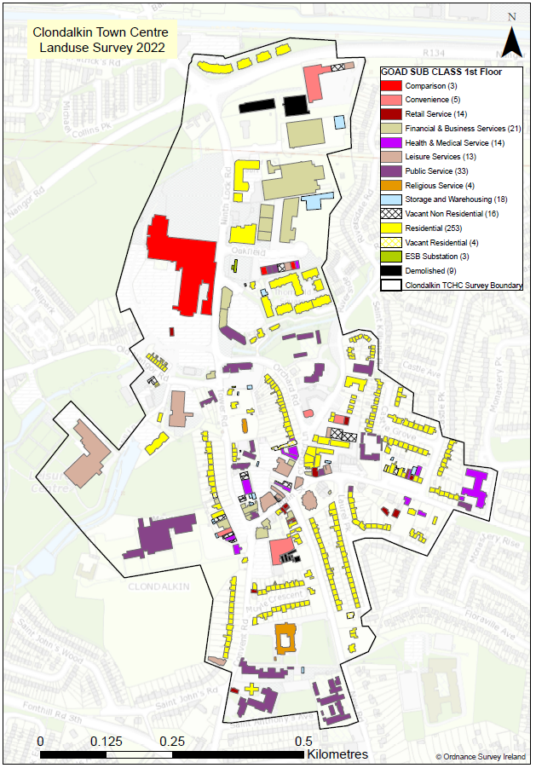
Clondalkin Town
Centre Health Check
Land use survey was completed for Clondalkin for ground, first, second and third floor.
In total, 490 buildings were surveyed.
Resulted in an overall low vacancy of 3.2% (16 buildings) within the study area of ground floor units.
Pockets of vacancy identified are predominantly located on Main Street and Orchard Lane.

Slide 8
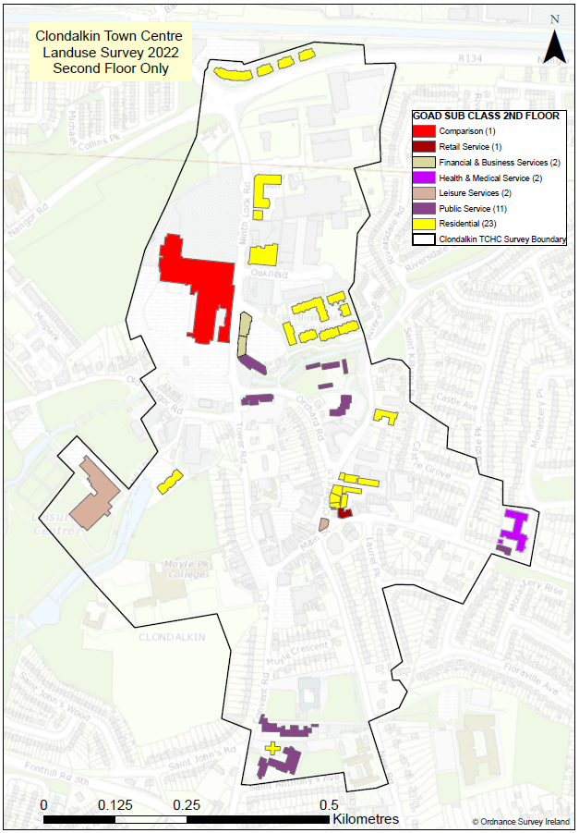
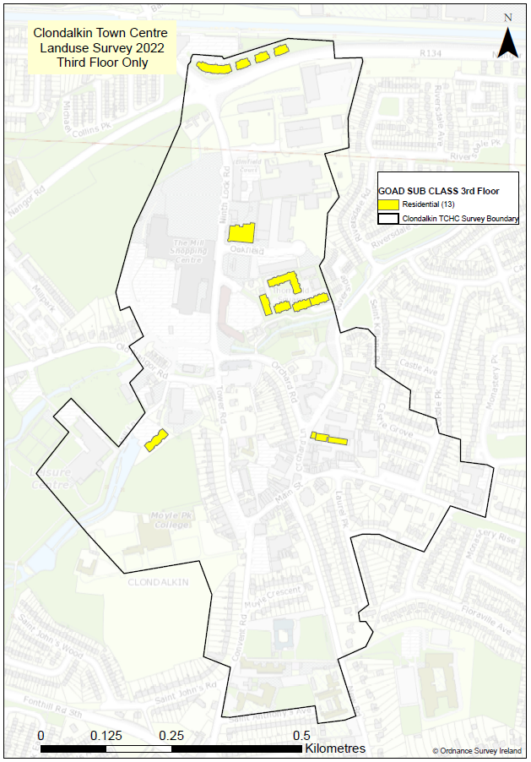
Clondalkin Town
Centre Health Check
These maps indicate second and third floor land uses.
Predominantly residential use.
No vacancy recorded for these floors.
Notes:
Scope for redevelopment of vacant and derelict properties, especially focusing on reducing underusage of ground and upper floors.

Slide 9
Public Consultation – Pre-Draft (Q1-Q3 2023)
Connect the Dots have been procured to facilitate public consultation to inform the early preparation of the plan
Consultation Plan / Strategy is in the process of being developed
A briefing will be held with ACM Members to review the consultation strategy
A cross-departmental internal workshop will inform early work
A survey will be issued to the public in March to get initial feedback
This will be followed by workshops for the public both online and in person
Further non-statutory feedback will be sought from public on early drafts of the Plan
There will be statutory formal public consultation on the Draft Plan when published
Notes:
Ask Tracy to inform this slide

Slide 10
Delivery
The Local Area Plan will:
Provide an Urban Design and Building Conservation Strategy for the LAP area
Deliver a movement strategy providing proposals for interventions which will maximise sustainable movement within and around the village
Identify Active Travel / Cycle South Dublin and Village Enhancement Projects
Include proposals for Parks/public realm and green infrastructure
Include policy and objectives in relation to Climate Change/Renewable Energy and De –carbonization Zone projects

Slide 11
Stages | Description | Provisional Timeframe | Statutory Status
1-3 | Preparing the Draft Plan - Background research and information gathering including informal public and stakeholder consultation and procurement of necessary consultants | Q3 2022 – Q3 2023 | Non-Statutory (60 + 4 weeks)
4-6 | Publication of Draft Plan, summarise submissions, Prepare CE Report, further consultation and consideration by Council | Q4 2023 – Q2 2024 | Statutory (35 weeks)
7 | Adoption of LAP | Q2 2024 | Statutory (4 weeks)
Total |  |  | Approx 99+4 weeks
Provisional Timeframe

