Slide 1
Lucan/Palmerstown and North Clondalkin Area Committee Meeting February 2023 Patricia Doonan Principal Environmental Health Officer

Slide 2
Round 4 Strategic Noise Mapping and Noise Action Plan Overview
National Approach to Round 4
Milestones and Progress to Date
Strategic Noise Modelling Results – Dublin
Next Steps
Questions / Discussion

Slide 3
European Communities (Environmental Noise) Regulations 2018 (S.I. 549/2018)
The Regulations give effect to the Environmental Noise Directive (END) 2002/49/EC
Apply to environmental noise, created by human activities, which people are exposed to; in built-up areas, in public parks/quiet areas, near schools & hospitals and other noise-sensitive buildings/areas.
Essentially it relates to road transport, trains and Luas, aircraft and industries
We are now in Round 4 and each round applies for 5 consecutive years
Maps are to be Clear, Comprehensive and Accessible

Slide 4
The Regulations/END requires the following two indicators to be applied in the assessment :-
Lden is the annual average noise level for the day, evening and night period and is designed to measure ‘annoyance’.
It has a defined threshold of 55dB.
Lnight is the annual average noise level for night-time periods and is designed to assess sleep disturbance.
It has a defined threshold of 50dB.
Member States must report on the numbers of people who are exposed to noise levels above these thresholds for a range of noise sources.

Slide 5
European Communities (Environmental Noise) Regulations 2018 (S.I. 549/2018)
The EPA in Ireland is the national competent authority for the purpose of overseeing implementation and for providing guidance.
The Regulations require Noise Mapping Bodies (NMBs) to prepare or review Strategic Noise
Agglomerations (>100,000 persons) (road, rail, airports & industry)
Major roads (>3,000,000 vehicle passages per year)
Major rail (>30,000 train passages per year)
Major airport (>50,000 movements per year)
The Regulations require Action Planning Authorities (APAs) to make or review Noise Action Plans
Maps - Completed 2022 and are being published by the end of this month (February 2023)

Slide 6
Round 4 – new National approach was adopted;
Dublin, Cork and Limerick were amalgamated into Super Agglomeration
A Noise consultant was appointed to complete the noise modelling and mapping.
Major Roads and Rail outside agglomerations – Transport Infrastructure Ireland (TII) would complete the noise modelling and mapping.
Major Airports – Dublin Airport Authority (DAA), complete the noise modelling and mapping.

Slide 7
New additions to Round 4 included
Celbridge and Leixlip are joined with SDCC boundary.
Bray is joined with Dun Laoghaire Rathdown.
Limerick City also in for first time
Dublin and Cork Ports measured.
Other state agencies include :
Transport Infrastructure Ireland (TII)
Irish Rail and Luas
Road Management Office (RMO),
National Transport Authority (NTA),
DAA

Slide 8
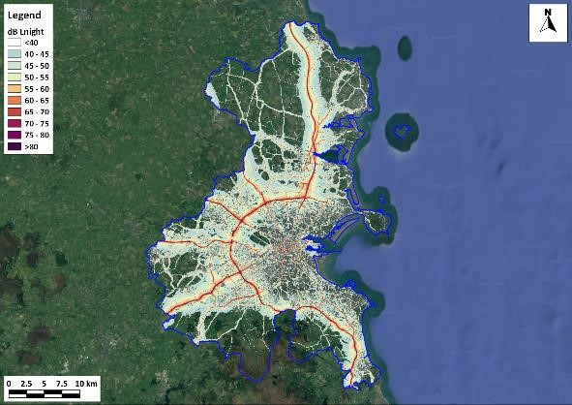
Dublin Strategic Noise Modelling Results – Roads Lden

Slide 9
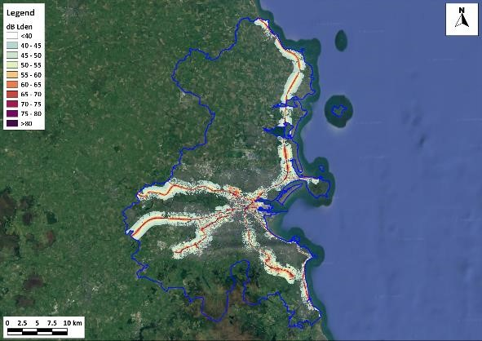
Dublin Strategic Noise Modelling Results – Roads Lnight

Slide 10
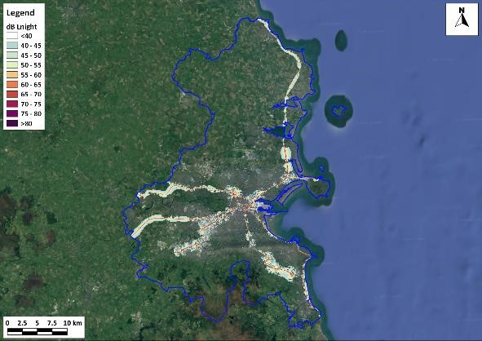
Dublin Strategic Noise Modelling Results – Rail Lden

Slide 11
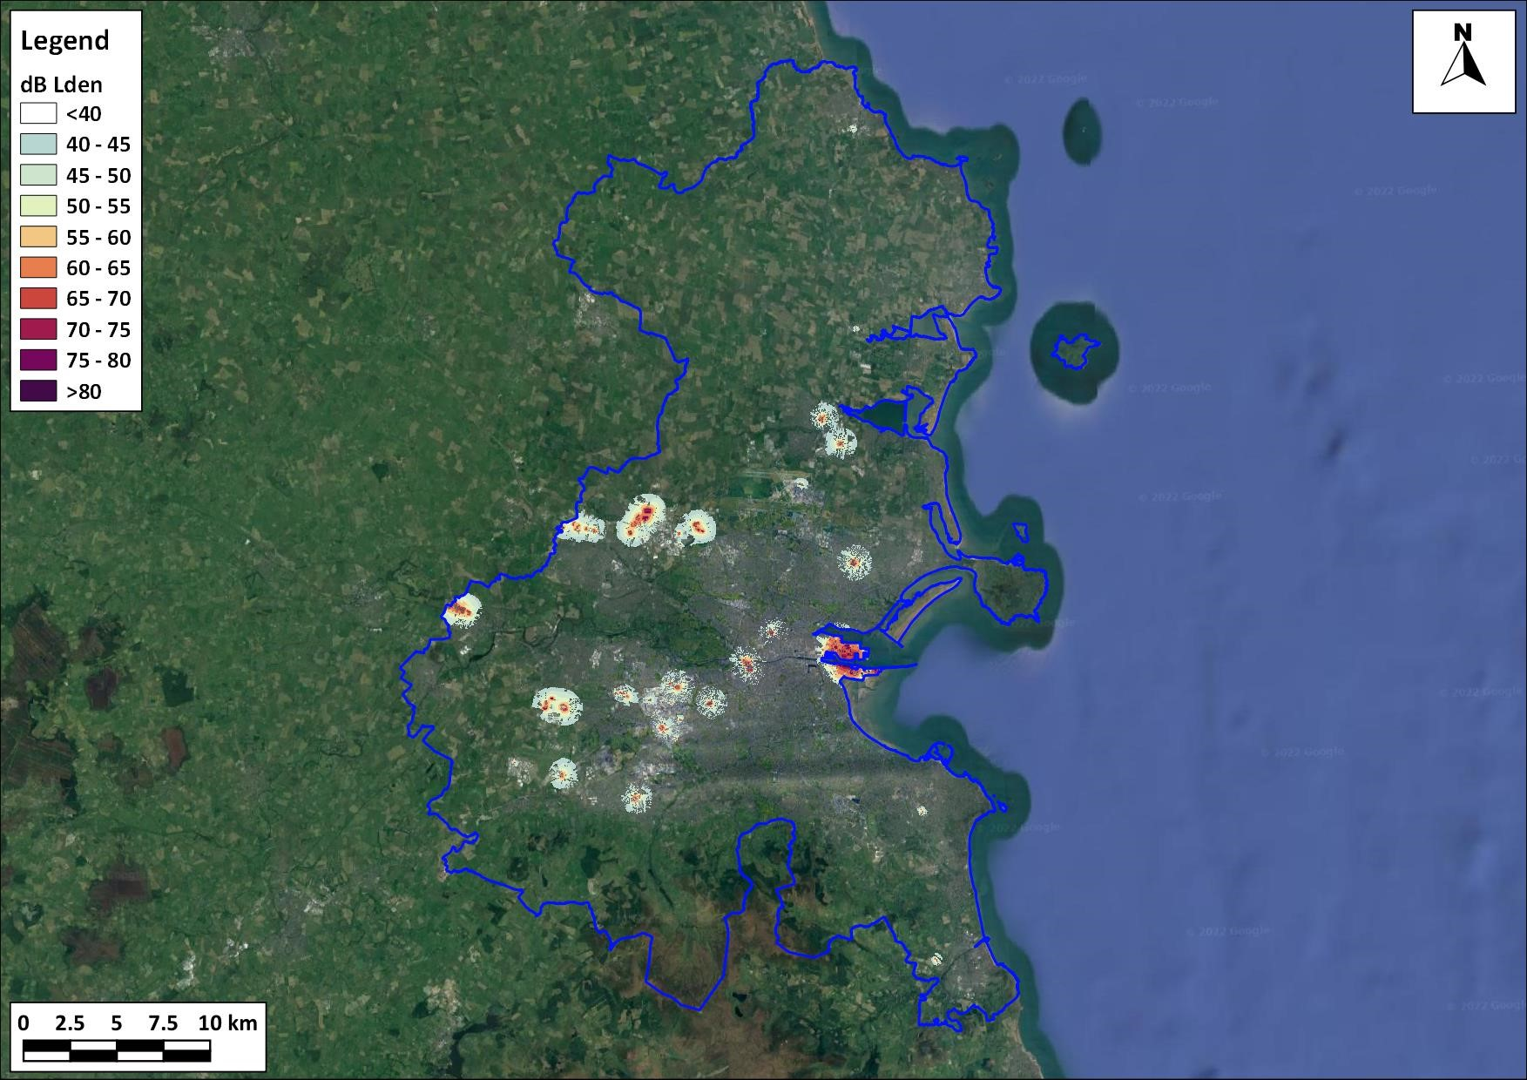
Dublin Strategic Noise Modelling Results – Industry Lden

Slide 12
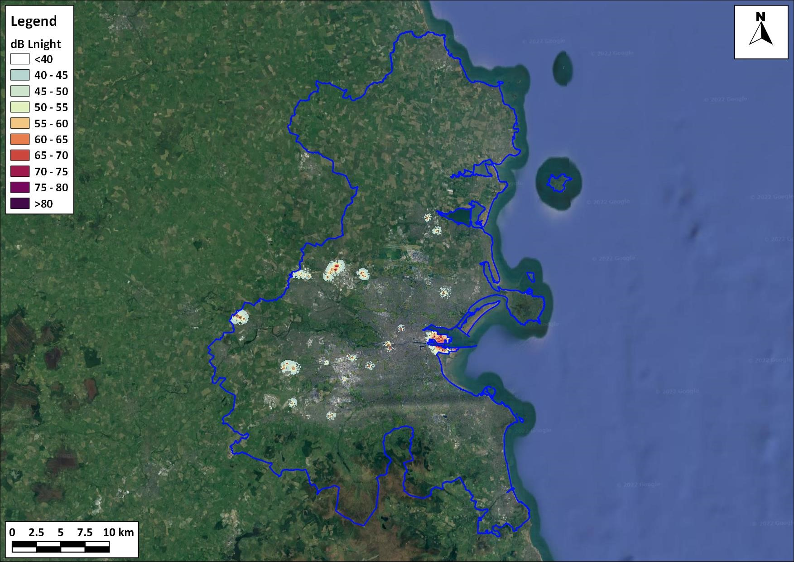
Dublin Strategic Noise Modelling Results – Industry Lnight

Slide 13
Phase 1 Deliverable | Programme Delivery Date
Finalise Graphical Strategic Noise Maps (Limerick, Cork & Dublin) | January /February 2023
Data Review, Evaluation and Model Set-up Reports (Limerick, Cork & Dublin) | January to April 2023
Noise Model Files (Limerick, Cork & Dublin) | January 2023
Noise Modelling and Exposure Assessment Report (Limerick, Cork & Dublin) | April to May 2023
Maps Available to the Public (Limerick, Cork & Dublin) | February 2023

Slide 14
Phase 2 Deliverable | Indicative Timeline
Commence Phase 2 | June 2023
Draft Noise Action Plans | Q4 2023
SEA / AA | Q4 2023 – Q1 2024
Public Consultation | Q1 2024
Final Noise Action Plans | Q2 2024
Deliver Final Noise Action Plans to EPA | Q3 2024
EEA Deadline | End 2024

Slide 15
Conclusions
New calculation system is better & will have more interactive website
Oden system should allow users to zoom around and get information
There will be a range of maps incorporating all 10 counties involved
Next phase to develop and assess new noise reduction measures
Quiet Areas will be completed.

