Slide 1
Residential Zoned Land Tax
Update to Planning SPC
SPC MEETING Feb - 2023

Slide 2
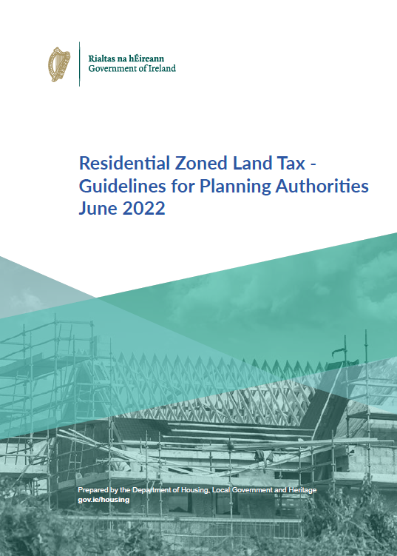
Recap - What is the Residential Zoned Land Tax?
The Government’s Housing For All – A New Housing Plan for Ireland proposed a new tax to activate vacant land for residential purposes as a part of the Pathway to Increasing New Housing Supply.
The Residential Zoned Land Tax (RZLT) was introduced in the Finance Act 2021. The process to identify land to which the tax applies is now underway and the tax will be payable from May 2024.
Note: Tax will be collected by Revenue

Slide 3
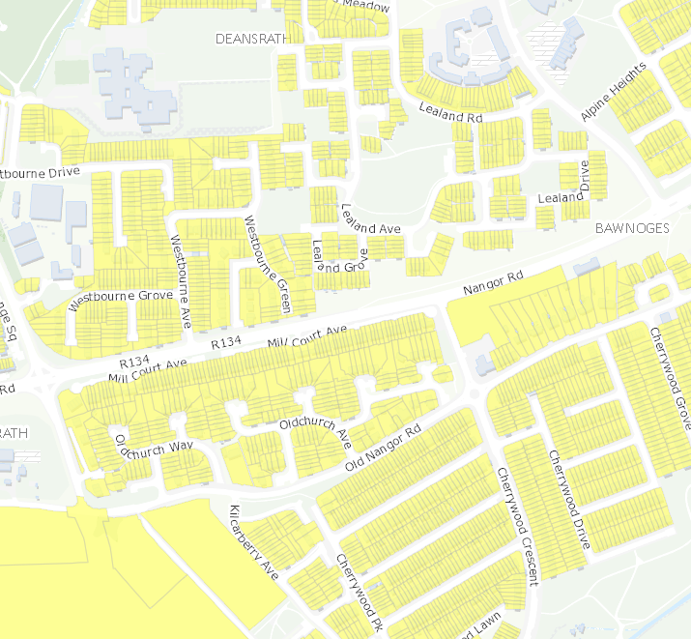
What is the Objective of the Residential Zoned Land Tax?
Activate land that is serviced and zoned for residential use or mixed use, including residential use, in order to increase housing supply and to ensure regeneration of vacant and idle lands in urban locations. This includes sites that are currently under construction.
Note: Deferrals on payment of the tax are available where a commencement notice is submitted, and substantial development begins (section 653AH). Deferral of the tax is only available so long as the development is underway and completed within the duration of the planning permission.
Residential Zoned Land Tax has two parts to the process
1) Identification and mapping of the land in scope for the tax, undertaken by local authorities.
2) Administration and collection of the tax, which is to be undertaken by the Revenue Commissioners from 2024 onwards.

Slide 4
Timeline and Process

Slide 5
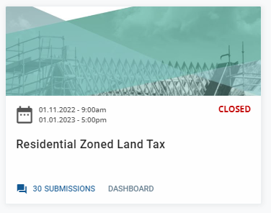
The Draft Map and Public Consultation:
South Dublin County Council prepared a draft map of the land ‘considered to be in scope’.
The Map was on public display from the 1st of November and the consultation ended on the 1st of January 2023.
A total of 30 Submissions were received during the consultation process.
During consultation landowners could set out:
Why their lands should be ‘Taken out of scope’
Why their lands should be ‘Put in-scope’ and included
Request that their lands be re-zoned

Slide 6
Amendments to Zonings:
A landowner who owns land included on the draft map can request a change to the zoning of the land.
The Local Authority will assess any such submissions and will determine if there is merit in rezoning the land in question.
Any such land zoning changes would be progressed by the Council as a variation to its County Development Plan under Section 13 of the Planning and Development Act
There were 0 submissions received which included a rezoning request.

Slide 7
Appeals Process:
Where submissions have been made by landowners regarding their lands, and where the local authority determines to retain the lands on the maps, and informs the landowner of this decision, the landowner may appeal the decision to An Bord Pleanála.
Appeals against the Local Authority decision must be made to the Board within one month of receipt of that decision, stating the grounds for the appeal.

Slide 8
Next Steps: Assessment of Submissions
1st April
Where submissions are received and considered by the local authority and the local authority determines that the lands continue to fulfil the relevant criteria, that determination, along with any reasons shall be provided to the landowner by 1 April 2023.
Note: Following receipt of a submission and where additional information is required re. water or wastewater infrastructure Irish Water can be consulted to inform determination on whether lands should remain within scope for the RZLT. Further Information was sought and received from Irish Water on 5 number sites/submissions

Slide 9
Next Steps: Assessment of Submissions
2. Where submissions are received and considered by the local authority and the local authority determines that the lands should be removed or part of the lands removed from the Draft Map, notification of this shall be issued to the landowner by the 1 April 2023.
A determination by the Local Authority should set out the reason why land or part of the land is proposed for exclusion. The removal of the land should be reflected in the final map to be published on 1 December 2023.
1st April

Slide 10
Timeline and Process

Slide 11
Next Steps: Assessment of Submissions
3. Where submissions from other interested parties raise matters regarding additional land to be included, and where the local authority considers that the land identified satisfy the relevant criteria, such land should be included in a supplemental map.
1st
May
Public Display Supplemental Map

Slide 12
Timeline and Process

Slide 13
Other Information and useful Links:
Consultation Portal:
Residential Zoned Land Tax | South Dublin County Council's Online Consultation Portal (sdublincoco.ie)
SDCC Draft RZLT Map:
Residential Zoned Land Tax (arcgis.com)
RZLT Timeline:
rzlt-timeline.jpg (1161×924) (sdcc.ie)
RZLT Frequently Asked Questions:
Template 1 Cover Front and Back Gov (sdcc.ie)
RZLT Guidelines:
gov.ie - Residential Zoned Land Tax - Guidelines for Planning Authorities (www.gov.ie)
Finance Act 2021:
a4521.pdf (oireachtas.ie)

