Slide 1
Community Enhancement Fund Tallaght - €250,000 Clondalkin - €250,000

Slide 2
Trim Trail, MacUilliam Estate (€70,000) Construction of footpath substantially complete. Line marking and seeding to be completed when temperatures increase. Adult changing room, St Aengus Community Centre (€50,000) Scope of works and assessment completed. Facilities and property manager appointed – seeking three quotes. Quotes to be returned before end of Q.1 Sensory garden, St Aengus Community Centre (€50,000) Design completed. Two quotes returned based on the design. Seeking final agreement on the contractor.
Community Enhancement Fund
Tallaght
Notes:
Trim Trail, MacUilliam Estate (€70,000)
The project was led by public realm and the construction of the footpath is substantially complete. Linemarking and seeding to be completed when temperatures increase so we should see this project being closed off within the next couple of months. Adult changing room, St Aengus Community Centre (€50,000) The project is being led by Cheeverstown who use St Aengus facilities each week and who requested the development of the space. They have completed a scope of works and assessment and have appointed a facilities and property manager to manage the project. They are in the process of seeking three quotes and have notified us that the quotes will be returned before end of Q.1.
Sensory garden, St Aengus Community Centre (€50,000) This project is being led between Slaintecare and St Aengus. A design was completed by a landscaping company and this was sent out for quotation. Over 5 companies were contacted and two quotes have been secured. The second quote was just returned this week and it is much more competitive so I am hoping that the contractor will be able to begin works shortly.

Slide 3
Community Enhancement Fund Tallaght
MUGA, Citywise Education (€100,000) Service Level Agreement (SLA) developed – to be reviewed by Legal Services.
Resilience programme Brookfield Community Centre (€3,000) Two six week women's resilience programmes delivered to 19 participants. Period Poverty initiative – Foroige Homeless Hub (€500) Project completed – funding disseminated to purchase products. Active Families (€26, 500) South Dublin County Partnership appointed Food and Community Nutritionist – will lead out on development of the programme.
Notes:
MUGA, Citywise Education (€100,000)
Slaintecare has committed the funding to part support the development of the MUGA. An SLA has been developed, as part of this we were reviewing whether a lease was needed, it has recently been confirmed it is not needed. The document is not being sent to be reviewed by legal and insurance. Following this and signing of the SLA we will be able to transfer the funds. Resilience programme Brookfield Community Centre (€3,000) Two programmes delivered by the Local Sports Partnership. The programme is six weeks long and focused on teaching the participants to learn movements required to defend themselves in a variety of potentially dangerous scenarios. 19 participants took part in the programme in Tallaght.
Period poverty initiative – Foroige Homeless Hub (€500) Project completed – the funding was disseminated to Foroige to purchase period products Active Families (€26, 500) South Dublin County Partnership appointed Food and Community Nutritionist who will lead out on development of the programme. They have developed the outline of the programme which includes nutritional and active lifestyle elements. They are working with different stakeholders to identify families for the programme and plan to roll the programme out before the summer and begin with families in Tallaght.

Slide 4
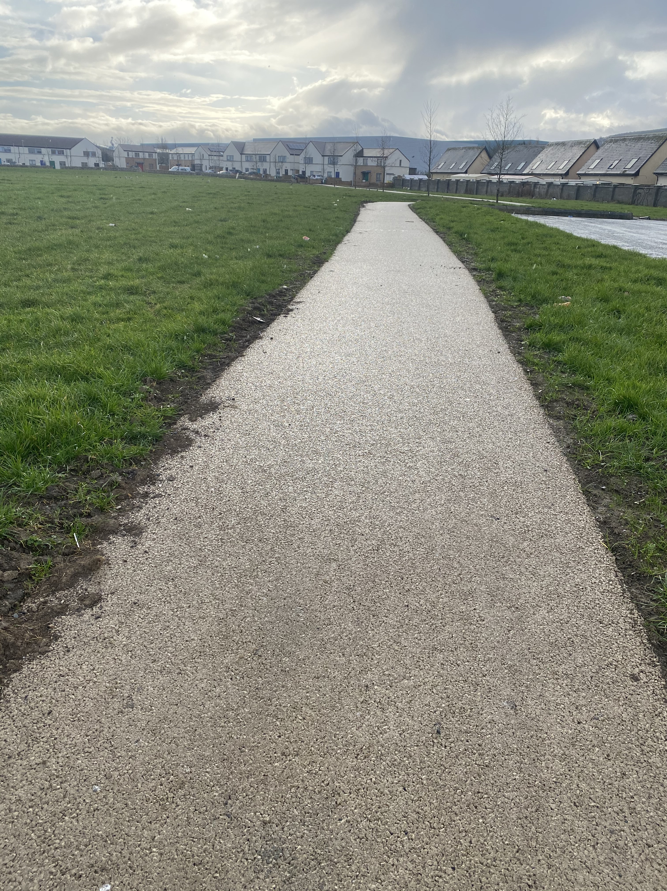
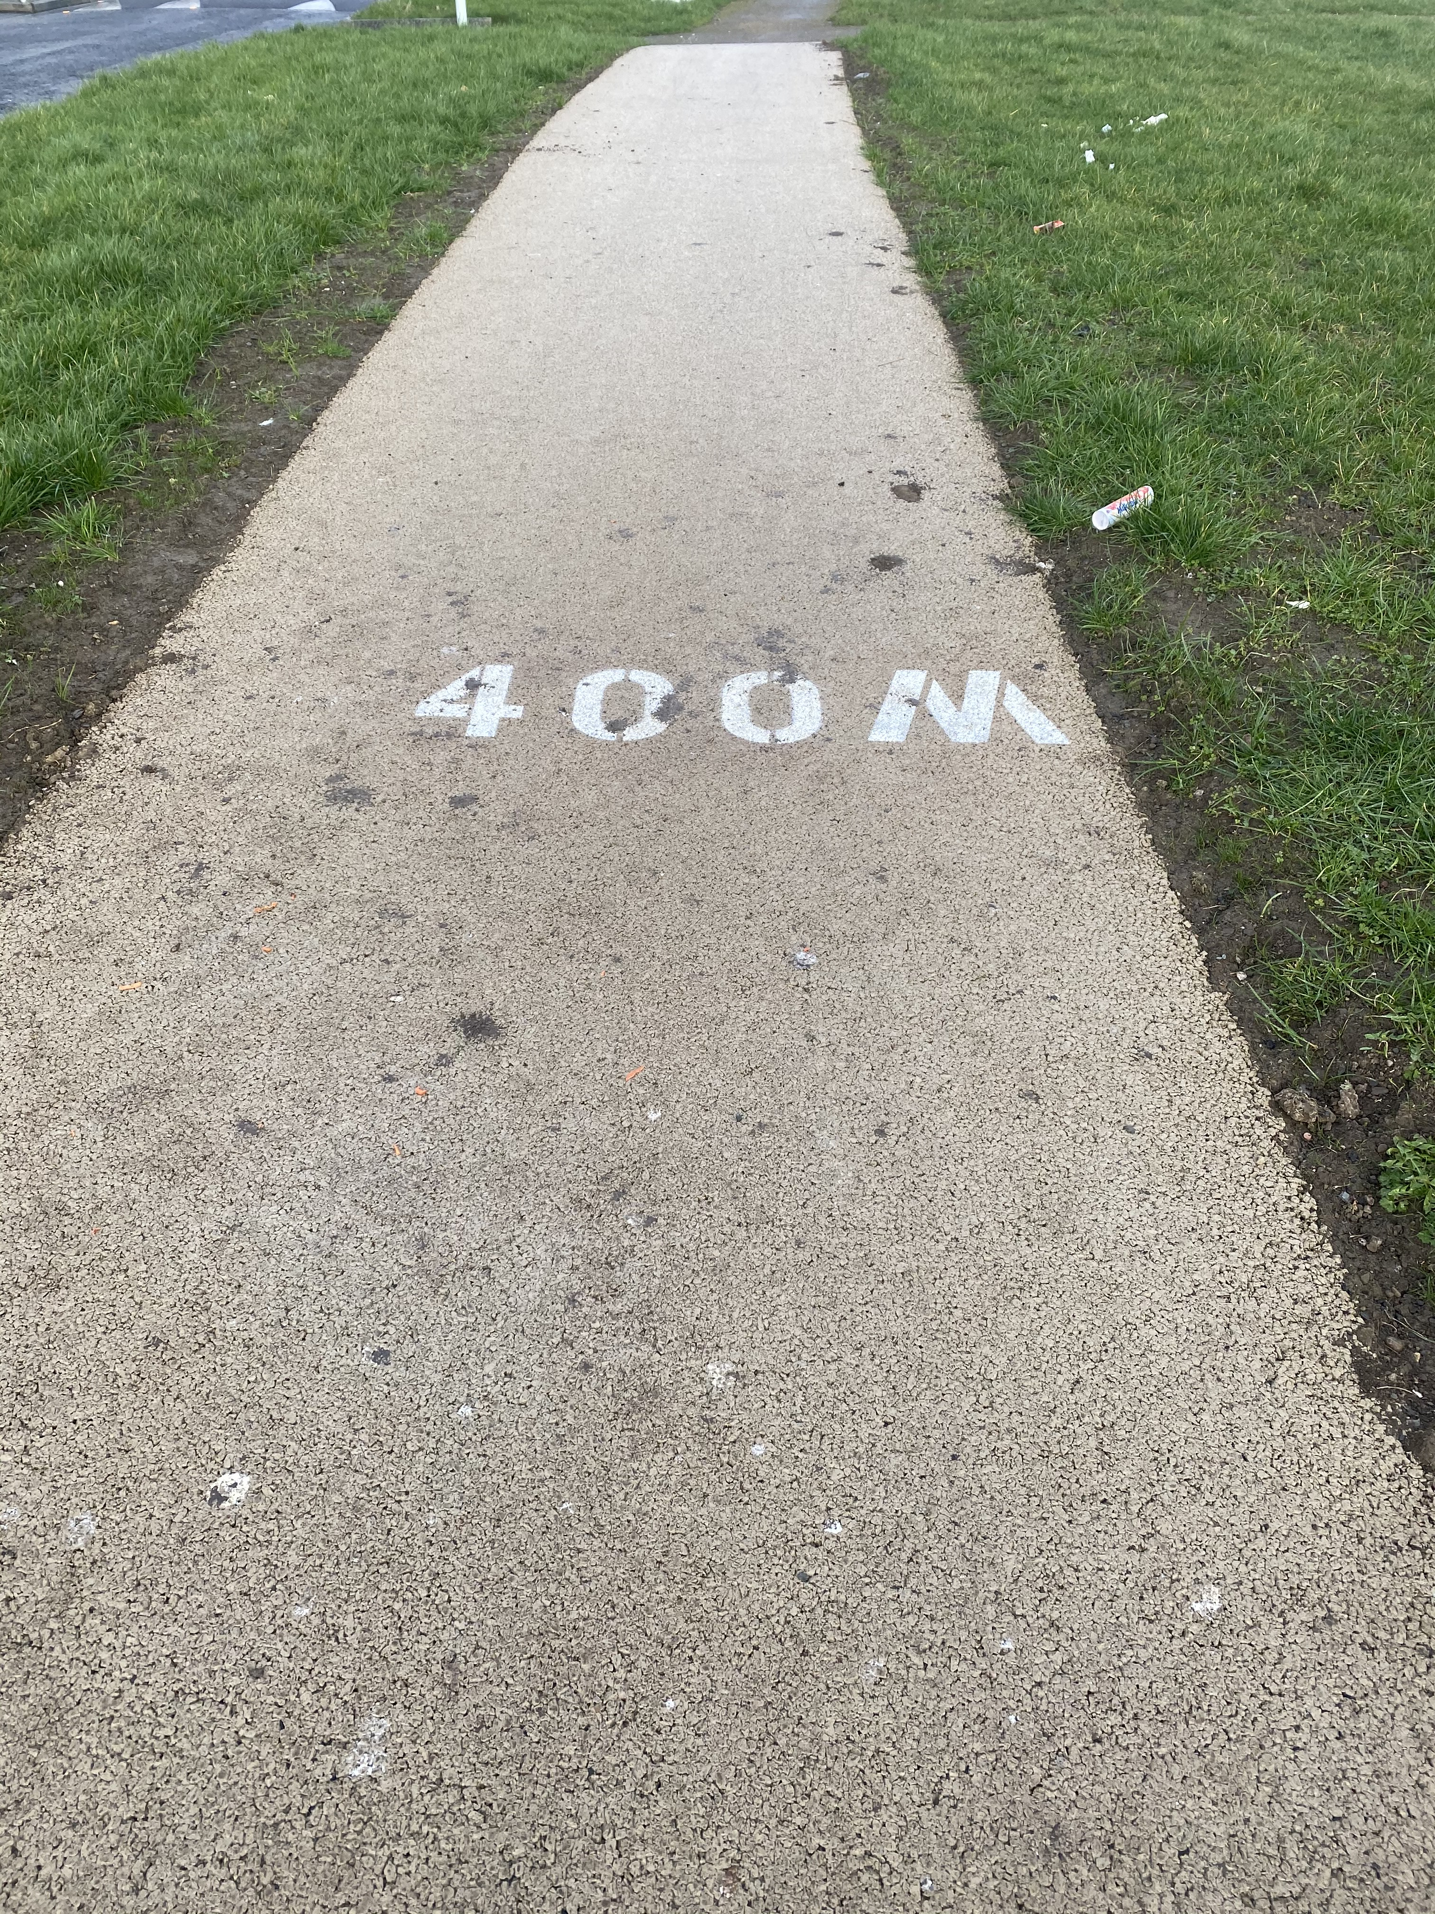
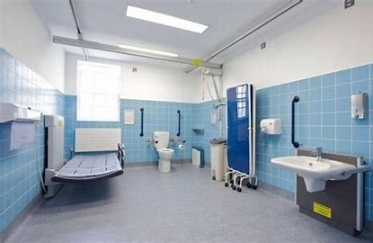
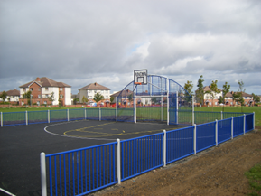
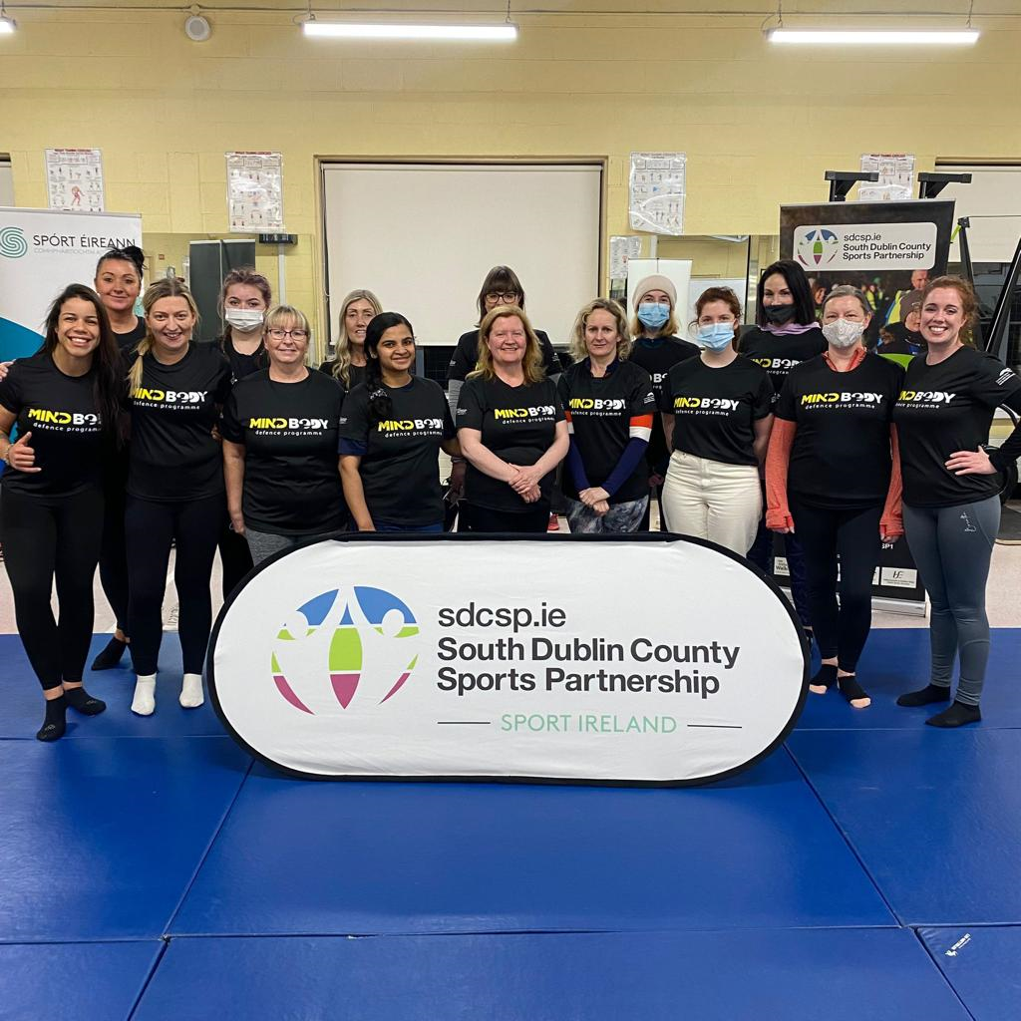
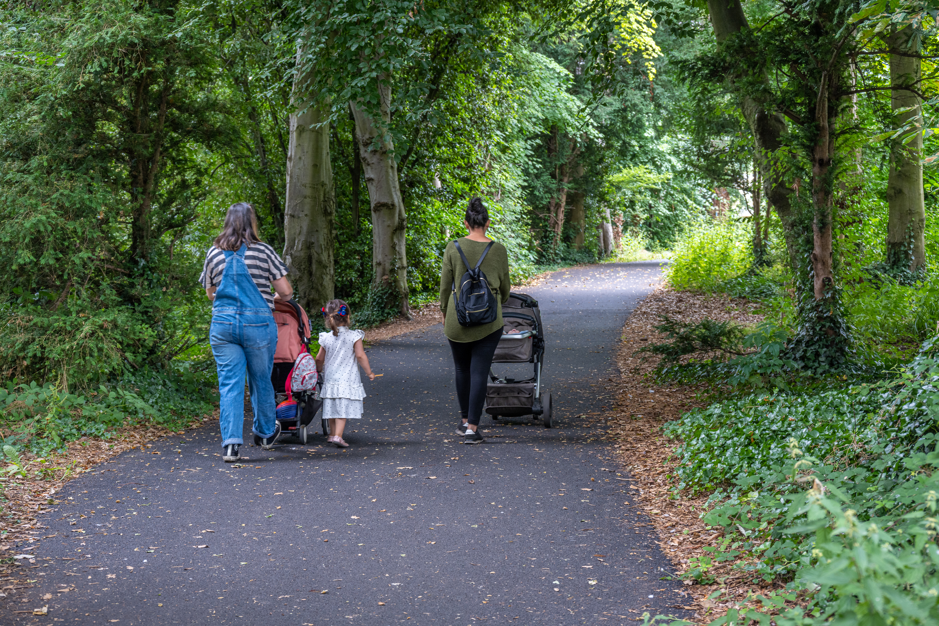
Community Enhancement Fund Tallaght
Trim Trail,
MacUilliam Estate
Adult Changing Room and Sensory Garden,
St Aengus Community Centre
Period Poverty Initiative,
Foroige Homeless Hub
MUGA (part funding)
Citywise Education
Resilience Programme, Brookfield Community Centre
Active Families, South Dublin County Partnership

Slide 5
Outdoor Callisthenic Equipment and Play Space Upgrades, Clondalkin Park (€120,000 + €7,000 Seed Funding) Delayed due to supplier issues and ground conditions. Additional €7,000 required for works to make good around the site by disposing soil and adding accessible footpaths to workout area. Excavations commenced on Monday 13th February 2023. Outdoor Callisthenic Equipment, Balgaddy (€60,000) Callisthenic equipment erected and operational. Black Lane Upgrades, Neilstown, Clondalkin (€50,000) Construction substantially complete. Lighting installed and awaiting testing. Minor landscape work to be completed when weather improves in Spring 2023.
Community Enhancement Fund
Clondalkin
Notes:
Callisthenic Equipment and Play Upgrades, Clondalkin Park (€120,000 plus 7k Seed Funding)
Initial delays due to supplier issues and subsequent ground conditions.
Site fencing was erected on Saturday 11th Feb. Excavations commenced on Monday 13th. Foundations being prepared at the moment. Expect to see equipment being installed next week.
An additional 7k was requested to cover the requirement to make good around the site by disposing of spoil and adding accessible footpaths to the workout area. 7k will be provided from 2022 Seed Funding Underspend.
Callisthenic Equipment, Balgaddy (€60,000)
Commenced after Halloween 2022. Callisthenic Equipment has been erected and is now operational in Balgaddy. Community engagement ongoing to support optimum community use.
Black Lane, Neilstown (€50,000)
A 2020 study on safety and inclusivity in Clondalkin identified the Black Lane as a location where people, particularly women, felt unsafe. Upgrades to the Black Lane, including the installation of lighting help to create safer access to local services and removes barrriers to physical activity.
Construction has substantially been completed. Lighting has been installed and is awaiting testing. Some minor landscape work to be completed when weather improves in Spring 2023.

Slide 6
Community Enhancement Fund Clondalkin
Active Families (€13,500) South Dublin County Partnership appointed Food and Community Nutritionist – will lead out on development of the programme. Summer 2023.
Community Health Fair, Rowlagh, Clondalkin (€5,000) Completed in October 2022 – funding transferred to South Dublin County Partnership. Resilience Programme for Women, Neilstown (€1,000) Completed by forty participants in Clondalkin, October 2022. Period poverty initiative – Bawnogue Community Centre (€500) Project completed – funding disseminated to purchase products.
Notes:
Active Families (€13,500)
South Dublin County Partnership will lead out on development of the programme. They are working with different stakeholders to identify families for the programme and plan to roll the programme out before the summer. Active Families will begin in Tallaght to begin with, before commencing in Clondalkin.
Community Health Fair, Rowlagh (€5,000)
A Community Health Fair took place at the Rowlagh Community Centre in October 2022. The event provided a welcoming community space for the provision of accessible health information in a relaxed community setting. The Sláintecare Community Enhancement Fund provided a contribution of 5000 EURO.
Resilience programme, Neilstown (€1,000)
Delivered by the Local Sports Partnership .40 participants in Clondalkin. The programme is six weeks long and focused on teaching the participants to learn movements required to defend themselves in a variety of potentially dangerous scenarios.
Period poverty initiative – Bawnogue Community Centre (€500)
Project completed, funding disseminated to Bawnogue Community Centre to purchase period products.

Slide 7
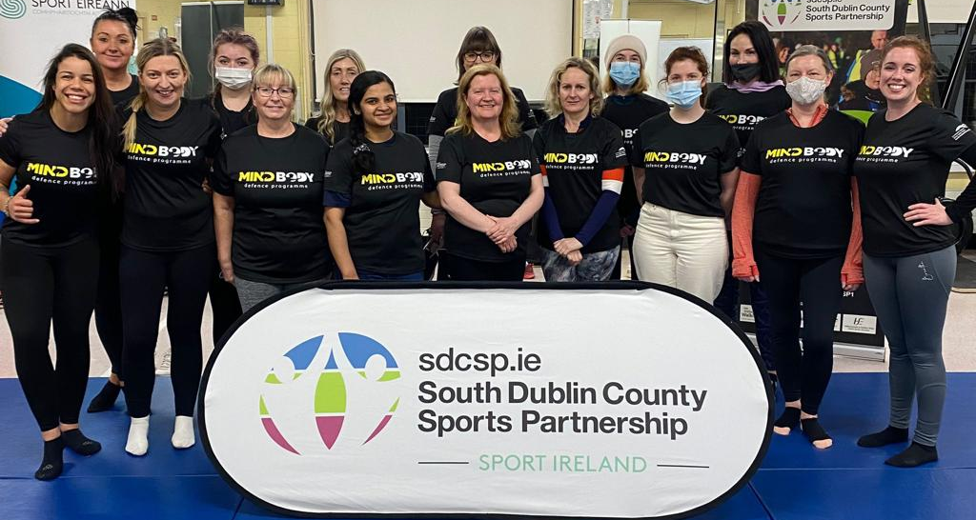
Community Enhancement Fund Clondalkin
CALLISTHENIC AND PLAYGROUND IMPROVEMENTS – CLONDALKIN PARK
BALGADDY, CALLISTHENICS
BLACK LANE IMPROVEMENTS NEILSTOWN
ACTIVE FAMILIES - CLONDALKIN
RESILIENCE PROGRAMME FOR WOMEN - CLONDALKIN
ROWLAGH HEALTH FAIR

