Slide 1
Active South Dublin Local Sports Plan 2023-2027

Slide 2
Consultation Activity
22
Semi Structured Interviews
29
People engaged in 5 x Focus Groups with Stakeholder Organisations
111 Responses
To our Online Survey for stakeholder organisations from 90 different groups
1626 Responses
To our Online Survey for local residents

Slide 3
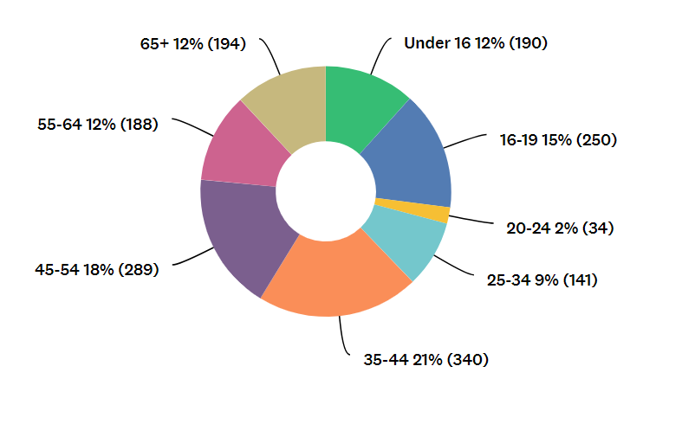
Headline Survey Findings

Slide 4
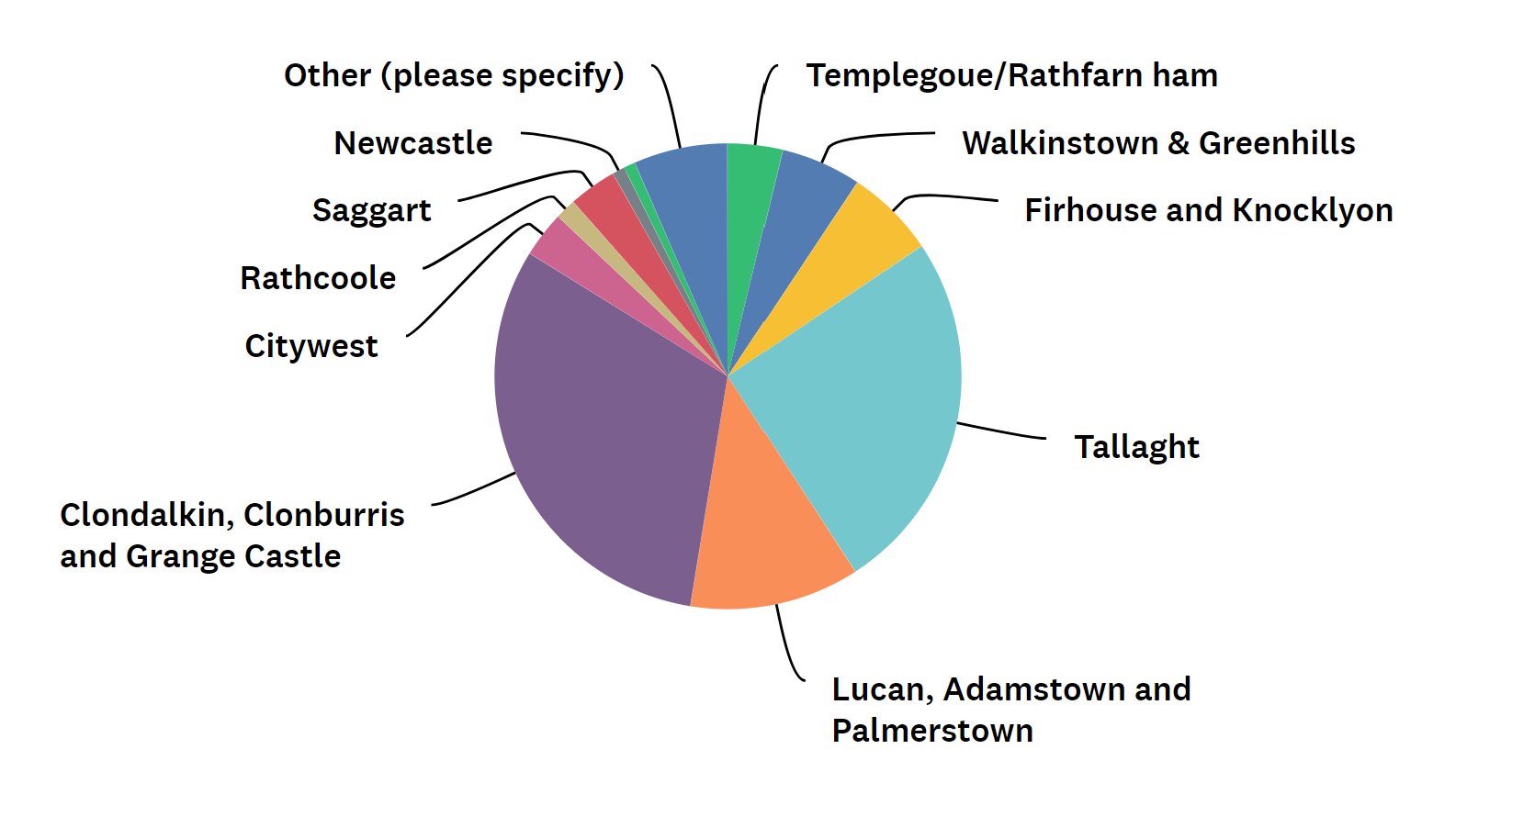
Headline Survey Findings

Slide 5
Headline Survey Findings
21%
of respondents reported that they had a disability, long term illness or health problem
13%
of respondents described their sexual orientation as LGBTQI+
69%
of respondents were female while 29% were male,
79%
‘White Irish’, 10% from any other white background, 4% Asian or Asian Irish, 1% from Black or Black Irish and 1% from other . ethnicities. 3 responses were received from Irish Travellers
Responses in line with the Irish Sports Monitor 2019

Slide 6
Headline Survey Findings

Slide 7
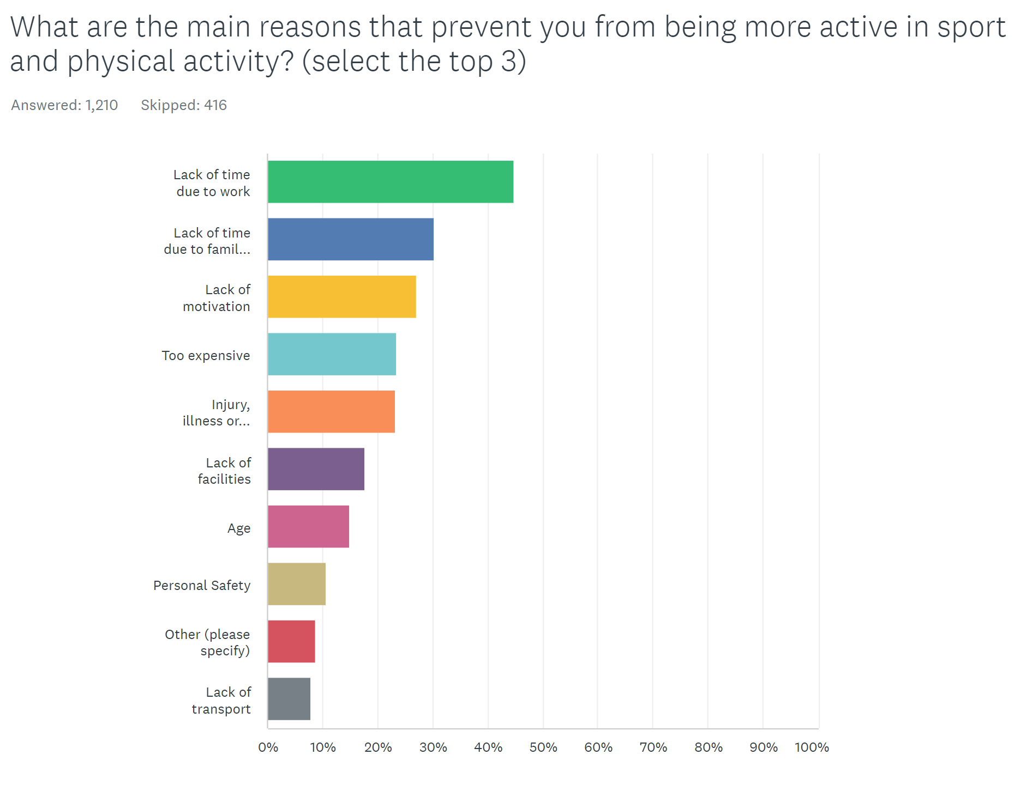

Slide 8
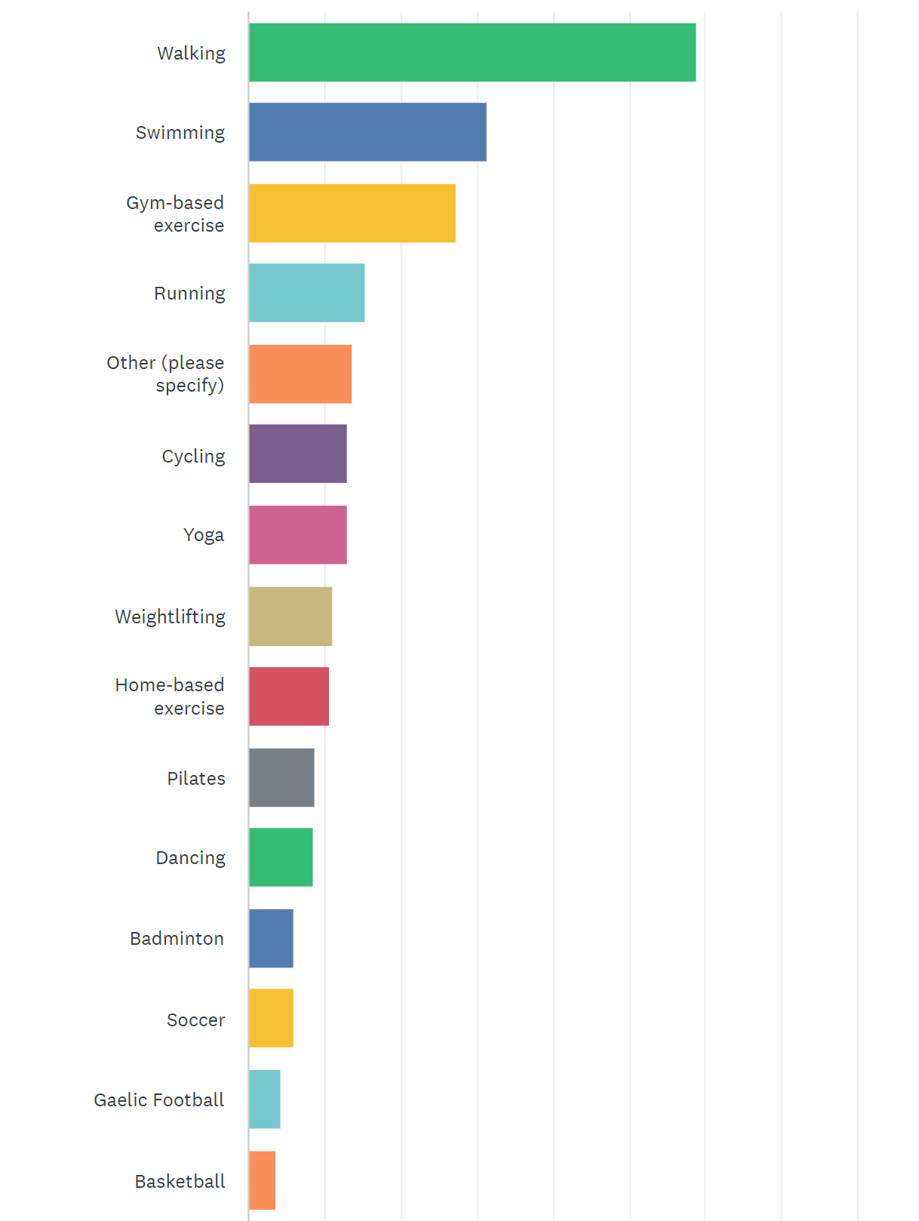
Overall, how would you rate opportunities to participate in sport, physical activity and recreation in South Dublin?
15% said 1,2,3 or 4 out of 10
31% said 5 or 6 out of 10
39% said 7 or 8 out of 10
16% said 9 or 10 out of 10

Slide 10
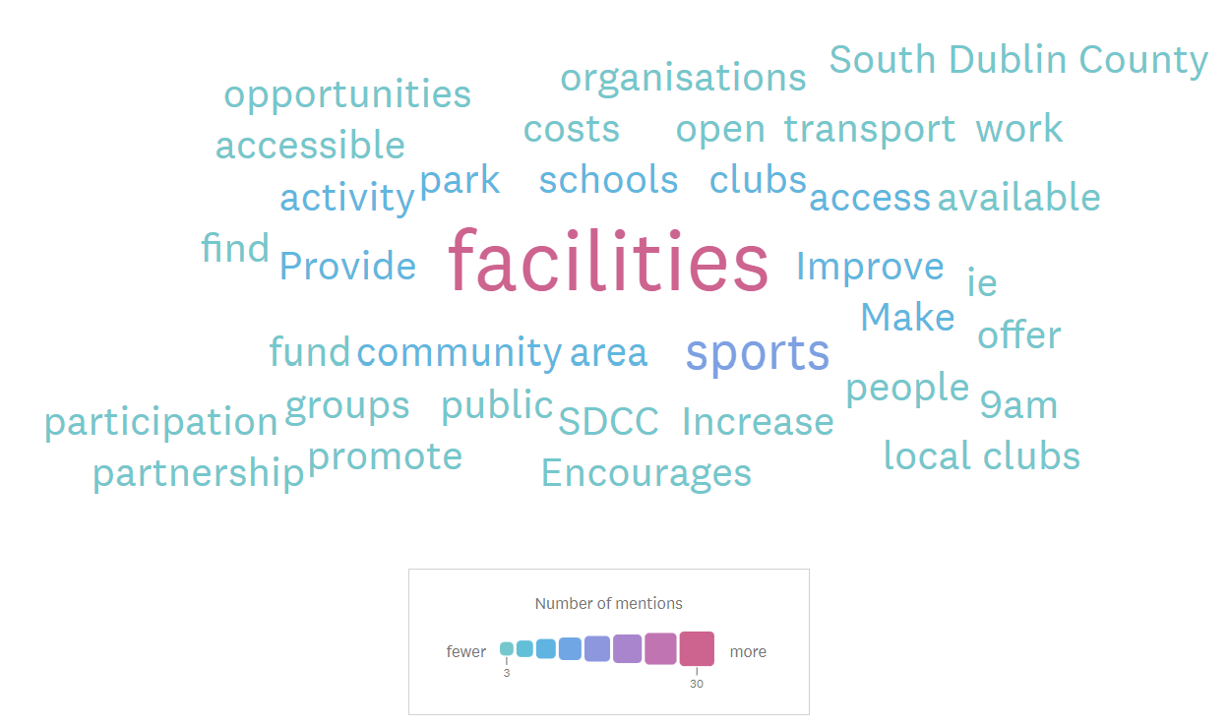

Slide 11
Stakeholder Priorities
Resident Priorities
Improved facilities (longer opening times, greater access and greater variety and type of sports facilities)
Reduced cost
Better promotion, advertising and marketing of sport and physical activities available
Facility improvements (new and existing). Priorities included swimming pools, outdoor green spaces, cycling tracks, outdoor basketball areas, tennis courts, more community sport facilities and public toilets.
Cost and affordability
Range of programmes and activities - especially fun based programmes, family activities organised to remove barriers (i.e. childcare) and programmes engaging key target groups

Slide 12
Consultation Insights
“its not that it (sport and physical activity) is not valued, it is siloed at the minute”
Good evidence that SDCC as an organisation values sport and physical activity – however, extent to which this value is integrated across SDCC departments is questionable
Limited/little or no awareness of the sports function, its structure and key personnel involved across several SDCC depts. Some SDCC staff “didn’t know they existed, didn’t know the difference between the sports office and the LSP”
This is reinforced by external stakeholders that the sports function lacks a strong identity and is “hidden away in the community team, if it is really valued, it would be front and centre of council structure”.
Limited sharing across directorates – the level of integration tends to be dependent on individual personnel: “it feels bottom up and so it is precarious, there needs to be more of a top down support and visibility”

Slide 13
Consultation Insights
The sports office are consulted in a limited way on new capital projects or local area plans etc
External stakeholders (i.e. ETB) report that multiple council sections “come at you” with programme ideas and funding and we haven’t the time or capacity – need for a more streamlined approach
Lots of investment going on across the council: play facilities, hang out facilities, natural play spaces, Corcagh park – but ensuring that these facilities are maximised is a challenge
“The sports office/sports function/LSP have experience and skills in activating spaces through their programmes and activities, maybe we aren’t utilising this enough to make spaces are optimised”
Sports club perspective – “never sure which department they are talking to, sports office or LSP”

Slide 14
Mission
To inspire Active & healthy lifestyles for all in South Dublin

Slide 15
Our Strategic Themes
Active Communities and Clubs
Active Spaces and Places
Active Partnerships and Systems
Active Communication

Slide 16
Theme 1 – Active Communities and Clubs
Develop active lifestyles amongst communities in South Dublin, in all their diversity, through an innovative annual programme of participation opportunities
1
2
Enhance South Dublin as an ‘Active Place’ by delivering flagship participation opportunities and sporting events
Active Communities and Clubs
3
Support the development of vibrant, inclusive sports clubs across South Dublin, building pathways to long term sustainable participation

Slide 17
Theme 2 – Active Spaces and Places
4
Optimise the potential of existing assets such as community centres, leisure centres and schools as providers of sport and physical activity opportunities
5
Ensure that sport and physical activity is imprinted into planning and decision making processes on new facilities and new developments in South Dublin
Active Spaces and Places
6
Significantly enhance the availability of quality sport and physical activity facilities and spaces through the full delivery of our sports capital programme

Slide 18
Theme 3 – Active Communication
7
Enhance the reach and presence of the Active South Dublin brand to promote the value, benefits and opportunities in sport and physical activity
8
Proactively target communities that are underserved and underrepresented through positive, inclusive messaging on motivation, capability and opportunity to be active
Active Communication
9
Maximise the use of data and evidence in sport and physical activity decision making and share good practice and communicate impact

Slide 19
Theme 4 – Active Partnerships and Systems
10
Develop a fully resourced and integrated Active South Dublin team and embed a unity of purpose across the Council to develop active and health lifestyles for all in South Dublin
11
Proactively engage and collaborate with a range of partners in the delivery of local, regional and national strategies and policies
Active Partnerships and Systems

Slide 20
Process to Completion
Internal meetings with SDCC departments to refine actions, consider resource requirements by 7th March
Full draft strategy document, including early sections, context, narrative by 10th March
Follow up, external consultation meetings (in person and online to validate or challenge draft by 21st March) – including Sport Ireland, External Orgs
Offer to engage members of SPC in specific meeting to review consultation document and strategy detail.
Full draft of strategy content submitted for consideration and sign off by SPC at 2nd April meeting
Design, branding and public launch to follow once content approved. Indicatively end April 2023

Slide 21
028 9048 0005
Twin Spires Centre, Belfast BT13 2JF
info@s3solutions.co.uk
Questions?

