Slide 1
Notes:
3 slides each x 4 people
Jagoda
Katherine + interagency
Halimat
Izzie

Slide 2
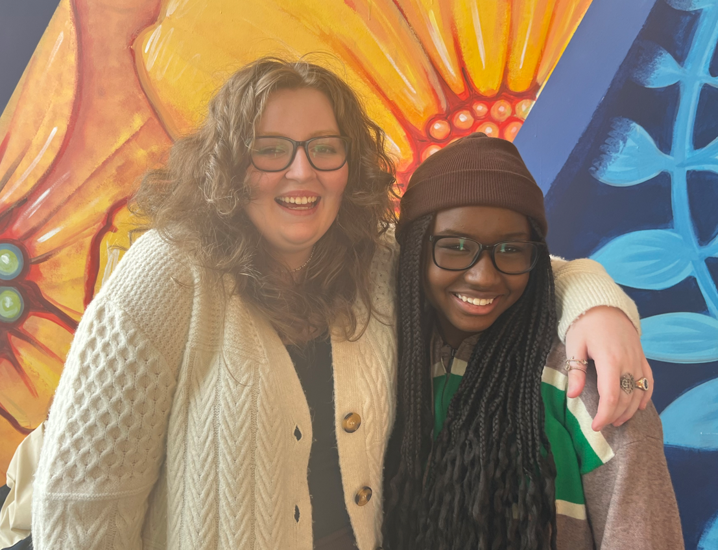
Comhairle na nÓg 2023
Members presenting today;
Alix Brady, Chair, South Dublin Comhairle na nÓg, 2023
Marly Bah, National Executive Representative, South Dublin Comhairle na nÓg, 2023

Slide 3
Introduction to Comhairle na nÓg
Comhairle na nÓg are child and youth councils in the 31 local authorities in the country, which give children and young people under the age of 18 an opportunity to have their voices heard
Comhairle na nÓg is designed to enable young people to have a say on the services, policies and decisions that affect them in their local area
Each year the Comhairle works on a topic of importance to young people in South Dublin
One representative from each Comhairlí is elected to the Comhairle na nÓg National Executive, which follows up on the recommendations from Dáil na nÓg to make changes for young people on a national level.

Slide 4
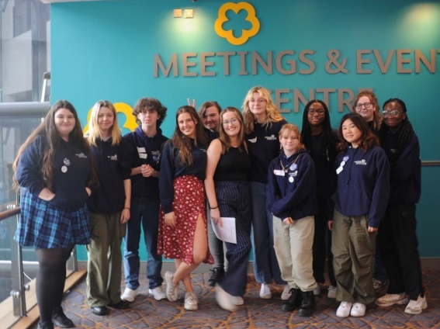
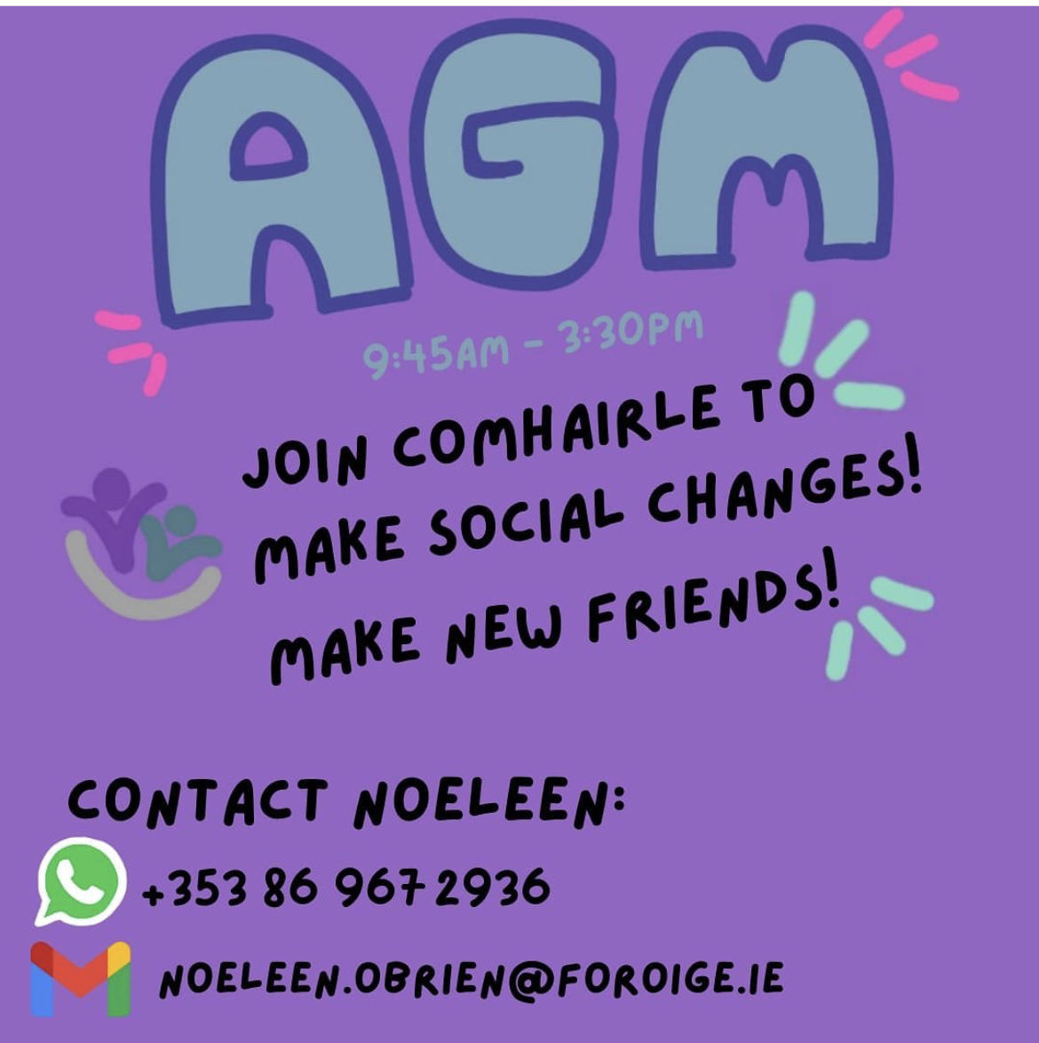
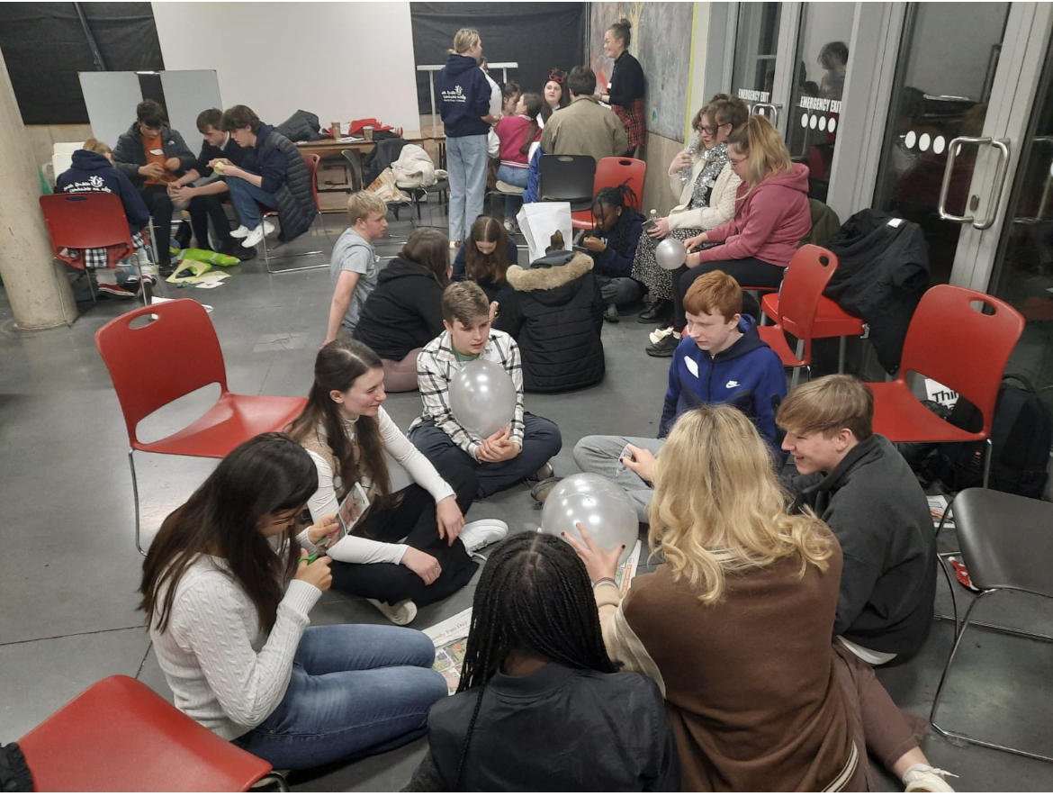
Introduction to Comhairle na nÓg
How a Comhairle is formed?
An AGM takes place every October or November, and in 2022 we were delighted to have the first in person AGM since 2019 !
AGM delegates who are interested in joining are invited to an introductory meeting at Christmas time
We then meet and elect our officers and start working on the topic chosen by the delegates at the AGM

Slide 5
2023 Steering Committee
The Comhairle na nÓg Steering Committee is designed to advise and guide the Comhairle in its work, with the membership tailored to the topic. It is also vital in ensuring that local decision makers are aware of the Comhairle workplan.
Our 2023 Steering Committee is made up of the following;
Mayor Emma Murphy
Cllr Carly Bailey
Cllr Madeleine Johansson
Izzie Solan, Comhairle
Richard McKeever, Comhairle
Liam Kelly, Comhairle
Su Clarke, SDCC
Noeleen O’Brien, Foróige
Siobhán Hennessey, Youth Participation
Sinead Harris, Crosscare
Aoife Heffernan, ETB
Andy Leeson, LCDC
Joe Rynn, CYPSC
YODA – to be confirmed
HSE – to be confirmed

Slide 6
Membership of Comhairle 2023
Our 2023 membership is at 50 members from all over the County
We had our first meeting of 2023 in the Council Chamber
At the meeting we elected our Officers
We also chose members to represent Comhairle on the Steering Committee and The Children and Young People’s Services Committee, and to present our work to the LCDC, the SPC and the full Council.

Slide 7
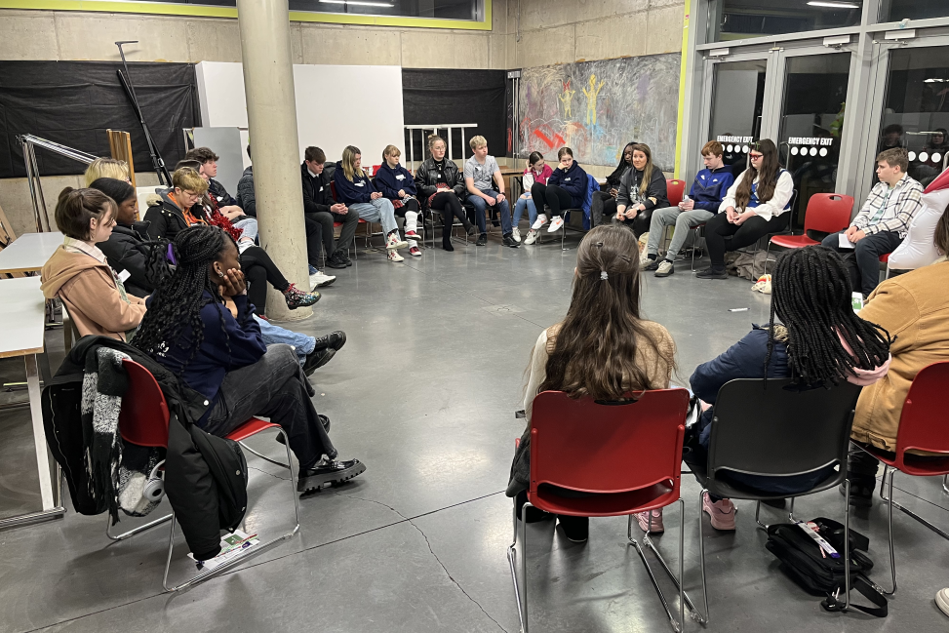
2022/23 Topic –Mental Health
Our 2022/23 Topic is Mental Health
We designed, created and produced posters utilising talent within the Comhairle, which focus both on general mental health and also on specific types of stress that may impact on a young person’s mental health; school and exam stress and growing up LGBTQIA+
The posters will be sent to all schools, alternative learning programmes and youth services in South Dublin

Slide 8
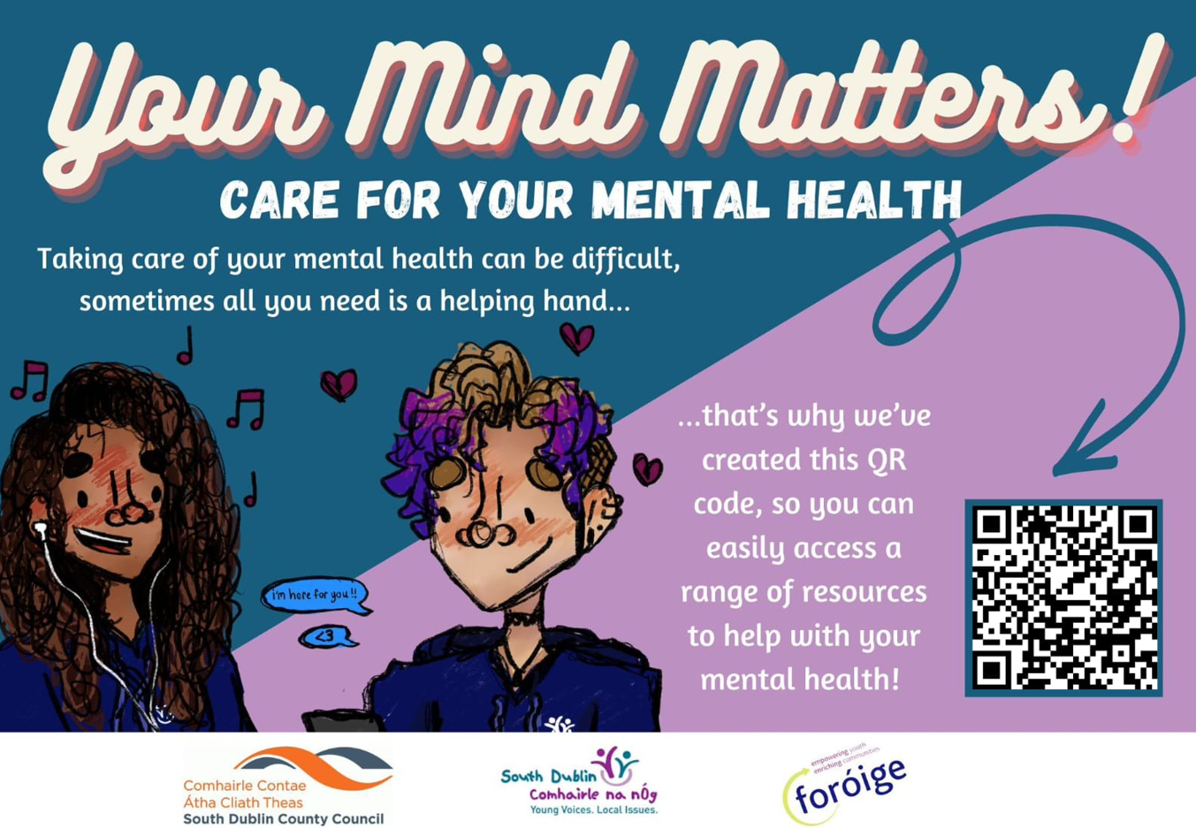
2022/23 Topic –Mental Health
The posters have a QR code that when scanned leads you to the websites of national and local organisations that can help young people who are experiencing mental health difficulties, like Jigsaw and Beacon of Light
We will launching the Mental Health campaign with Mayor Emma Murphy during the Easter break

Slide 9
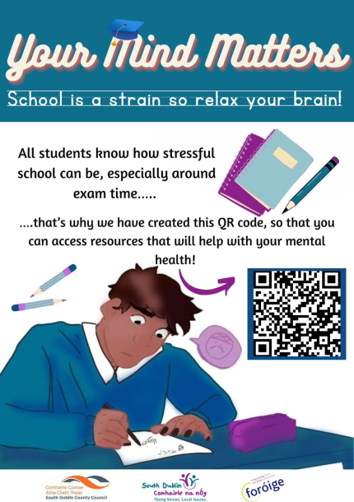
2022/23 Topic –Mental Health Posters

Slide 10
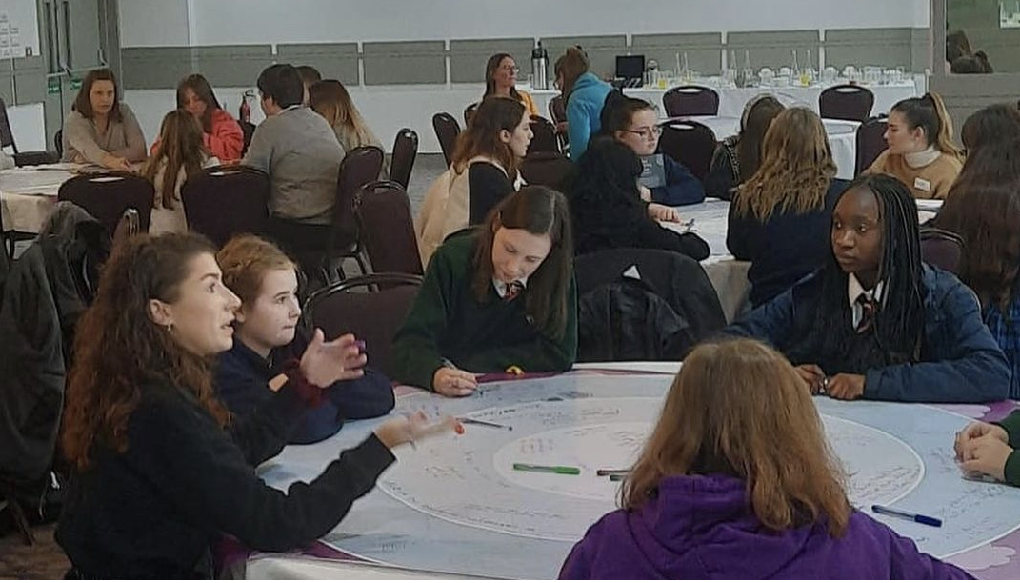
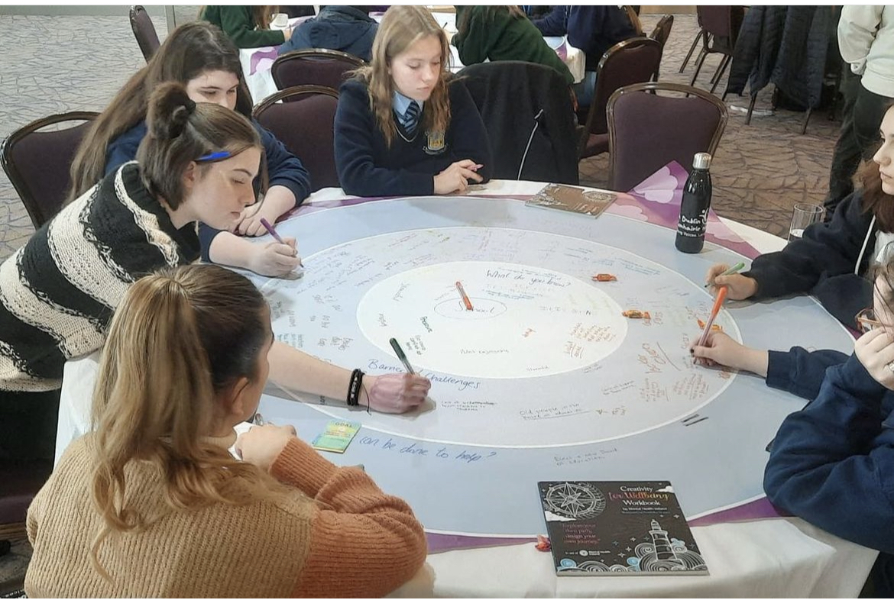
2023 Topic – Drugs and Addiction
At our AGM last November the delegates brought up multiple issues that they felt are important to young people living in South Dublin
These included poverty, homelessness, facilities for young people and the raising up of young people’s voices
Following a vote, the topic we agreed at the AGM for our 2023 topic was Drugs and Addiction

Slide 11
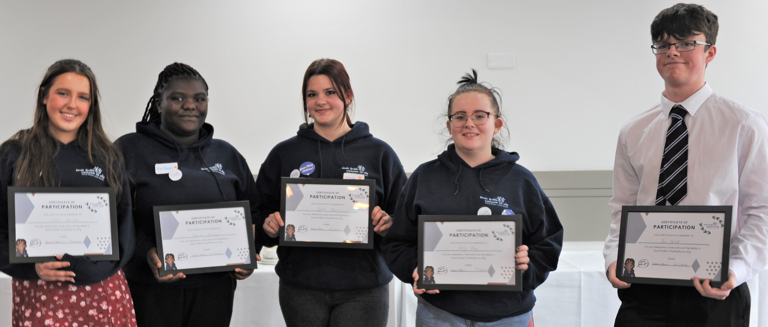
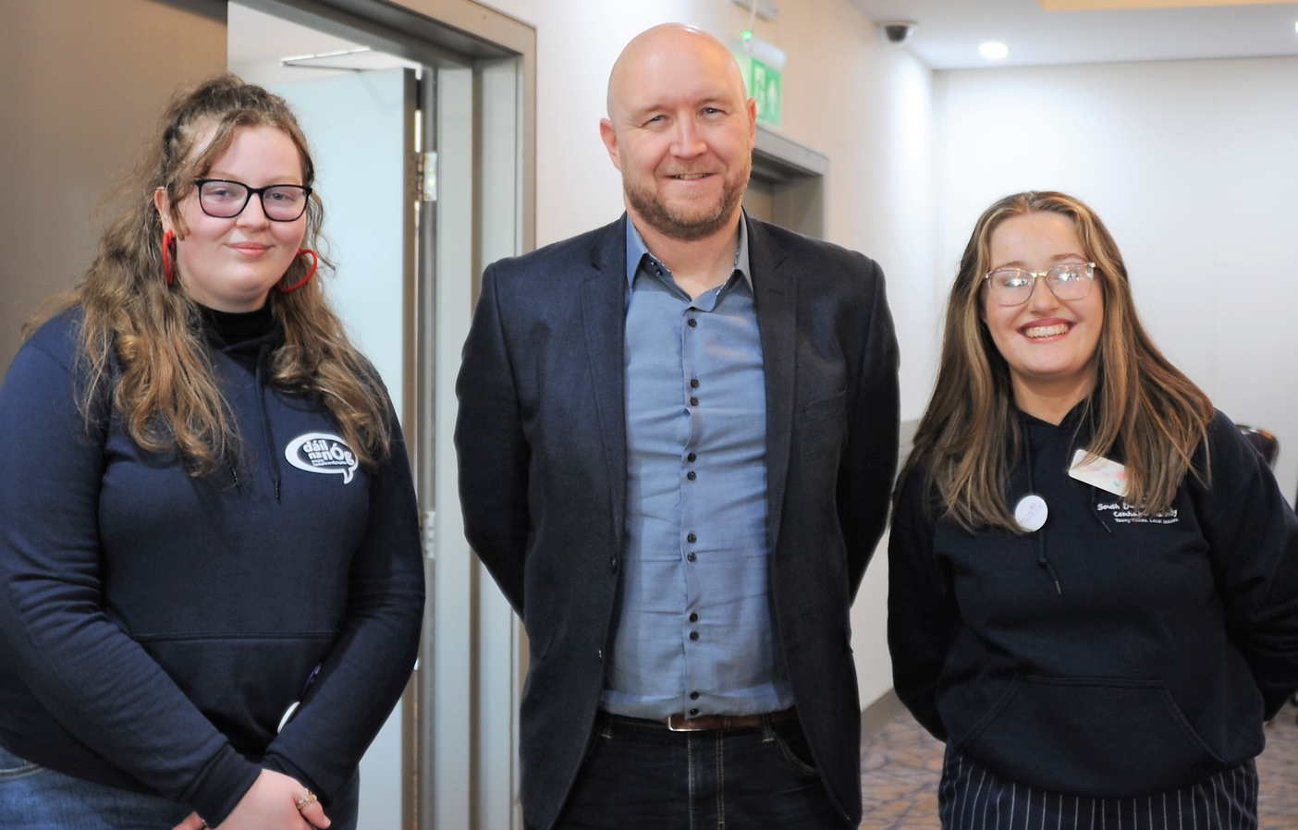
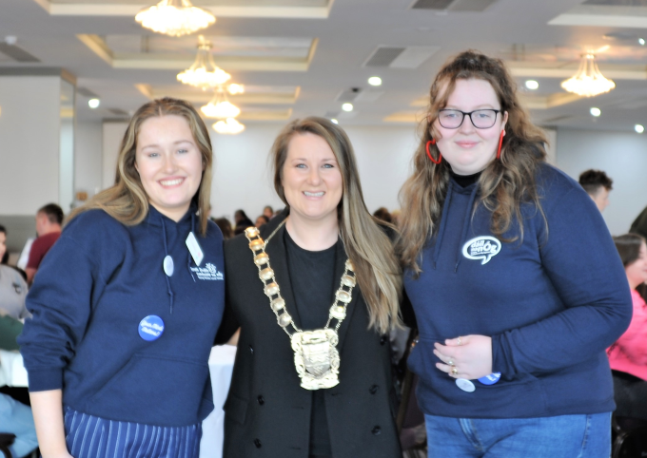
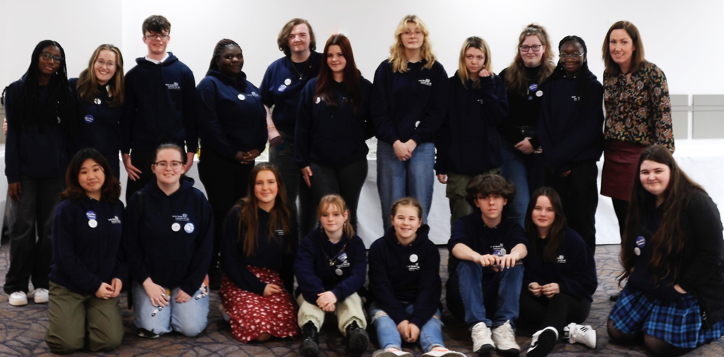
Annual General Meeting

Slide 12
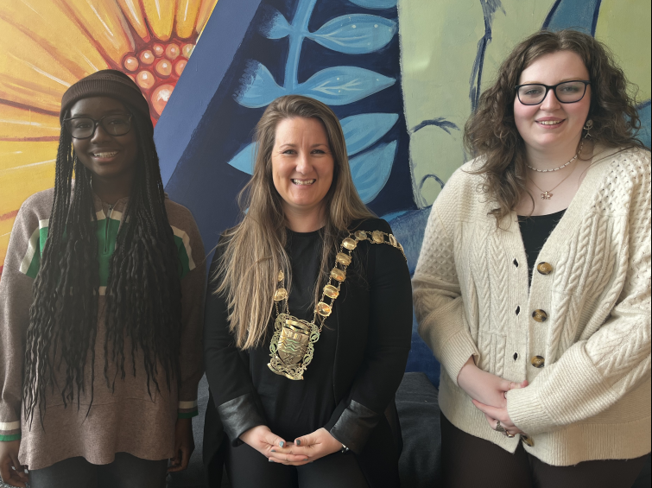
Involvement in Council Work
Teen Spaces – we are currently liaising with Public Realm on locations and design for teen spaces in the county
Mayor’s Initiative – we are working with the Mayor Emma Murphy on our topic of Drugs and Addiction
Have Your Say - €20K has been allocated for young people to help choose amenities in their area

Slide 13
Working with Decision Makers
South Dublin CYPSC
Members of Comhairle will sit on the CYPSC subgroups
LCDC
We hope to present our work to the LCDC twice a year
Council
We hope to present to the Elected Members twice a year also
Notes:
Katherine

Slide 14
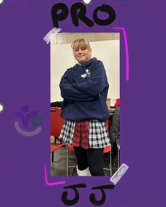
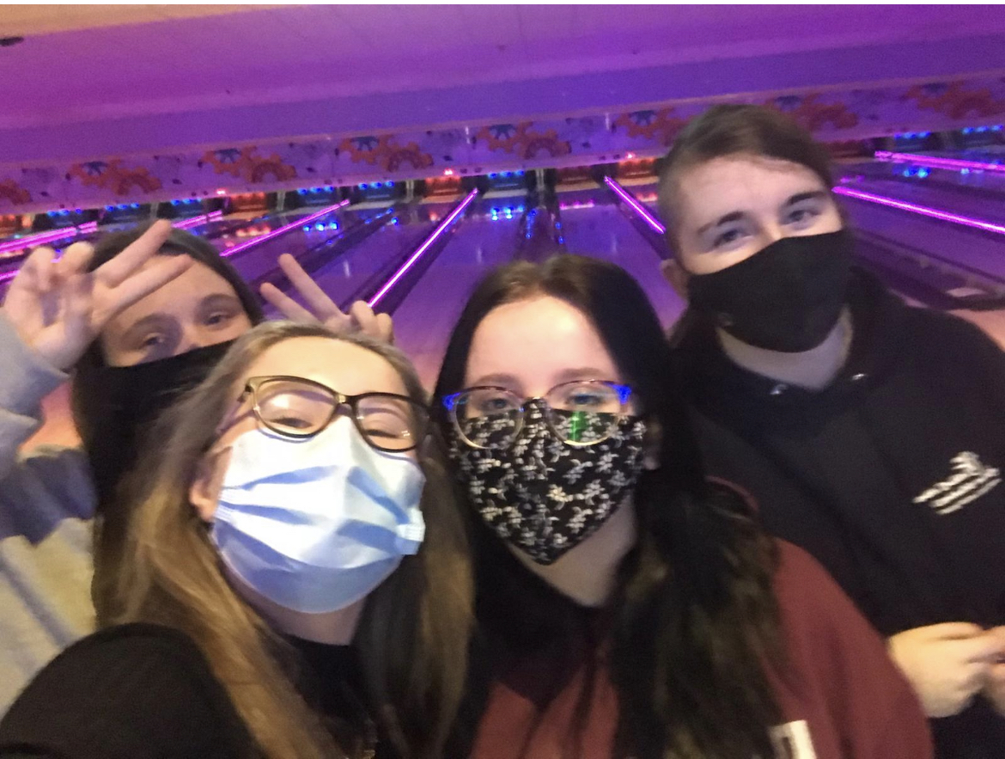
Social Media
We are active on Social Media and have Instagram, Tik Tok and Twitter accounts
We use talent within Comhairle and the Comhairle colours to create a strong brand for South Dublin
We plan on starting a digital newsletter that will be sent to all schools, alternative learning programmes and youth services in South Dublin

Slide 15
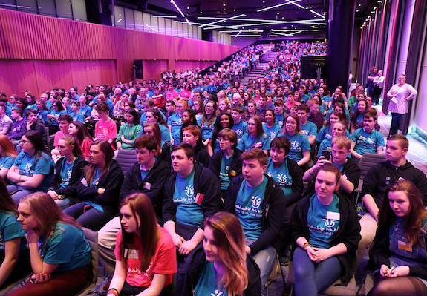
Work plan for the rest of the year
In addition to working on our topic, Comhairle take part in the following;
National Showcase
Every two years all the Comhairlí in the country come together to have a national showcase where they can see each other’s work and network
Consultations
Comhairle regularly take part in national consultations on subjects like Growing Up in Ireland, Skin Cancer and Seanad n nÓg.

