Slide 1
Housing Delivery Update Report Housing Strategic Policy Committee Meeting 16th February 2023

Slide 2
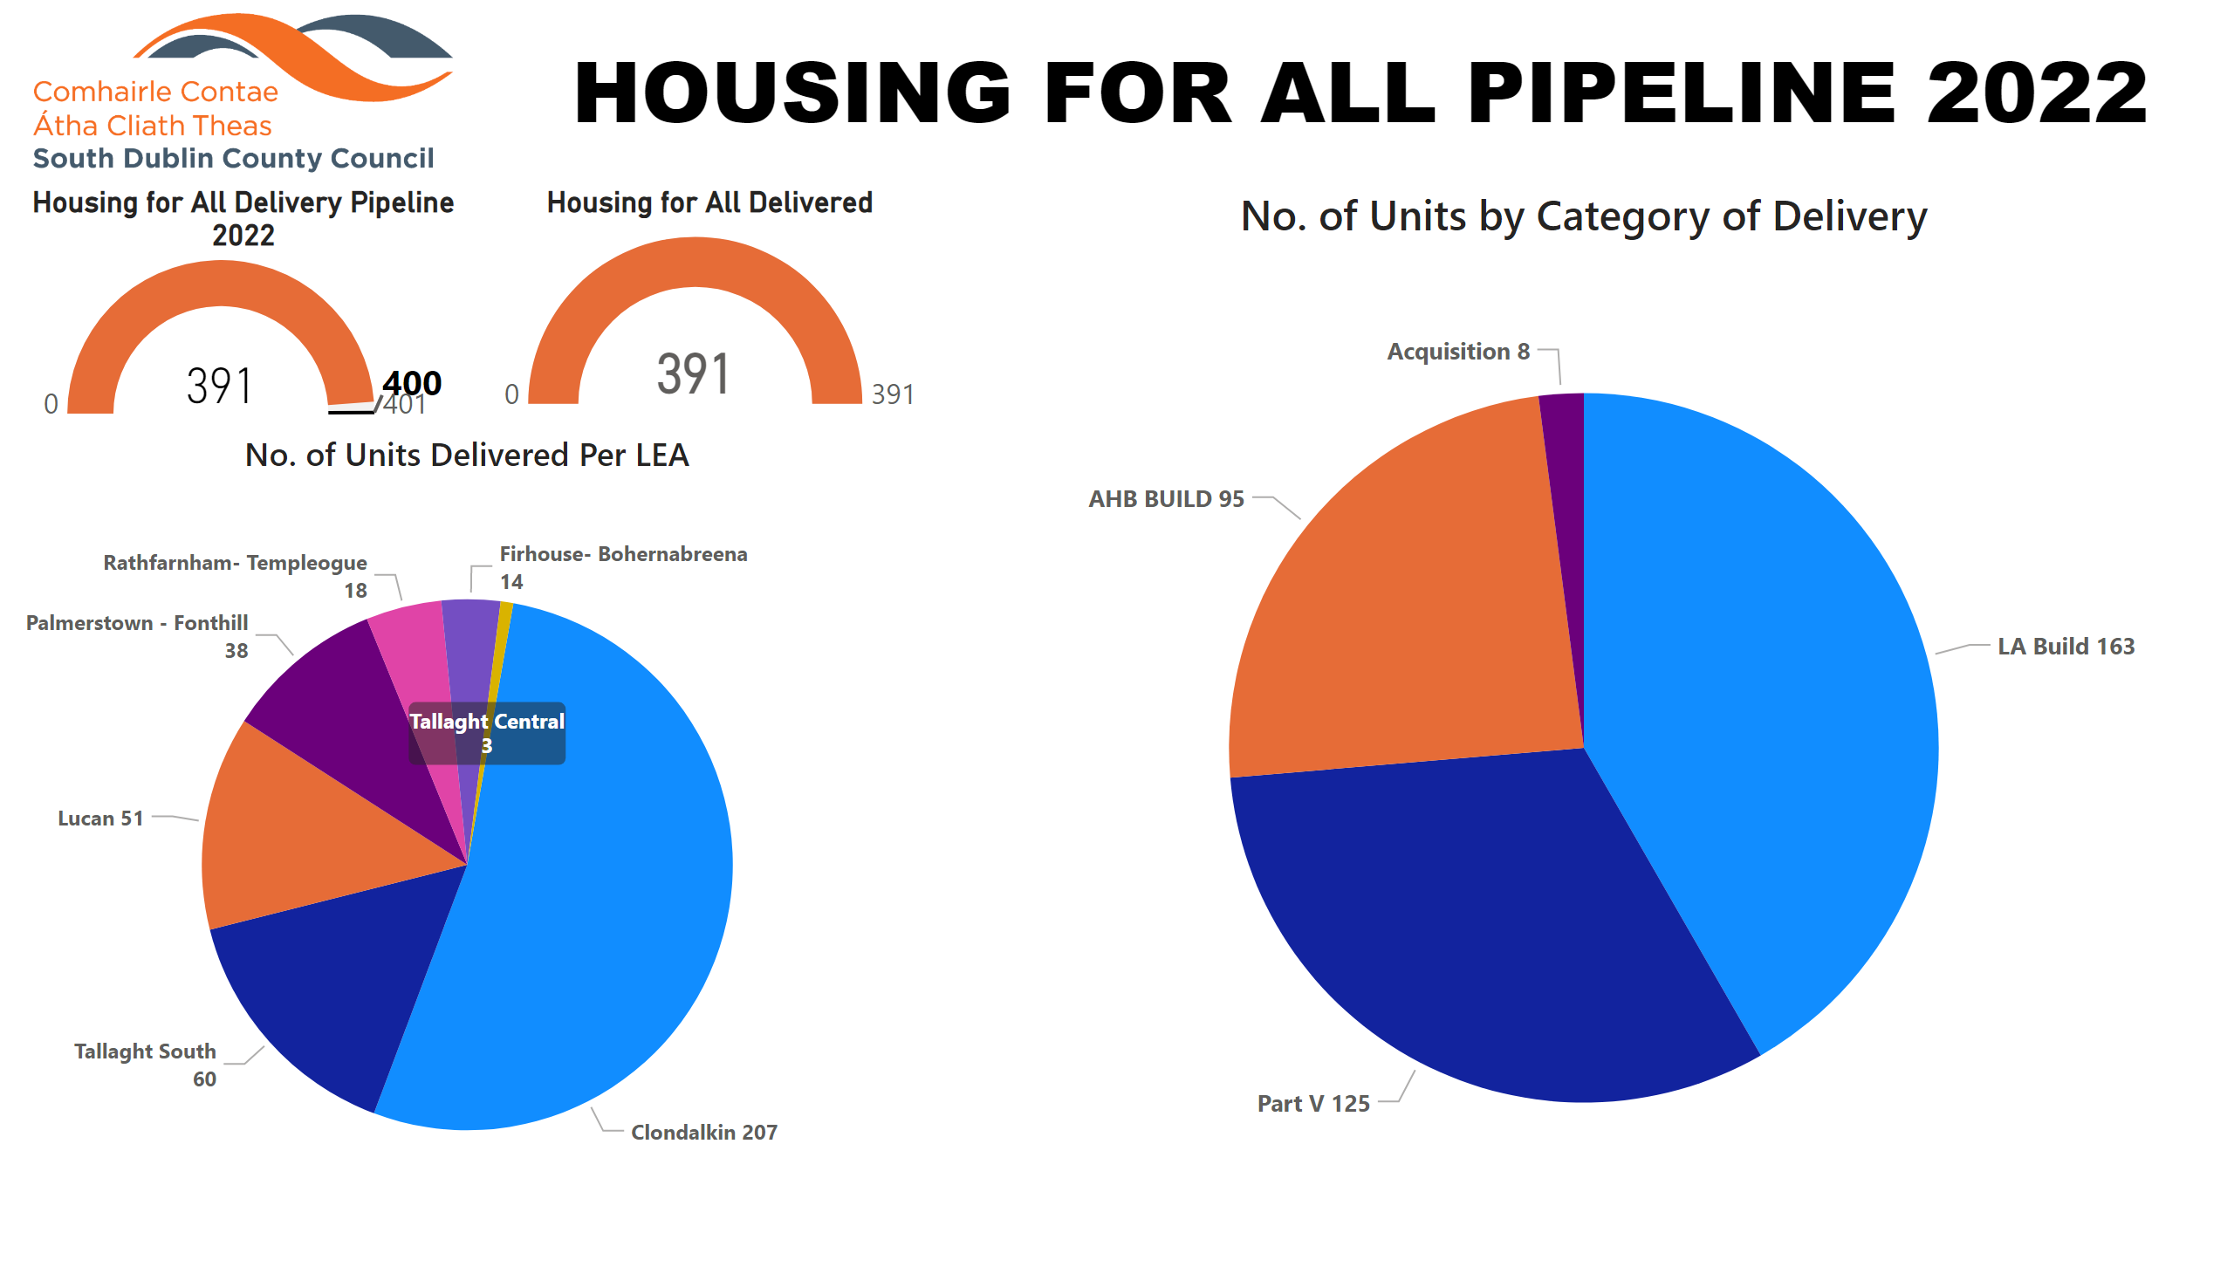
2022
Notes:
image
No alt text provided
No. of Units Delivered Per LEA
No alt text provided
Housing for All Delivery Pipeline 2022
No alt text provided
textbox
No alt text provided
pieChart
No alt text provided
Housing for All Delivered
No alt text provided

Slide 3
2023
Notes:
Housing for All Delivered
No alt text provided
tableEx
No alt text provided
image
No alt text provided
No. of Potential Units Per LEA
No alt text provided
Housing for All Delivery Pipeline 2023
No alt text provided
textbox
No alt text provided

Slide 4
Approved/Proposed Developments by LEA (1)
LEA | Site | No. | Update
Clondalkin | Mayfield/Riversdale Phase 2 * | 18 | On site-due for completion Q4 2023
 | New Nangor Rd. (”eircom” site) * | 93 | On site-due for completion Q4 2023
 | Lindisfarne * | 19 | Site start delayed, risk for 2023 delivery.
 | Old Nangor Rd. (Simon) | 10 | Revised planning application- AI 31/3/2023 - delivery 2024
 | Deansrath/Melrose * (Age Friendly) | 25 | Concept design brought to ACM Dec 2022/Planning design to be progressed & advertised
 | Oldcastle Park (Mixed Tenure) | 50 | Concept design brought to ACM Dec 2022/Planning design to be progressed
 | Alpine Heights* (Age Friendly) | 12 | Concept design to ACM Feb 2023
 | Kilcarbery 2* | 20 | Concept design to ACM Q2 2023
 | Cloverhill (Pt V) | 4 | On site-due for completion June 2023
 | New Road Clondalkin (Pt V) | 2 | On site-due for completion 2023
 | Watery Lane (Pt V) | 6 | Part V to be agree/ delivery 2024
 | Gordon Pk/Clondalkin Rugby Club (Pt V) | 7 | Part V to be agreed/delivery est. 2024
Rathfarnham/Templeogue | Garretstown House (Pt V) | 2 | Part V to be agreed/delivery est. 2024
Firhouse/Bohernabreena | Homeville * | 16 | Tender to appoint contractor to issue Feb 2023
 | Pearse Brothers Park * (Age Friendly) | 10 | Design & technical team appointed
 | Castlefield * (Mixed Tenure) | 25 | Concept design to ACM Feb 2023/progress to planning
 | Stocking Lane * | 30 | Feasibility for AHB/CAS-priority needs
Notes:
* Denotes SDCC owned site

Slide 5
Approved/Proposed Developments by LEA (2)
LEA | Site | No. | Update
Tallaght Central | Old Bawn * | 12 | On site-due for completion Sept ‘23
 | Fernwood/Maplewood (Clúid) | 40 | New contractor to commence on site W/C 8th Feb 2023. Estimated completion Maplewood Q2, Fernwood Q3 2023
 | Whitestown Way (Clúid) | 81 | On site-due for completion Dec 2023/temporary closure of carpark and removal of bottle bank
 | Mountain Gate (Part V) | 7 | On site-due for completion mid-2023
 | St. Aongus’ Green | 10 | Design & technical team appointed Q2 2022
Tallaght South | Rossfield * | 9 | Scheduled for planning in Q1 2023
 | Parklands Citywest | 54 | On site-due for delivery from June 2023 (29 units 2023, balance 2024)
 | Citywest Village/Mews (Pt V) | 27 | On site-due for completion Q2 2023
Lucan | Aderrig (Pt V) | 21 | 2 homes in Q4 2022 & balance in Q4 2023
 | Somerton Phase 2 (Pt V) | 24 | On site-due for completion Q2 2023
 | St Helens/Somerton (Part V) | 12 | On site-due for completion Q2 2023
 | Tandys Lane (Pt V) | 24 | On site-due for completion 2023
 | St Helens Plaza (Pt V) | 4 | On site-due for completion 2023
 | St Edmunds (Pt V - TAU Fonthill) | 7 | Part V agreed – off site delivery 2024
 | Adamstown Station/District Centre (Pt V) | 74 | Part V units various phases/delivery from 2024
 | Sarsfield Park * | 6 | Concept design to be brought to ACM Q2 2023
Palmerstown/Fonthill | Balgaddy * | 69 | Contractor on site, delivery 2024
 | Old Lucan Rd (Túath) | 4 | Scheme paused currently financially unviable. SDCC investigating acquiring adjacent strip of land.
 | St. Ronan’s * | 9 | Design & technical team appointed Q3 2022
Notes:
* Denotes Council owned site

Slide 6
SDCC-owned Large Sites
Kilcarbery: 1,034 homes with 30% social (310 homes)
78 social, 16 affordable purchase & 74 cost rental (Túath) homes complete in 2022 Projected delivery of 103+ social and 29 discounted/affordable purchase homes in 2023, scope for further social homes
Killinarden: 620 homes (including 125 social & 372 affordable purchase).
LSRD planning application lodged, decision due End Feb 2023 then projected from 2024 (subject to planning)
Clonburris: Phases 1 & 2 comprising 382 homes (149 social), Phases 3,4,5 with potential for 1,600 homes (40% social)
Tender to be advertised to appoint mutli-disciplinary design teams for Phases 3,4 & 5 this month. Tender advertised to appointed contractor for Ph 2 (CA) – Closing end Feb. Tender for Phase 1 to be advertised Q1 2023 Proposed PPP site comprising 120 social homes–Section 85 agreement brought to Council in Feb 2023 – see further slide
Belgard Square North: 133 cost rental apartments
Tender to appoint contractor complete – letter of appointment to issue Feb 23 Engagement with DHLGH and Housing Agency on cost model, AHF subsidy and project viability – report to Council in February 2023
Rathcoole: Number of homes & tenure mix to be confirmed
Design team appointed to redesign site following re-zoning County Development Plan Plan to include social homes and Traveller accommodation, scope for affordable housing to be examined

Slide 7
LEASING 2022
Target (HFA) 40
Notes:
image
No alt text provided
textbox
No alt text provided
shape
No alt text provided
Number of Leases Completed by LEA and Lease Type
No alt text provided
Number of Leasing Completed by Type
No alt text provided

Slide 8
2023
Target (HFA) - 90
Notes:
textbox
No alt text provided
shape
No alt text provided
Number of Lease units by Project and Lease type
No alt text provided
Number of Lease units by LEA
No alt text provided
image
No alt text provided

Slide 9
Clonburris PPP Site – S85 Agreement
Overview of PPP Programme
Nov 2014: Social Housing Strategy 2020 - boost social housing supply (incl. through off-balance sheet mechanisms e.g., large scale Public Private Partnership programme)
PPP: DHLGH, LAs, NDFA & specially-formed project company
Programme rolled out in bundles (Bundle 1: SDCC/109 homes in Corkagh Grange)
Sept 2021: ‘Housing for All’: increase use of PPPs for social housing delivery & call for sites
SDCC submitted site within Clonburris SDZ with capacity for approx. 120 homes & capable of being independently delivered – subsequently included in bundle 5
Overview of Functions/Responsibilities
DCC (lead LA) will enter agreement with Project Company for delivery/management of Bundle 5 social housing
Project Company to be selected via open EU tender competition
Project Company to occupy land under licence for purposes set out in Project Agreement
SCC responsible for obtaining planning approval under Planning & Development Acts

Slide 10
Bundle 5 Sites
Site | Local Authority
Barry Road, Finglas | Dublin City Council
Cherry Orchard Avenue | Dublin City Council
Balally, D16 | Dun Laoghaire- Rathdown County Council
Lambs Cross, Sandyford | Dun Laoghaire- Rathdown County Council
Oldtown Mill, Celbridge | Kildare County Council
Coolaghknock Glebe, Kildare Town | Kildare County Council
Ballymakenny East | Louth County Council
Clonburris | South Dublin County Council
Burnaby, Greystones | Wicklow County Council
Rehills, Bray | Wicklow County Council

Slide 11
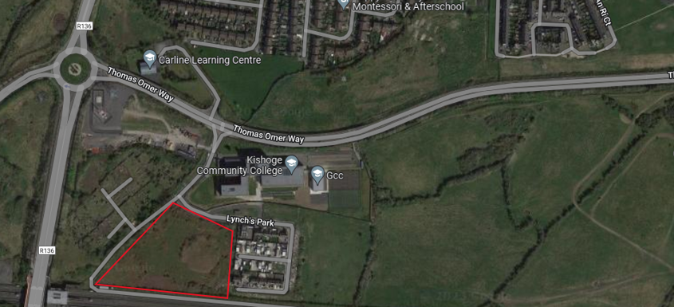
SDCC PPP Site Clonburris
HDAP – prevailing social housing need/interim HNDA
Site SDZ – 2.4 ha. Kishogue North East (Sub-Sector 4)
Zoned residential/density 45-55 units per ha. Potential 110-120 homes.
Well serviced site/local amenities/benefits from transport opportunities

Slide 12
Council Functions & Responsibilities
Next Steps after s85 Approval
Land remains in Council’s ownership
Homes fully revert to Council management after 25 years
SDCC will retain the following functions for the PPP social housing development:
Responsibility for calculation of tenant rents, under our differential rent scheme.
100% tenant nomination rights for PPP social homes
Role of landlord under our tenancy agreement
Project Company act as Council’s agent for management & maintenance of development (25 years)
Design teams appointed / work in collaboration with lead authority and SDCC
SDCC senior officials on relevant working & steering groups
Planning process – undertaken in 2024
Tender process to select Project company to be managed by NDFA
Regular communication and updates via SPC for members at project key stages
Project Company appointed for management & maintenance of development.
Project completion & delivery of homes anticipated 2026

Slide 13
New Planning Measures
Context & Overview
Prevailing housing market conditions: homelessness/temporary deferral of NTQs in private market/supply challenges
Planning and Development and Foreshore Act 2022 amends s.179 of LG Act
New, temporary, timebound provisions for accelerated housing delivery
S.179 (a.) temporarily dis-applies Part 8 planning approval process for LA housing developments in strictly defined circumstances:
Development works to be commenced by 31st December 2024
Appropriately zoned land in Council ownership
Aligned with Housing strategy
Land serviced/capable of being serviced
Not required to undergo environmental impact assessment
Notification of plans for proposed development to elected members & public
Where criteria are not satisfied, normal Part 8 process applies

