Slide 1
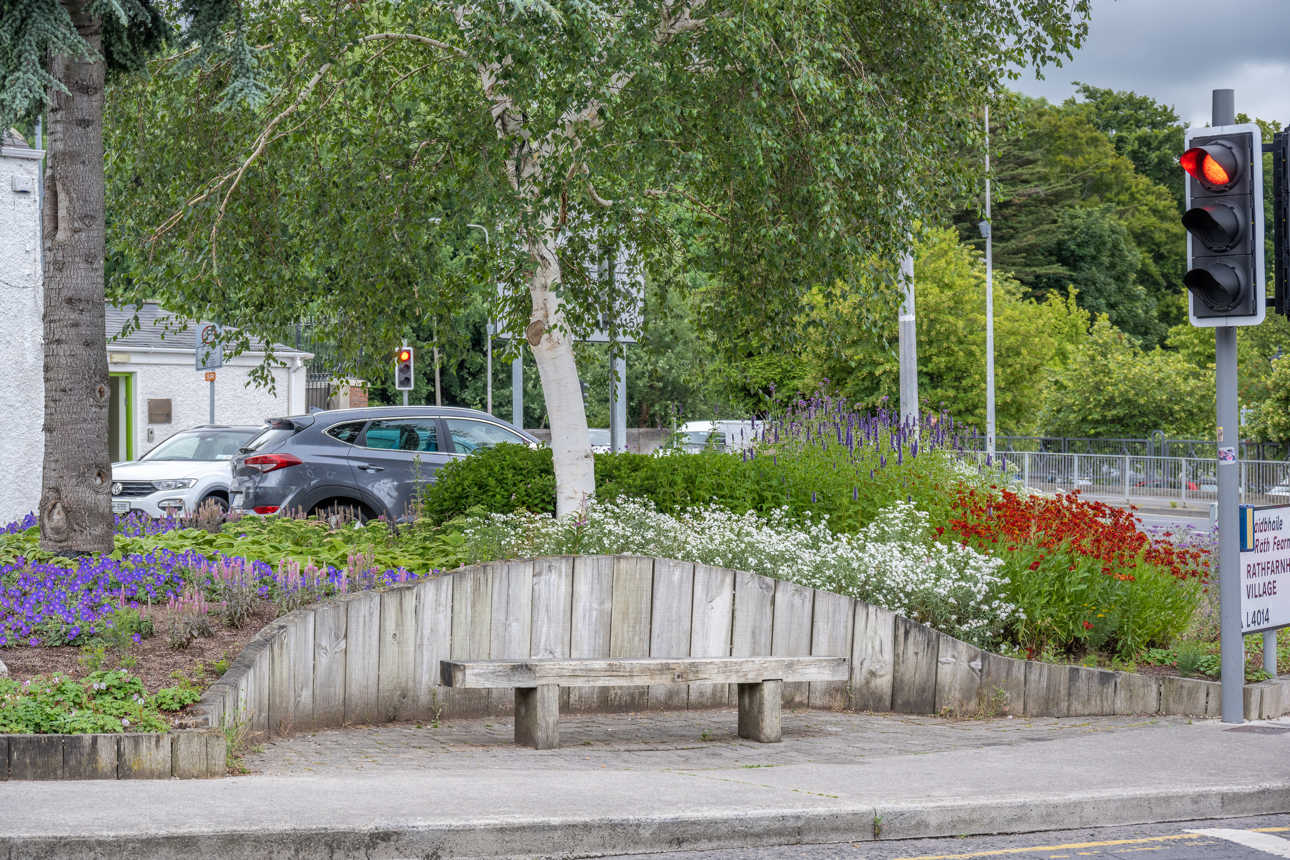
2023 Public realm & Surface Water improvement works Programme
Notes:
Some of you may know me but for those who don’t my name is Brendan Redmond I'm an Senior Executive Landscape officer in the Public Realm Section, I manage half the county's parks & open spaces. Today I'm going to talk to you about the mini woodlands we have planted to date and our experiences.
So lets start with the WHY…. In 2019 Ireland declared that we as a country are in a climate change & biodiversity emergency, we as people must react to this to put our best foot forward to protect, preserve and enhance biodiversity of our county & country.
Around the world, trees take up 30% of land. Ireland is lagging behind with 11% tree canopy cover particularly in urban settings. This project gives great hope to future generations that we can up our tree canopy cover.

Slide 2
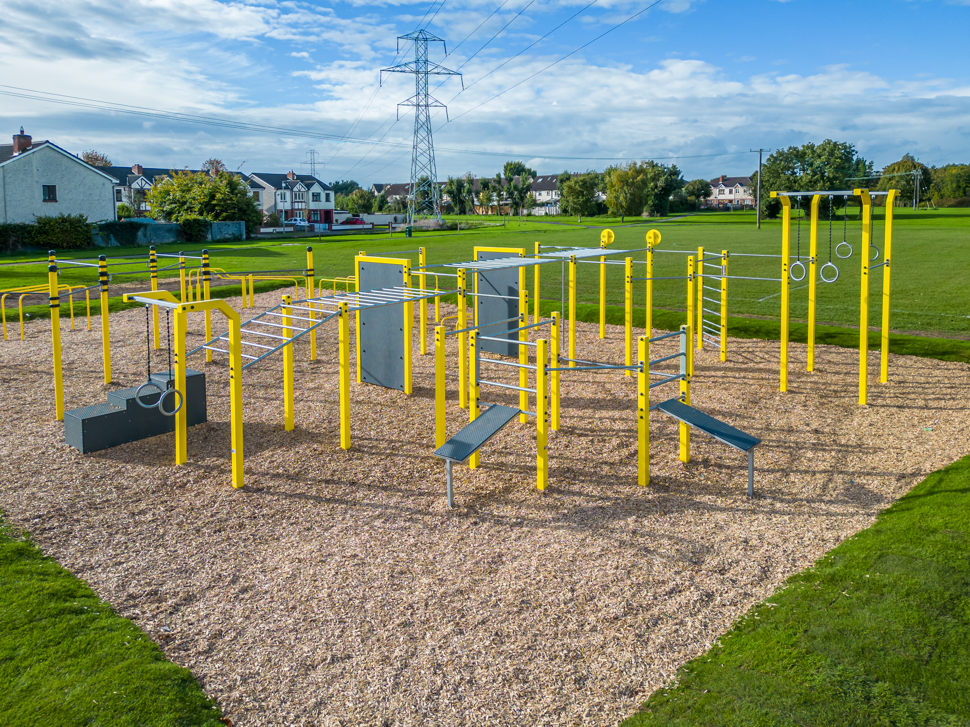
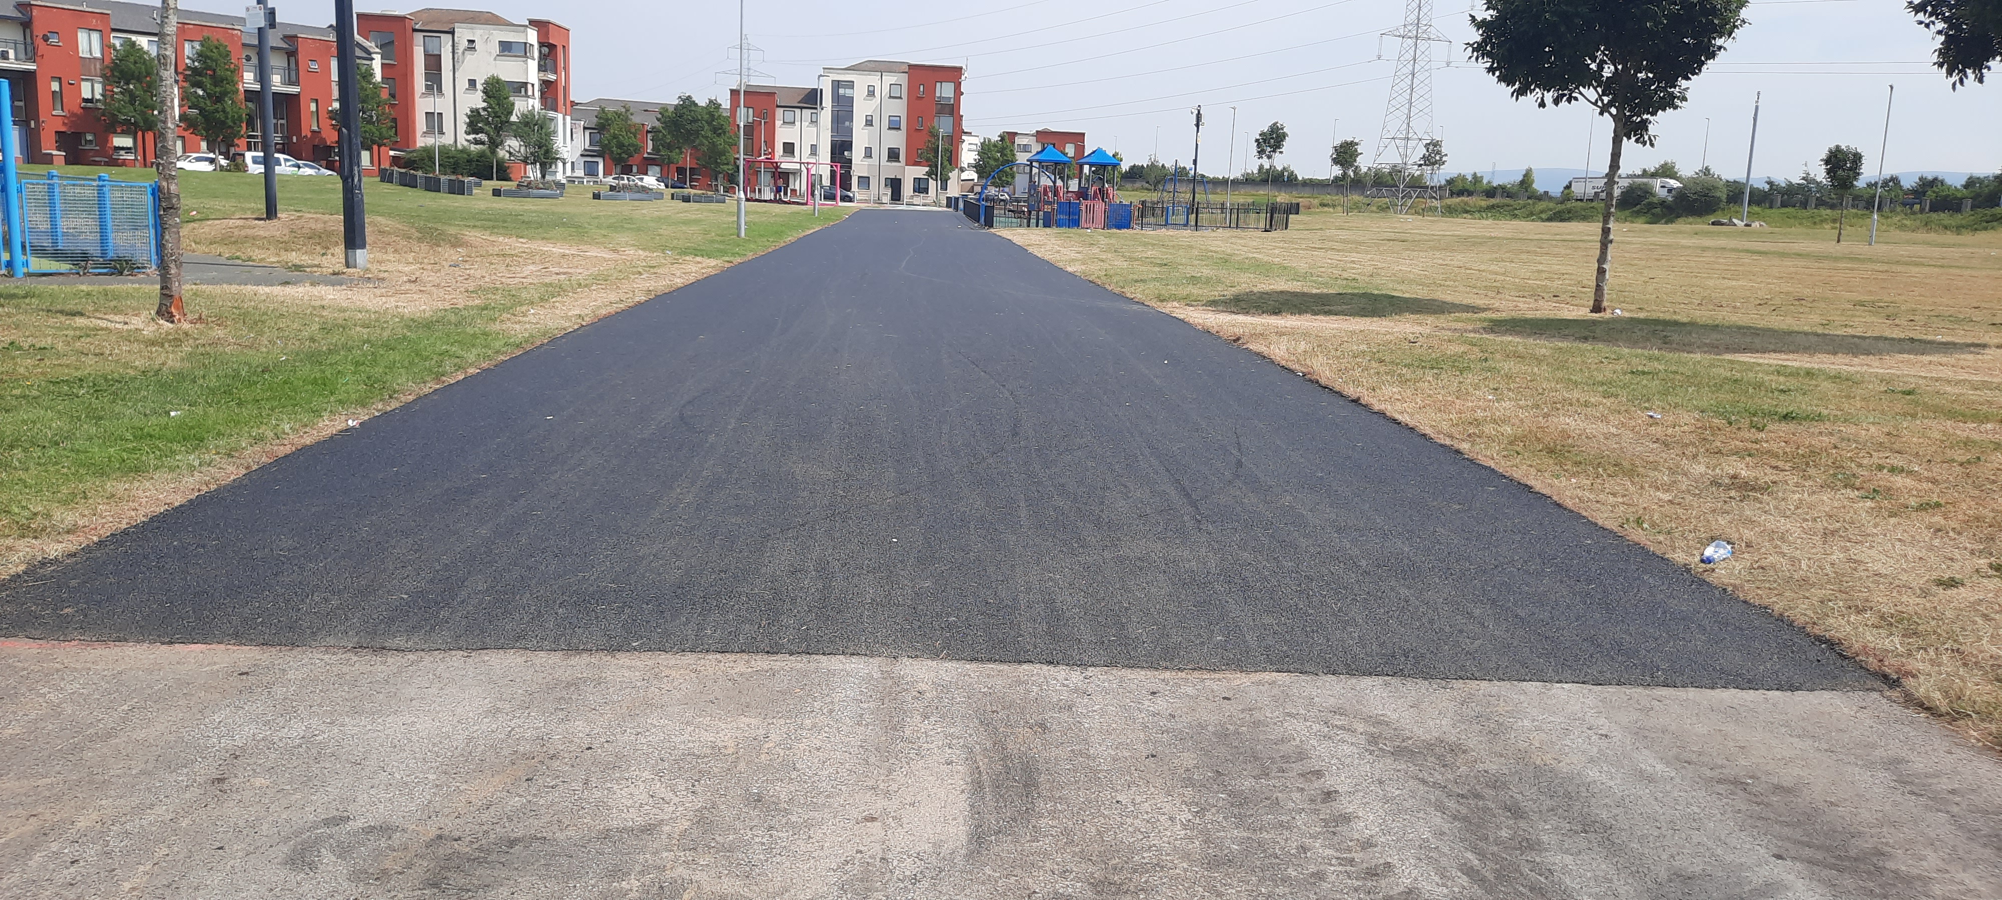
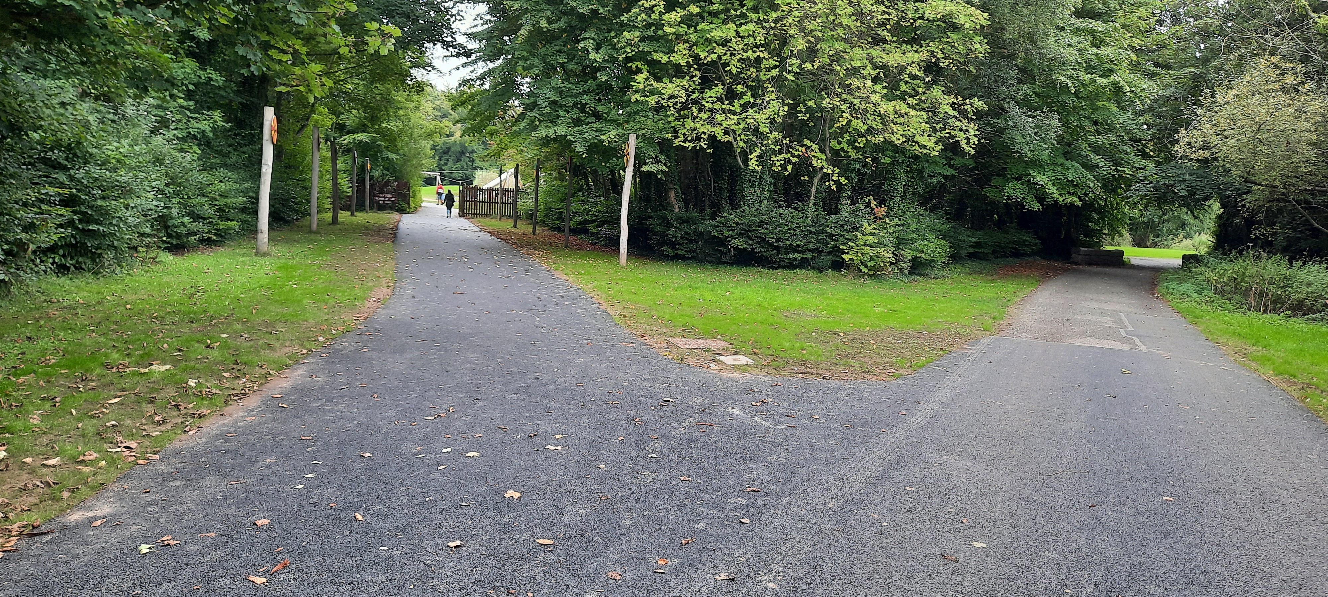
Clondalkin
No | Location | Description of Works | Estimated cost
1 | Clondalkin Playground | New equipment | €15,000
2 | Clondalkin Skatepark | Provide lighting (subject to DPIA) | €50,000
3 | Corkagh Park | Surface path on north side of fishing lake | €52,000
4 | Corkagh Park | Upgrade section of Oak Avenue beside fairy walk | €25,000
5 | Corkagh Park | Surface path to dog run & paddock area | €10,000
6 | Corkagh Park | Restore section of wall at entrance to Walled Garden | €45,000
7 | Corkagh Park | St Johns Car Park - replace bollards with stone wall | €50,000
8 | Corkagh Park | Replace vehicle barrier at MANN centre with park gates | €15,000
9 | Corkagh Park | Pollinator bulbs | €10,000
10 | Lealand estate | Upgrade path between Lealand Walk and Lealand Close | €10,000
11 | Monastery Gate Villas | Boundary upgrade between Mount Talbot Apartments & Monastery Gate Close | €15,000
12 | Monastery Road | Accommodation works for gateway sculpture | €15,000
13 | Monksfield Avenue | Path upgrade works | €15,000
14 | Mt St Joseph Cemetery | New information panel and headstone repairs | €10,000
15 | R120 Rathcoole Village | Pollinator bulbs | €10,000
16 | Rathcoole Park | Pollinator bulbs | €10,000
17 | Woodford Park | Path upgrade works | €30,000
18 | Woodford Park | Surface paths around Calisthenics equipment | €10,000
 |  |  | €397,000
Woodford Park
Balgaddy
Corkagh Park

Slide 3
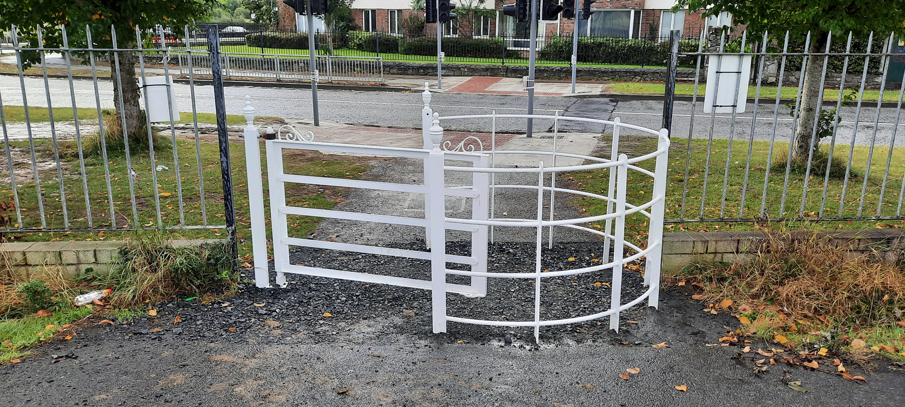
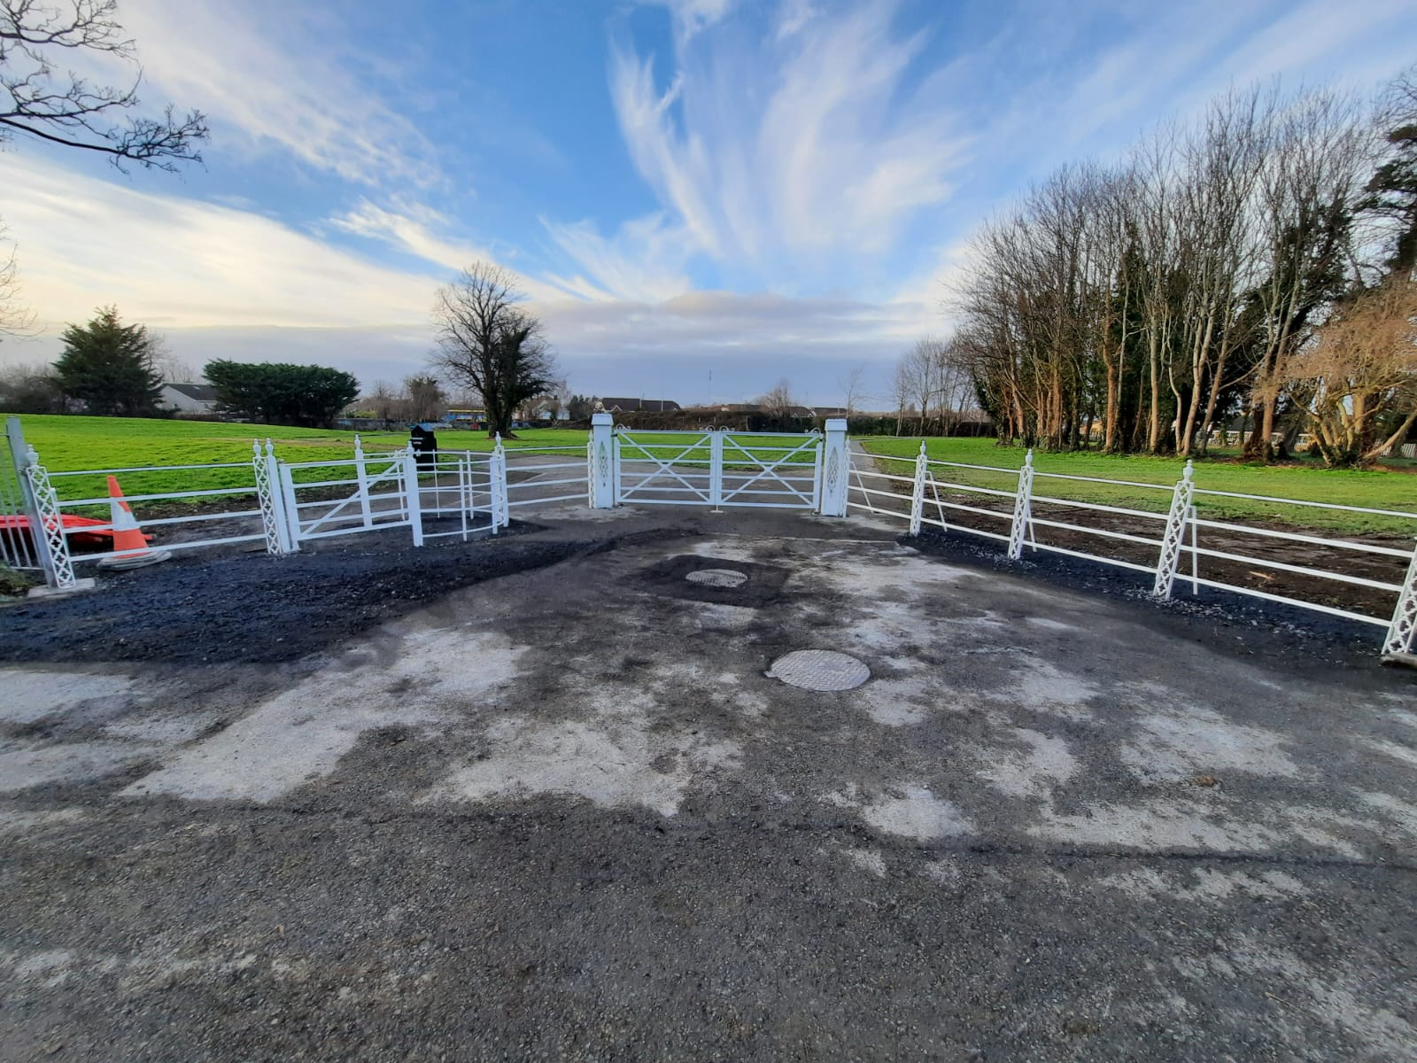
Lucan
No | Location | Description of Works | Estimated cost
1 | Lucan Demesne | Path upgrade works | €35,000
2 | Lucan Demesne | Upgrade fairy walk and provide accessible picnic bench | €10,000
3 | Lucan Village | Provide 4 flower boxes at Lucan Bridge & 1 at Vesey Bridge | €10,000
4 | Lucan Village | Upgrade handrail on ramp to Lucan Weir at St Andrew's Hall | €10,000
5 | Vesey Park | Upgrade sections of path network throughout park | €40,000
6 | Beech Park Green | Provide 2 benches on open space | €5,000
7 | Beechpark | Upgrade section of path on open space | €15,000
8 | Airlie Park | Resurface path opp Scoil Mhuire N.S | €15,000
9 | Esker Glebe | Replace pedestrian bridge over River Griffeen | €25,000
10 | Griffeen Valley Park | Surface path in Haydens Estate natural playground | €10,000
11 | Griffeen Valley Park | Upgrade ramps to footbridges to improve accessibility | €10,000
12 | Griffeen Valley Park | Pollinator bulbs | €5,000
13 | GVP - Newcastle Road car park | Mark car park | €10,000
14 | GVP - Haydens Lane car Park | Landscape area between parking bays and boundary wall | €10,000
15 | GVP - Haydens Lane car Park | Provide new entrance gates | €15,000
16 | Haydens Lane/Griffeen Avenue | Upgrade 2 roundabouts at Haydens Lane & 1 at Rosberry | €15,000
17 | Hermitage Park playground | Upgrade path system in playground beside embankment slide | €10,000
18 | Balgaddy | Surface path from Tor an Rí to Méile An Rí across open space | €15,000
19 | Harelawn | Surface path between Harelawn Park & Grove | €15,000
20 | Collinstown Park | Widen & surface path | €25,000
21 | Collinstown Park | Surface area inside vehicle entrance | €10,000
22 | Collinstown Crescent | Upgrade kissing gate between Collinstown Cres & Palmerstown Woods | €15,000
23 | Ballyowen Park | Path upgrade works | €20,000
24 | Glenaulin Park | Install interceptor drain along slope at the side of pitch 29 | €10,000
25 | Waterstown Park | Pollinator bulbs | €10,000
26 | Waterstown Park | Wheelchair-capacity play equipment | €15,000
 |  |  | €385,000
Griffeen Valley Park
Cluain Rí Park

Slide 4
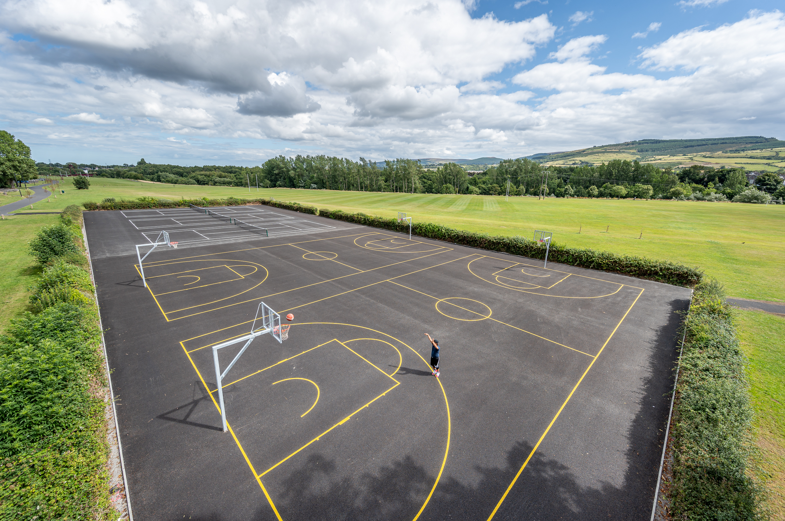
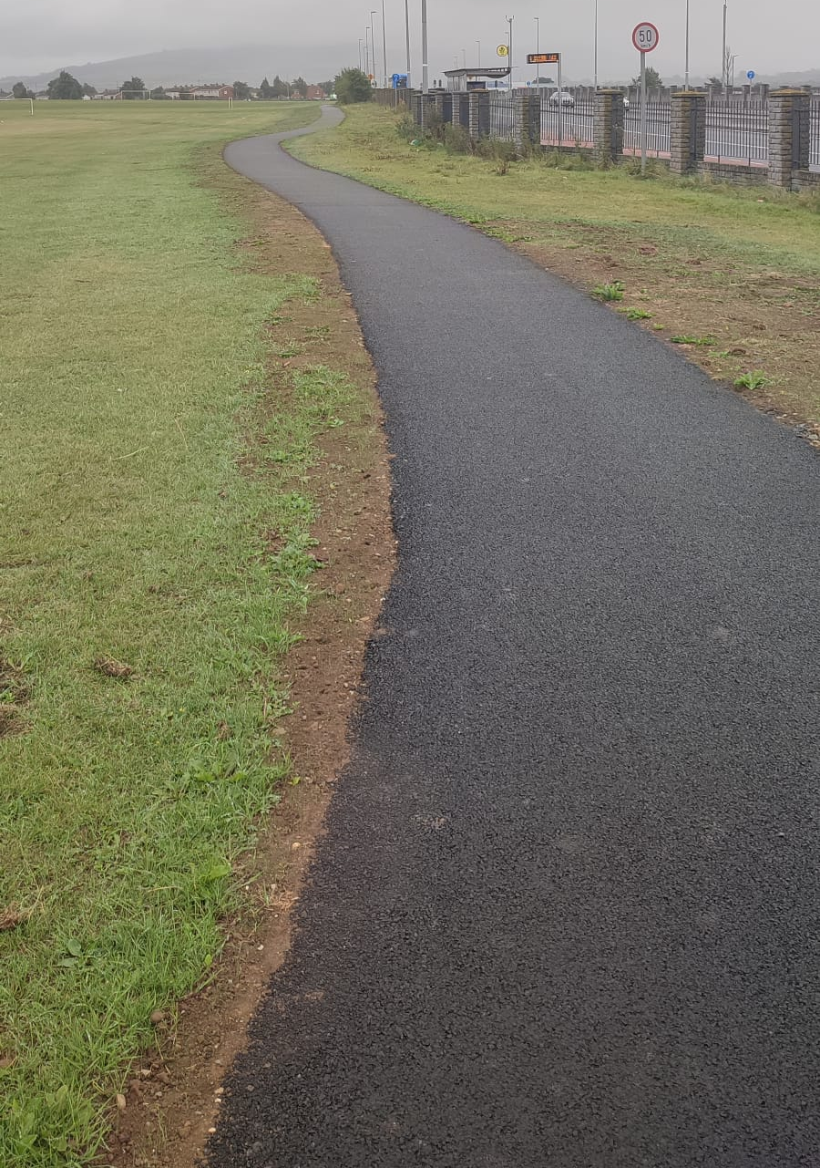
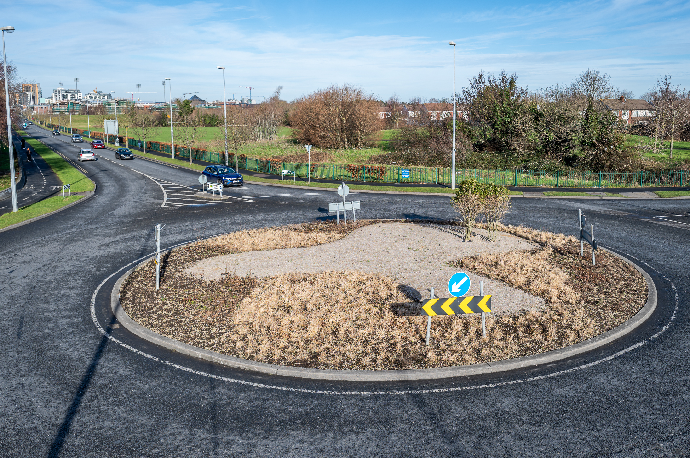
Tallaght
No | Location | Description of Works | Estimated cost
1 | Kingswood Playground | New perimeter fence for playground | €20,000
2 | Ashfield Road | Vehicle restriction fence between Walnut & Ashfield estates | €3,000
3 | Ballymount Park | Upgrade paths | €5,000
4 | Butler McGee Park | Looped footpath, constrcut next phase | €50,000
5 | Kilmartin Estate | Entrance from Outer Ring Road opposite Brookfield Community Centre, landscaping and fencing works | €40,000
6 | Sean Walsh Park | Installation of public lighting along footpath from Blue Bridge down towards sensory garden, adjacent to N81 | €25,000
7 | Old Bawn Drive/Parkwood | Install entrance gate to open space area between estates | €3,000
8 | Dodder Valley Park | Overseed previously planted wildflower areas | €5,000
9 | Aylesbury | Construct footpath across main open space from Pineview Rise to Firhouse Road West | €25,000
10 | Balrothery Rise | Install railing around open space | €30,000
11 | Tymon Park | Install railing along main Castletymon entrance road, from roundabout to depot | €40,000
12 | Cairnwood | Install lighting on new path from Cookstown Way to Cairnwood | €10,000
13 | De Selby estate | Provide new footpath across open space from De Selby Lawns to De Selby Road | €5,000
14 | Dodder Valley Park | Install perimeter fencing around tennis and basketball courts | €40,000
15 | Kilclare Estate | Provide footpath fromm Kilclare Gardens to Fortunestown Way | €10,000
16 | Avonmore Grove / Bolbrook Grove | Overlay footpaths between estates as necessary | €15,000
17 | Bancroft Park | Construct new footpath from entrance at Castle Park/Scoil St Aonghusa to link with path adjacent to the Poddle. | €15,000
18 | Belgard Rd/Belgard Sq North junction | Landscape upgrade works to roundabout at entrance to TUD | €20,000
19 | Tymon Park | Overlay footpaths where required. | €25,000
20 | Dodder Valley Park | Overlay footpaths where required. | €25,000
21 | Kilnamanagh | Landscape corner of open space on Treepark Road adjacent to M50. | €20,000
 |  |  | €431,000
Dodder Valley Park
Butler Magee Park
Whitestown Way Roundabout

Slide 5
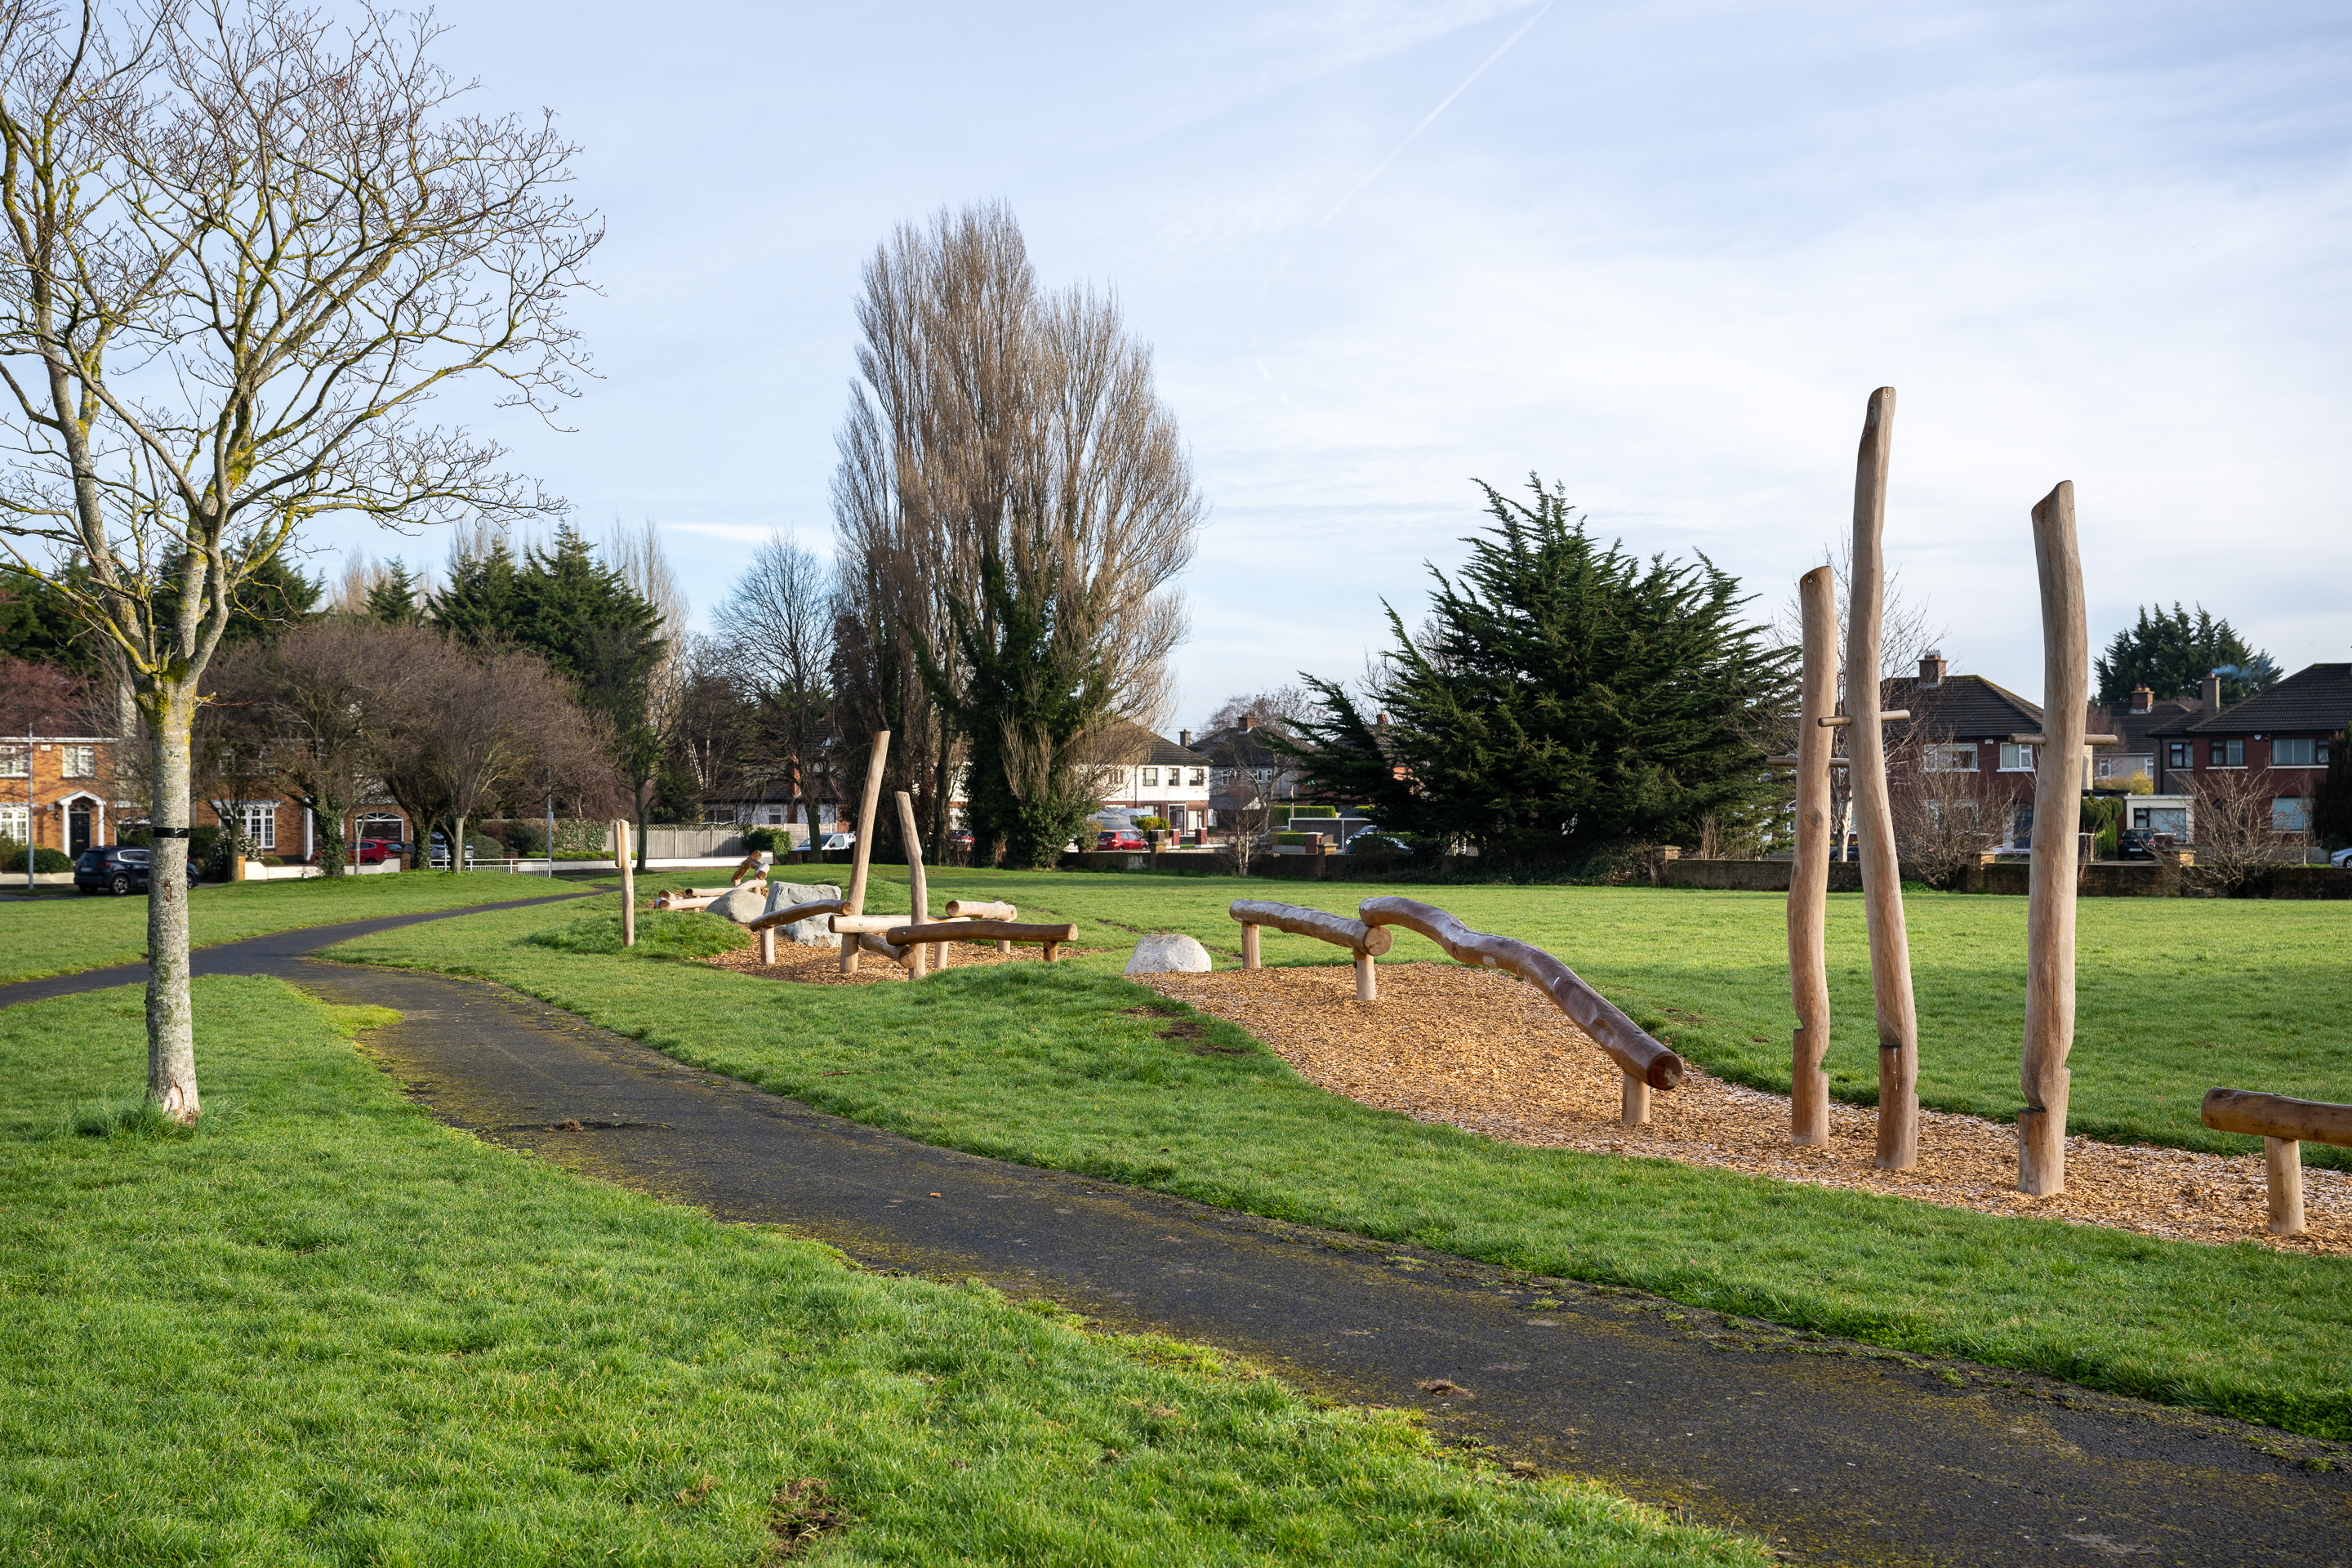
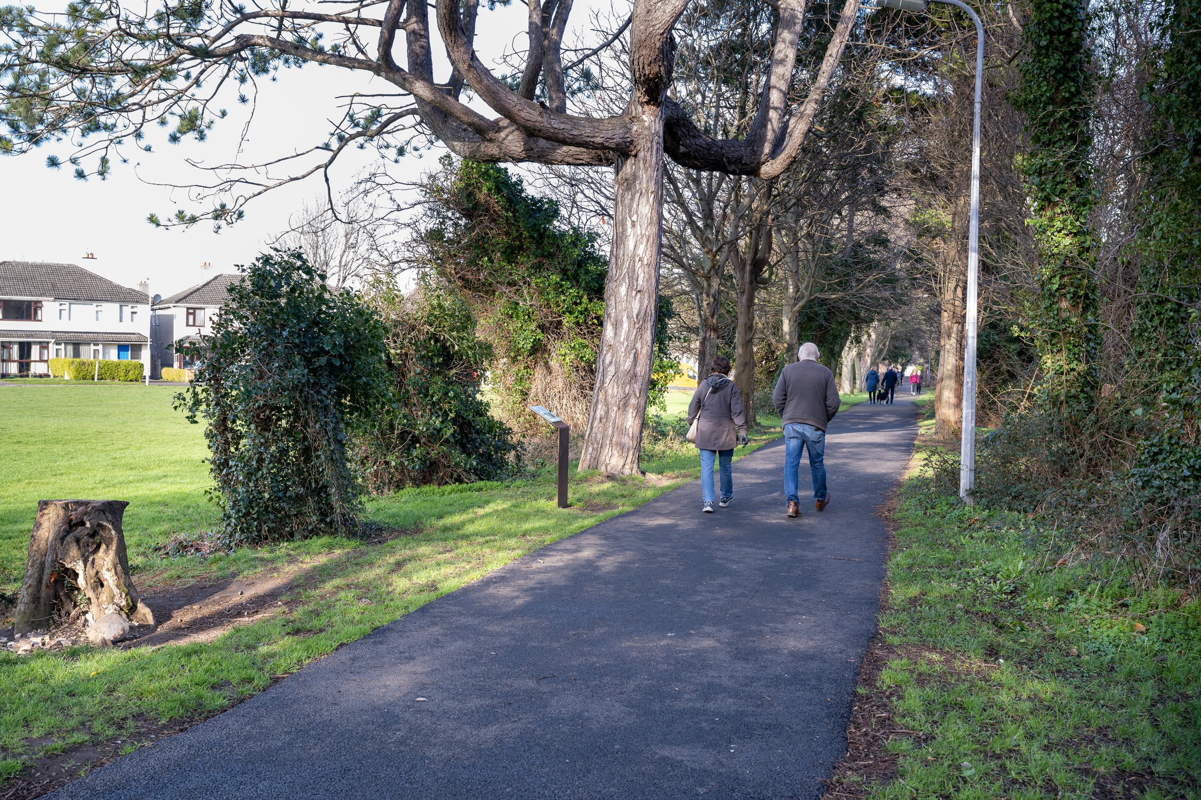
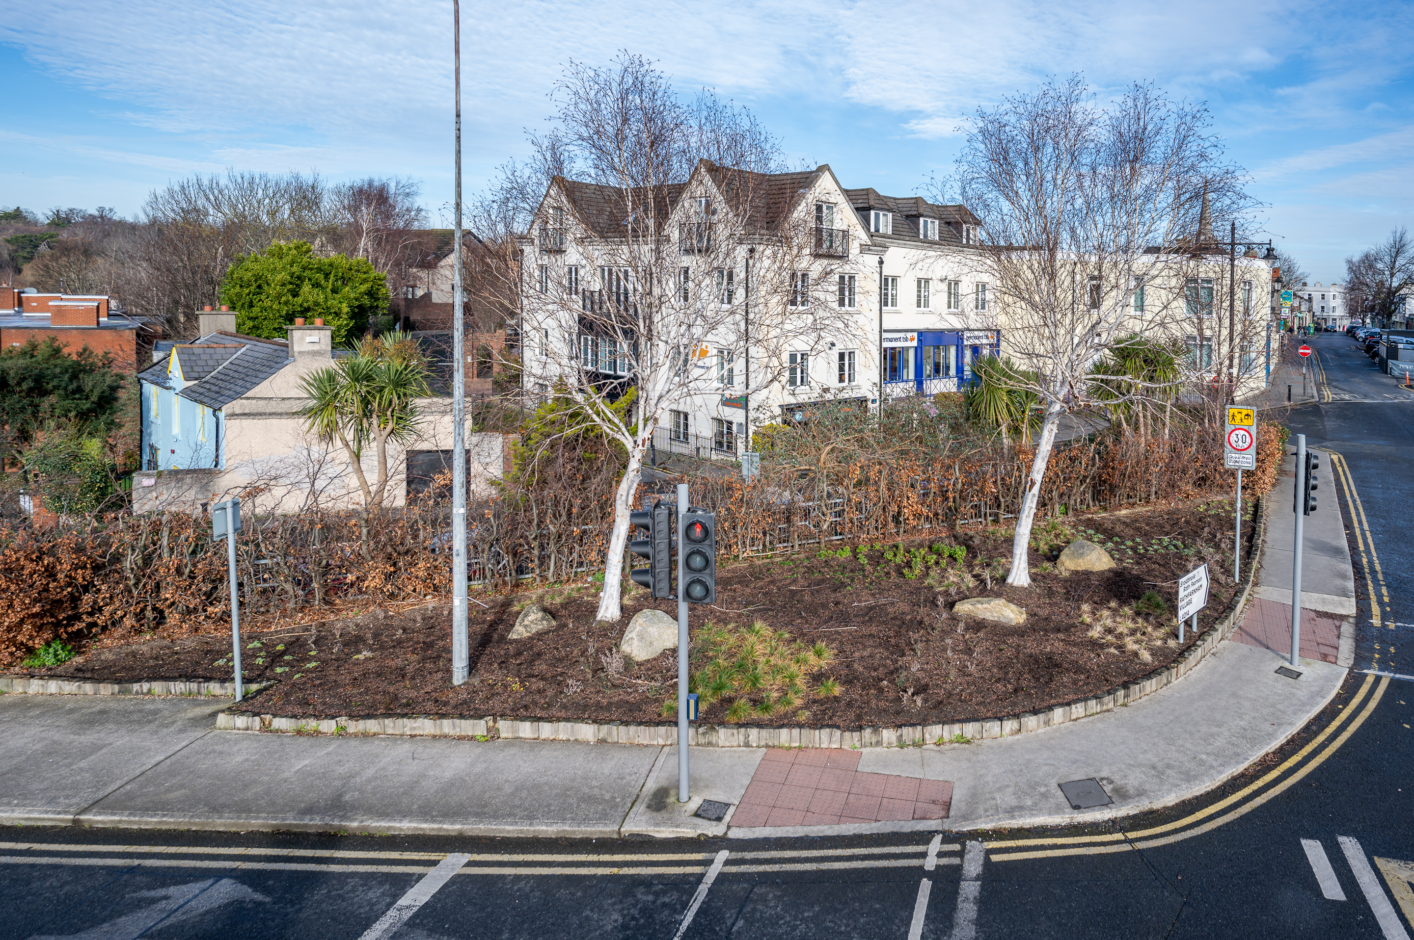
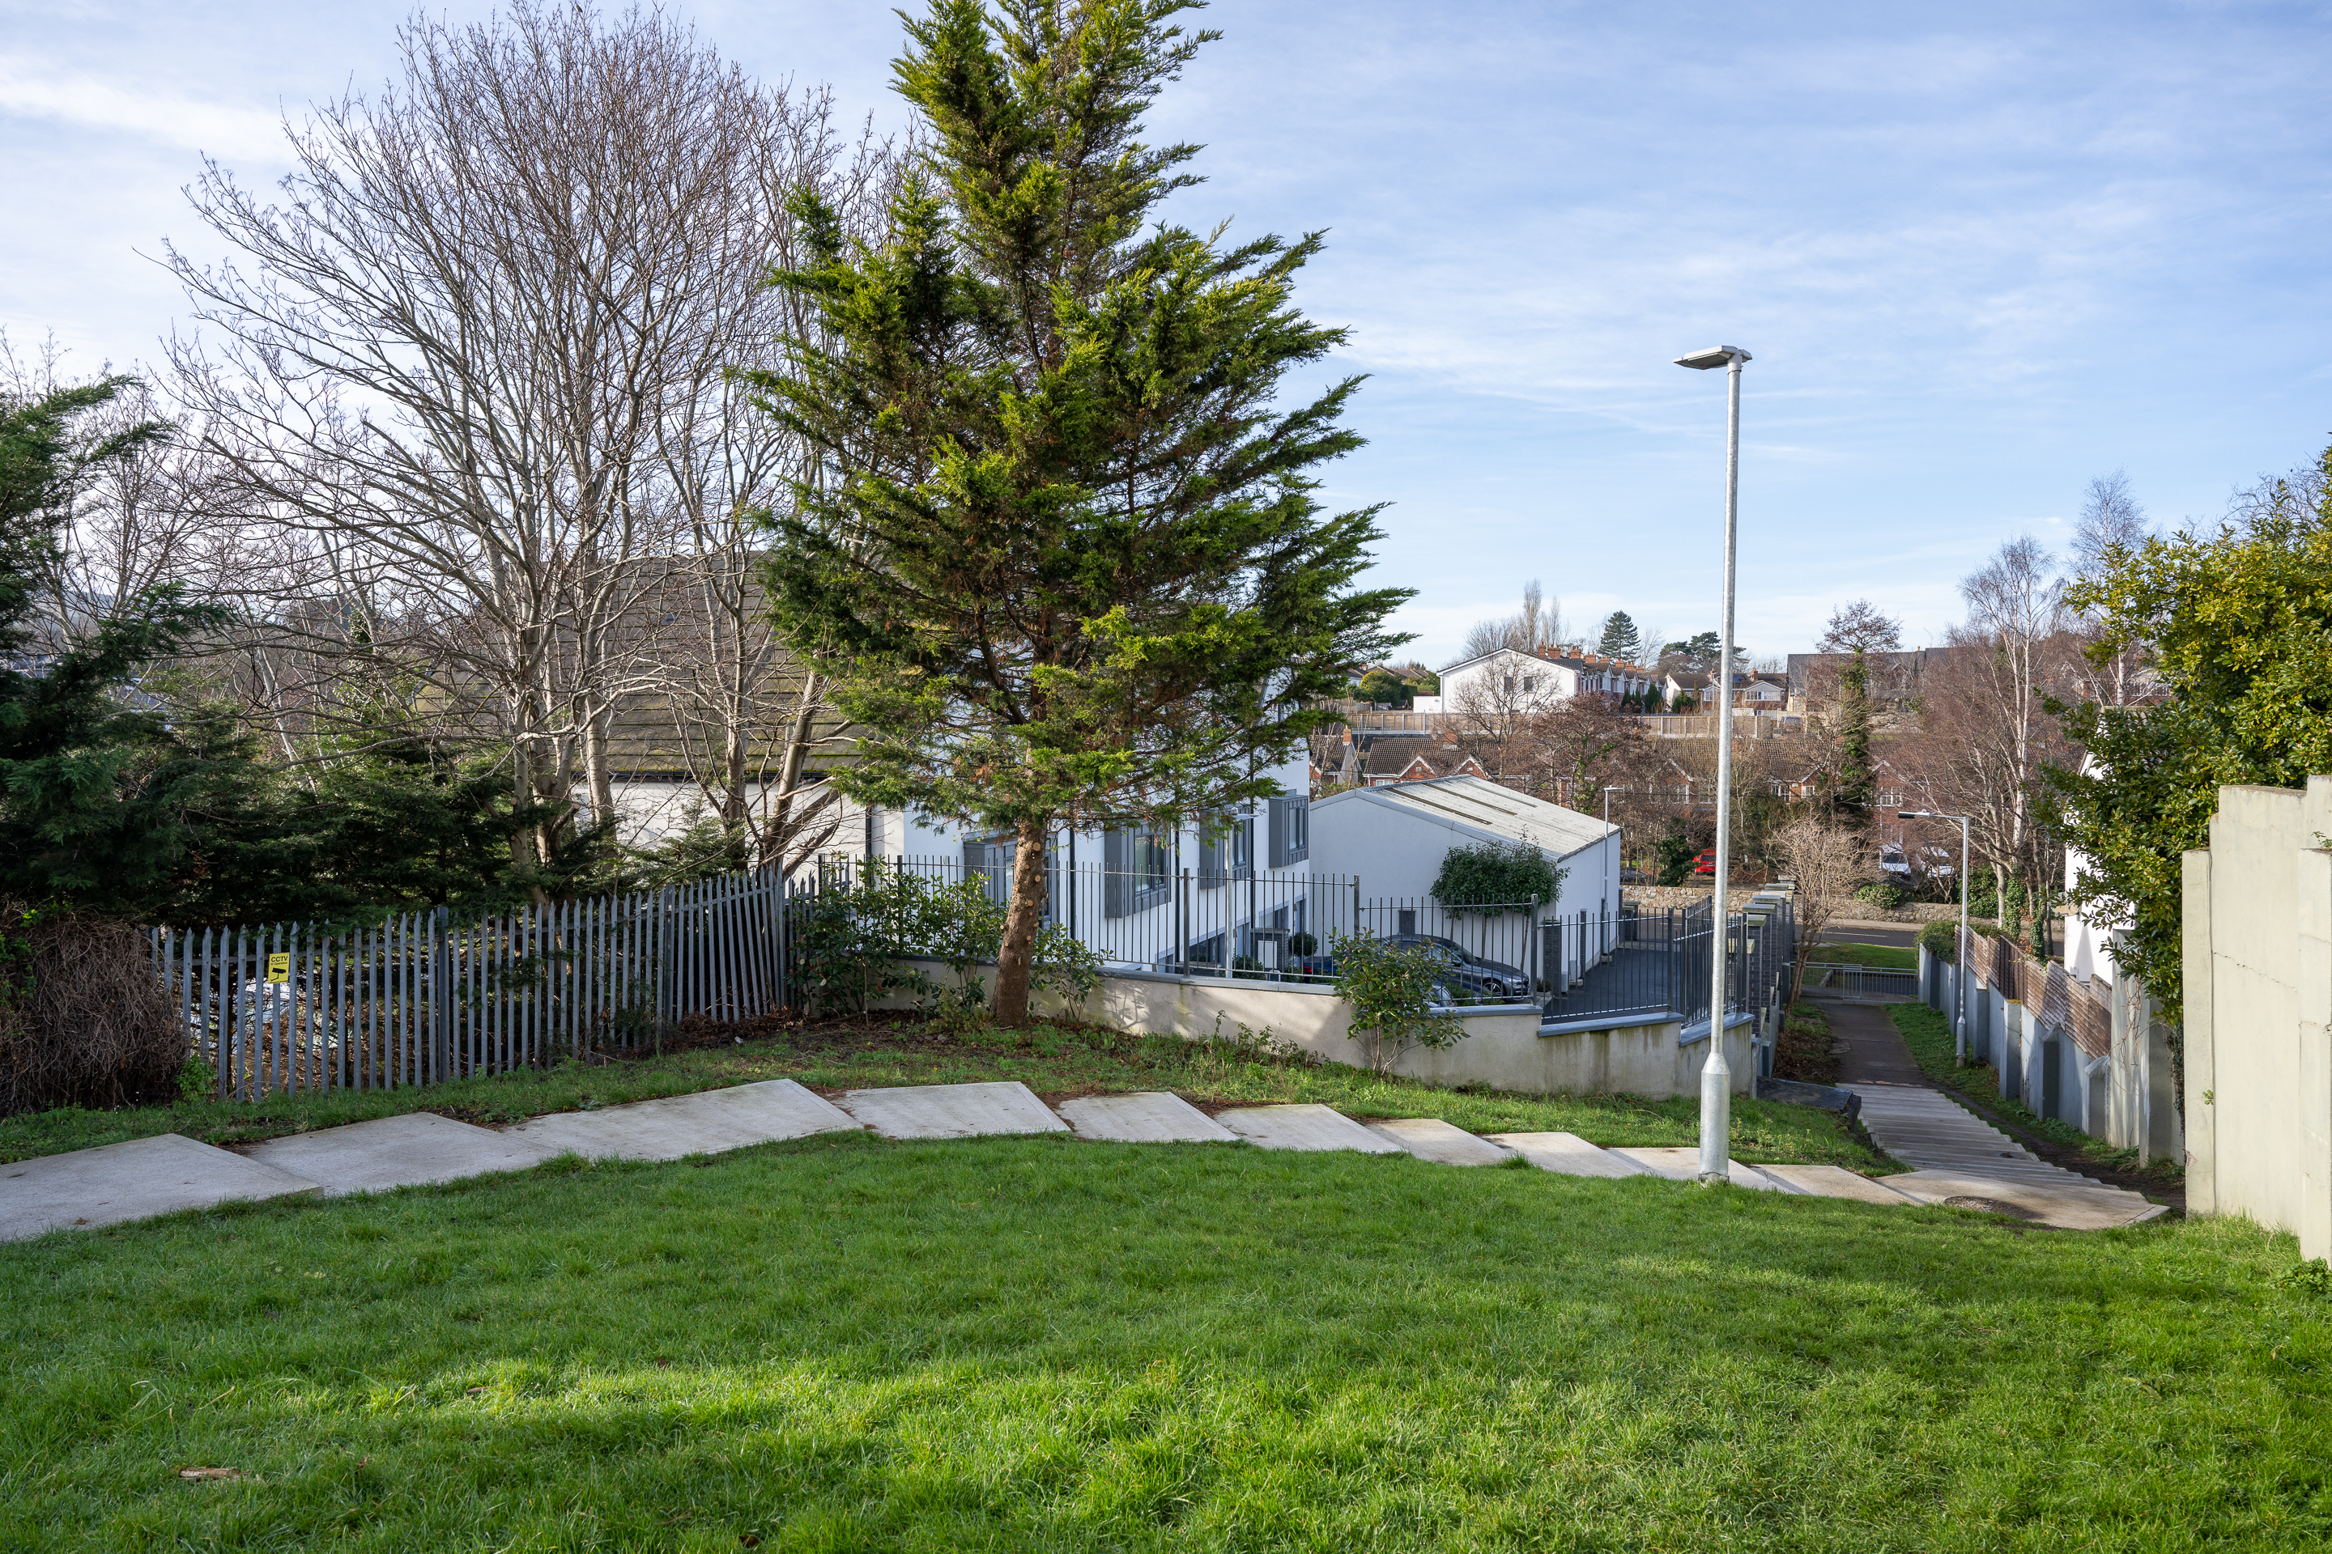
Rathfarnham
No | Location | Description of Works | Estimated cost
1 | Moyville Estate | Construct perimeter path around main open space adjacent to Whitechurch Estate | €40,000
2 | Cypress Lawn | Overlay existing footpath on open space between Cypress Lawn and Cypress Grove Road. | €45,000
3 | Ely Arch | Public Realm upgrade works on Ely Arch open space | €50,000
4 | Willbrook/Fonthill estates | Wildflower/bulb planting on open space between estates | €10,000
5 | Tymon Park | Improvement works to accommodate new intergenerational facility at the Wellington Lane car park | €150,000
6 | Firhouse | Public lighting scheme on footpath on open space adjacent to Scoil Treasa | €30,000
7 | Firhouse | Overlay existing footpath from Scoil Treasa to Carrigwood | €10,000
8 | Carrigwood | Erect fencing around Carrigwood playspace | €40,000
9 | Glendown | Erect fencing around Glendown playspace | €40,000
10 | Glenmore Court | Overlay hard surface area between Glenmore Court and Whitechurch estate | €30,000
11 | Grange Road | Upgrade works to wildflower margin along cycletrack/walkway from Grange Road to Grange Downs | €5,000
12 | Cypess Downs | Overlay existing footpath on open space adjoining The Heath & The Court. | €10,000
13 | Dodder View Road/Fairways | Bulb planting scheme at Fairways Estate and adjacent to Dodder View Road | €5,000
14 | Dodder Valley Park | Bulb planting at focal points within Dodder Valley Park | €10,000
15 | Templeroan Estate | Construct phase one of loop footpath around main open space | €35,000
 |  |  | €510,000
Cypress Downs
Rathfarnham Village
Moville Estate
Woodlawn Park

Slide 6
SURFACE WATER MINOR WORKS PROGRAMME 2023
Location | Project | Projected Exp. For 2022
Rathcoole Park | Regrade river bank – to alleviate overspill during heavy rainfall | €5,000
Tay Lane, Rathcoole | Regrade road to allow installation of upsized surface water pipework | €15,000
Hazelhatch Road | Repair and upgrade surface water pipe ~1km | €150,000
Lucan Village | New surface water pipeline required to facilitate and improve road drainage | €100,000
Butterfield Park | New surface water sewer to allow separation of surface water and foul sewage to alleviate foul sewer flooding. | €65,000
Cloverhill Road (Palmerstown Woods) | New surface water pipeline required to provide improved drainage. Project will coordinate with a Roads project in same location. | €100,000
Total |  | €435,000

