Slide 1
Shopfront Grant Scheme review year end 2022

Slide 2
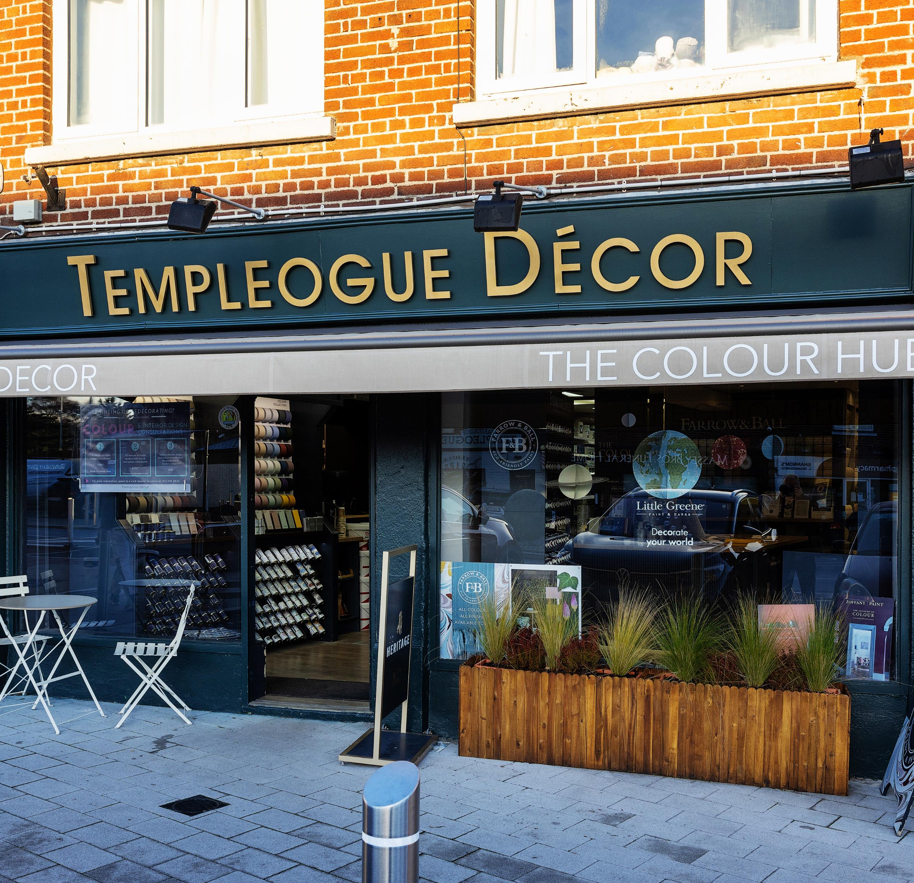
Shopfront Grant Scheme
Notes:
Details of the scheme including Terms and Conditions and application details for 2023 are available on the Council’s website at http://www.sdcc.ie/business/enterprise/business-support/shop-front-grant
Contact econdev@sdublincoco.ie or phone 01-4149000 with any queries regarding the scheme.

Slide 3
2022 vs 2021
2022
2021
New applications: 15
Carried forward: 10
Complete: 14
Average grant: €2,296.21
Total spend: €32,146.94
New applications: 28
Carried forward: 4
Complete: 16
Average grant: €2,855.13
Total spend: €45,682.05
Notes:
The annual Shopfront Grant Scheme provides grants for shopfront improvements ranging from painting updates to replacing an entire shopfront. Grants are available for a maximum of 50% of overall costs. Furthermore, a prize of €1,000 is awarded for the Best Designed Shopfront under the scheme. 2022 is the ninth successive year of this progressive scheme, supported by South Dublin County Council. The scheme is becoming increasingly popular, and the council would encourage local businesses to apply for the 2023 scheme.

Slide 4
Best Shopfront winner 2022
Templeogue Decor paint a beautiful picture with new shopfront
Notes:
Paint, wallpaper and decor experts Templeogue Décor have been awarded €1,000 in recognition of the work undertaken to transform the shopfront design of its business premises.
Templeogue Décor, 293 Templeogue Road, Templeogue Village, received €1,000 from South Dublin County Council under the Council’s annual Shopfront Grant Scheme. The award of Best Designed Shopfront was in addition to a grant received to part fund the installation of an improved shopfront design.

Slide 5
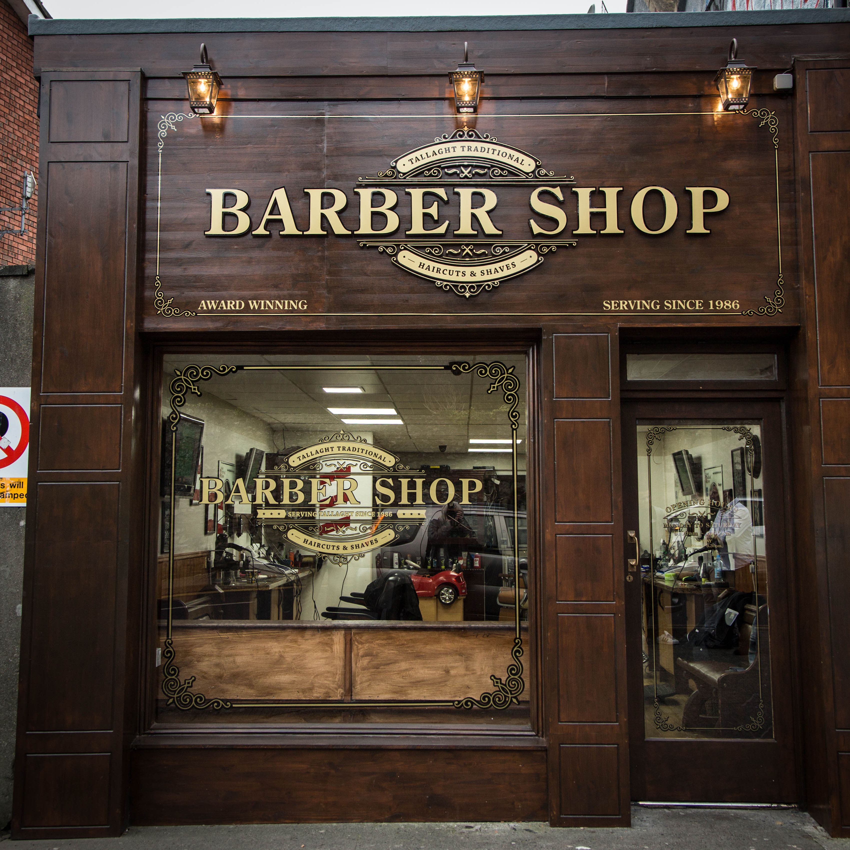
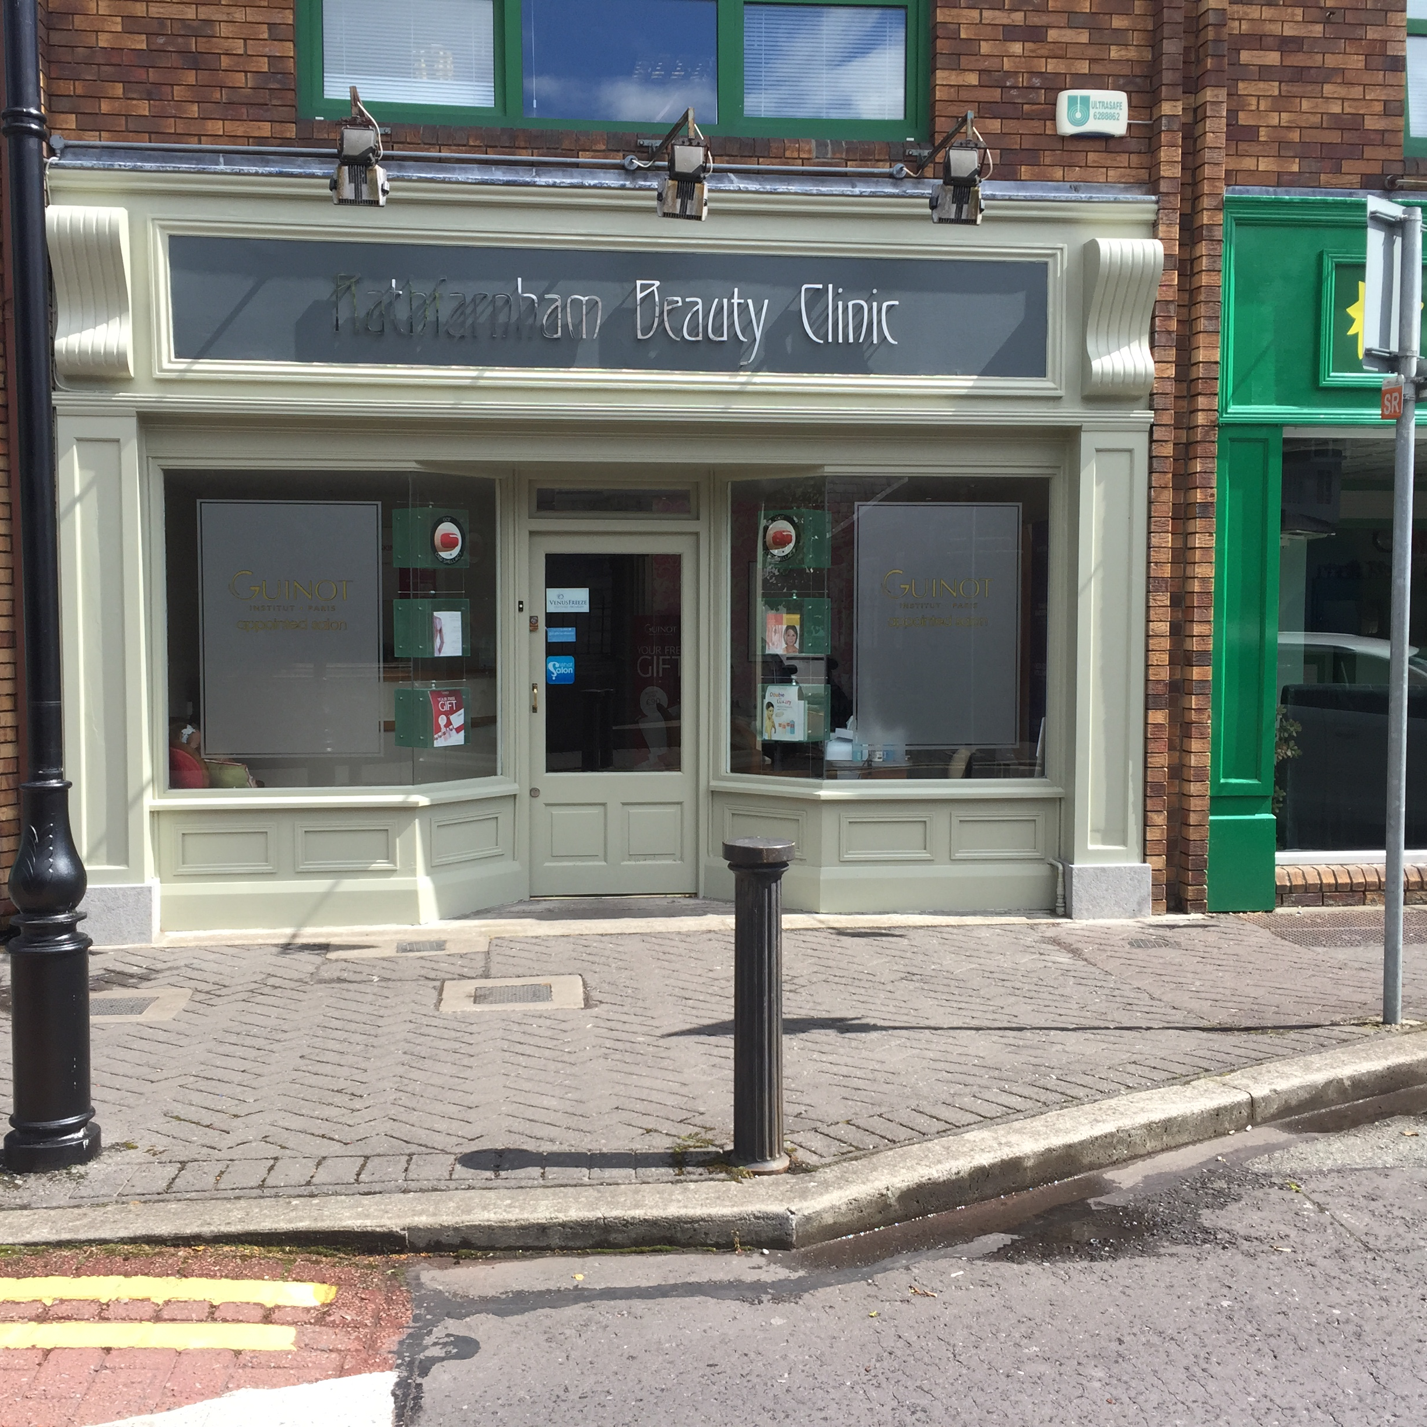
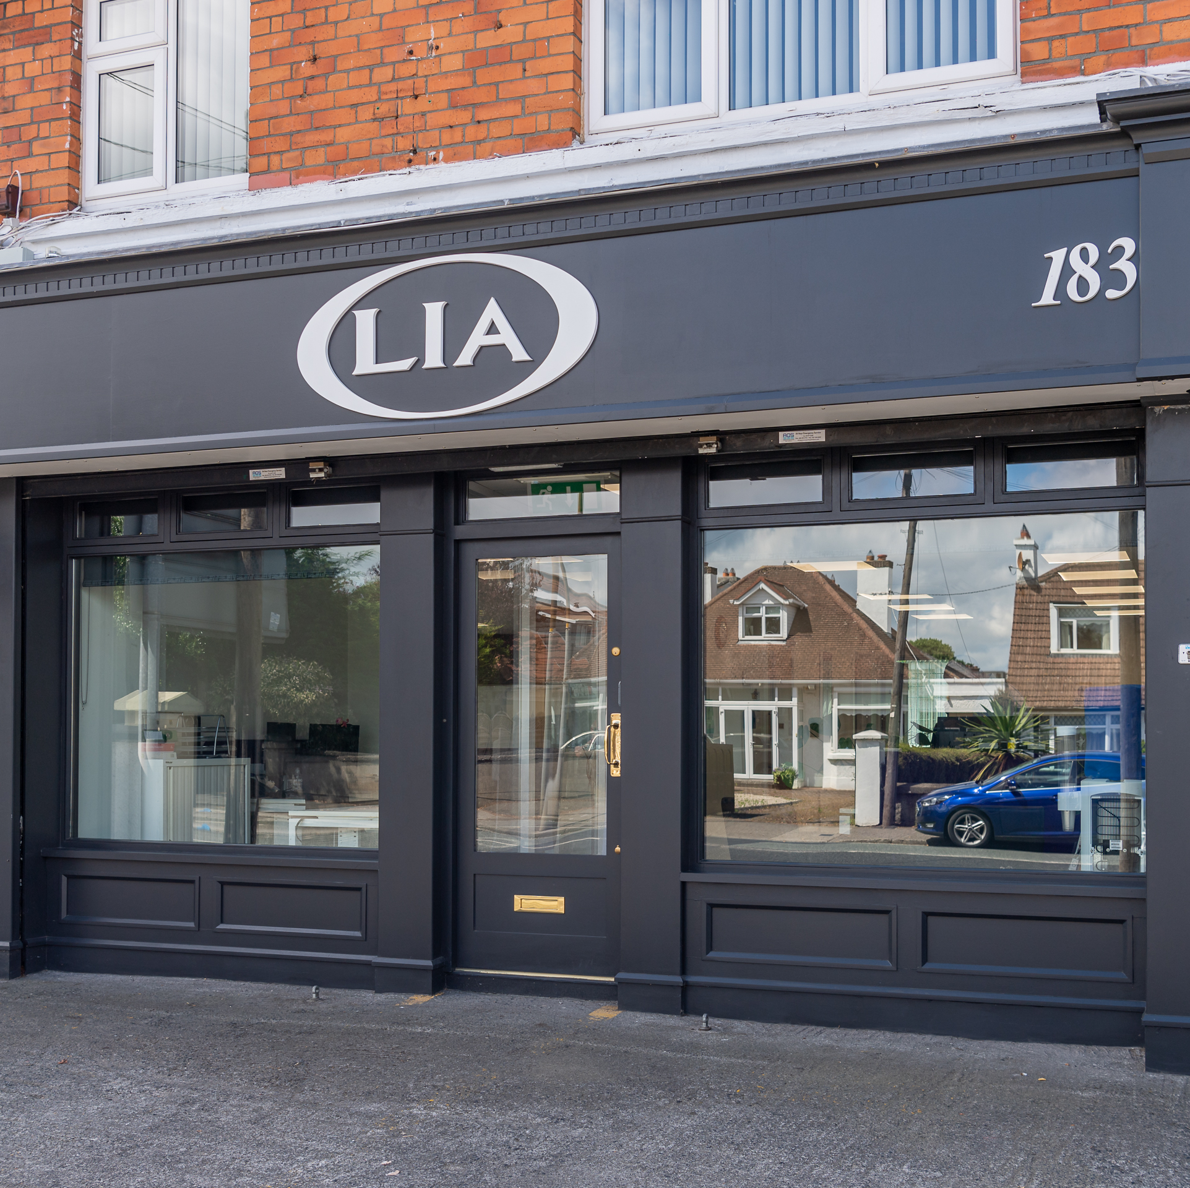
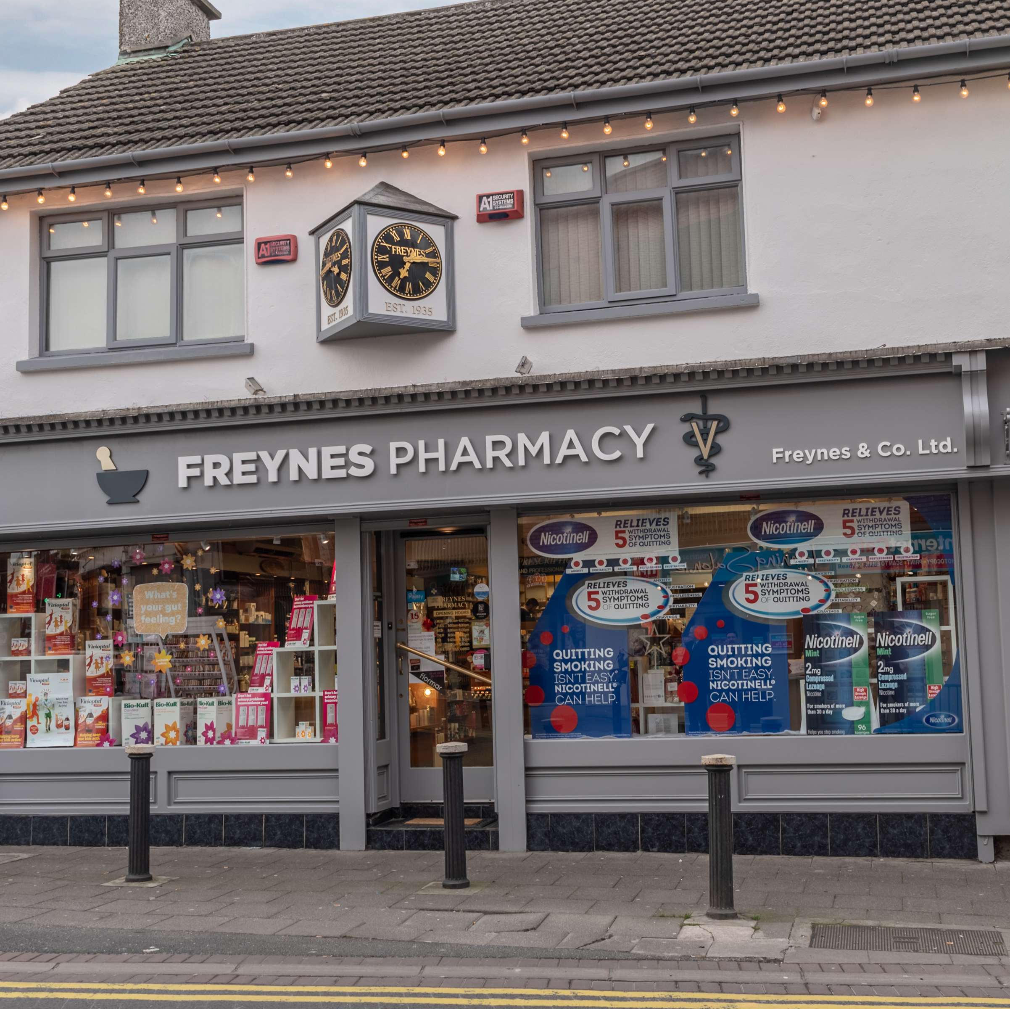
2023 launch steps
€60,000 budget for 2023
2022 Best Shopfront Winner selected
Press Release issued
Excess of 6,000 bi-lingual leaflets issued with rates letters
Website and application form updated
Village visits planned
Suite of ads designed in English and Irish
Press/bus shelter adverts planned.

