Slide 1
Innovation Centre Project Update
Agreed project scope / targets:
The design, build and operation of a 3,000 sq. metre enterprise/innovation space in the County
KEY MILESTONES | Agreed Date | Revised Date
Detailed Design | 10/06/2021 | Complete
Final Tender Construction | 01/02/2022 | Complete
Project implementation | 04/04/2022 | Complete
Project Completion | October 2023 | In progress

Slide 2
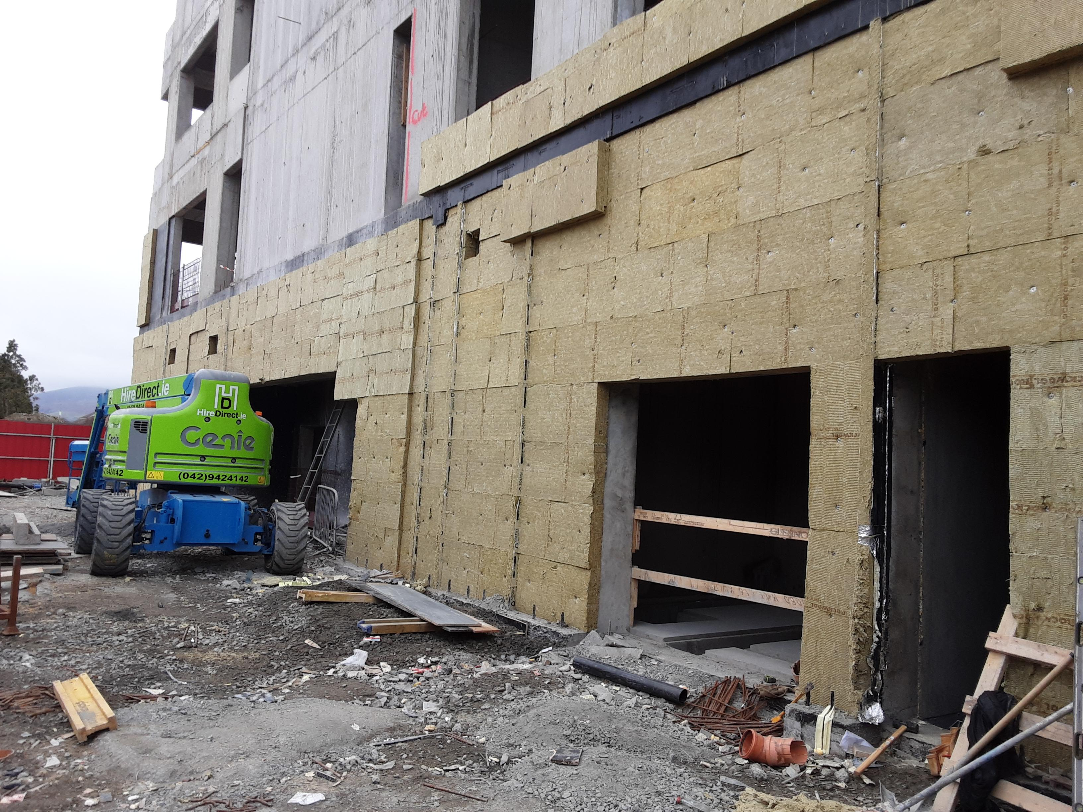
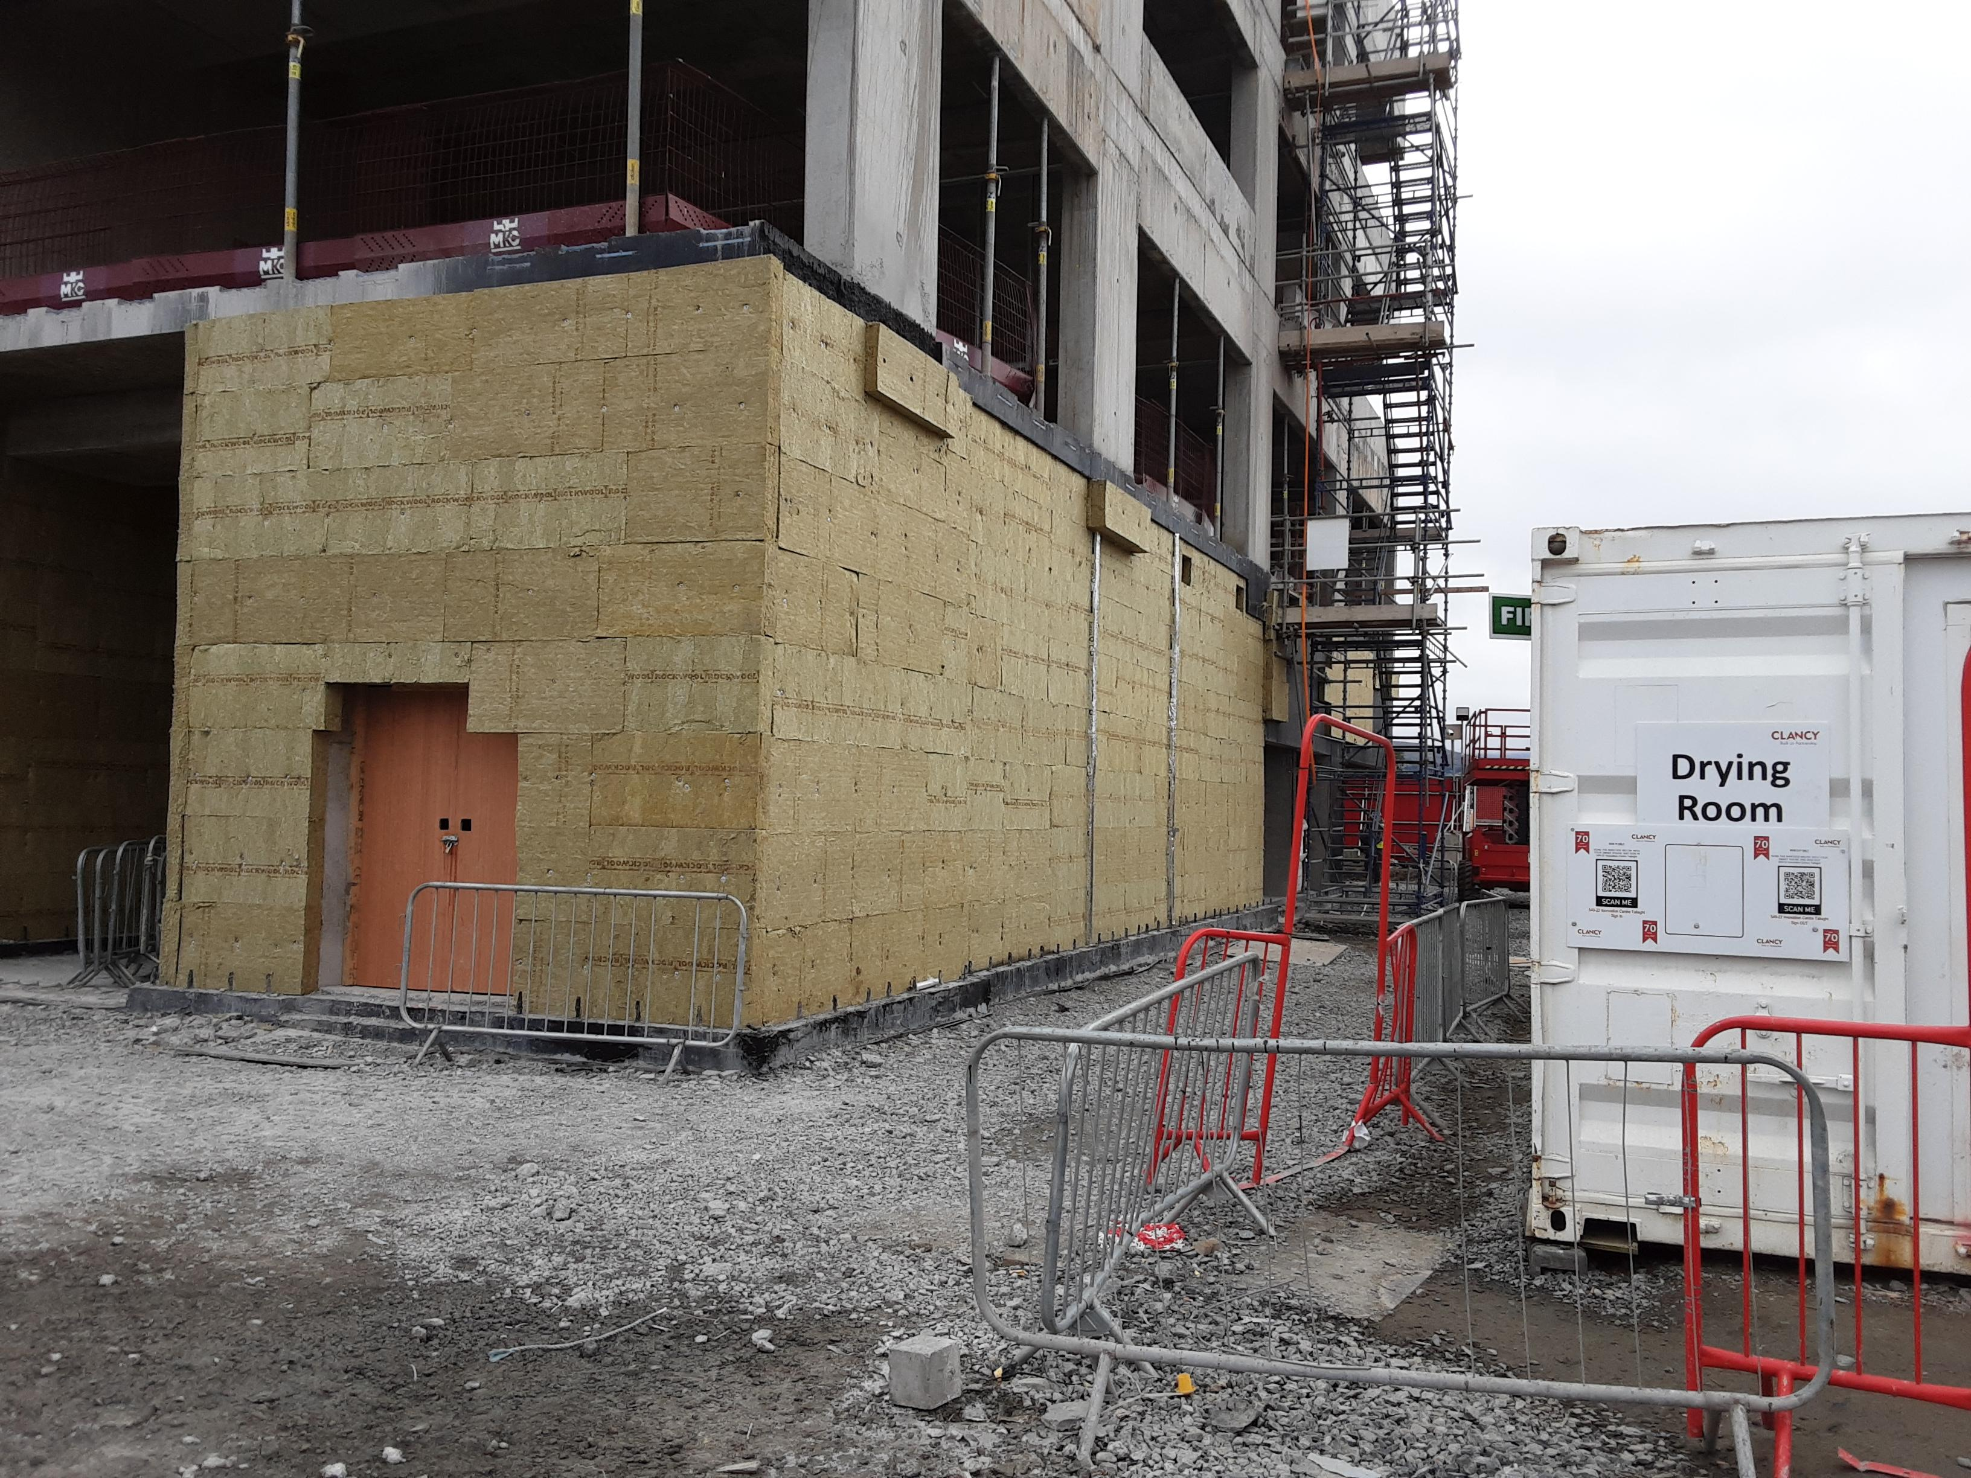
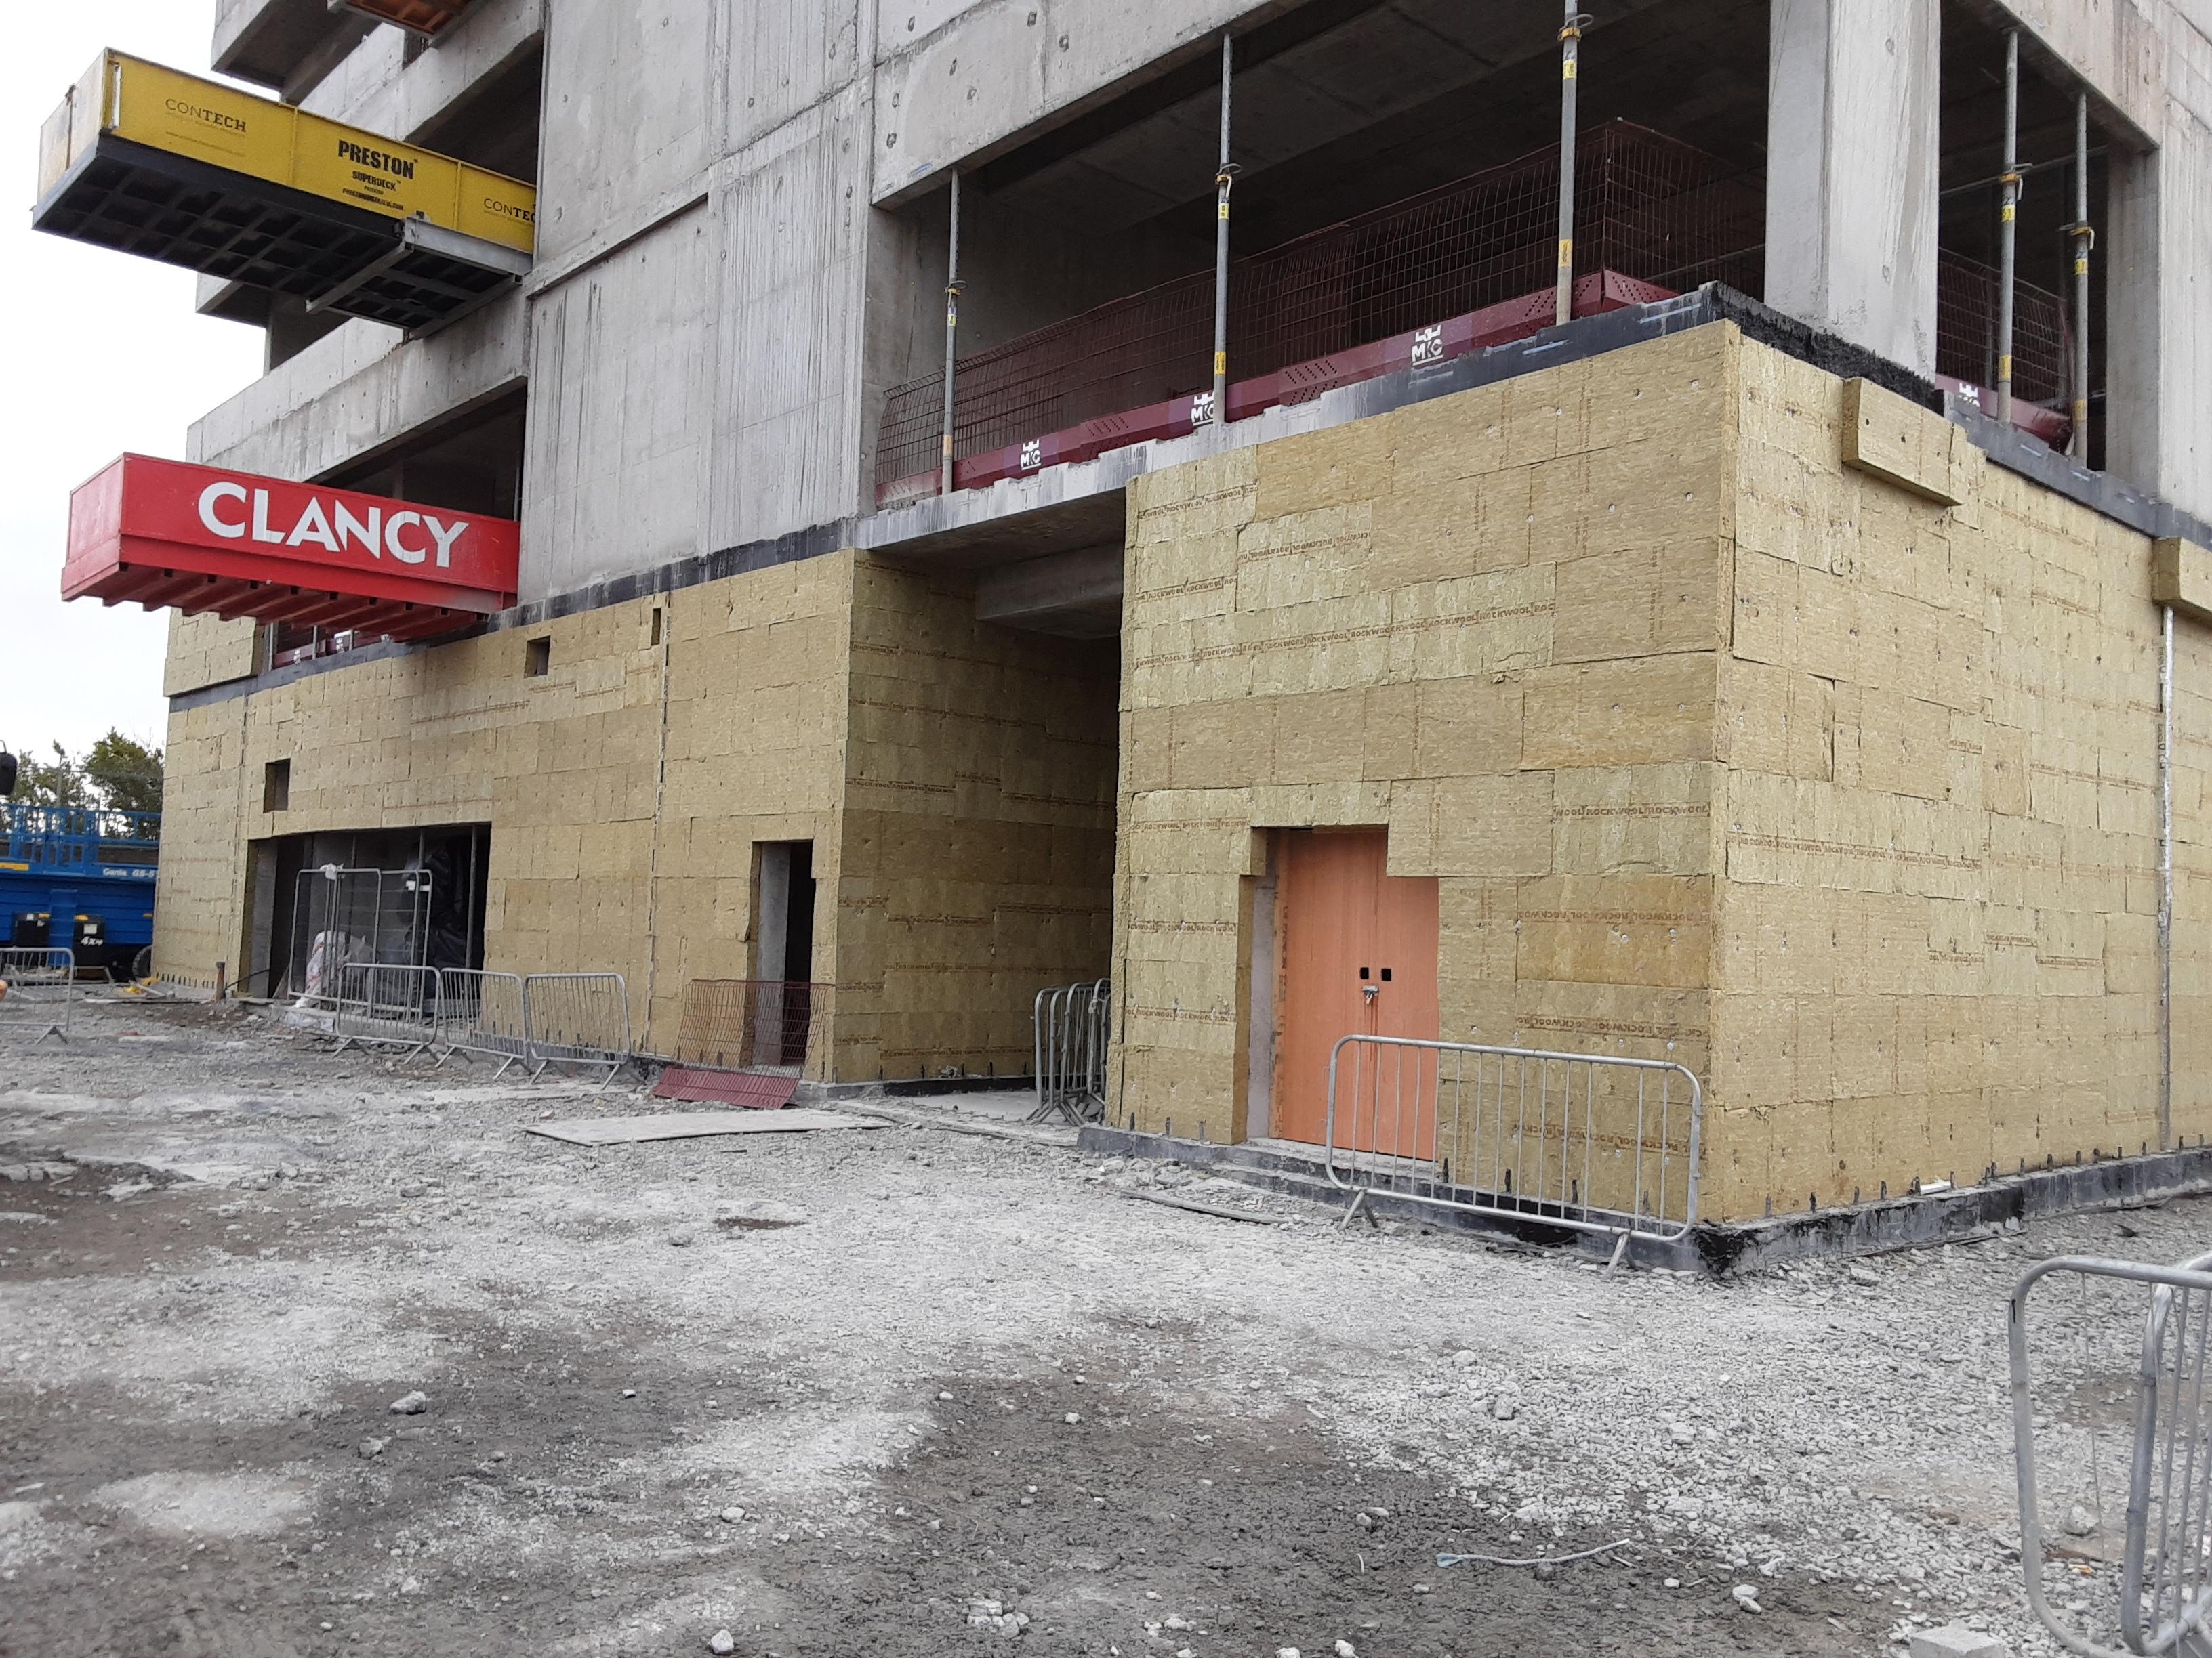
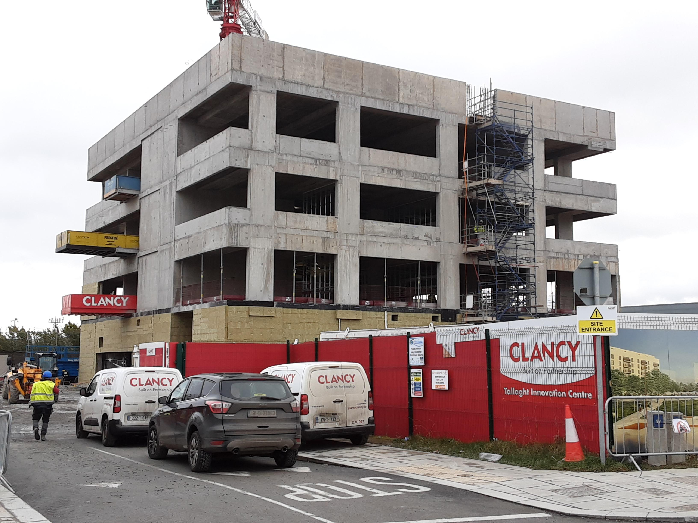
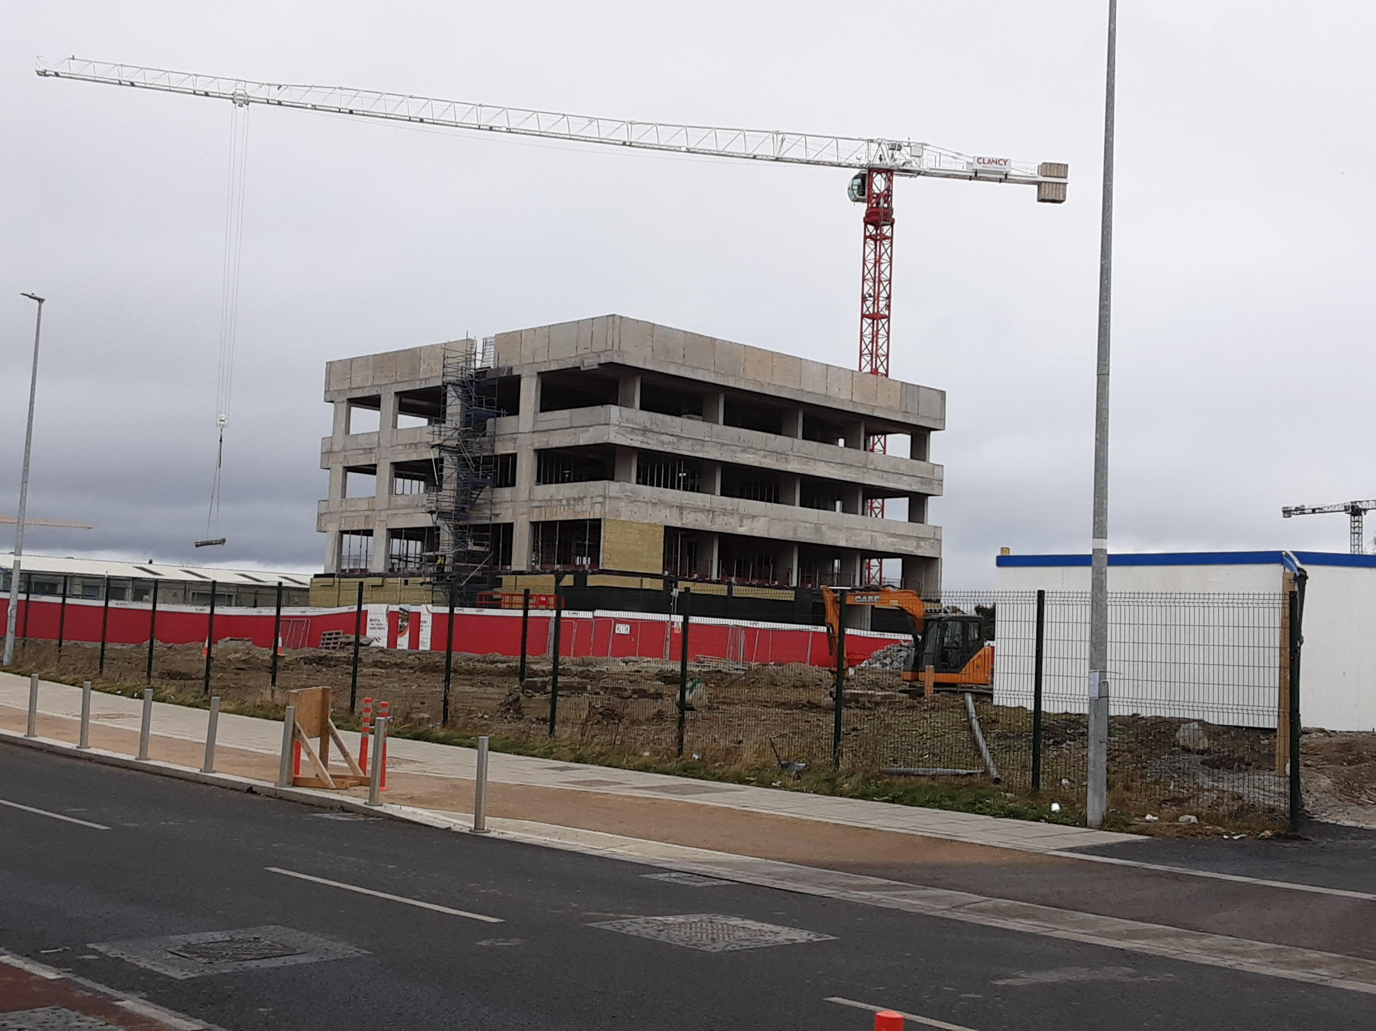
Innovation Centre Tallaght - site inspection - 230202

Slide 3
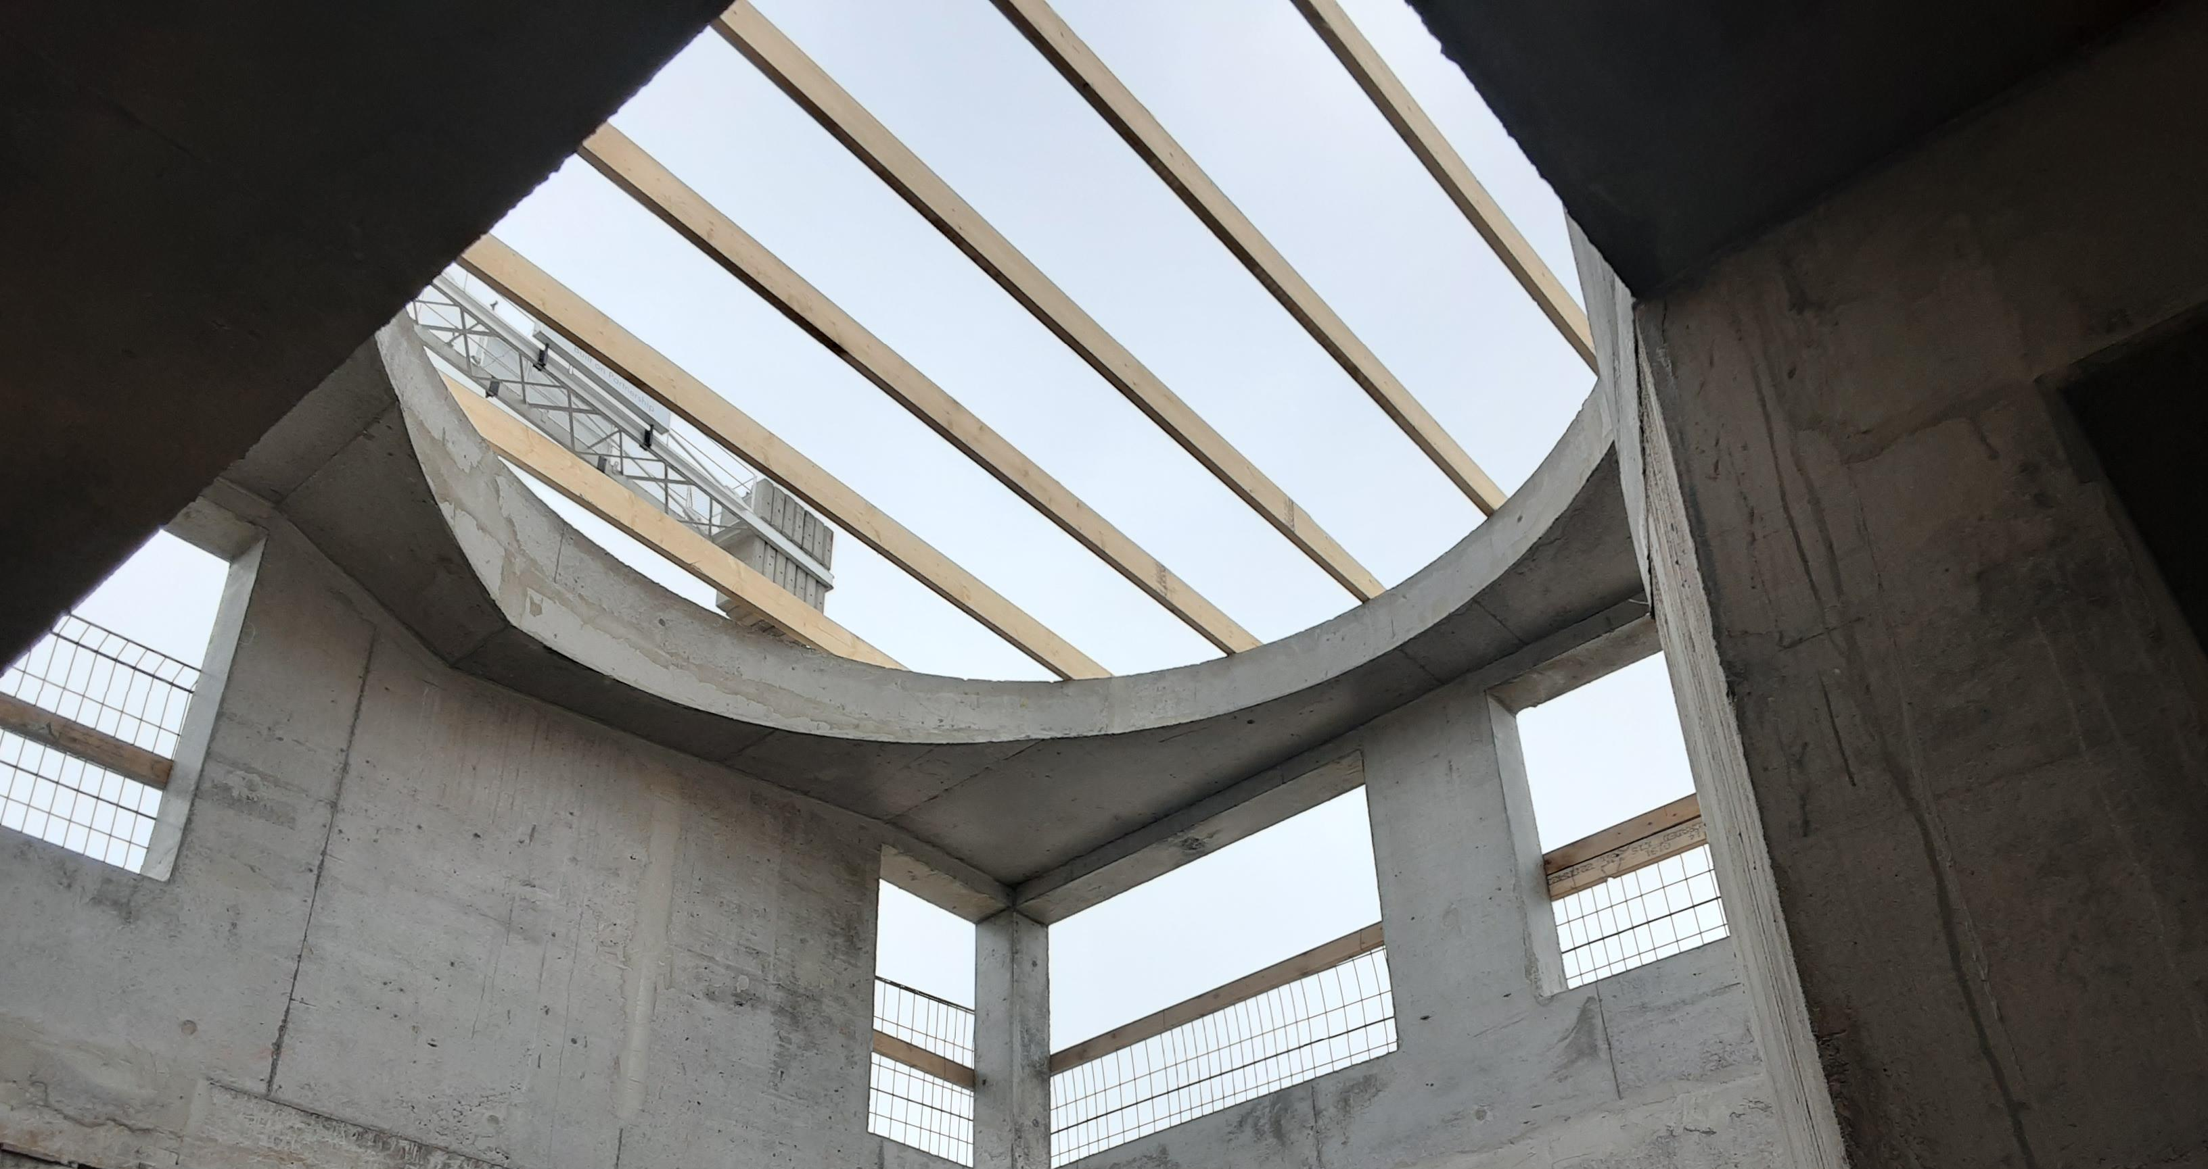
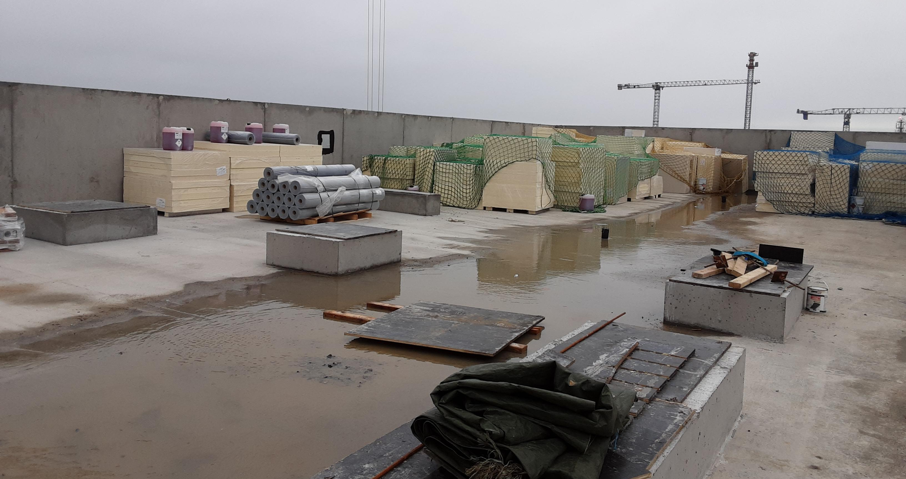
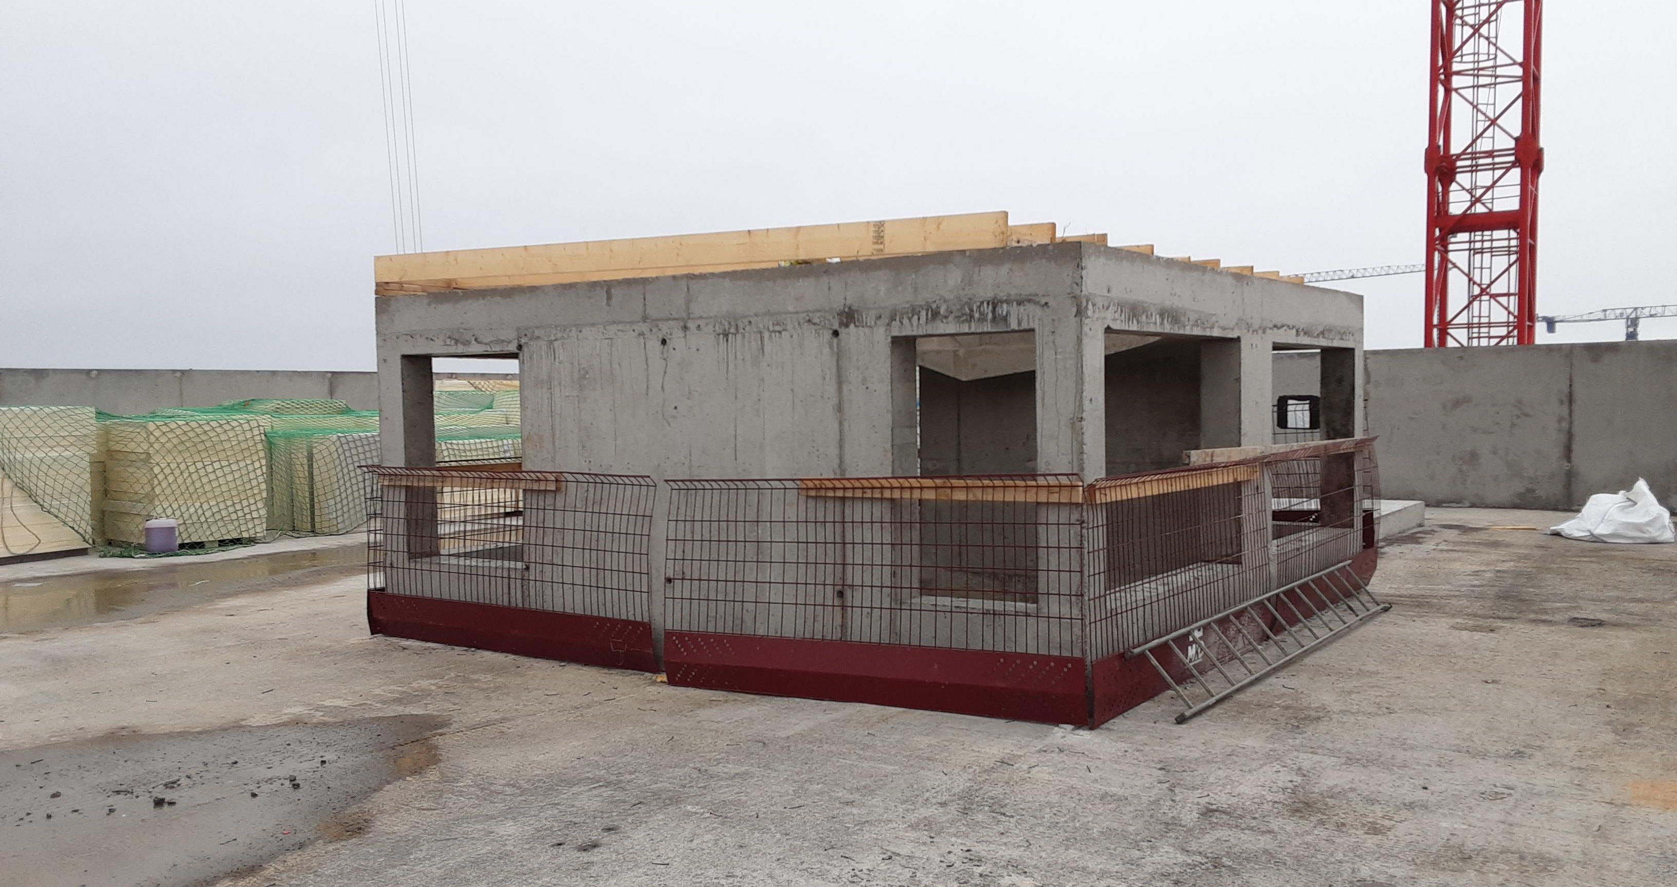
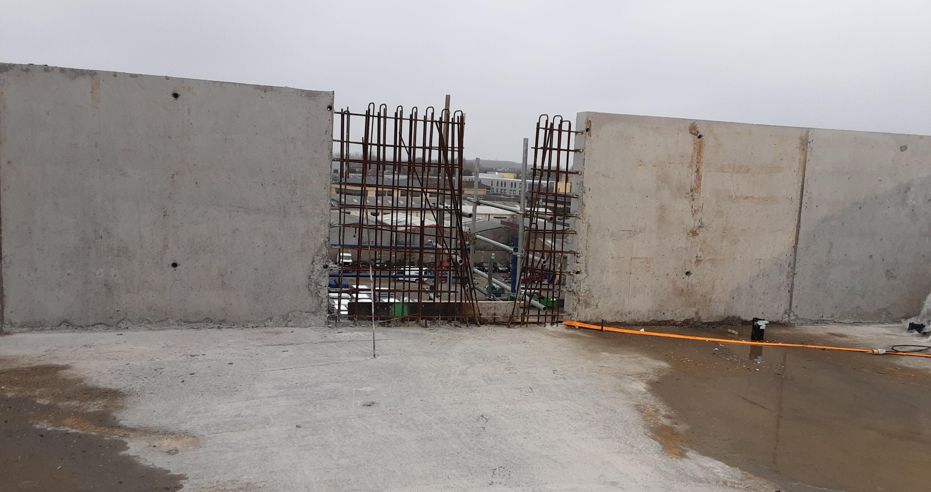
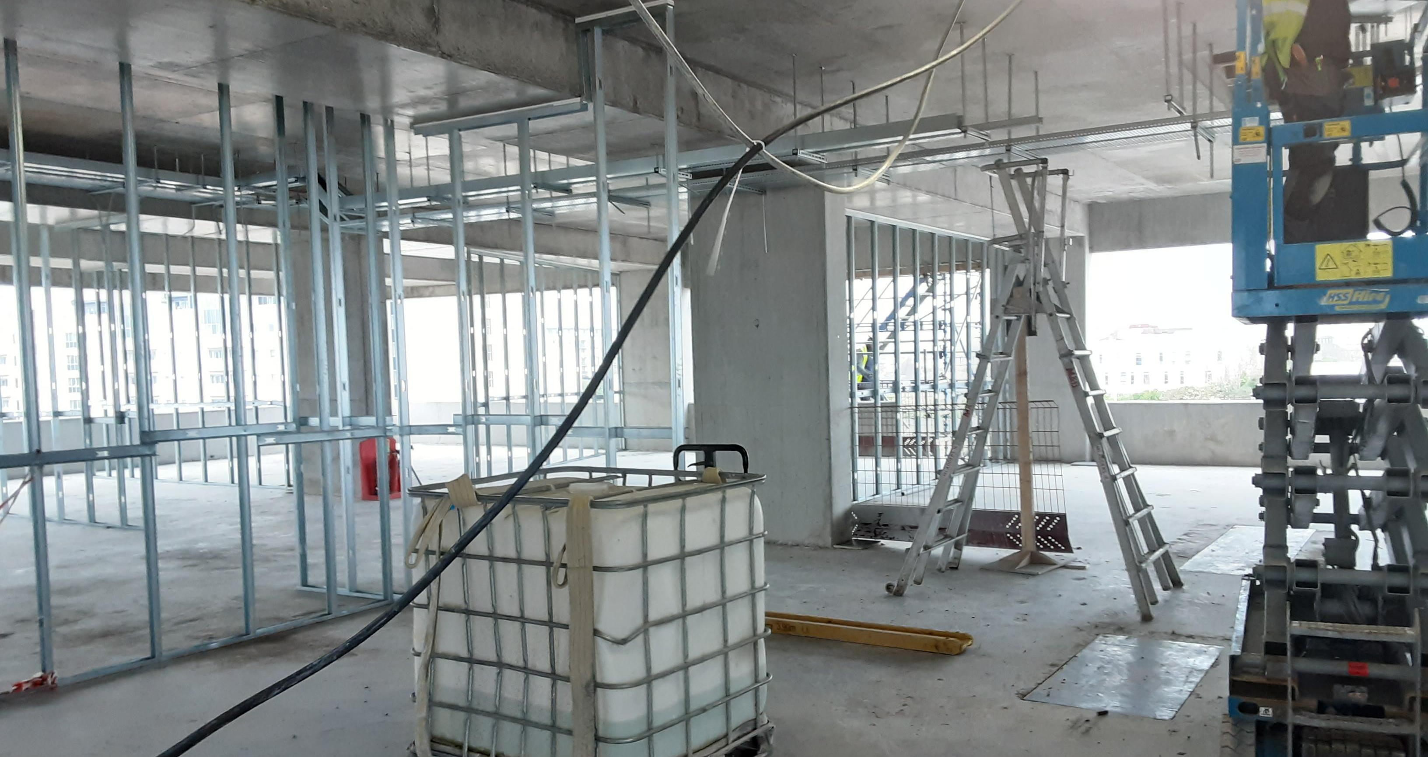
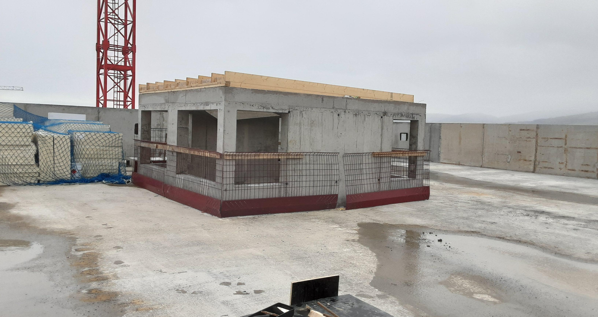
Innovation Centre Tallaght - site inspection - 230202
Innovation Centre Tallaght
Photographs as at February 2023

Slide 4
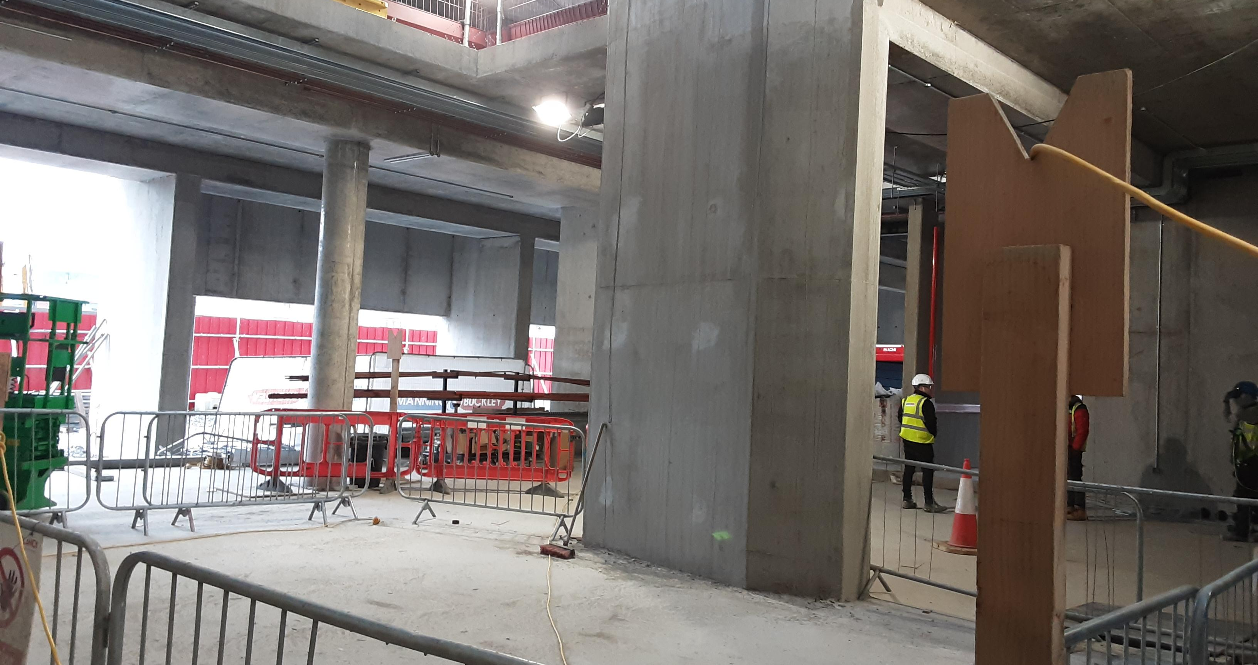
Innovation Centre Tallaght - site inspection - 230202
Innovation Centre Tallaght
Photographs as at February 2023

Slide 5
Work IQ Website & Mobilisation Plan
Oxford Innovation have development a ‘Mobilisation Plan’ which will go into Active Phase from August / September 2023 to January 2024
Preplanning activities / meetings with Oxford Innovation & SDCC are ongoing with regard to :
Building Design and Fitout
IT / Access Security
Website and Social Media

Slide 6
WORK IQ

Slide 7
WORK IQ
WORK IQ – Sharp Ahead Client Feedback (wpengine.com)

