Slide 1
Economic Enterprise & Tourism Development SPC 8th February 2023
Economic Development

Slide 2
Grange Castle West Masterplan
Multi Disciplinary Team
Masterplan Report
Transport Strategy
Planning Report
Branding & Marketing
Website
Architects Report
Landscape Strategy

Slide 3
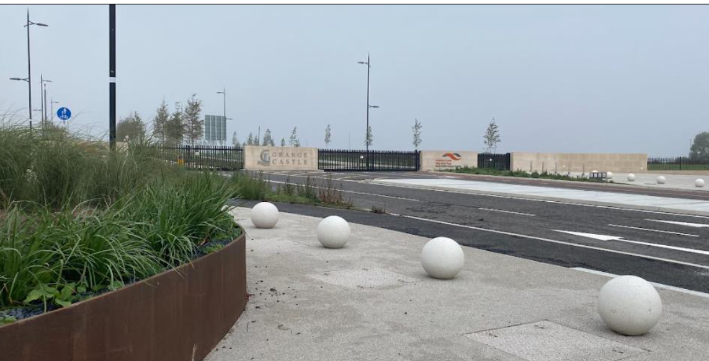
Masterplan Vision
To create a sustainable employment hub in Grange Castle West that attracts new economic development opportunities to the area while enhancing the climate resilience of the existing environment and providing a healthy and attractive place to work for a growing local population.

Slide 4
Site Context

Slide 5
Grange Castle West

Slide 6
Placemaking Principals

Slide 7
Sample site massing

Slide 8
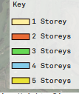
Potential Building Heights

Slide 9
Aerial /3D Massing

Slide 10
Potential Land Use Mix

Slide 11
Employment Potential

Slide 12
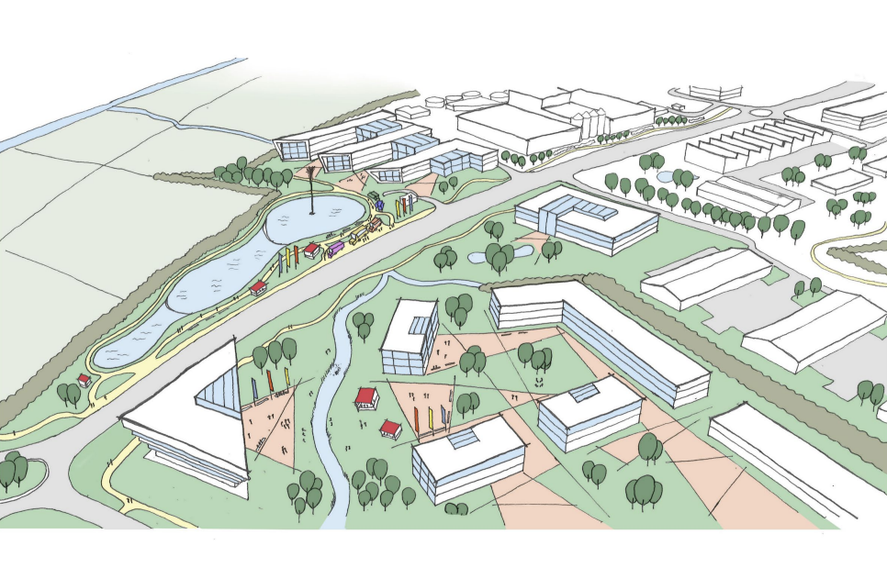
View to Central Feature

Slide 13
Landmark Buildings -Wayfinding

Slide 15
New Brand /Presentation template

Slide 16
New Website LINK

Slide 17
Tallaght Stadium – Progress Update Construction commenced August 2022 Time Lapse Video https://vimeo.com/753804030/f7d9a4154a

Slide 18
Main Stand – Internal Works

Slide 19
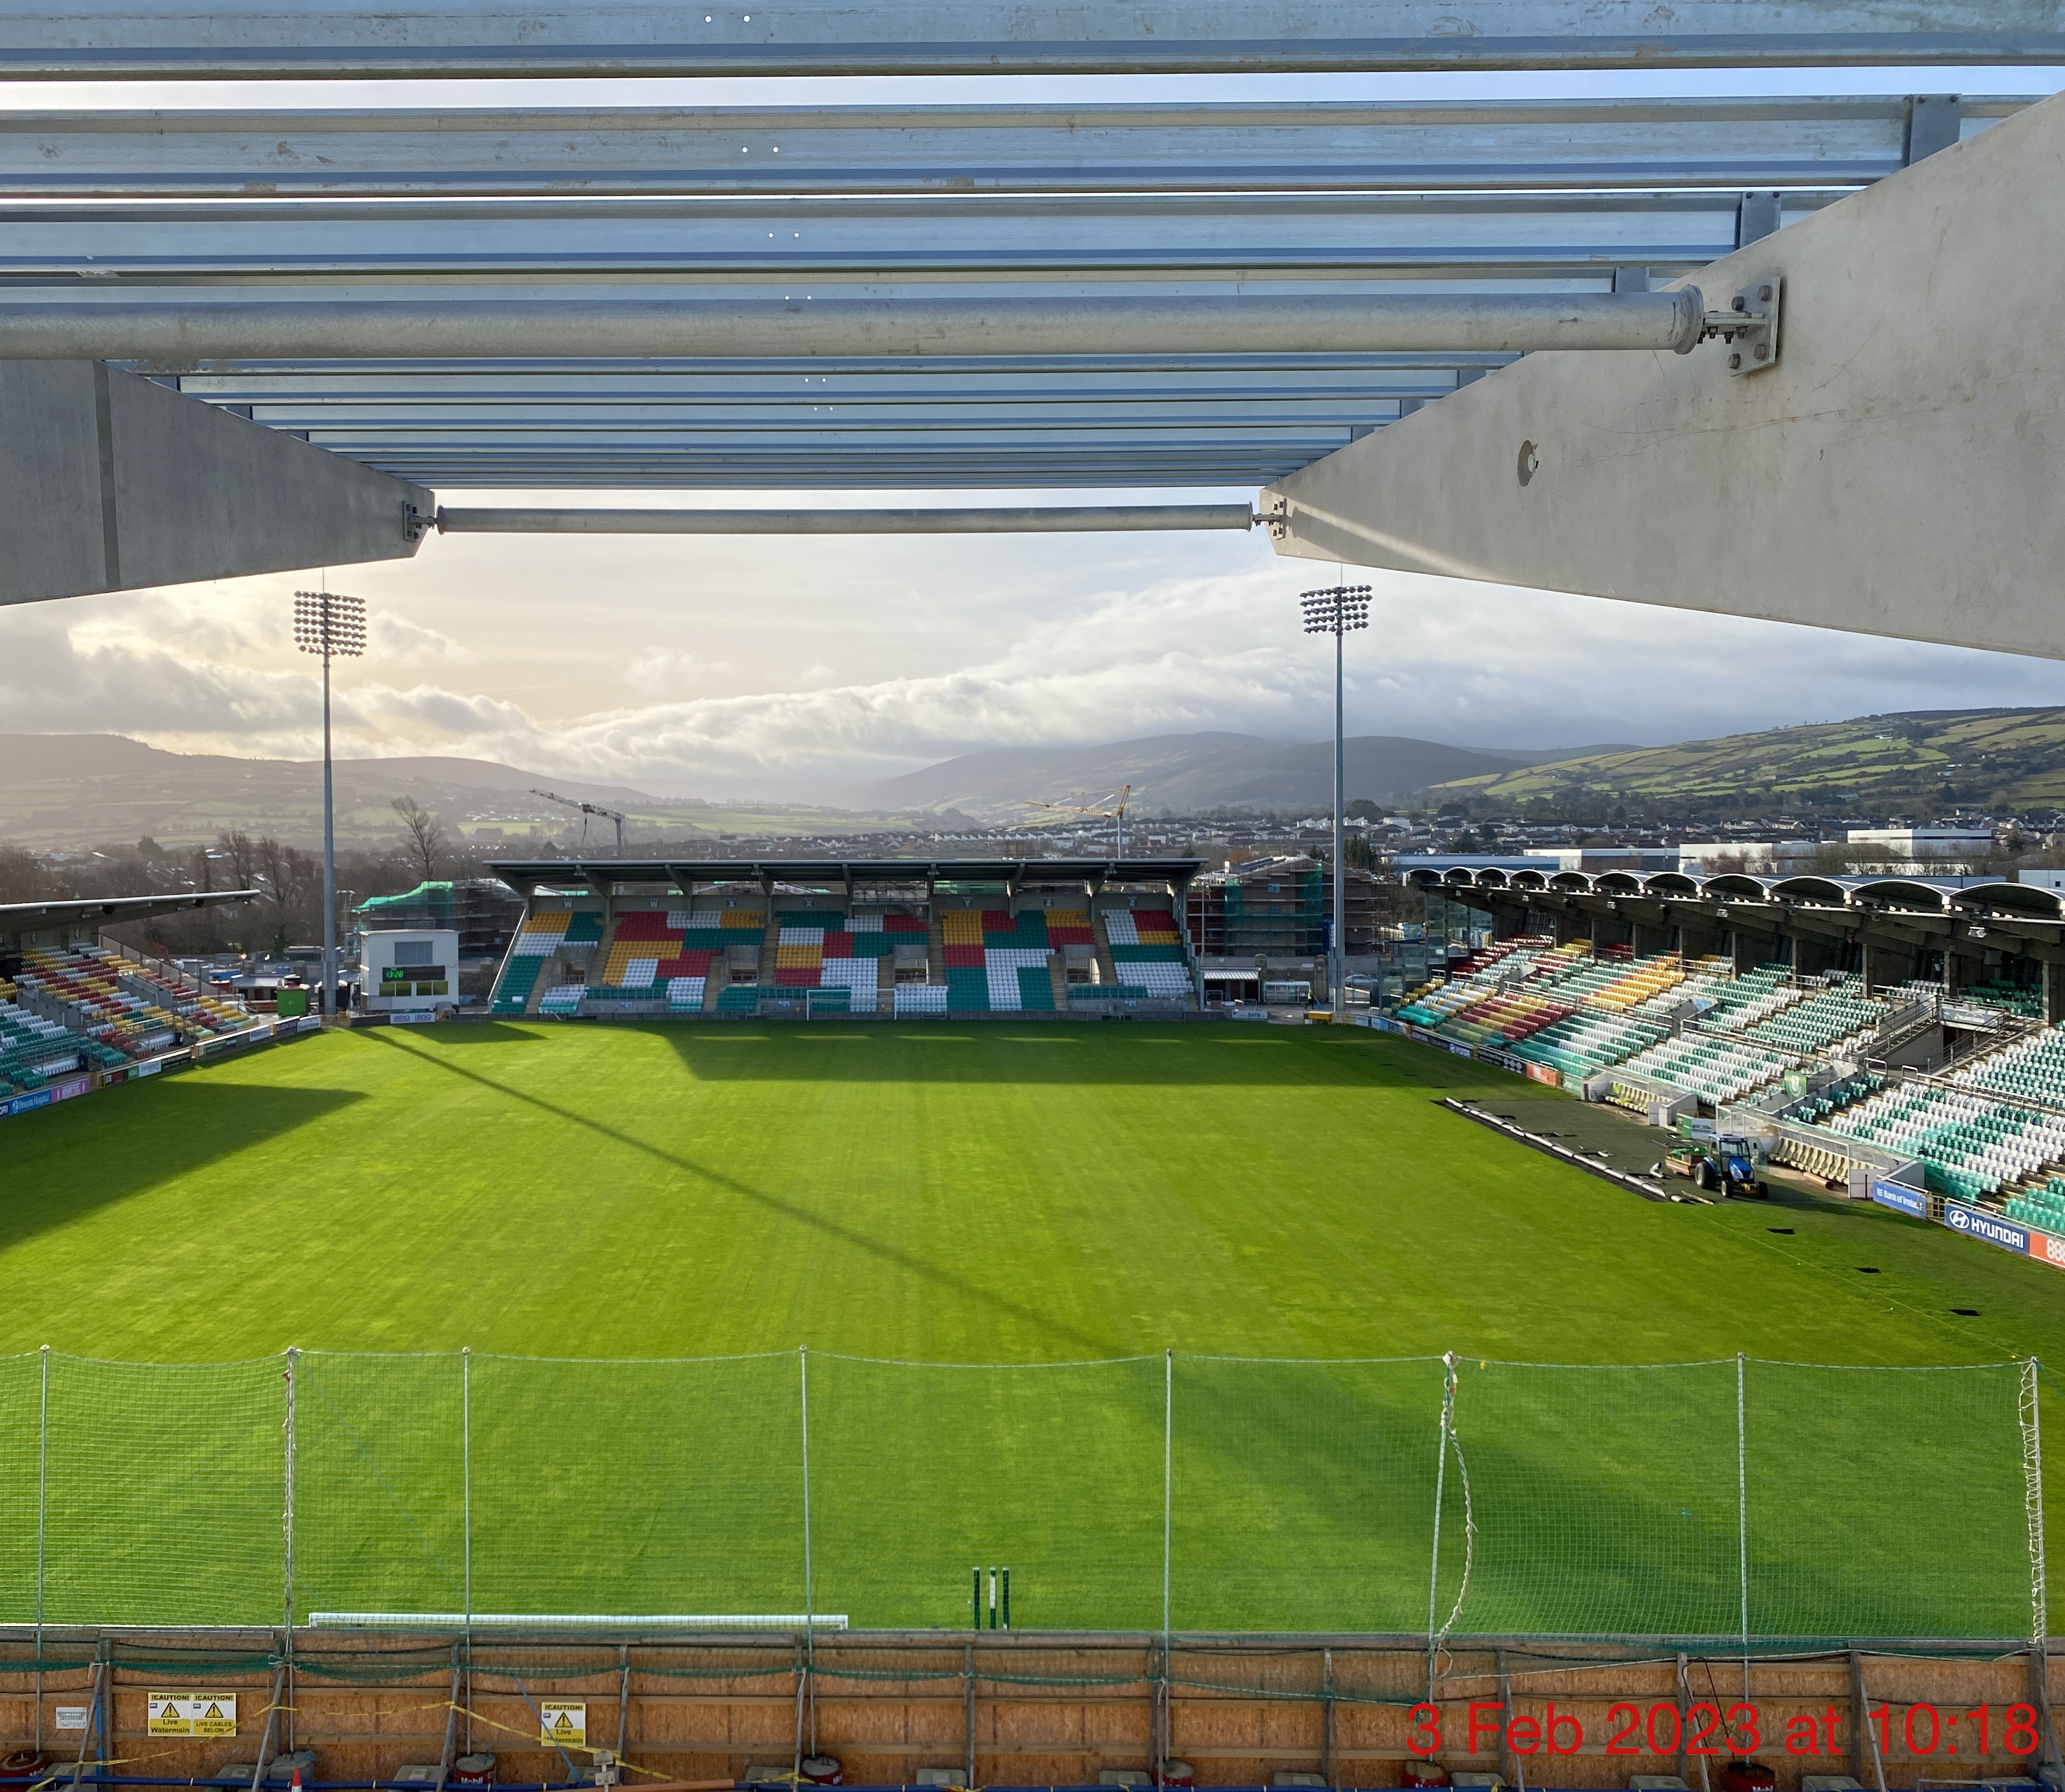
View from North Stand

Slide 20
Next Steps
The Stadium will re-open for football games from the first weekend of March,
Shamrock Rovers, SSE League Champions, host first home league games of the 2023 Season.
Construction works are scheduled to be completed by the end of July 2023.

