Slide 1

Circular Economy & Environmental Awareness Activities
South Dublin County Council
Environment, Public Realm & Climate Change SPC
7th February 2023

Slide 2
What is the Circular Economy?
“In the circular economy system, we replace our current take, make, use and dispose system. Instead, we use less raw materials, we design products for long-life and recyclability, we share products or use them for longer, we reuse and repair things before we recycle or throw them away” EPA website

Slide 3
Circular Economy Activities 2023
New National Waste Management Plan for a Circular Economy in 2023
Align with the Resource Management Actions of the current CCAP
  Re-introduced Deposit and Return Cup into canteen
  Create & deliver Stop Food Waste Campaigns
  Deliver events such as Eco-Week, Reuse Month
  Green Procurement Working Group
  Sustainable Business Initiative

Slide 4
Environmental Awareness in South Dublin
To educate and create awareness of the local environment and climate change within communities, schools and local businesses
Empowering South Dublin residents to take actions that will improve their environment, making the County a better place to live work and do business

Slide 5


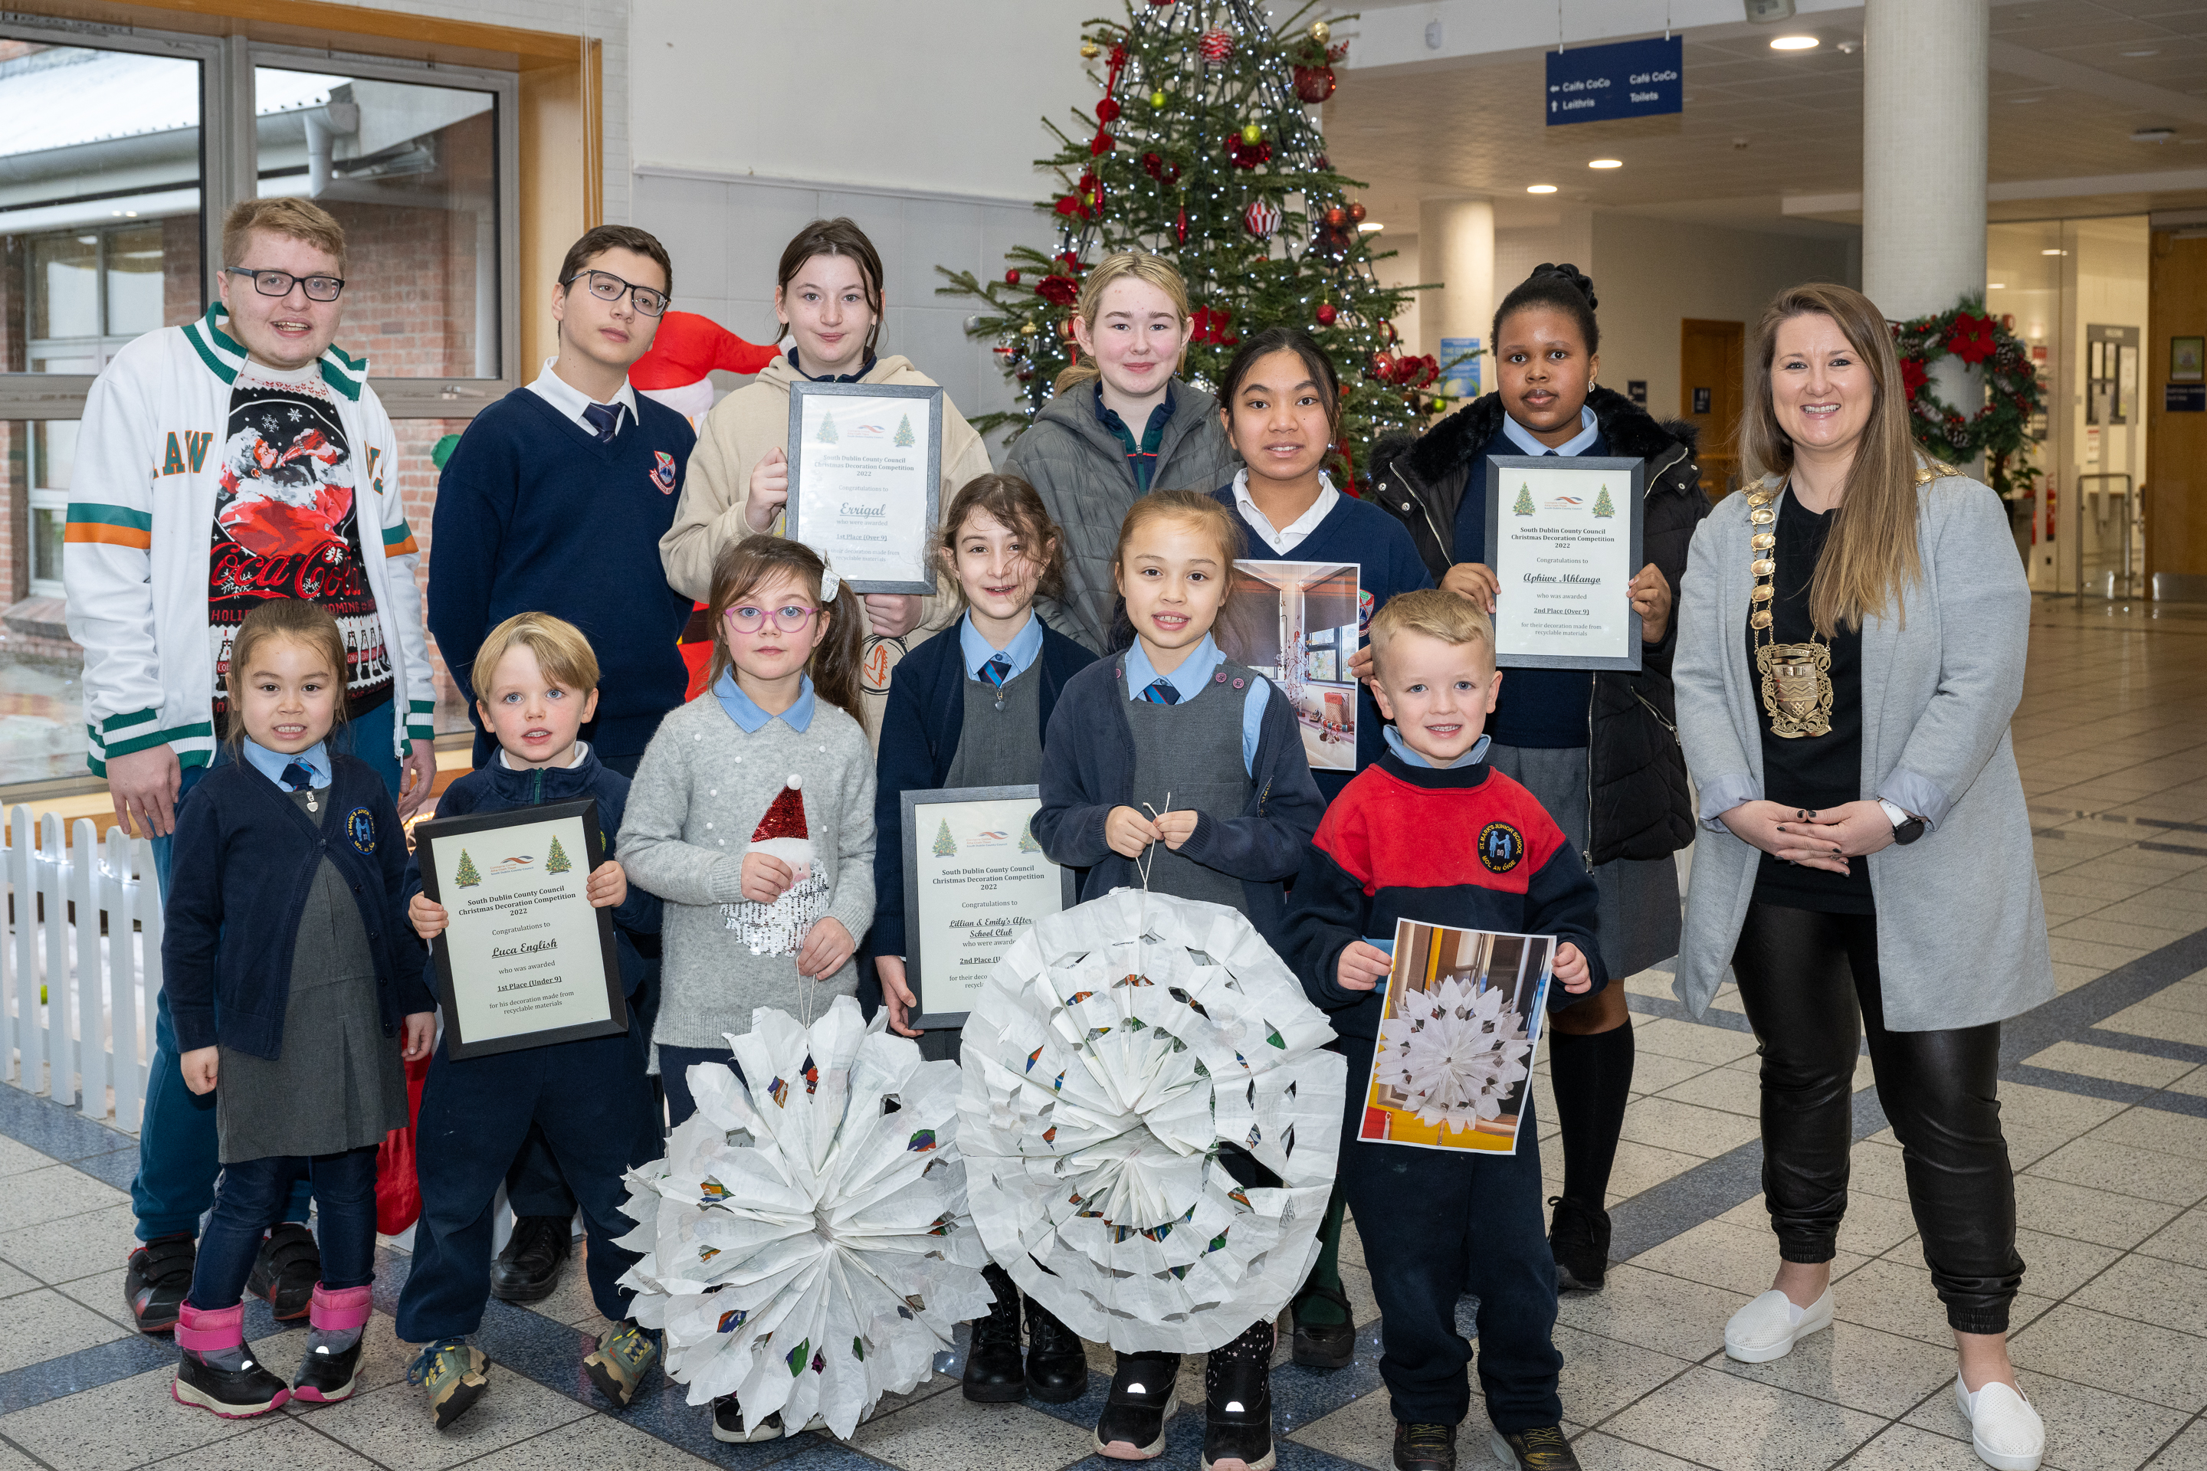
Environmental Education Programme 2023
Manage and deliver the Green Schools programme in South Dublin
Deliver Annual Programme including:
  Eco Week 6th – 10th March 2023
  Provide workshops/talks to schools
  Delivered Sorted - How to Reduce, Segregate and Manage School Waste with the other DLA’s
  Competitions:
    Anti-Litter Poster
    Christmas Decoration Competition
    Relove Fashion Competition (2nd Level)

Slide 6
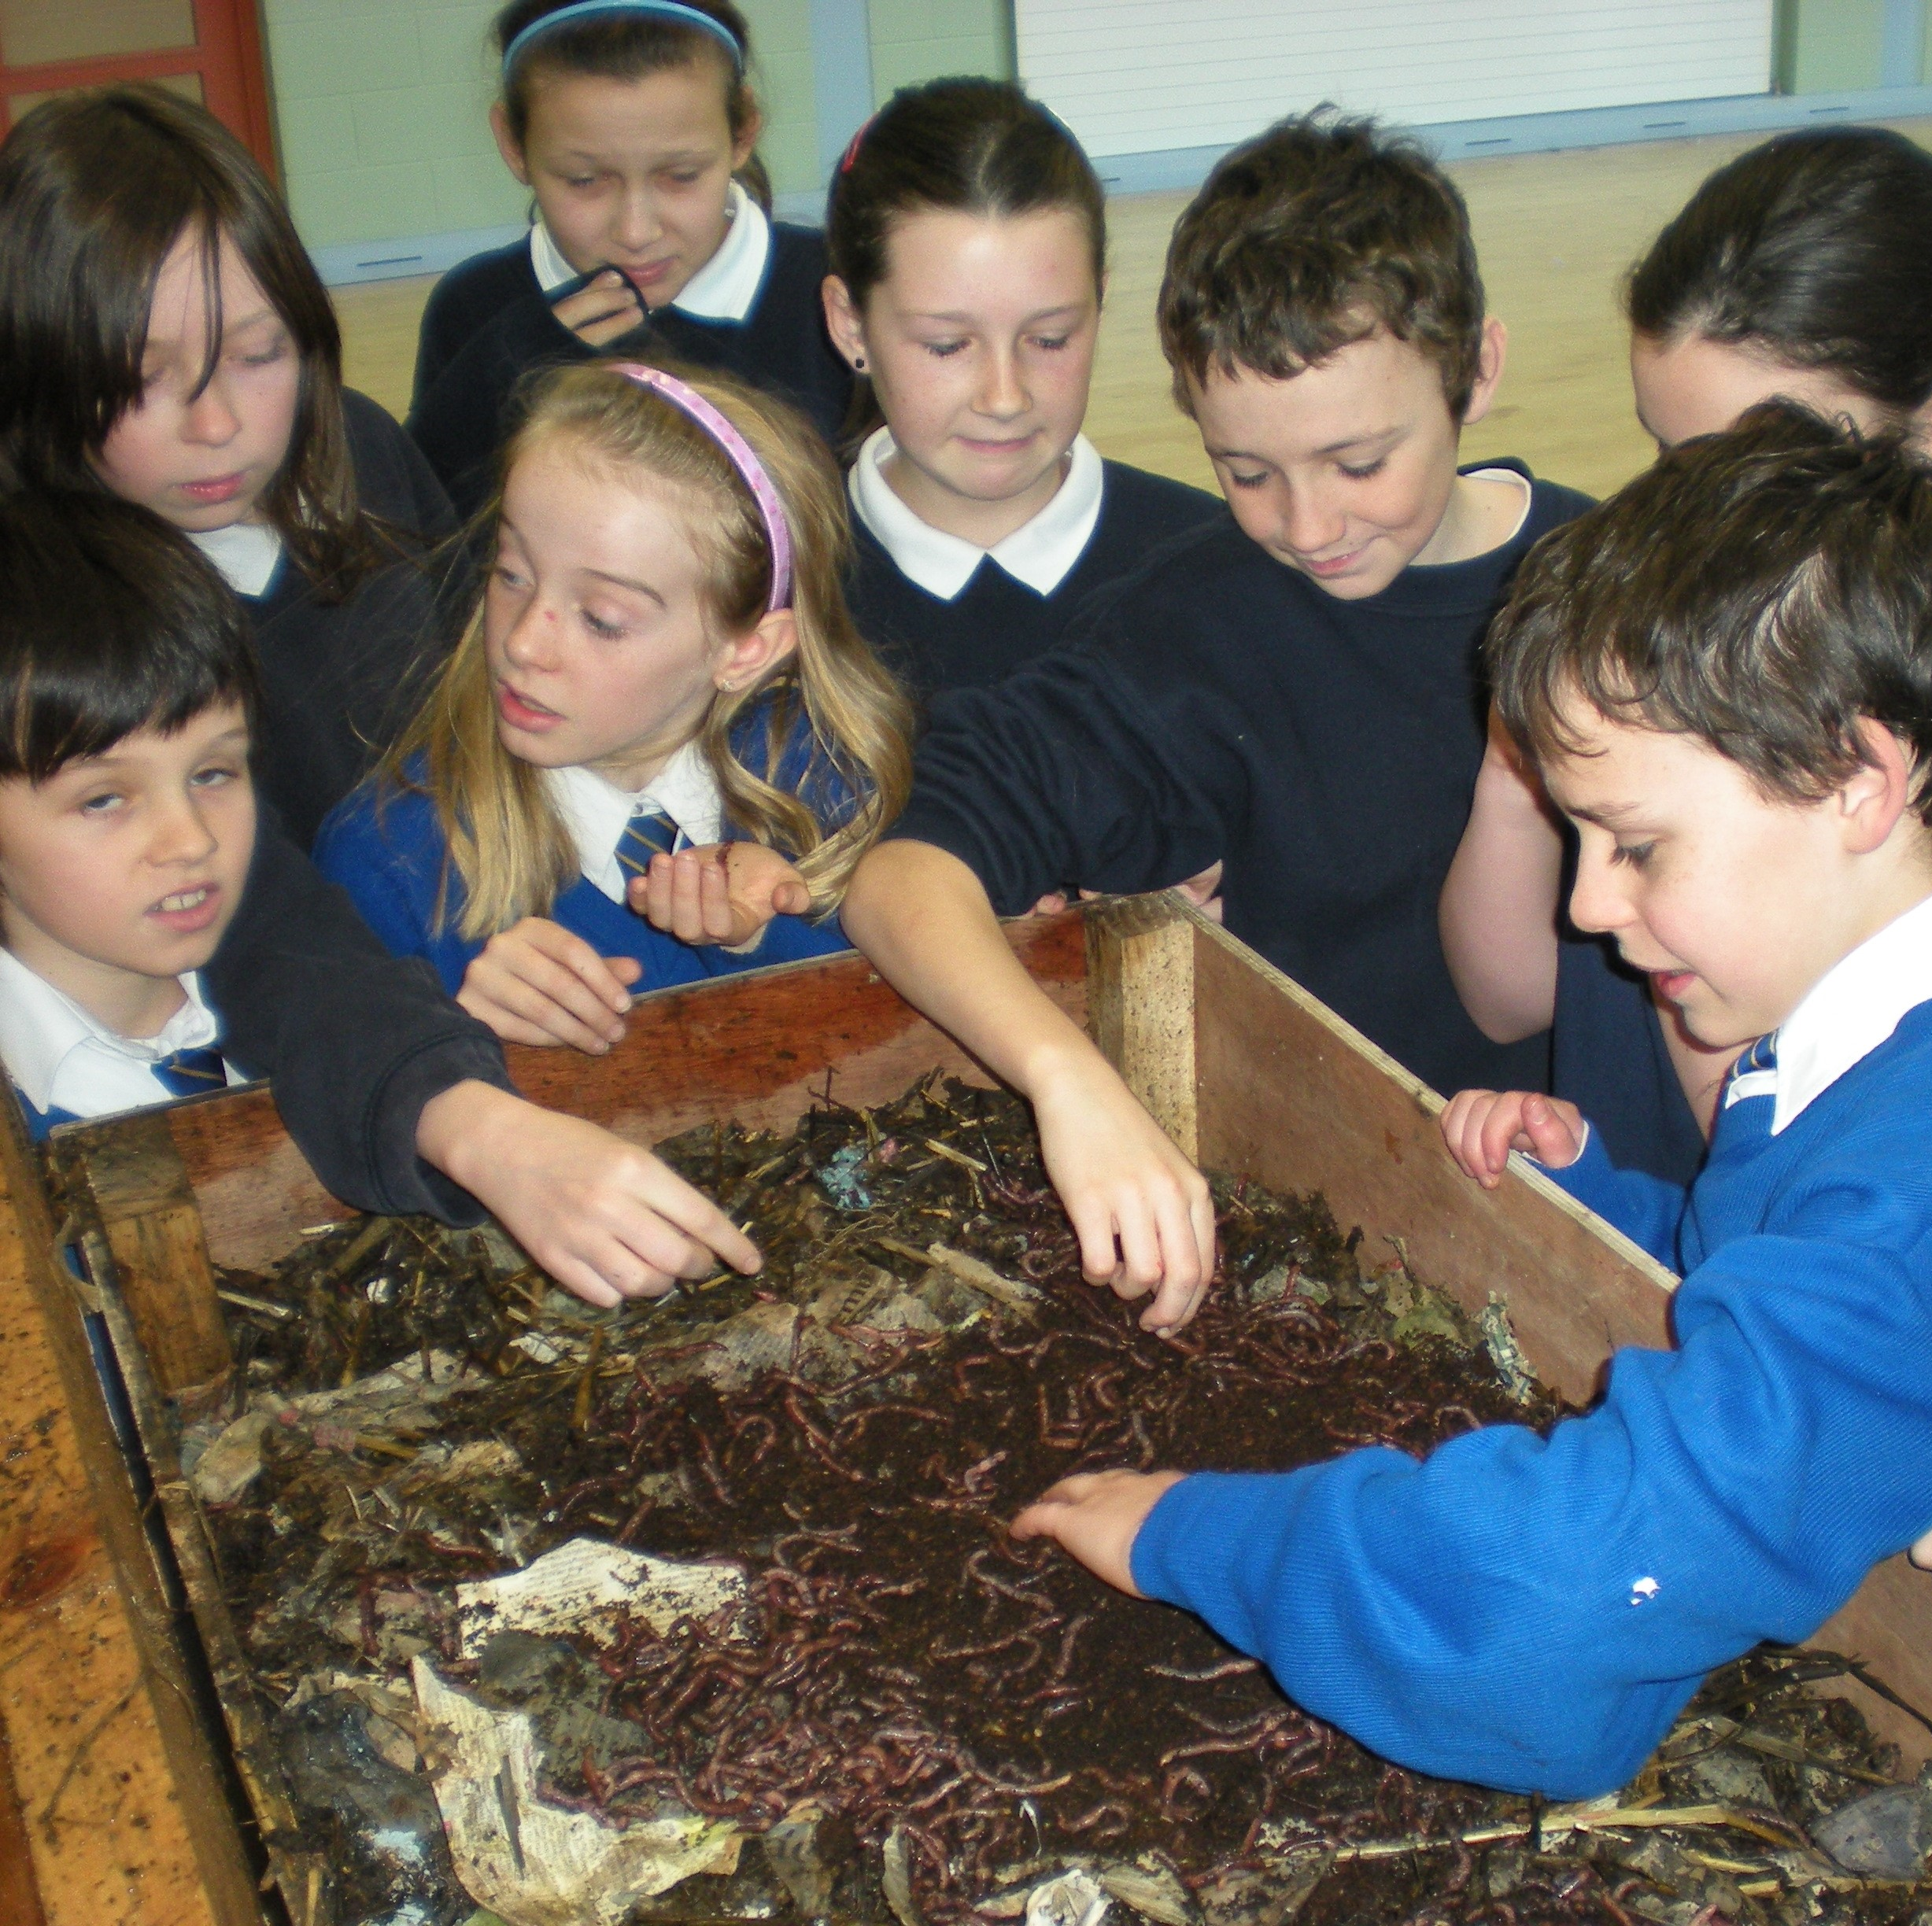
Composting for Schools Training Programme
Project for primary & secondary schools launched September ‘21
Pilot project with other DLA’s
Help schools set up &/or improve composting, save money and tackle climate change
Won a Repak Pakman Award in the Education and Awareness Category
Currently procuring for 2023/24

Slide 7
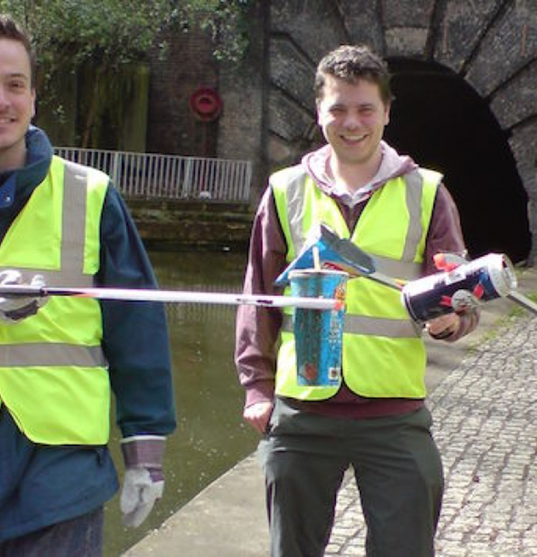
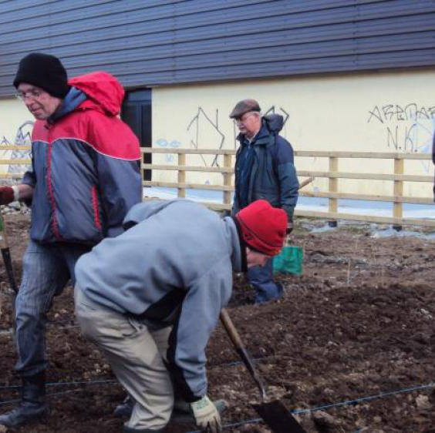
The Social Credit Scheme
The Social Credit's Scheme rewards community groups who take ownership & improve their local area by carrying out pro-environmental actions.
3 elements to the Social Credits Scheme
clean-ups scheme – supply materials, pick up bags afterwards
Paint enhancement scheme – provide paint and painting materials to groups
Minor Community Landscaping Scheme – helps groups carry out minor planting work in their area
Notes:
- The Social Credit's Scheme rewards community groups who improve their environment by carrying out pro-environmental actions such as
community clean-ups
maintenance of community gardens
graffiti removal and weeding of footpaths
The scheme is open to all community groups and schools in South Dublin County Council's area.

Slide 8
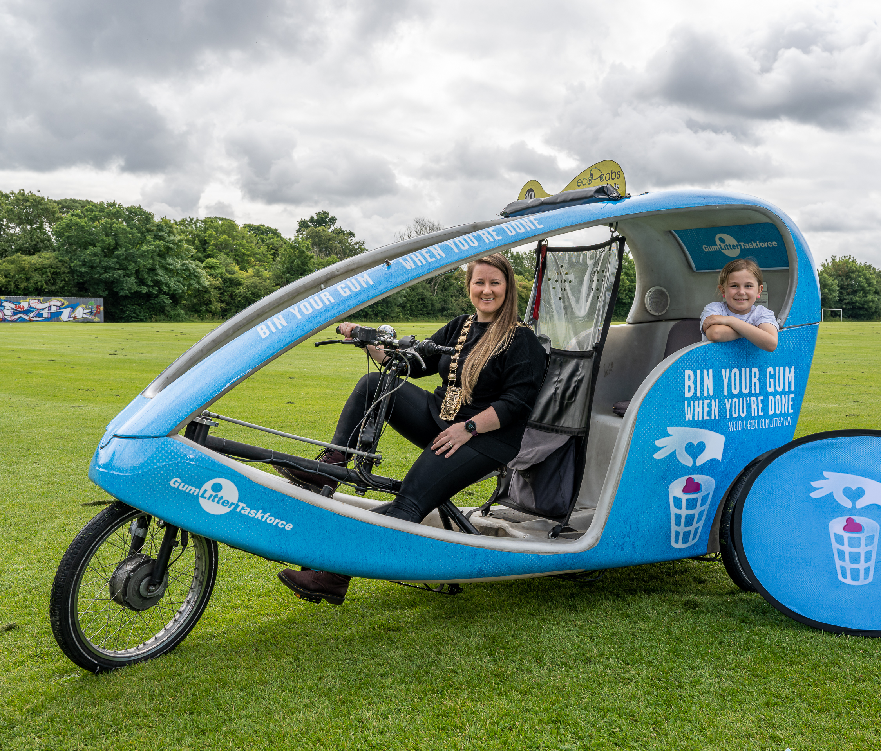
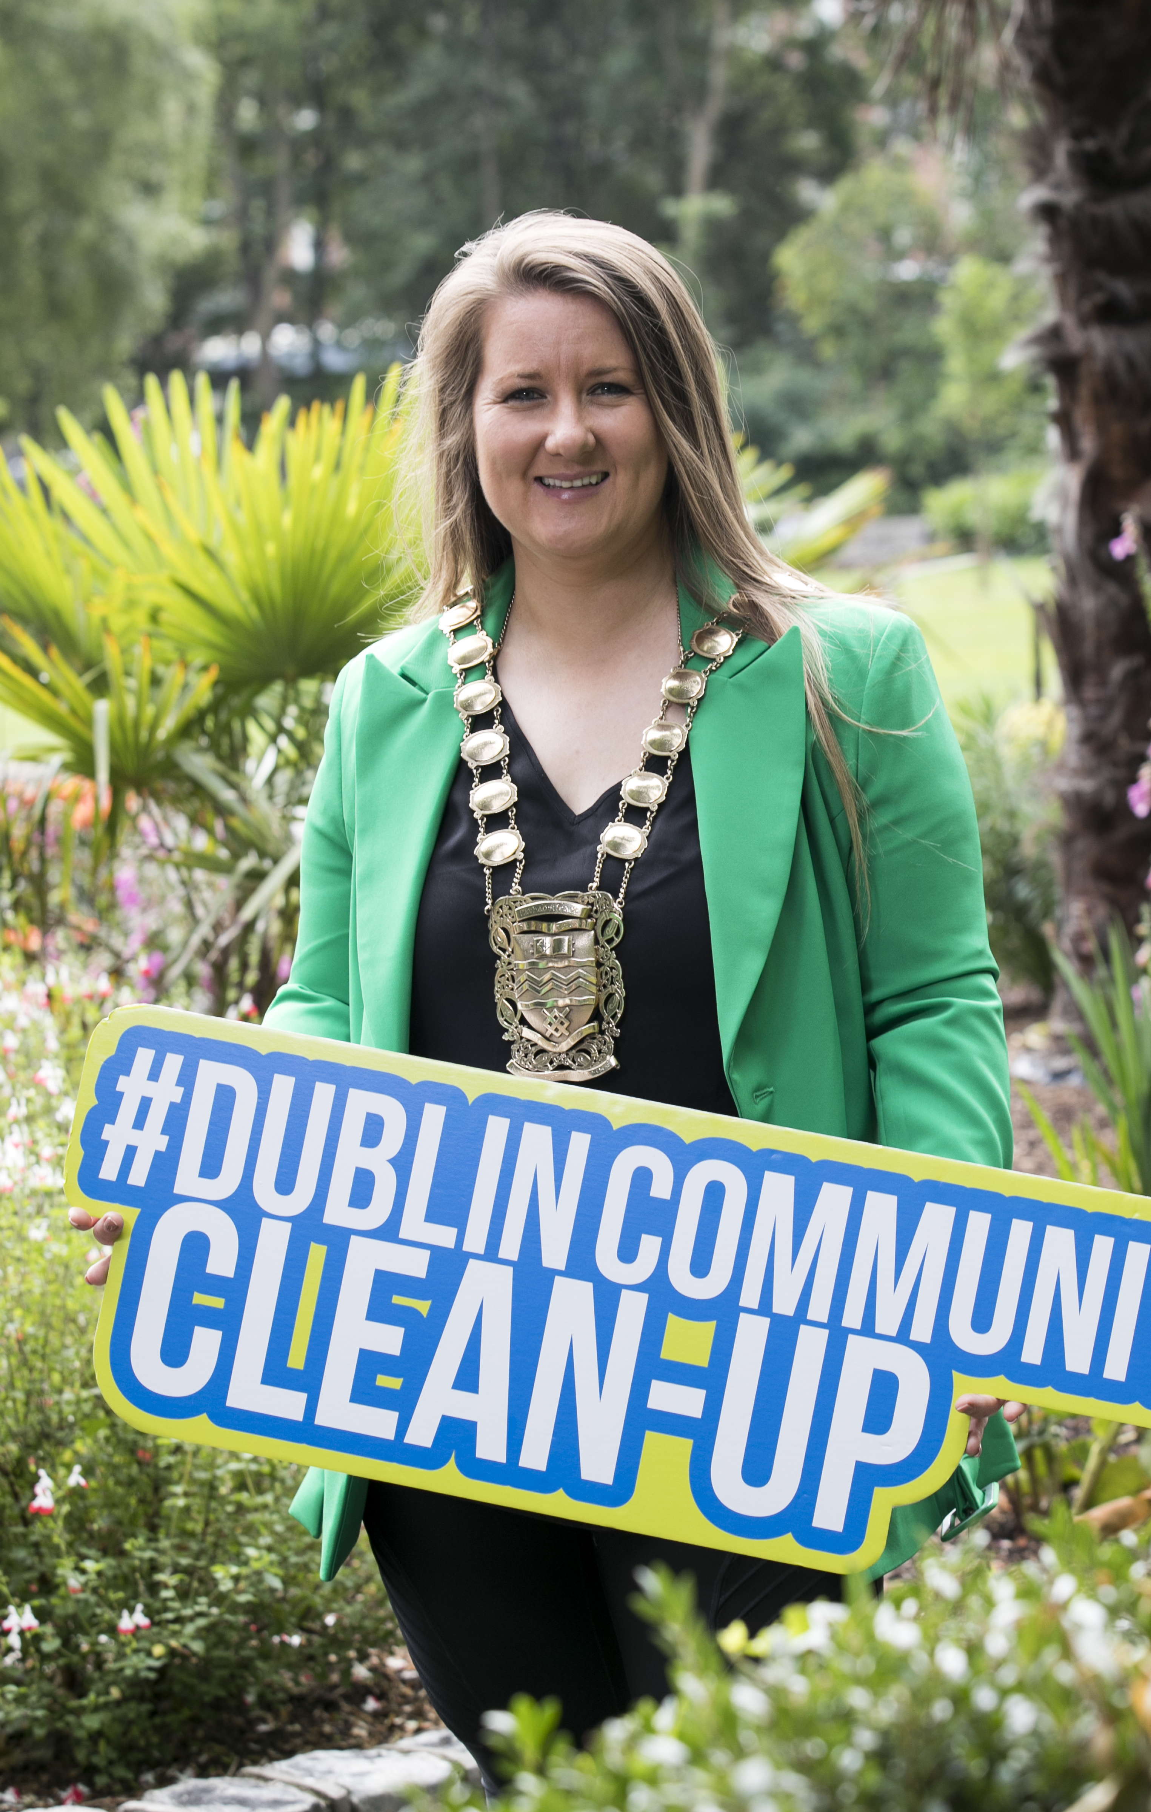
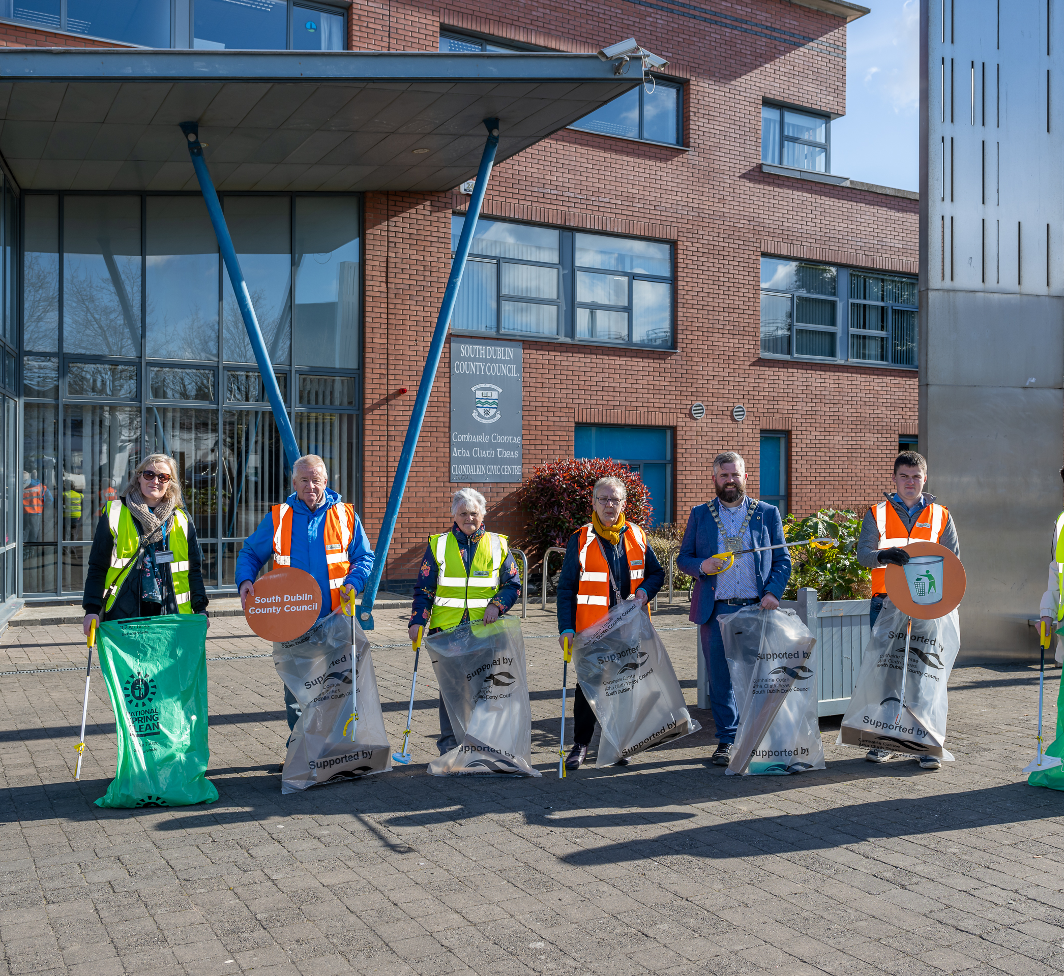
Litter Management Campaigns
National Spring Clean – April
  55 clean ups registered in 2022
  Launched in Clondalkin in 2022
Gum Litter Taskforce
Dublin Community Clean Up – September
Seasonal Campaigns at Hallowe’en and Christmas

Slide 9
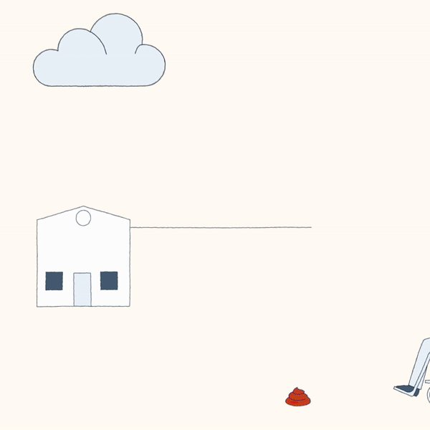
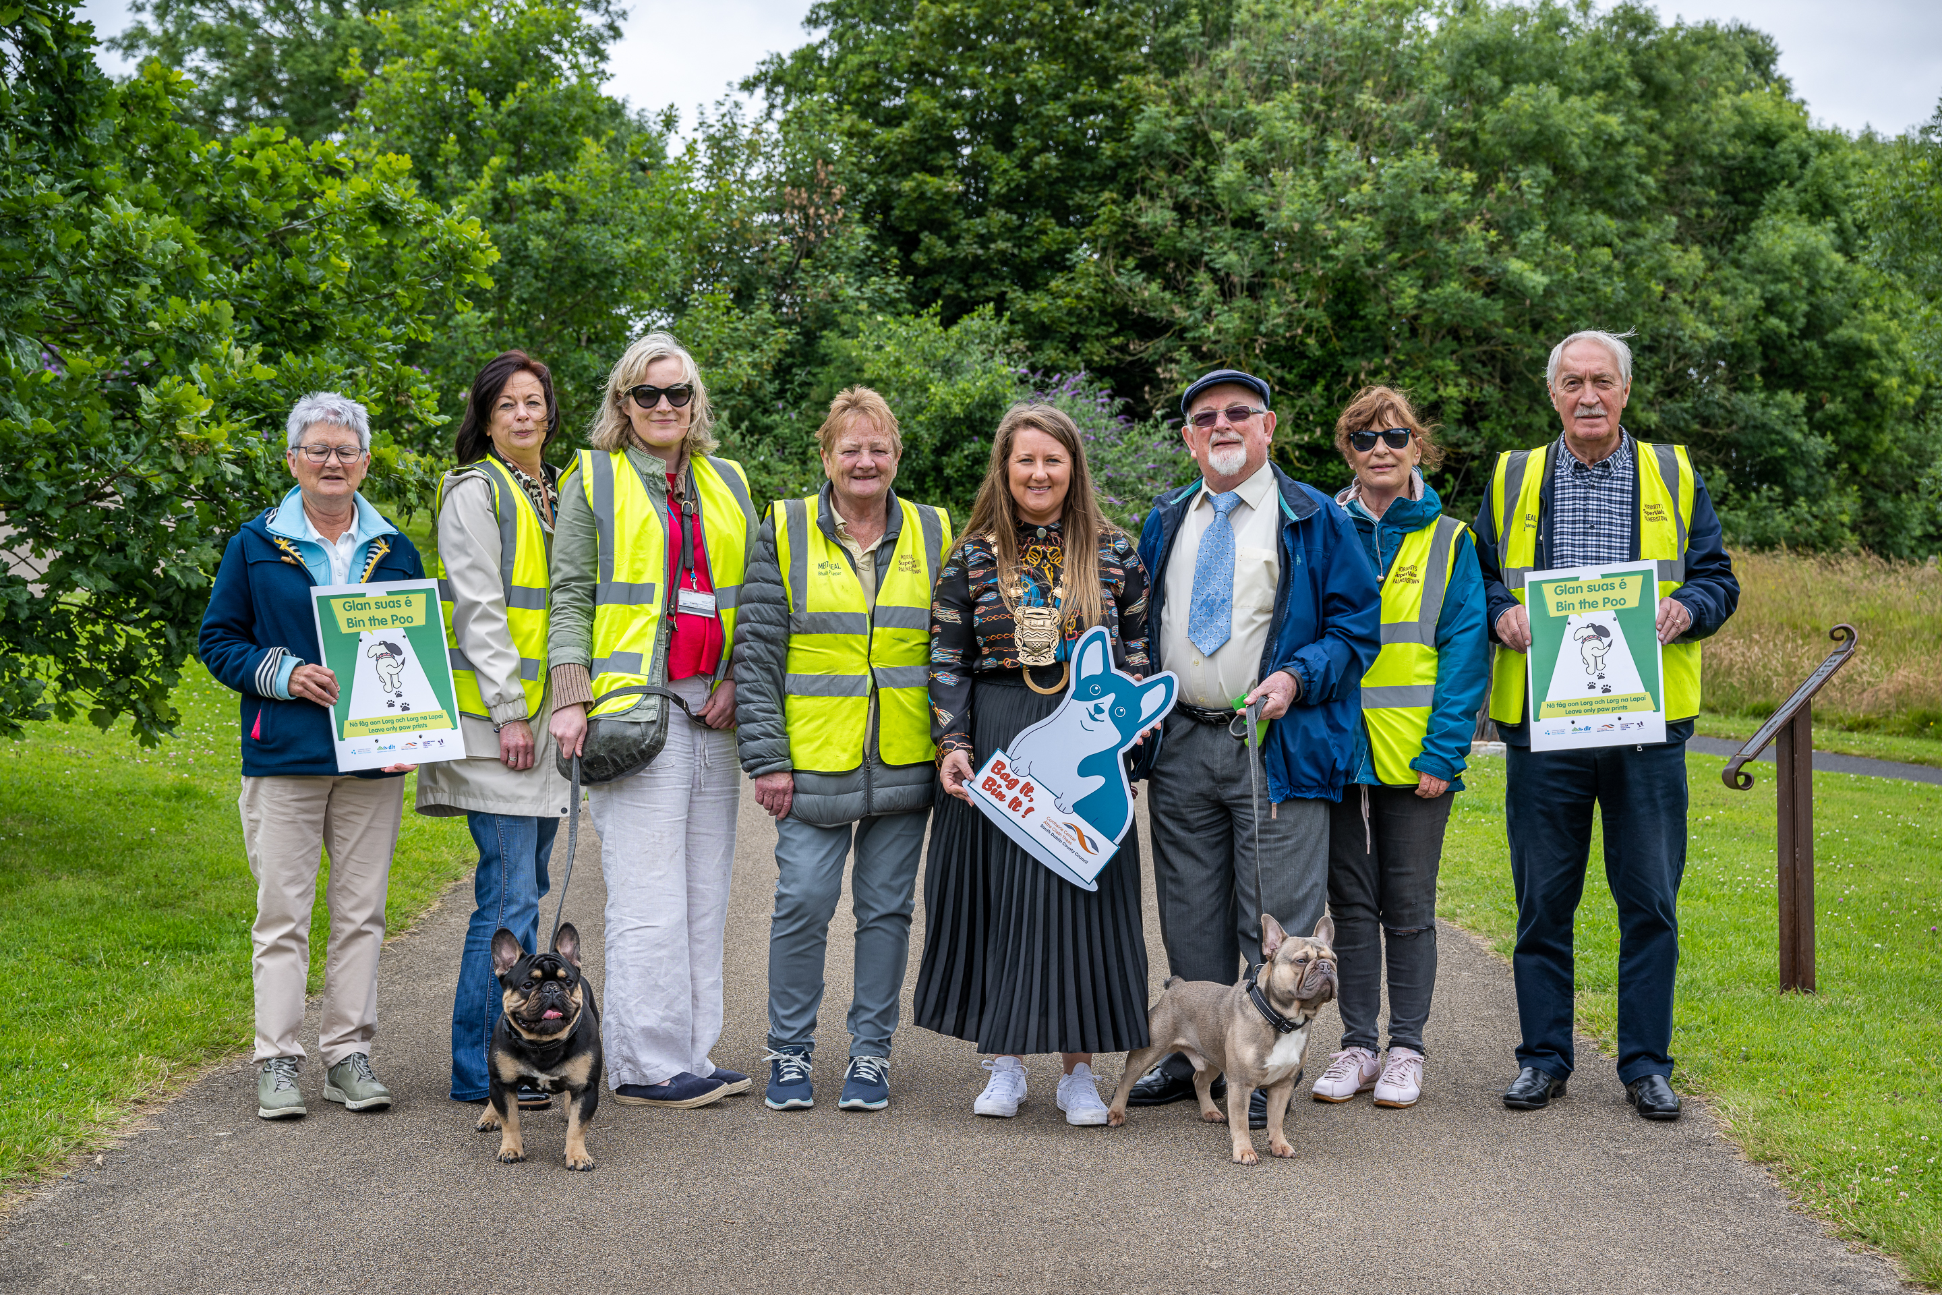
Dog Fouling Campaign Launched July’22

Slide 10
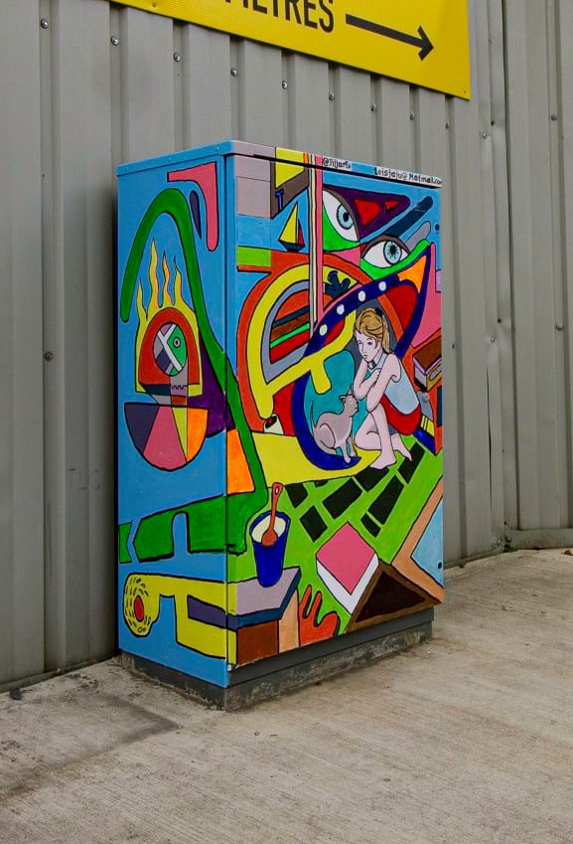
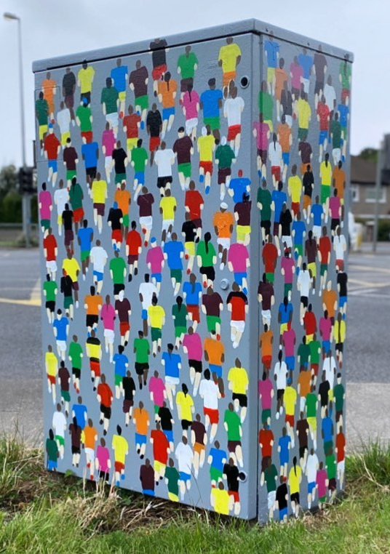
Dublin Canvas
Programme launched in 2018
Anti-graffiti project
118 traffic light boxes painted across the County
Delivered in partnership with Dublin Canvas
BusinessConnects and Active Travel Works has effected delivery of this project

Slide 11
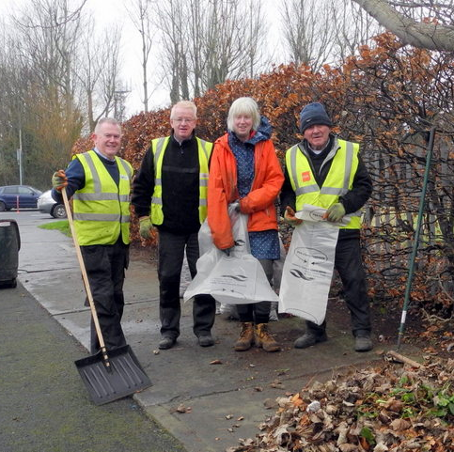
Tidy Towns
Moved to Env. Awareness in 2023
Currently communicating our new role to groups – checking contacts etc.
Seed funding round will be launched shortly.

Slide 12

Dublin Climate Action Week
12th – 17th September
Delivered with other DLA’s, CARO & Codema
South Dublin Chaired the Steering Group in 2022
Events include: Climate Fest in Tymon Park, Climate Youth Conferences, Biodiversity Walks

Slide 13
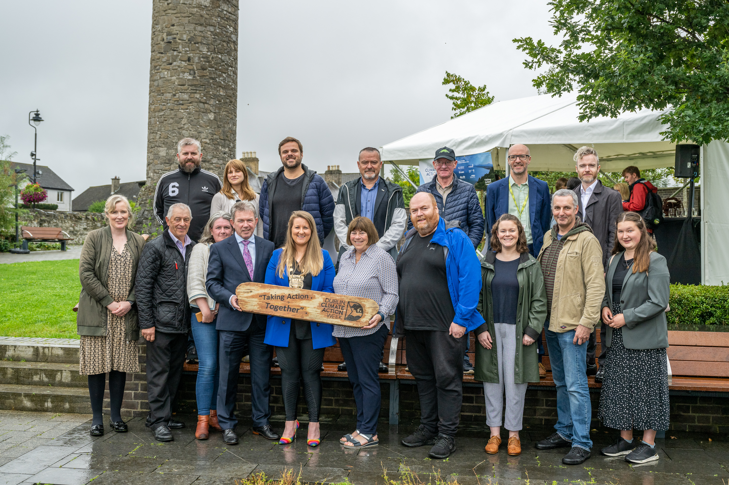
DCAW Launched in Clondalkin 13th September

Slide 14
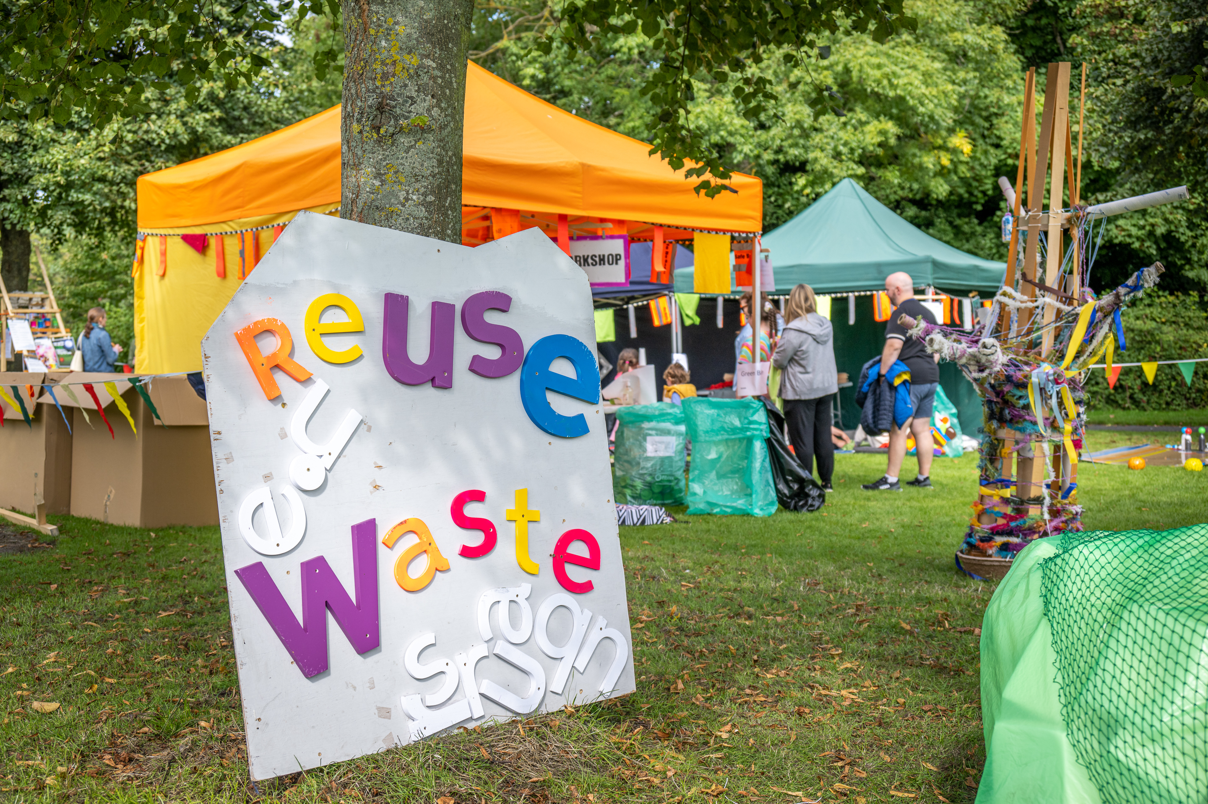
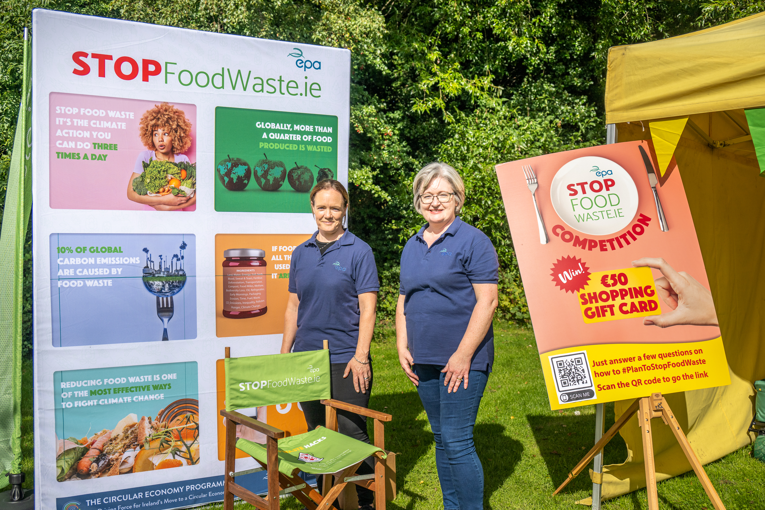
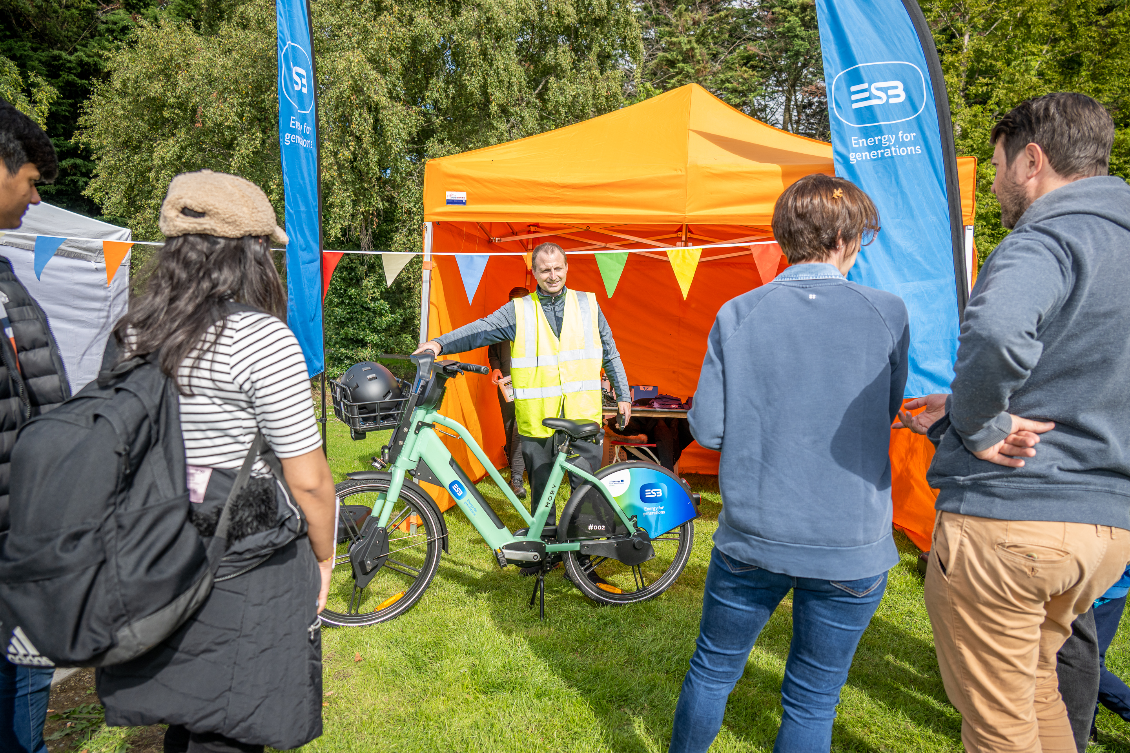
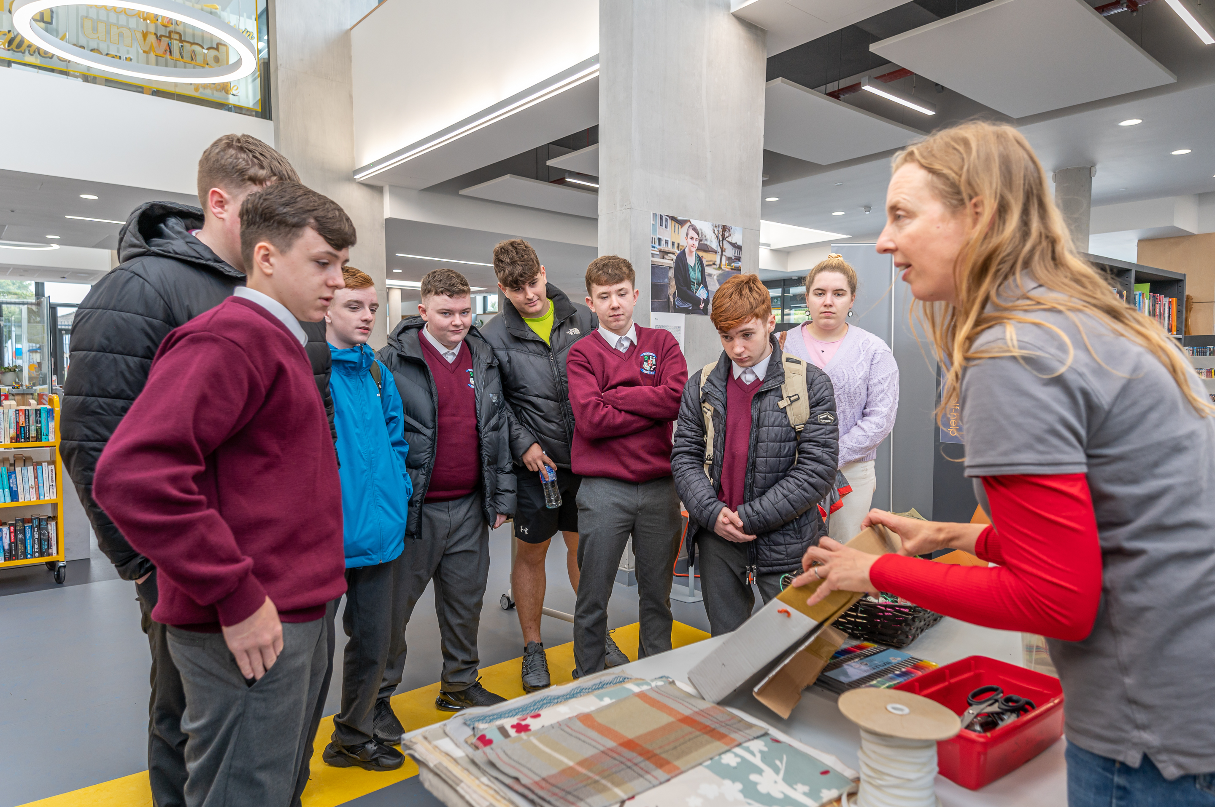
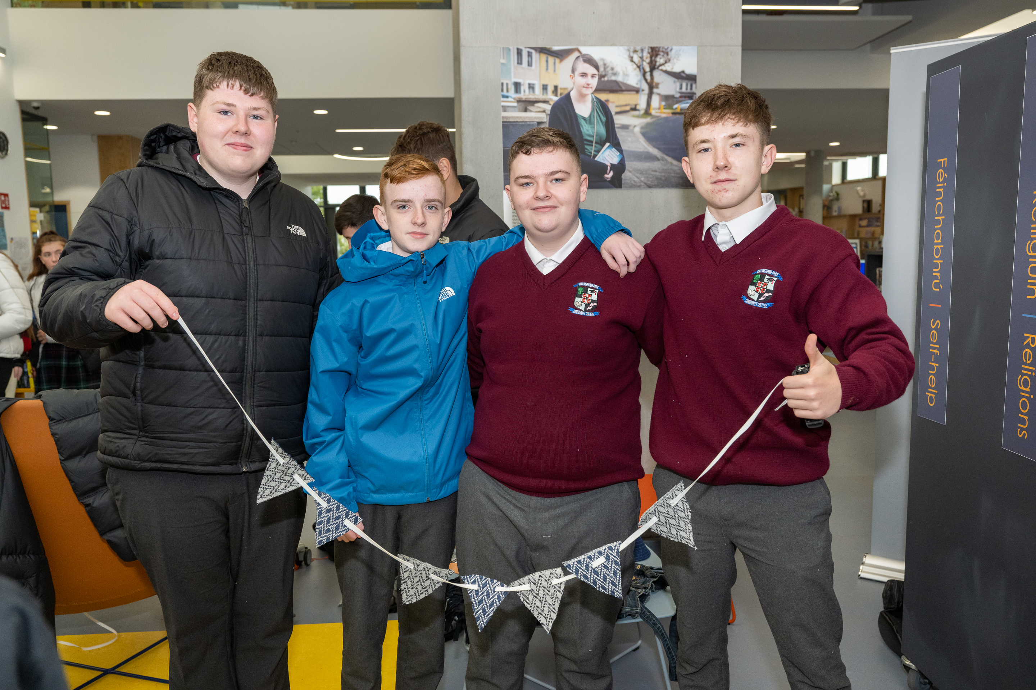
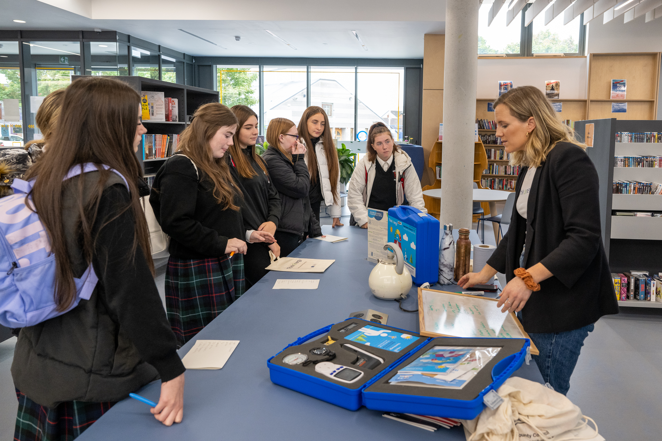
DCAW Events

Slide 15
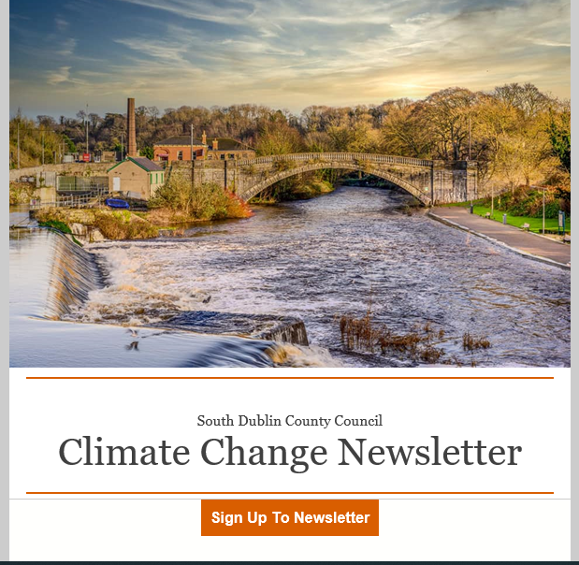
Climate Change Newsletter

Slide 16
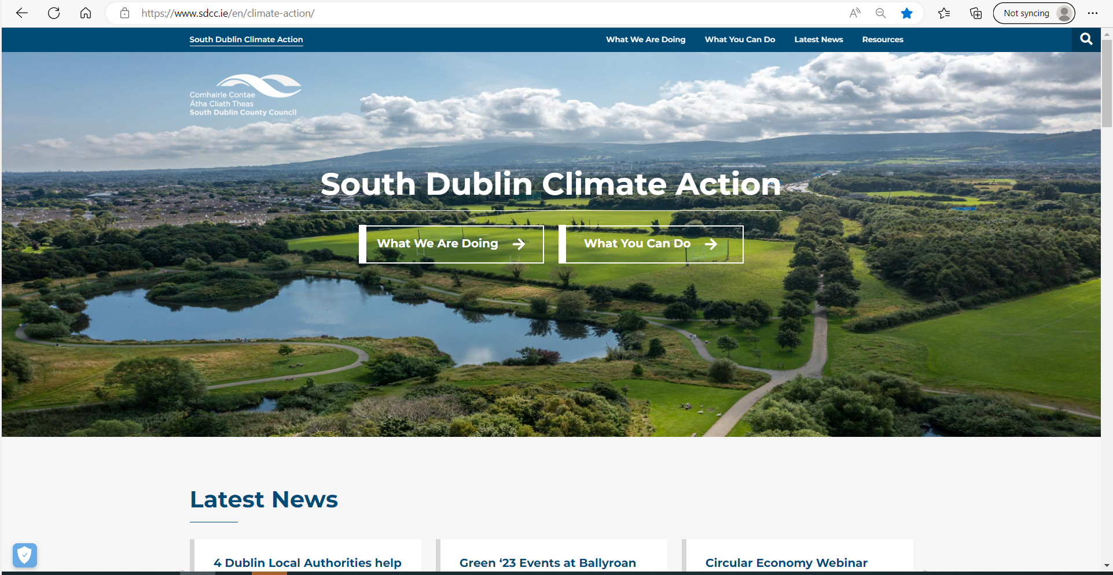
South Dublin Climate Website – www.southdublinclimate.ie
Launched June 2022.
The home for climate action in South Dublin
First dedicated local authority climate website
shows what the Council are doing and what citizens can do to mitigate, and adapt to climate change.
Approx 140 pages of content.
Approx. Page Hits: 3200
Version 2 in development due for launch in 2023, - increasing interactivity, improving the visual experience, and yielding a more dynamic, inspiring experience.

Slide 17
Thank you

