Slide 1
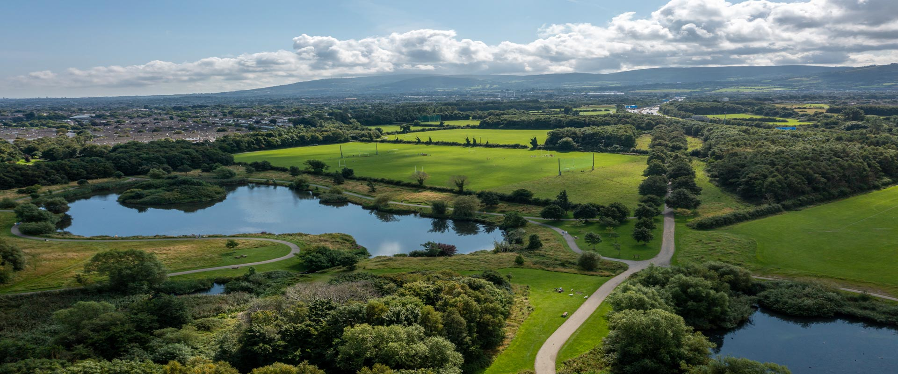
South Dublin County Council Climate Change Action Plan Implementation Plan 2023

Slide 2
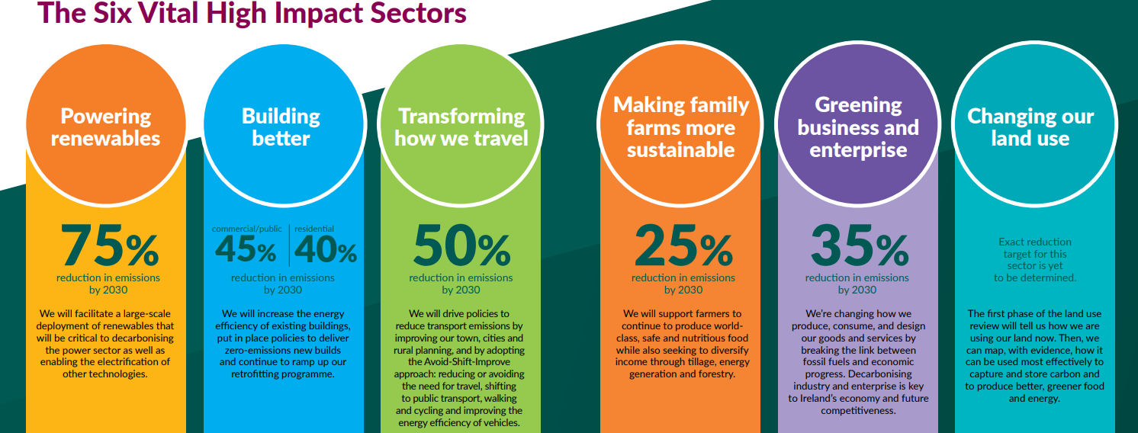
National Climate Action Plan 2023
National Climate Action Plan 2023 published on 21st December 2022.
Supplementary Annex of Actions will be published in early 2023.
Implements carbon budgets and sectoral emissions ceilings
Sets a roadmap for action to halve our emissions by 2030 and reach net zero no later than 2050.

Slide 3
CAP Implementation Plan 2023
National Climate Action and SDCC Targets
51% reduction in CO2 emissions by 2030
Net Zero by 2050
50% Improvement in Energy Efficiency by 2030
6 Action Themes in SDCC’s CCAP
Transport
Flood Resilience
Nature Based Solutions
Resource Management
Citizen Engagement
To make Dublin a climate resilient region by reducing the impact of future climate related events
Energy & Buildings

Slide 4
CCAP Current Status of Actions
Citizen Engagement

Slide 5
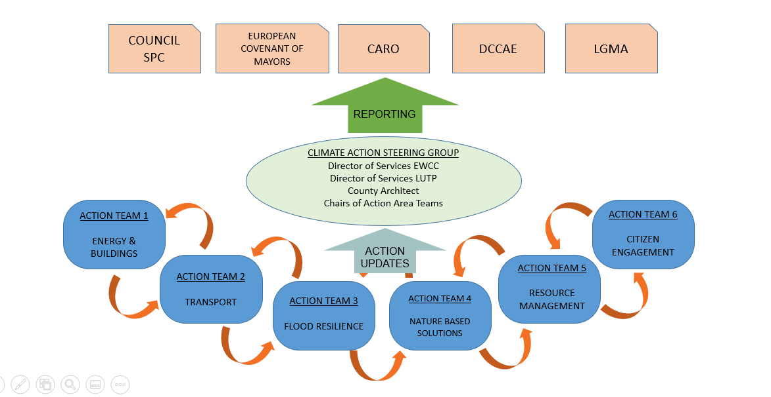
CCAP Delivery Structure

Slide 6
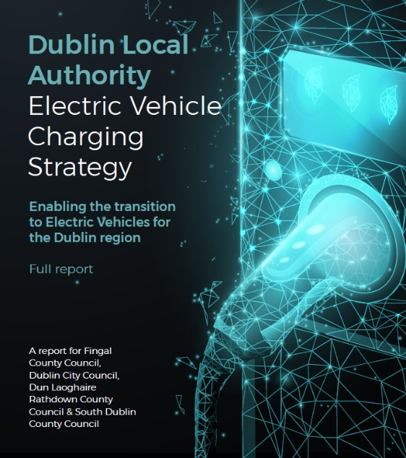
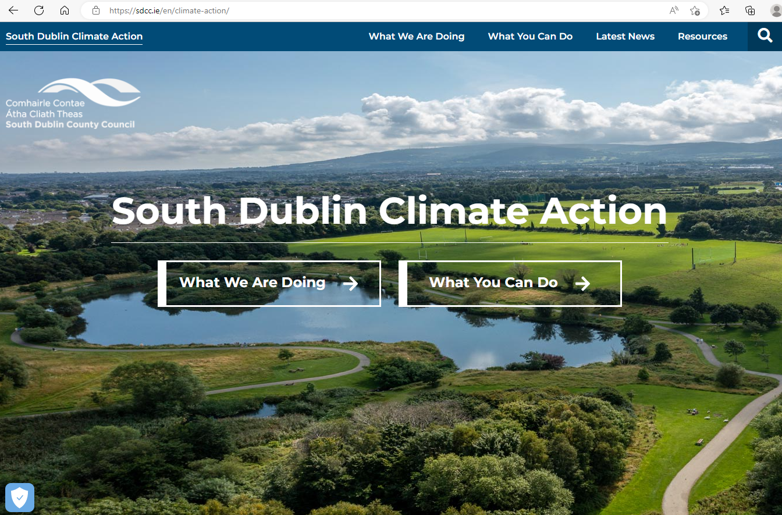
2023 Key Actions
Public Lighting Upgrades (Action E.2)
Office Lighting Upgrades – Phase 4 (Action E.15)
EV Charging Pilot Project (Action T.7)
Fleet Review (Action T.2)& Depot Facilities Review
Cycle South Dublin/Greenways (Action T.10)
BusConnects Core Corridors (Action T.18)
Arthurstown Landfill Solar PV Project (Action E.20 and E.29)
Flood Alleviation Schemes (Action F.17 & F.18 & F.19)
Climate Action Website Review (Action CE.1)
Continue Climate Awareness Training LGMA/LASNTG (Action R.29)
Climate Action Plan 2024-2029
Decarbonising Zones (Action E.31)

Slide 7
2023 Funding
Climate Innovation Fund 2023 - Council approved €300,000 for 2023
Departmental Project Funding
Community Climate Action Funding guaranteed for 3 years
ZEVI Funding Opportunities
OPW funding for agreed Flood Alleviation Schemes, etc.
Other grants to be investigated (SEAI Grants, TII/NTA, Government Departments)

Slide 8
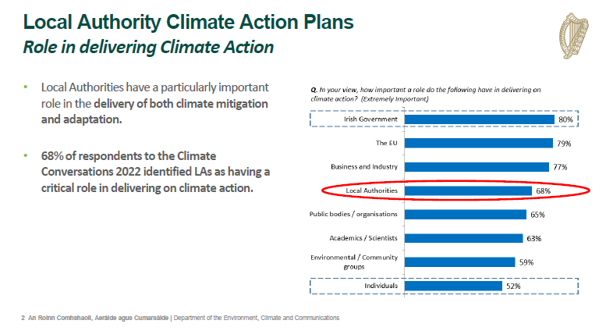
Climate Action Plan 2024 - 2029
Climate Action and Low Carbon (Amendment) Act 2021 – sets out Role of Local Government

Slide 9
Climate Action Plan 2024 - 2029
Under Section 16 of the Act: Minister may issue guidelines consistent with furthering the achievement of the national climate objective, to local authorities in respect of the content and preparation of a local authority climate action plan and a local authority shall comply with any such guidelines.’
Draft Guidelines developed by Multi Stakeholder Project Advisory Group

Slide 11
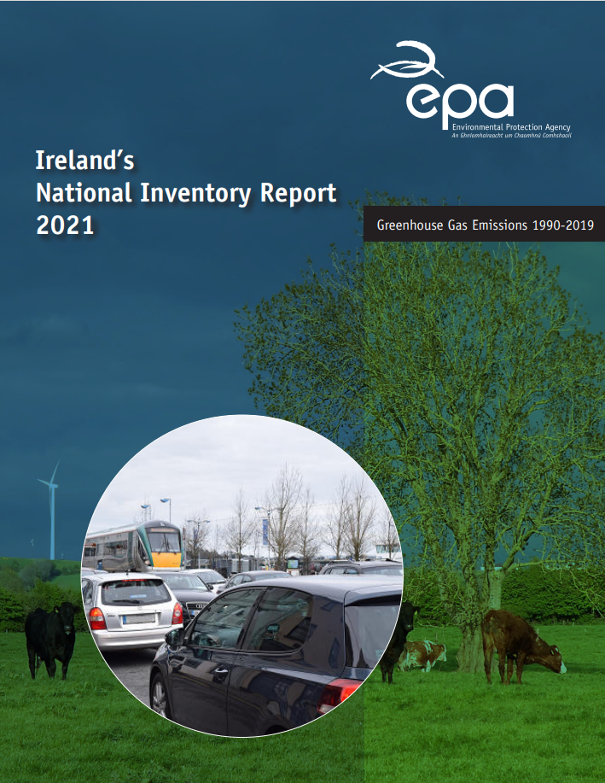

Slide 13
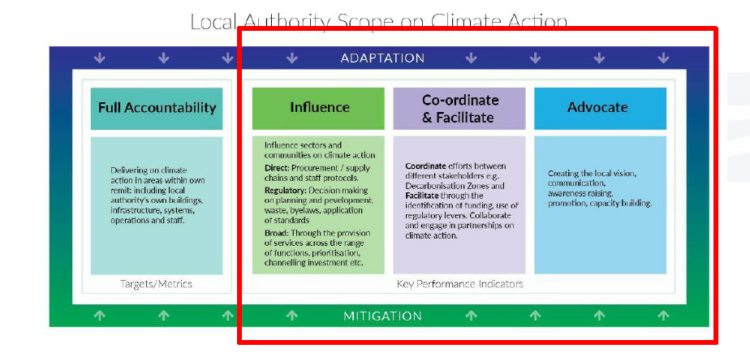
CAP 2024–2029: SDCC Approach
DLAs have comprehensive CCAPs in place
SDCC will seek to increase the level of ambition in the existing CCAP and to align with the actions and targets in the National Climate Action Plan 2023 and the key responsibilities set out by the Draft LA CAP Guidelines.

Slide 15
Strengthen Risk Assessment and Climate Mitigation Assessment

Slide 16
LAs to bring forward a DZ Plan as part of their Climate Action Plans – one DZ

Slide 17
Thank You

