Slide 1
Balgaddy UPDATE Area Committee Meeting 20th December 2022

Slide 2
Housing Relets 2022
Status | Ready | In progress | Quotation Stage | Total
Number of Re-lets | 2 | 4 | 16 | 22
Type | Allocations
No. of New Tenancies | 22

Slide 3
Planned Maintenance- Balgaddy
Roofing Works –
Roofing repairs completed to properties in Buirg an Rí
initial investigations for roofing works have commenced at the following
Tor an Rí – flat roofed properties
Méile an Rí Drive – apartment units
Communal Areas –
Installation of communal doors and fan lights to 3 communal doors on Foxdene Avenue rescheduled to January 2023.
Additional security lighting to be installed in conjunctions with the door works.
Energy Efficiency Retrofit Programme-
Properties in Tor an Rí to be assessed for inclusion in the EERP programme for 2023/24
Painting –
Works on 57 properties in Tor and Rí to commence early 2023.
Tender documentation is being prepared for external painting works and communal areas in Foxdene Avenue with works to commence in Quarter 1 2023
Bin Storage Areas –
Ongoing refurbishment of bin storage areas being carried out to reduce anti social behaviour.

Slide 4
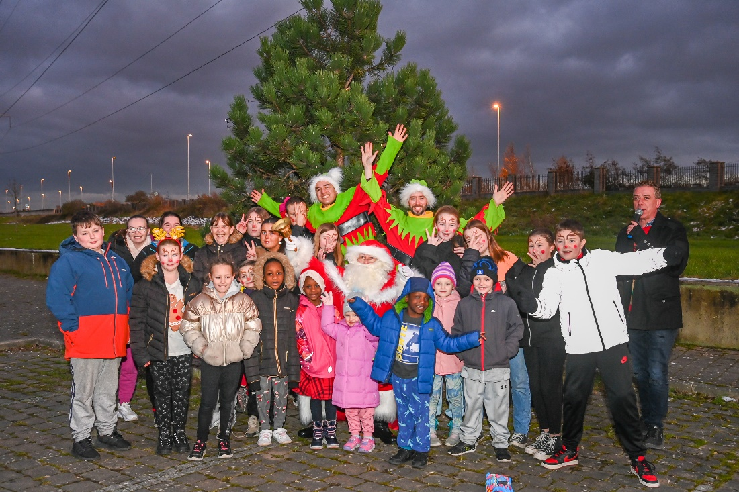
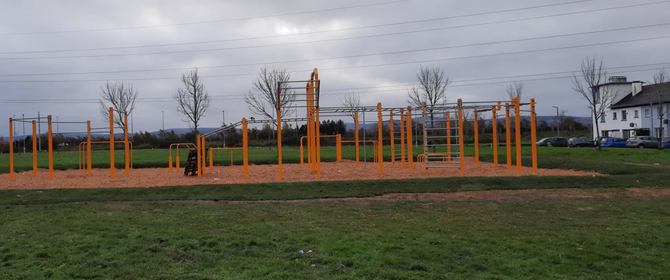
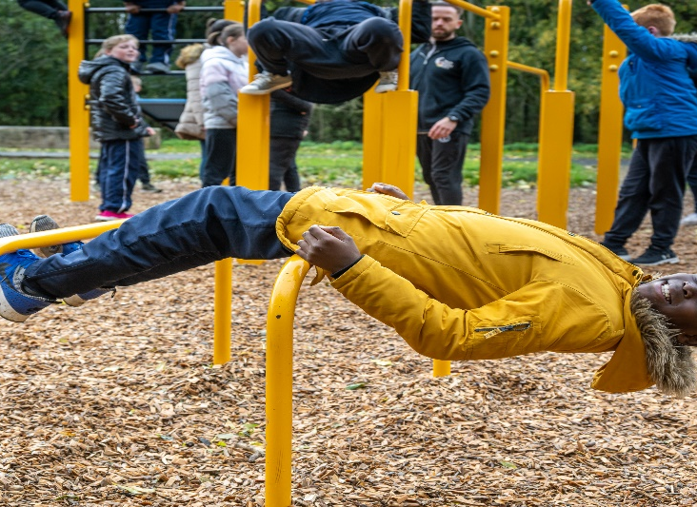
Estate Management

Slide 5
New Social Housing & Community Centre update
The contractor is due to start on site in January 2023 due to be delivered by the end of August 2024.
The construction period for the project is approx. 20 months.
With the development of any new community facility the Community team will engage with local residents and community groups to undertake local consultation and to provide a full analysis of community needs in advance of facility usage planning.
The consultation will take place in advance of, and during, the early construction phase of the community facility.

