Slide 1



South Dublin County

Slide 2

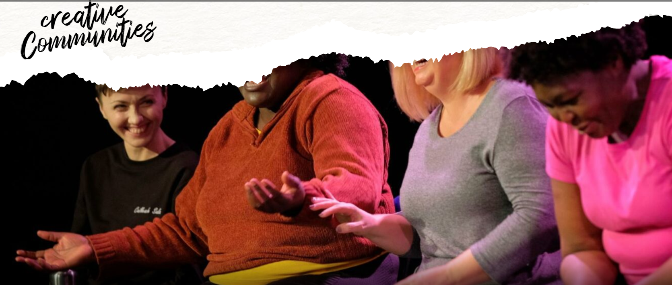
National Context
Local Context
Vision
Objectives
Implementation

Slide 3
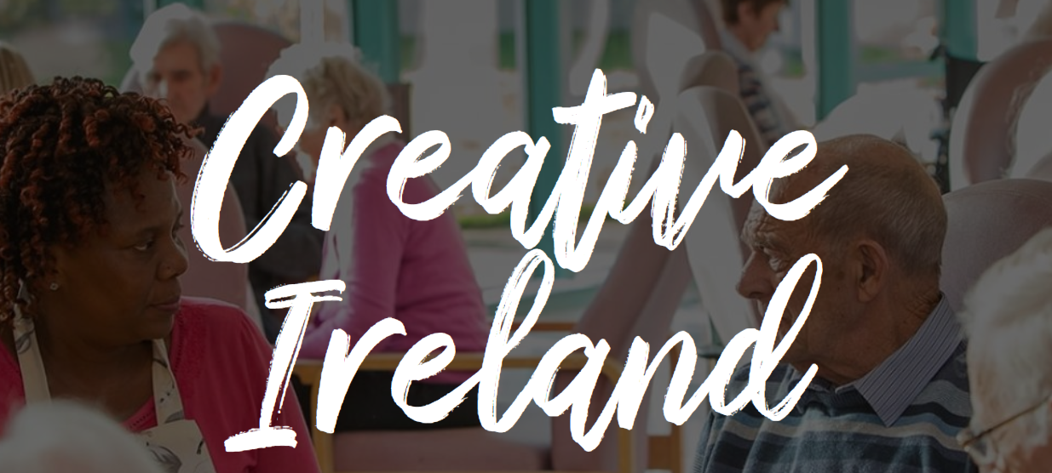
All of government programme initiated in 2017 as a legacy of the 1916 Commemorations programme
To mainstream creativity in the life of the nation to realise our full creative potential thereby promoting individual, community and national wellbeing.
Partnership with Local Government to deliver Creative Communities but also working across all priority areas
5 Key Priorities 2023-2027:
Creative Youth
Creative Communities
Creative Industries
Creative Health and Wellbeing
Creative Climate Action and Sustainability
National Context

Slide 4
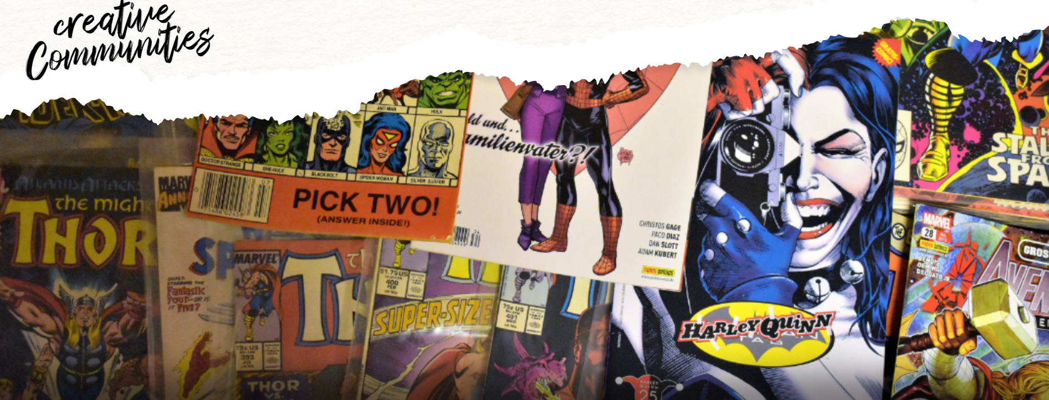
274,000 people in the county engaged in Creativity Activity between 2018-2022
€1.38m invested by government in Creative Ireland South Dublin County over this period
873 Creative Practitioners engaged over this period
Cruinniú na nÓg, national day of free events
celebrating children’s creativity established in the calendar
The potential for further growth and development places us on this hinge of opportunity
Local Context

Slide 5
Building on our key strengths
Diverse and enterprising local communities
A strong sense of local identity
Strategic use of funding and resources to deliver high quality arts and creative programming
Strong/Sustaining networks, partnerships, and collaborations
Utilisation of venues and spaces located across the county

Slide 6

A broad based high level strategy
Overall aim to strengthen community, economy, space, and place by designating Culture and Creativity as the keystone to development and regeneration work.
Our Creative Ireland South Dublin County vision is for:
A culturally rich, multi-faceted, and inclusive environment in which key decision makers and citizens value and embrace the importance of culture and creativity as a powerful agent for change, celebration of identity, solidarity, well-being, sustainable community and economic development.
Vision

Slide 7



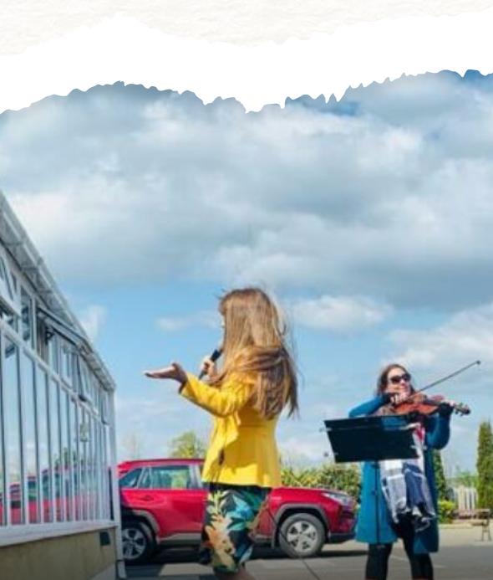
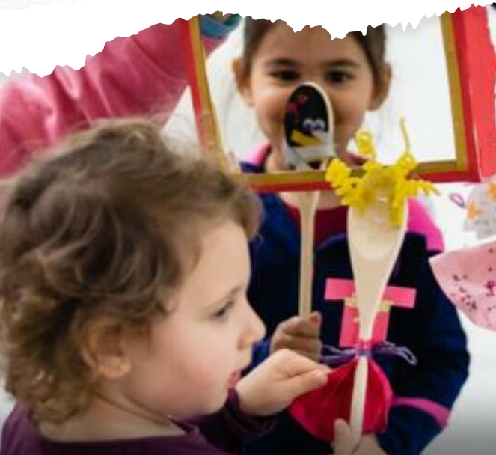

4 Key Objectives
  Leaving It Better
  Strive for excellence, appreciation and understanding
  Equal Voices
  Cultivate inclusivity and equity, giving a voice to local communities
  Celebrating Diverse Identities
  Celebrate identities among diverse groups of people
Inspiring Spaces
Optimise public venues, spaces, and communities for access and participation to cultural and creative initiatives

Slide 8
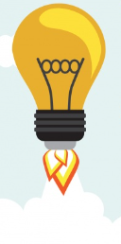





Implementation
Implementation by Councils Cultural & Creativity Team through
annual programmes that address local priorities
Delivered by Creative Ireland South Dublin Co-Ordinator and Public Engagement Officer, providing more opportunities for people to engage with and enjoy culture and creativity
Through stronger alignment with other Council strategies
Creative Ireland’s continued support to local authorities
Partnership between central and local government, and South Dublin County and our local culture and creative sectors.

