Slide 1
Housing Delivery Update Report Lucan/Palmerstown/North Clondalkin
Area Committee Meeting 20th December 2022

Slide 2
2022
Notes:
Housing for All Delivery Pipeline 2022
No alt text provided
textbox
No alt text provided
textbox
No alt text provided
tableEx
No alt text provided
Housing for All Delivered
No alt text provided
actionButton
No alt text provided
textbox
No alt text provided
tableEx
No alt text provided

Slide 3
Approved/Proposed Developments by LEA (2)
LEA | Site | No. | Update
Tallaght Central | Old Bawn | 12 | On site-due for completion Sept ‘23
 | Fernwood/Maplewood (Clúid) | 40 | AHB tender process complete. Contractor to be appointed andon site Jan 2023
 | Whitestown Way (Clúid) | 81 | On site-due for completion 2023
 | Mountain Gate (Part V) | 7 | On site-due for completion mid-2023
 | St. Aongus’ Green | 10 | Design team appointed Q2 2022
Tallaght South | Rossfield | tbc | Scheduled for Part 8 in Q1 2023
 | Parklands Citywest | 54 | On site-due for delivery from June 2023
 | Citywest Village/Mews (Part V) | 27 | On site-due for completion Q2 2023
Lucan | Aderrig (Part V) | 25 | 2 homes in Q4 2022 & balance in Q4 2023
 | Somerton Phase 2 (Part V) | 24 | On site-due for completion Q2 2023
 | St Helens/Somerton (Part V) | 12 | On site-due for completion Q2 2023
 | Tandys Lane (Part V) | 24 | On site-due for completion 2023
 | Shackleton 4 | 12 | On site-due for delivery Dec 2022
 | St Helens Plaza (Part V) | 4 | On site-due for completion 2023
Palmerstown/Fonthill | Balgaddy | 69 | Contractor appointed for site start Dec 2022
 | Old Lucan Rd (Túath) | 4 | Scheme to be reviewed, acquisition of additional strip of land
 | St. Ronan’s | 9 | Design team appointed Q3 2022
 | Kennelsfort Road | 20 | BTR due for completion 2023

Slide 4
Part V Agreements
LEA | Site | No. | Update
Lucan | Adamstown Station (The Crossings) | 28 | Part V under negotiation
 | Adamstown Station/District centre – 2nd permission | 19 | Part V under negotiation/off site units Aderrig
 | Aderrig Phase 2 | 23 | Part V under negotiation
 | Citywest View | 40 | Part V negotiations underway
Palmerstown/Fonthill/ North Clondalkin | Palmersgate BTR | 20 | Under negotiations

Slide 5
Approved/Proposed Developments by LEA (1)
LEA | Site | No. | Update
Clondalkin | Mayfield/Riversdale Phase 2 | 18 | On site-due for completion Q4 2023
 | New Nangor Rd. (”eircom” site) | 93 | On site-due for completion Oct 2023
 | Lindisfarne | 19 | Site start Nov-due for completion Q4 2023
 | Old Nangor Rd. (Simon) | 10 | Revised planning app, decision Jan 2023
 | Deansrath/Melrose | Tbc | Concept design to ACM Dec 2022
 | Oldcastle Park | Tbc | Concept design to ACM Dec 2022
 | Alpine Heights | Tbc | Concept design to ACM Q1 2023
 | Kilcarbery 2 | tbc | Concept design to ACM Q1 2023
Rathfarnham/Templeogue | Templeogue Village | 10 | On site-due for completion Dec 2022
Firhouse/Bohernabreena | Homeville | 16 | Tender docs being prepared Bill of Quantities, to be issued late Jan/early Feb 2023
 | Cloragh Mills | 8 | Sale to complete 16/12/2022
 | Pearse Brothers Park | 10 | Design team appointment Q4 2022
 | Castlefield | tbc | Concept design to ACM Q1 2023
 | Stocking Lane | tbc | Feasibility for AHB/CAS-priority needs

Slide 6
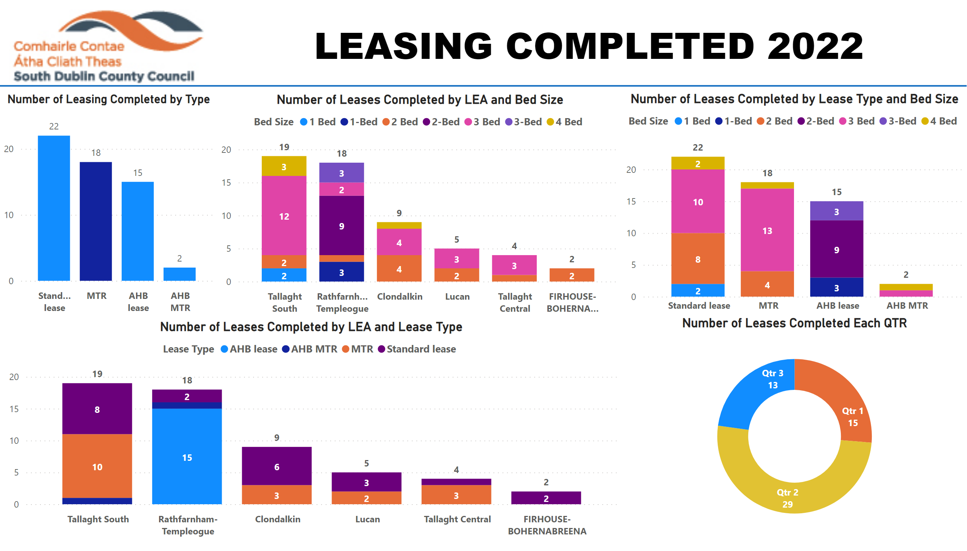
SDCC-owned Large Sites
Kilcarbery: 1,034 homes with 30% social (310 homes)
36 social, 16 affordable purchase & 74 cost rental (Túath) homes complete with 42 more social homes due by year end Projected delivery of 150+ social and 29 discounted/affordable purchase homes in 2023
Killinarden: 620 homes (including 125 social & 372 affordable purchase)
LSRD planning application being finalised (lodged Dec 2022) with delivery then projected from 2024 (subject to planning)
Clonburris: Phases 1 & 2 comprising 382 homes (149 social), Phases 3,4,5 with potential for 1,600 homes (40% social)
Part 8s for Phase 1 (Kishogue) & Phase 2 (Canal Extension) approved-contractors to be appointed by end of Q1 2023 Tender process for design teams for Phases 3,4 & 5 to be completed by year end 2022 Proposed PPP site comprising 120 social homes–Section 85 agreement to be brought to Council in Q1 2023
Belgard Square North: 133 cost rental apartments
Tenders for construction works received & being assessed – significant uplift on projected costs Engagement with DHLGH and Housing Agency on cost model, AHF subsidy and project viability – report to Council in December 2022
Rathcoole: Number of homes & tenure mix to be confirmed
Extension of design team appointment to redesign site following County Development Plan Plan to include social homes and Traveller accommodation, scope for affordable housing to be examined

Slide 7
2023
Notes:
image
No alt text provided
Housing for All Delivery Pipeline 2023
No alt text provided
textbox
No alt text provided
shape
No alt text provided
shape
No alt text provided
Target HFA
No alt text provided
Delivery Pipeline Target
No alt text provided
Difference
No alt text provided
Revised Total
No alt text provided
shape
No alt text provided
shape
No alt text provided
shape
No alt text provided
shape
No alt text provided
shape
No alt text provided
columnChart
No alt text provided

