Slide 1
Capital Projects Update
December 2022

Slide 2
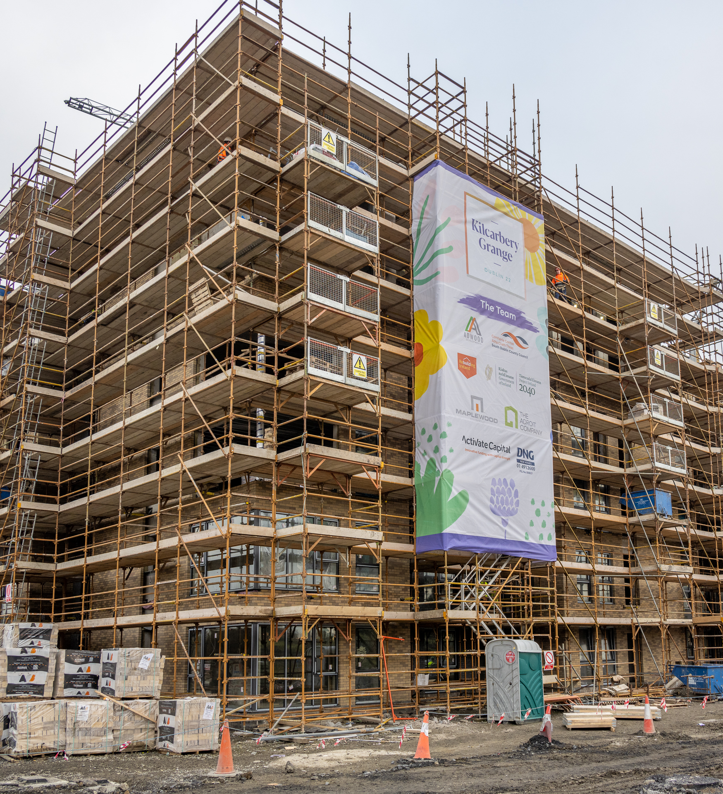
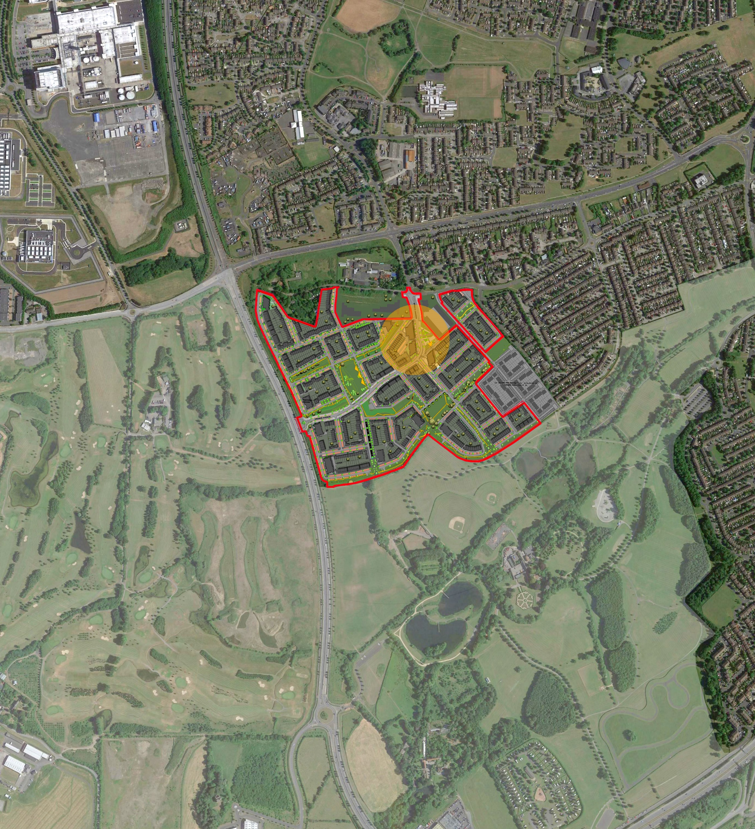
Kilcarbery and Other Large Sites
Kilcarbery - 2022 delivery - 16 affordable, 74 cost rental, 78 social.
Clonburris – Phase 1 (266)and Phase 2 (116) through planning and at tender stage
Killinarden – LRD application for 620 to SDCC – to be lodged by year end.
Belgard North Cost Rental Apartments (133)– report to February Council meeting.
Rathcoole – new site layout, masterplan required.

Slide 3
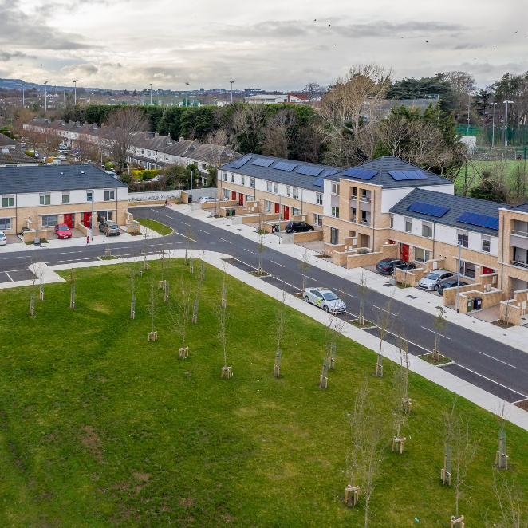
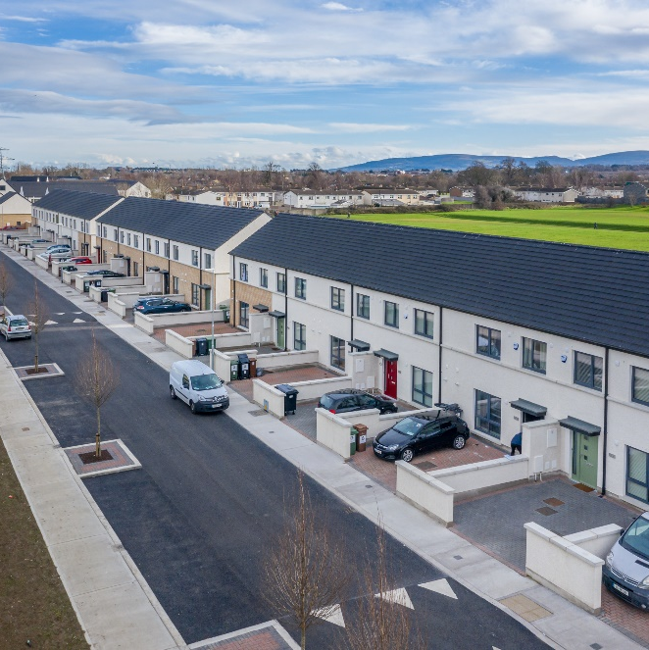
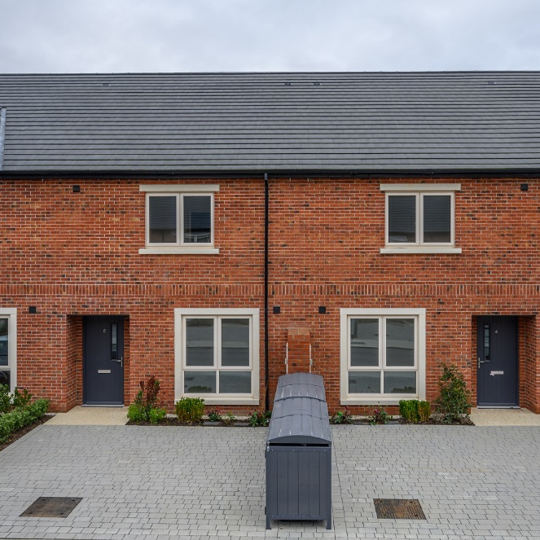
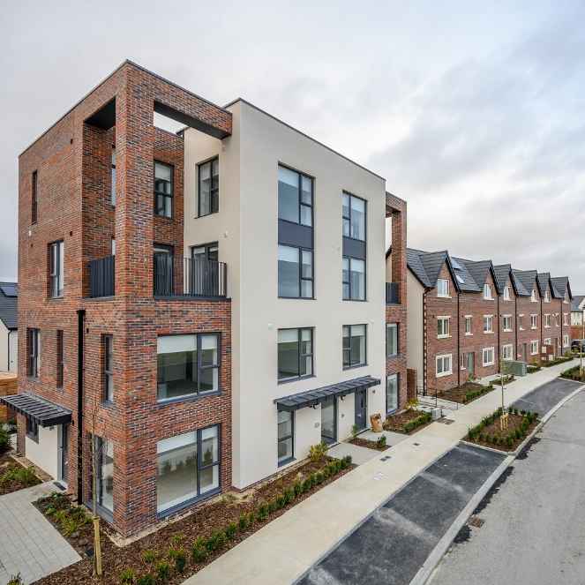
Housing Delivery
Fernwood/Maplewood (40) - tender determined - back on-site January.
Mayfield (43) – Phase 1 (25) delivered.
Homeville (16) – Retender January 2023.
St Catherines Knockmore (12) – due December 2022.
St. Marks Ave. (38) – practically complete.
Templeogue (10) - just completed.
Whitestown Way (81) - due Q4 2023.
Nangor Road (93) – due Q4 2023.
Old Bawn (12) – onsite October.
Balgaddy (69) – just on site.
Lindisfarne (19) – on site.
Design work progressing (40) – St. Aongus, St. Ronans, Pearse Bros., Rossfield.
Lucan Road (4) – AHB considering options.
TA fonthill (7) – planning approved.
Oldcastle park – redesign well advanced.
Adamstown – 7 delivered.

Slide 4
Housing
5 year plan – 3,707 social 1,133 affordable/ cost rental.
Delivery 2022 – 391 – 98% of target.
Target 2023 – 700. At this point target achievable.
498 households currently on homeless register.
  126 exits from EA in 2022 (62 allocations – balance homeless hap tenancies)
556 allocations completed YTD 2022, of which 433 were new tenancies and 123 were transfers.
Housing Needs Assessment completed – net need of 4,929 compared with 5,062 at same time in 2021.
Energy Efficiency Retrofit Programme
  Funding for 117 properties approved as part of 2021 programme and 146 properties approved as part of 2022 programme.
  Works completed on 72 properties to bring them up to BER of B2 or higher.
  60 properties on site, tenders awarded for 109 properties and 122 properties at pre-tender assessment.
Windows and Doors Programme
  180 full/partial replacement of windows and doors in 2022 with orders for 120 more properties.
  Tender issued for replacement windows/doors to 108 properties and tender to issue for 100 further properties in coming weeks.

Slide 5
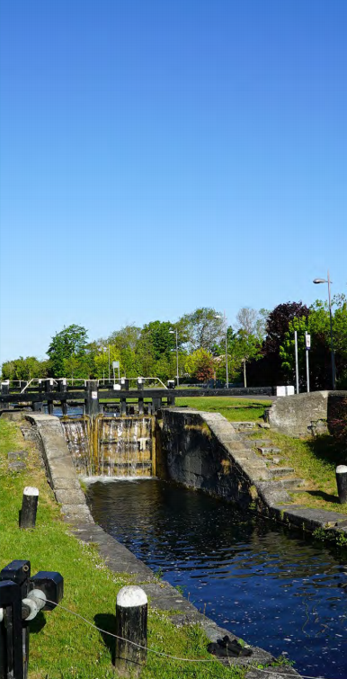


Clonburris
SDZ
URDF Business case for €186m approved – phase 1 of central carriageway on site.
8,714 Homes for 23,000 people
€2.9bn Regen.
Programme
€520m Exchequer Returns
2,360 Direct Jobs
44% Social &
Affordable Homes
8 Schools &
90ha of Parkland
Date:
29.06.2022

Slide 6
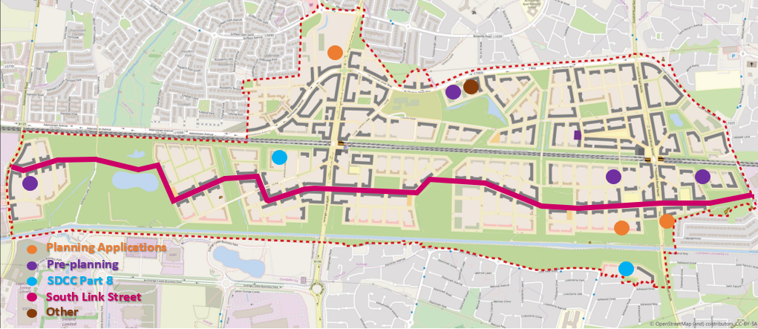
SDZ Activity
Planning
South Link Street and Utility Corridor (SDZ20A/0021) – Permission granted 12/08/21
Irish Water Pump Station (SDZ21A/0006) – Permission granted 08/11/21
Post primary school (SDZ21A/0013) – Permission granted 02/02/22
Cairn Homes 569 dwellings (SDZ21A/0022) – granted
SDCC Part 8
116 dwellings south of Grand Canal
266 dwellings adjacent to Kishogue
SDZ Requirements
Phase 0 Requirements
  Surface Water Management Plan – Approved
  Water and Wastewater Strategy – Approved
  Parks and Landscape Strategy – Under review

Slide 7
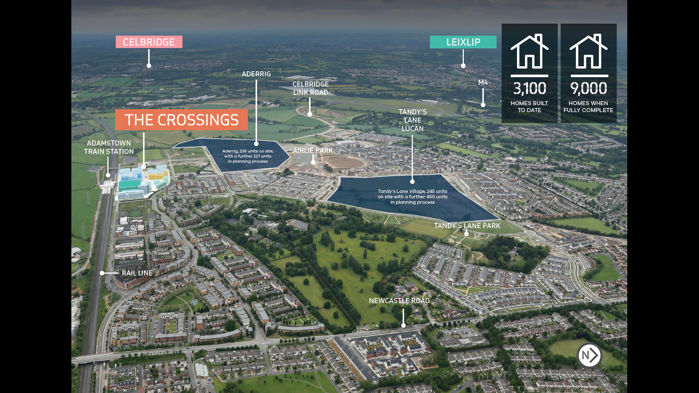
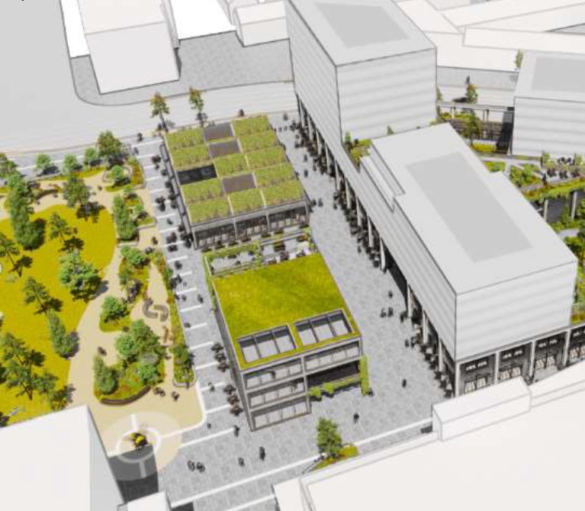
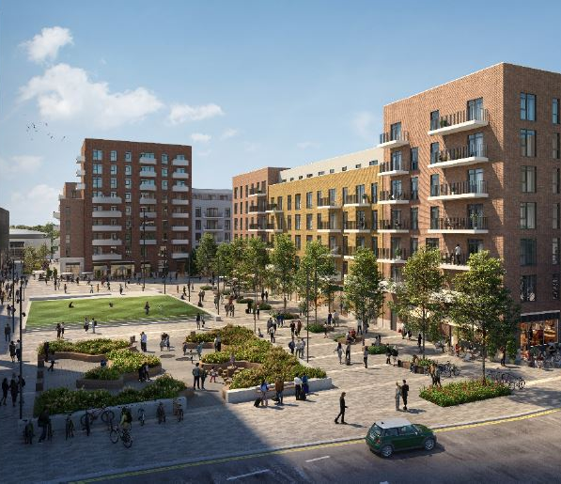
Adamstown
3,500 homes completed
The Crossings – 1,000 homes
11,700sqm of retail
Public Plaza, Library, Innovation Space
€13m public investment –URDF
Celbridge Link Road – August

Slide 8
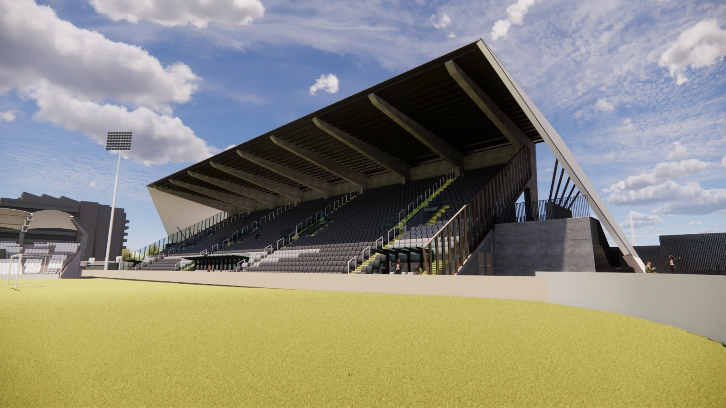
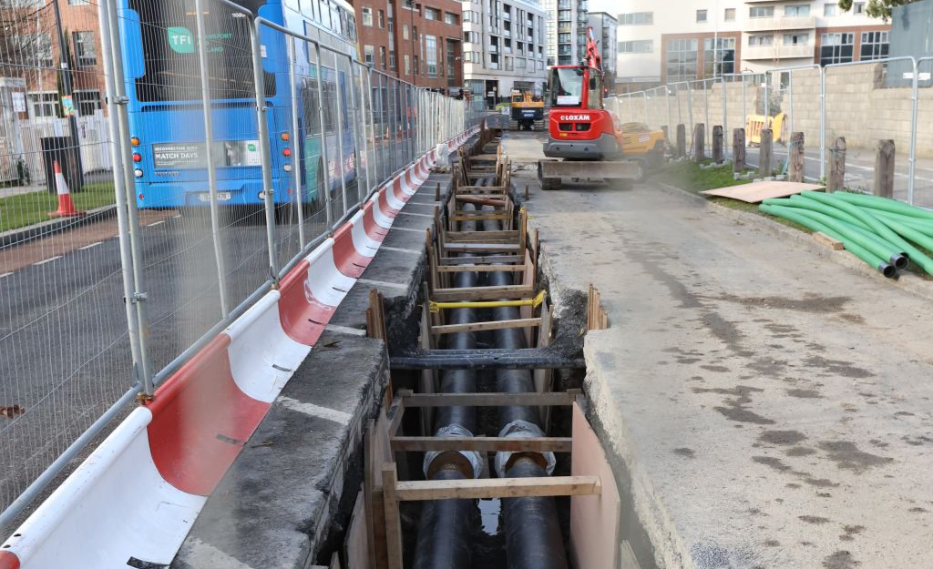
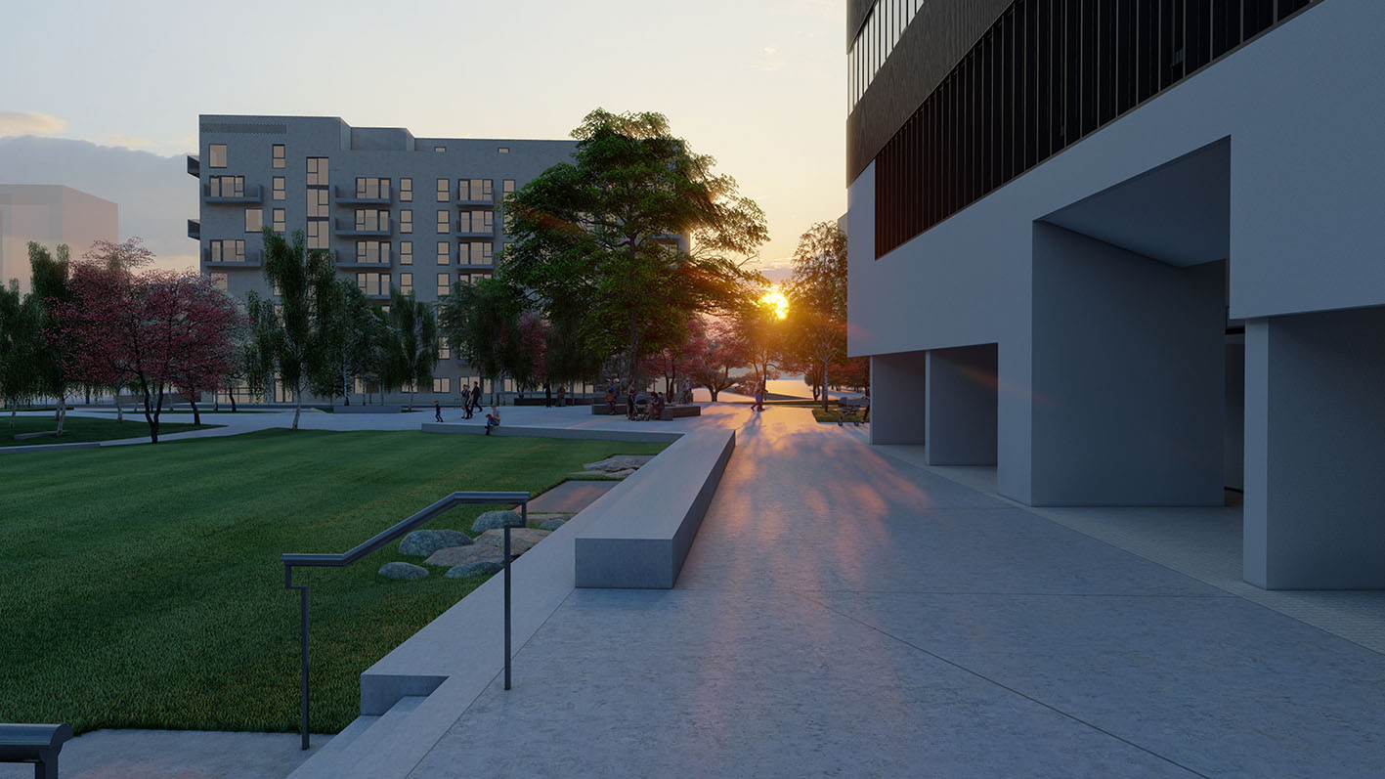
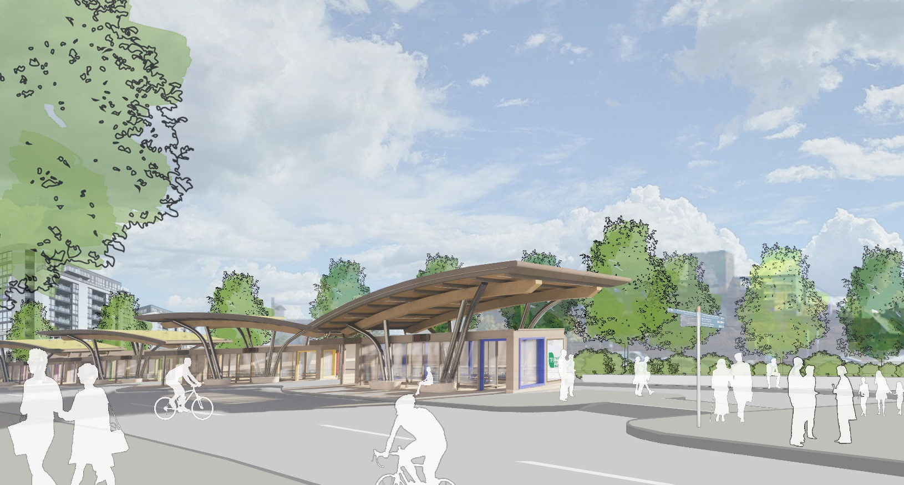
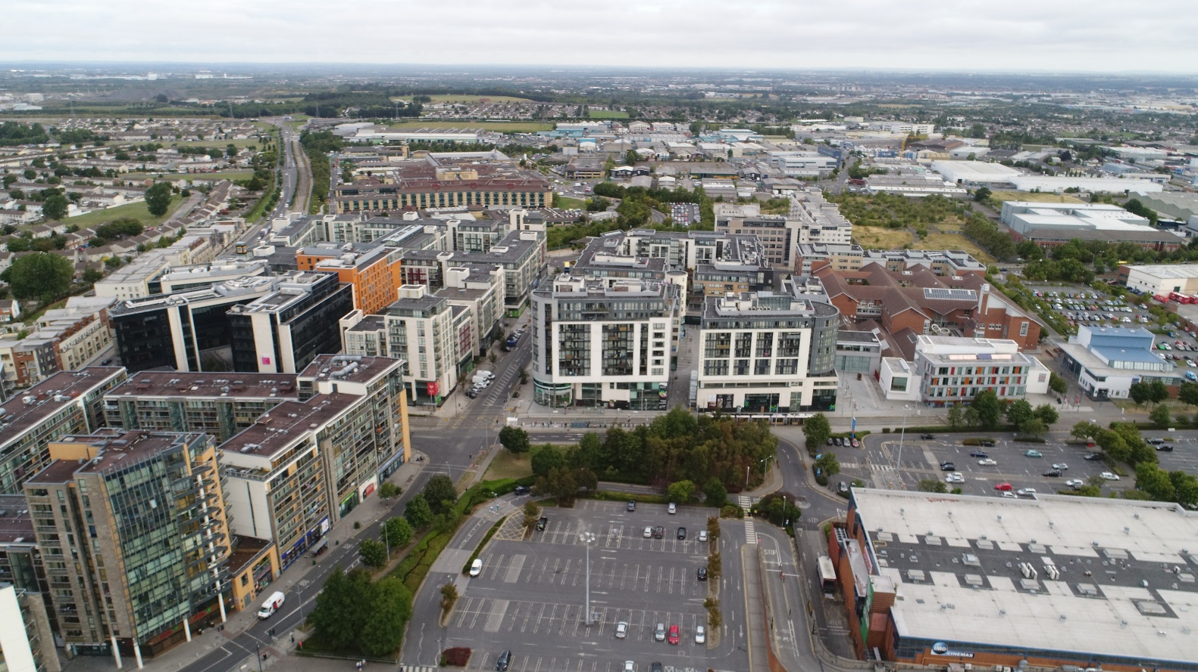
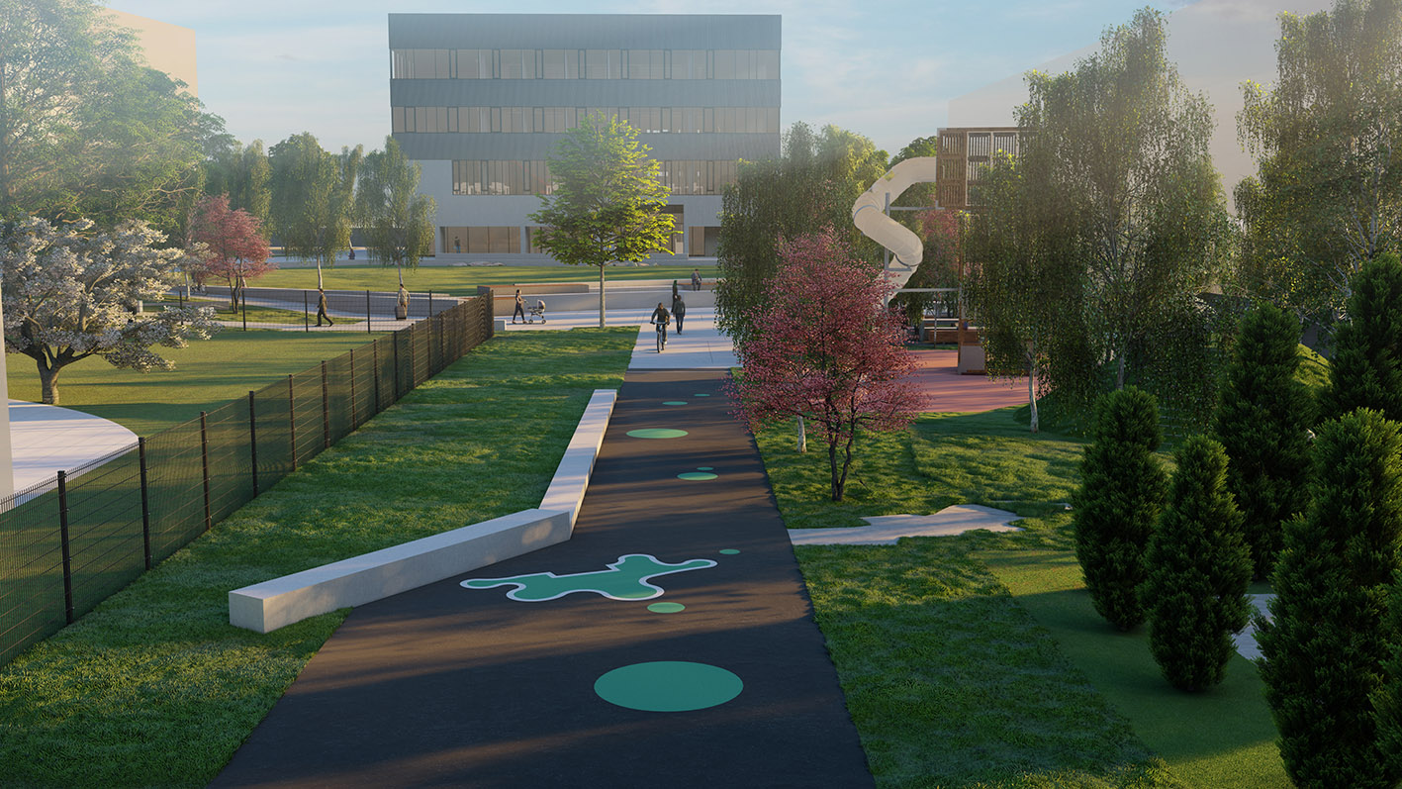
TALLAGHT TOWN CENTRE
€32m URDF funding
Innovation Centre – onsite.
Stadium North Stand – onsite.
District Heating – December 22.
Innovation Square, Chamber Square, Mobility Hub, pedestrian links – one contract to commence in January.
Cost rental apartments – tenders and options will be assessed by end of January 2023.
Heritage Centre – Part 8 by March 2023.
Airton Link Road – on site by April 2023.

Slide 9
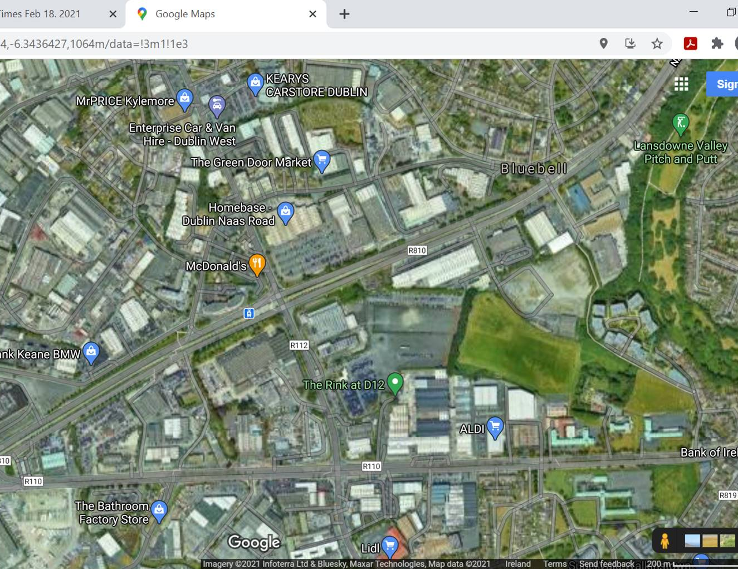
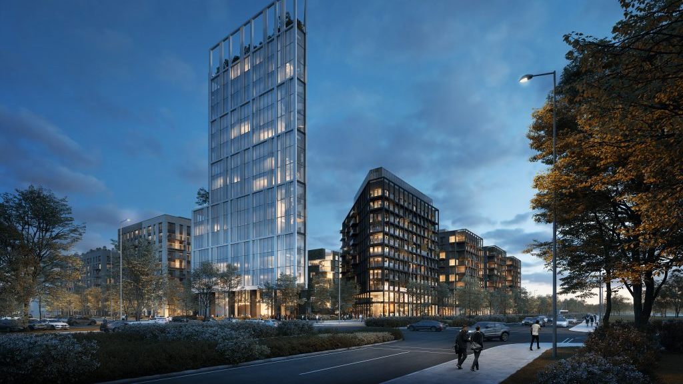
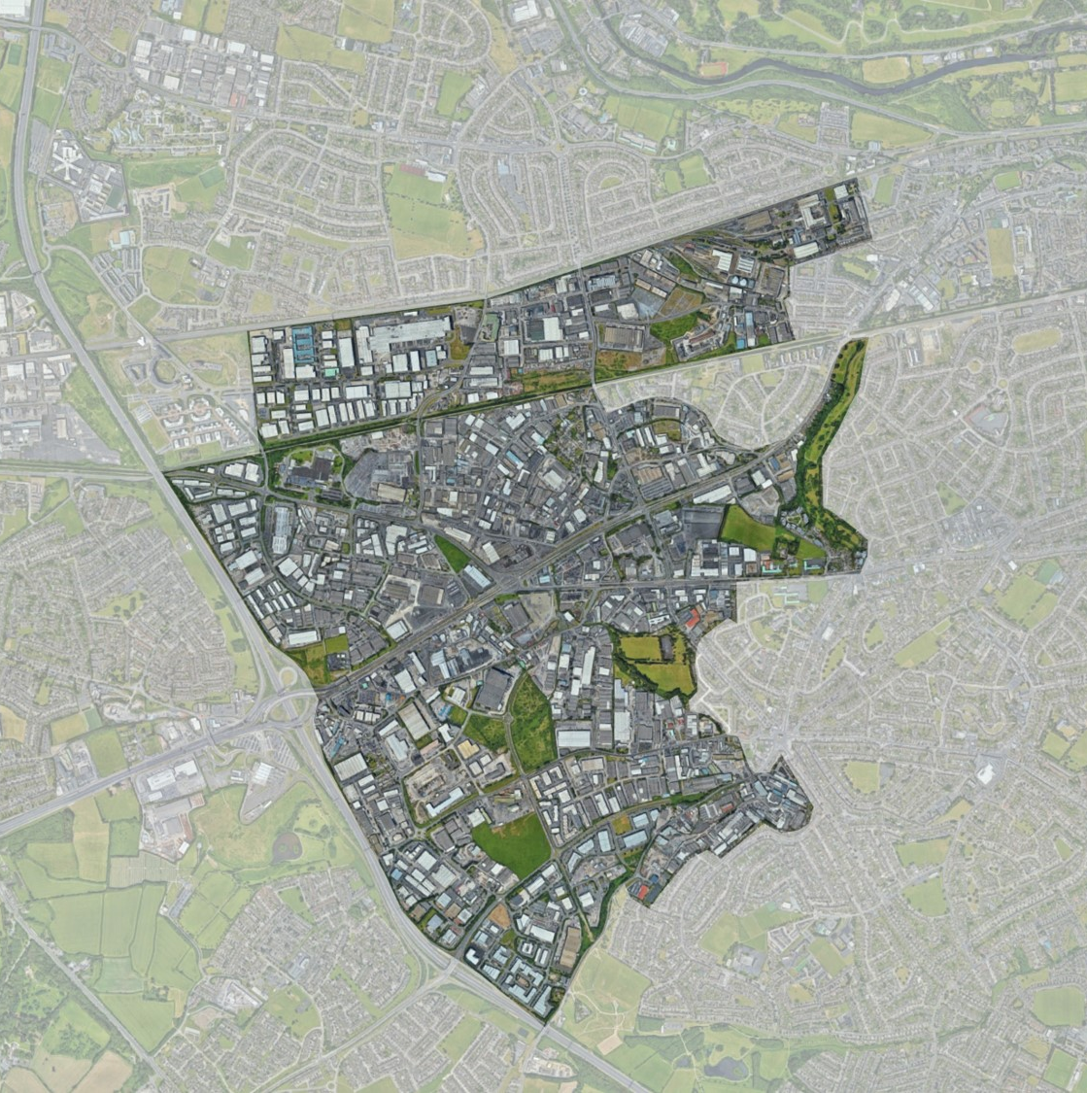
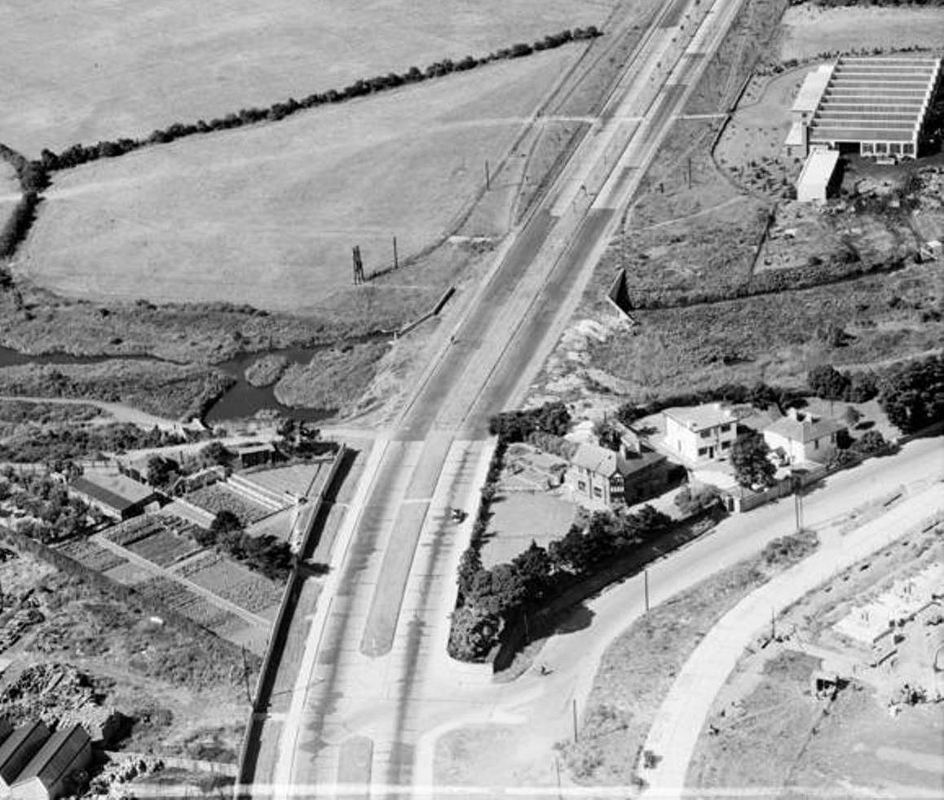
City Edge – Naas Road Regeneration
Strategic framework for regeneration up to 2070 presented to both Councils.
Potential – 40,000 homes, 75,000 jobs, €13b GVA per annum.
Report issued to Minister O'Brien.
Hopeful of cross government support and funding for key enablers.
CDP variation and LAP.

Slide 10
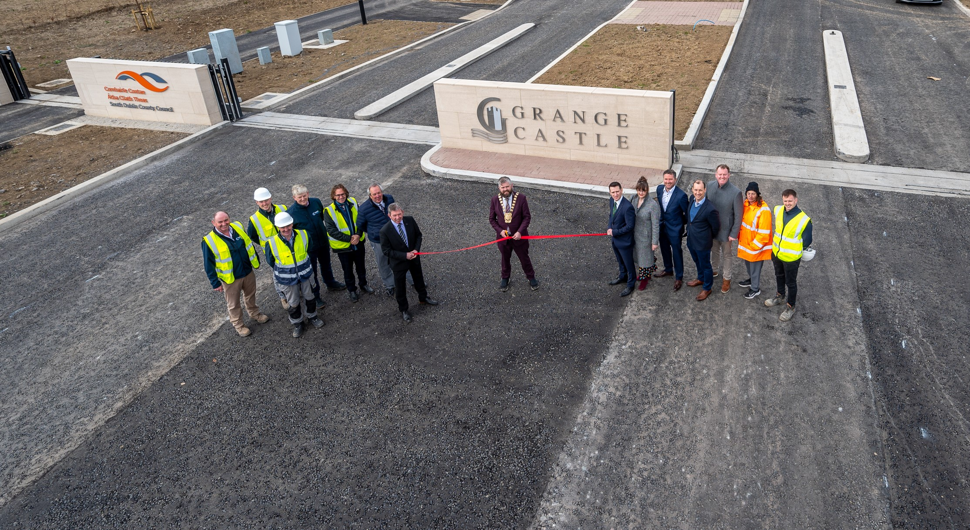

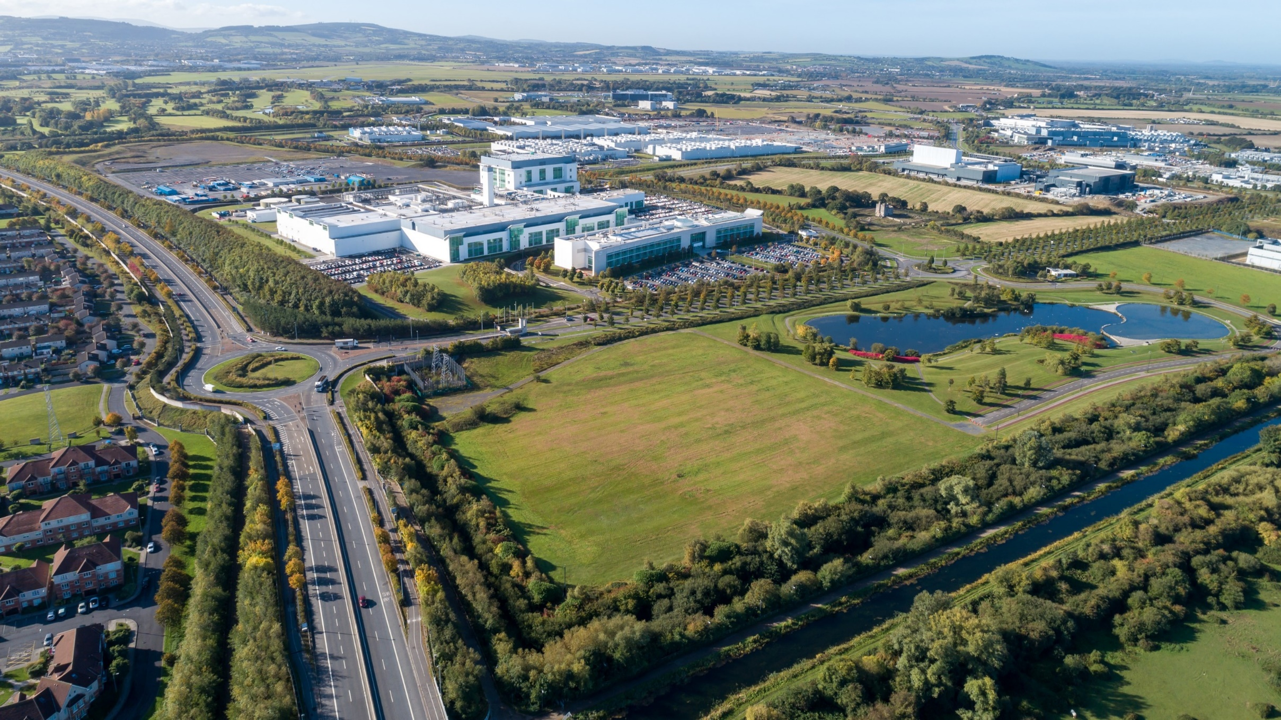
Grange Castle Business Park
Currently 6,500 jobs.
Lens Media potential 1,500 jobs.
Pfizer – 500 jobs announced.
Takeda 100 jobs announced.
New access road to additional 500 acres opened by Mayor.
Medium to long term jobs projection 20,000.
Looking at office potential in conjunction with Dart +.

Slide 11
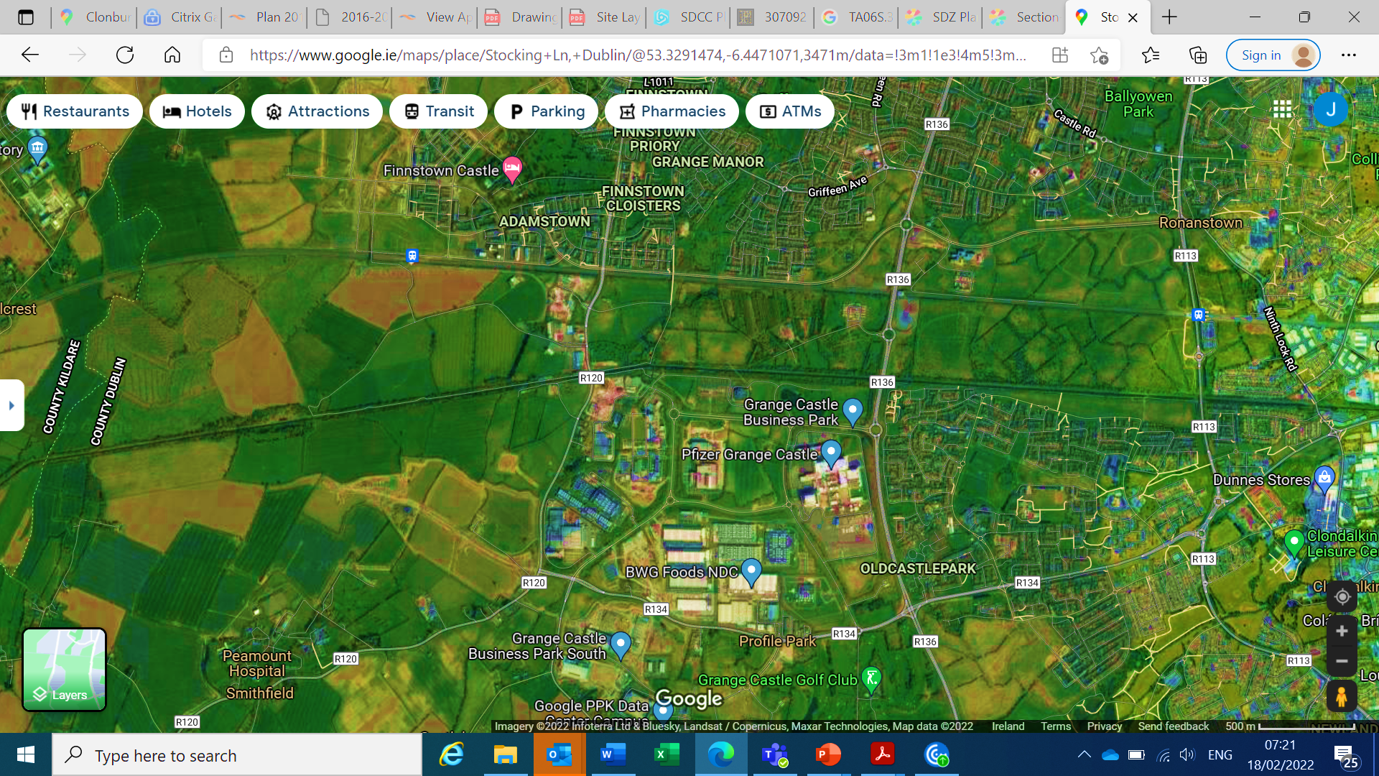
Adamstown SDZ
Kishogue Train Station
Adamstown Train Station
Clonburris Train Station
Clonburris SDZ
12th Lock Lands
Grand Canal
Grand Canal
Grange Castle
Office Opportunity
Grange Castle
Business Park
Grange Castle West

Slide 12
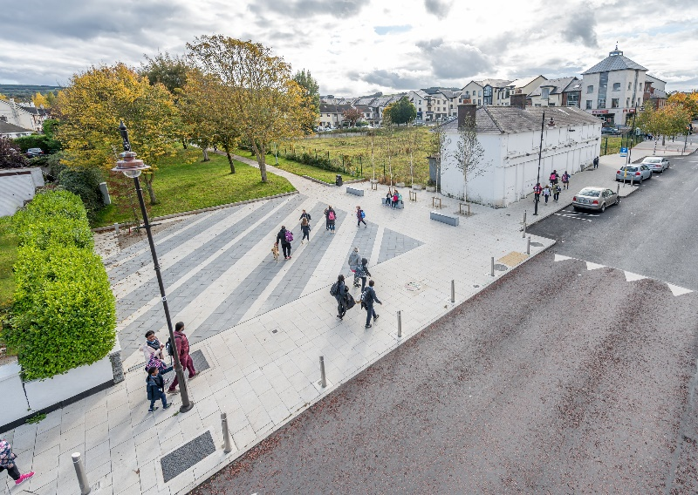
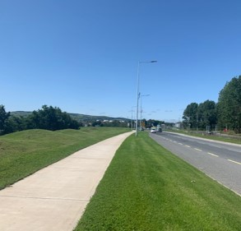
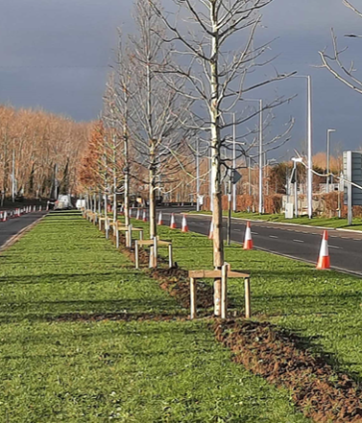
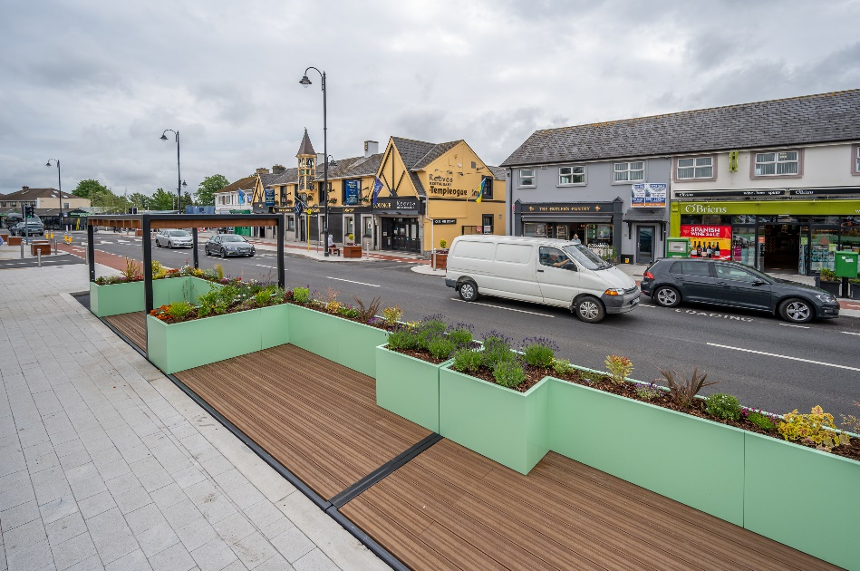
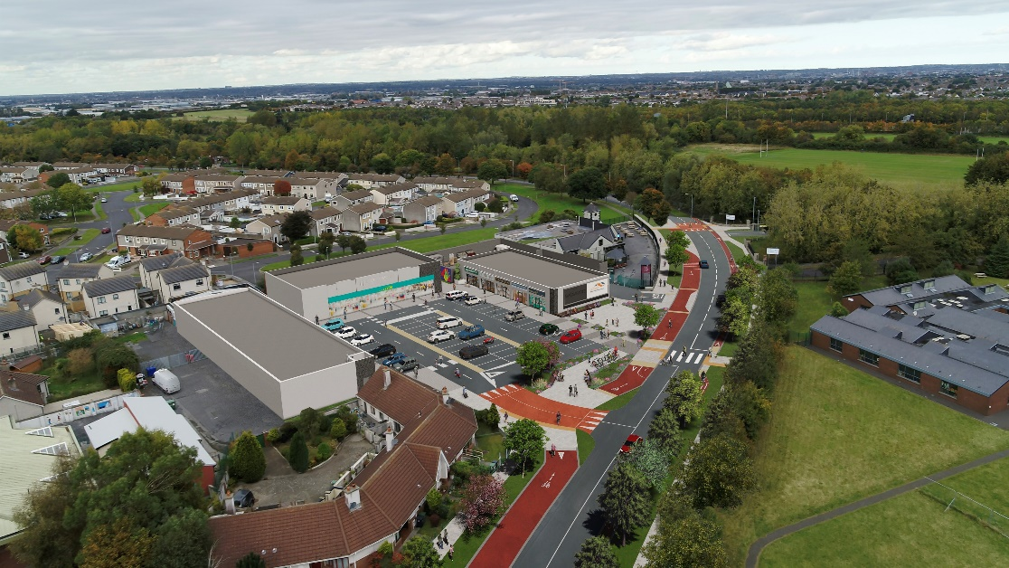
Village Enhancements and Aesthetics
Saggart and Templeogue complete.
Castletymon on site January 2023.
Rosemount District Enhancement Scheme about to commence design.
Clondalkin Village enhancements to be agreed with LAP.
Lucan on site January 2023.
N81 – Phases 1&2 complete – Phase 3 being scoped.

Slide 13
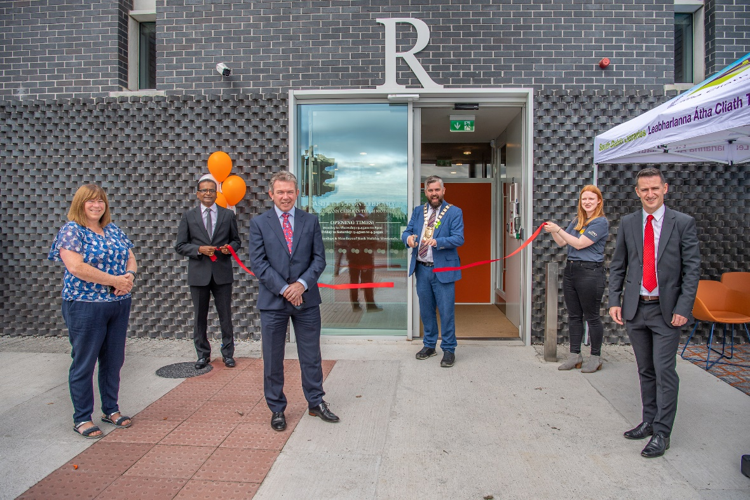
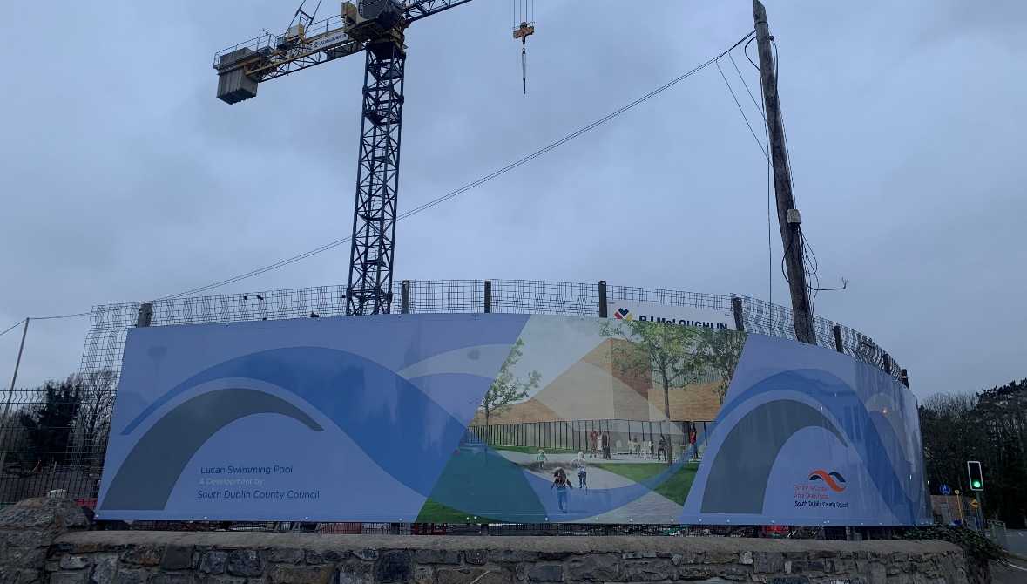
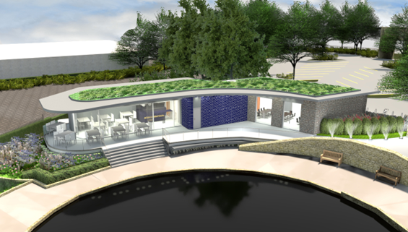
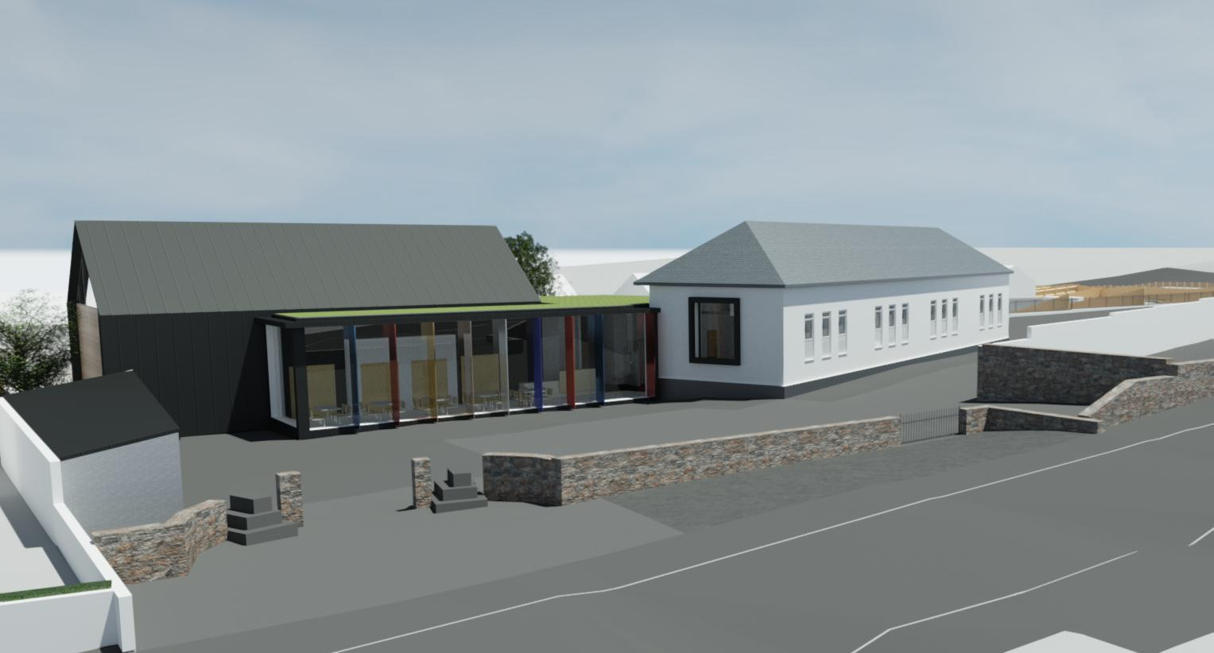
Community Facilities
Lucan Pool and Leisure – summer 2023.
Templeogue Intergenerational Facility – retender.
Saggart Community Centre – onsite.
Adamstown Library – agree proposal with elected members in new year.
Citywest Community Centre – site agreed in principle.
Newcastle Community Centre – Part 8 imminent .
Citywest Library – EOI sought for design build.
Clondalkin Active Aged – Open early 2023.
Balgaddy, Killinarden, Kilcarbery, Ballycullen – all advanced in planning.
Rathcoole Courthouse – onsite.

Slide 14
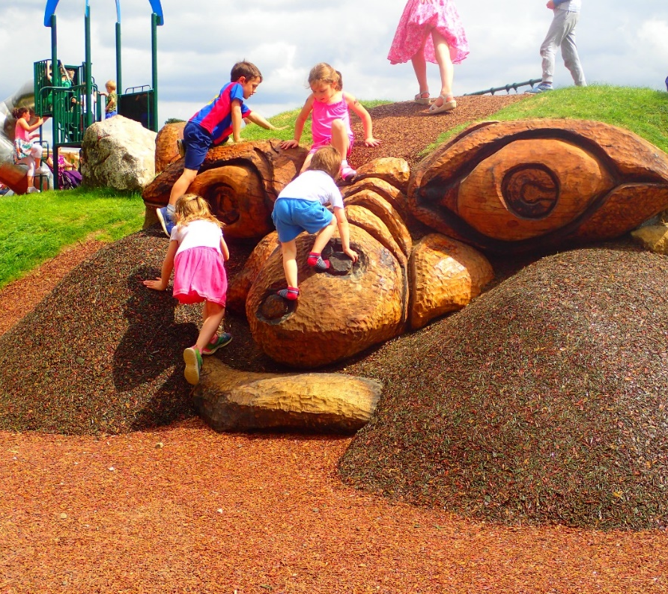
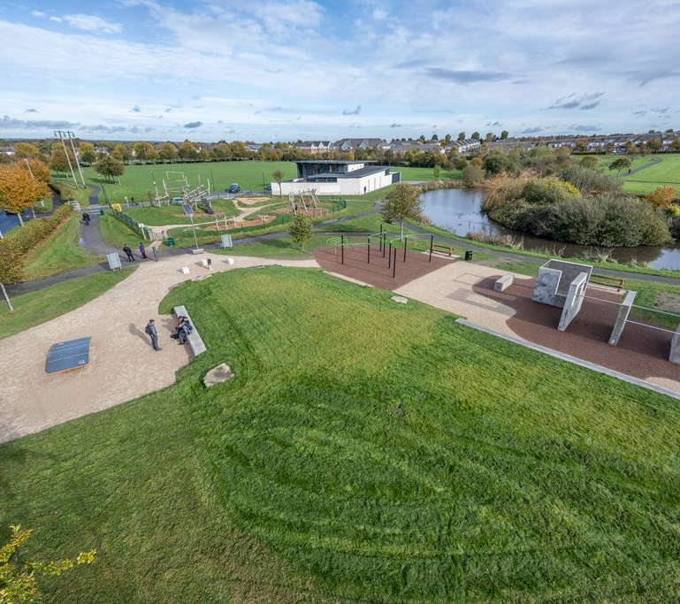
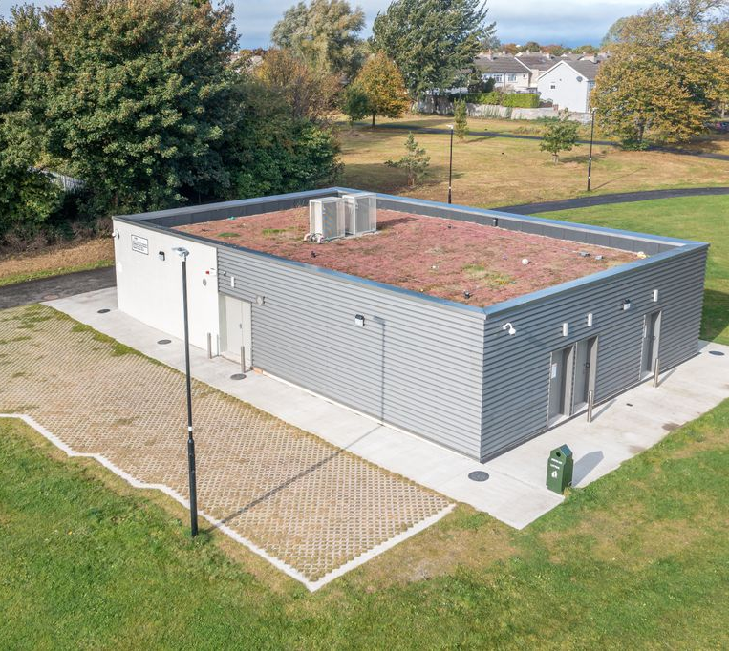
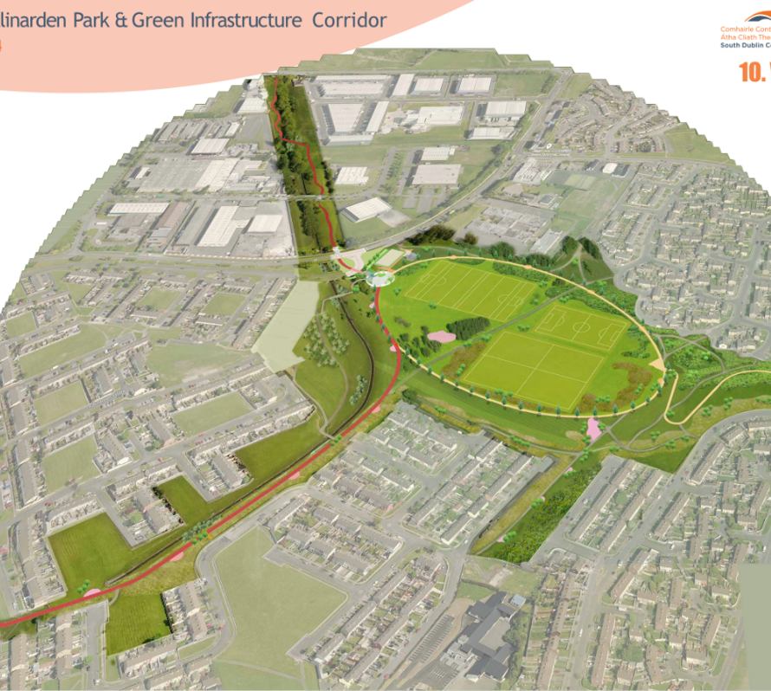
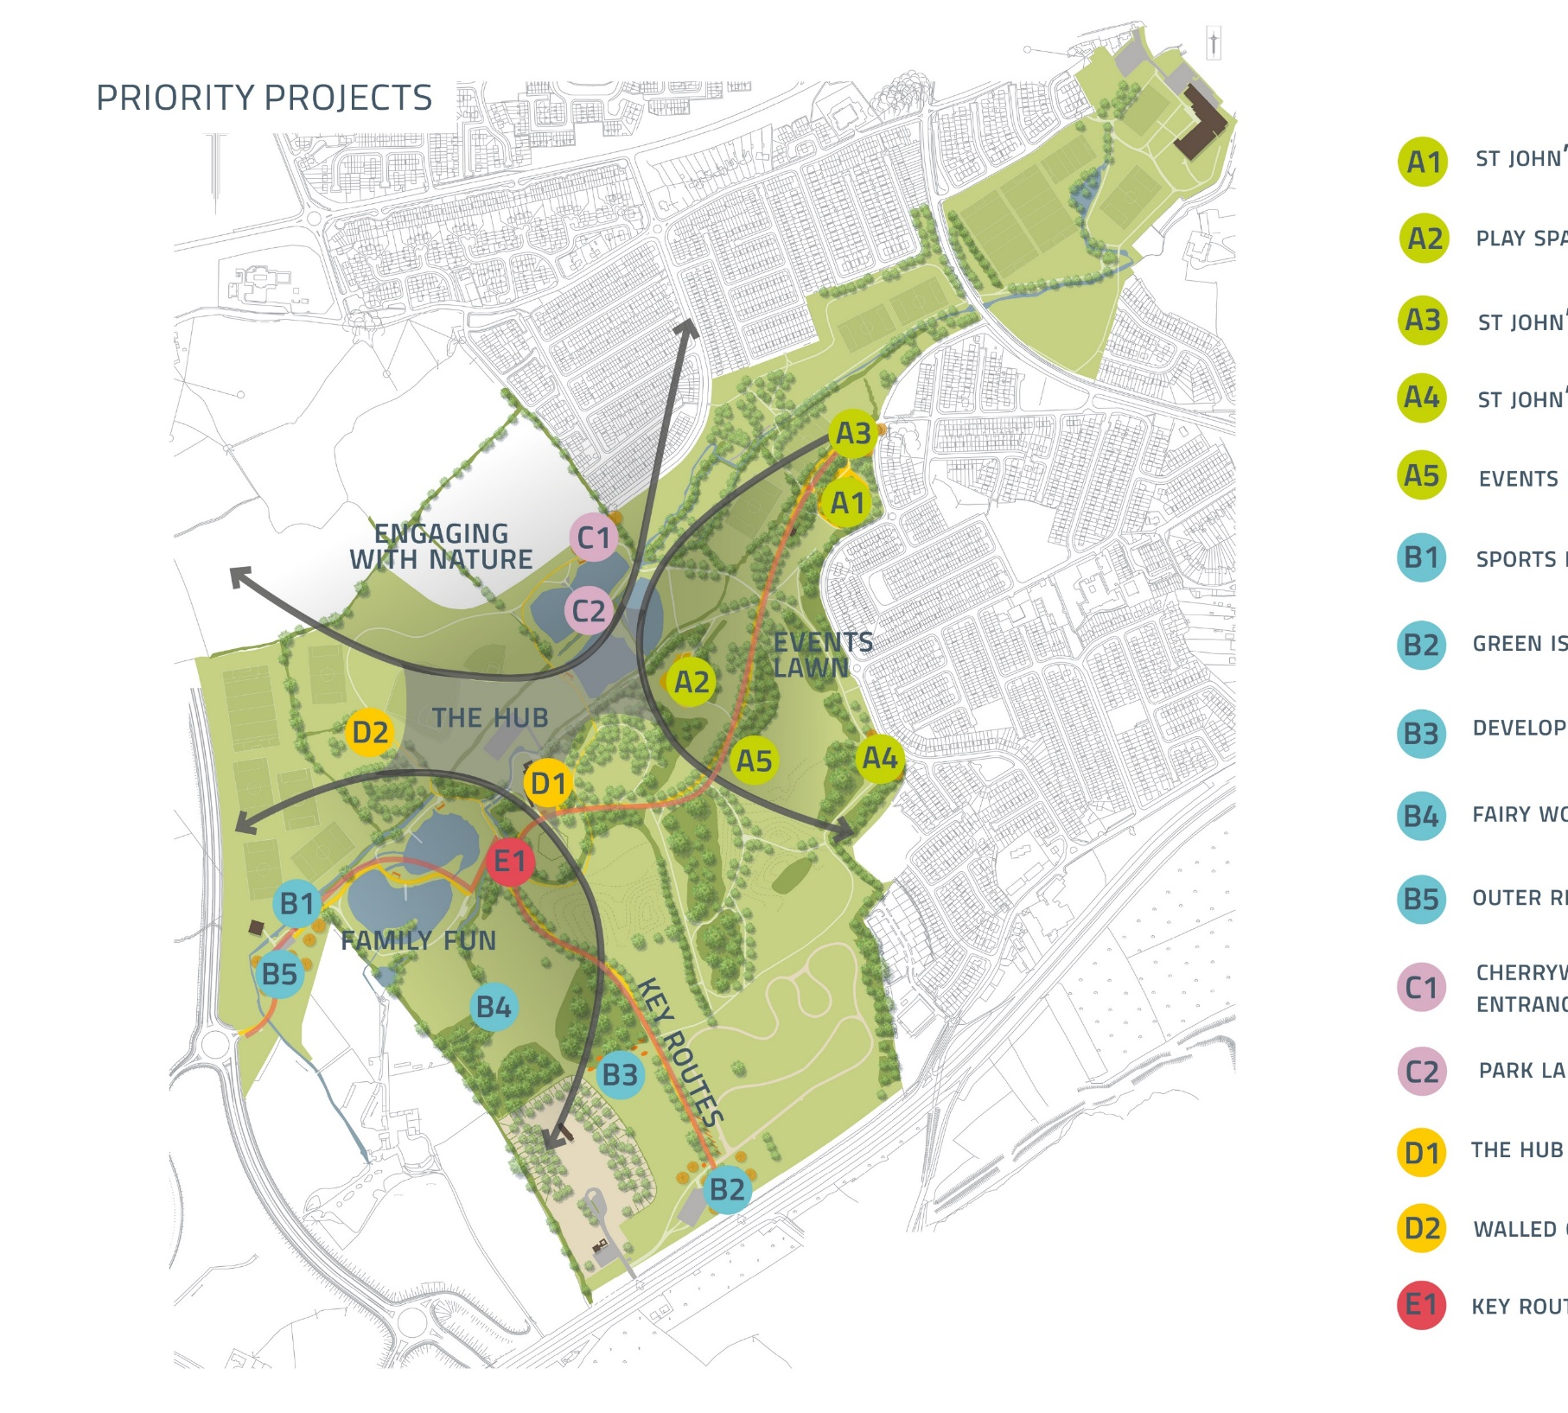
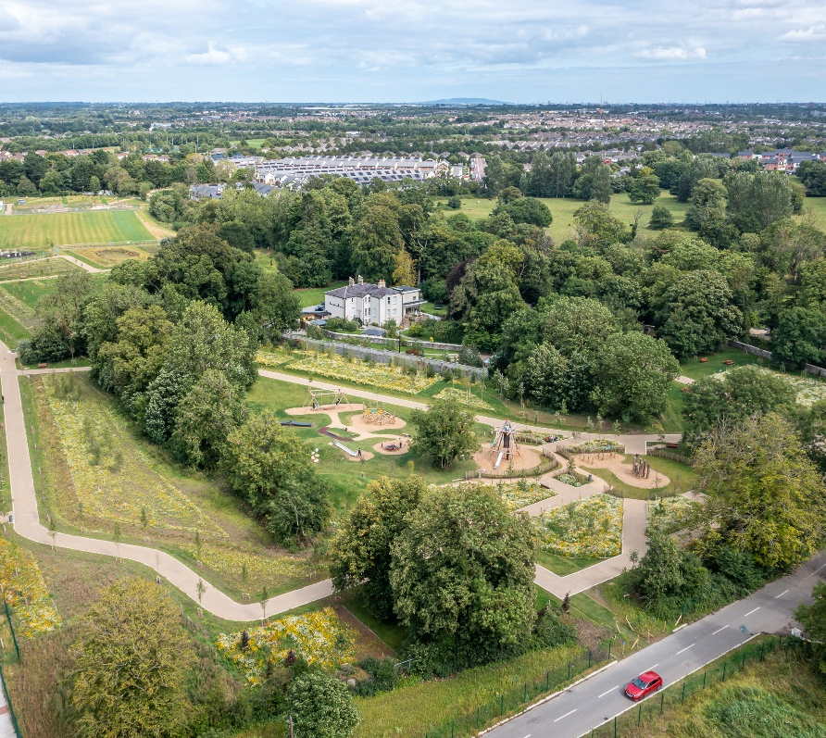
Parks, Pitches, Playgrounds & Pavilions.
Playspace Programme largely complete for now.
Teen spaces – Collinstown, Ballycragh, Tandy’s Lane, Esker completed. Next up Griffeen Valley and Bancroft.
Pavillions – Griffeen and Corkagh to be retendered.
Airlie Park – opening February next.
Killinarden Park – on site January 2023.
St. Cuthberts Park – part 8 approved
Quarryvale and Jobstown – tender for consultants early new year.
Corkagh Park Hub etc. – €5m construction to commence in March.
Mount Carmel Phase 3 – onsite.
Sean Walsh Astro – onsite January 2023.
Astro East of M50 under assessment.
Whitestown Stream amenity – onsite.

Slide 15
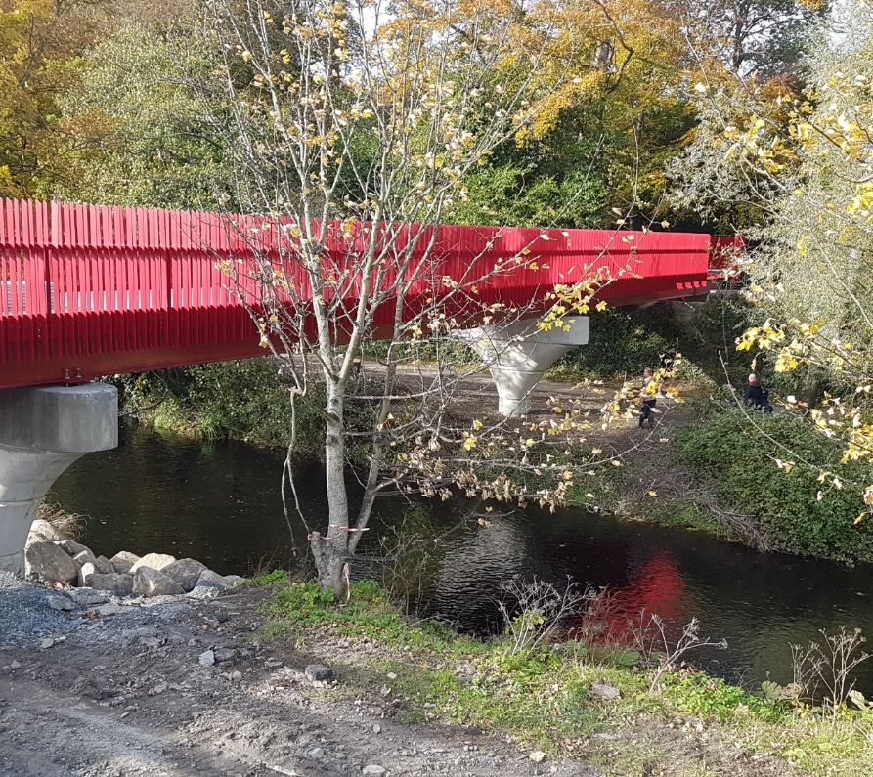
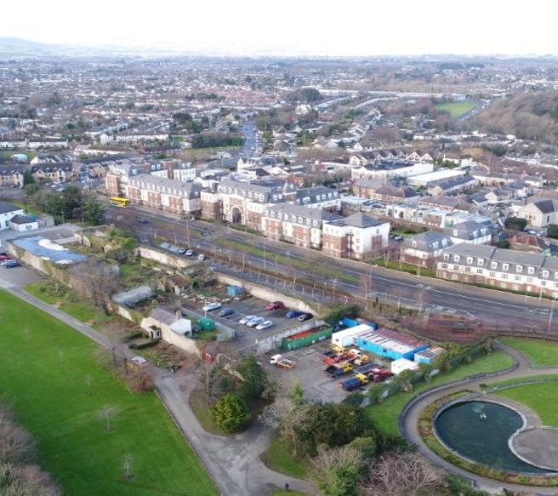
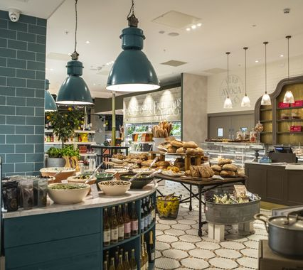
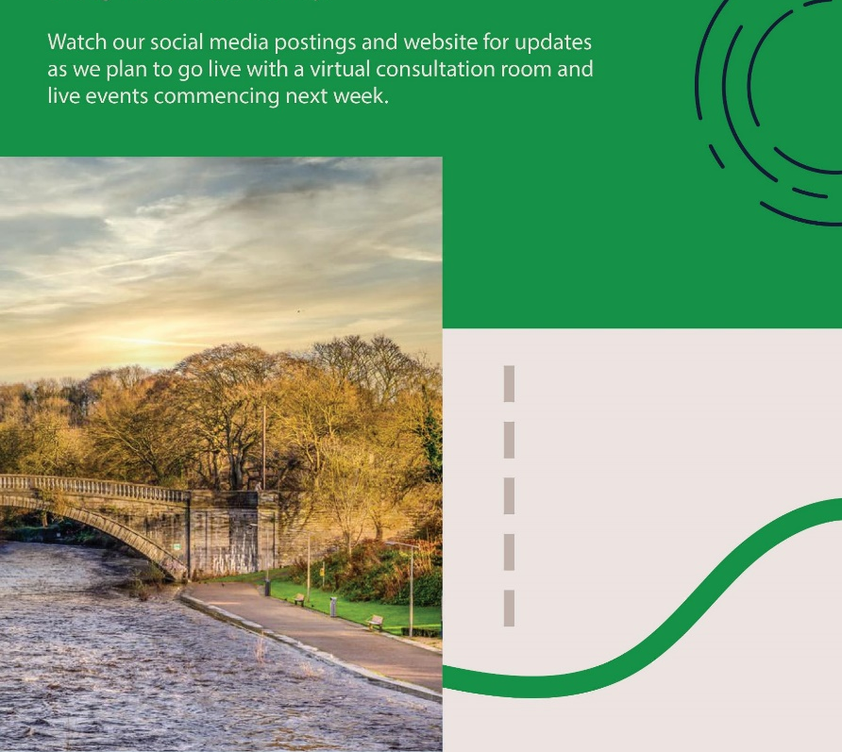
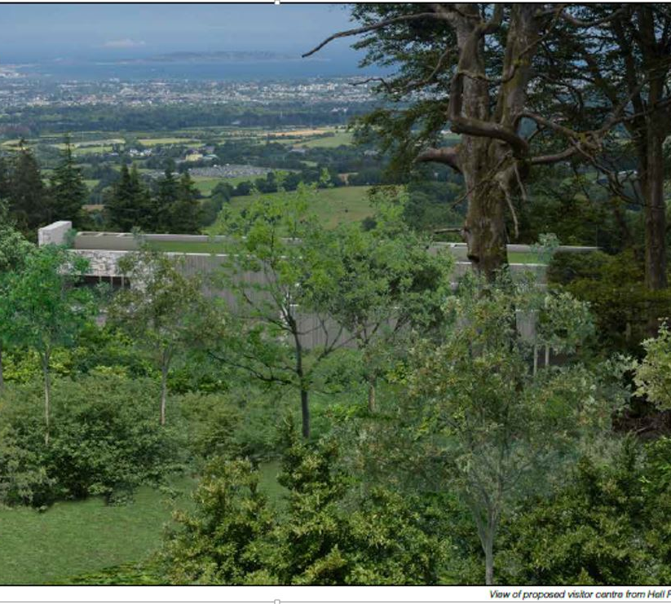
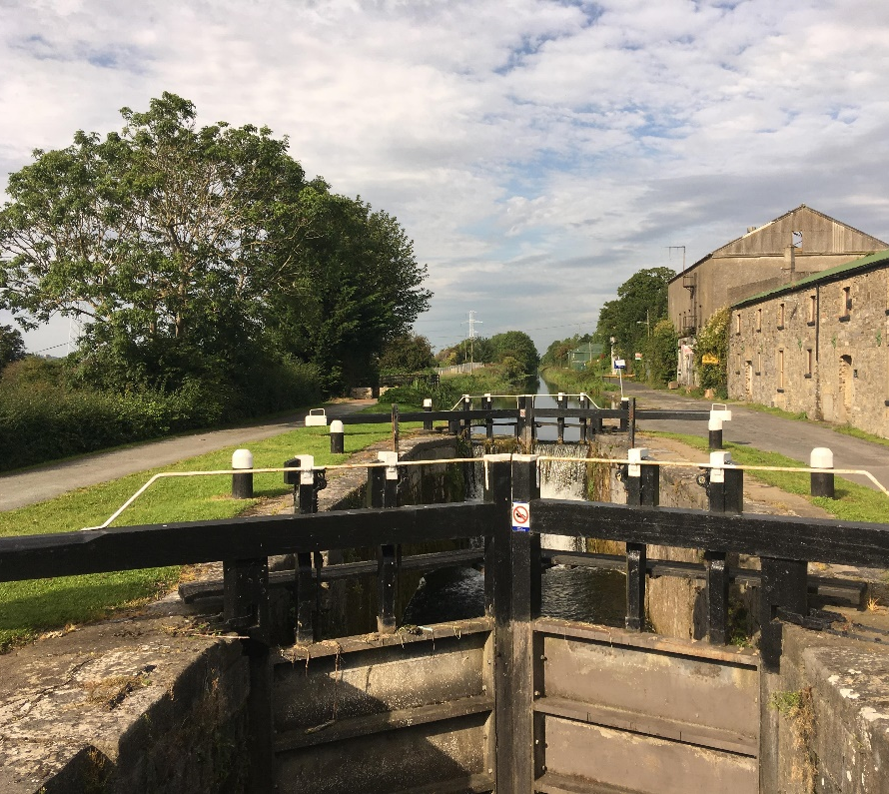
Tourism Promotion
Dublin Mountains – SC decision.
Rathfarnham Castle – EOI for JV partner – good response.
Dodder Greenway – Phase 4 onsite. Phase 5 (Blue Haven junction) on site.
Liffey Valley Greenway – Part 8 approved.
Grand Canal Ext. – on site Q1 23.
12th Lock Study – underway.
Corkagh Park, Tallaght Stadium and Tallaght Heritage Centre – reported elsewhere.

Slide 16
Climate Action Initiatives
Tallaght District Heating
Cycle South Dublin – 260km
Flood relief and constructed wetlands
150 hectares wildflower meadow
2,500 new trees annually
EV charging 12 sites – pilot
Council fleet transition to EV
Solar farm potential – Arthurstown landfill
Solar potential council buildings
18,000 public lighting upgrades
Energy Retrofit Programme
Leisure centre energy upgrades
Public water fountains
https://sdcc.ie/en/climate-action

Slide 17
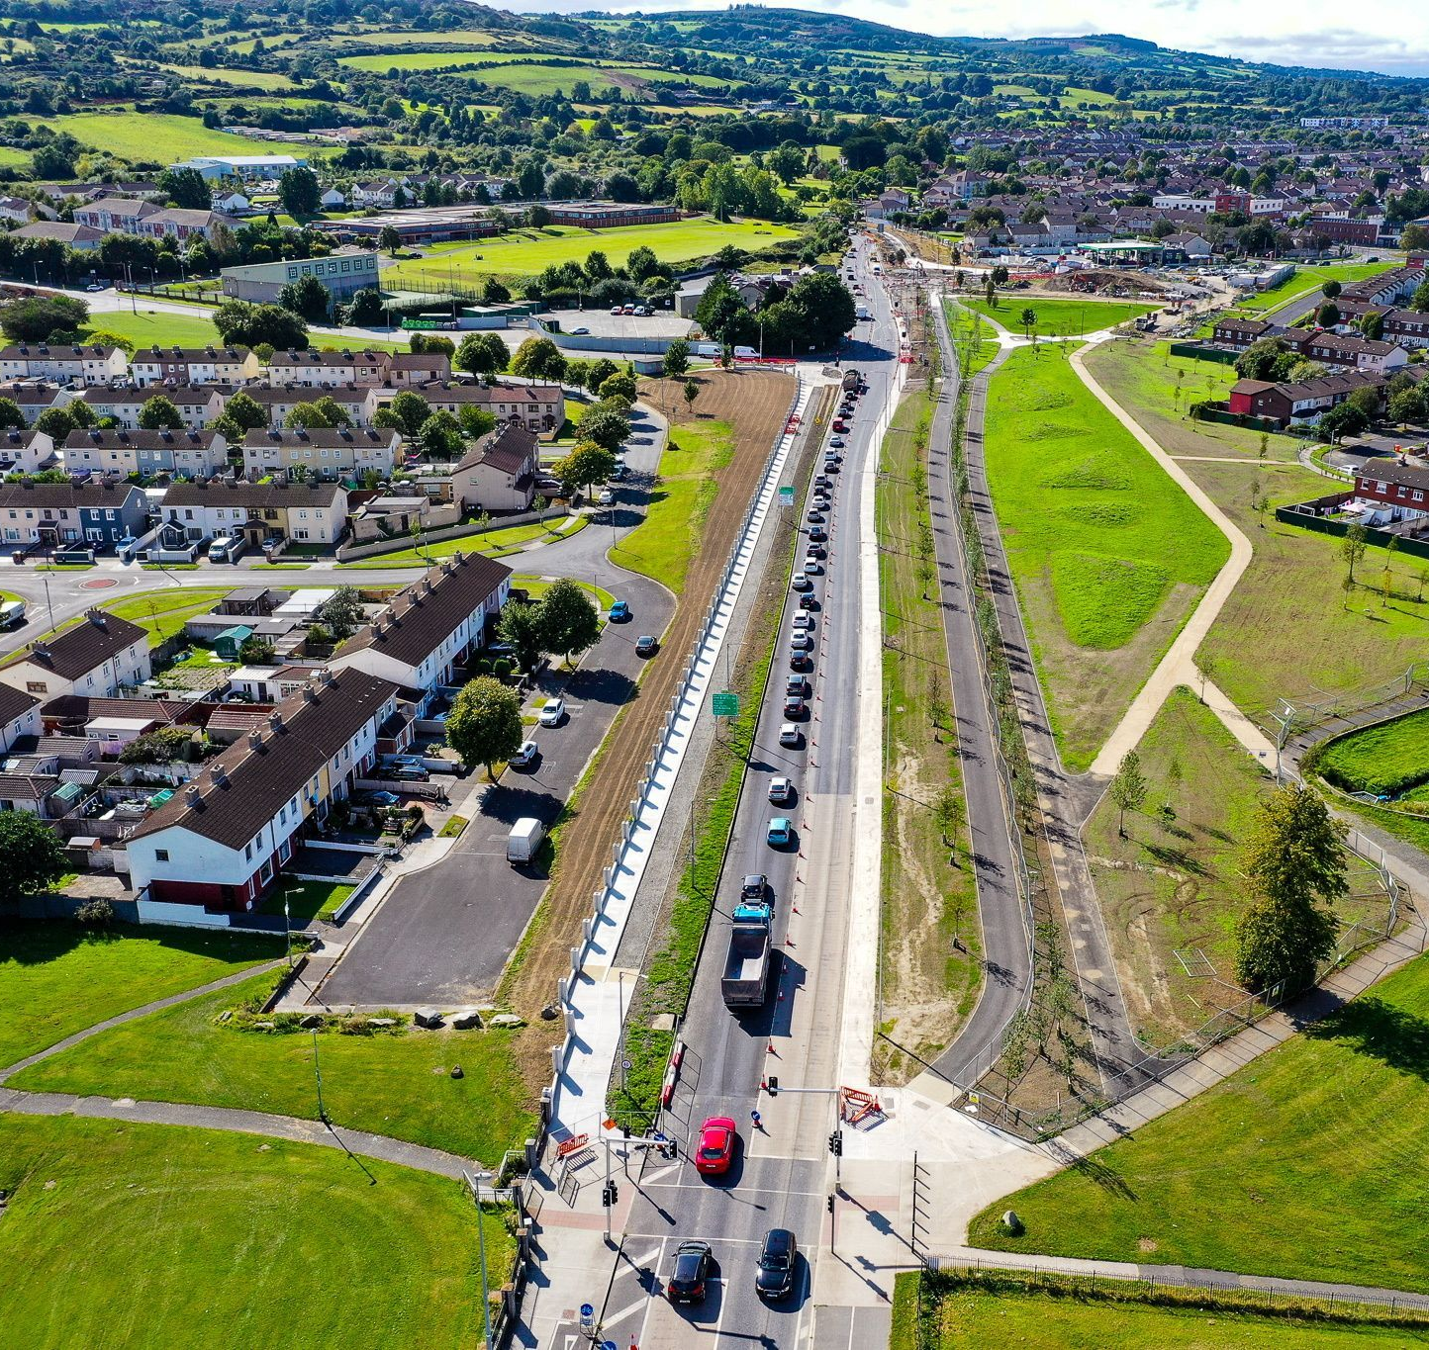
Cycle South Dublin
10-year Strategy.
63 routes - 263 km - €280m.
Includes Dodder and Canal Loop Greenways and final leg of Grand Canal Greenway.
Avonbeg, Grange Road & Jobstown recently completed.
Knocklyon Road & Old Bawn underway.
Templeville Road and Wellington Lane next up.

Slide 18
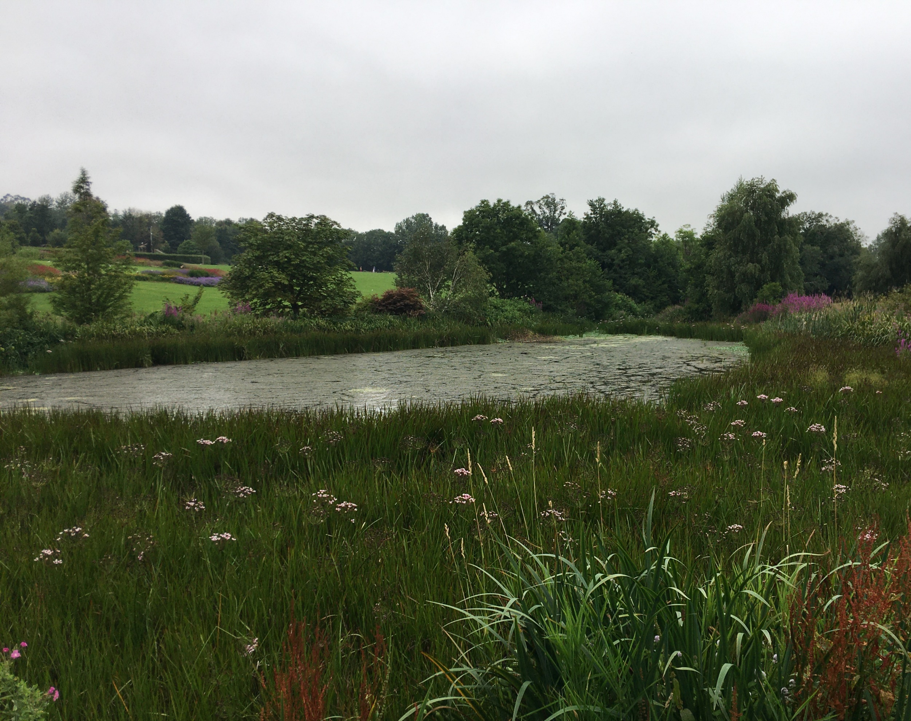
Flood Relief & Constructed Wetlands
Whitechurch FAS – court ruling.
Camac FAS – design options review underway – informal public consultation held 28/29 June.
Poddle FAS – with ABP.
Griffeen Integrated Constructed Wetlands (ICW) onsite July.
2 Dodder ICW project commenced.
Kilnamanagh ICW under review.

