Slide 1
Wellington Lane Walking and Cycling Scheme
Part 8 presentation
Sdcc full council meeting December 2022

Slide 2
Scheme Extents

Slide 3
Consultation To Date: What We Have Done
Delivered workshops on the proposed scheme with local people in late 2019; in 2020/21 we erected bollards to trial the design to determine what worked well and not to inform the final scheme
Series of business, schools and sports clubs briefings held via MS Teams during the 3rd week of November 2021
6 Weeks of non-statutory public consultation ran from mid-December 2021 to the end of January 2022, 82 submissions received
Statutory consultation commenced from 08/09/2022 until 28/10/2022, resulting in 121 submissions, note the portal shows more due as the remainder were made by a couple of individuals
Meetings held with principals of Bishop Shanahan and Bishop Galvin schools during the stat consultation period
Completed 1,600 leaflets drops to residential areas and business’s in the area
Put up Corriboards and Part 8 notices informing the Public of the Statutory Consultation on the scheme route
Advertised consultation through social media on SDCC Facebook/Twitter and Active Travel Website
Met with Resident Associations and Councillors during the consultation to discuss specific issues raised

Slide 4
Overview of Submissions Received
Submissions in support of the scheme received from schools, sports clubs and residents' associations representing communities of over 4,750 people
Bishop Galvin and Bishop Shanahan Schools - 800 pupils combined
St Mac Dara's School- 850 pupils
Templeogue College - 650 pupils
Riverview ETNS - 100 pupils
St Jude's GAA Club - 1,500 members
WORK Residents Association, particularly in favour of Safe to Schools for Rossmore Road, representing over 850 households
OPTRA Residents Association, supports the Safe Routes to Schools with some changes such as park and stride which we have agreed with the Spawell
Some of the above have made submissions with some changes requested such as park and stride from the Spawell, bus drop-off zone for Rossmore, safer crossing points for children.

Slide 5
Overview of Issues raised
Submissions opposing Rossmore Road Safe Routes to School received from Templeogue Woods Residents Association, citing parking issues and questioning the need for the scheme. Issues relative to parking can be addressed
Individual submissions received from local residents, particularly from Whitehall Road, against this part of the scheme citing safety, emergency vehicle access, parking etc.
Submissions from Recorders Residents Association, some local businesses and a couple of local councillors. Main issues raised were loss of parking, safety concerns, accessibility for residents and the need for a trial initially.
Remaining submissions against, which are fewer in number, cite loss of trees, parking and safety across different areas of the scheme, but mainly Whitehall Road and Rossmore Road. It is important to note that there is significant support for the scheme overall, in particular from Wellington Lane to Templeville Roundabout and including Rossmore Road.

Slide 6
Rossmore Road proposal and Concerns
Safe Routes to School [SRTS] is a National Programme that the school applied for and won.
Safe Routes to School Programme was developed in response to ongoing issues of safety and congestion at the school gate and on routes to school.
The programme aims to support active travel to school (walking and cycling).
Concerns raised were in relation to parent drop-off and collection from the school if nowhere to park or set down
Concerns raised that Safe Routes to School zones will force cars to park in the estates close to the schools
Concerns raised over parking for funerals which may take place during the week in the Rossmore Road vicinty

Slide 7
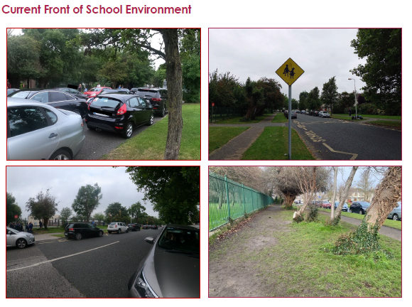

Slide 8
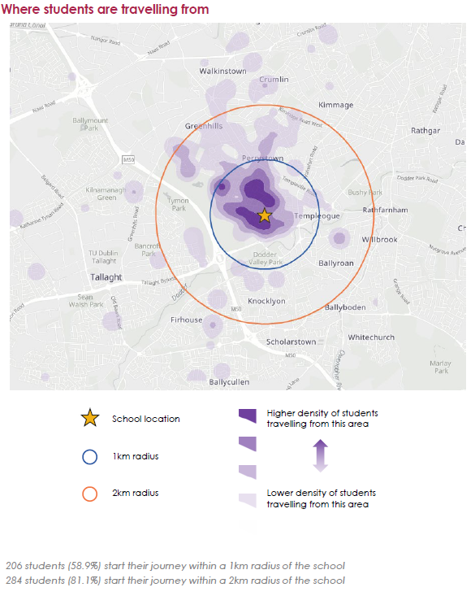
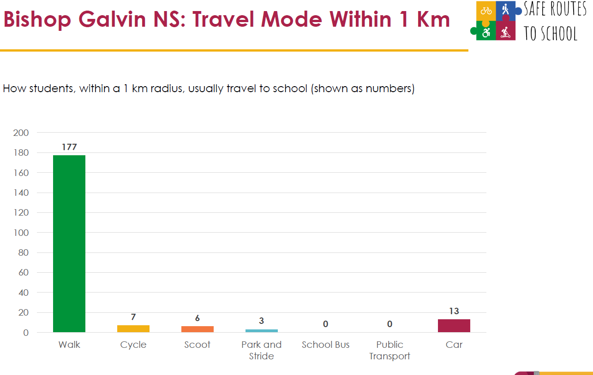
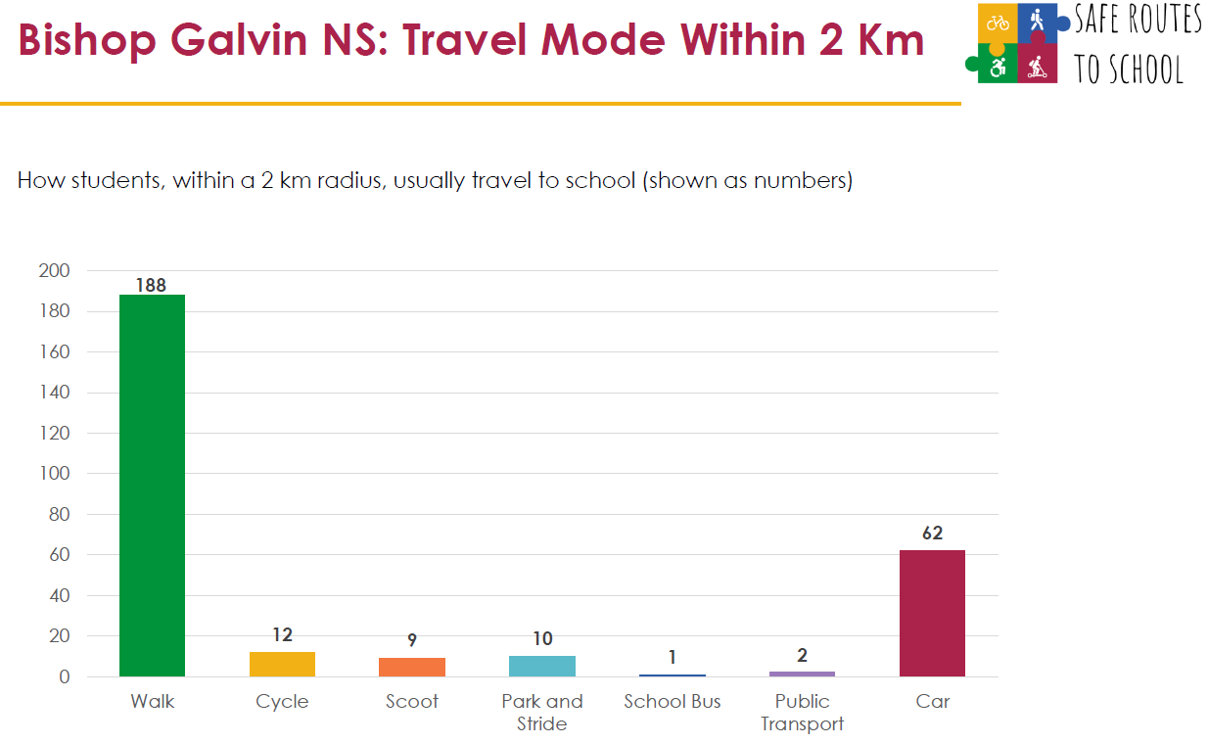
Bishop Galvin School SRTS Survey Results

Slide 9
Solutions for Rossmore Road
Formally agreed a park and stride with the Spawell lower carpark, which both parents and teachers can use. This is just 600m from the school and can accommodate over 120 cars.
Likely that both schools will be included in an NTA led Bike Library Pilot giving parents the option of a free e-bike on long term rental so they can cycle their children to school. Options of e-bikes with child seats for the younger children and a selection of e-cargo bikes will be available also. With bike library, parents leave their car at home when they avail of the scheme and enjoy cycling safely to school with their children.
A design solution to accommodate temporary bus pick up and parking for school tours is being examined

Slide 10
Whitehall Road Update and Concerns
Whitehall Road is an important connection within the overall South Dublin network and, as part of Wellington Road Walking and Cycling Scheme, is very important.
Without the Whitehall Road section there will be a missing section the Cycle Network, thereby impacting on peoples desire to use the cycle network.
Initial comments/feedback relating to the Whitehall Road Section of the scheme are as follows.
Accessing Driveways: Submissions received outline that residents may have difficulty accessing their driveways due to the two-way cycle track and the lack of visibility. This is increased by the high volume of traffic and the need for many residents to stop traffic and reverse into their driveways
Narrow Road Carriageway: Some submissions received noted concerns that the road carriageway may be too narrow for two buses to pass safely without going into the cycle lane
Visitor Parking: Some submissions received indicate that there is concern regarding where visitors and delivery drivers will park
Submissions from Recorders Residents Association and a number of local councillors have reflected the above concerns and asked for a trial on this particular section of the route
There is a concern on parking at the Pines and nearby shops.

Slide 11
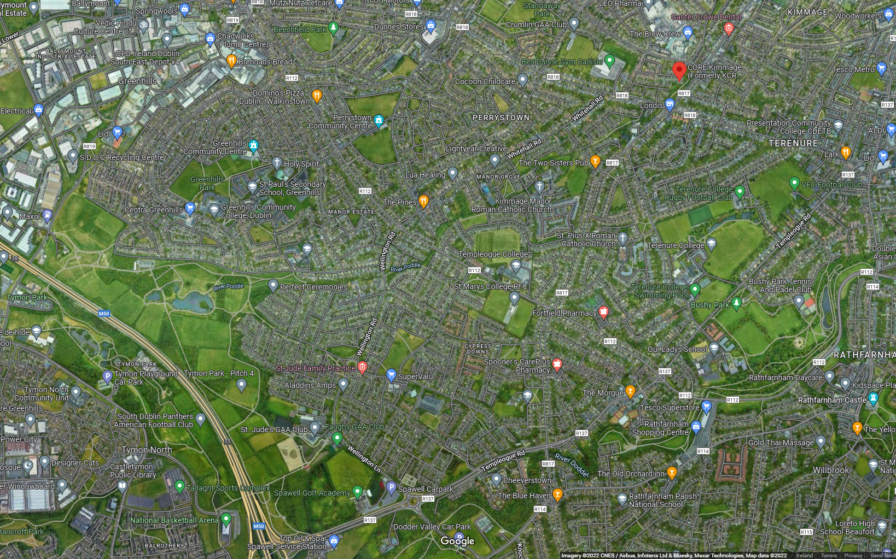
Whitehall Road
is an important
part of the network
SDCC’s
Active Travel Network
Status Map
Brown:
Wellington Scheme
Red:
Bus Connects
Green:
On site or Planning approved
Purple
Templeogue Village
Blue:
In early design
Pink:
Schemes in design by DCC

Slide 12
Next steps & Questions
Subject to Part 8 decision and the approval of funding from the NTA, the team will progress the detailed design of the scheme with the aim of having a contractor ready to start on site c.Q4 2023

