Slide 1
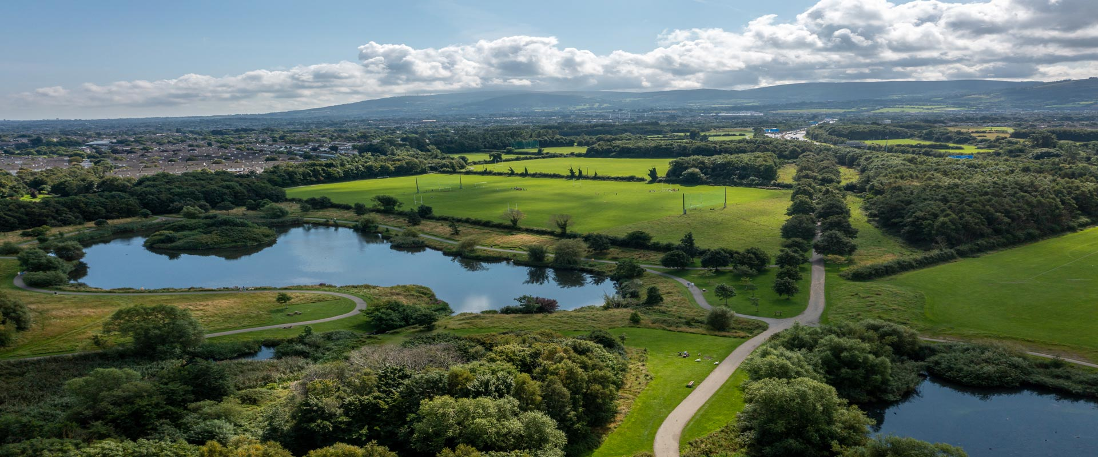
SDCC Climate Change Action Plan Annual Report December 2022

Slide 2
SDCC Climate Change Action Plan 2019-2024
154 Actions
23 Complete
107 Ongoing
0 Not Started
24 New Actions
SDCC progress Report to DECC End of Year 2022

Slide 3
Green Tallaght Stadium
Progression of the DeliveREE
Procure Energy Audits on County Hall, Clondalkin Office
Implementation Plans for Clondalkin and Tallaght Decarbonising Zones
Align Objectives of Clondalkin Decarbonising Zones with LAP
Dublin Regional Air Quality Plan
Interim Urban Traffic Related Air Pollution (UTRAP) Report
Participate in Clean Air Together pilot project
Support School Streets projects (Safe Routes to Schools)
Support WeCount/I-Change Air quality monitoring project
Support South Dublin Sports Partnership on community active travel projects
Include/Support active travel options for travelling for Work
Implement actions from the Biodiversity Action Plan
Carry out wetland surveys of lakes and ponds in South Dublin
Investigate sustainable solutions to the management of grass cuttings
Investigate option to replace fossil fuelled hand tools with battery powered alternatives
Provide Climate Awareness training for all staff
Establish Green Procurement working group
Develop SDCC Climate Change website
Produce Climate Action newsletters
Support the SEAI Sustainable Energy Communities project
Support GAA Green Clubs project
Support/Participate with DLAs Climate Action Awareness Campaign Climate Action Week
Support local schools and universities on Climate Change awareness projects and studies
24 New Actions in the CCAP

Slide 4
6 Key Themes in the CCAP
Energy and Buildings
Transport
Flood Resilience
Nature- Based Solutions
Resource Management
Citizen Engagement

Slide 5
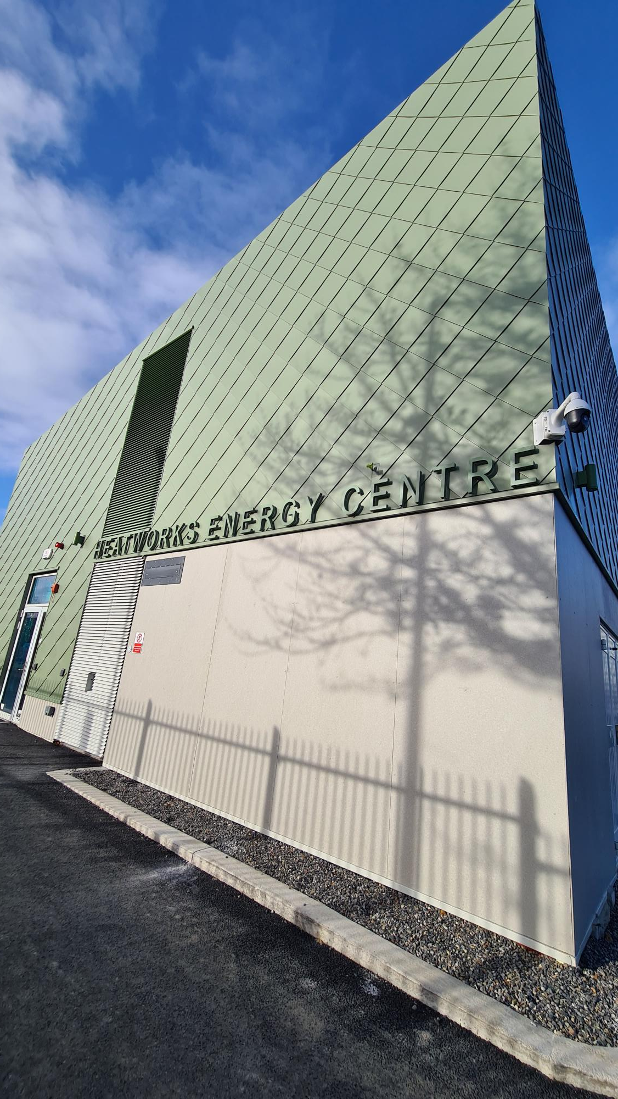
SDCC CCAP 2022 – Energy and Buildings
Dublin Region Energy Masterplan completed.
Phase 2 of Public Lighting Programme (2020 -2026)
Phase 1 of Tallaght District Heating Scheme currently being commissioned
PV Projects
Arthurstown Landfill – Project Appraisal to assess potential for solar PV to meet onsite energy demand.
Planned procurement of consultant to assess site for potential commercial solar PV opportunities.
Review of SDCC buildings/facilities with potential for Solar PV installations to meet operational energy costs.

Slide 6
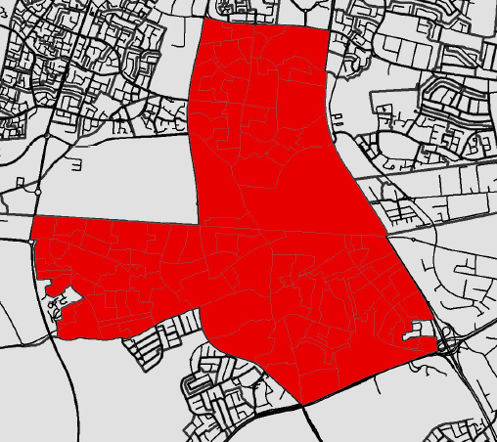
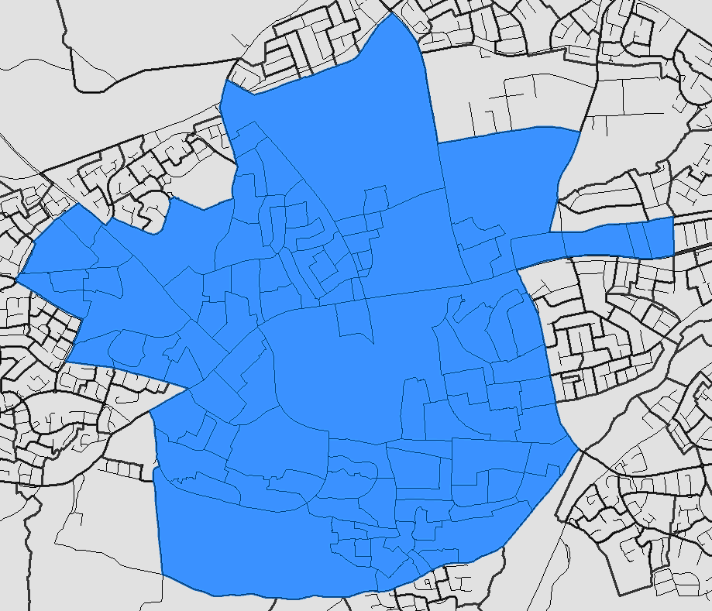
Decarbonising Zones (DZ)
Option Assessment – April 2021
SDCC submitted proposal identifying Clondalkin and Tallaght
Delivery Approach
4 Dublin LAs approached CoDEMA to develop Decarbonising Zone Implementation Plans
SDCC Project Commencement – Sept 2022
Cost proposal accepted
Planned Work
Project potential increases/decreases
Develop Gap to Target Analysis Register of Opportunities
Prepare Cost Estimates
Project Planning meeting held with CoDEMA
Establish Baseline Data
Outline funding opportunities and project partners/stakeholders
Ongoing work: develop full evidence base of emissions sources
Action 165 of the National Climate Action Plan (2019), to enable Ireland meet its carbon emissions reduction targets by 2030
DZ Implementation:
Map and analyse energy demand across the Decarbonising Zone, mapping stakeholders, identifying early-stage projects to create a Register of Opportunities
Define the portfolio and pipeline of decarbonisation projects and develop an appropriate plan for delivery
Clondalkin
Tallaght

Slide 7
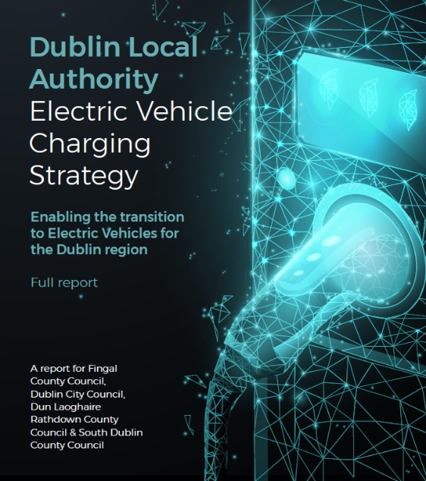
SDCC CCAP 2022 – Transport
EV Strategy
SDCC Working Group Established (EWCC, LUPT, Planning)
Review of Fleet and Depot Requirements underway – Sustainability Consultant Appointed
Pilot scheme for Public charging at SDCC facilities
Identified 14 trial locations for public charging at SDCC public facilities, predominately in SDCC carparks near amenities.
Coordinated tender with Dublin Region LAs planned for delivery
Identifying solutions around Taking in Charge – (parking spaces, equipment)
Steering Group continue to meet, engage with stakeholders
Fleet Review Feasibility Study
Prepare a robust plan to achieve a sustainable, decarbonised fleet to 2030.
Two Packages of work: Vehicle, Plant and Machinery Review and Fleet Management System Review
Procurement Process – Sustainability consultant appointed
Data Collection and Review stage commencing

Slide 8
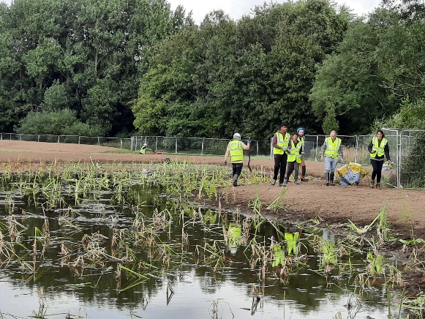
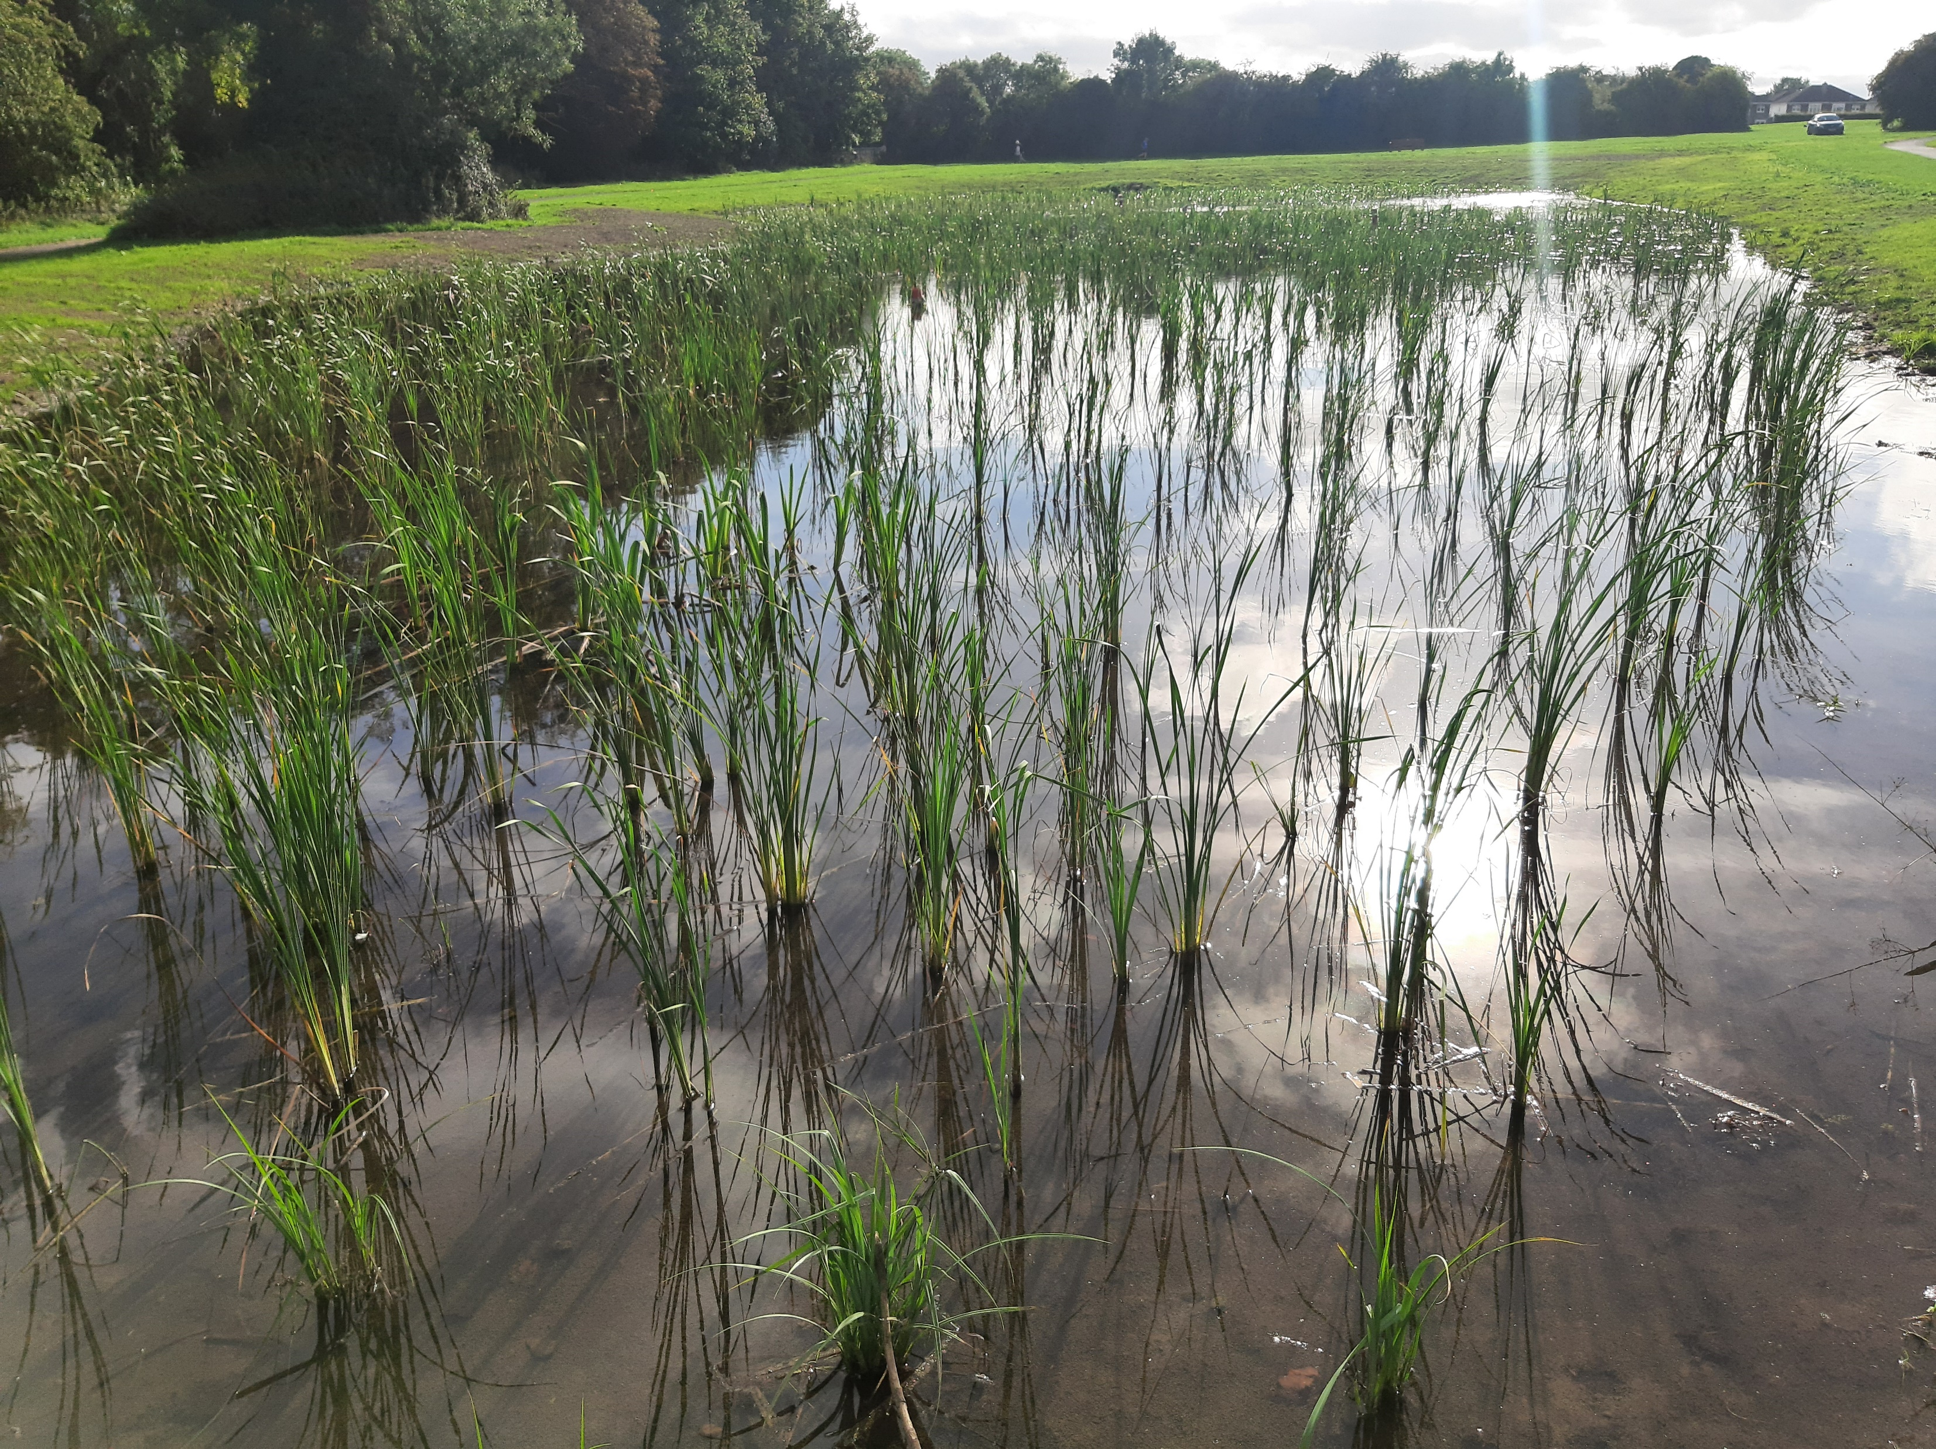
SDCC CCAP 2022 – Flood Resilience
River Poddle FAS: In Part 10 Planning. Awaiting ABP Decision – expected by end of 2022.
Whitechurch Steam FAS: Supreme Court judgement delivered on 15/11. Judgement in favour of scheme to commence. Scheme expected to commence in Q1 2023
River Camac FAS: Stage 1 - Flood extents full model works currently scheduled to be completed in early Q4 2022. Appropriate Assessment, required on Site Investigation locations completed and reports being reviewed by OPW Environmental team. Site Investigation tender to proceed by end of Q4.
Whitehall Rd Drainage: Outputs from CCTV and Rainfall and Flow Surveys currently being assessed to determine if Scheme is required.
Integrated Constructed Wetlands (ICWs) – 3 ICWs constructed in 2022 as part of the DURL Life Project (1 No in Griffeen Valley Park and 2 No on the Dodder)

Slide 9
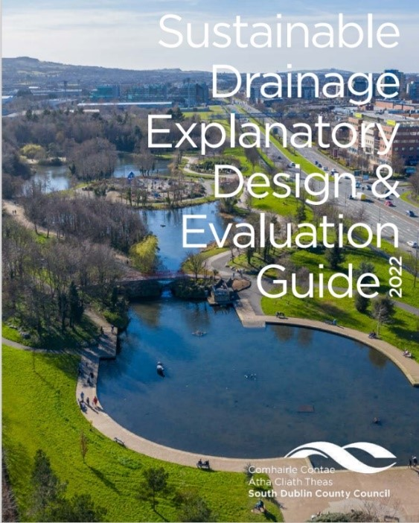
SDCC CCAP 2022 – Nature-Based Solutions
The programme to incorporate natural play areas into existing parks has been completed.
New 3 year Tree Maintenance programme for period 2023 is being prepared, with current maintenance programme currently being implemented
Surveying of trees is continuing - Approximately 50,000 trees have been surveyed. Tree surveying is being managed by Arbortrack . 2625 trees were planted in 2022.
Mini Woodlands Project at Mill Lane Park, Palmerstown. Staff and clients of Stewarts Hospital and local schoolchildren helped to plant around 1500 native trees.
Workshops on Nature Based Solutions were delivered, including SuDS guidance
South Dublin County Council SuDS guidance documents were launched on 7th February 2022 and is available on SDCC website. https://www.sdcc.ie/en/services/planning/planning-applications/water-and-drainage-considerations/. Householders guide to SuDS was launched in May 2022.

Slide 10
SDCC CCAP 2022 – Resource Management
Anti Dumping Campaign
SDCC Environmental Awareness Office running regular anti-dumping/anti-litter campaigns.
New dog fouling campaign were launched in South Dublin in July.
Anti-Graffiti - Dublin Canvas 2022: Traffic light control cabinets across the county were decorated/painted under the project.
Anti-Dumping Initiatives being progressed including a mattress amnesty and household hazardous liquid takeback scheme.
Other initiatives and campaigns in 2022:
Launching a gum litter taskforce
WEEE Collection
Anti – Dumping Initiative Clean-up at Killtalown Project
Outreach programme with Vulnerable Communities
Anaerobic Digestor Feasibility Study
To review/examine sustainable solutions/options to managing grass cuttings
Tender issued. SDCC reviewing the response.

Slide 11
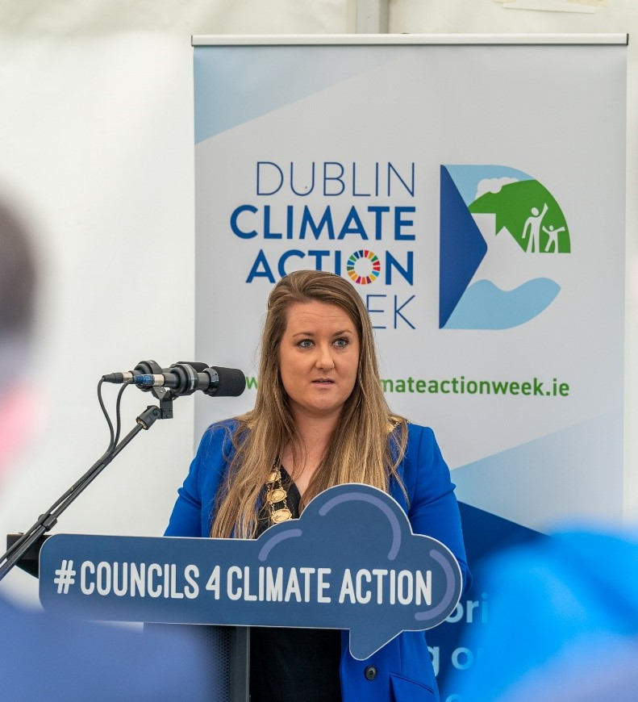
SDCC CCAP 2022 - Citizen Engagement
Launched new South Dublin Climate Action website in June 2022 – continuing to review and update.
Climate Change Newsletter published over the year - Including a special Energy Edition of the newsletter to hep citizens better understand their energy use
Worked with Culture Team to incorporate climate changes as a fundamental part of the South Dublin Culture and Creativity Strategy 2023 -2027.
Supported Tallaght Community Arts to deliver a climate/arts installation in St Enda’s Park.
Marked World Water Day in South Dublin in March 2022.
Delivered Climate Action Data Challenge with other DLAs and Smart Dublin.
Chaired Steering Group and delivered Dublin Climate Action Week in September 2022, including a range of South Dublin events such as Climate Fest in Tymon Park.

Slide 12
Community Action Fund (CAF)
Strand 1- Action: Building Low Carbon Communities
Strand 1a – Shared Island Community Climate Action
€24 million is being provided to local authorities to partner communities, within their areas of operation to build low carbon communities in a considered and structured way.
Allocation of €1,073,000.00 to SDCC under Strand 1 over 3 years
Framework document for Strand 1 and Strand 1a issued to LAs to outline the implementation of the Programme and how it will work.
Recruitment for a Community Climate Action Officer (Grade 6) has commenced.
Strand 2 Education: Climate Education, Capacity Building and Learning by Doing
€6 million is being provided to Pobal and the Creative Ireland Programme to build community capacity to undertake and step-up climate action. The focus of this strand is on education directly leading to action as opposed to awareness education.

Slide 13
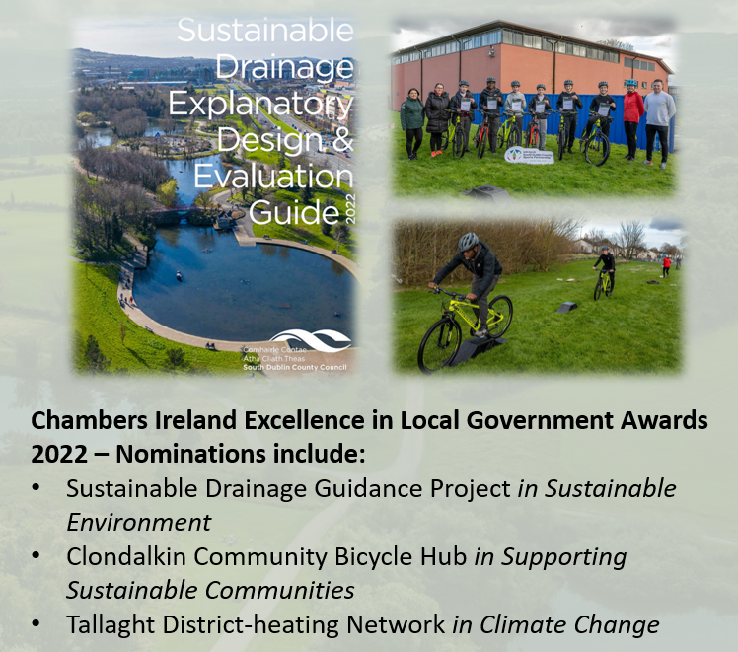
SDCC Climate Innovation Fund 2022
UCD - WeCount Community Air Quality Monitoring - €1,660
SDCC Climate Action Website - €14,637
SuDS Guidance - €22,447
EV Strategy – €5,462
Energy Elephant – €14,760
South Dublin Sports Partnership - North Clondalkin Bicycle Hub - €30,000
E-Bicycles for Park Rangers - €6,900
GPS Equipment to support SuDS, ICWs and Drainage projects - €24,354
Mini Woodlands Media and Information - € 7,500
Biodiversity Video - €4,875
Dublin Climate Action Week 2022 - €22,871
Fast Fashion Video – €25,000 (Contributions from DLAs)
Climate Action Family Event at SDCC Libraries - €3,630
Anaerobic Digestor Feasibility Study - €25,000
Greening Tallaght Stadium Feasibility Study - €20,000
DLAs, Smart Dublin - Open Data Challenge - €2,000
Total Approved Funding €211,000 (Approx.)

Slide 14
Next Steps:
National LA CAP review process to commence March 2023
Draft Guidelines issued by LGMA to each LA
Getting started workshops held in November
Ministerial Instruction due March 2023 to require each LA to have a Statutory Climate Action Plan (CAP) in place within 12 months.
SDCC building on existing CAP

Slide 15
Thank You

