Slide 1
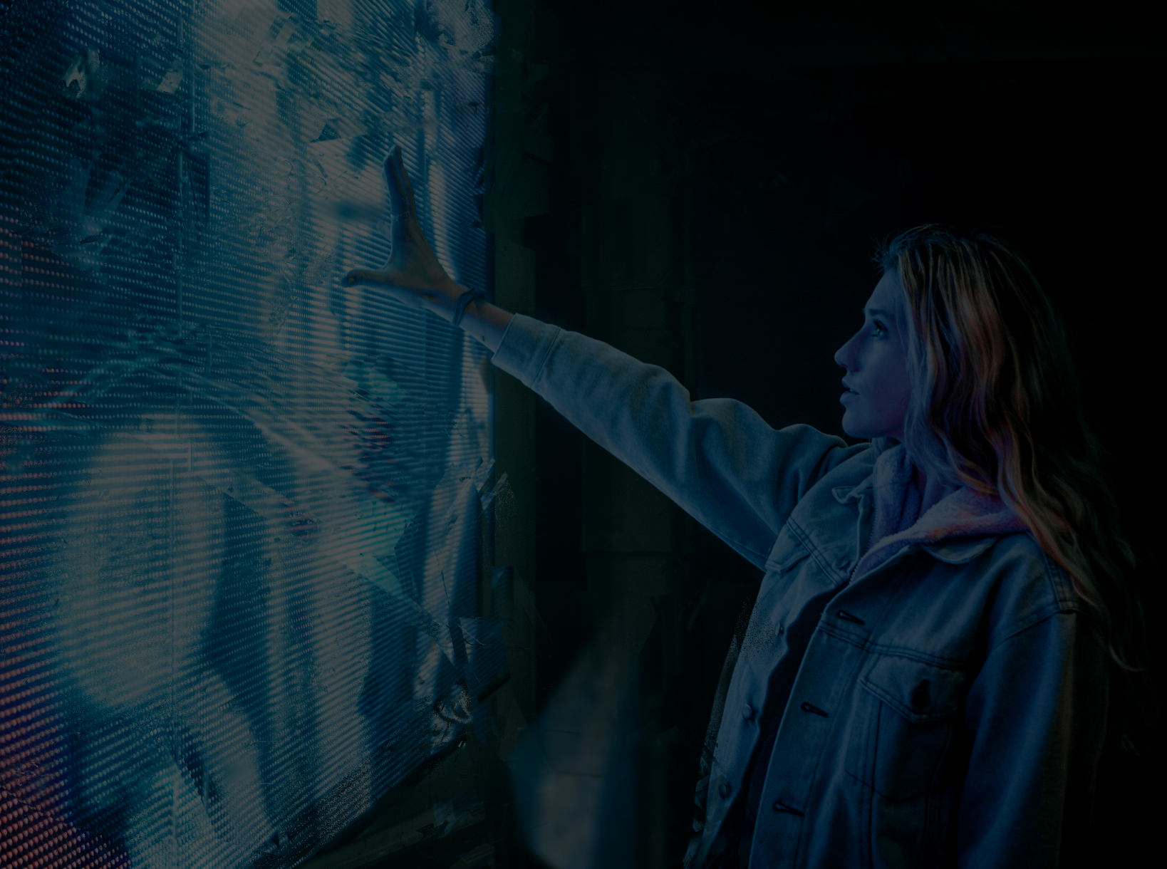
Our
Library,
Our
Future
South Dublin Libraries
Development Plan
2023 - 2027
Energising, Inspiring, Creating, Rejuvenating & Empowering

Slide 2
Our Purpose
Our Aspiration
We exist to inspire, support and enable the people of South Dublin to live, learn and thrive.
We do this by removing barriers to knowledge and information. By creating space to think, talk and explore and by being there if and when they need us.
What we as a library do today will have impact on all our futures.
South Dublin Libraries will become a benchmark for what a public library can be in terms of engagement, relevance, innovation and impact.
We will do this by questioning why we exist, what we do and how we can better serve the public.
Today, society and communities face many challenges, where accurate information, human connection and inspiration is needed. South Dublin Libraries will use our position in the heart of communities to better serve those communities.
Our
Library,
Our
Future

Slide 3
Our
Library,
Our
Future
Our Aspiration
South Dublin Libraries will become a benchmark for what a public library can be in terms of engagement, relevance, innovation and impact. We will do this by questioning why we exist, what we do and how we can better serve the public.
Today, society and communities face many challenges, where accurate information, human connection and inspiration is needed. South Dublin Libraries will use our position in the heart of communities to better serve those communities.
South Dublin Libraries
Development Plan
2023 - 2027
Innovation for the library we need today
Human-Centred Innovation
for, with & through the library
Our
Library,
Our
Future
The library working
for tomorrow
Responding to increasing community, social and global challenges
South Dublin Library Champions
Key Development areas
SDL champion for
Environment & Sustainability
SDL champion for
Innovation &
Creativity
Expanding our Community
Energising our Collections
Sharing our stories, making our places
SDL champion for
Equality, Diversity
& Inclusion
SDL champion for
Community
& Outreach
Attracting teenagers & young adults:
Finding our purpose
Transition to experiences
Adapting to member needs
Innovative Curation:
Wayfinding life:
Meaningful partnerships
Adapting delivery
Literacy & Healthy Ireland:
New Heritage
Technology for all
Collect & curate
SDL champion for
Literacy & the
Irish language
SDL champion for
Heritage &
Placemaking
Rejuvenating our Physical & Virtual Spaces
Empowering
our Staff
The library as a third+ space
Targeted Comfort
Innovation & improvement
Getting out into the community
Irish Language
Innovation & improvement
Finding play, purpose & potential
The library as a third+ space

Slide 4
Our Library, Our Future
Overarching
Overview of South Dublin Libraries Development Plan
Areas we will focus on Q2 In what key strategic areas should we focus our efforts over the next 5 years | Achieving Success in these areas Q3 In each of these area, how will we ensure we are successful? | The capabilities needed to support Q4 What capabilities do we need to put in place to support our efforts | How management will support Q5 How should we manage in order to achieve our purpose?
We will prioritise two distinct but interwoven areas; growing our active and new memberships by focusing on teenagers and young adults and responding to the great challenges we face today and into the future. While we will continue to support all members of the community, these new focus areas offer opportunity for growth, sustainability and immense positive impact. | We are living in a time of unprecedented change and growing community, societal and global challenges. Leaders have called for action, and in response, we will authentically position our libraries as places of truth, inspiration and action. This is the right thing to do, but it will also resonate and align with the values, needs and motivations of a highly desirable cohort of non-library users. | We will build on our current people and research expertise and our enviable position in the heart of communities, to better understand the unmet and unarticulated needs of this exciting cohort. We will build relationships not transactions, we will train, empower and reward or teams to co-create initiatives, events and collections with members, not for them. | Leadership and management will be aligned around our aspiration and values. We will communicate regularly to highlight the urgency and importance of our work, discuss issues and review strategy in the open. We will empower and enable our workforce to make this strategy a success, and we will celebrate those successes.
Our
Library,
Our
Future

Slide 5
Expanding & Inspiring Our Community
Areas we will focus on Q2 In what key strategic areas should we focus our efforts over the next 5 years | Achieving Success in these areas Q3 In each of these area, how will we ensure we are successful? | The capabilities needed to support Q4 What capabilities do we need to put in place to support our efforts | How management will support Q5 How should we manage in order to achieve our purpose?
Teens & Young Adults: We see engaging with teenagers & young adults as a powerful opportunity for sustainable growth & positive impact. Purpose: Aligning SDL to an inspiring purpose centred around responding to increasing community, social and global challenges will have a positive impact at many levels for SDL. Experience: Transitioning the library from a place of transaction towards unique experiences and developing an emotional connection with the needs of the public. Adapt: We recognise the need to adapt the delivery of library services to suit the needs of our members. This relates not only to an increase in online services but by continuing to diversify how we deliver our physical services. | Develop specialist events relating to challenges the new proposed target demographic care about. Redesigning existing services and creating new one so as to develop unique ‘SDL experiences.’ Aligning the library vision, values and behaviours more closely with those of teenagers & young adults. Stepping up to take real action, facilitate meaningful dialogue and ensure that reliable and inspirational content is easy to access. Deliver additional opening hours through the provision of ‘My Open Library’ and explore all opportunities to deliver library services in a variety of building types, sizes, and locations to best serve the needs of the community. | Use our staff’s research skills and our access to the community, to carry out rich qualitative and quantitative research on the needs, goals and motivations of this new market. Upskill our staff on the principles of human-centred innovation and experience design, and empower them to respond to needs and opportunities. Build a network of community change makers, national experts and work with them to develop initiatives | Work with the South Dublin Libraries workforce to get behind the new mission. Set up a system where individuals can join branch and inter-branch working groups. Provide time and space for staff to carry out research relating to understanding needs and designing services/experiences.

Slide 6
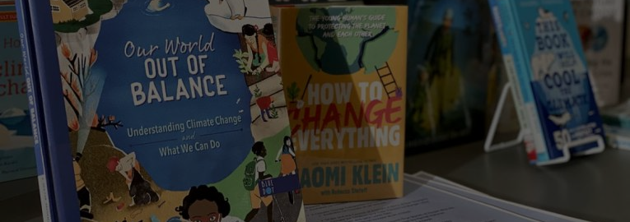
Energising Our Collection
Areas we will focus on Q2 In what key strategic areas should we focus our efforts over the next 5 years | Achieving Success in these areas Q3 In each of these area, how will we ensure we are successful? | The capabilities needed to support Q4 What capabilities do we need to put in place to support our efforts | How management will support Q5 How should we manage in order to achieve our purpose?
Innovative Curation: Rather than competing with online retailers, we will focus on expert curation over quantity, and insight over scale. Wayfinding and responding to life: While communities are diverse, they share consistent life events, some scary, some exciting. We as a library can help people navigate these events, when they need it. We can be responsive. Meaningful partnerships: We will strengthen existing partnerships, and provide support for local and national strategies. Literacy & Healthy Ireland: Develop our ‘Right to Read’ and ‘Healthy Ireland’ offerings. | Shift our focus towards providing unique experiences and emotional connections with our members needs, goals and motivations. Respond to, and stay ahead of community needs by stocking books/materials/forms that align with key events in their lives or currently affecting the community. Identify new, common needs of the community that we may not offer / or are difficult to offer. Partner with organizations to offer these services. These could range from assistive technologies to power tools etc. Continue to deliver literacy supports and the sustained prioritisation of the nationally coordinated ‘Right to Read’ programme. The ‘Healthy Ireland at Your Library’ will be supported by expanding our programme of events and promoting the library as a reliable source of information on public health. | Cross-branch collaboration to ideate potential ways of curating collections, sharing insights and creating a level of consistency across branches. As above, upskill staff in the principles human-centred innovation and experience design to question orthodoxies and develop meaningful approaches and initiatives. Demonstrate that we care by involving people in our research activity and co-creating services and experiences with the public. Identify partners that may add value to our customers (assistive technology, consumer tech, tools, art equipment, large toys etc.). Ensure that health, well-being and community resilience are promoted through our collections and events programmes. | Open up possibilities for more cross-branch collaboration. Top-level support to allow staff time and flexibility to research and work on opportunities for innovative curation. Open up dialogue, forming memorandums of understanding and negotiating terms with partner organisations.

Slide 7
Our Library, Our Future
Sharing Our Stories, Making Our Places
Overview of South Dublin Libraries Development Plan
Areas we will focus on Q2 In what key strategic areas should we focus our efforts over the next 5 years | Achieving Success in these areas Q3 In each of these area, how will we ensure we are successful? | The capabilities needed to support Q4 What capabilities do we need to put in place to support our efforts | How management will support Q5 How should we manage in order to achieve our purpose?
New Heritage: Heritage is what we have inherited from the past, to value and enjoy in the present, and to preserve and pass on to future generations. As a young local authority with a growing population and a mix of established and new urban centres, SDL recognises its position in creating as well as curating our county's heritage. Explore the opportunities presented by digitisation, social media, and virtual reality to bring our collections and programmes to a wider audience. Collect and curate materials relating to South Dublin County and its people, preserving them for future generations, and explore new ways of promoting the history and heritage of the county. | Partner to develop quality creative programmes focused on introducing people to areas of cultural & creative importance. Position SDL as a portal for creative pursuits Support local artists and creators through unique exhibitions and help preserve and promote their works for our archives. We will put emphasis on works that are relevant to our proposed target areas. Explore the ideas of working with local authors to publish their books at a small scale. | Depending on the types of creative initiatives we may need more adaptable spaces (Wipeable surfaces for art based activity, storage for crafts, equipment and recording space for podcasts, etc.) We will explore partnerships for small scale printing of local authors’ work. | Create and identify funding sources to ensure quality and success Build partnerships and collaborations with creative individuals and organisations who value sustainability and their place within the community. Engage with creative individuals and organisations who are expert in delivering content to a wide audience through a variety of media.

Slide 8
Our Library, Our Future
Rejuvenating Our Physical & Virtual Space
Overview of South Dublin Libraries Development Plan
Areas we will focus on Q2 In what key strategic areas should we focus our efforts over the next 5 years | Achieving Success in these areas Q3 In each of these area, how will we ensure we are successful? | The capabilities needed to support Q4 What capabilities do we need to put in place to support our efforts | How management will support Q5 How should we manage in order to achieve our purpose?
A third+ space: The library is already a ‘third place’ (a social space separate from home and the workplace). Expectations have evolved amongst key demographics and these spaces must now offer more function, better atmosphere and “instagrammable” features and aesthetics. There is an opportunity to transform areas of our libraries into places that people want to be, want to be seen in and want to share. We call this third+ Space as it provides what similar spaces cannot - library services. We recognise the need to adapt the delivery of library services to suit the needs of our members. | Deliver new libraries in line with the County Development Plan (2022-2028): Adamstown and Citywest, and the renewal of Clondalkin. Through continued investment in library services, we will support healthy placemaking and sustainable movement. Deliver additional opening hours through the provision of My Open Library, explore all opportunities to deliver library services in a variety of building types, size, and location. Create attractive, comfortable and “edgy” spaces within our branches. Their job is twofold; firstly, they will be comfortable places to relax, talk and read, and secondly, they will provide a tangible focal point as well as a digital one. This will aid marketing and branding efforts. | While this may appear to be an expensive endeavour, it does not need to be. Work in collaboration with target demographics, with local designers, architects and South Dublin County Council architects to identify creative solutions that are desirable and attractive to our customers, feasible from a technical perspective and financially viable. Task branch and inter-branch working groups with identifying potential aesthetics/ additions / technologies (sound absorption, coffee, furnishings, etc.) that will allow this space to meet identified needs and impacts, and create a desirable atmosphere. | Offer support to branches to create the right space solutions for their branch. We will be brave, by understanding that what appeals to us may differ from what appeals to those we wish to attract.

Slide 9
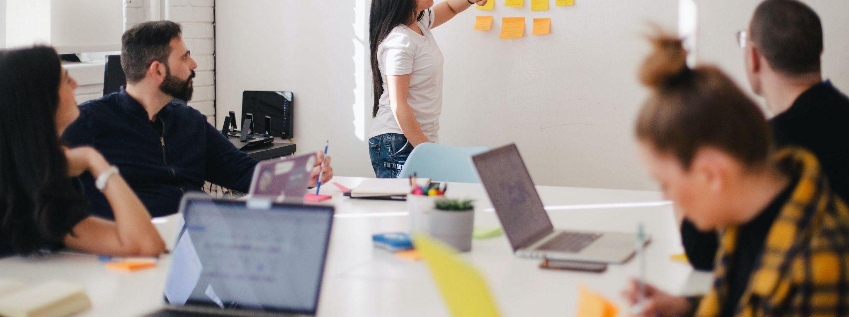
Empowering Our Staff
Areas we will focus on Q2 In what key strategic areas should we focus our efforts over the next 5 years | Achieving Success in these areas Q3 In each of these area, how will we ensure we are successful? | The capabilities needed to support Q4 What capabilities do we need to put in place to support our efforts | How management will support Q5 How should we manage in order to achieve our purpose?
Innovation & improvement: Our staff are creative, empathetic and passionate about their roles and serving society. These values align with the qualities of human-centred innovators and offer huge opportunities for improving our services, creating efficiencies and empowering our staff. It also aligns with Our Public Service 2020 strategy and the Civil Service Renewal 2030 strategy and the newly published ‘Design Principles for Government” Irish Language: Supporting staff to improve their proficiency and their confidence to use the Irish language. | Develop a high impact innovation programme specifically tailored to library innovation. We will use the outputs of this programme to create a funnel of innovations and service improvements to be supported and implemented over the next 5 years. Enable staff to avail of training opportunities in the Irish language to encourage use of the language in all aspects of service delivery. | Identify a suitable partner(s) to deliver this high impact training. They will design a programme which aligns to the goals of the library, accommodates all staff to participate, and provide time for staff to carry out research work and develop innovation proposals. Prioritise courses to improve Irish language proficiency through annual training programme and work with local partners to provide Irish language upskilling opportunities for staff. | We will commit to test and pilot high-potential ideas emerging, and provide time and space for the relevant staff to do so. We will commit to provide funds to roll out suitable, high potential innovations that align with this development plan and South Dublin Libraries objectives. Form a cross-network working group to promote and advocate service delivery improvements in the Irish language.

